Slide 1
Restful Api Auth
Subtitle

Slide 2

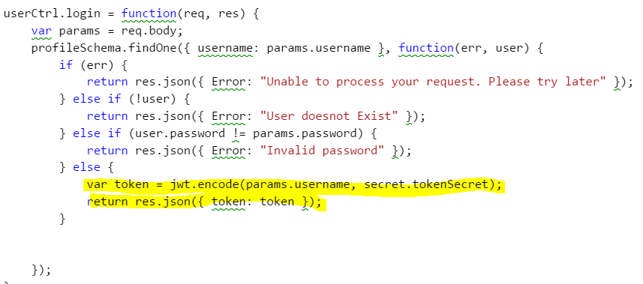
Steps to integrate token based auth.
Install jwt-simple
Add logic to handle the login.
Once the login is successful then generate the token and send the token back to the client.

Slide 3
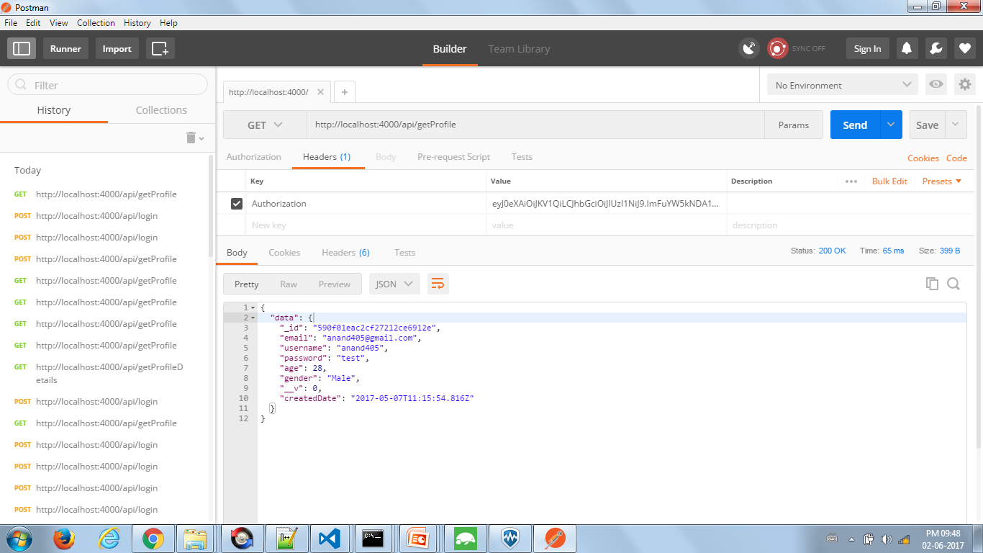
Request from post for get user details

Slide 4
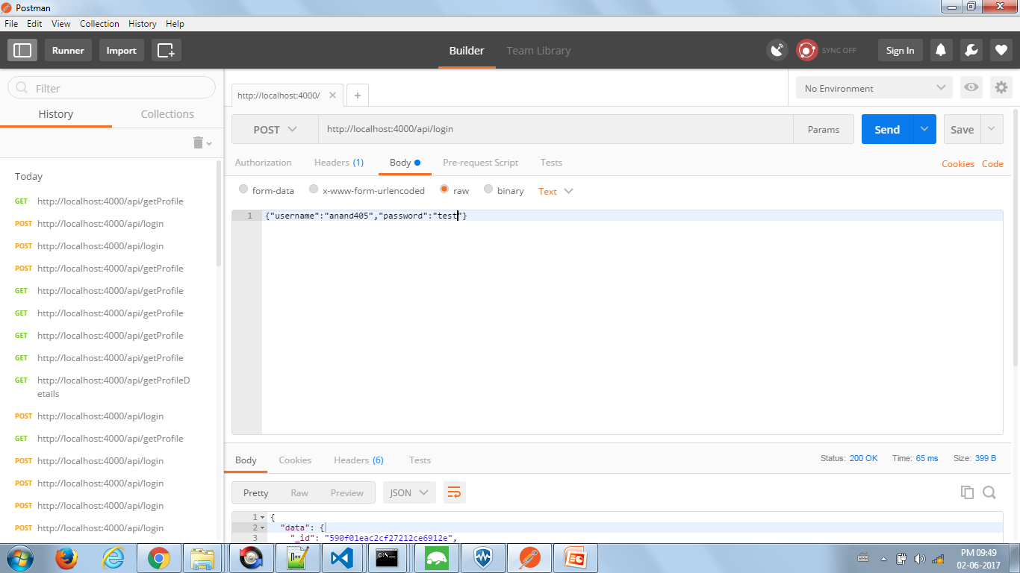
Request from post for login request

Slide 5
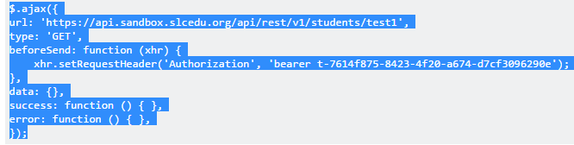
Making a request from a jquery client
Inorder to set the token follow the below for =jquery
.

Slide 6
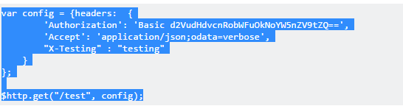
Angularjs client.

Slide 7
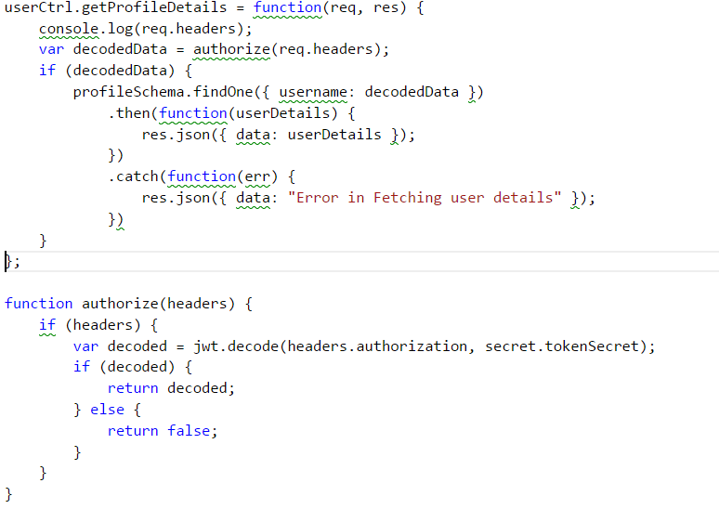
How to decode.

Slide 8
Server
UI will pass the username and password
Server will check the user name and password with db.
If they both match it will send a token to the UI back.
From the next request UI will send the token to the server.
Once server receives token it will validate the token and authorizes the user.
UI
DB

Slide 9
Title and content layout with list
Add your first bullet point here
Add your second bullet point here
Add your third bullet point here

Slide 10
Title and content layout with chart

Slide 11
Two content layout with table
First bullet point here
Second bullet point here
Third bullet point here
 | Group 1 | Group 2
Class 1 | 82 | 95
Class 2 | 76 | 88
Class 3 | 84 | 90

Slide 12
Title and content layout with SmartArt
Step 1 Title
Task description
Step 2 Title
Task description
Step 3 Title
Task description

