Slide 1
MEAN Stack
Subtitle

Slide 2
Why MEAN Stack
M – Mongo db database No Sql document database.
E – Express Web Framework for Nodejs.
A – Angular Client side Framework for App development
N – Nodejs Platform to build applications.

Slide 3
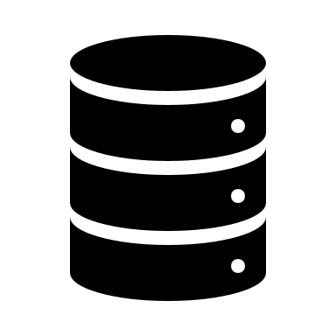
R
Angular
Node
Express
HTTP calls
Get
Post
Put
Delete
Monodb
Couchdb
Cassandra
Dynamodb/aws

Slide 4
Mongodb
No Sql Database
There are no joins
There is no relationship between two schemas/tables
It automatically replicates or maintains nodes/instances or replica sets.
No Transactions.
No combinational queries.
Data is in the form of documents
Data is in the form of JSON
mongodb
It maintains 4 nodes.

Slide 5
Installation
Installations steps are given in the pdf.
By default there is no user interface for Mongodb.
Querying happens via commad line.
We can have third party GUI’s mongo chef, RoboMongo.
Open command prompt
The above command will run the mongodb server. This command prompt should be always up and running.
By default it will be running on a port 27017.

Slide 6
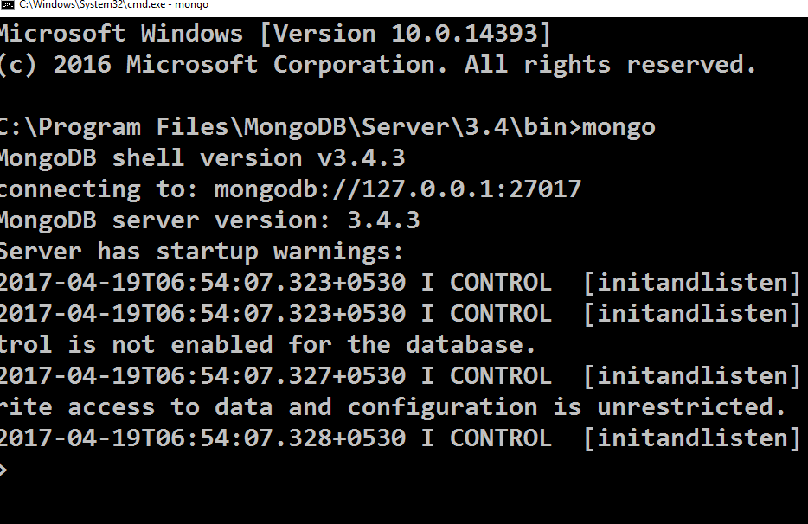
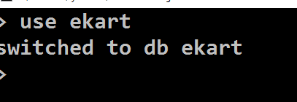
Creating Client
To create the database
“use <dbname>”
The above command will create a db called ekart.
To see the list of databases in your system command is “show dbs”

Slide 7

Creating tables
To create a table in the mongo we will use a query.
The above query is “Create +Insert”.
If the table is existing it will insert the data.
If the table is not existing it will create the table and Insert the data
Inserting various kind of data.
db.profiles.insert({ name:”kiran”})
The above command will create a document called profiles.
It will insert a document in to the profiles.
The document is having a field called “name”.
db.profiles.insert({ name:”ravi”, age:30 })

Slide 8

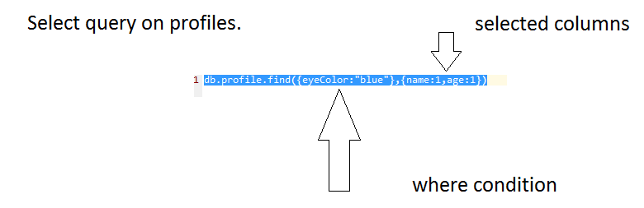
Read Data
To read the list of countries.
To read specific country
db.countries.find({code:"IN"})
{
"_id" : ObjectId("58f80c649bfabbb8bf8a6d98"),
"name" : "India",
"code" : "IN"
}

Slide 9
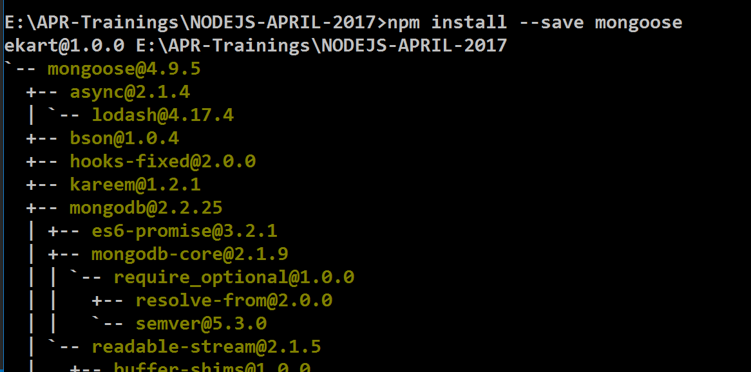
Connecting to db from node.
Mongoose is a library that will allow the user to connect to mongodb from node.
To connect to database we should be having the connection string.
We need to create models.

Slide 10
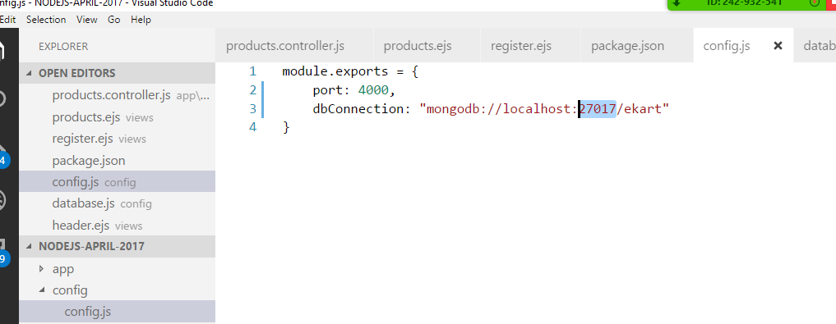
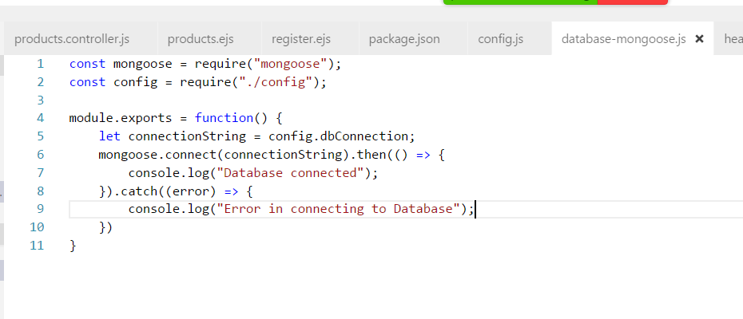
Create an entry in the config.js to have the connectionstring.
Create a file to connect to the database at the loading of the application.

Slide 11
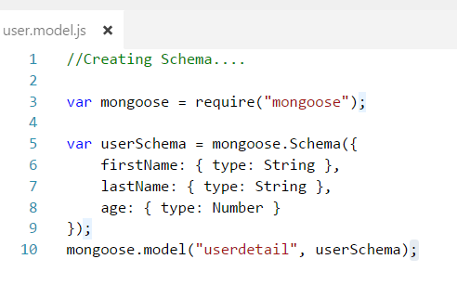
Refer the mongoose.js in the server.js.
Create Schema
Schema types.
String
Number
Date
Buffer
Boolean
Mixed
ObjectId
Array

Slide 12
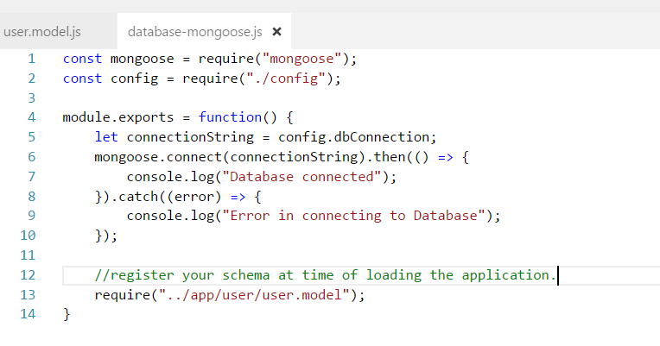
Working with schema
Once schema is created register your schema with the mongoose.

Slide 13
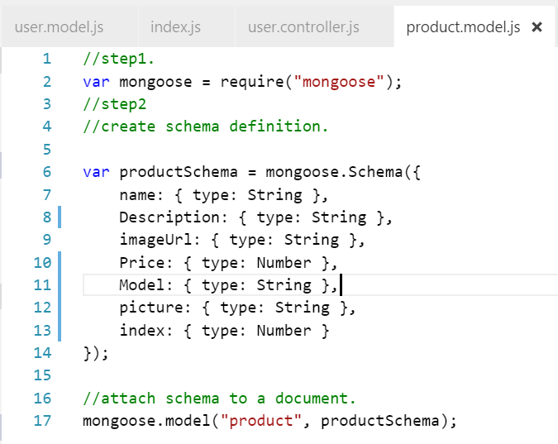
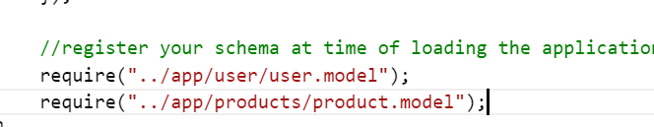
Fetching products from the db.
Assume we have list of products in the mongodb.
Create the model. You find the model creation.
Connecting model to mongoose.
Open the database-mongoose.js file we have created in our app.
Register the model with the mongoose.

Slide 14
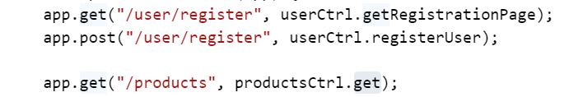
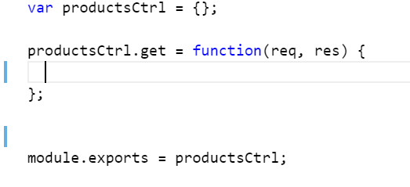
Creating the route and calling the products
Create a route to fetch the list of products.
Create a controller and then have a get method.
Refer the mongoose model inside the controller.

Slide 15
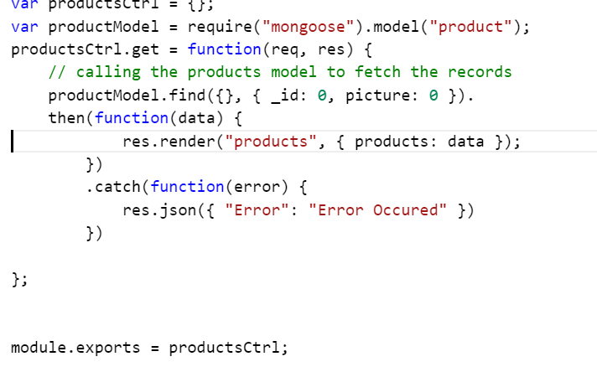
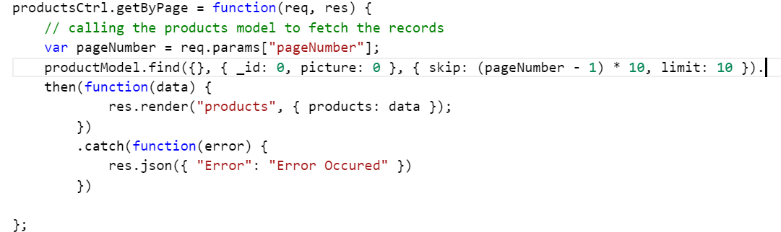
Enabling pagination for the products page.
To enable the pagination we have to use two concepts. Skip number items and limit number of products to display.
“skip(5)” is a method avaibale with the find query. It will skip the first five records.
“skip(10) it will skip first 10 recs
“limit(10)” will display only 10 recs from the result set

