Slide 1

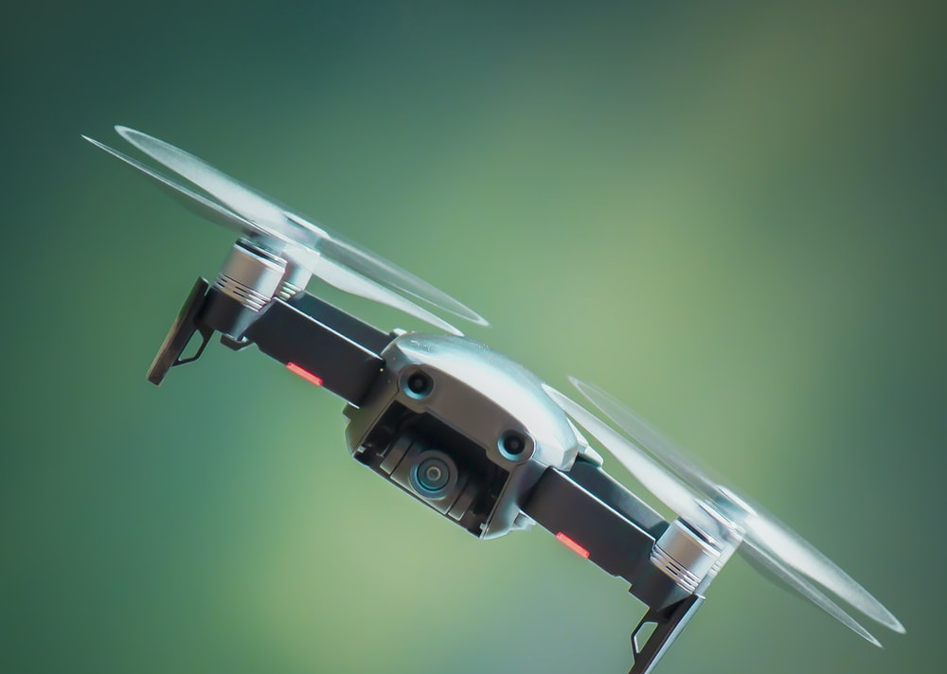
QUICK RESCUE BOT
ANAND PRAKASH
JITIKANTHA SARANGI
ADWAIT BAJPAI
ANANYA REGINALD FREDERICK

Slide 2
Motivation

Slide 3
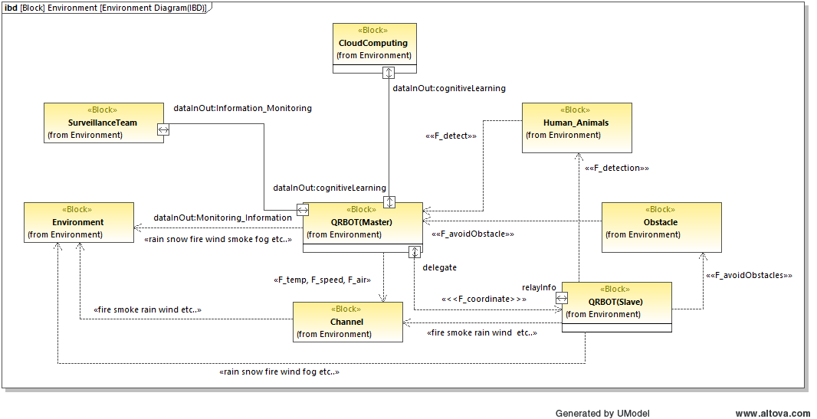
Environment Model

Slide 4
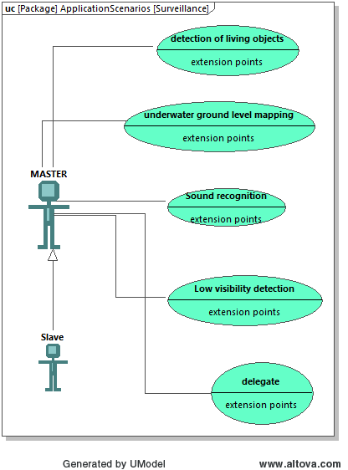
Application Scenarios
Application Scenario AS01
Description: The rescue robots must act in a community and each bots must be assigned specific tasks. The robots must be able to detect living objects and also do the survey of the rescue area.
Principle Solution: The leader bot is responsible for doing the survey of the area. It analyses the area and assigns tasks and location to the follower robots. The detection is done by the follower robot.

Slide 5
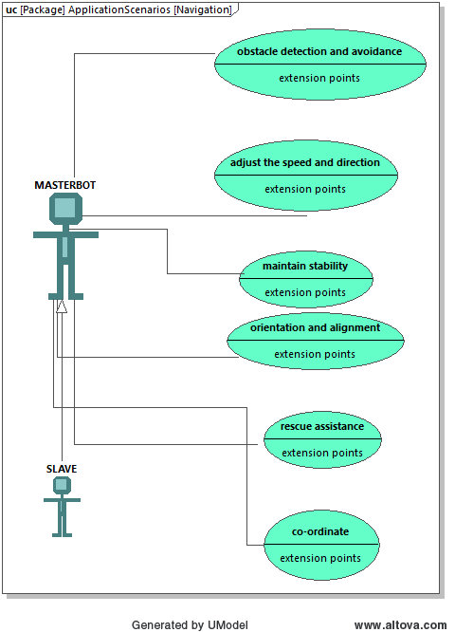
Application Scenarios(contd..)
Application Scenario AS02
Description: The robot must be able to co-ordinate with each other in order to provide better rescue assistance.
Principle Solution: The leader robot gets the position of each follower bot. After surveying the area, the leader bot assigns the follower bot with the location to carry out the detection task.

Slide 6
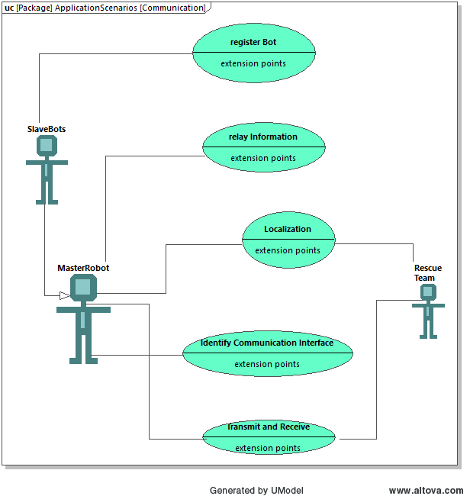
Application Scenarios(contd..)
Application Scenario AS03
Description: The robot must have the capability to identify the best communication interface in order to communicate within the robot system as well as with the Rescue team.
Principle Solution: The signal strength of the communicating devices is analysed at real time. If the signal strength is weak, an optimization loop is run to enhance the signal strength or hop to other communication interface.

Slide 7
Requirements Model

Slide 8
Functional Model

Slide 9
Active Structure

Slide 10
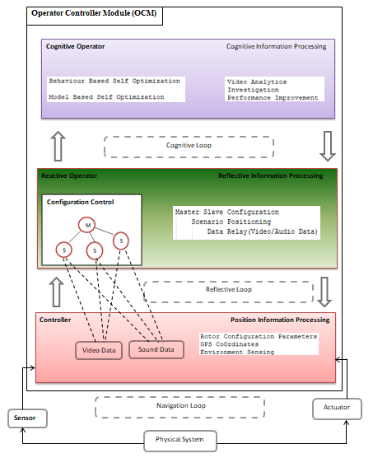
Operator-Controller-Module

Slide 11
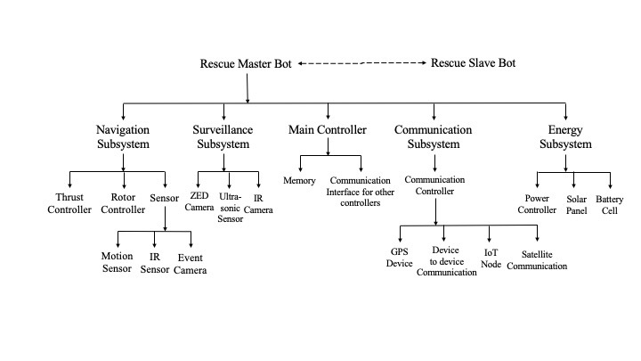
Macro Architecture

Slide 12
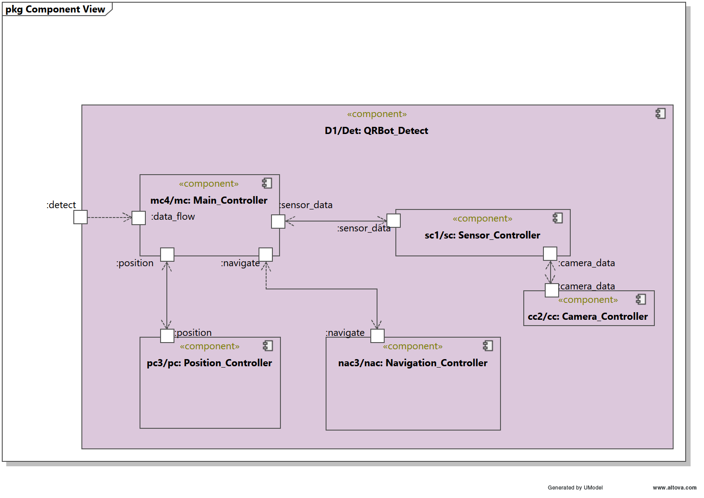
Detect Role

Slide 13
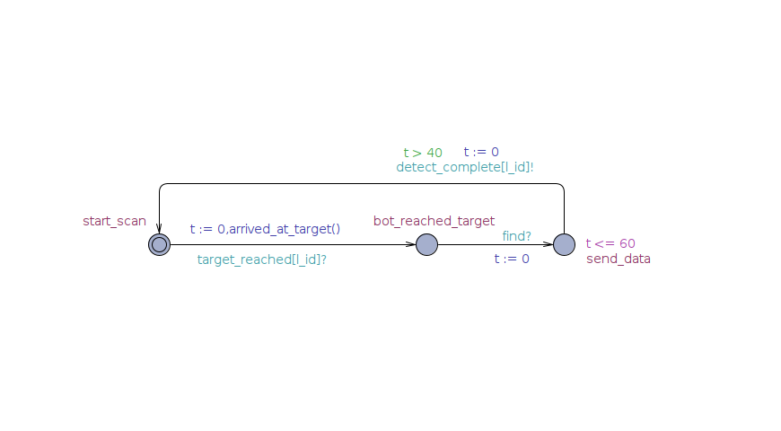
Detect Role

Slide 14
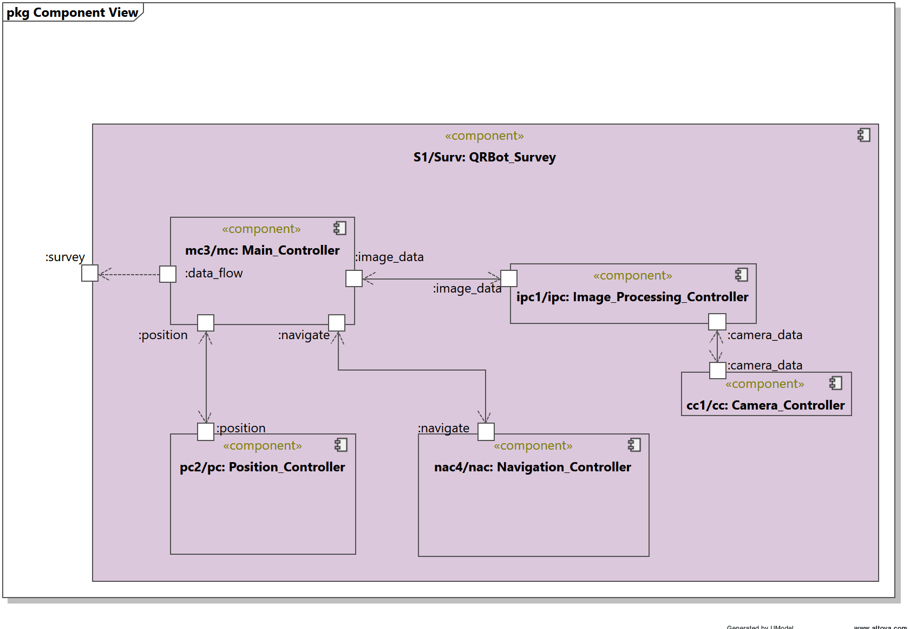
Survey Role

Slide 15
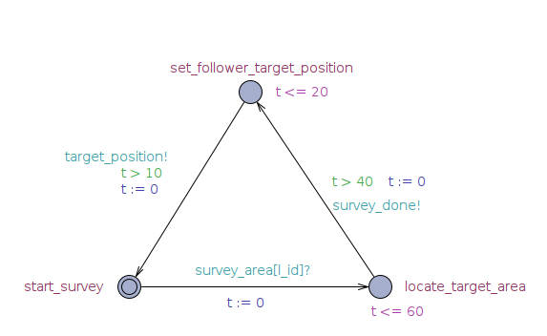
Survey Role

Slide 16
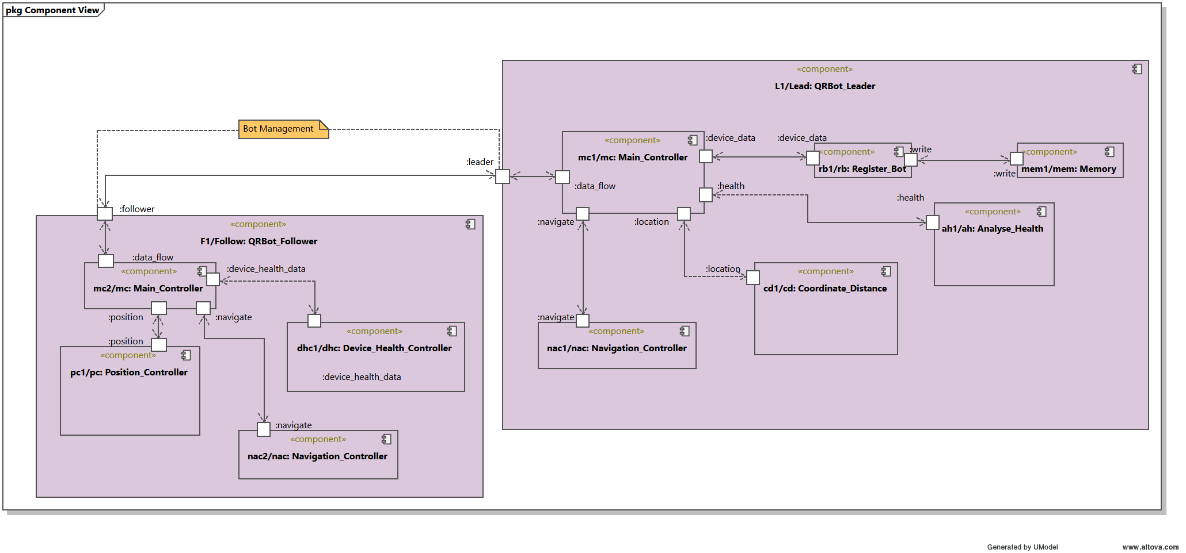
Leader-Follower Role

Slide 17
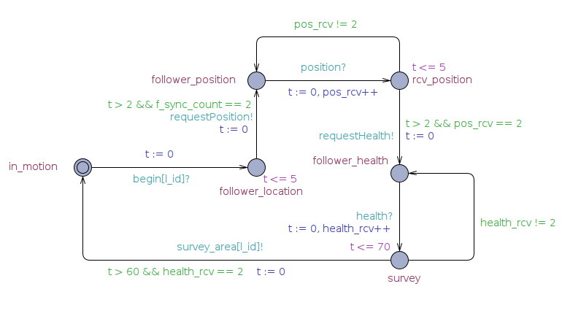
Leader-Follower Role

Slide 18
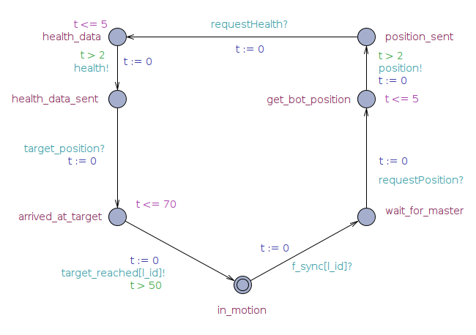
Leader-Follower Role

Slide 19
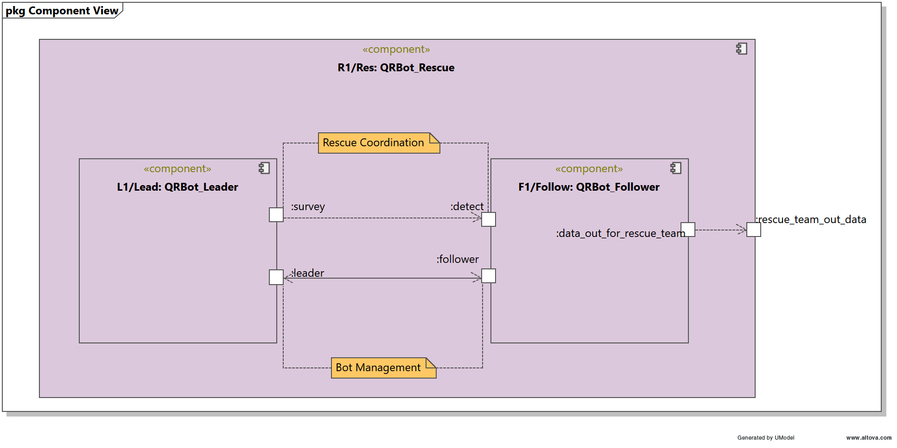
Rescue Scenario

Slide 20
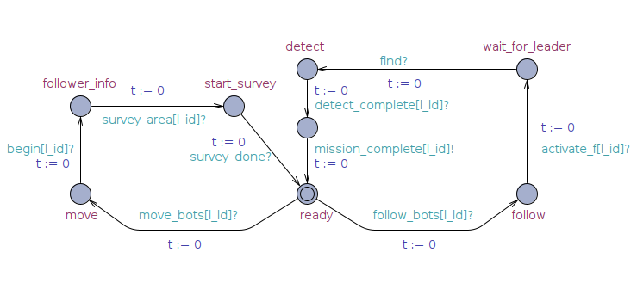
Co-ordinator Role

Slide 21

QUESTIONS!!

Slide 22


