Slide 1

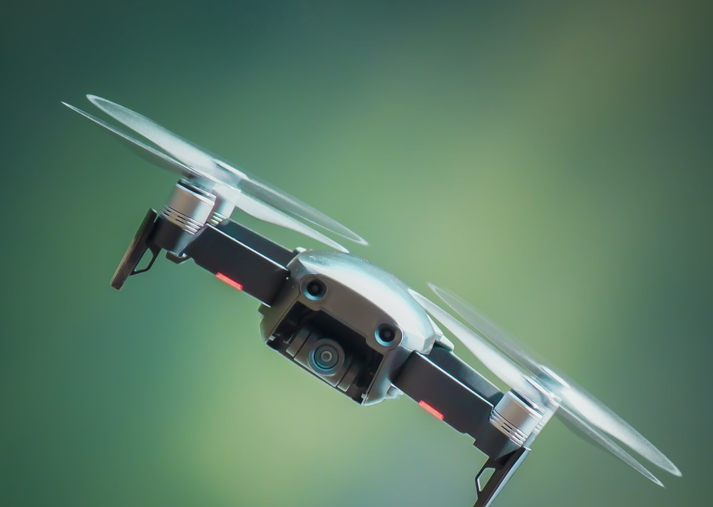
QUICK RESCUE BOT
ANAND PRAKASH
JITIKANTHA SARANGI
ADWAIT BAJPAI
ANANYA REGINALD FREDERICK

Slide 2

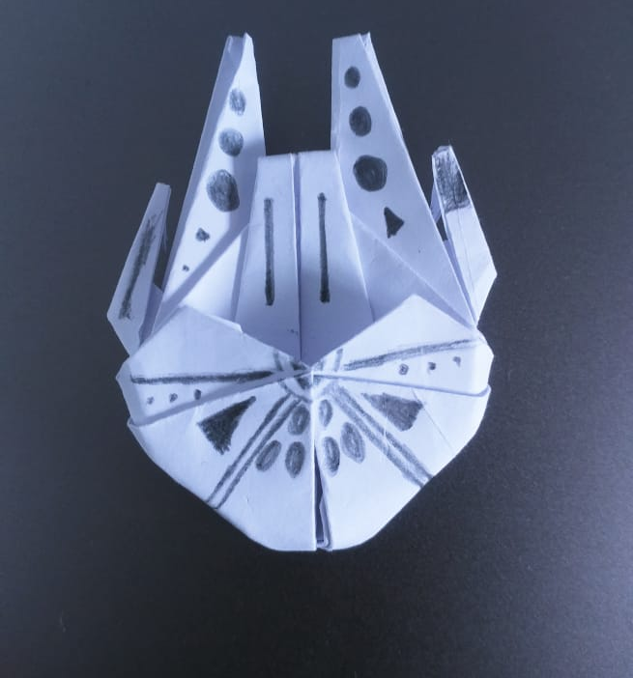
Objectives
Develop Rescue Robot for assistance in recovery and exploration of dangerous areas.
Rescue Robot must be able to drive in water.
It should have to capability to adapt to environmental changes.
Capable of working in community.

Slide 3
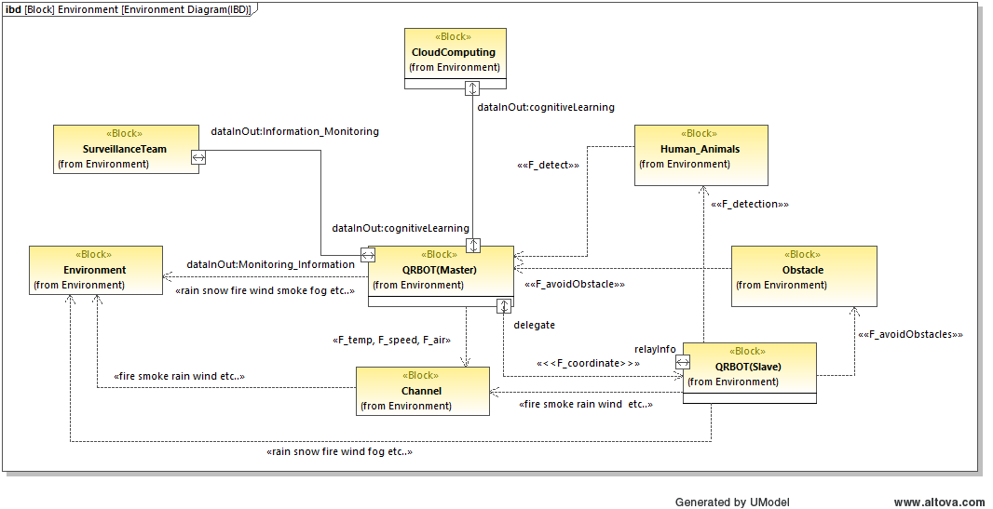
Environment Model

Slide 4
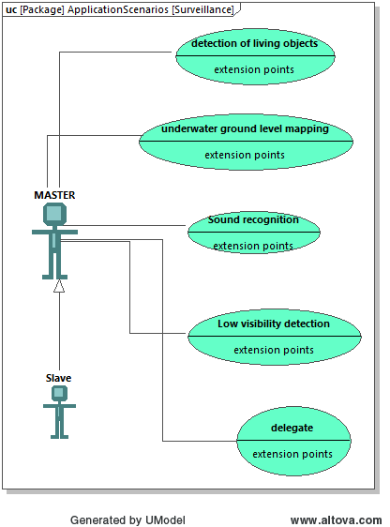
Application Scenarios
Application Scenario AS01
Description: The rescue robots must act in a community and each bots must be assigned specific tasks. The robots must be able to detect living objects and also do the survey of the rescue area.
Principle Solution: The leader bot is responsible for doing the survey of the area. It analyses the area and assigns tasks and location to the follower robots. The detection is done by the follower robot.

Slide 5
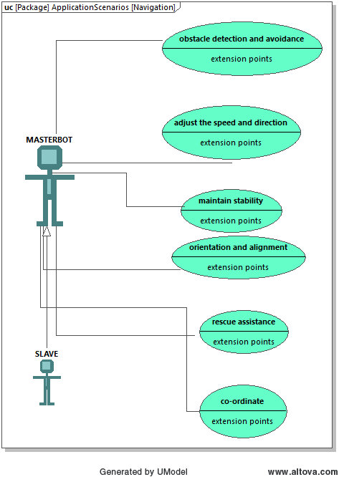
Application Scenarios(contd..)
Application Scenario AS02
Description: The robot must be able to co-ordinate with each other in order to provide better rescue assistance.
Principle Solution: The leader robot gets the position of each follower bot. After surveying the area, the leader bot assigns the follower bot with the location to carry out the detection task.

Slide 6
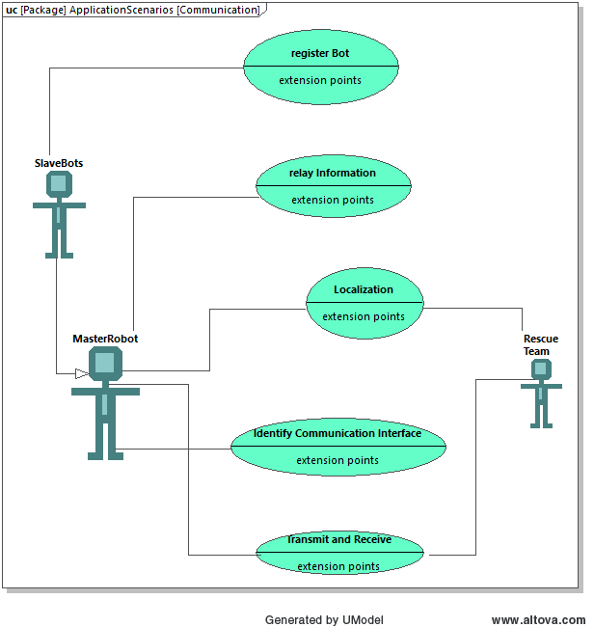
Application Scenarios(contd..)
Application Scenario AS03
Description: The robot must have the capability to identify the best communication interface in order to communicate within the robot system as well as with the Rescue team.
Principle Solution: The signal strength of the communicating devices is analysed at real time. If the signal strength is weak, an optimization loop is run to enhance the signal strength or hop to other communication interface.

Slide 7
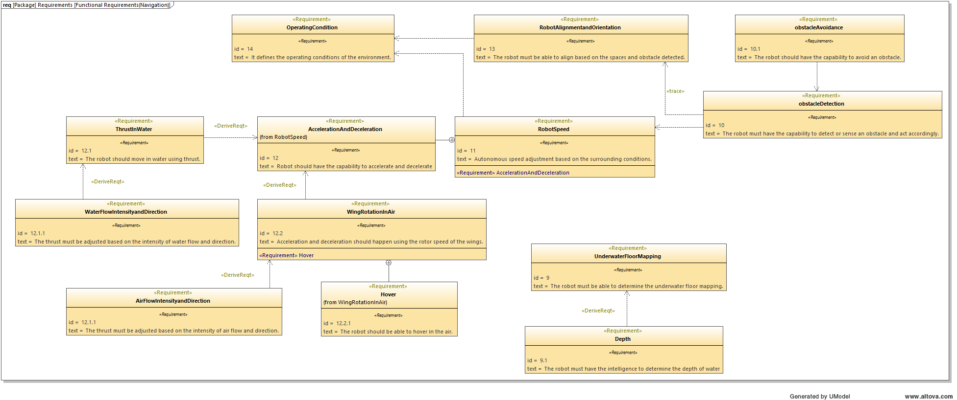
Requirements Model

Slide 8
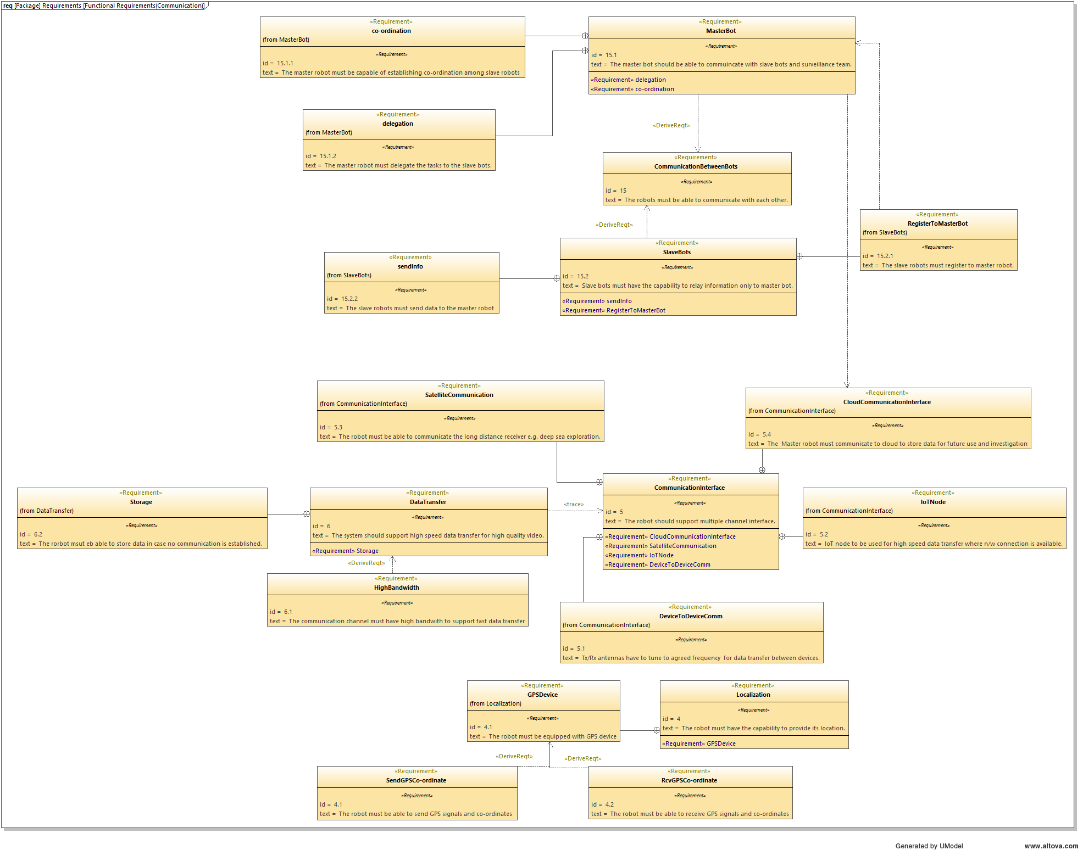
Requirements Model

Slide 9
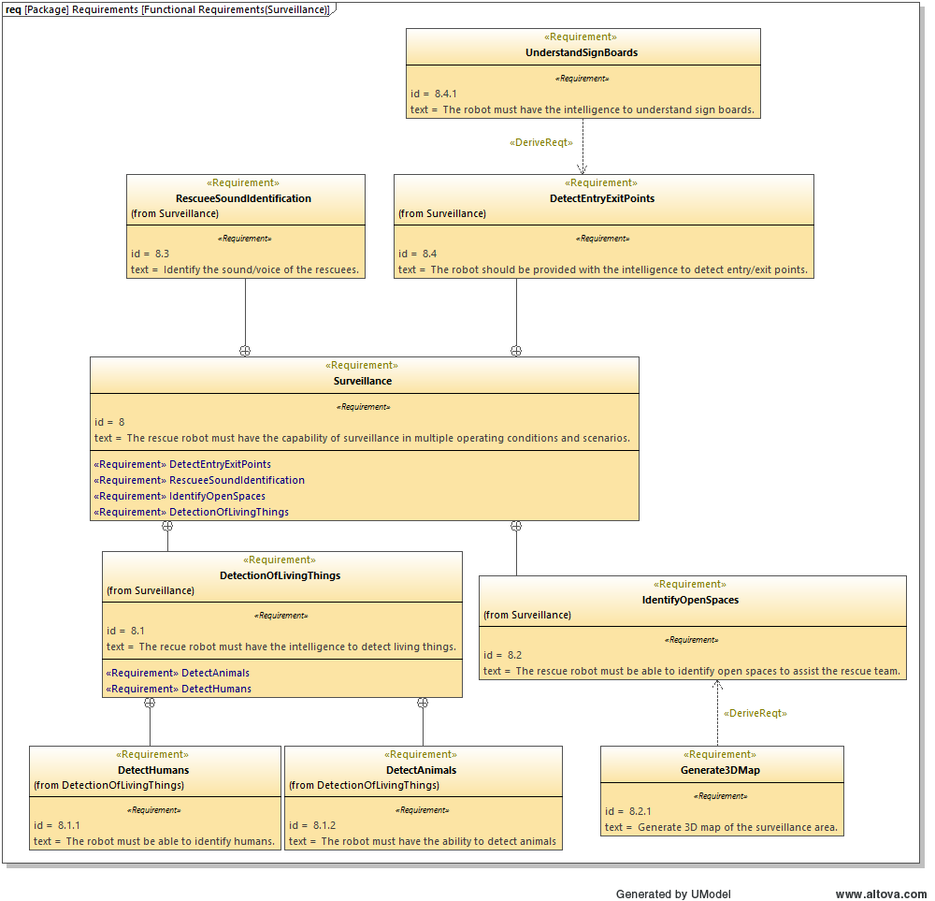
Requirements Model

Slide 10
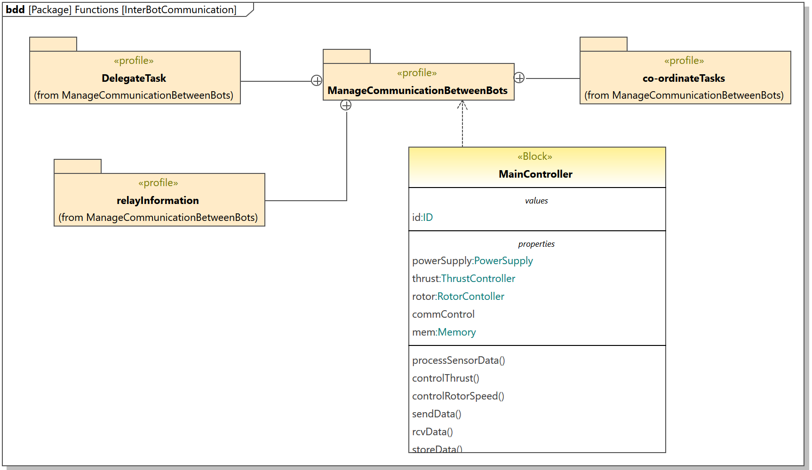
Functional Model

Slide 11
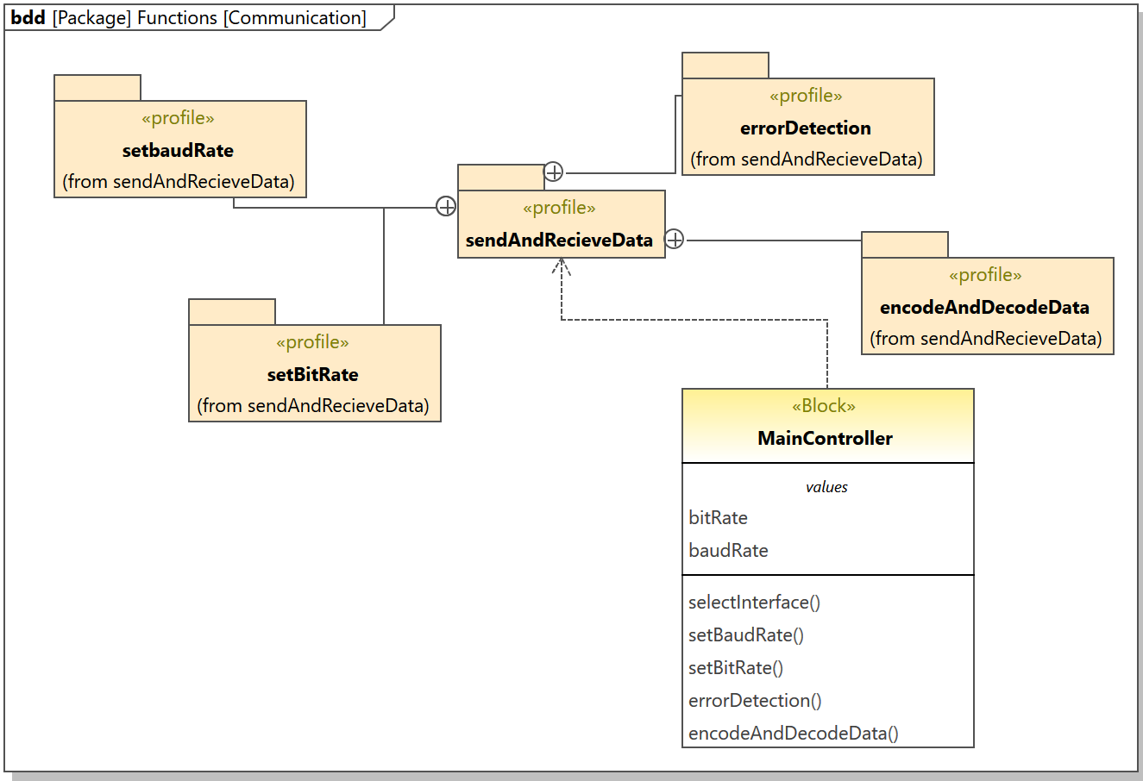
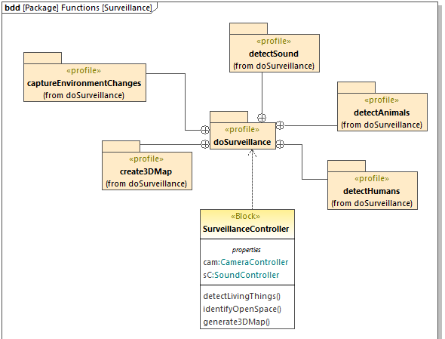
Functional Model

Slide 12
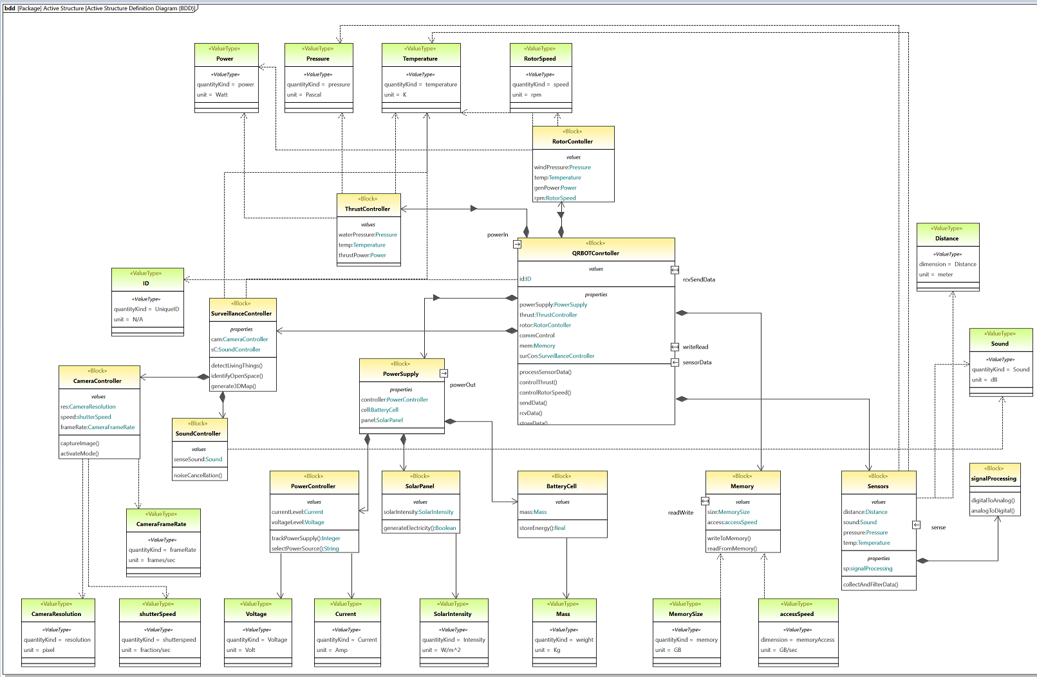
Active Structure

Slide 13
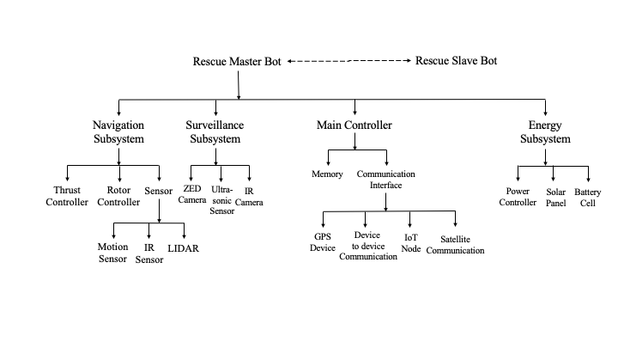
Macro Architecture

Slide 14
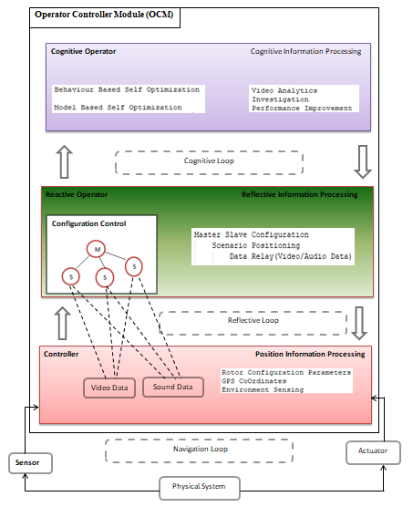
Operator-Controller-Module

Slide 15
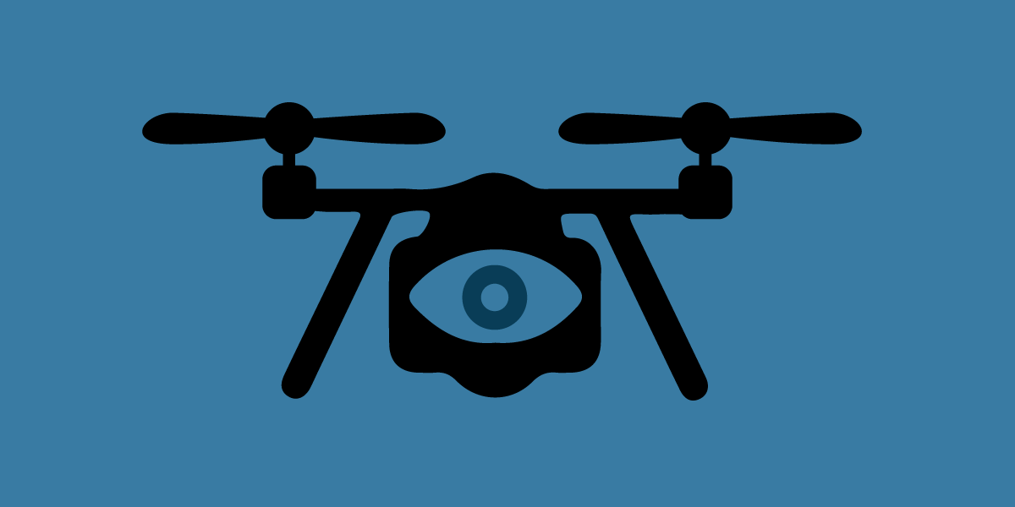






Rescue System
Leader Bot
Manage and Co-ordinate
with Follower
Manage and Co-ordinate
with Follower
Leader Bot survey’s area
Follower Bot
Follower Bot
Identify Rescuee
Identify Rescuee
Report for Rescue
Report for Rescue

Slide 16
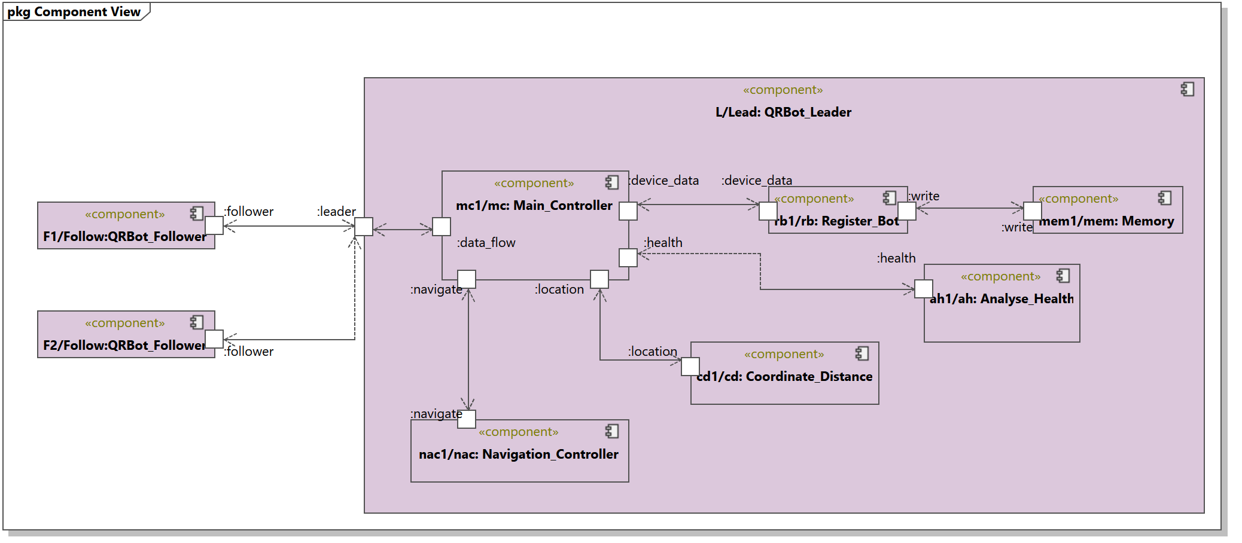
Leader Role

Slide 17
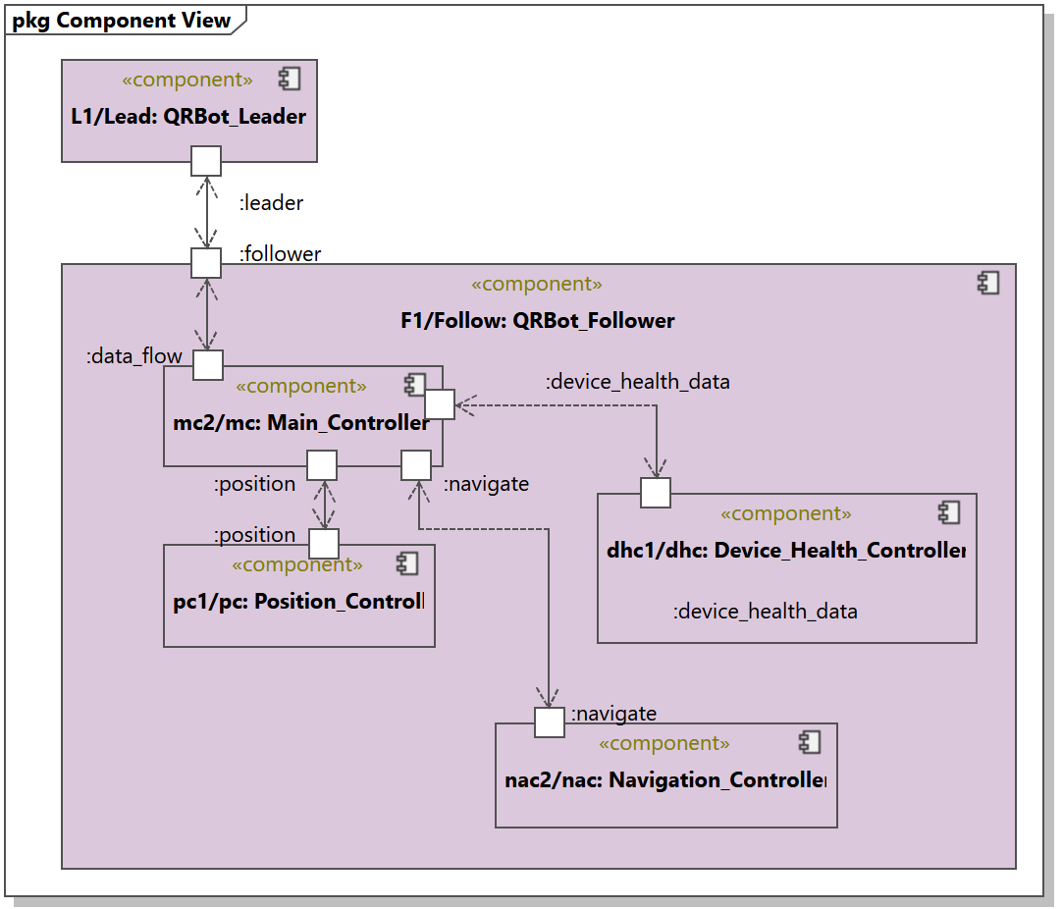
Follower Role

Slide 18
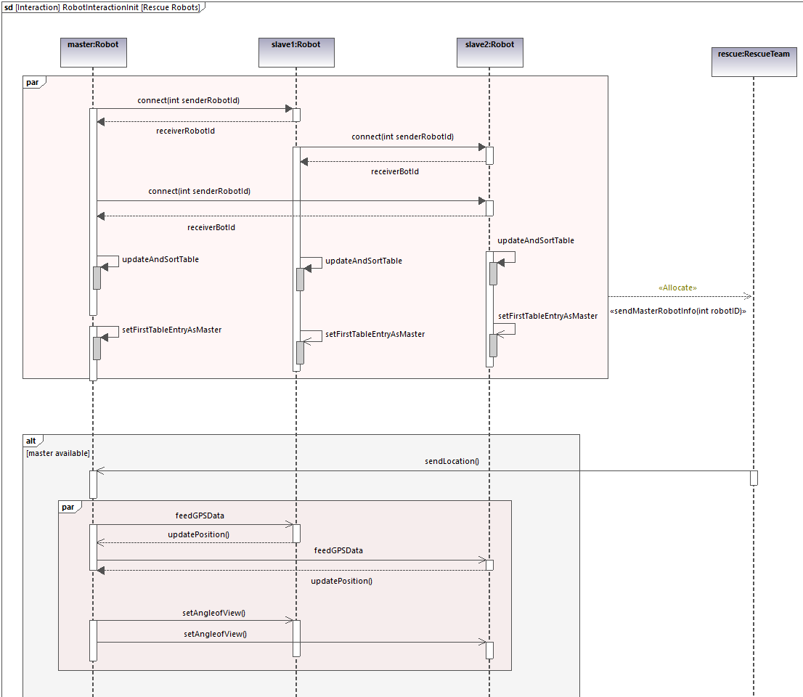
Leader-Follower Sequence Diagram

Slide 19
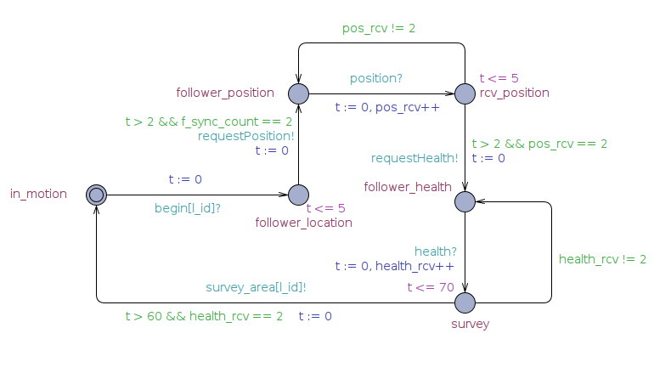
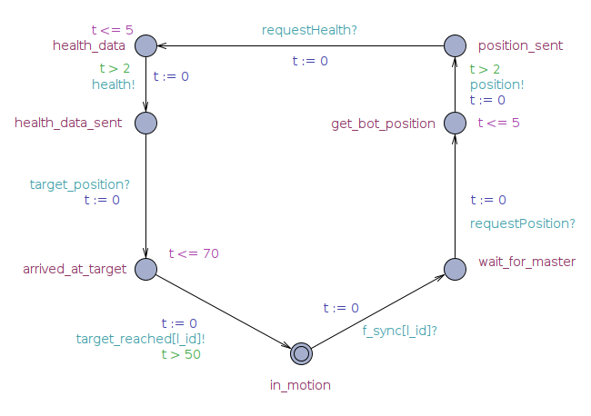
Leader-Follower Real-Time State Chart
LEADER ROLE
FOLLOWER ROLE

Slide 20
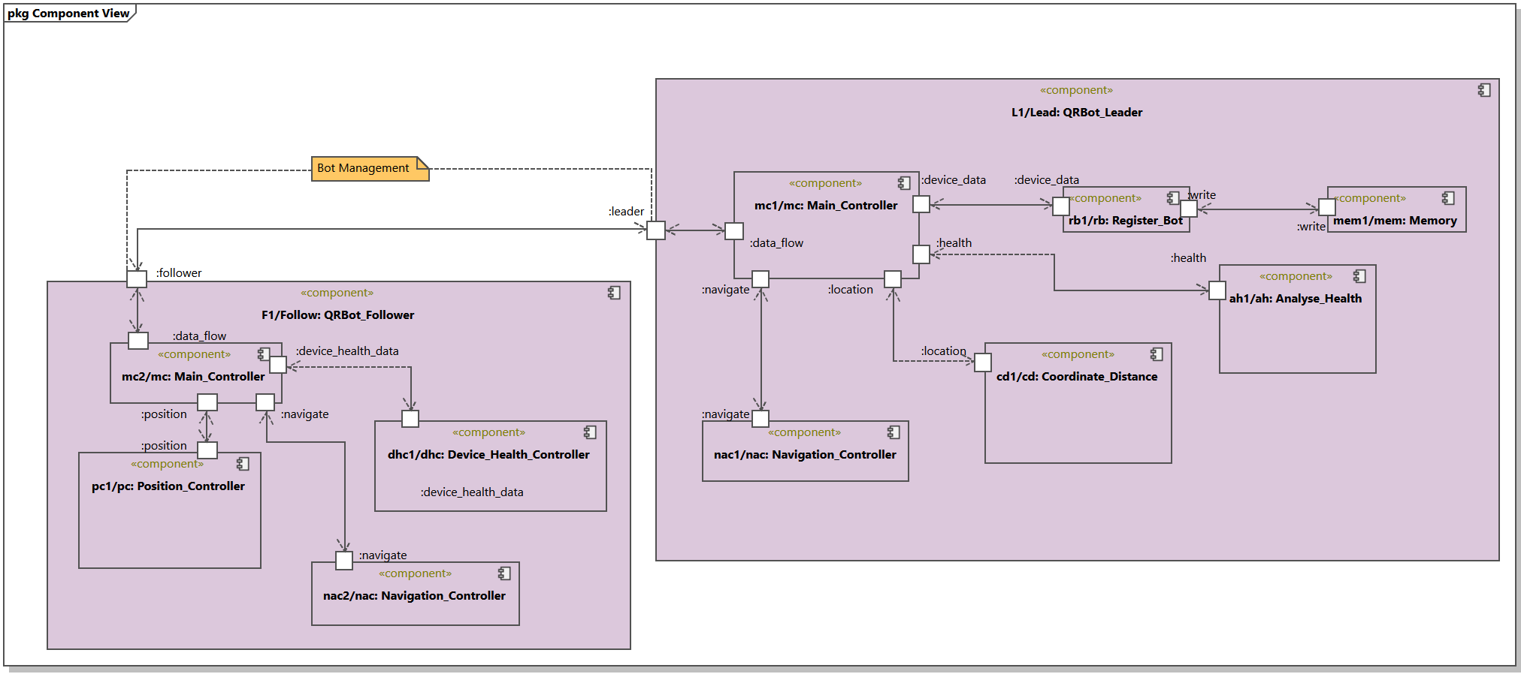
Leader-Follower Co-ordination

Slide 21
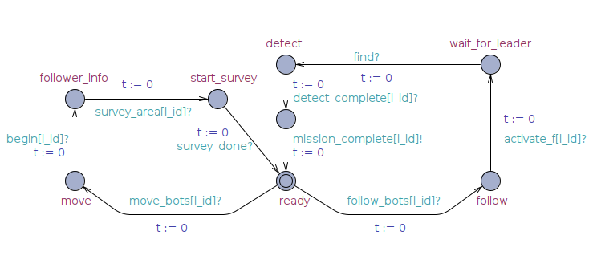
Co-ordinator Role

Slide 22
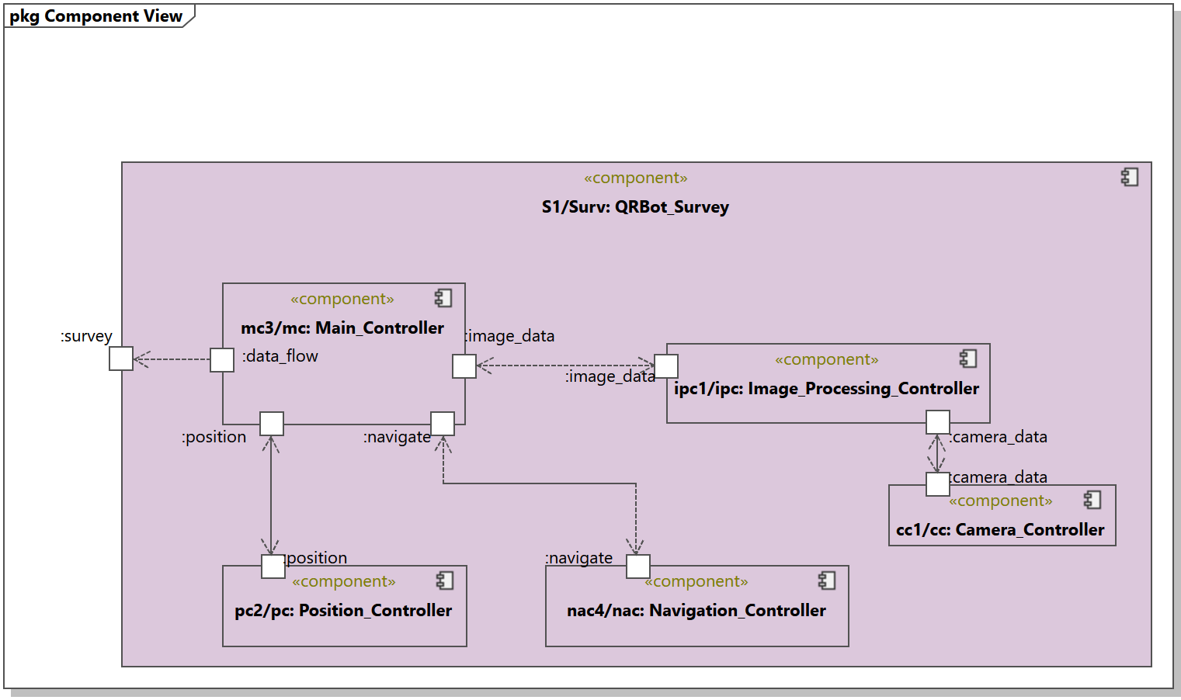
Survey Role

Slide 23
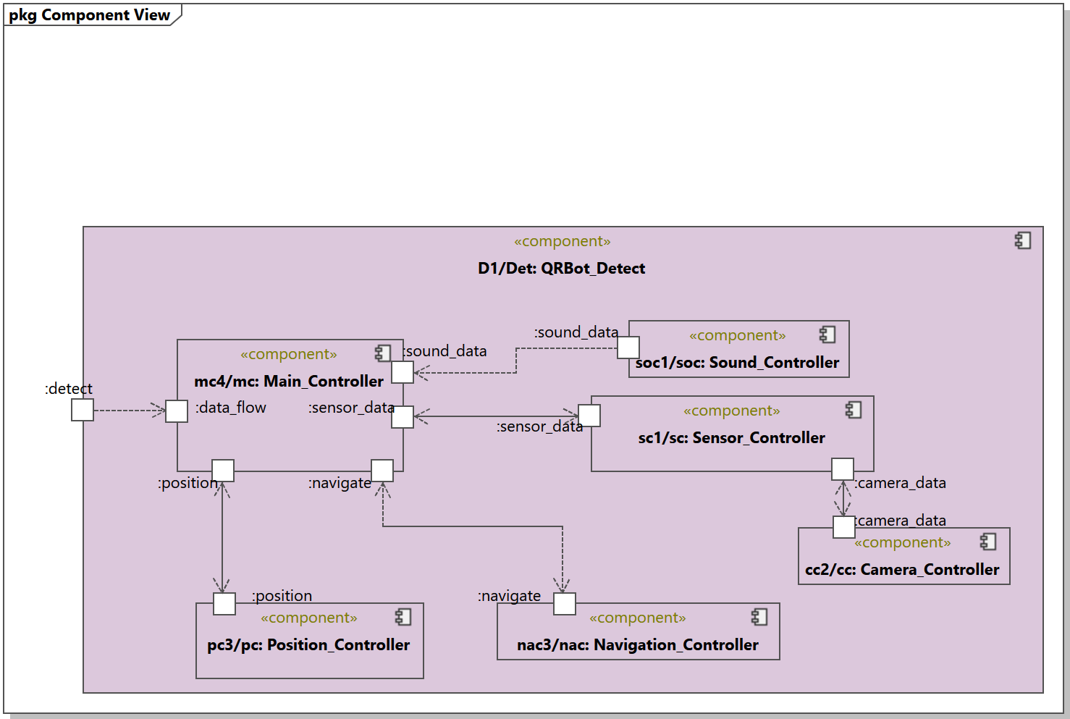
Detect Role

Slide 24
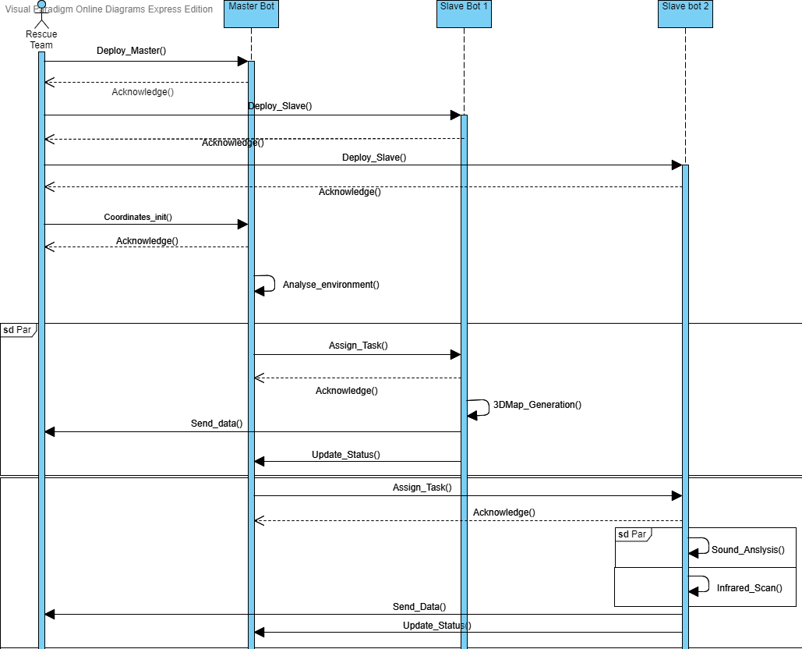
Survey and Detect Role Sequence Diagram

Slide 25
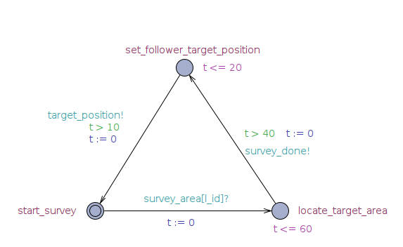
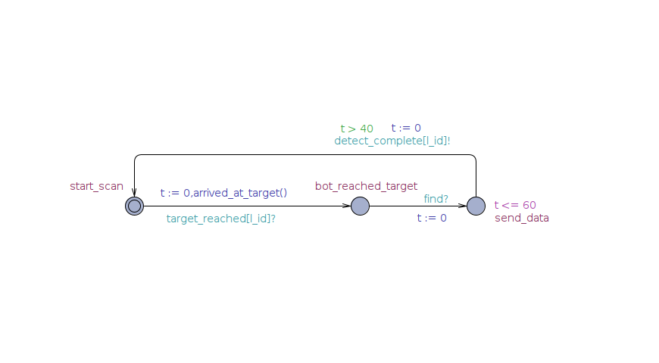
Survey and Detect Role Real-time State Chart
SURVEY ROLE
DETECT ROLE

Slide 26
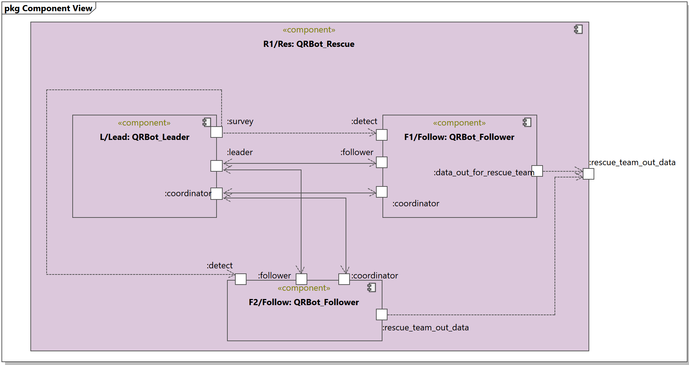
Rescue Scenario

Slide 27

QUESTIONS!!

Slide 28


