Slide 1

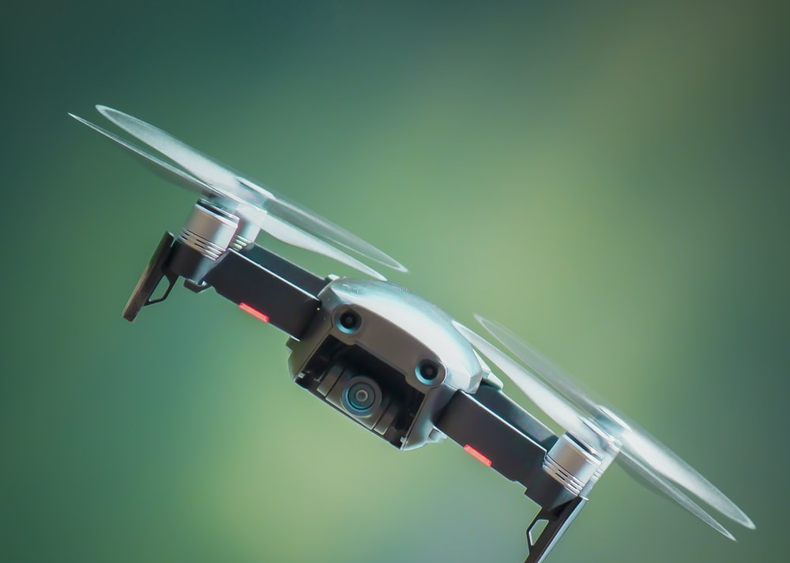
QUICK RESCUE BOT
ANAND PRAKASH
JITIKANTHA SARANGI
ADWAIT BAJPAI
ANANYA REGINALD FREDERICK
Notes:
Jeet

Slide 2

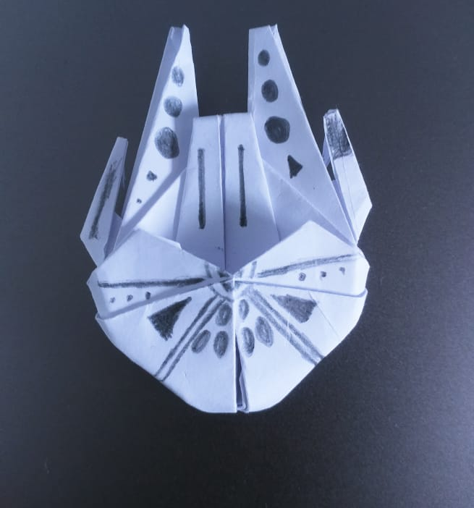
Objectives
Develop Rescue Robot for assistance in recovery and exploration of dangerous areas.
Rescue Robot must be able to drive in water.
It should have to capability to adapt to environmental changes.
Capable of working in community.
Notes:
jeet

Slide 3
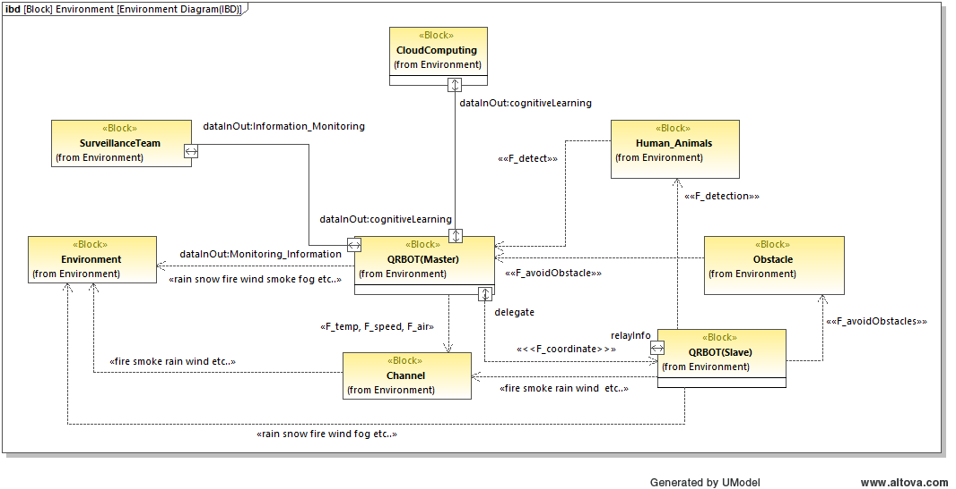
Environment Model
Notes:
jeet

Slide 4
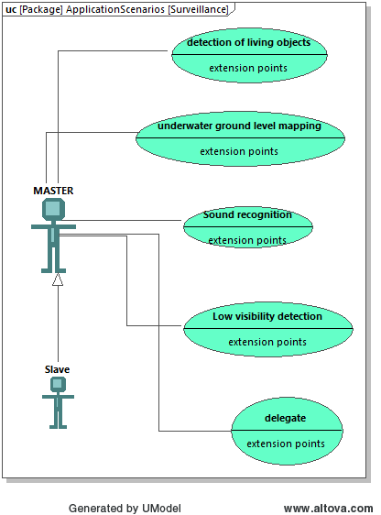
Application Scenarios
Application Scenario AS01
Description: The rescue robots must act in a community and each bots must be assigned specific tasks. The robots must be able to detect living objects and also do the survey of the rescue area.
Principle Solution: The leader bot is responsible for doing the survey of the area. It analyses the area and assigns tasks and location to the follower robots. The detection is done by the follower robot.
Notes:
jeet

Slide 5
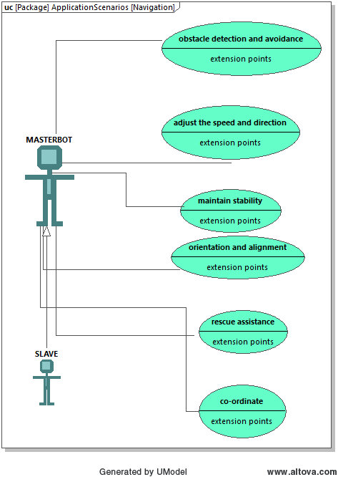
Application Scenarios(contd..)
Application Scenario AS02
Description: The robot must be able to co-ordinate with each other in order to provide better rescue assistance.
Principle Solution: The leader robot gets the position of each follower bot. After surveying the area, the leader bot assigns the follower bot with the location to carry out the detection task.
Notes:
jeet

Slide 6
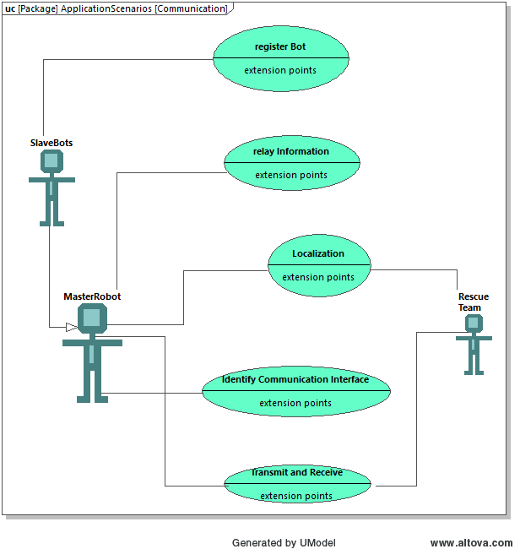
Application Scenarios(contd..)
Application Scenario AS03
Description: The robot must have the capability to identify the best communication interface in order to communicate within the robot system as well as with the Rescue team.
Principle Solution: The signal strength of the communicating devices is analysed at real time. If the signal strength is weak, an optimization loop is run to enhance the signal strength or hop to other communication interface.
Notes:
jeet

Slide 7
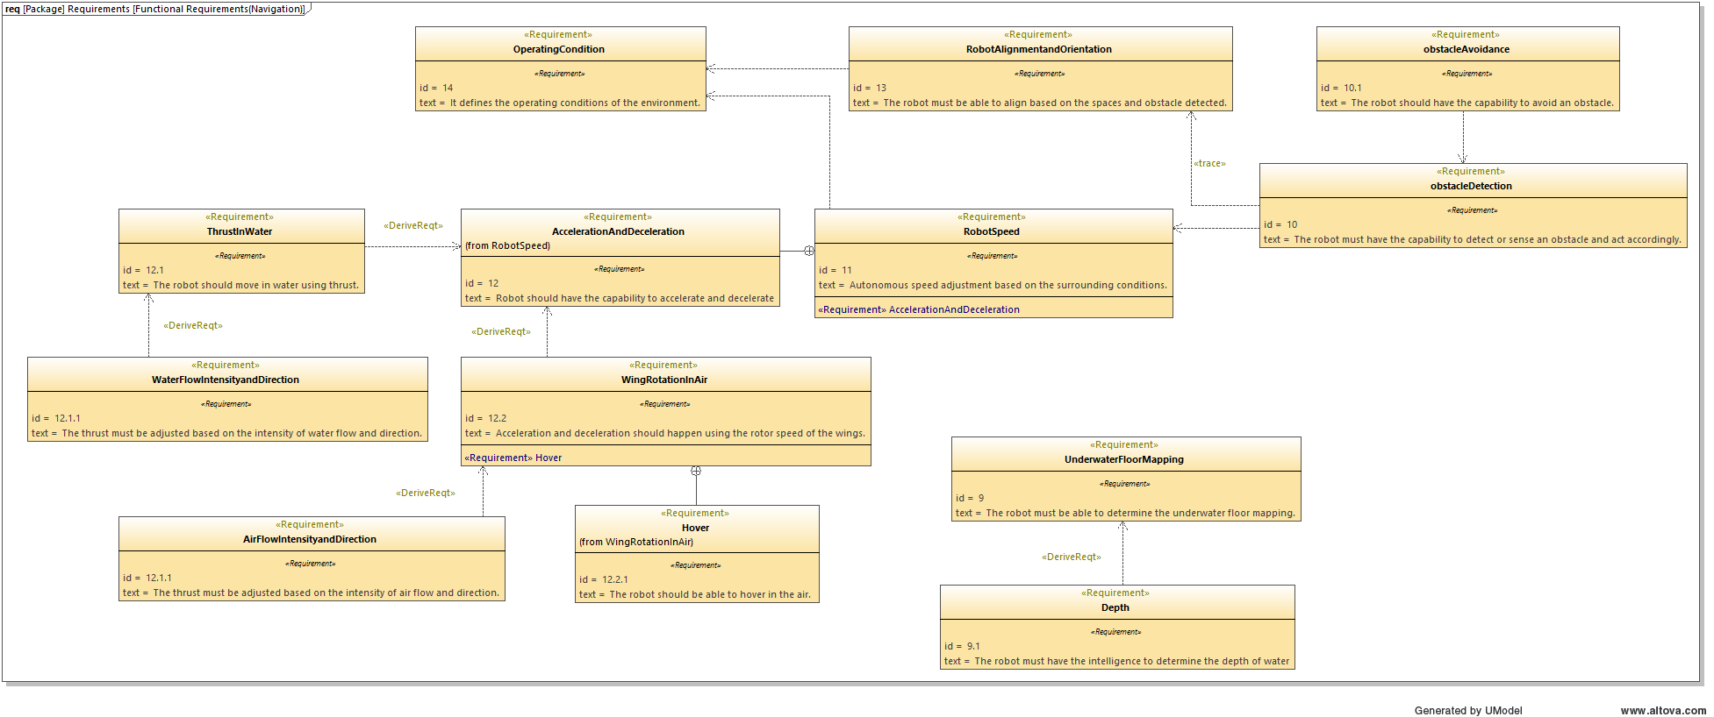
Requirements Model
Notes:
jeet

Slide 8
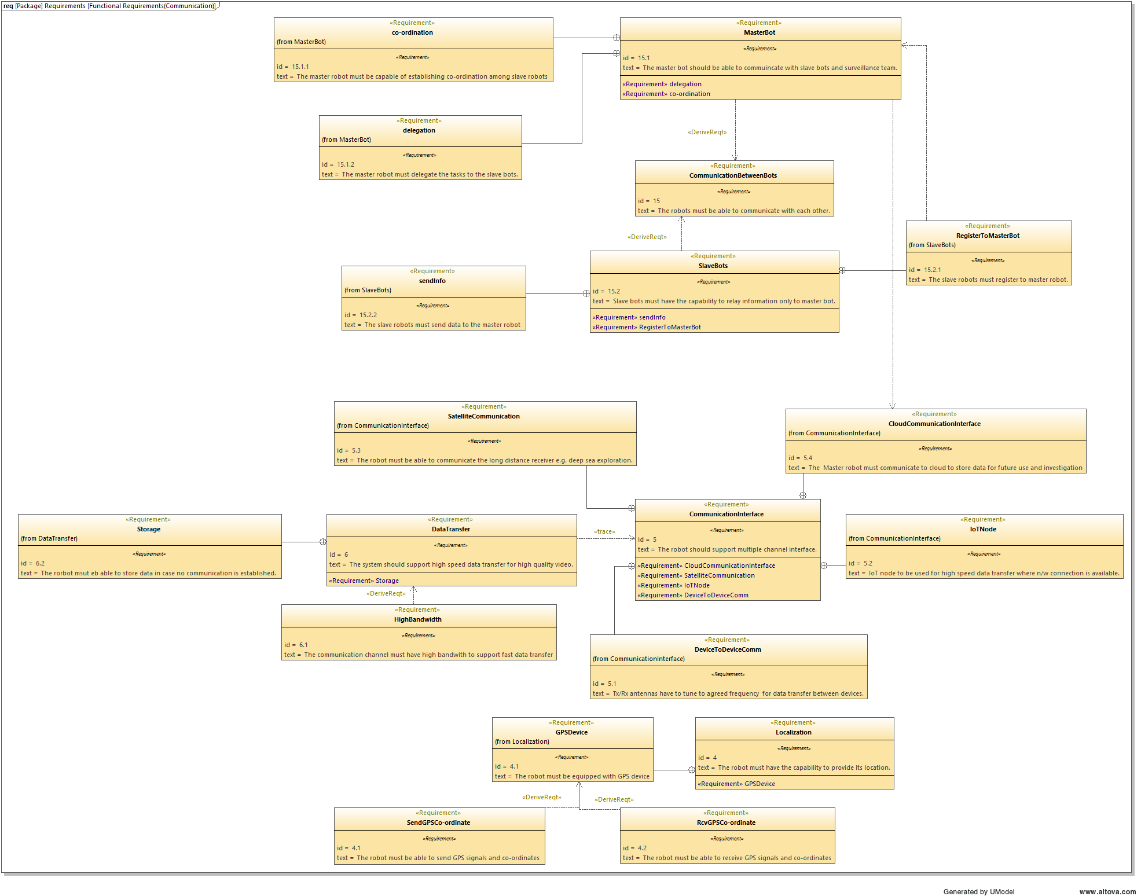
Requirements Model
Notes:
jeet

Slide 9
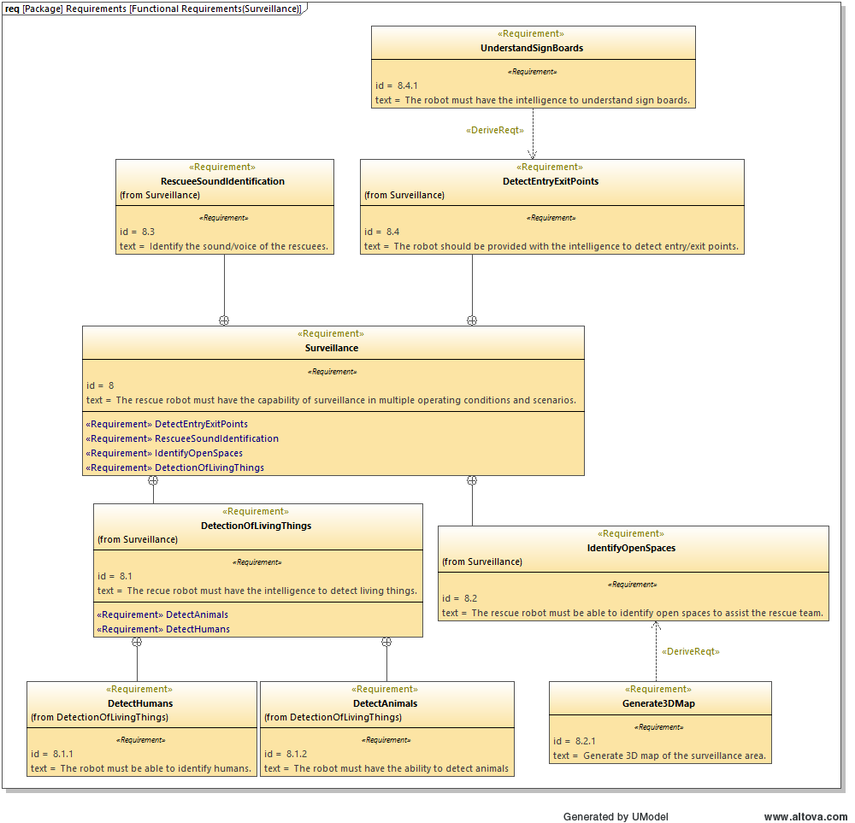
Requirements Model
Notes:
jeet

Slide 10
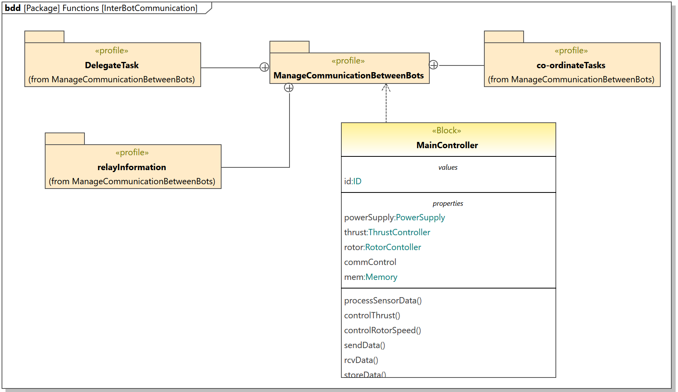
Functional Model
Notes:
adwait

Slide 11
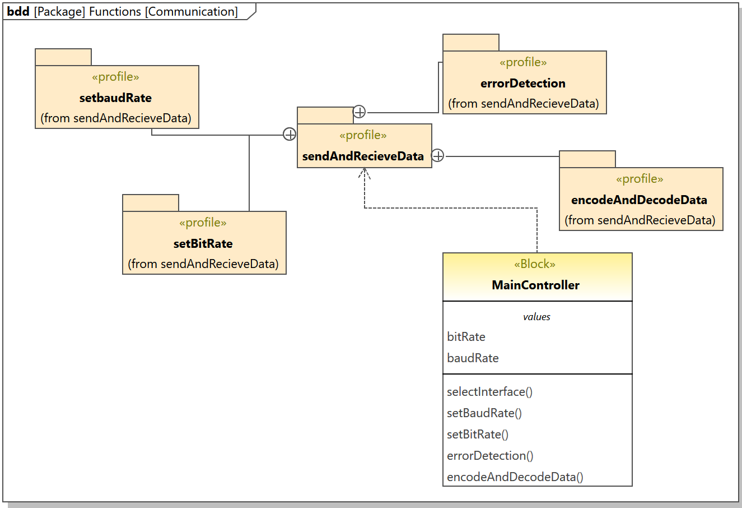
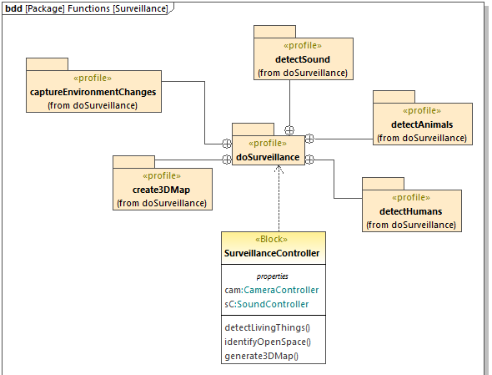
Functional Model
Notes:
adwait

Slide 12
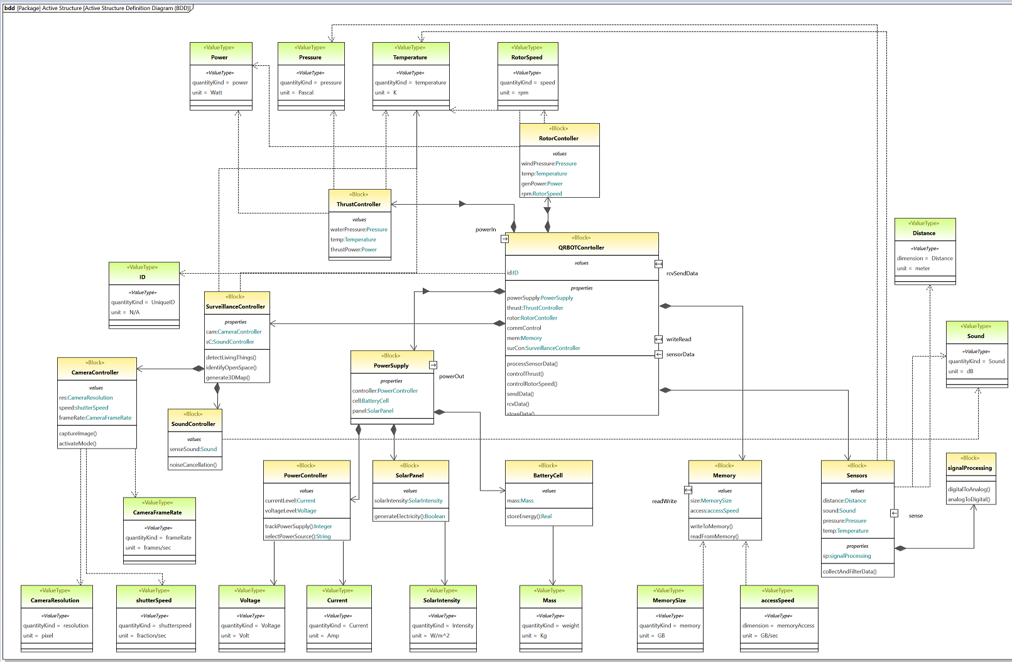
Active Structure
Notes:
adwait

Slide 13
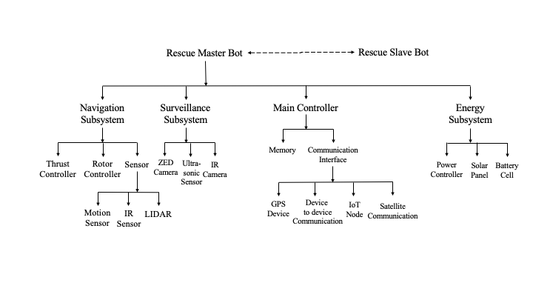
Macro Architecture
Notes:
adwait

Slide 14
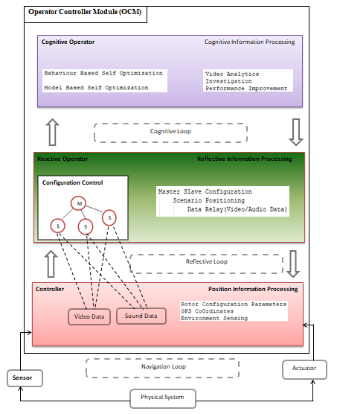
Operator-Controller-Module
Notes:
Adwait

Slide 15
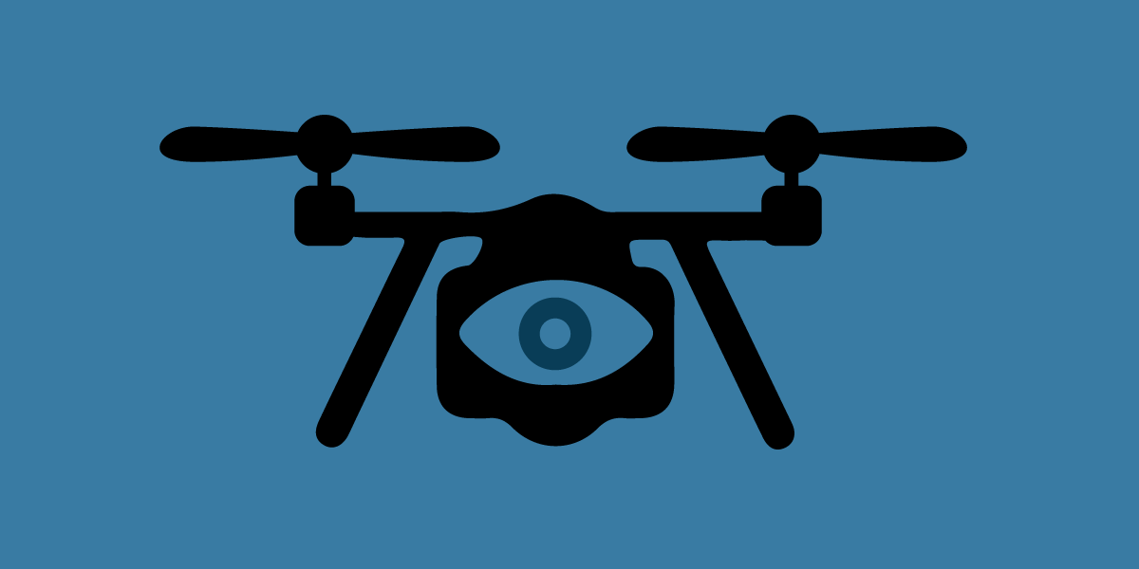






Rescue System
Leader Bot
Manage and Co-ordinate
with Follower
Manage and Co-ordinate
with Follower
Leader Bot survey area
Follower Bot
Follower Bot
Identify Rescuee
Identify Rescuee
Report for Rescue
Report for Rescue
Notes:
anand

Slide 16
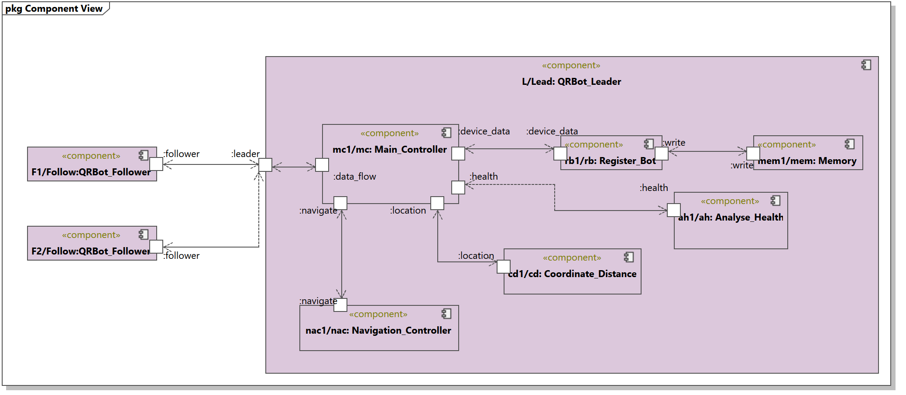
Leader Role
Notes:
anand

Slide 17
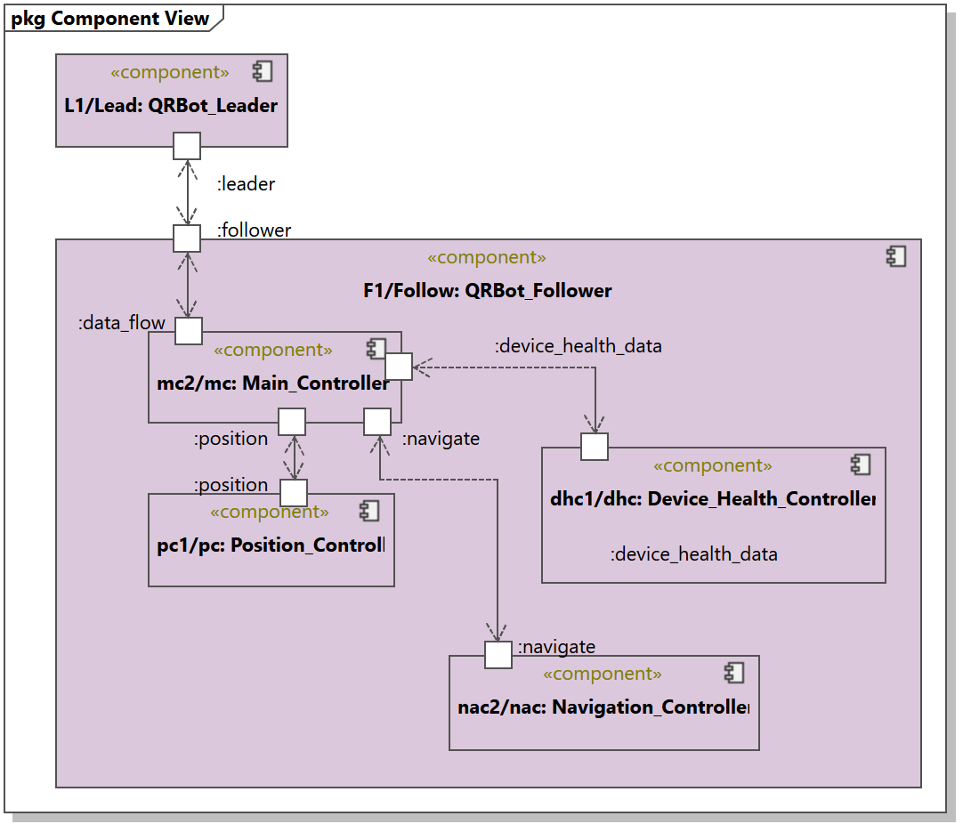
Follower Role
Notes:
anand

Slide 18
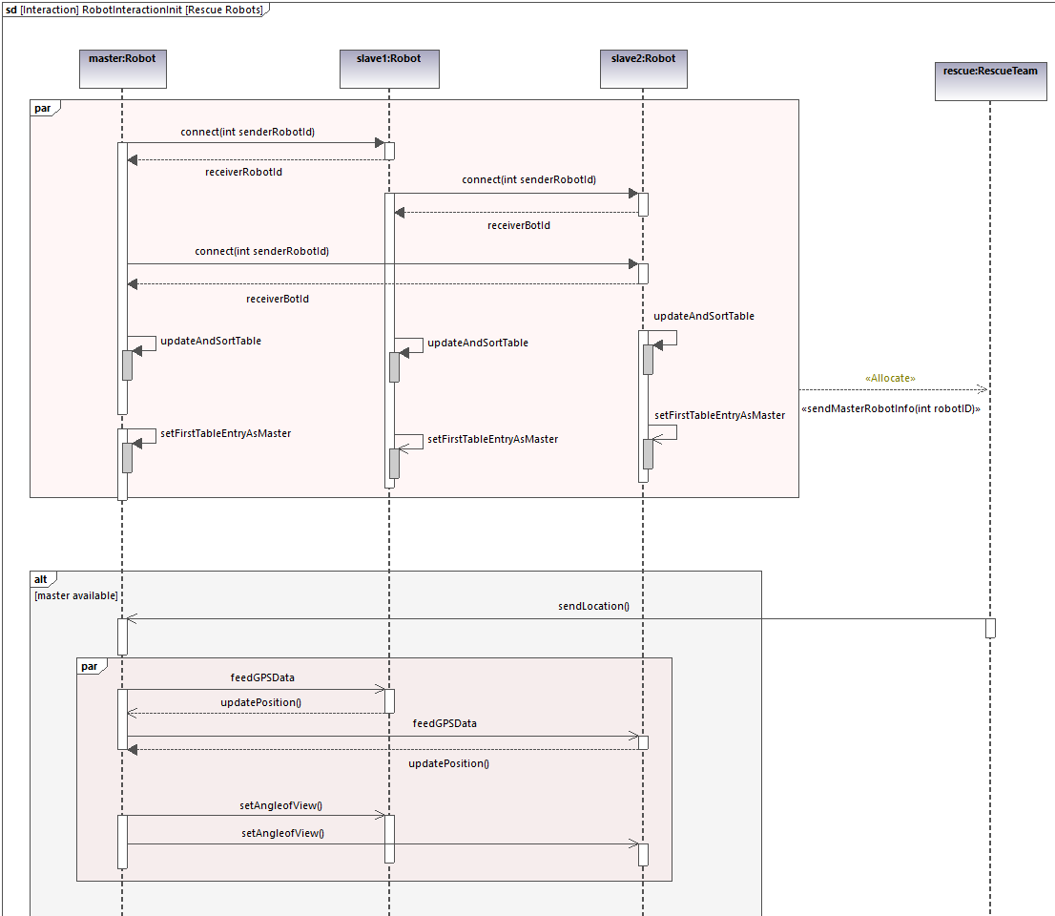
Leader-Follower Sequence Diagram
Notes:
anand

Slide 19
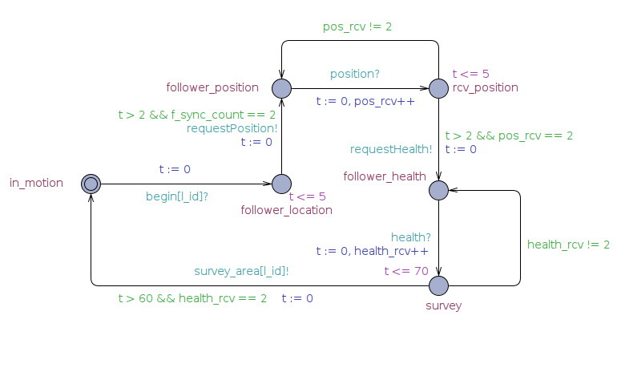
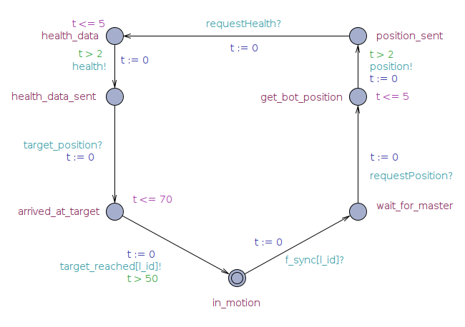
Leader-Follower Real-Time State Chart
LEADER ROLE
FOLLOWER ROLE
Notes:
anand

Slide 20
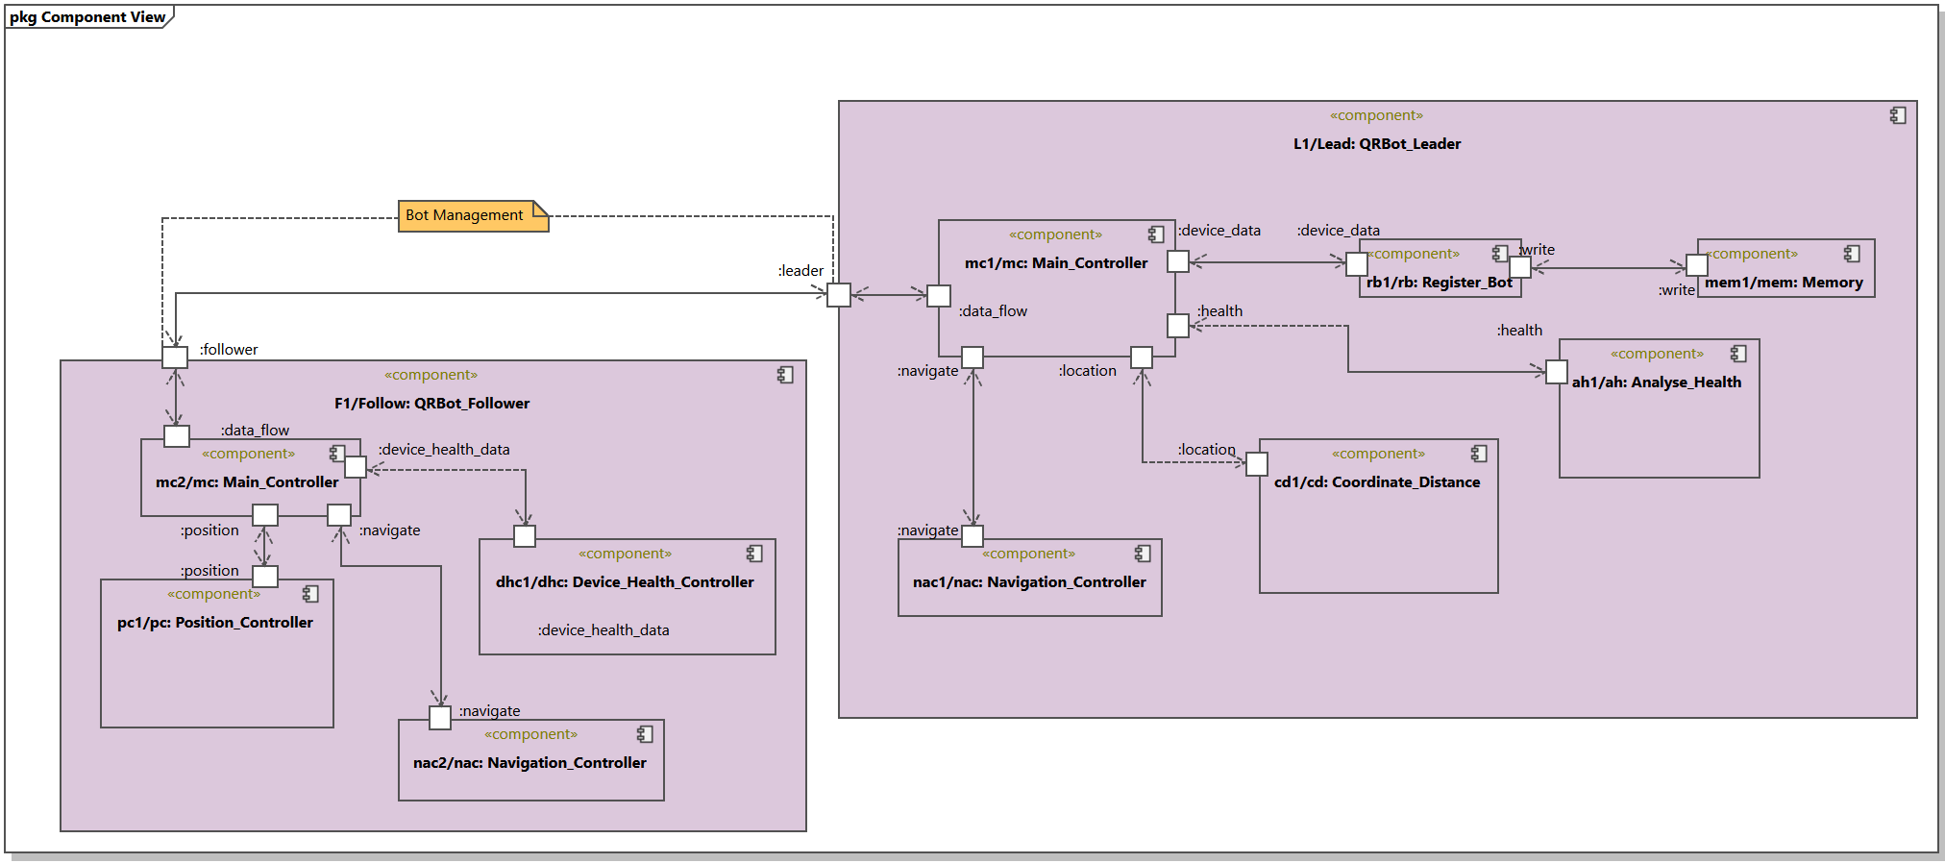
Leader-Follower Co-ordination
Notes:
anand

Slide 21
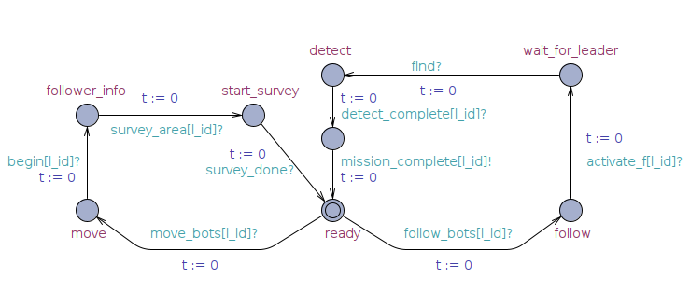
Co-ordinator Role
Notes:
Anand

Slide 22
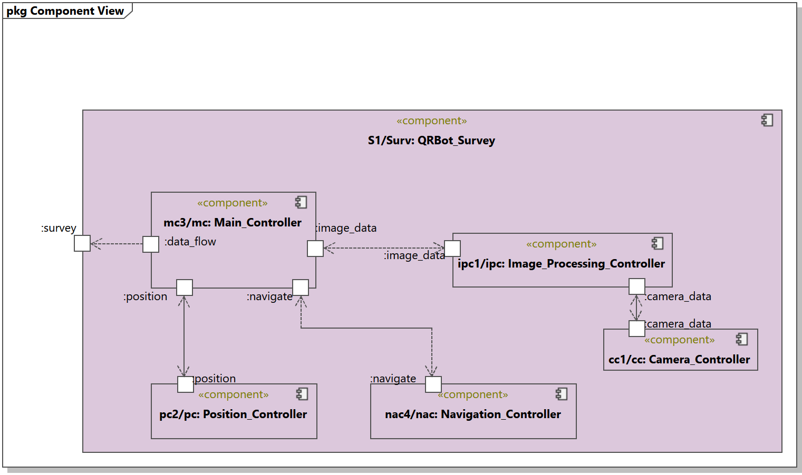
Survey Role
Notes:
ananya

Slide 23
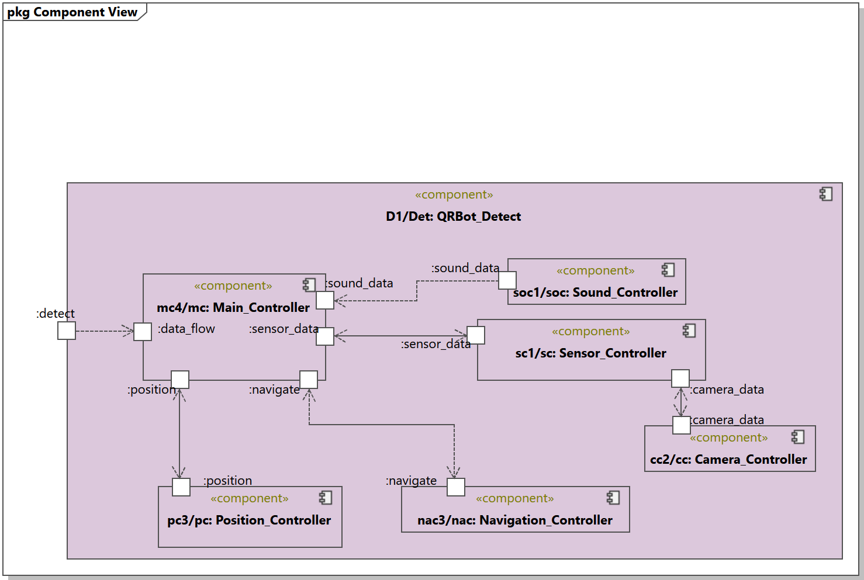
Detect Role
Notes:
ananya

Slide 24
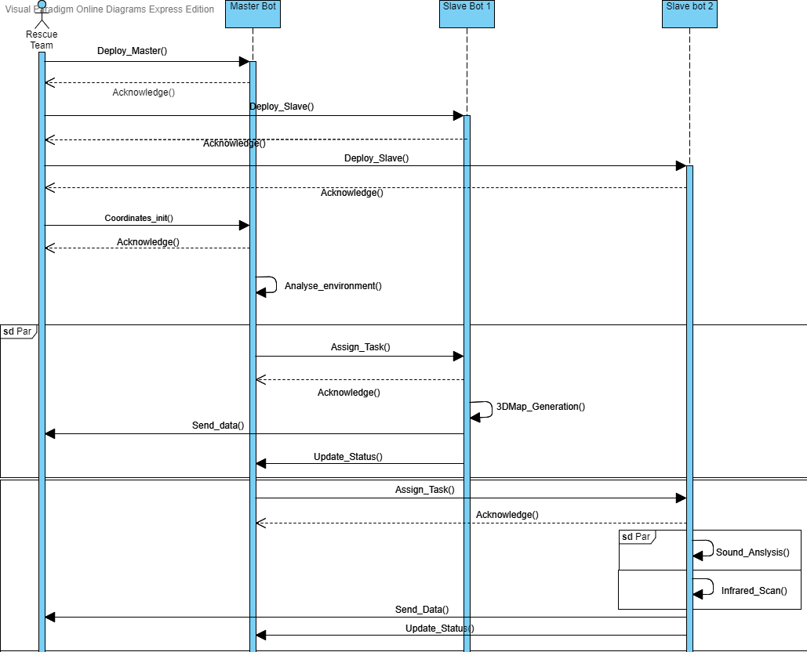
Survey and Detect Role Sequence Diagram
Notes:
ananya

Slide 25
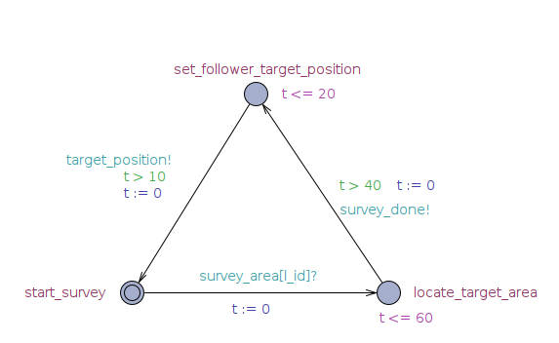
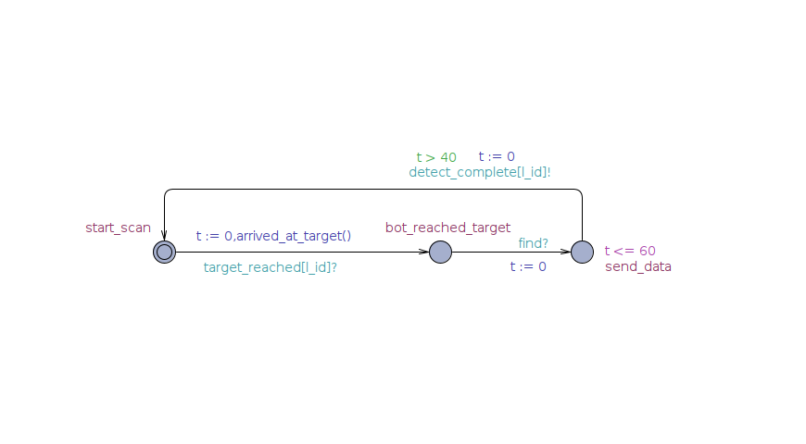
Survey and Detect Role Real-time State Chart
SURVEY ROLE
DETECT ROLE
Notes:
ananya

Slide 26
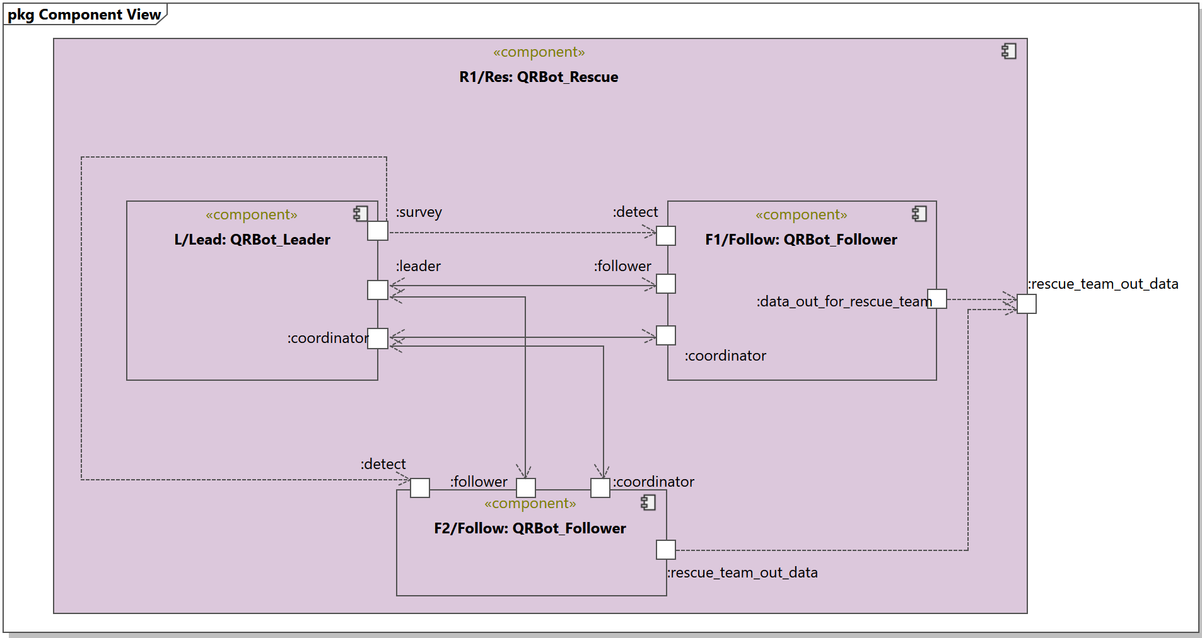
Rescue Scenario
Notes:
ananya

Slide 27
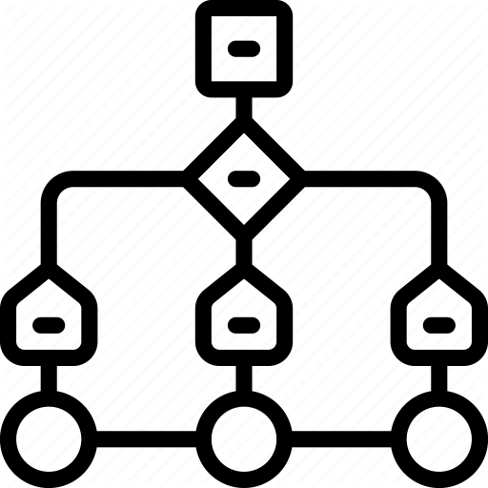
Decision Tree (Cognitive Layer)
Decision Tree as part of Cognitive Layer.
Optimization loop
Improving Bot response based on Data Set.
Notes:
Ananya

Slide 28
Initial Data Set
Signal_Strength | Interference | Error_Rate | Synchronization | Optimization
Low | Low | Low | S | No
Low | Low | High | O | Yes
Low | Medium | Low | S | No
Low | Medium | Medium | O | Yes
Low | High | High | O | Yes
Low | High | High | S | Yes
Low | High | Medium | S | Yes
Low | High | High | S | Yes
Medium | Low | Medium | S | No
Medium | Low | Low | O | Yes
Medium | Medium | High | S | Yes
Medium | Medium | High | O | Yes
Medium | High | Low | O | Yes
Medium | High | Medium | S | Yes
High | Low | Low | S | No
High | Low | Low | S | No
High | Medium | Medium | S | No
High | Medium | High | O | Yes
High | High | High | O | Yes
High | High | Medium | S | No
High | Low | High | S | Yes
Notes:
adwait

Slide 29
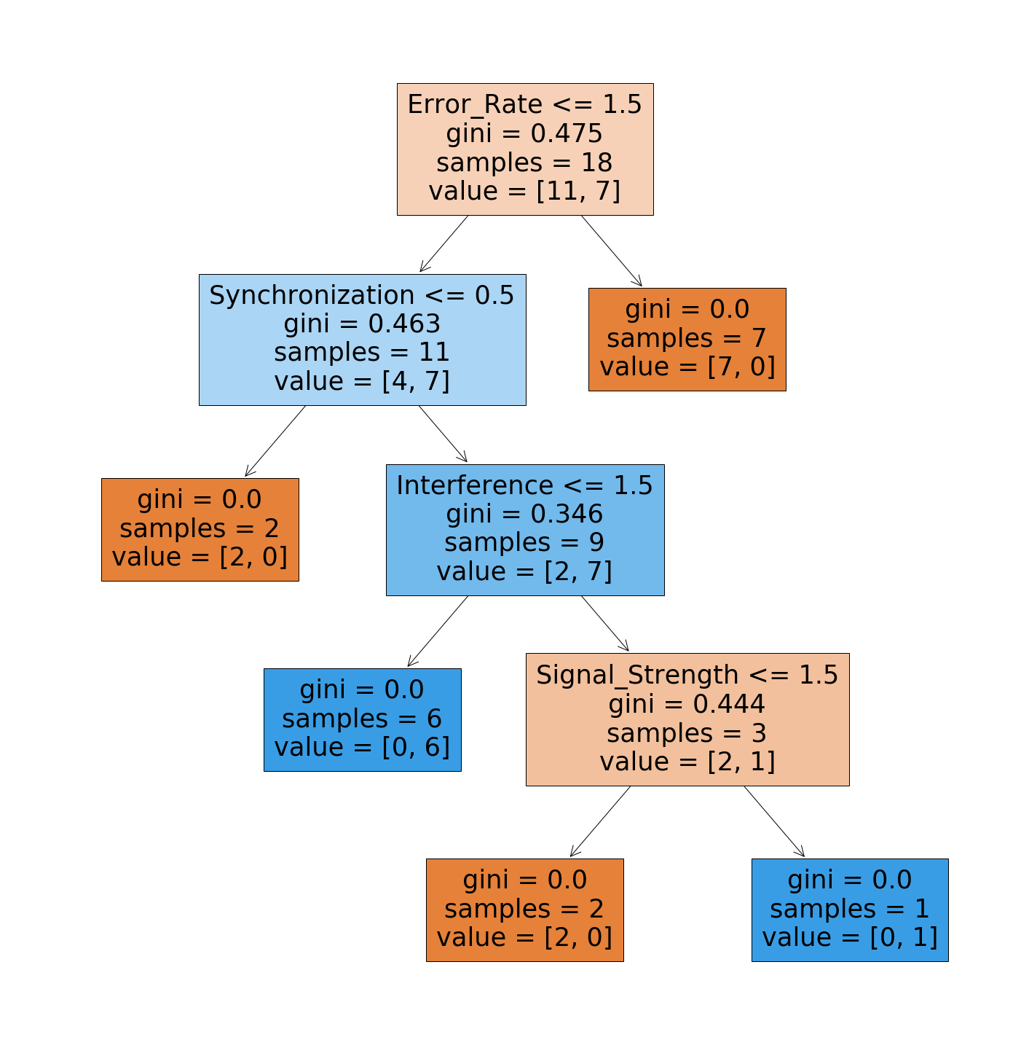
Initial Decision Tree
Notes:
Adwait

Slide 30
Final Data Set
Signal_Strength | Interference | Error_Rate | Synchronization | Optimization
Low | Low | Low | S | No
Low | Low | High | O | Yes
Low | Medium | Low | S | No
Low | Medium | Medium | O | Yes
Low | High | High | O | Yes
Low | High | High | S | Yes
Low | High | Medium | S | Yes
Low | High | Low | S | No
Low | Medium | High | S | Yes
Medium | Low | Medium | S | No
Medium | Low | Low | O | Yes
Medium | Medium | High | S | Yes
Medium | Medium | High | O | Yes
Medium | Low | Low | S | No
Medium | High | Low | O | Yes
Medium | High | Low | S | No
Medium | Medium | Medium | S | No
Medium | High | High | O | Yes
Medium | High | Medium | S | Yes
High | Low | Low | O | No
High | Low | Low | S | No
High | Medium | Medium | S | No
High | Medium | High | S | No
High | High | High | O | Yes
High | High | Medium | S | No
High | Low | High | S | No
High | Medium | High | O | Yes
High | Medium | Low | O | No
High | Medium | Low | S | No
Notes:
ananya

Slide 31
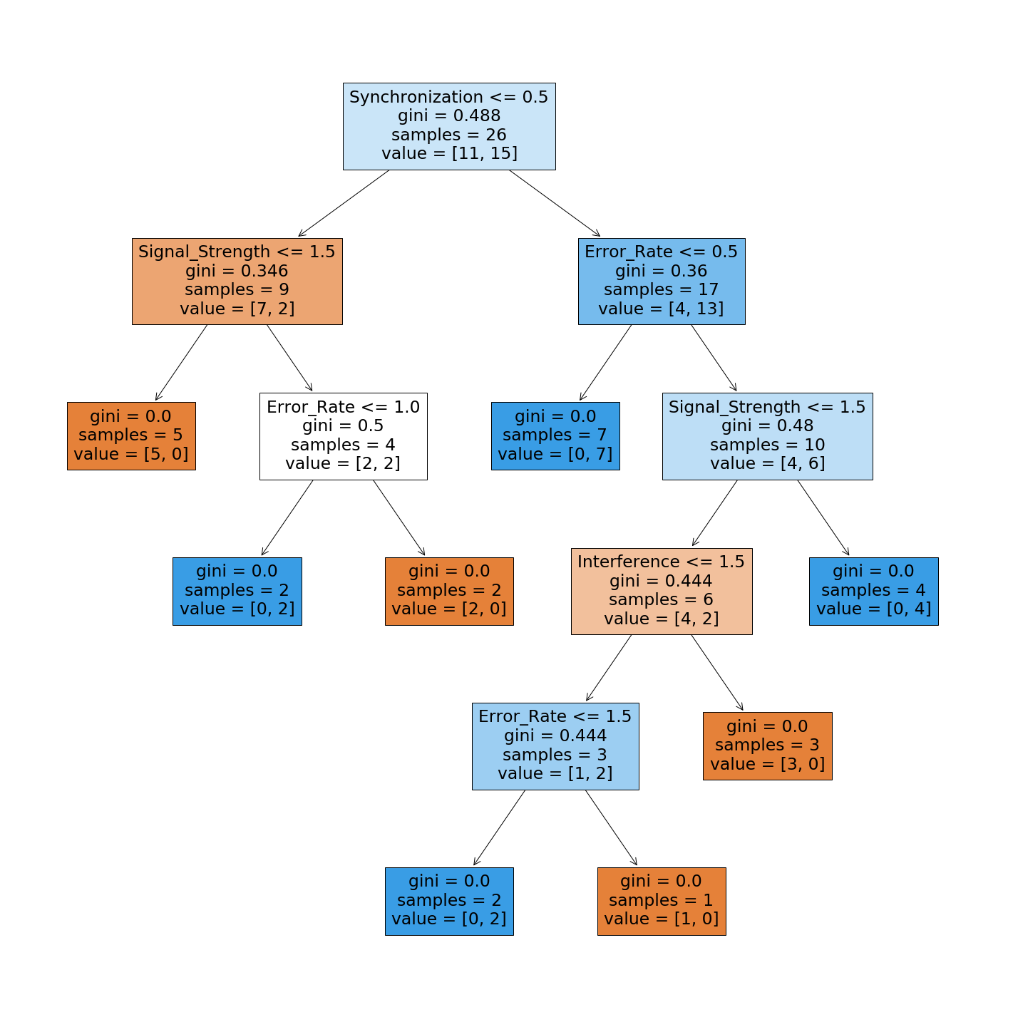
Final Decision Tree
Notes:
ananya

Slide 32
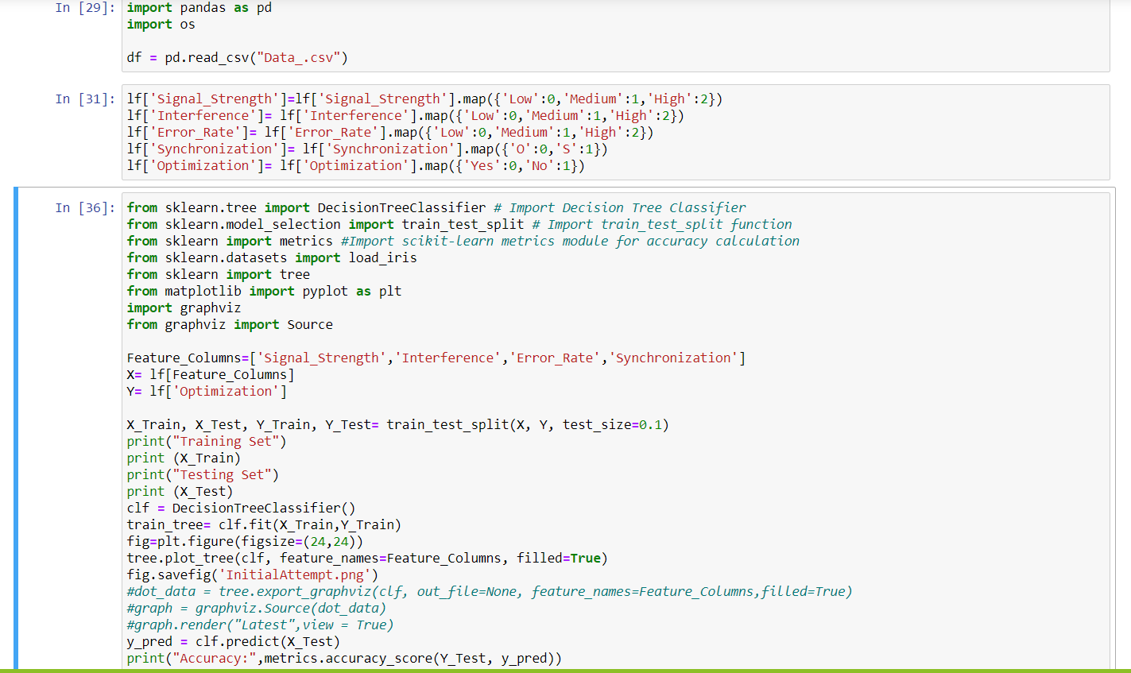
Decision Tree Code
Reading Dataset from Excel Sheet
Converting String attributes to numbers
Splitting Data set into training and Testing
Training Decision Tree
Visualising Decision Tree
Notes:
Ananya

Slide 33

Notes:
Ananya/anand

Slide 34

QUESTIONS!!

Slide 35
References
Design Methodology for Intelligent Technical Sysetms – Gausemeier, Rammig, Schäfer; Springer.
A Tutorial on Uppaal 4.0 - Gerd Behrmann, Alexandre David, and Kim G. Larsen Department of Computer Science, Aalborg University, Denmark.
Uppaal 4.0 : Small Tutorial.
https://scikit-learn.org
https://towardsdatascience.com

Slide 36


