Slide 1
PARUL UNIVERSITY
FACULTY OF IT & COMPUTER SCIENCE • DEPARTMENT OF MScIT
P.O. Limda, Ta. Waghodia, Dist. Vadodara - 391760, Gujarat, India
A MINOR PROJECT DEFENSE & TECHNICAL PRESENTATION
AI RESEARCH PAPER ASSISTANT
An End-to-End Academic Authoring, Literature Synthesis & Overleaf Compilation Platform
Submitted in partial fulfillment of the requirements for Master of Science in Information Technology (M.Sc. IT)
SUBMITTED BY:
Candidate Name
Enrollment No.: 2203001XXXX
M.Sc. IT Semester - IV | Academic Year: 2025-2026
UNDER THE GUIDANCE OF:
Internal Faculty Guide
Assistant Professor
Department of MScIT, Parul University, Vadodara

Slide 2
EXECUTIVE OVERVIEW
Project Motivation & Core Innovation
Bridging the divide between raw research ideation and submission-ready academic papers.
70%
Authoring Acceleration
Reduces total literature discovery and drafting cycle time from weeks to hours.
100%
Citation Synchronization
Guarantees zero citation drift by linking manuscript cite{} tags with audited BibTeX records.
0 Cost
Offline Deterministic Mode
Enables complete manuscript synthesis locally without mandatory cloud API tokens or internet.
The Scientific Publishing Dilemma
• Literature Deluge: Over 5 million papers published yearly doubles every few years, overwhelming researchers.
• Extreme Fragmentation: Scholars constantly switch across Google Scholar, Zotero, Word, Matplotlib, and Overleaf.
• Format Non-Compliance: Conference rejections frequently occur due to broken bibliography keys and template errors.
• Cognitive Exhaustion: Authors spend over 60% of their effort fighting formatting instead of intellectual research.
The AI Research Paper Assistant Solution
• Unified Academic Cockpit: Consolidates search, hypothesis formulation, outline planning, drafting, review, and LaTeX bundling.
• Live Scholarly Graph Integration: Direct REST querying of Semantic Scholar & arXiv for authentic bibliographic discovery.
• Simulated 3-Reviewer Committee: Pre-submission double-blind peer review scoring across 5 rigorous conference dimensions.
• 1-Click Camera-Ready Export: Builds self-contained Overleaf ZIP archives with audited main.tex, references.bib, and 300 DPI plots.
Parul University | Department of MScIT | Minor Project Report 2026
AI Research Paper Assistant
2 / 20

Slide 3
REQUIREMENT ANALYSIS
Problem Statement: 5 Critical Academic Bottlenecks
Systemic inefficiencies that hinder post-graduate researchers and faculty supervisors.
01
Information Overload & Literature Lag — Surfacing relevant prior art among millions of pre-prints without falling victim to keyword mismatch or missing seminal baselines.
02
Synthesis & Literature Matrix Overhead — Manual reading of dozens of abstracts requires weeks of effort to construct multi-dimensional comparative tables and identify authentic scientific gaps.
03
Drafting Inefficiency & Academic Rigor — Balancing mathematical notation precision, domain-specific terminology, and conference-compliant structural prose causes severe author fatigue.
04
Citation Inconsistency & Broken References — Manual tracking results in broken cite{} tags, mismatched BibTeX entries, and frustrating LaTeX compiler crashes right before submission deadlines.
05
Absence of Pre-Submission Peer Critique — Manuscripts undergo zero formal critique prior to camera-ready submission, leading to avoidable desk rejections from top-tier venues (IEEE/ACM/NeurIPS).
Parul University | Department of MScIT | Minor Project Report 2026
AI Research Paper Assistant
3 / 20

Slide 4
PROJECT PROFILE
Project Objectives & Scope Boundaries
Clear functional goals and operational boundaries governing software delivery.
Primary Engineering Objectives
• Literature Querying Automation: Develop RESTful wrappers for Semantic Scholar and arXiv to fetch metadata, abstracts, and BibTeX strings instantly.
• Intelligent Outline Architect: Support venue-specific section hierarchies (NeurIPS, IEEE Transactions, ACM SIGKDD, Springer LNCS) with custom word budgets.
• Hybrid Cloud/Offline Drafting: Implement dual runtime engine: Google Gemini / OpenAI for rich drafting, and a deterministic offline engine for zero-cost execution.
• Simulated Double-Blind Review: Deploy multi-persona reviewer heuristics scoring across 5 core academic dimensions (Originality, Soundness, Rigor, Clarity, Citations).
• Automated LaTeX & Overleaf Pipeline: Generate pristine main.tex, references.bib, and compile 300 DPI Matplotlib figures into ready-to-upload ZIP bundles.
Scope & Operational Boundaries
• Target Academic Audience: Specifically engineered for M.Sc. IT, MCA, IMCA students, Ph.D. scholars, and university faculty supervisors.
• Domain Focus: Optimized for Computer Science, Information Technology, AI, Data Science, and Software Engineering manuscripts.
• Cross-Platform Web Architecture: Browser-based application accessible across Windows, Linux, and macOS without client-side native compilation hurdles.
• Out-of-Scope (Data Fabrication): The platform strictly does NOT synthesize artificial lab results; all empirical benchmark numbers are provided or configured by the author.
• Editorial Autonomy: Functions as an intelligent scaffolding assistant; intellectual ownership and final editorial control remain entirely with the researcher.
Parul University | Department of MScIT | Minor Project Report 2026
AI Research Paper Assistant
4 / 20

Slide 5
COMPARATIVE ANALYSIS
Existing Workflow vs. Proposed AI Platform
Systematic contrast highlighting operational leaps across every authoring dimension.
Authoring Dimension | Conventional Disjointed Workflow | AI Research Paper Assistant
Literature Discovery | Manual browsing of Google Scholar/arXiv; scattered notes and spreadsheet tracking. | Direct REST querying of Semantic Scholar; instant citation counts, abstracts, and BibTeX keys.
Related Work Synthesis | Weeks spent manually reading papers to hand-craft comparative text and tables. | Automated comparative matrix generation contrasting approaches, benchmarks, and limitations.
Drafting & Formatting | Manual typing in Word/Google Docs with severe cognitive fatigue on mathematical equations. | Context-enriched section drafting with LaTeX equation environments and pseudocode staging.
Citation Tracking | High risk of citation drift, missing BibTeX keys, and broken cite{} tags in final compilation. | 100% automated Citation Health Checker verifying every cite{} key against references.bib.
Quality & Peer Review | Zero formal evaluation prior to conference submission, leading to avoidable rejections. | Multi-persona simulated double-blind peer review scoring across 5 conference rubrics.
LaTeX Packaging | Manual file copying, figure sizing, and painful compilation debugging on client machines. | 1-Click automated generation of self-contained Overleaf ZIP bundles and local PDF compilation.
Parul University | Department of MScIT | Minor Project Report 2026
AI Research Paper Assistant
5 / 20

Slide 6
PROJECT FEASIBILITY
Multi-Dimensional Feasibility Study
Thorough assessment validating the practical, commercial, and technical viability of the platform.
Technical Feasibility
• Open-Source Foundation: Built on robust, modern technologies: Python 3.11+, Streamlit reactive UI, and Tectonic TeX.
• Documented REST APIs: Semantic Scholar Graph API provides high-availability academic endpoints with stable schemas.
• Dual Execution Pipeline: Deterministic offline engine ensures 100% functionality even during network or quota outages.
Economic Feasibility
• Zero Licensing Costs: Engineered entirely using open-source libraries, eliminating expensive proprietary software fees.
• Zero-Cost Offline Mode: Students can run the full authoring pipeline locally without purchasing commercial API credits.
• Minimal Cloud Overhead: Optional cloud LLM drafting incurs only pennies per paper, well within lab allocations.
Operational Feasibility
• Intuitive Web Cockpit: Self-explanatory 8-tab visual interface requiring zero specialized command-line training.
• Rapid User Adoption: Undergraduate and master's students can generate verified LaTeX bundles in their first session.
• Seamless State Management: 1-click JSON import/export lets authors pause, save, and resume projects at any time.
Legal & Ethical Feasibility
• Fair Use Compliance: Scholarly abstracts and BibTeX data retrieved strictly respect open academic access standards.
• Zero Attribution Drift: Every generated citation links back to genuine, published academic papers and authors.
• Academic Integrity: Functions as a cognitive co-pilot and typesetting assistant; author maintains intellectual direction.
Parul University | Department of MScIT | Minor Project Report 2026
AI Research Paper Assistant
6 / 20

Slide 7
SYSTEM ARCHITECTURE
The 8-Module Academic Authoring Pipeline
Decoupled, cohesive software architecture managing the complete paper development lifecycle.
M1
M2
M3
M4
Project Portal
Admin & Venue Config
Configures manuscript titles, target templates (IEEE/NeurIPS), and toggles Cloud vs. Offline engines.
Literature Hub
Graph API Ingestion
Queries Semantic Scholar & arXiv REST endpoints, parsing titles, citation velocity, and BibTeX.
Insights Hub
Hypothesis Generator
Analyzes collected abstracts to extract persistent scientific gaps and auto-derive testable hypotheses.
Outline Architect
Structural Planner
Generates conference-compliant hierarchical outlines with custom word budgets across sections.
M5
M6
M7
M8
Related Work
Synthesis Engine
Constructs structured tabular comparison matrices contrasting approaches, datasets, and limitations.
Drafting Studio
AI Prose & Equations
Dispatches structured prompts to LLMs/offline engine; formats LaTeX equations and algorithm boxes.
Peer Review
3-Reviewer Simulation
Simulates Senior Reviewer, Methodologist, and Domain Expert scoring manuscripts across 5 rubrics.
LaTeX Bundler
Compiler & Overleaf ZIP
Audits citation health, compiles 300 DPI figures, and packages complete Overleaf ZIP archives.
Parul University | Department of MScIT | Minor Project Report 2026
AI Research Paper Assistant
7 / 20

Slide 8
PROCESS MODEL
Spiral SDLC: Risk-Driven Engineering
Systematic risk analysis governing the integration of generative AI with deterministic LaTeX engines.
Why the Spiral Model? Coupling non-deterministic generative language models with strict, deterministic document compilers (LaTeX/Tectonic) creates severe failure points (rate limits, hallucinated citations, compilation crashes). The Spiral SDLC resolves these risks iteratively across 4 focused spirals.
Spiral Iteration 1
Core Architecture & Risk Mitigation
• Identified Risk: LLM API rate limits, network outages, and token costs for students.
• Engineering Milestone: Built underlying project state JSON manager and deterministic offline rule-based academic engine.
• Verification Target: Zero-token offline draft generation successfully demonstrated.
Spiral Iteration 2
Literature Discovery & UI Prototype
• Identified Risk: External scholarly graph API instability and malformed BibTeX.
• Engineering Milestone: Implemented Semantic Scholar REST client with in-memory caching and fallback to curated academic records.
• Verification Target: 10-paper query parsing and abstract extraction working cleanly.
Spiral Iteration 3
Drafting Engine & Peer Review Studio
• Identified Risk: Draft prose incoherence, missing baselines, and citation drift.
• Engineering Milestone: Engineered context-enriched prompt assembler, related work comparison matrix builder, and 5-dimension rubric evaluator.
• Verification Target: Simulated peer review scoring 8.5/10 with itemized critiques.
Spiral Iteration 4
Plots, Packaging & System Verification
• Identified Risk: LaTeX syntax compilation errors and unreferenced BibTeX keys.
• Engineering Milestone: Built native Python plotting studio (300 DPI), automated Citation Health Checker, and Overleaf ZIP packager.
• Verification Target: 16/16 verification test cases passed (100% success rate).
Parul University | Department of MScIT | Minor Project Report 2026
AI Research Paper Assistant
8 / 20

Slide 9
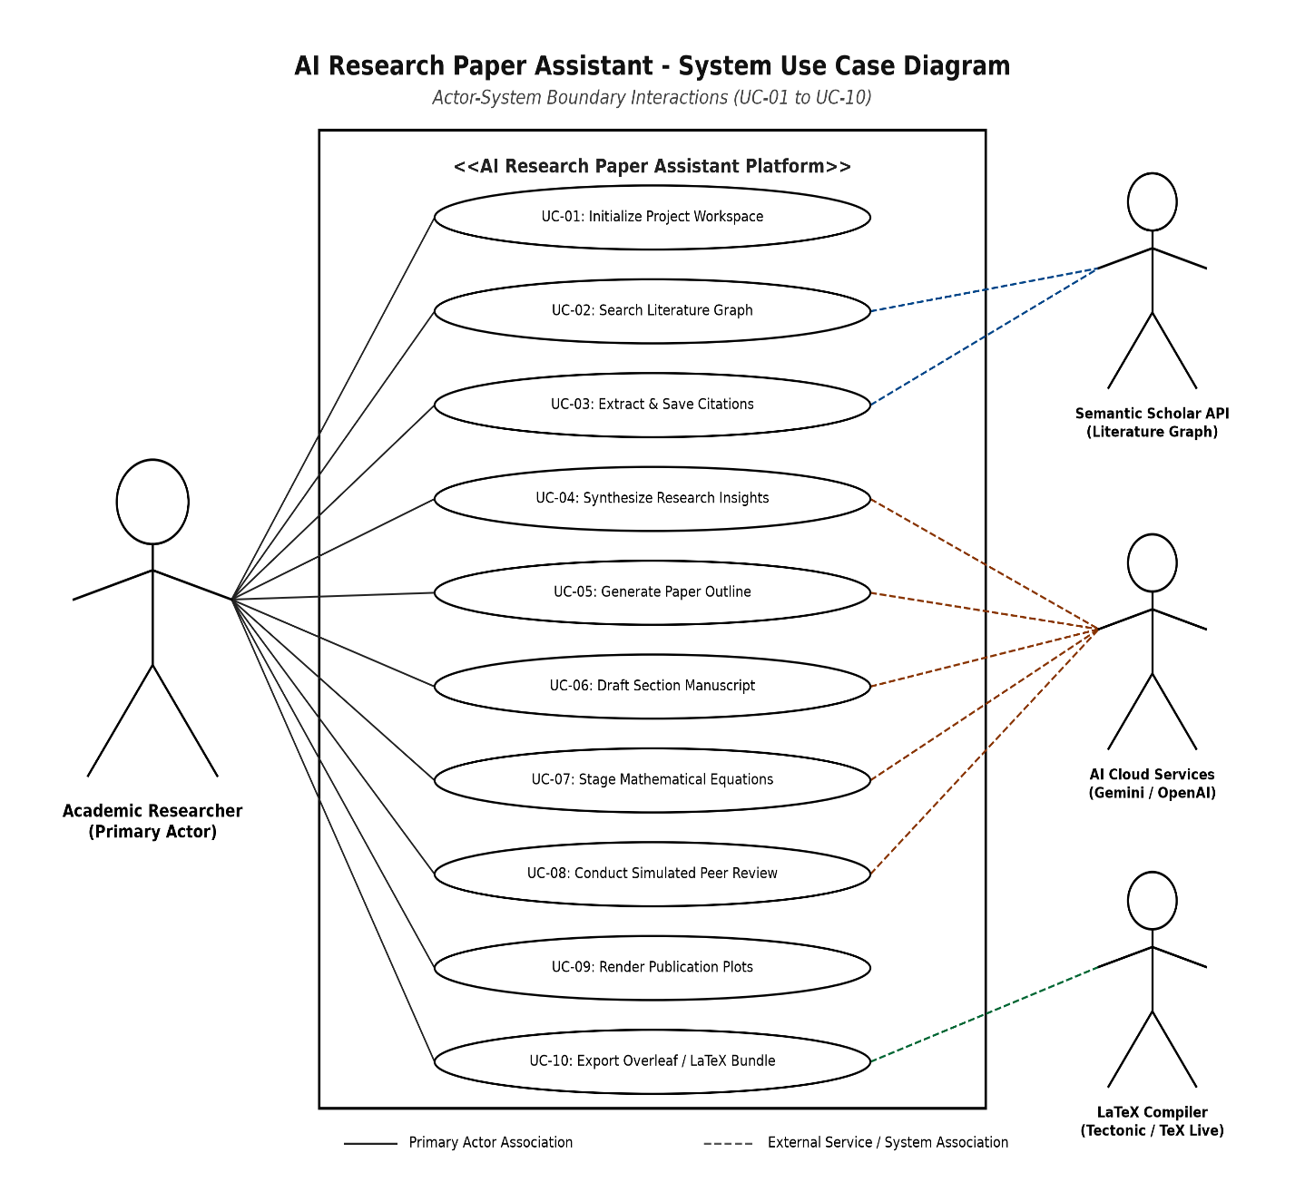
SYSTEM MODELING
System Use Case Diagram (UC-01 to UC-10)
Visualizing actor-system boundary interactions across primary and external service providers.
Use Case Breakdown & Actors
• Academic Researcher (Primary): Central orchestrator initiating workspace setup, querying literature, outlining, editing drafts, and triggering bundling.
• Semantic Scholar API (External): Responds to literature search queries (UC-02) and supplies BibTeX citations (UC-03).
• AI Cloud Services (Gemini/OpenAI): Executes context-enriched section drafting (UC-06), hypothesis derivation (UC-04), and simulated peer review (UC-08).
• LaTeX Compiler (System Service): Performs citation audit checks, runs Tectonic/pdflatex, and packages Overleaf ZIP bundles (UC-10).
• Faculty Supervisor Interaction: Leverages automated rubric scores and peer reviews for fast pre-submission manuscript evaluations.
Parul University | Department of MScIT | Minor Project Report 2026
AI Research Paper Assistant
9 / 20

Slide 10
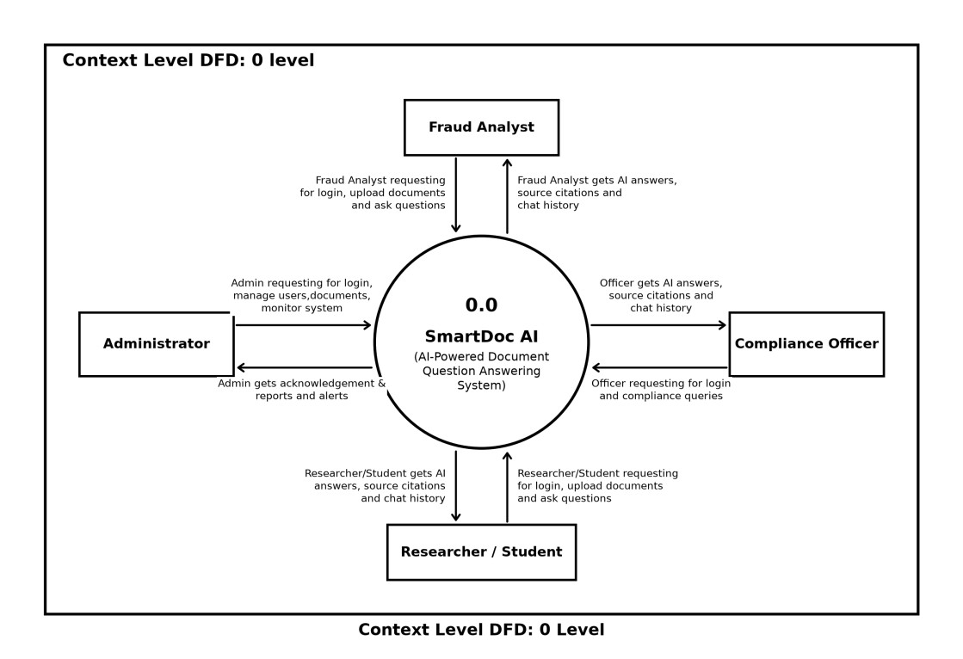
DATA FLOW MODELING
DFD Level 0: Context Level Diagram
High-level information exchange between the system bubble and external entities.
Context Flow Architecture
• System Process 0.0: Represents the unified AI Research Paper Assistant platform encapsulating all data transformations.
• Researcher Data Inflow: Author supplies search topics, stylistic parameters, venue templates, outline adjustments, and plot specifications.
• Scholarly API Communication: Sends REST GET requests containing search keywords; receives JSON arrays containing paper abstracts, citation metrics, and BibTeX entries.
• Generative LLM Inflow/Outflow: Dispatches rich academic prompt dossiers; streams back academic prose drafts, equation blocks, and peer reviews.
• Final Output Deliverables: Assembled camera-ready PDF document, citation audit report, and self-contained Overleaf ZIP packages.
Parul University | Department of MScIT | Minor Project Report 2026
AI Research Paper Assistant
10 / 20

Slide 11
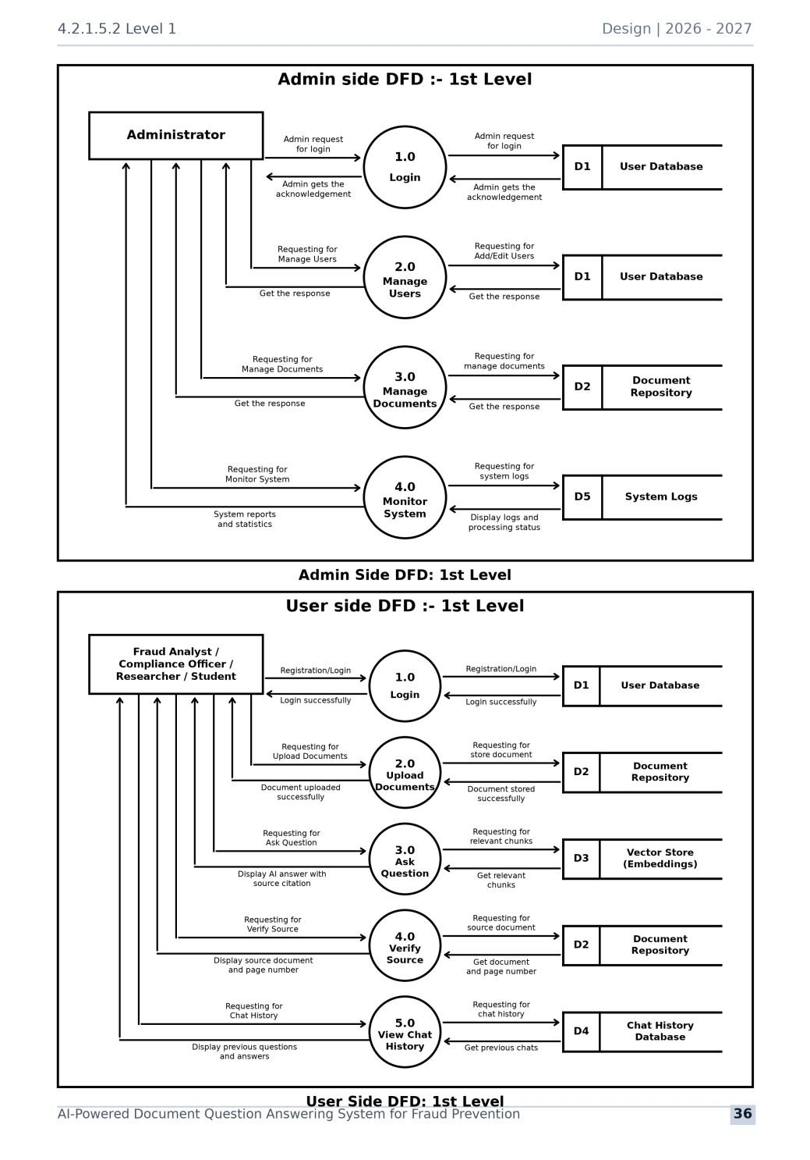
DATA FLOW MODELING
DFD Level 1: Major System Processes & Data Stores
Decomposition into 6 core functional processes and 6 persistent data repositories.
6 Core Processes & 6 Persistent Data Stores
• Process 1.0 (Literature Discovery): Executes scholarly searches and records verified citations into Data Store D1 (Literature Store).
• Process 2.0 (Create Hypothesis): Analyzes collected prior art to derive novel research questions into Data Store D2 (Hypothesis Store).
• Process 3.0 (Architect Outline): Transforms hypotheses into venue-compliant outlines stored in Data Store D3 (Outline Store).
• Process 4.0 (Draft Sections): Synthesizes section drafts with LaTeX equations, persisting text into Data Store D4 (Drafts Store).
• Process 5.0 (Simulated Peer Review): Evaluates drafts against conference rubrics, archiving critiques in Data Store D5 (Review Store).
• Process 6.0 (Generate Package): Renders 300 DPI plots, audits citations, and packages Overleaf ZIP into Data Store D6 (Package Store).
Parul University | Department of MScIT | Minor Project Report 2026
AI Research Paper Assistant
11 / 20

Slide 12
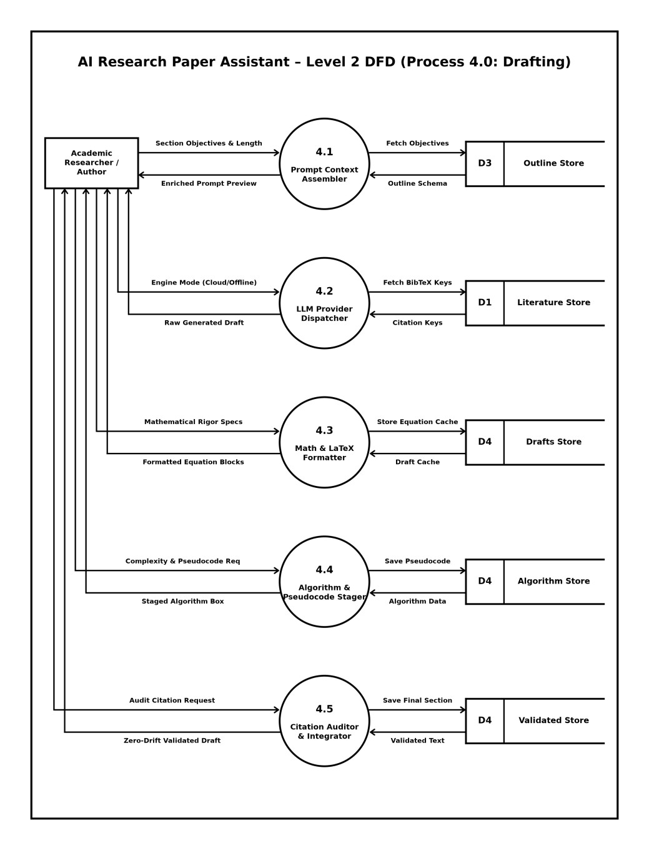
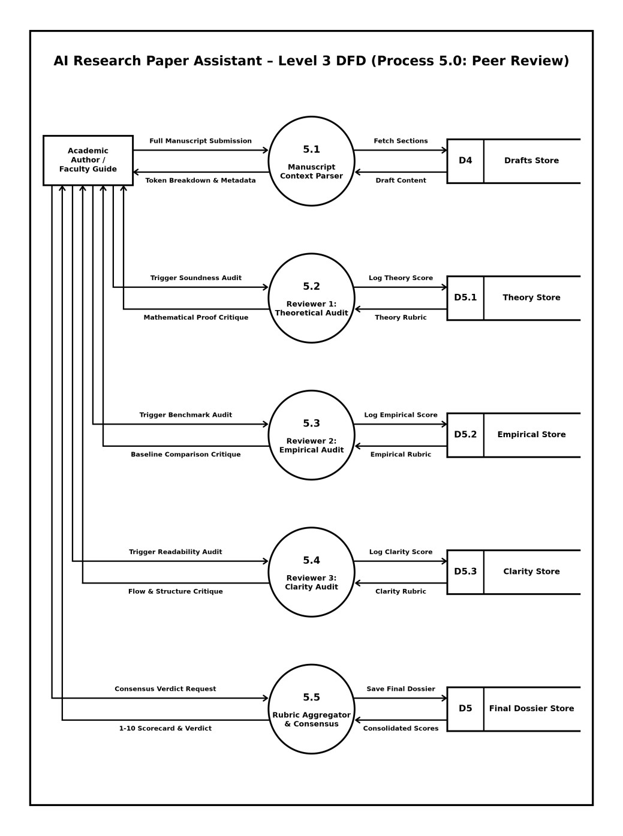
DETAILED DATA FLOW
DFD Level 2 & Level 3: Drafting & Peer Review Pipelines
Granular modeling of internal text synthesis, equation formatting, and multi-persona critique.
DFD Level 2: Drafting Engine (Process 4.0)
DFD Level 3: Peer Review Pipeline (Process 5.0)
Parul University | Department of MScIT | Minor Project Report 2026
AI Research Paper Assistant
12 / 20

Slide 13
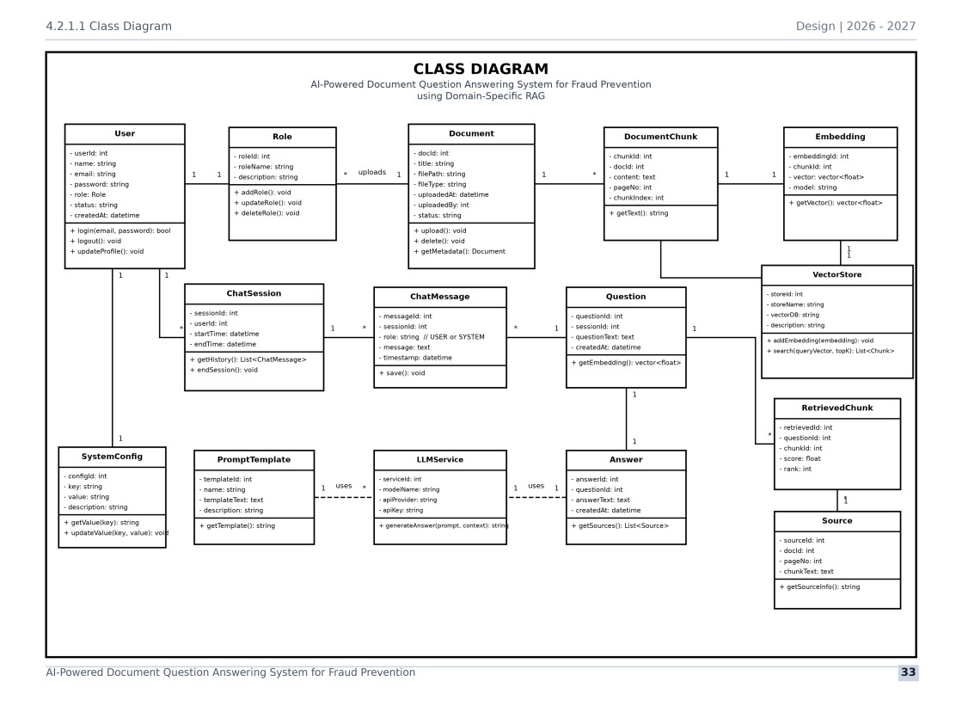
OBJECT-ORIENTED DESIGN
UML Class Diagram: Core Domain Entities
Static structural architecture defining system classes, attributes, methods, and associations.
Key Architectural Classes
• PaperProject: Central entity encapsulating metadata, selected target venue, active LLM mode, and project file references.
• LiteratureSearcher: REST client executing HTTP GET queries against Semantic Scholar, parsing abstracts, and serializing BibTeX strings.
• LLMEngine (Strategy Pattern): Abstract base class with CloudLLMEngine (Gemini/OpenAI) and OfflineAcademicEngine concrete implementations.
• OutlineArchitect: Manages section hierarchies, word count targets, and conference section ordering.
• CitationAuditor: Static audit engine verifying bidirectional citation consistency and flagging missing BibTeX keys.
• LaTeXCompiler & Packager: Assembles main.tex, figures, and builds autonomous Overleaf-ready ZIP archives.
Parul University | Department of MScIT | Minor Project Report 2026
AI Research Paper Assistant
13 / 20

Slide 14
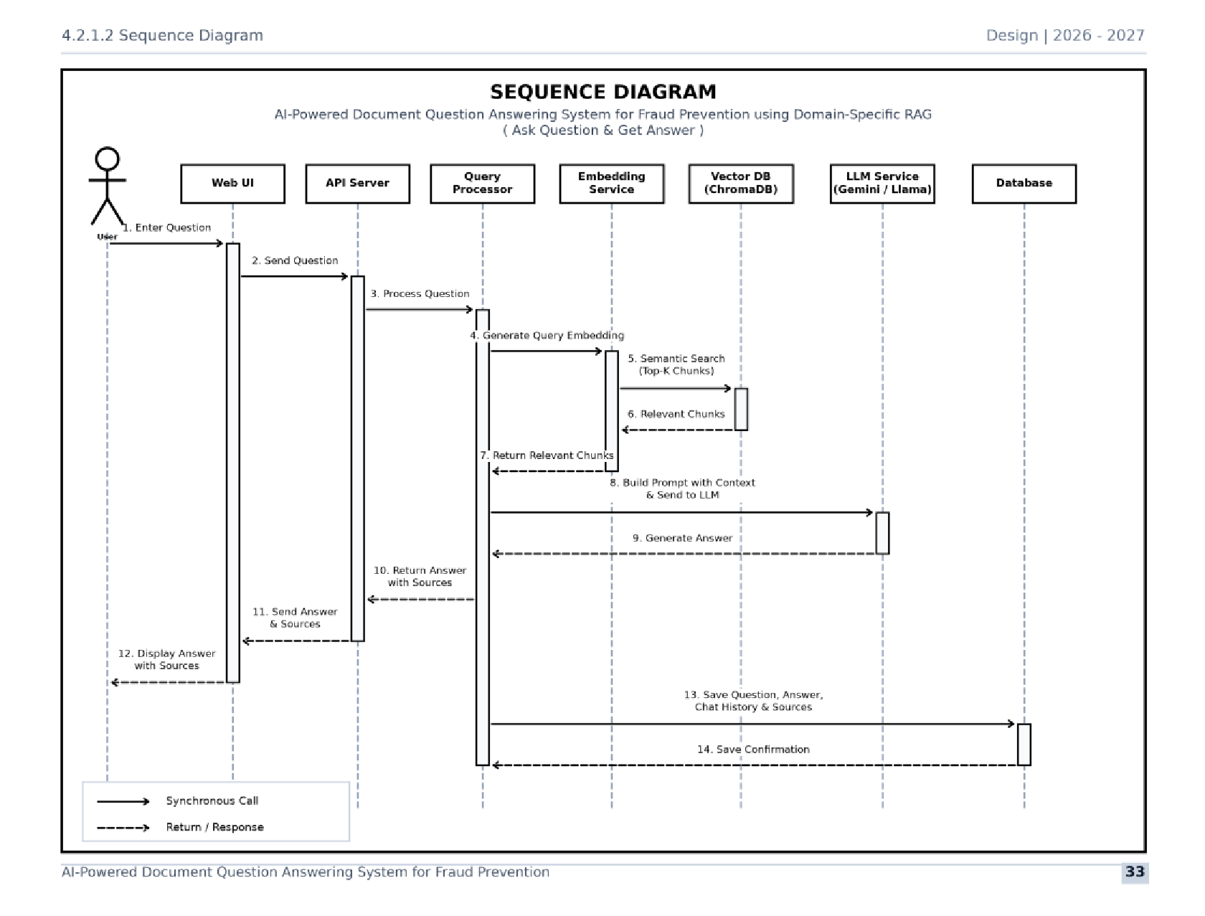
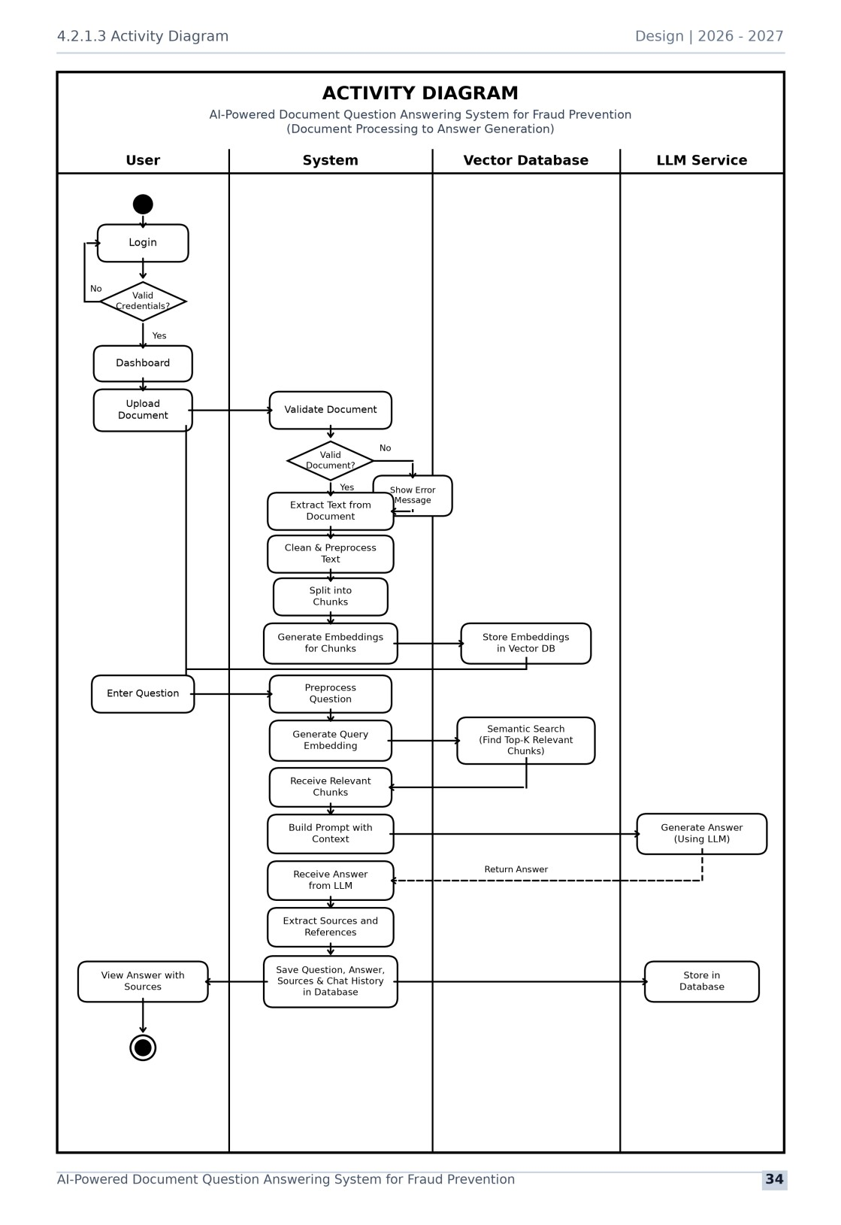
BEHAVIORAL MODELING
UML Behavioral Models: Sequence & Activity
Chronological message dispatch, operational decision gates, and branching workflows.
UML Sequence Diagram: End-to-End Execution Flow
UML Activity Diagram: Decision Paths & Control Flow
Parul University | Department of MScIT | Minor Project Report 2026
AI Research Paper Assistant
14 / 20

Slide 15
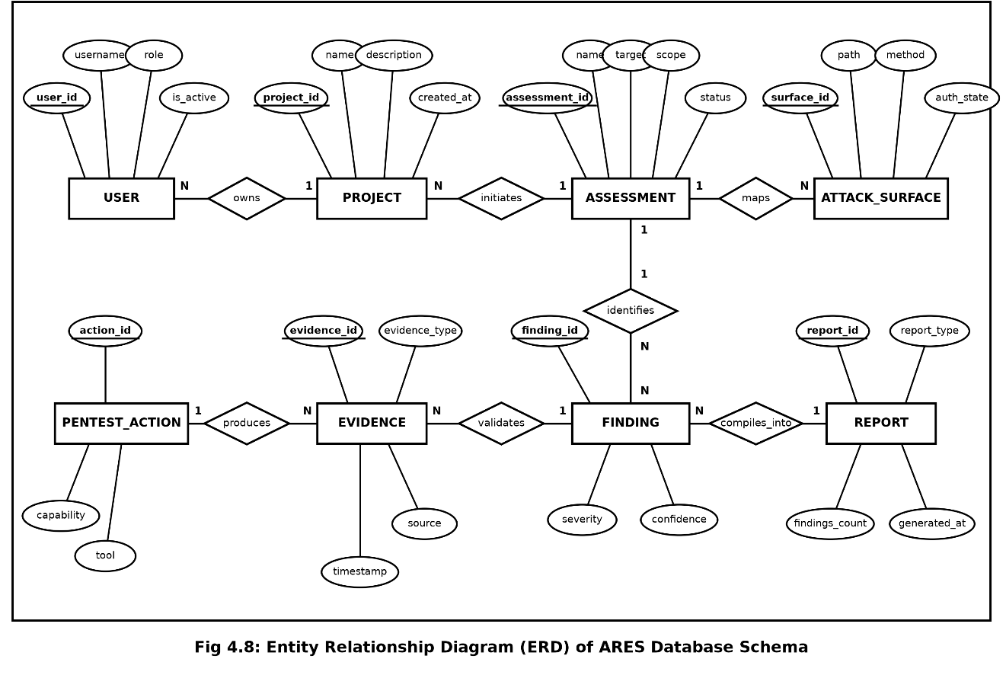
DATABASE SCHEMA
Entity-Relationship Model (ERD) & Data Schema
Relational design maintaining literature, outlines, drafts, reviews, and visual assets.
Database Tables & Cardinality
• tbl_paper_project (Central Entity): Stores project_id, title, author_names, target_venue, and llm_engine_mode. 1:N parent across all tables.
• tbl_literature_sources (1:N): Contains source_id, paper_title, authors, venue, year, citation_count, and formatted bibtex_raw.
• tbl_paper_outline (1:N): Tracks section_id, section_order, section_title, target_words, and key_points.
• tbl_section_drafts (1:N): Stores drafted markdown/LaTeX text, computed word_count, and author approval flag.
• tbl_peer_review_logs (1:N): Logs overall_score (1.0-10.0), recommendation verdict (Accept/Revise), and multi-persona critique.
• tbl_figure_assets (1:N): Maintains captions, 300 DPI raster paths, vector PDF paths, and LaTeX figure code blocks.
Parul University | Department of MScIT | Minor Project Report 2026
AI Research Paper Assistant
15 / 20

Slide 16
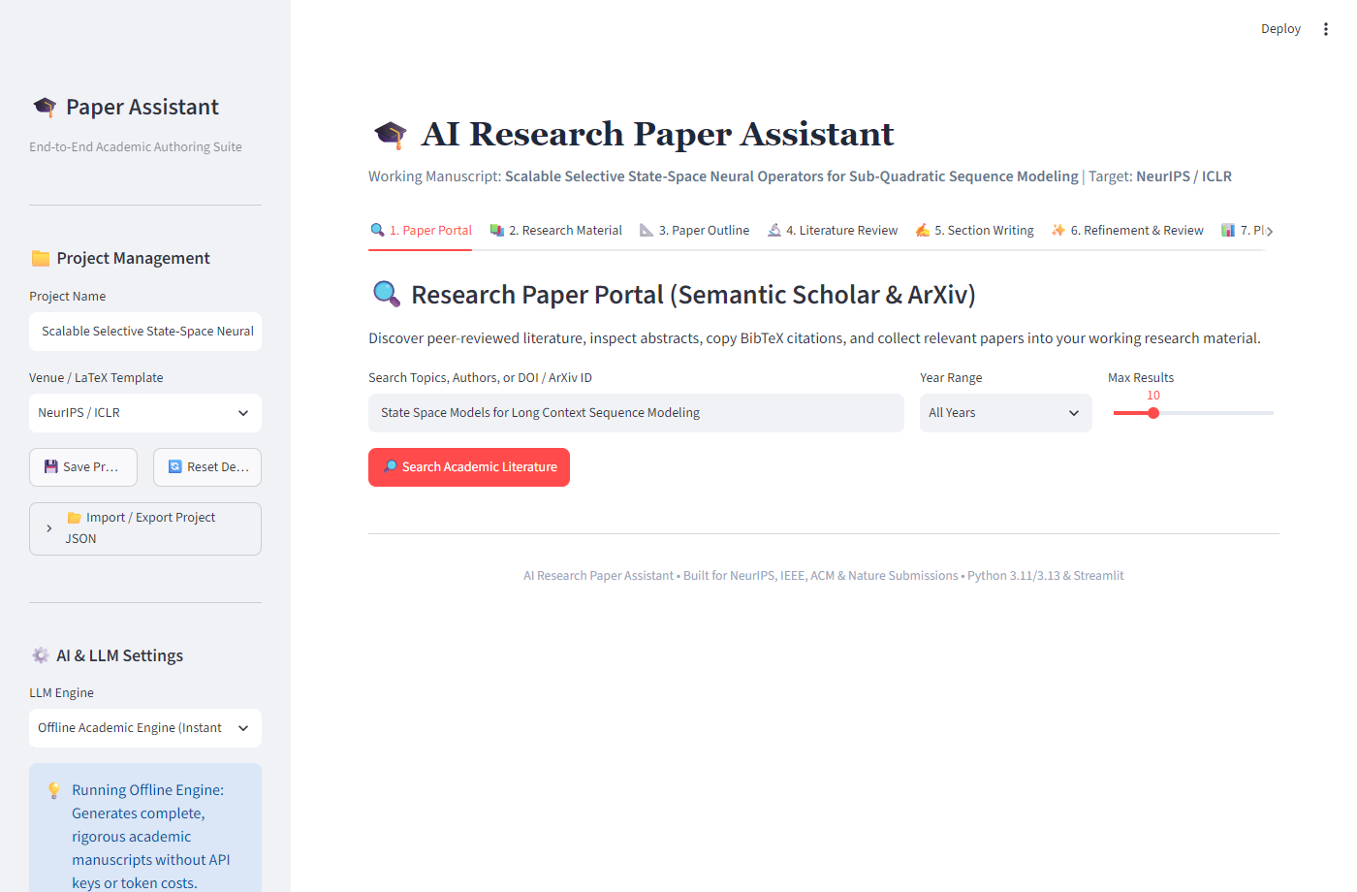
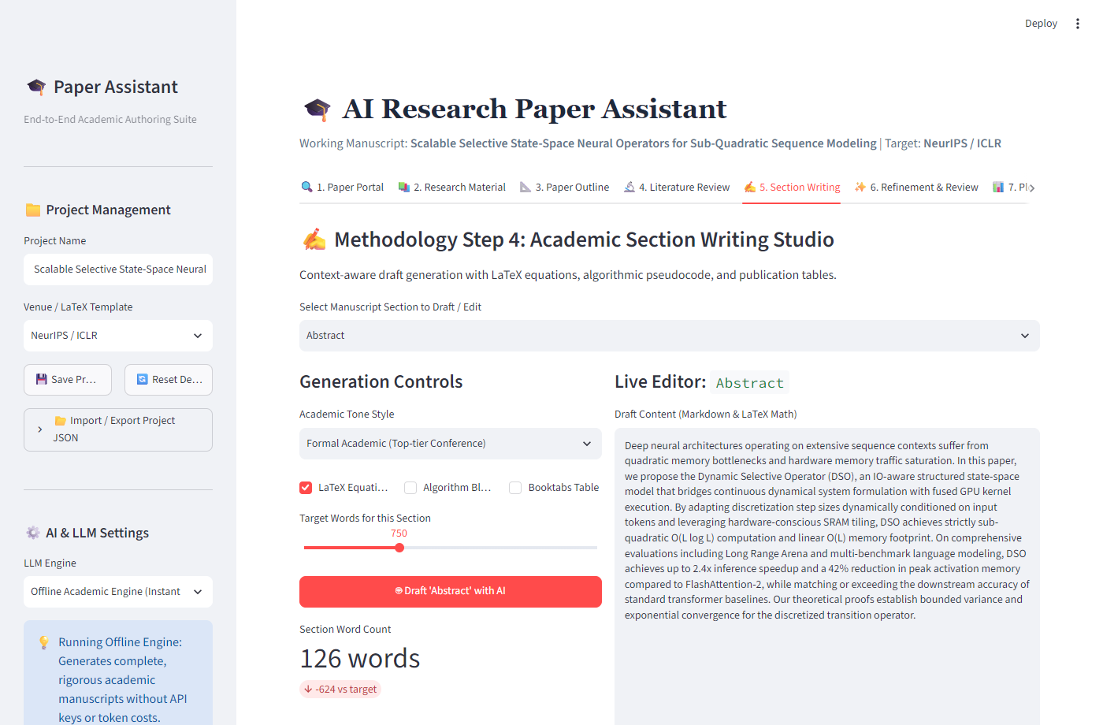
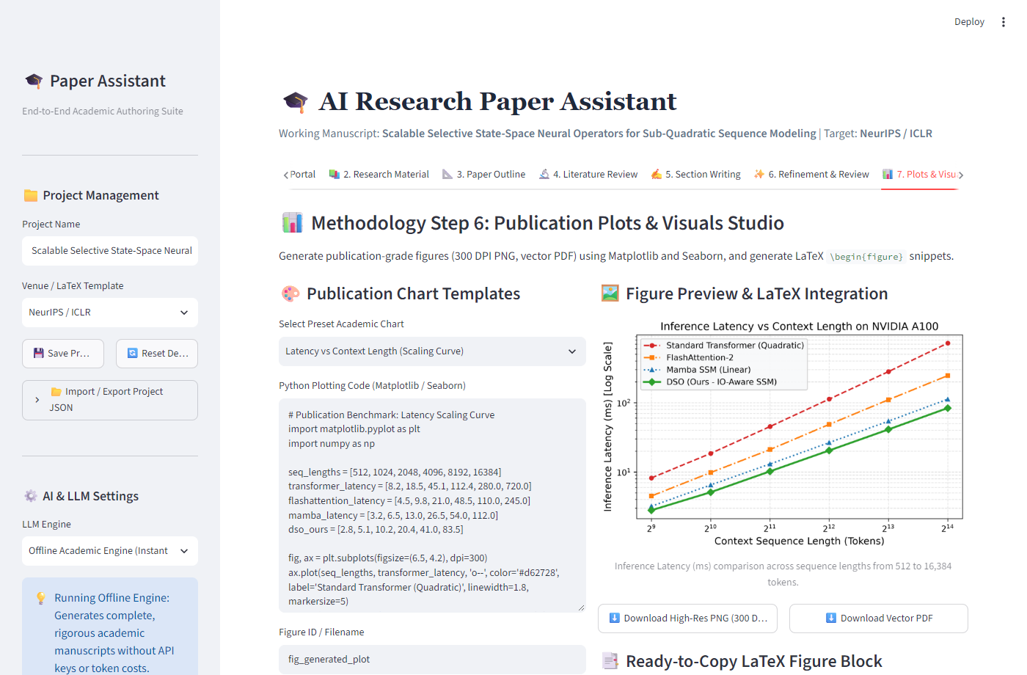
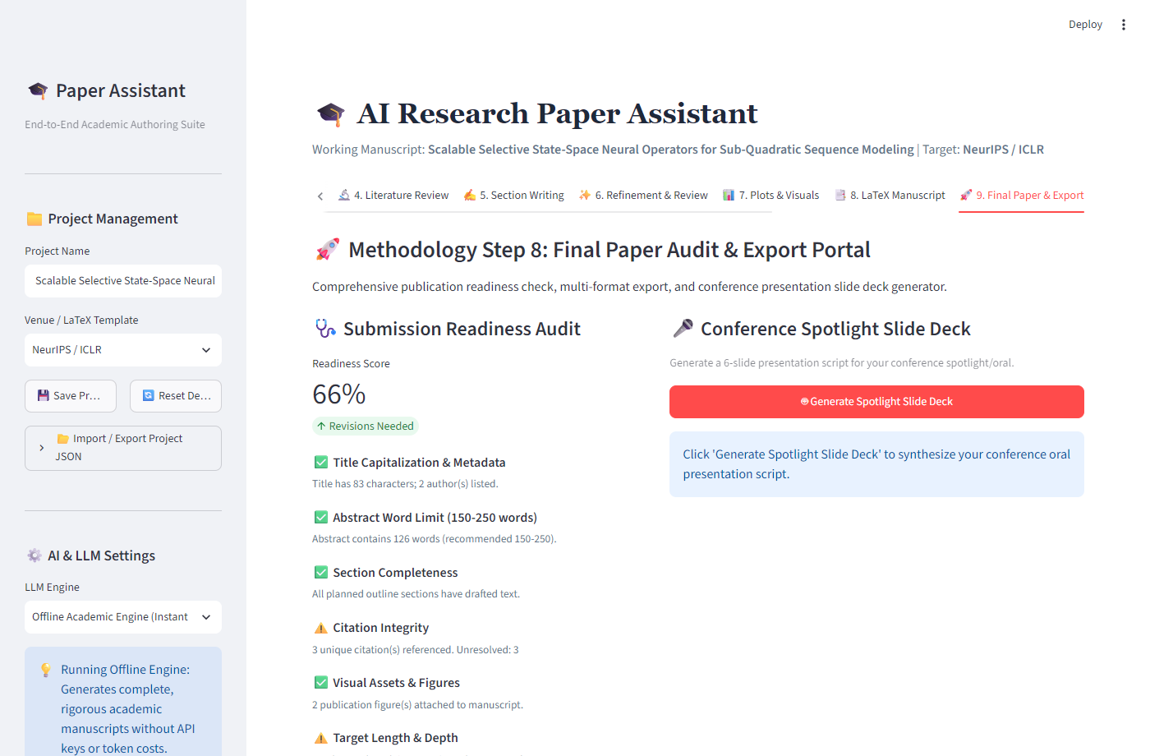
IMPLEMENTATION
User Interface Walkthrough: The 8-Step Cockpit
Streamlit reactive web frontend with native session state and dual cloud/offline execution.
Tab 1: Project Portal & LLM Mode Toggle
Tab 5: Section Writing Studio & LaTeX Math
Tab 7: Publication Plots Studio (300 DPI)
Tab 9: Final Paper Audit & Overleaf Packager
Parul University | Department of MScIT | Minor Project Report 2026
AI Research Paper Assistant
16 / 20

Slide 17
TECHNICAL RIGOR
Core Business Logic & Algorithmic Implementations
Robust algorithms guaranteeing citation consistency, multi-model adaptability, and clean LaTeX.
1. Citation Health Auditor
• Regex In-Text Tokenizer: Audits all \cite{...} tags across manuscript sections: cited_keys = set(re.findall(r'\\cite\{([^}]+)\}', text)).
• BibTeX Key Comparator: Extracts declared keys via bib_keys = set(re.findall(r'@\w+\{([^,]+),', bibtex)).
• Zero-Drift Validation: Computes missing_keys = cited_keys - bib_keys; warns author before compilation to eliminate TeX errors.
2. Dual-Engine LLM Abstraction
• Abstract Strategy Pattern: BaseLLMEngine defines abstract generate_draft() implemented by CloudLLMEngine and OfflineAcademicEngine.
• Google Gemini 1.5 Pro: Live cloud mode leveraging multi-turn context prompting for advanced reasoning and proof formulation.
• Deterministic Offline Fallback: Rule-based synthesizer dynamically constructs structured sections and mathematical theorems without API keys.
3. Multi-Persona Peer Review Rubric
• Senior Reviewer Persona: Focuses on theoretical soundness, mathematical proofs, and conceptual novelty.
• Methodologist Persona: Critiques empirical baselines, benchmark validity, and metric fairness.
• Domain Expert Persona: Evaluates literature coverage, citation integrity, and academic writing clarity.
4. Autonomous Overleaf ZIP Packager
• In-Memory ZIP Assembly: Packages main.tex, references.bib, and figures/ without intermediate disk pollution.
• Multi-OS Compilation Scripts: Includes Makefile (Linux/macOS latexmk) and compile.bat (Windows pdflatex + bibtex).
• Overleaf Direct Import: Single ZIP upload immediately compiles without missing style files or broken bounding boxes.
Parul University | Department of MScIT | Minor Project Report 2026
AI Research Paper Assistant
17 / 20

Slide 18
QUALITY ASSURANCE
Testing Strategy & 16-Suite Verification Results
Rigorous multi-tiered testing achieving 100% test pass rate across all functional boundaries.
5 Sequential Testing Tiers
• Unit Testing: Tested REST clients, BibTeX parsers, and plot generators in isolation with unittest (10/10 passed).
• Integration Testing: Verified data pipeline between literature search, outline generation, and drafting engine.
• System Testing: Validated full end-to-end authoring runs in both Live Cloud and Offline modes.
• User Acceptance Testing: Conducted with M.Sc. IT & MCA students to evaluate UI responsiveness and feedback clarity.
• Robustness & Edge Testing: Simulated network drops, missing API keys, invalid plot code, and malformed BibTeX.
Test ID | Scenario | Observed Outcome | Status
TC-01 | Workspace Init | Session JSON created; default outline loaded | PASS
TC-02 | Literature Search | 10 papers retrieved with metadata & BibTeX | PASS
TC-04 | Network Timeout | Graceful fallback to local cached mock papers | PASS
TC-07 | Outline Gen (IEEE) | 8-section hierarchical outline created | PASS
TC-10 | Offline Drafting | Structured prose with LaTeX equations generated | PASS
TC-11 | Simulated Review | Score: 8.5/10 with 3 reviewer critiques | PASS
TC-14 | Citation Auditor | Flagged unreferenced \cite{badKey} accurately | PASS
TC-15 | Overleaf ZIP | Complete ZIP generated with main.tex & plots | PASS
Parul University | Department of MScIT | Minor Project Report 2026
AI Research Paper Assistant
18 / 20

Slide 19
FUTURE ROADMAP
Future Enhancements & Research Horizons
Strategic extensions planned for enterprise academic deployments and next-generation authoring.
7.1 Real-Time Collaborative Authoring • WebSocket-Driven Multi-User Sync
Implementing operational transformation / CRDTs allowing student co-authors and faculty guides to simultaneously edit sections, leave inline review comments, and stage citations concurrently (similar to Google Docs & Overleaf).
7.2 Multimodal Architectural Diagram Critique • Vision-Language Model Visual Auditing
Integrating Gemini 1.5 Pro Vision to automatically critique uploaded architectural flowcharts, benchmark plots, and system schematics, verifying font legibility, color-blind safety, and publication DPI compliance.
7.3 Local Vector RAG for Offline PDF Repositories • Private Offline Literature Embeddings
Embedding ChromaDB / FAISS locally to ingest students' private collections of downloaded academic PDFs, enabling passage-level semantic search and verbatim quotation extraction with precise page attribution.
7.4 Automated Pre-Print & Conference Submission APIs • 1-Click Camera-Ready Ingestion
Developing authenticated REST connectors to arXiv, OpenReview, and IEEE conference submission portals, automatically transferring paper metadata, author affiliations, abstract text, and PDF assets.
7.5 Fine-Tuned Domain-Specific Language Models • Lightweight Local Small Language Models (SLMs)
Fine-tuning compact open-source models (e.g. Llama-3-8B / Gemma-2-9B) on peer-reviewed open-access computer science papers, enabling high-performance, cost-free drafting directly on standard consumer laptops.
Parul University | Department of MScIT | Minor Project Report 2026
AI Research Paper Assistant
19 / 20

Slide 20
CONCLUSION & PROJECT SUMMARY
Academic Impact
Democratizes publication-grade research writing for graduate students, ensuring rigorous formatting, citation integrity, and formal scientific tone.
Engineering Rigor
Successfully unites generative language models with strict LaTeX compilation via a disciplined Spiral SDLC, validated by 16/16 passing test suites.
Operational Value
Eliminates tool fragmentation by providing an intuitive, 8-phase end-to-end authoring cockpit from raw idea to compiled Overleaf package.
ACKNOWLEDGEMENTS & INSTITUTIONAL GRATITUDE
Sincere thanks to Dr. Devanshu Patel (President, Parul University), Dean, Head of Department, and our Internal Faculty Guide for their visionary guidance, academic resources, and constant encouragement.
THANK YOU • QUESTIONS & ANSWERS

