Slide 1

Crime Type Prediction
UMBC, Information Systems

Slide 2
Introduction
Breaking the law by an overt act is called Crime.
Crimes are typical social issues affecting the economic development of society.
The complexity of relationships among the types of crimes and location has made it an emerging field to apply data mining techniques.
Data mining techniques has been proved helpful in predicting crime across the globe.

Slide 3
Data Preprocessing
Selection of attributes : Crime code, Post, Inside/outside, Weapon, Total incidents were not considered.
Crime time was binned into four bins:
Night : 00:00:00 am to 05:59:00 am
Morning : 06:00:00 am to 11:59:00 am
AfterNoon : 12:00:00 pm to 17:59:00 pm
Evening : 18:00:00 pm to 23:59:00 pm
Missing values were removed.
Street numbers in the Location attribute was removed to avoid overfitting.

Slide 4
Classification
Mining: Naive Bayes Algorithm
Cross validation Folds: 10
Accuracy: 41.118%
Crime time | Description | 38.389%
Crime date | Description | 36.799%
location | Description | 40.158%
District | Description | 38.225%
Neighborhood | Description | 40.369%

Slide 5
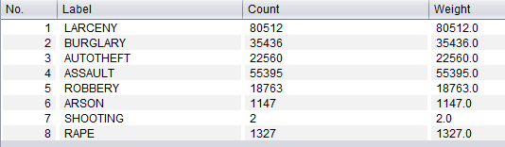
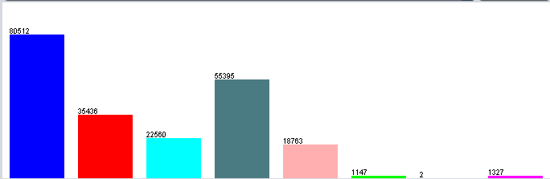
Class Distribution

Slide 6
Iteration #2
Description: Violent crime, Arson, Theft, Larceny, Assault.
Cross validation Folds: 10
Accuracy: 41.046%
Crime time | Description | 36.60%
Crime date | Description | 37.57%
location | Description | 40.50%
District | Description | 37.62%
Neighborhood | Description | 40.08%

Slide 7
Iteration #3
Description : Violent Crime, Property crime, Larceny, Assault
Cross validation Folds: 10
We undersampled the Larceny data
Accuracy: 40.24%
Crime Date | Description | 33.32%
Crime Time | Description | 34.94%
Location | Description | 39.08%
District | Description | 36.06%
Neighborhood | Description | 38.73%

Slide 8
Iteration #4
Description : Violent Crime, Property crime.
Cross validation Folds: 10
Accuracy: 61.32%
Hypothesis Baseline- The majority label classifier accuracy : 0.58 or 58%
We split the date into month and year.
CrimeMonth | CrimeYear | CrimeTIme | Location | District | Description | Accuracy=61.174%
CrimeYear | Location | Description | Accuracy=60.346%

Slide 9
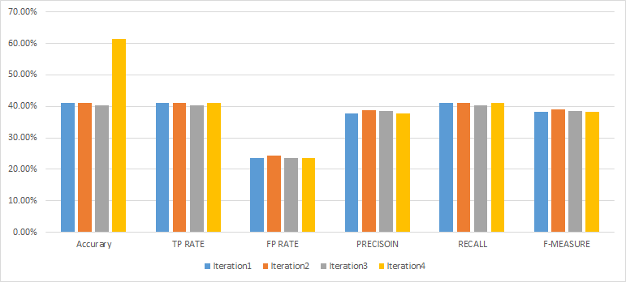
Comparisons

Slide 10
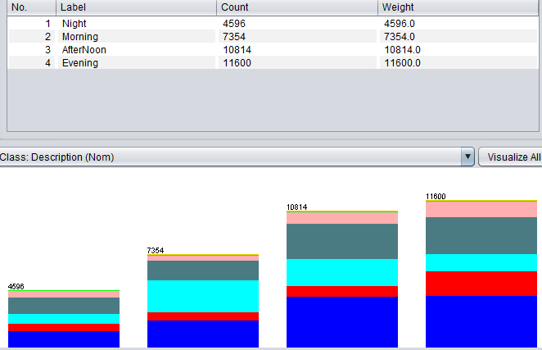
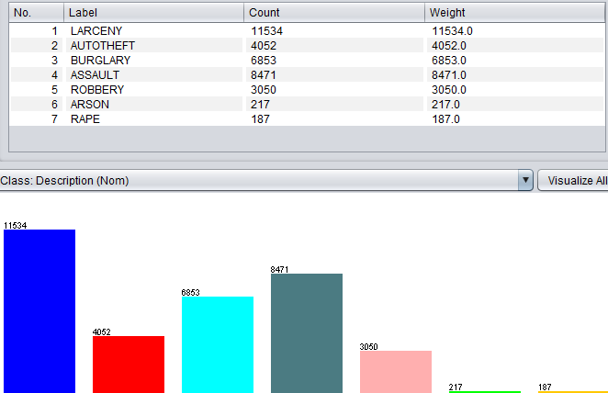
Finding #1
District - NorthEast District.
Crime type - 1) Larceny 2) Assault 3) Burglary
CrimeTime - Evening.

Slide 11
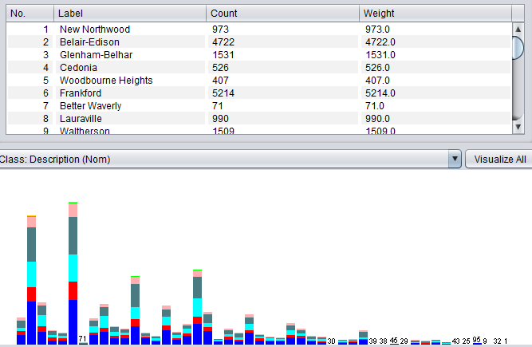
Finding #2
District : NorthEast
Neighborhood: Frankford Neighborhood

Slide 12
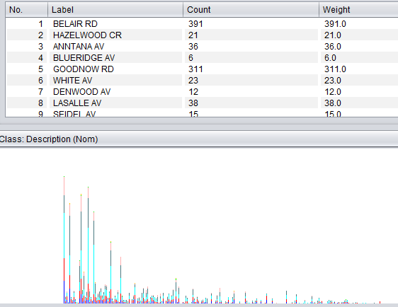
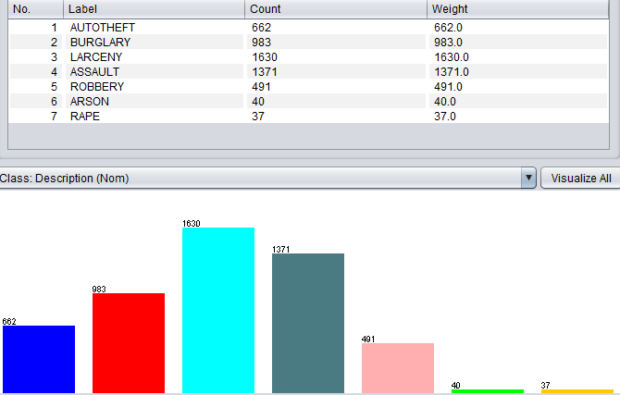
Finding #3
Location: Belair Road
Neighborhood: Frankford
Crime Type: Larceny
CrimeTime: Evening

Slide 13
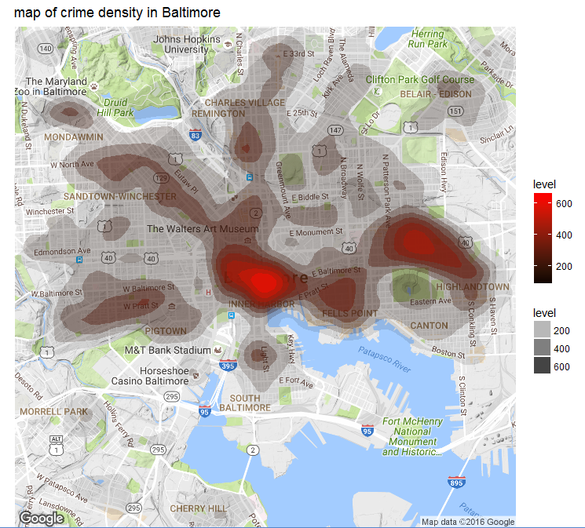
Hot Spots

Slide 14
Conclusion
Through the analysis the Northeast district was affected the most with high rate.
Property crime (Larceny, Arson, theft, Burglary) is more likely to happen during Evening
The affected area can be provided with more patrolling for safety.
Property investments can be made in the safer areas ( Western Baltimore)

