Slide 1
✈
BLUEWINGS AIRLINES
Conversational Booking & Servicing
A WhatsApp- and PWA-first assistant that lets passengers check in, pick a seat, manage baggage, and cancel bookings — without calling the contact centre.
22North Product Engineering Challenge 2026 · Challenge 2
Team <Team Name>

Slide 2
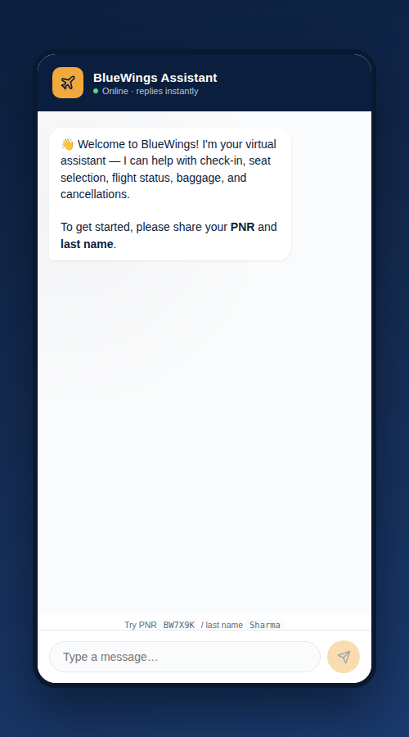
THE PROBLEM
Contact-centre calls for things passengers could do themselves
BlueWings wants passengers to complete common booking and servicing journeys on WhatsApp and a Progressive Web App — not the phone.
Our approach: build fewer journeys, but make each one feel like a real airline talking to you — real authentication, real step-up verification before risky actions, and a clean handoff to a human when the bot genuinely can't help.
5
48h
Self-serve journeys
Build window
2
1
Failed intents before agent handoff
Codebase powering chat + REST API
BlueWings · Conversational Booking & Servicing
2

Slide 3
SCOPE
Five journeys, chosen for volume and buildability
Retrieve booking
Flight status
Check-in + seat
Add baggage
Cancel + refund
PNR + last name — the entry point for everything else.
The single highest-frequency pre-travel query.
Multi-step self-serve journey; replaces airport queues.
Ancillary revenue journey with simulated payment.
High-risk journey — requires OTP step-up auth.
Out of scope for this MVP:
New bookings / fare search — servicing dominates airline call volume, not new sales
Group bookings & special assistance — higher regulatory weight, routed to a human
Loyalty redemption & multi-currency — deferred; payments are simulated throughout
BlueWings · Conversational Booking & Servicing
3

Slide 4
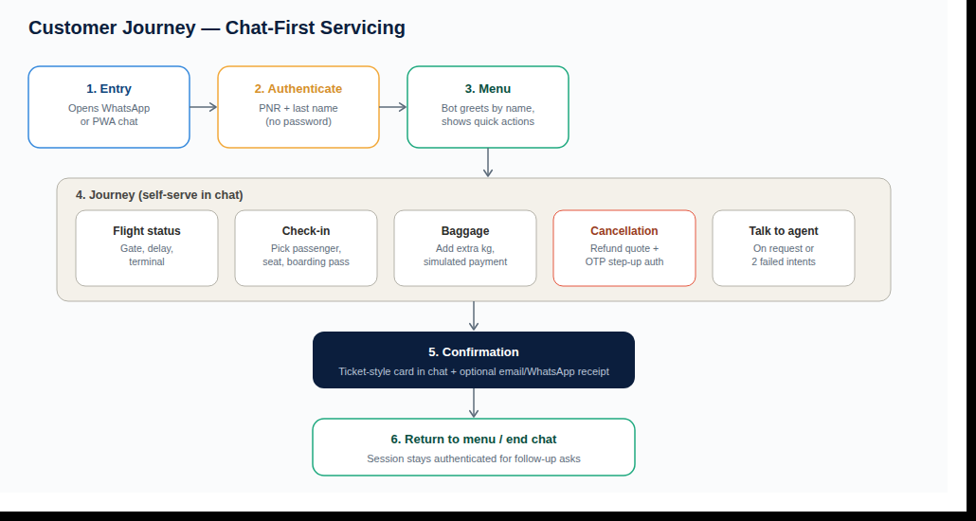
CUSTOMER JOURNEY
One authentication, then everything is a quick reply away
BlueWings · Conversational Booking & Servicing
4

Slide 5
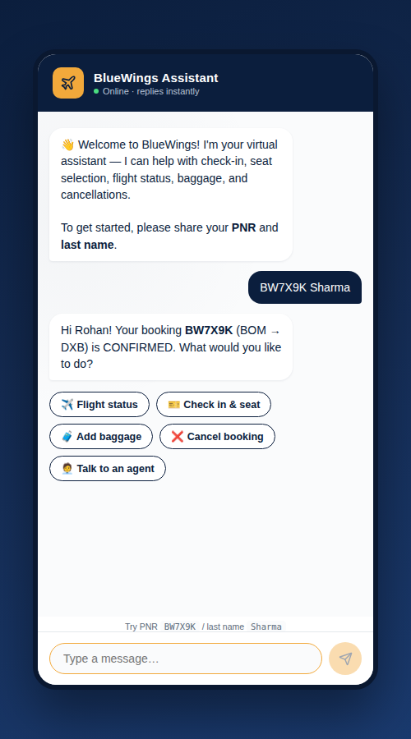
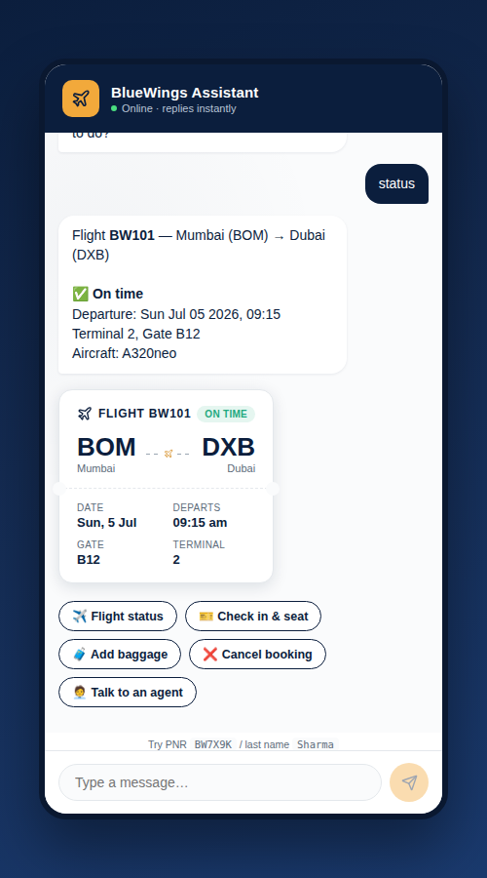
PRODUCT WALKTHROUGH
Authenticate once, get a personal, ticket-style reply
No password, no app install to start — just PNR + last name in one message.
Structured data (flight status, boarding pass, cancellation) renders as a ticket-stub card, not a wall of text.
Quick-reply buttons keep the bot's menu discoverable without typing.
BlueWings · Conversational Booking & Servicing
5

Slide 6
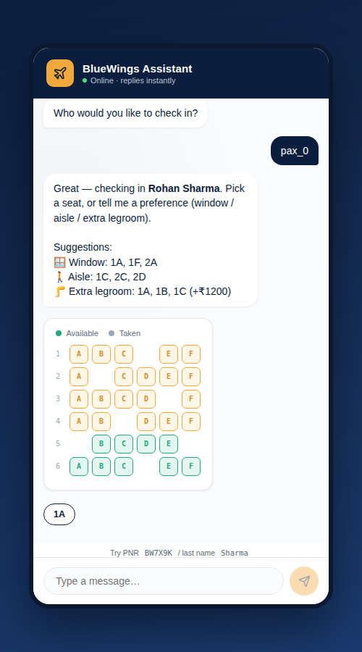
PRODUCT WALKTHROUGH
Check-in and seat selection, end to end in chat
Pick a passenger, then a seat — by preference ("window") or by tapping the live seat map.
Check-in and boarding pass issuance happen in the same turn once a seat is confirmed.
Cancellation follows the same pattern, gated behind an OTP step-up before the refund is issued.
BlueWings · Conversational Booking & Servicing
6

Slide 7
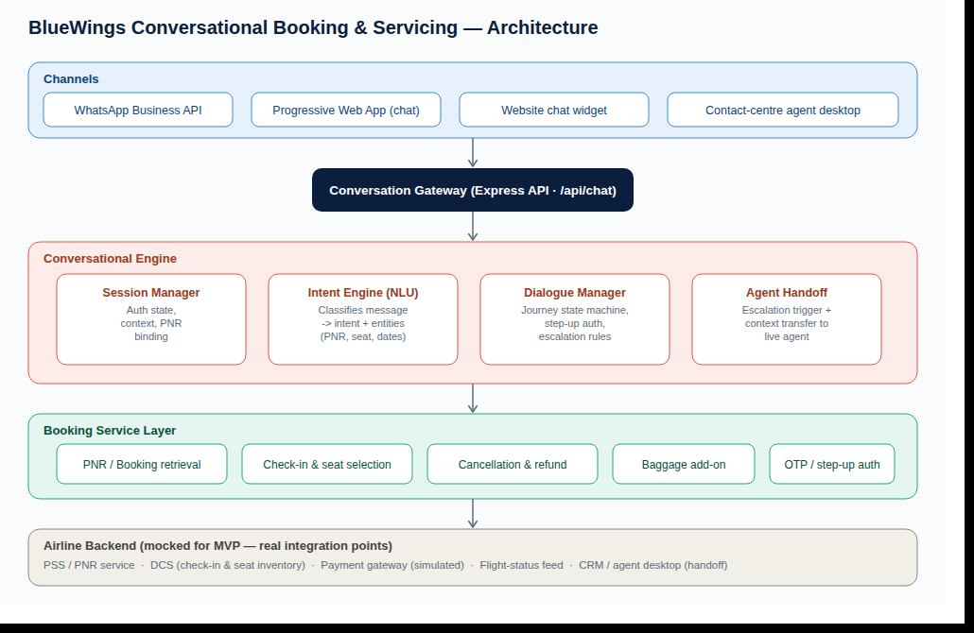
ARCHITECTURE
One conversation gateway, channel-agnostic underneath
BlueWings · Conversational Booking & Servicing
7

Slide 8
API DESIGN
A conversational API for channels, a REST API for the booking system
Conversational API
REST booking API (/api/v1/…) mirrors a real airline PSS/DCS contract
Endpoint | Method | Purpose
/api/session | POST | Create a chat session
/api/chat | POST | Send a message; get reply + quick replies + widget
Endpoint | Method
/bookings/:pnr | GET
/flights/:fn/status | GET
/bookings/:pnr/seatmap | GET
/bookings/:pnr/passengers/:id/seat | POST
/bookings/:pnr/passengers/:id/checkin | POST
/bookings/:pnr/otp | POST
/bookings/:pnr/cancel | POST
/bookings/:pnr/passengers/:id/baggage | POST
BlueWings · Conversational Booking & Servicing
8

Slide 9
ASSUMPTIONS & TRADE-OFFS
What's real, what's simulated, and why
Key assumptions
Trade-offs made
Booking data is mocked in-memory, standing in for real PSS/DCS APIs
Payments (baggage, refunds) are simulated per challenge constraints
OTP is simulated — code shown in-chat instead of sent via SMS
WhatsApp is represented by a WhatsApp-styled PWA (Business API needs Meta approval we can't obtain in 48h)
Intent recognition is rule-based, not LLM-based, for a fast, deterministic demo
Rule-based NLU over an LLM — deterministic and free to demo, less flexible with phrasing
Single Express server (API + PWA) over separate deployments — simpler to run in 48h
In-memory data over a real database — fine for a stateless demo, not durable across restarts
BlueWings · Conversational Booking & Servicing
9

Slide 10
WHAT'S NEXT
From MVP to production
Real WhatsApp Business API
LLM-based intent & entity extraction
Webhook integration on the same /api/chat contract
With graceful fallback to the current rule engine
New-booking & fare search journey
Persistent store + horizontal scale
Plus loyalty redemption and multi-currency support
Redis/Postgres session & booking state
Real OTP & payment gateway
Proactive messaging
CPaaS SMS/WhatsApp OTP, live payment provider
Push delay/gate-change alerts instead of purely reactive chat
Thank you — happy to walk through the live demo.

