Slide 1
Progress update
Sabrina and Scott, Elon

Slide 2

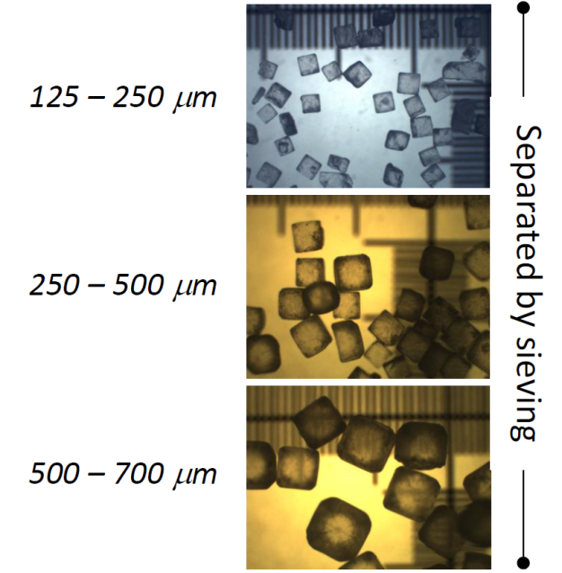
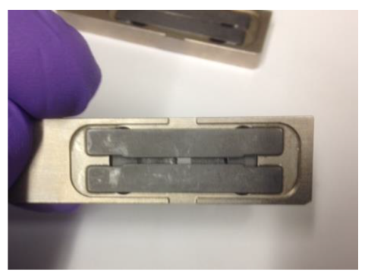

Ongoing research:
To study the effect of particle (grain) size and aperture size on diffraction pattern variability.
Multi factor space
Aperture size:
1 x 16 mm²
0.6 x 16 mm²
0.1 x 16 mm²
Particle size:
Aperture size
Particle size
Approach evaluated using X-ray diffraction spectra from NaCl powder…

Slide 3


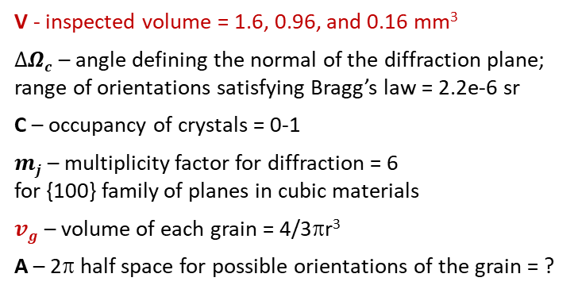
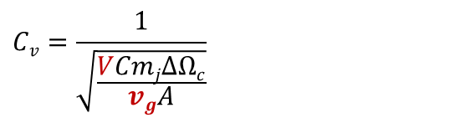

Ongoing research:
To study the effect of particle (grain) size and aperture size on diffraction pattern variability
- quantified by determining the Coefficient of Variation, C_{v}
Coefficient of variation – calculated*:
$$n=\frac{VC}{vg}$$
Number of grains in the analyzing volume
$Cv=\frac{1}{SNR}$ $=\frac{1}{\sqrt{np}}$
Coefficient of variation
$$p=\frac{mj∆Ωc}{A}$$
Probability that a grain is correctly oriented
$$Cv=\frac{1}{\sqrt{\frac{VCmj∆Ωc}{vgA}}}$$
V - inspected volume = 1.6, 0.96, and 0.16 mm³
$∆Ωc$ – angle defining the normal of the diffraction plane; range of orientations satisfying Bragg’s law = 2.2e-6 sr
C – occupancy of crystals = 0-1
$mj$ – multiplicity factor for diffraction = 6
for {100} family of planes in cubic materials
$vg$ – volume of each grain = 4/3πr³
A – 2π half space for possible orientations of the grain = ?
Assumption! Random orientation of particles (grains) in the analyzing volume.
*B. Ghammraoui et al., “Effect of grain size on stability of X-ray diffraction patterns used for threat detection”, Nuclear Instruments and Methods in Physics Research A 683 (2012) 1-12

Slide 4
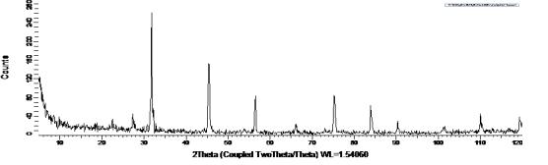

Ongoing research:
To study the effect of particle (grain) size and aperture size on diffraction pattern variability
- quantified by determining the Coefficient of Variation, C_{v}
Coefficient of variation – Experimentally determined*:
$Cv=\frac{1}{SNR}$ $=\frac{1}{\sqrt{np}}$
Coefficient of variation inversely proportional to SNR
- Ghammraoui et.al. evaluated this numerically and experimentally
- Cv=(std.deviations of intensities)/(average intensities of scans)
Simplifies out to 1/std. deviation
*B. Ghammraoui et al., “Effect of grain size on stability of X-ray diffraction patterns used for threat detection”, Nuclear Instruments and Methods in Physics Research A 683 (2012) 1-12

Slide 5

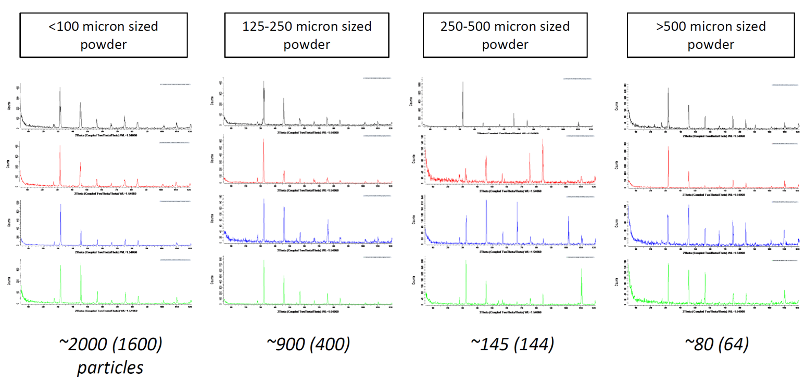
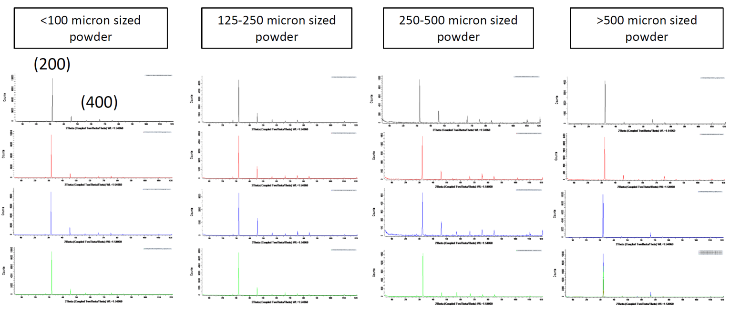
1 x 16 mm² aperture spectra – example spectra variation, fn(particle size):
As-entered powder, loose packing
Characteristic spectra for random particle distribution – deviation from this spectra… increased Cv
Powder pressed into the holder

Slide 6
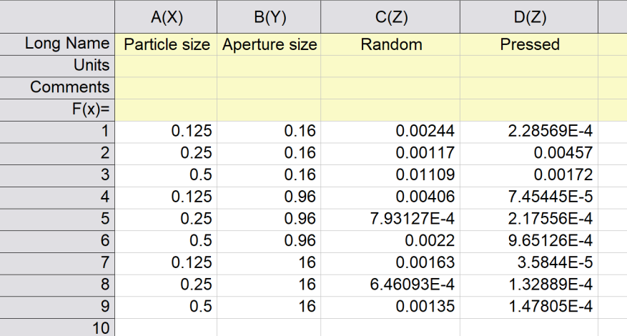
2D Contour color fill maps per straight-forward Ghammraoui et.al. approach – for ‘as-entered powder, loose packing (random)’ and ‘powder (pressed) into the holder’…
This approach seems flawed… Data outcome not in-line with visual inspection of spectra.

Slide 7
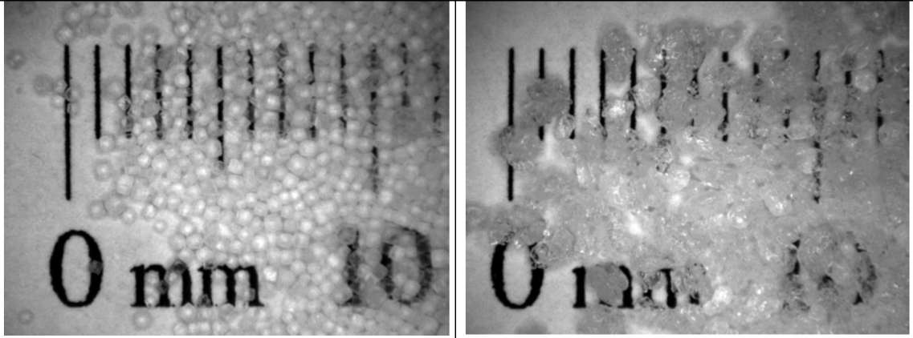
Ongoing and future work
Data processing (ongoing) will explore the following:
Normalize the spectra since counts are impacted by aperture size
Determine the standard deviation using a reference spectra for random particle distribution – possibly an average spectra from the pressed in holder spectra
Evaluate one or a few of the prominent XRD peaks as opposed to all the spectral peaks
We have also begun collecting spectra for sugar (sucrose) and will be collecting spectra for ammonium nitride (AN) and other powder specimen…
NaCl
AN
less faceted

