Slide 1
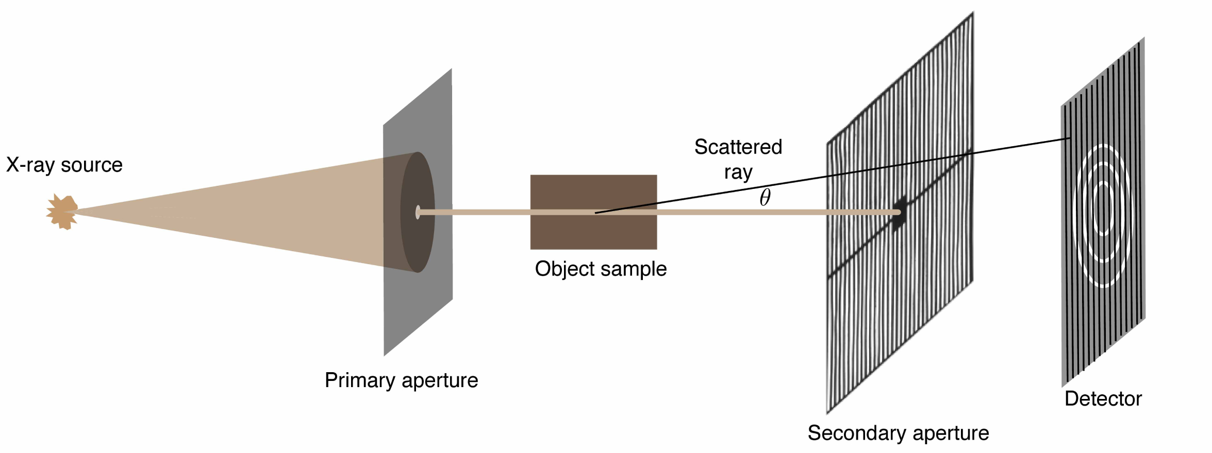

Fig. 1 Citation Kenneth MacCabe, Kalyani Krishnamurthy, Amarpreet Chawla, Daniel Marks, Ehsan Samei, David Brady, "Pencil beam coded aperture x-ray scatter imaging," Opt. Express 20, 16310-16320 (2012); https://www.osapublishing.org/oe/abstract.cfm?uri=oe-20-15-16310
Image © 2012 Optical Society of America and may be used for noncommercial purposes only. Report a copyright concern regarding this image.

