Slide 1
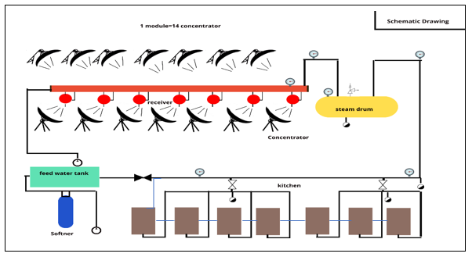
Utilizing Solar Thermal Energy for Hostel Cooking
Under the Guidance of : Prof Anish Modi
Aayush M Anand (21d170001)
Brahadish Balaji D (23m1341)
Prasad Madhukar Pawar (23d0640)
Vishnu T S (22n0413)
Figure 1: Schematic of the System

Slide 2
Problem Statement :
System Parameters:
Scheffler Dish
Medium : Water
Operating Temp - 150–200 ⁰C
Pressure- 3-7 bar.
Daily total energy requirement – 5900 MJ.
9 LPG Cylinders a Day
H17 | 1300 PEOPLE
Total LPG Gas per day | 5900 MJ
Consumption distribution:
Milk steamer | 350 litres
Rice | 240 kg
Roti | 240 kg
Curry & Dal | 90 kg
Vegetable side dish | 90 kg
Non veg | 30 kg
Oil frying | 9 litres
Hot water | 100 litres
Work:
Design and Feasibility Analysis
Goal:
Cost Savings
Reducing Environmental Impacts
2

Slide 3
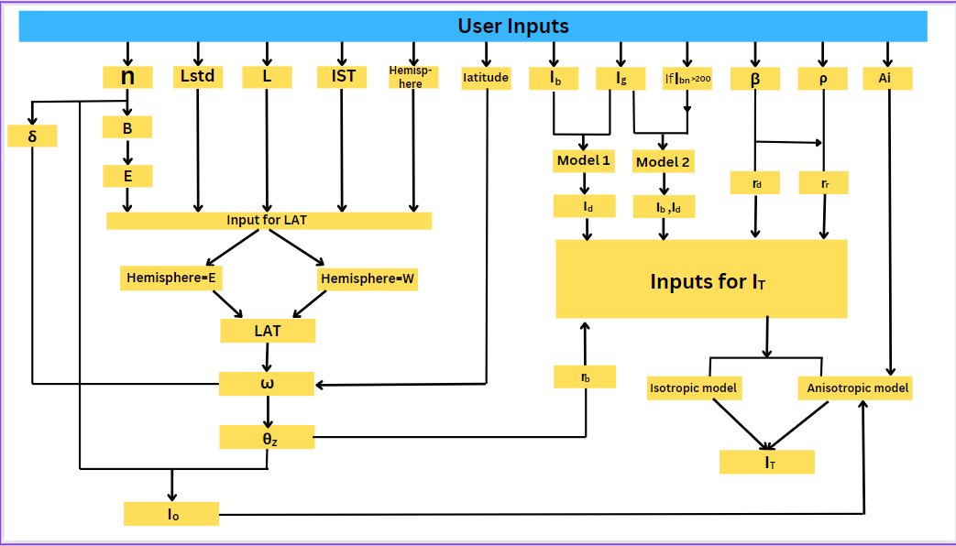
Algorithm for DNI Calculations

Slide 4
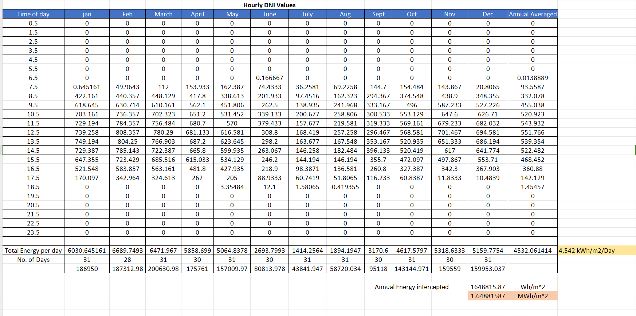
IIT Bombay Coordinates: 19.15˚ N,72.95˚ E
Link to Code: https://onlinegdb.com/_S2x3dky9

Slide 5
Mumbai
Max DNI Recorded in a Year | 847 W/m²
Median DNI over dry months | 474 W/m²
Average Design DNI | 665 W/m²
The DNI is recorded on May 17th, 137th day of the year

Slide 6
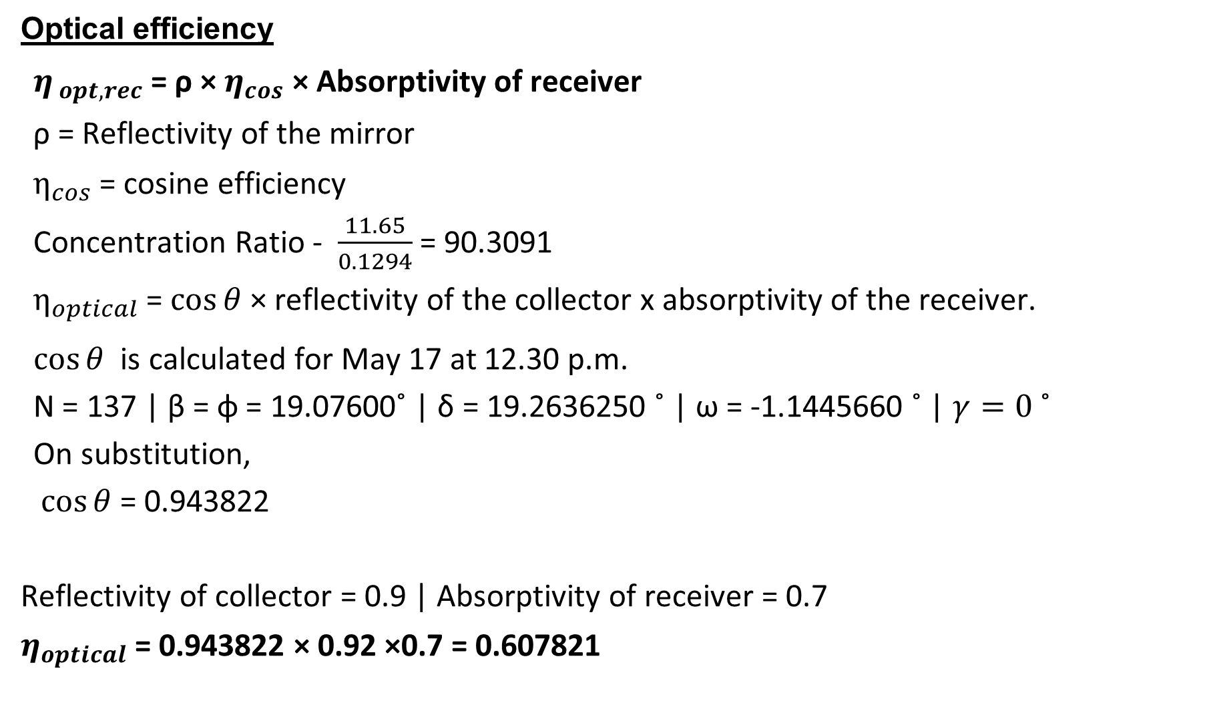
Optical efficiency
$η_{ opt,rec}$ = ρ × $η_{cos}$ × Absorptivity of receiver
ρ = Reflectivity of the mirror
$η_{cos}$ = cosine efficiency
Concentration Ratio - $\frac{11.65}{0.1294}$ = 90.3091
$η_{optical}$ = $\cos{θ}$ × reflectivity of the collector x absorptivity of the receiver.
$\cos{θ}$ is calculated for May 17 at 12.30 p.m.
N = 137 | β = ɸ = 19.07600˚ | δ = 19.2636250 ˚ | ω = -1.1445660 ˚ | $γ=0$ ˚
On substitution,
$\cos{θ}$ = 0.943822
Reflectivity of collector = 0.9 | Absorptivity of receiver = 0.7
$η_{optical}$ = 0.943822 × 0.92 ×0.7 = 0.607821

Slide 7
Reiever End Thermal efficiency
Heat loss at the receiver end = Loss due to convection + Loss due to radiation
The aperture area of receiver(A_{r}) = 0.1294 m²
Convective Heat Transfer Coefficient(h) =25 W/(m² ⋅K)
T_{r}=473 K : T_{a}=301 K
T_{sky} = 0.00553 × (T_{a}^{1.5}) +10 = 298K (Swinbank’s equation)
q_{loss} = {h ×A_{r} × (T_{r} -T_{a})} + {σ × ε × A_{r} × (T_{r}⁴ - T_{sky}⁴)}
q_{loss} = {25 × A_{r} × (473 – 301)} + {5.67 × 10⁻⁸ × 0.2 × A_{r} × (473⁴ – 298⁴)}
q_{loss} = 4778.1 × 0.1294
q_{loss} = 618.29 W
Aperture area of reflector(A_{ref}) = 11.65 m²
Energy absorbed by a receiver: Average DNI ×A_{ref} × optical efficiency = 665 × 11.65 × 0.6078 = 4708.9 W

Slide 8
Heat loss due to convection and radiation = 618.29 W.
η_{the-rcv} = (Energy absorbed-Heat loss)/Energy absorbed
=(4708.9-618.29)/4708.9
η_{the-rcv} = 0.8687
Overall thermal Efficiency = η_{optical} × η_{rcv}
=0.607 × 0.868
η_{overall} = 0.528.

Slide 9
Load Calculations
For rice cooking - 20 litres of water and 28 kg of rice are taken.
T_{a} =25℃
T_{c} =120℃
M_{f} = 20kg
M_{w} = 28 litre
C_{pf} = 1.8 KJ/Kg ℃
K_{fi} = Energy required for the chemical reaction of rice and water
Q = {(m × C_{p}) _{w} + (m × C_{p}) _{f} } × (T_{c} - T_{a}) + m_{f} K_{f} =17.97 MJ
The energy required for 140kg (345kg cooked rice) rice for lunch = 125.79 MJ
The energy required for 100kg (230kg cooked rice) rice for Dinner = 89.85 MJ
Consider the water uptake ratio = 2.3

Slide 10
For milk heating
V=150 litre
S=1.035
Cp = 3.85 KJ/Kg ℃
Tc=95℃
Q = m × Cp× (Tc - Ta) = 41.84 MJ
The energy required for 150-litre milk (morning)= 41.84 MJ
The energy required for 150-litre milk (Evening)= 41.84 MJ
For water heating
V=100 litre
S=1.035
Cp = 3.85 KJ/Kg ℃
Tc=100℃
Q = m × Cp× (Tc - Ta) = 31.40 MJ

Slide 11
Solar cooking can replace LPG Demand in heating and cooking of Milk, water, Veg curry and Dal.
Energy requirements for:
Milk V=150 litre, S=1.035,C_{p} = 3.85 KJ/Kg ℃ ,T_{c}=95℃
Q = m × C_{p}× (T_{c} - T_{a})= 41.84 MJ
Water V=100 litre, S=1.035, C_{p} = 3.85 KJ/Kg ℃, T_{c}=100℃
Q = m × C_{p}× (T_{c} - T_{a}) = 31.40 MJ
From data collected –
LPG Cylinder required for vegetable curry and Dal=1.5 /day
The total energy required for curry & Dal =654.6×1.5×0.6=589.14MJ
Item | Morning | Lunch | Snacks | Dinner
Milk | 41.84 MJ | 0 | 20MJ | 41.84MJ
Water | 7.85MJ | 7.85MJ | 7.85MJ | 7.85MJ
Veg Curry and Dal | 0 | 294.57MJ | 0 | 294.57MJ
Rice | 0 | 125.79MJ | 0 | 89.85MJ
Total | 939.86 MJ
Specific Heat of foods (https://www.fao.org/3/Q1085E/q1085e0b.html)

Slide 12
Load requirement for a Day.
Hence, designing our system for maximum load.
Considering the factor of safety=1.1
Total heat load required in a day
Load requirement=1.1×939.86 MJ=1033.846 MJ
Cooking efficiency of the cooking pot =0.72
ɳ=Cooking load/(ṁ_{h})st
(ṁ_{h})steam=1435.89 MJ
No. Of Collectors Needed :
Heat needed = 1435.89 x 10⁶ J.
Heat from one Scheffler dish = 665 x 11.65 x 3600 x 7 x 0.8687 x 0.6078
No of Scheffler = 1435.89 x 10⁶ / 665 x 11.65 x 3600 x 7 x 0.8687 x 0.6078 = 13.929 = 14 dishes.

Slide 13
Annual Energy Saved using Scheffler Dish
Useful Energy = Net energy Intercepted in a year x Optical Efficiency x Efficiency of the receiver.
1.6488 MWh/m² x 0.607 x 0.868 x 16 x 14 = 194.591 MWh per year
Key components
Reflector Dish
Receiver
Dish and Receiver Support Structure
Tracking System
Piping and Insulation
Pumps
Instrumentation and Safety mechanisms
Heat Storage System
Mainly 2 variants of dish is available: 16m² and 32 m², we will be utilising the 16m² variant for our analysis
Parameter | 16m²
Average Aperture Area | 11.65 m²
Shadow Free Area | 35m²
Thermic Medium | Steam, hot water, thermic fluid
Delivery capacity | Up to 12 bar pressure, Up to 180 C temperature
Weight | Minimum 400 Kg

Slide 14
Sustainability Analysis of the Scheffler cooking system
LPG cylinder - 14.2 kg propane (C₃H₈).
C₃H₈ + 5O₂ ------------------> 3CO₂ + 4H₂O + Heat
LPG equivalent of steam produced to achieve cooking
= 1436 MJ / 655 MJ =2.2 Cylinders.
Cylinders Saved by incorporating Scheffler based Cooking = 2.2/0.6
=3.67 cylinders per day i.e 52.06 Kg of LPG saved per day
CO₂ calculations
C₃H₈ + 5O₂ ------------------> 3CO₂ + 4H₂O + Heat
44 gm of propane has 36 gm of C.

Slide 15
Economical Analysis of the Scheffler cooking system
As per govt of India single axis tracking based Scheffler system costs 18,000 per m^{2 .}
Cost of one Scheffler dish of 16m2 = 16 x 18,000= 288,000 Rs
In a cylinder of 14.2 kg propane we have 11.61 Kg of C.
C + O₂ → CO₂
1 mole of C produce one mole of CO₂ i.e 12 gm of C gives 44gm of CO₂
Thus 11.61 kg of C gives 42.6kg of CO_{2.} CO₂ saved per cylinder = 42.6kg
42.6 x 3.67 = 156.34 Kg of CO₂ emission is saved.
Hence per year = (156.34x 365)/1000 =57.06 Tonnes

Slide 16
Cost of retrofitting existing kitchen and adding suitable accessories = 30% of capital cost = 374400 per dish
Total cost of system of 14 dishes = 5241600 Rs
Fuel saving cost per yr
Cost of LPG cylinder= 950 Rs
Fuel saving cost per yr = 950 x 365 x 3.67 = 1272572.5 Rs
SPP =Capital Investment/ Annual Savings = 4.11 yrs
ROI = (1/SPP)x100 =24.33%
Expected life of Scheffler dish = 15 yrs
Annual cost of O&M = 2% of capital cost =104832 Rs
Annual escalation in cost of LPG = 1.31 times
Discount rate = 10%
Salvage value = 5% of capital cost =262080 Rs

Slide 17
₹ 1272572.5 ₹ 1272572.5 +₹ 262080
n=0 n=1 n=15
₹ 5241600 ₹ 104832 ₹104832
Net Present Value of the project
=∑NPV of fuel saving + NPV Salvage – NPV O&M- Capital Cost
NPV of fuel saving= 9679287.61 Rs
NPV of O&M = 797360.5 Rs
NPV of Salvage=62739.86 Rs
NPV of Project= 9679287.61+ 62739.86 -797360.5 -5241600
=3703066.09 Rs

Slide 18
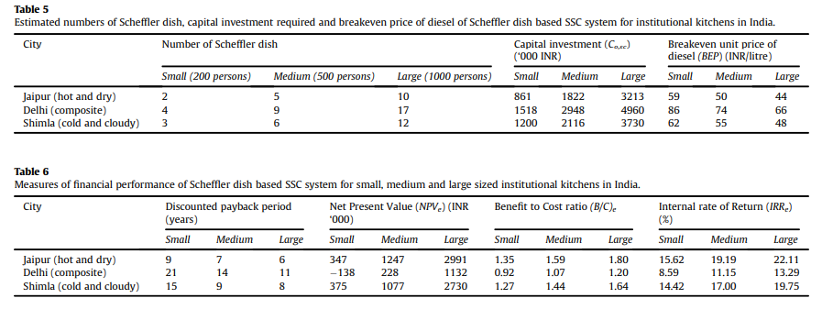
Benefit to Cost Ratio =
(NPV fuel saving + NPV salvage value)/(Capital cost + NPV O&M)
=1.613
IRR = Discount rate at which NPV is zero(taking n=15), on solving
IRR=21.07%
Ref:Financial appraisal of using Scheffler dish for steam based institutional solar cooking in India 2018, Sunil Indora et.al

Slide 19
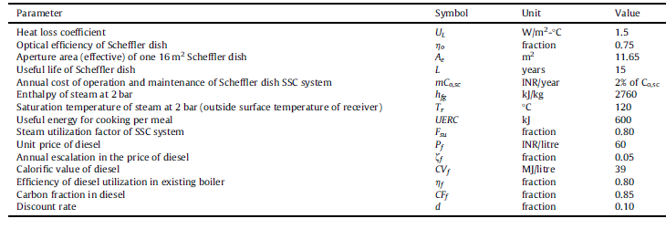
Input parameters used in the analysis for estimating fuel savings and monetary benefits with the use of Scheffler dish based SSC systems for institutional cooking.

Slide 20
References
System Advisor Model Version 2022.11.29 (SAM 2022.11.21). National Renewable Energy Laboratory. Golden, CO. Accessed July 26, 2023. https://https://sam.nrel.
Scheffler Dish. (n.d.). https://trlindia.com/wp-content/uploads/2020/12/TRL-Parabolic-dish-based-Solar-System-Operations-Maintenance-Manual-1.pdf
Final-booklet-2-scheffler-dish.PDF. (n.d.-a). https://www.itpower.co.in/wp-content/uploads/2016/01/Final-Booklet-2-Scheffler-Dish.pdf
Net zero emissions target (no date) Press Information Bureau. Available at: https://pib.gov.in/PressReleaseIframePage.aspx?PRID=1945472 (Accessed: 31 March 2024).
Service, T.N. (no date) A peep into piped comfort, Tribuneindia News Service. Available at: https://www.tribuneindia.com/news/archive/features/a-peep-into-piped-comfort-660183 (Accessed: 31 March 2024).
Jatinra Khan (2021) ‘Comparative evaluation of parabolic collector and Scheffler Reflector for solar cooking’, International Journal of Science and Society, 3(1), pp. 56–61. doi:10.54783/ijsoc.v3i1.267.
Home: Food and agriculture organization of the United Nations (no date) FAOHome. Available at: https://www.fao.org/home/en (Accessed: 31 March 2024).
Lather, R.S. (2020) ‘Performance analysis of an LPG cooking stove for improvements and future usability perspective’, Lecture Notes in Mechanical Engineering, pp. 633–643. doi:10.1007/978-981-15-5996-9_50.
Author links open overlay panelMohammad Malekan 1 et al. (2021) Parabolic Trough Solar Collectors, Design and Performance Optimization of Renewable Energy Systems. Available at: https://www.sciencedirect.com/science/article/abs/pii/B9780128216026000079 (Accessed: 31 March 2024).
Thirunavukkarasu, V. and Cheralathan, M. (2018) ‘Experimental study on heat losses from external type receiver of a solar parabolic dish collector’, IOP Conference Series: Materials Science and Engineering, 402, p. 012196. doi:10.1088/1757-899x/402/1/012196.

