Slide 1
4-Stage & VFD Compressor Heat Pump Program — Scenario Comparison
Scenario 1 — Sequential Execution
Complete the full 4-Stage program (testing → EC release → Selection Navigator → agency → production release) before starting the VFD compressor project.
Scenario 2 — Parallel Execution
As each 4-Stage unit completes testing, the same unit is immediately converted to a VFD compressor and tested (Units 1–4 flow 4-Stage test → VFD test).
Milestone | Scenario 1 — Sequential |  | Scenario 2 — Parallel
 | 4-Stage | VFD Compressor | 4-Stage | VFD Compressor
Testing Complete | 19-Jul-27 | 25-Apr-28 | 5-Nov-27 | 18-Apr-28
EC Release @25 | 26-Oct-27 | 5-Oct-28 | 25-Apr-28 | 2-Oct-28 ⚠
Sel. Navigator Deliverable Release | 25-Feb-28 | 1-Jan-29 | 20-Jul-28 | 8-Jan-29
Selection Navigator Release | 7-Apr-28 | 12-Feb-29 | 31-Aug-28 | 19-Feb-29
MTL Build | 28-Mar-28 | 31-Jan-29 | 21-Aug-28 | 7-Feb-29
MTL EC Release | 25-Apr-28 | 28-Feb-29 | 18-Sep-28 | 7-Mar-29
Agency Approval | 30-May-28 | 4-Apr-29 | 23-Oct-28 | 11-Apr-29
1st Production | 28-Jul-28 | 9-May-29 | 27-Nov-28 | 16-May-29
⚠ 2-Oct-28: EC release team conflict between 4-Stage MTL EC and VFD compressor EC release.
Scenario 1 — Challenges
• Refrigeration team must work on VFD compressor unit testing in parallel with Selection Navigator & UL deliverables.
Scenario 2 — Challenges
• Firmware for VFD compressor & EXV must be ready by Nov 2026 • Ultra-high-efficiency component selection needed before Nov 2026
• Refrigeration team can only work one project at a time • EC conflict: 4-Stage MTL EC vs. VFD EC release • Mechanical team loaded on both projects simultaneously
Key takeaway: Sequential execution (Scenario 1) reaches 4-Stage 1st production ~4 months earlier (28-Jul-28 vs 27-Nov-28) and VFD 1st production ~1 week earlier (9-May-29 vs 16-May-29), with fewer resource and EC conflicts.

Slide 2
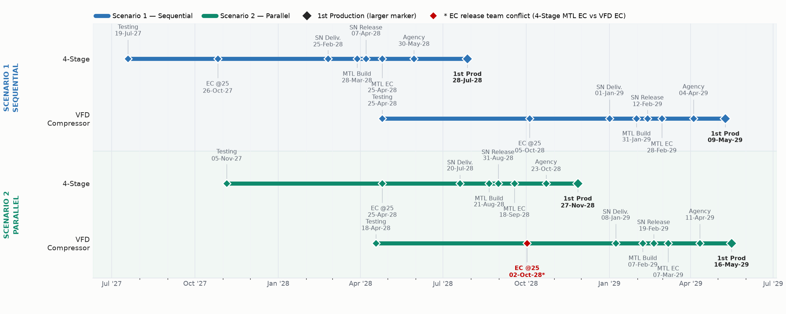
Program Timeline — Gantt View: Sequential vs Parallel Execution
Scenario 1 — Sequential Execution
What it is: Finish the entire 4-Stage program first (testing → EC release → Selection Navigator → agency submission → production release), then start the VFD compressor project.
Challenges: Refrigeration team must run VFD compressor unit testing alongside the Selection Navigator & UL deliverables.
Scenario 2 — Parallel Execution
What it is: As each 4-Stage unit finishes testing, the same unit is converted to a VFD compressor and tested — both programs run concurrently.
Challenges: VFD/EXV firmware & ultra-high-efficiency component selection needed by Nov 2026; refrigeration team can only work one project at a time; EC conflict (4-Stage MTL EC vs VFD EC release); mechanical team loaded on both projects simultaneously.

