Slide 1
Ceph: A Scalable, High-Performance Distributed File System
Priya Bhat, Yonggang Liu, Jing Qin

Slide 2
Content
1. Ceph Architecture
2. Ceph Components
3. Performance Evaluation
4. Ceph Demo
5. Conclusion

Slide 3
Ceph Architecture
What is Ceph?
Ceph is a distributed file system that provides excellent performance, scalability and reliability.
Features
Decoupled data and metadata
Dynamic distributed metadata management
Goals
Easy scalability to peta-byte capacity
Adaptive to varying workloads
Reliable autonomic distributed object storage
Tolerant to node failures

Slide 4
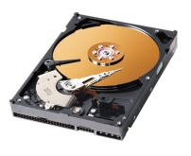
Ceph Architecture
Object-based Storage
Traditional Storage
Object-based Storage
Applications
Applications
System Call Interface
System Call Interface
Operating System
File System
Operating System
File System Client Component
Logical Block Interface
Logical Block Interface
File System Storage Component
Hard Drive
Block I/O Manage
Object-based Storage Device
Block I/O Manage
Notes:
Recently, DFS have adopted architectures based on OSD (object based storage) in which conventional hard-disks are replaced with intelligent OSDs which combine a CPU, networj interface and local cache with an underlying disk or RAID. OSDs replace traditional block level interface in which clients can read or write byte ranges to much larger and variable sized objects, leaving low level allocation decisions to the devices themselves.

Slide 5
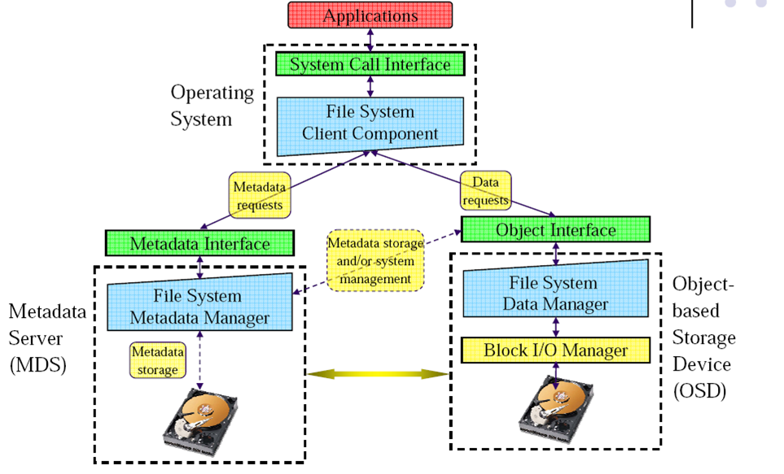
Ceph Architecture
Decoupled Data and Metadata

Slide 6
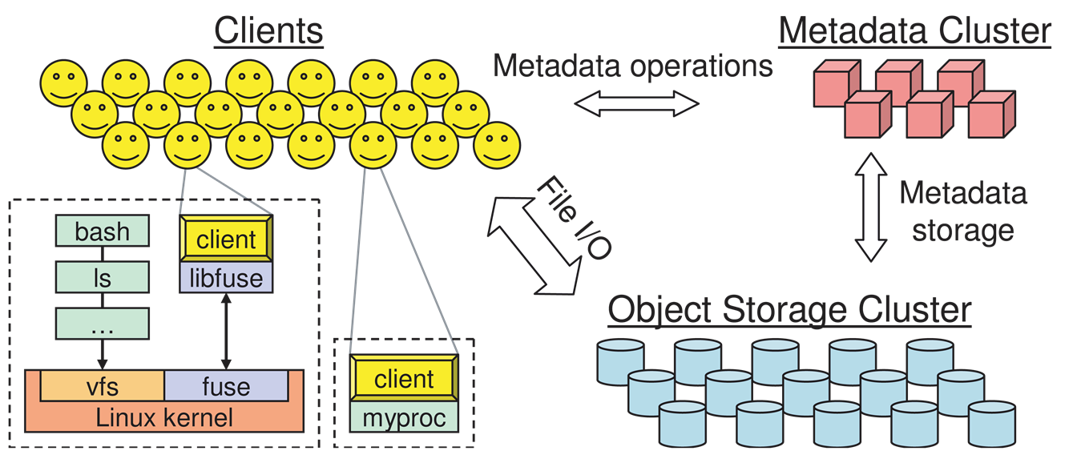
Ceph Architecture

Slide 7
Ceph: Components

Slide 8
Ceph Components
Clients
Metadata ops
File I/O
Cluster
monitor
Metadata
Server
cluster
Object
Storage
cluster
Metadata I/O

Slide 9
Ceph Components
Client Operation
Clients
CRUSH is used to map Placement Group (PG) to OSD.
Close Request, Details of Read/Write
Read/Write
Open Request
Capability, Inode, size, stripe
Object
Storage
cluster
Meta Data
cluster
Capability Management

Slide 10
Ceph Components
Client Synchronization
POSIX
Semantics
Reads reflect previously written data
O_LAZY Flag: relaxed coherency
Applications can explicitly synchronize
Relaxed Consistency
Writes are Atomic
lazyio_propagate lazyio_synchronize
Synchronous I/O. performance killer
Solution: HPC extensions to POSIX
Default: Consistency / correctness
Optionally relax
Extensions for both data and metadata

Slide 11
Ceph Components
Namespace Operations
Namespace Operations
But by default “correct” behavior is provided at some cost.
Stat operation on a file opened by multiple writers
Applications for which coherent behavior is unnecessary use extensions
Ceph optimizes for most common meta-data access scenarios
(readdir followed by stat)

Slide 12
Ceph Components
Metadata Storage
Advantages
Per-MDS journals
Eventually pushed to OSD
Sequential Update
More efficient
Reducing re-write workload.
Easier failure recovery. Journal can be rescanned for recovery.
Optimized on-disk storage layout for future read access

Slide 13
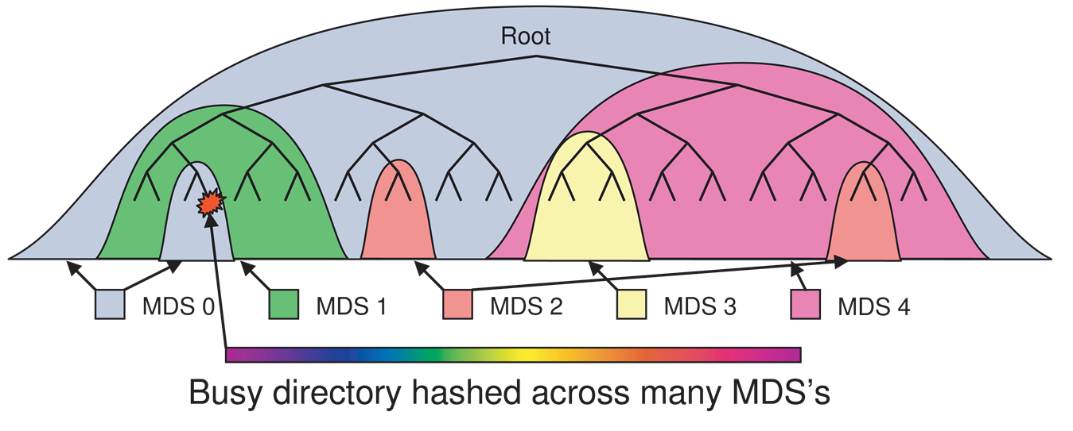
Ceph Components
Dynamic Sub-tree Partitioning
Adaptively distribute cached metadata hierarchically across a set of nodes.
Migration preserves locality.
MDS measures popularity of metadata.

Slide 14
Ceph Components
Traffic Control for metadata access
Challenge
Partitioning can balance workload but can’t deal with hot spots or flash crowds
Ceph Solution
Heavily read directories are selectively replicated across multiple nodes to distribute load
Directories that are extra large or experiencing heavy write workload have their contents hashed by file name across the cluster

Slide 15
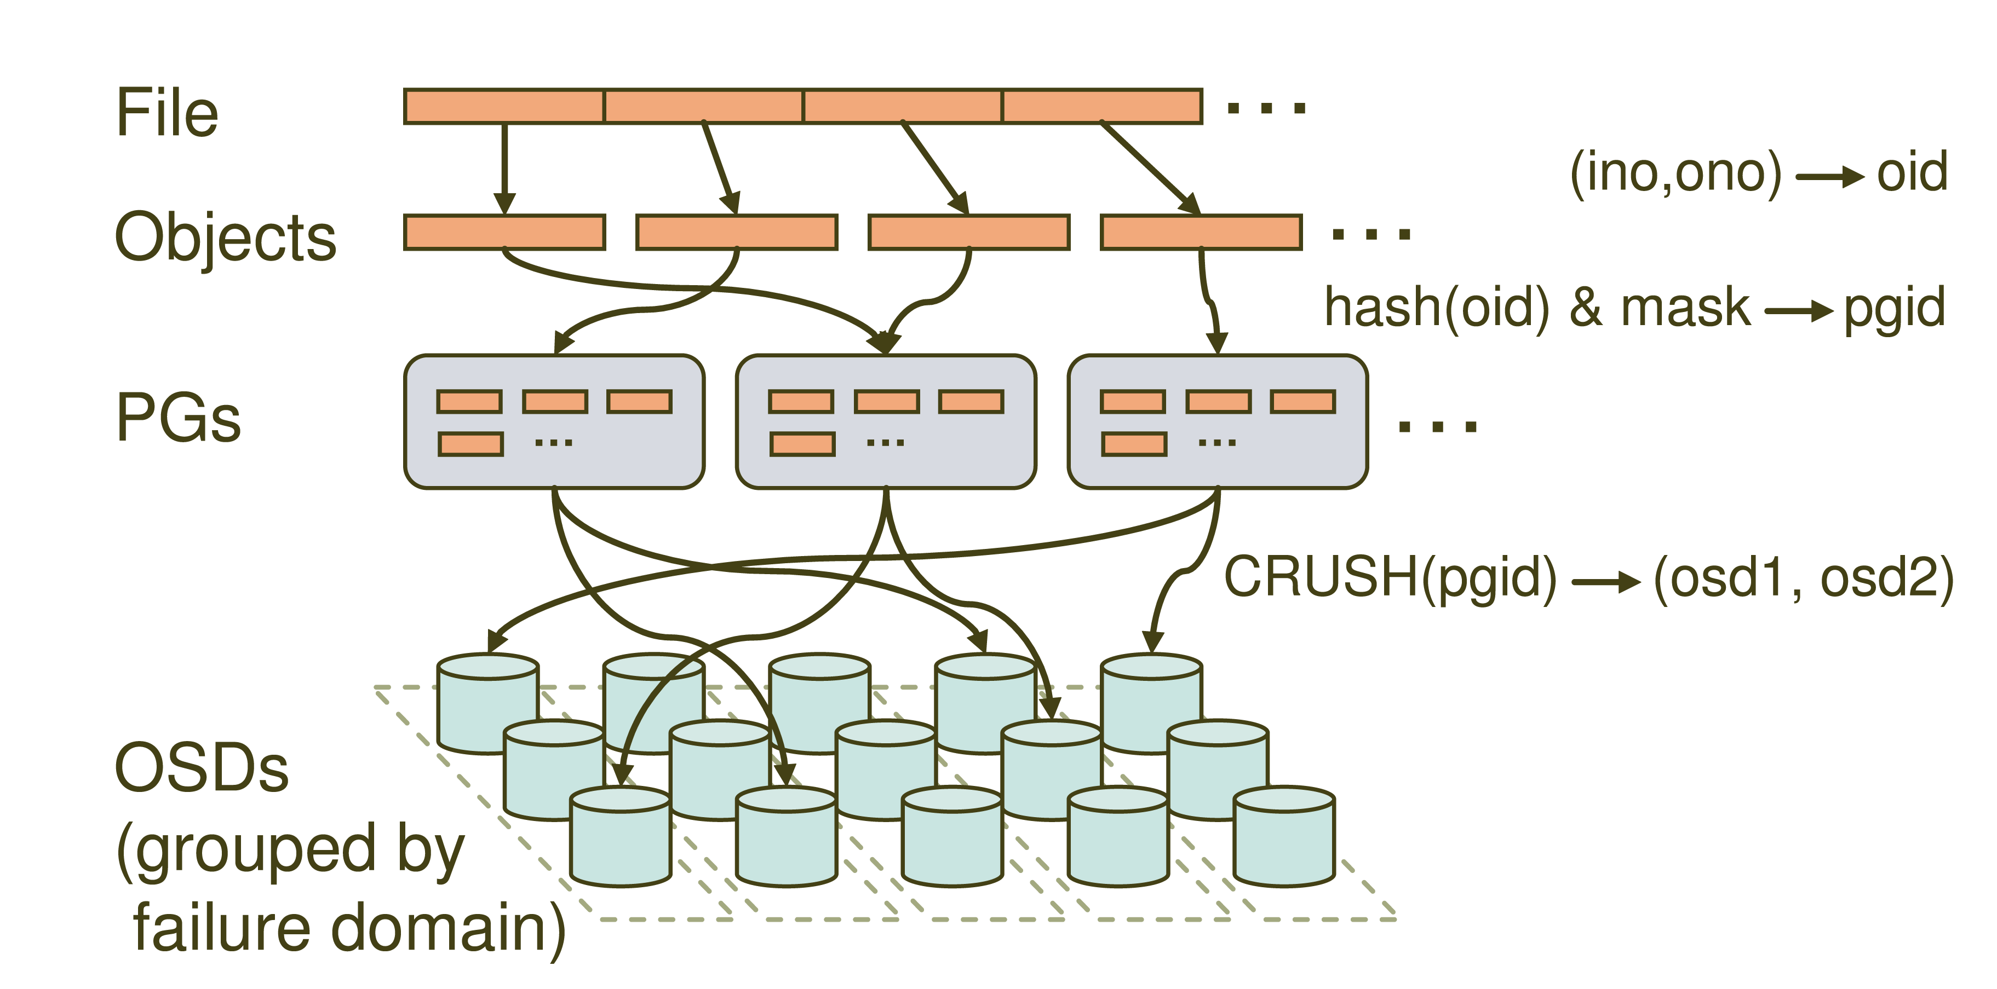
Distributed Object Storage

Slide 16
CRUSH
CRUSH(x) → (osd_{n1}, osd_{n2}, osd_{n3})
Inputs
x is the placement group
Hierarchical cluster map
Placement rules
Outputs a list of OSDs
Advantages
Anyone can calculate object location
Cluster map infrequently updated

Slide 17
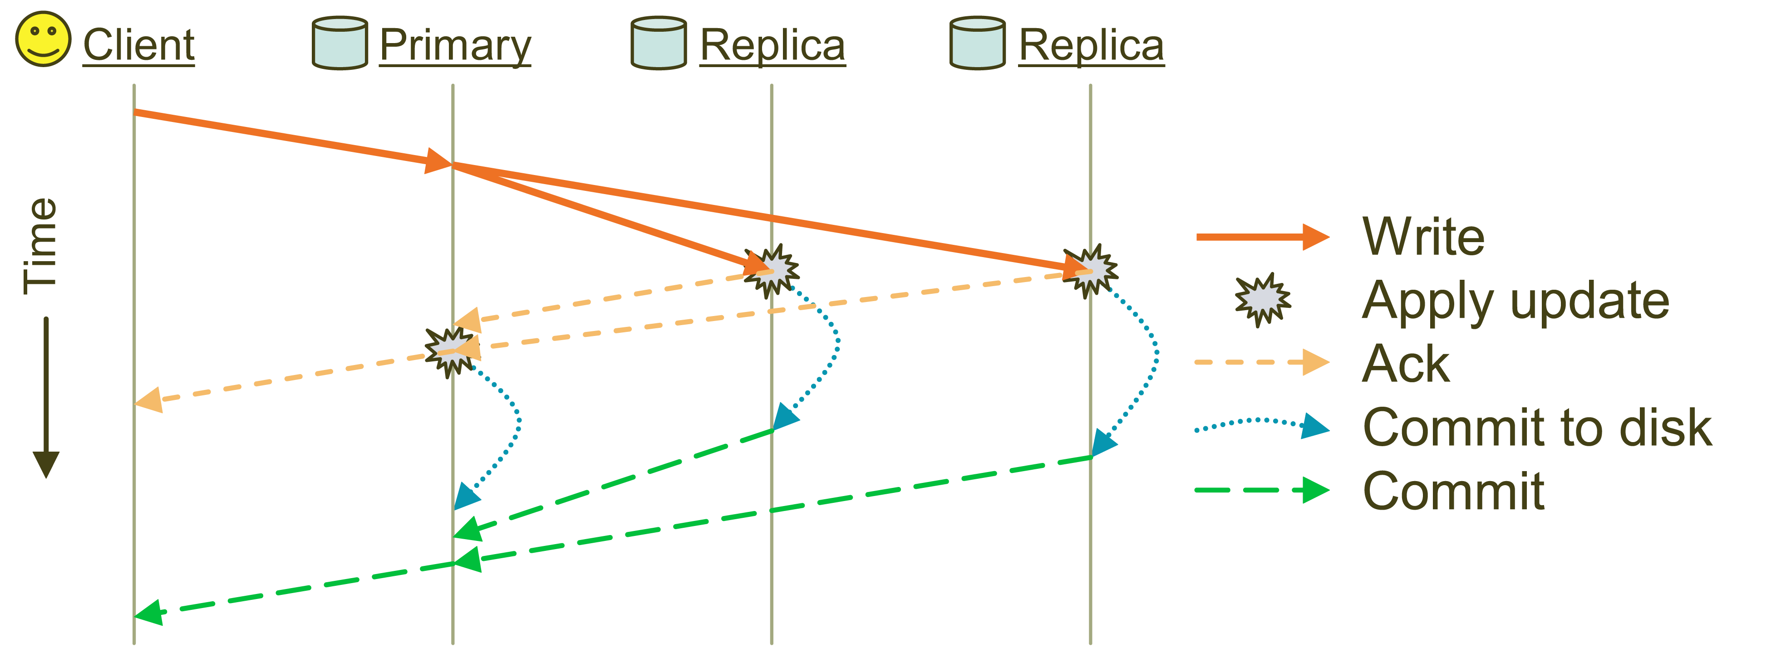
Replication
Objects are replicated on OSDs within same PG
Client is oblivious to replication

Slide 18
Ceph: Performance

Slide 19
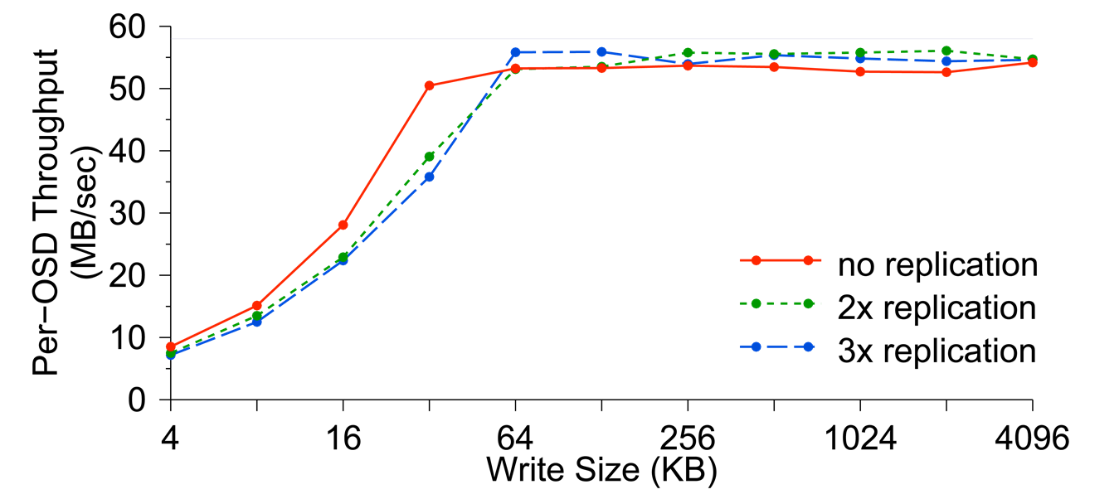
Performance Evaluation
Data Performance
OSD Throughput

Slide 20
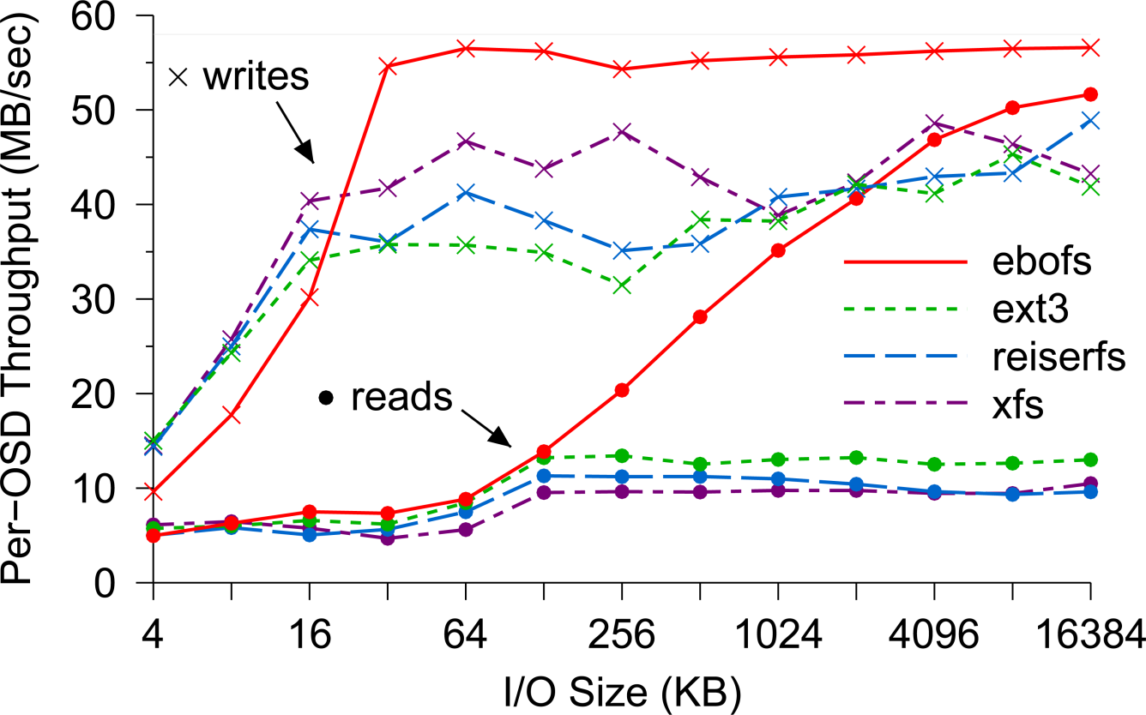
Performance Evaluation
Data Performance
OSD Throughput

Slide 21
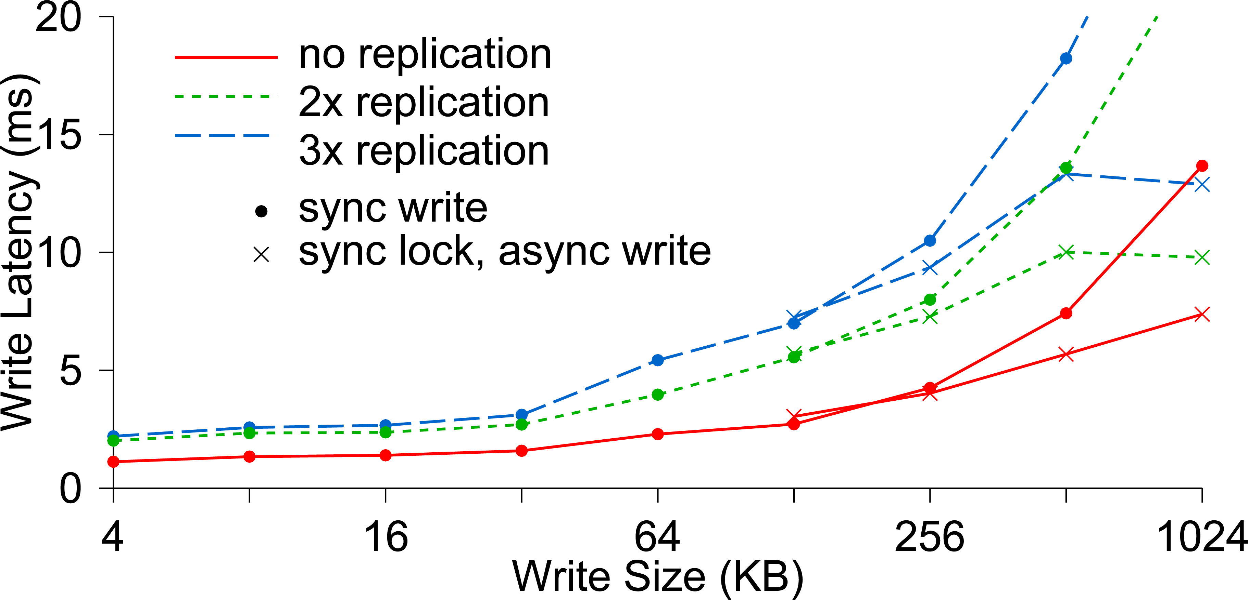
Performance Evaluation
Data Performance
Write Latency

Slide 22
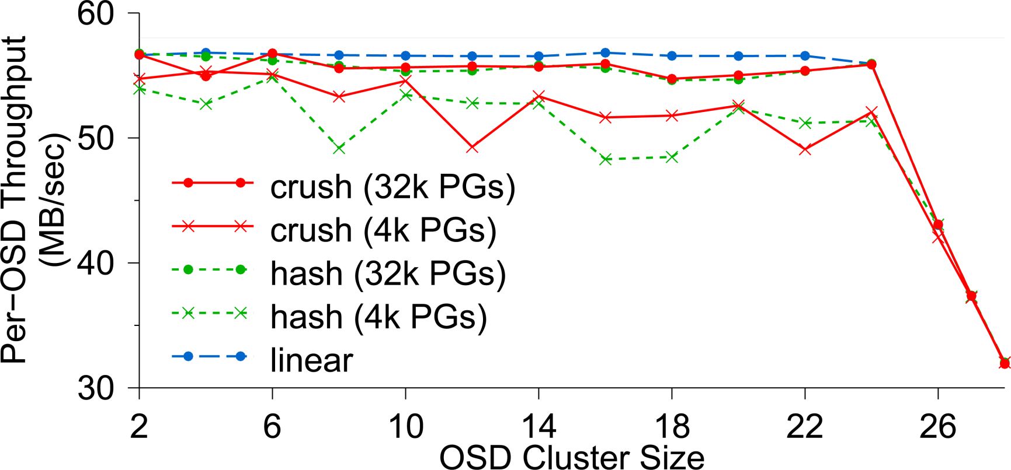
Performance Evaluation
Data Performance
Data Distribution and Scalability

Slide 23
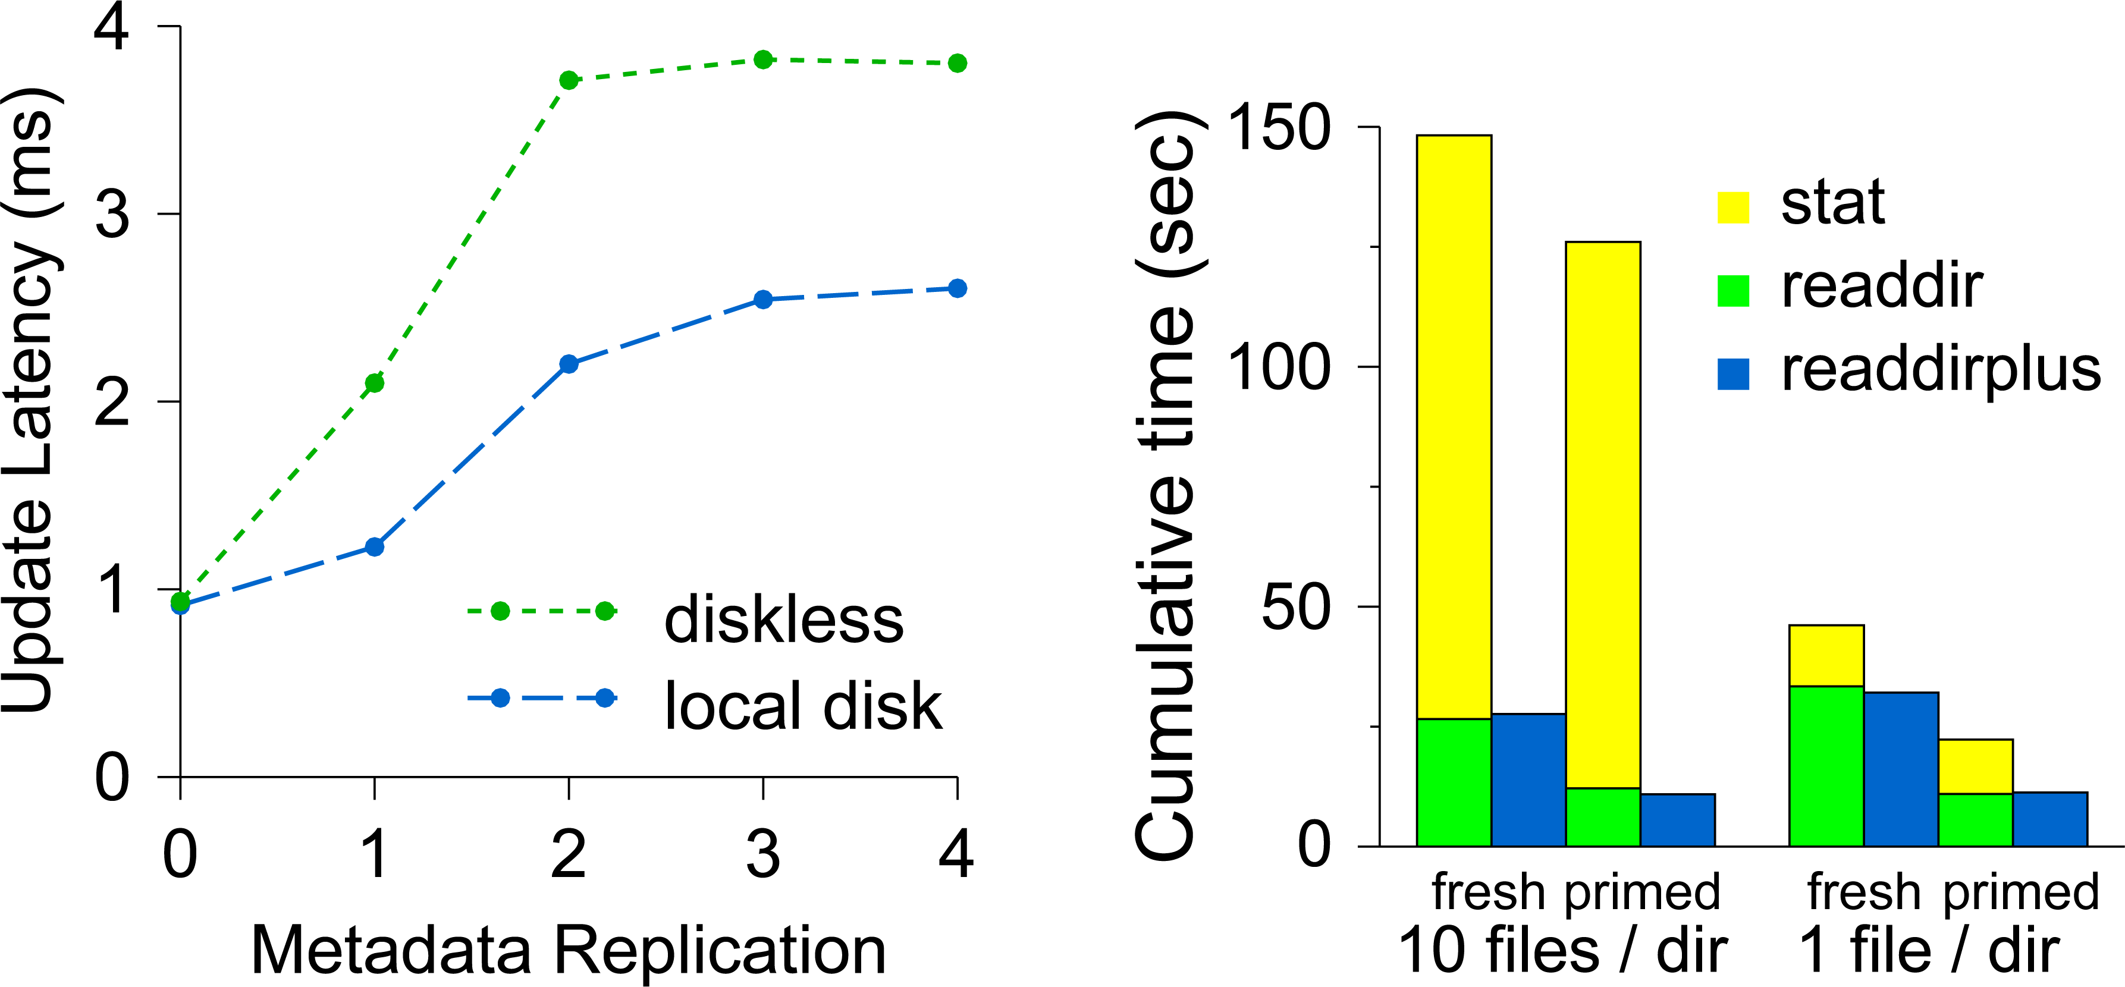
Performance Evaluation
MetaData Performance
MetaData Update Latency & Read Latency

Slide 24
Ceph: Demo

Slide 25
Conclusion
Strengths:
Easy scalability to peta-byte capacity
High performance for varying work loads
Strong reliability
Weaknesses:
MDS and OSD Implemented in user-space
The primary replicas may become bottleneck to heavy write operation
N-way replication lacks storage efficiency

Slide 26
References
“Ceph: A Scalable, High Performance Distributed File System” Sage A Weil, Scott A. Brandt, Ethan L. Miller and Darrell D.E. Long, OSDI '06: th USENIX Symposium on Operating Systems Design and Implementation.
“Ceph: A Linux petabyte-scale distributed file System”, M. Tim Jones, IBM developer works, online document.
Technical talk presented by Sage Weil at LCA 2010.
Sage Weil's PhD dissertation, “Ceph: Reliable, Scalable, and High-Performance Distributed Storage” (PDF)
“CRUSH: Controlled, Scalable, Decentralized Placement of Replicated Data” (PDF) and “RADOS: A Scalable, Reliable Storage Service for Petabyte-scale Storage Clusters” (PDF) discuss two of the most interesting aspects of the Ceph file system.
“Building a Small Ceph Cluster” gives instructions for building a Ceph cluster along with tips for distribution of assets.
“Ceph : Distributed Network File System: Kernel trap”

Slide 27
Questions ?

