Slide 1
CrowdDJ
Anand Altekar
NYU-Courant
anandaltekar@gmail.com
9293913898, New York

Slide 2
WHAT IS IT?

Slide 3








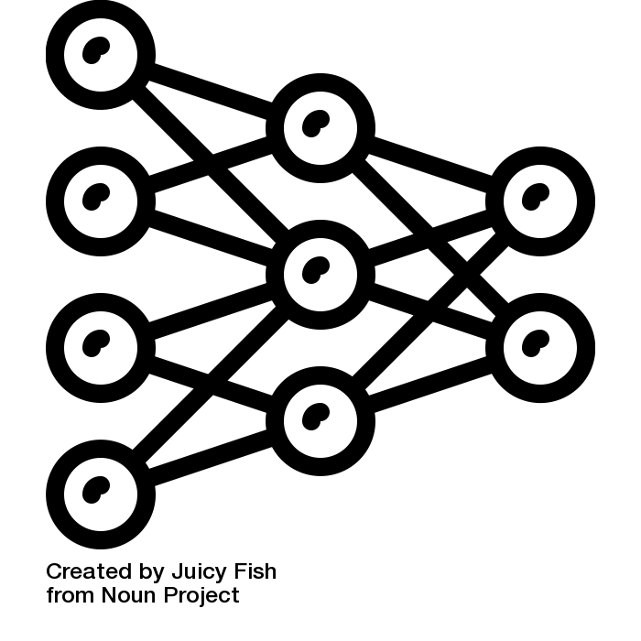




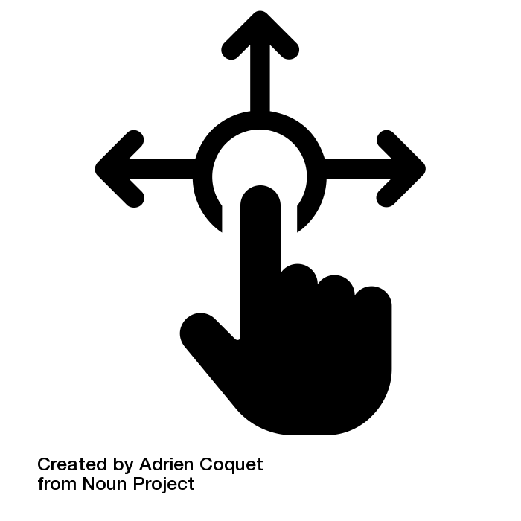
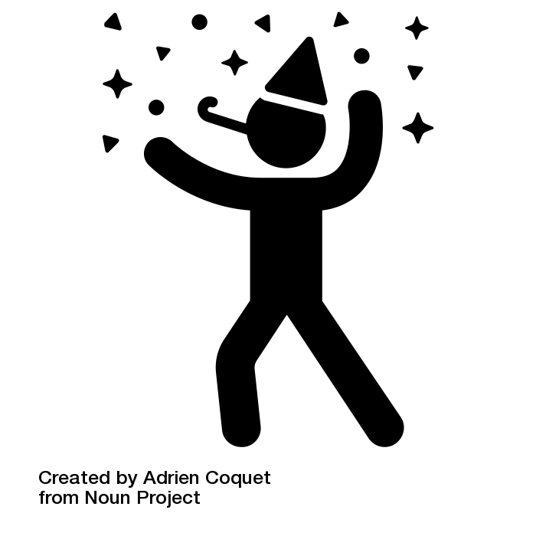


Imagine you’re at a party and want to play music that everyone will enjoy
You create a playlist on Spotify and invite your friends to join it
An algorithm populates the playlist*
The algorithm learns through users’ interactions with the playlist
Thanks to CrowdDJ the party just got better!
*Refer to How

Slide 4
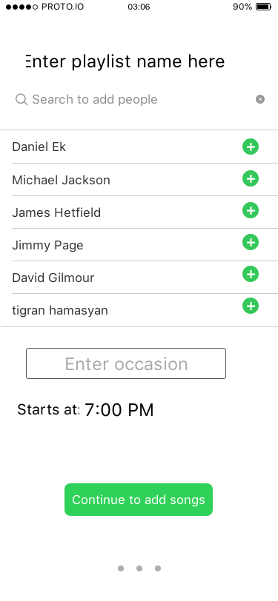
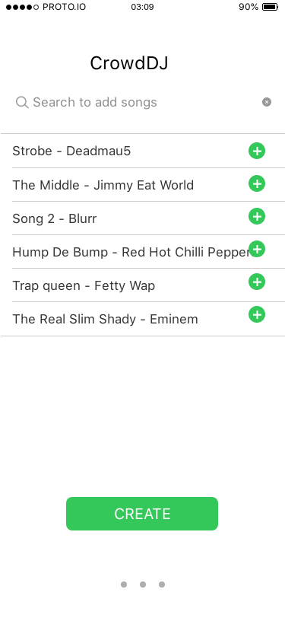
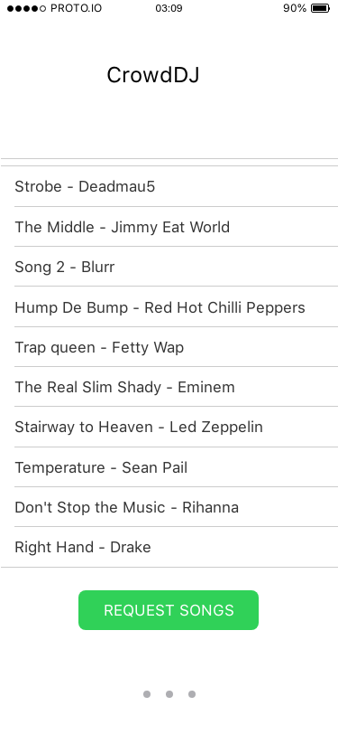
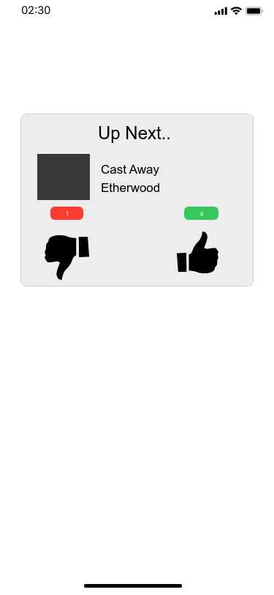
INVITE
CREATE
INTERACT
ENGAGE

Slide 5
WHY:
Users:
Solves the problem of deciding what to play and lets users focus on the event
Increases social interaction around music and creates fun moments
Spotify:
Create stories around spotify => Increased brand awareness
Social pressure to join spotify on guests who are not customers => Growth
Understand user networks within Spotify => Better recommendations

Slide 6
HOW:
Could build on top of existing recommender system.
Collaborative Filtering
Latent features in music audio
Factor in additional data
Ex: Start, end time and occasion will help understand changes in moods over time
Song votes can help in improving personal recommendations
There’s more but keeping it short for the sake of this presentation.

Slide 7
Thank You!

