Slide 1


MTech Program
Advanced Industry Integrated Programs
Jointly offered by VIT University and LTIMindTree
Review III
Visual Intelligence for Football: Deep Learning-based Image Analysis with Automated Reporting
Anandam Paul
(T8635)
Knowledge partner | Implementation partner

Slide 2
Visual Intelligence for Football: Deep Learning-based Image Analysis with Automated Reporting
INTRODUCTION
Football matches produce massive visual data
Manual analysis is slow and biased
Deep learning
Analysis
Converts images into match insights
Scalable Solution

Slide 3
Visual Intelligence for Football: Deep Learning-based Image Analysis with Automated Reporting
OBJECTIVE
Build Ai systems for football analysis
Detect key football events
Use deep learning models
Generate simple reports
Scalable Framework

Slide 4
Visual Intelligence for Football: Deep Learning Based Image Analysis with automated reporting
Problem Statement
Manual match analysis is slow, labor-intensive, and subjective.
Existing AI tools rely mostly on video data, not static images.
Coaches and analysts face delays in obtaining clear insights.
Sports websites lack quick summaries for commentary

Slide 5
Visual Intelligence for Football: Deep Learning Based Image Analysis with automated reporting
Modules
Dataset Collection & Annotation
Image Preprocessing & Feature Extraction
Deep Learning Architectures for Event Recognition
Integration of LLM
Visualization and Insights

Slide 6
Visual Intelligence for football: Deep Learning based image analysis with automated reporting
Methodology
Dataset Preparation
Football Image Segmentation dataset from Kaggle.
Images annotated with masks for players, ball, and field regions.
Preprocessing
Image cleaning, resizing, normalization.
Data augmentation (flipping, rotation, brightness adjustments).

Slide 7
Visual Intelligence for football: Deep learning based image analysis with automated reporting
Methodology
Model Development
Baseline: CNN for initial event detection.
Advanced: CNN + Vision Transformer (ViT) hybrid → best accuracy.
Experimental: CNN + ViT + RNN for sequence-based event analysis.
Reporting & Insights
Lightweight LLM integration to generate match summaries.
Highlight team strengths, weaknesses, and key match events.

Slide 8
Visual Intelligence for football: Deep learning based image analysis with automated reporting
Methodology
Deployment
Interactive Streamlit frontend for real-time visualization.
Display predictions, metrics, and generated reports.

Slide 9
Visual Intelligence for Football: Deep Learning Based Image Analysis with automated reporting
Algorithms and Tools….
Algorithms:
CNN (ResNet): Extract spatial features from images
Vision Transformer (ViT): Capture global context
RNN: Model temporal dependencies between events
Tools:
Streamlit: Interactive UI for uploading images & reports
PyTorch / Torchvision: Model training
Transformers: LLM integration
NumPy, Pandas: Data handling & preprocessinng

Slide 10
Visual Intelligence for Football: Deep Learning Based Image Analysis with automated reporting
Findings and Results….
Overall Performance
Training Duration: 769.3 minutes
Best Model: CNN+VIT+RNN
Best Weighted F1 Score: 0.9060
Final Training Accuracy: 98.01%
Final Validation Accuracy: 90.62%
Final Validation Loss: 0.6827

Slide 11
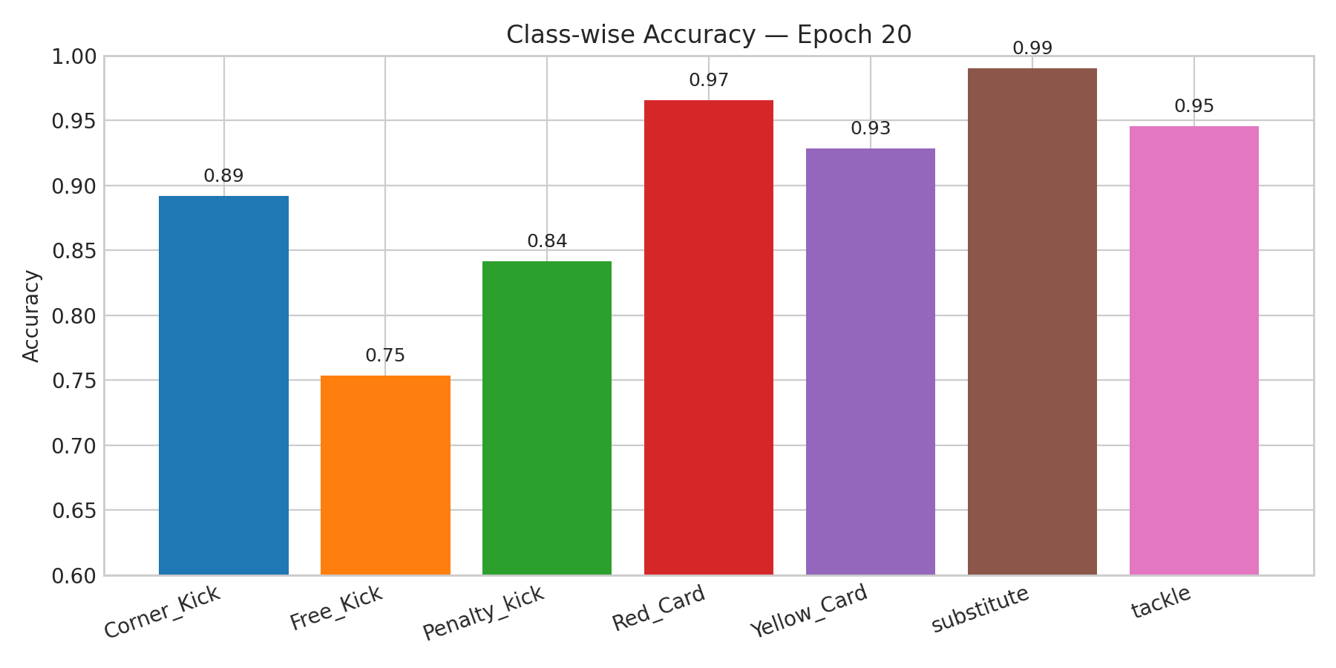
Visual Intelligence for Football: Deep Learning Based Image Analysis with automated reporting
Findings and Results…. Calibri body -36

Slide 12
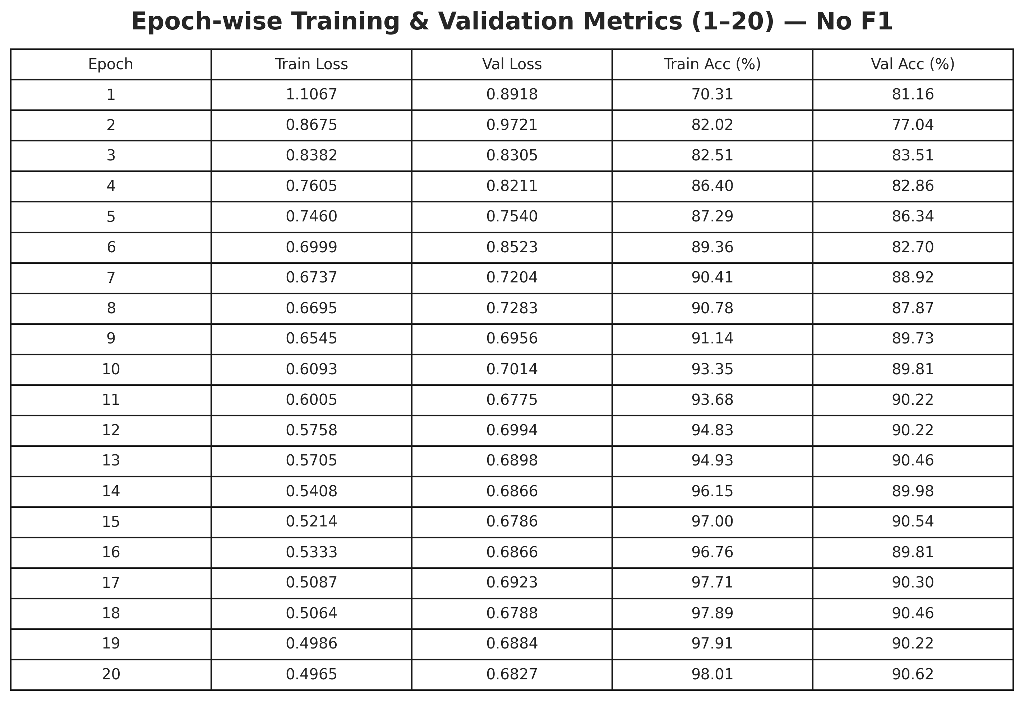
Visual Intelligence for Football: Deep Learning Based Image Analysis with automated reporting
Findings and Results…. Calibri body -36

Slide 13
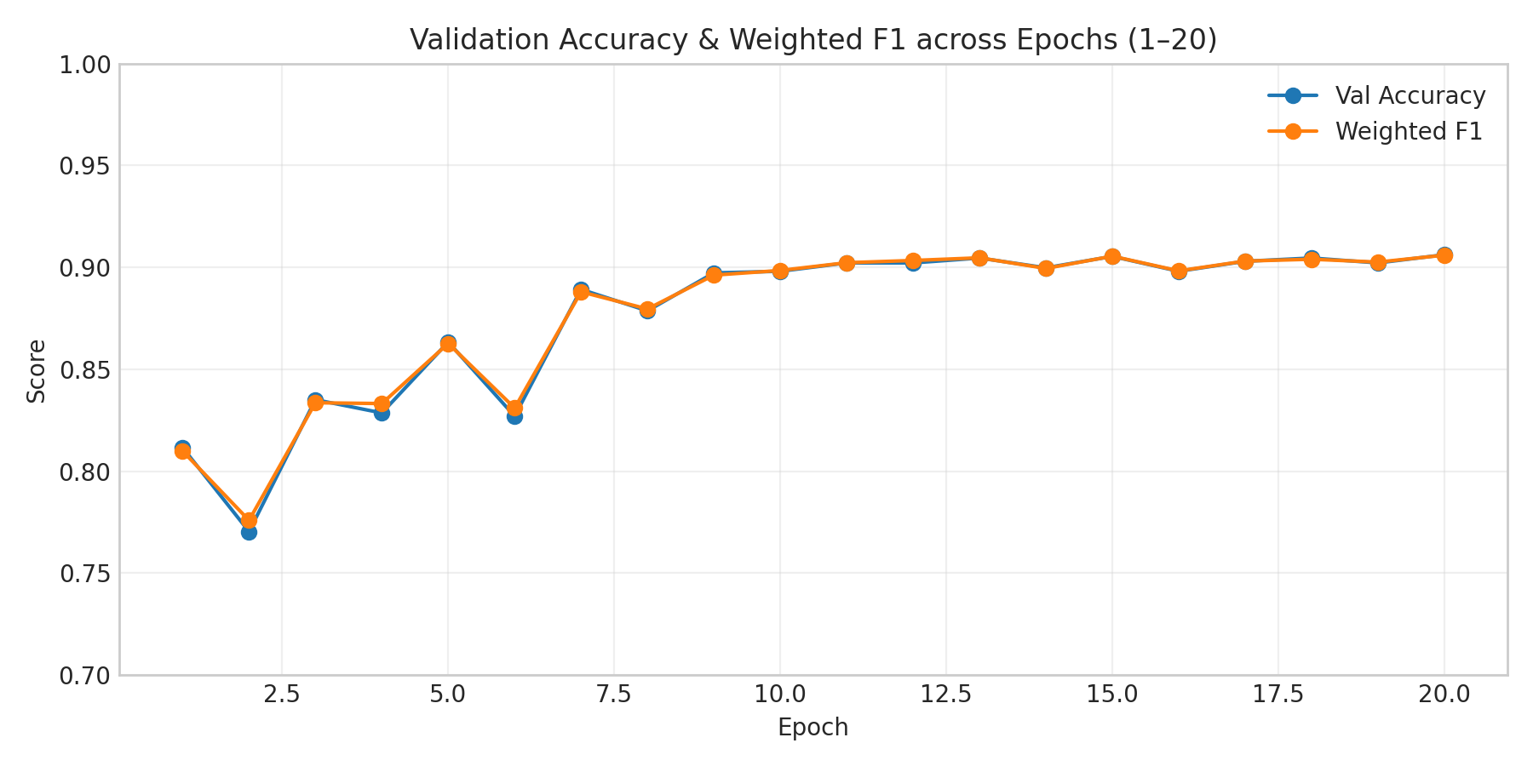
Visual Intelligence for Football: Deep Learning Based Image Analysis with automated reporting
Findings and Results…
It shows how my model’s performance
improved over 20 epochs.
Two lines:
Blue: Validation Accuracy (how many predictions were correct).
Orange: Weighted F1 (balances precision and recall).
Both lines go up and stabilize near 90%, meaning the model learned well and didn’t overfit.

Slide 14
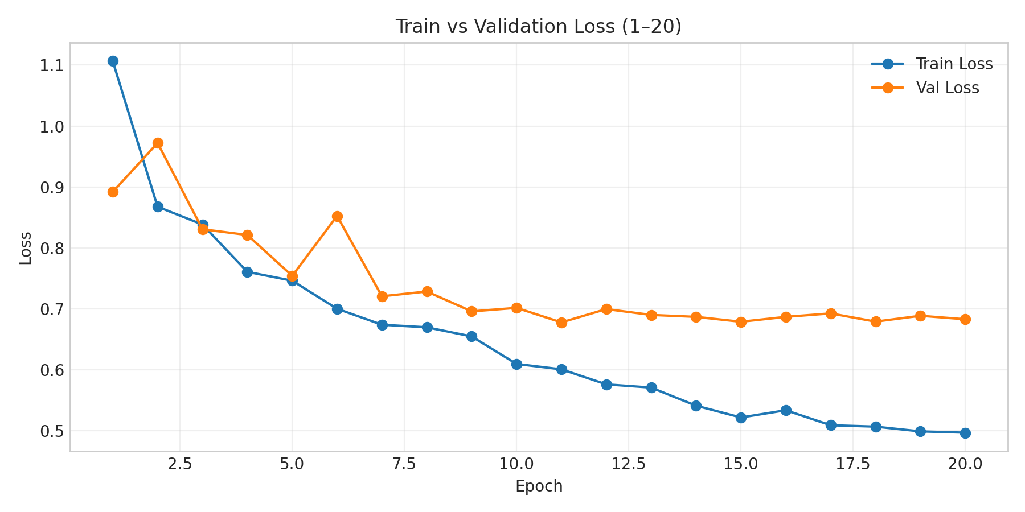
Visual Intelligence for Football: Deep Learning Based Image Analysis with automated reporting
Findings and Results…
Train vs Validation Loss
What it shows: How much error the model made during training and validation.
Two lines:
Train Loss: Goes down as the model learns.
Validation Loss: Also goes down and stays close to train loss.
No big gap → model generalizes well (not overfitting).
Loss decreased consistently and stayed stable, showing good learning.

Slide 15
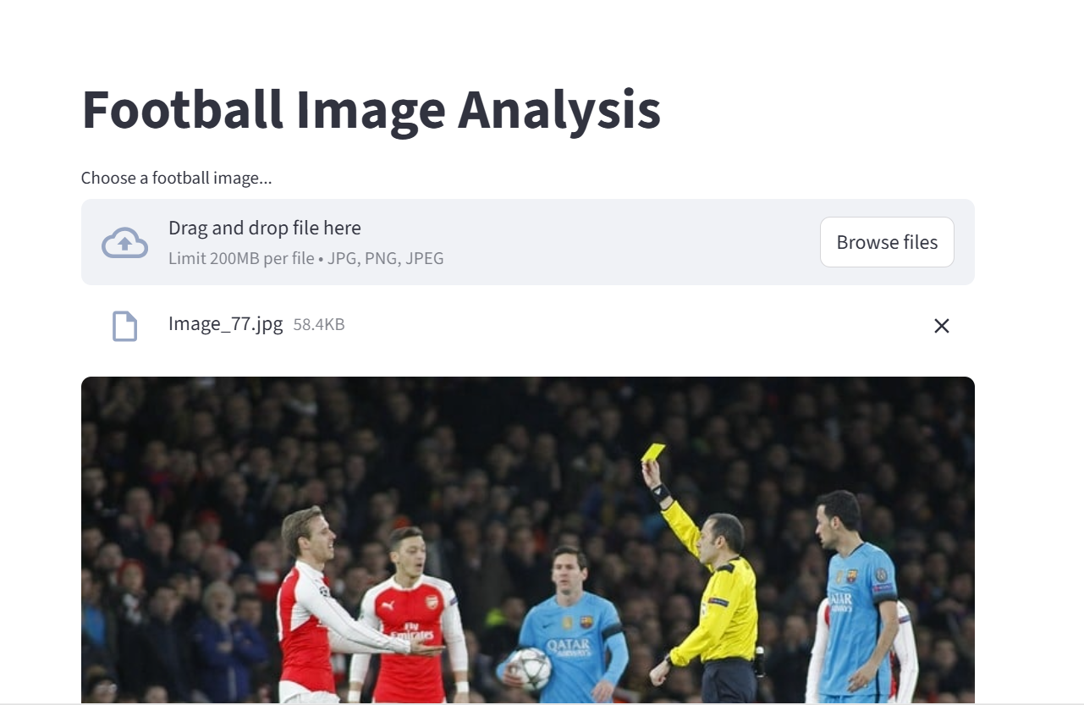
Visual Intelligence for Football: Deep Learning Based Image Analysis with automated reporting
Findings and Results

Slide 16
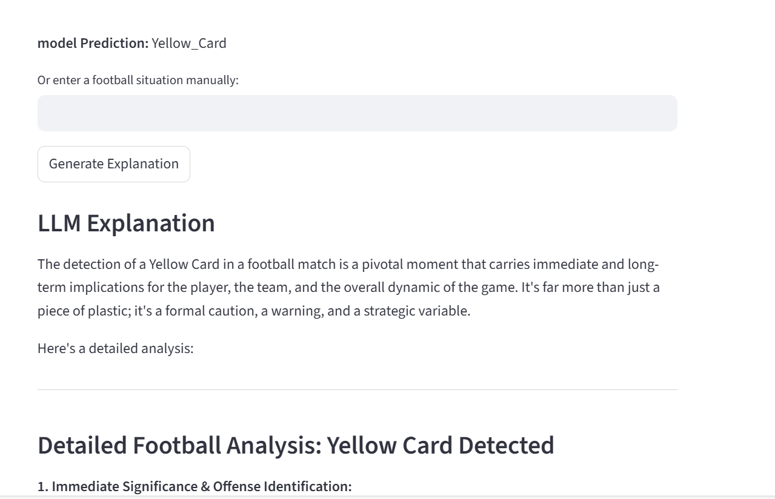
Visual Intelligence for Football: Deep Learning Based Image Analysis with automated reporting
Findings and Results

Slide 17
Visual Intelligence for Football: Deep Learning Based Image Analysis with automated reporting
Conclusion
This project demonstrates an AI system that can analyze football images and generate clear, human-readable match summaries. The system can be extended to real-time video analysis, automated player performance tracking, predictive match insights, and richer tactical commentary in future making it a powerful tool for enhancing how we watch, understand, and enjoy football. Overall, this work highlights the potential of AI to transform sports data into meaningful stories.

Slide 18
Visual Intelligence for Football: Deep Learning Based Image Analysis with automated reporting
Acknowledgement
VIT Chennai – for curriculum
LTI Mindtree – for platform and resources
SME Melvin Sir – for mentorship and insights
Dataset & tool creators – for resources
Friends & family – for motivation and encouragement

Slide 19
Visual Intelligence for Football: Deep Learning Based Image Analysis with automated reporting
Reference…
Zheng, F.; Al-Hamid, D. Z.; Chong, P. H. J.; Yang, C.; Li, X. J. (2025). A Review of Computer Vision Technology for Football Videos.
Seweryn, K.; Chęć, G.; Łukasik, S.; Wróblewska, A. (2024). Improving Object Detection Quality in Football Through Super-Resolution.
An Image is Worth 16×16 Words: Transformers for Image Recognition at Scale — Dosovitskiy, A.; Kolesnikov, A.; Beyer, L.; Weissenborn, D.; Zhai, X.; Unterthiner, T.; Dehghani, M.; Minderer, M.; Heigold, G.; Gelly, S. (2021).

Slide 20
Visual Intelligence for Football: Deep Learning Based Image Analysis with automated reporting
Reference…
Detecting and Tracking Player in Football Videos Using Two-Stage Mask R-CNN Approach — Husein, A. M.; Chalvin; Kalvintirta Ciptady; Raymond Suryadi; Mawaddah Harahap (2023)
Wang, J.; Zhang, Y.; Li, X.; Huang, Z.; Yu, X. (2024). SportsMetrics: Blending Text and Numerical Data to Understand Information Fusion in Large Language Models.
Xia, H.; Yang, Z.; Zou, J.; Tracy, R.; Wang, Y.; Lu, C.; Lai, C.; He, Y.; Shao, X.; Xie, Z.; Wang, Y.; Shen, W.; Chen, H. (2024). SPORTU: A Comprehensive Sports Understanding Benchmark for Multimodal Large Language Models.

Slide 21
Project Title - Calibri body 18
Reference…
Zheng et al., 2025 – Computer Vision in Football Videos. Reviews state-of-the-art CV techniques for analyzing football matches, including tracking, detection, and event recognition.
Seweryn et al., 2024 – Super-Resolution for Football Object Detection. Improves detection quality by applying super-resolution techniques to football video frames before detection.
Dosovitskiy et al., 2021 – Vision Transformers. Proposes the Transformer architecture
for image recognition, treating images as sequences of patches for high accuracy.

Slide 22
Project Title - Calibri body 18
Reference… Calibri body -36
Husein et al., 2023 – Two-Stage Mask R-CNN for Player Tracking. Uses a two-stage Mask R-CNN to detect and track football players accurately in video footage.
Wang et al., 2024 – CoSportsMetrics. Explores how combining text and numerical sports data improves information fusion in large language models.
Xia et al., 2024 – SPORTU Benchmark. Introduces a multimodal dataset to evaluate sports understanding in large language models using text, images, and video

