Slide 1
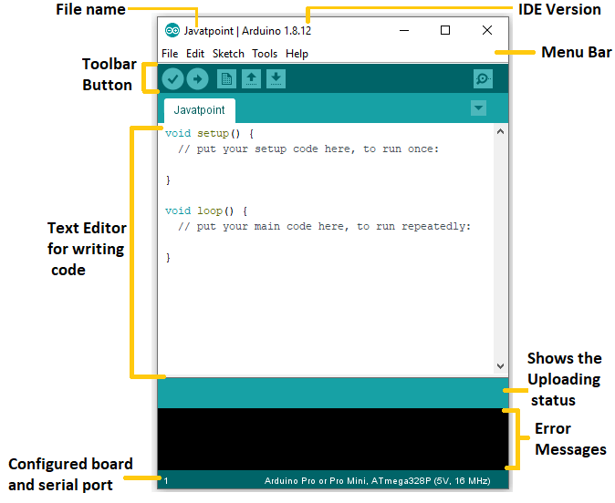
Arduino IDE
The Arduino IDE is an open-source software, which is used to write and upload code to the Arduino boards. The IDE application is suitable for different operating systems such as Windows, Mac OS X, and Linux. It supports the programming languages C and C++. Here, IDE stands for Integrated Development Environment.

Slide 2
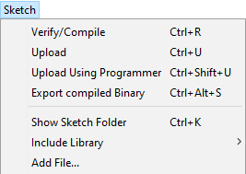
Include Library
Include Library includes various Arduino libraries. The libraries are inserted into our code at the beginning of the code starting with the #. We can also import the libraries from .zip file.

Slide 3
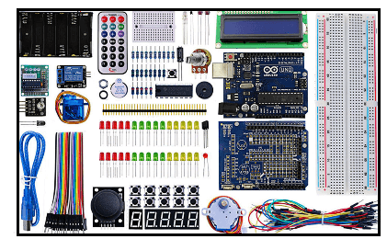
Arduino Kit
The components in the Starter kit are listed below:
1)Arduino UNO board, 2) Breadboard 3) LED , 4) LCD Alphanumeric 5) Solid core jumper wires, 6) 9V Battery 7) Resistors, 8) Small DC Motor 6/9V 9) Diodes, 10)Capacitors of 100uF 11) Opto-couplers, 12) Small servo motor 13) Piezo Capsule, 14) Push Buttons 15)Tilt Sensor, 16)Potentiometer 17)Phototransistor, 18)Temperature Sensor 19) MOSFET Transistors, 20)H-bridge Motor Driver

Slide 4
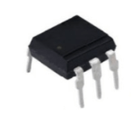
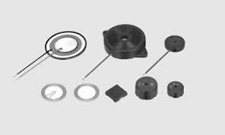
Opto-couplers
The noise from the electrical signals is removed by the Opto-couplers. It is also used to separate the low power circuits from the high-power circuits and transfers the electrical signals between these separated circuits.
Piezo Capsule
The piezo in Arduino is defined as an electronic device, which produces a voltage when deformed by some mechanical strain, sound wave, or a vibration.

Slide 5
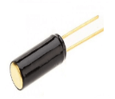
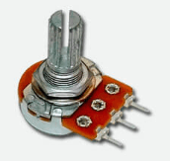
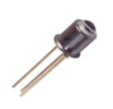
Tilt Sensor
The tilt sensor is used to measure the tilt with respect to the reference plain. It is also used to detect the inclination of the plane.
Phototransistor
The phototransistor uses the NPN transistors to sense the light level and convert it into the current.

Slide 6
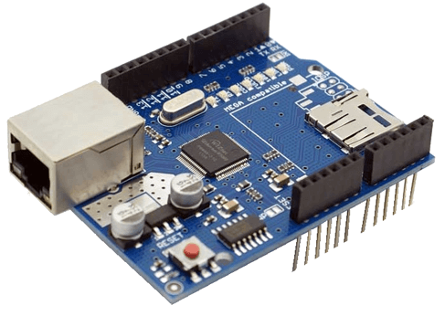
Arduino Shields
Arduino shields are the boards, which are plugged over the Arduino board to expand its functionalities. There are different varieties of shields used for various tasks, such as Arduino motor shields, Arduino communication shields, etc.
Ethernet shield:
The Ethernet shields are used to connect
the Arduino board to the Internet.
We need to mount the shield on the top of
the specified Arduino board.

Slide 7
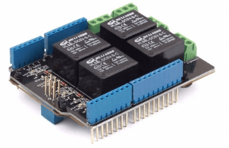
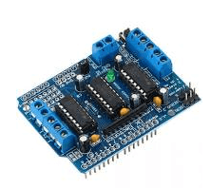
RELAY SHIELD :
The Arduino digital I/O pins cannot bear the high current due to its voltage and current limits. The relay shield is used to overcome such situation. It provides a solution for controlling the devices carrying high current and voltage.
It also provides NO/NC interfaces and a shield form factor for the simple connection to the Arduino board.
The NO (Normally Open), NC (Normally Closed), and COM pins are present on each relay.
MOTOR SHIELD :
It controls the direction and working speed of the motor. We can power the motor shield either by the external power supply through the input terminal or directly by the Arduino.
It can drive inductive loads, such as solenoids, etc.
The operating voltage is from 5V to 12V.

Slide 8
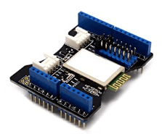
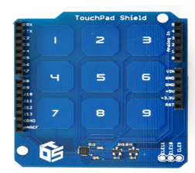
BLUETOOTH SHIELD:
The Bluetooth shield can be used as a wireless module for transparent serial communication.
It includes a serial Bluetooth module. D0 and D1 are the serial hardware ports in the Bluetooth shield, which can be used to communicate with the two serial ports (from D0 to D7) of the Arduino board.
The communication distance of the Bluetooth shield is upto 10m at home without any obstacle in between.
CAPACITIVE TOUCHPAD SHIELD:
It has a touchpad interface that allows to integrate the Arduino board with the touch shield.
The Capacitive touchpad shield consists of 12 sensitive touch buttons, which includes 3 electrode connections and 9 capacitive touch pads.

Slide 9
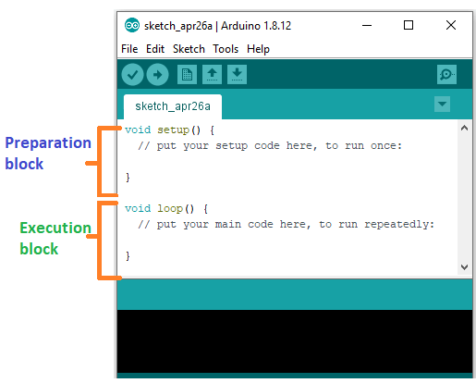
ARDUINO CODING
CODING SCREEN:

Slide 10
We want to set the 12 pin number as the output pin.
pinMode (12, OUTPUT);
digitalWrite( )
The digitalWrite ( ) function is used to set the value of a pin as HIGH or LOW.
Where,
HIGH: It sets the value of the voltage. For the 5V board, it will set the value of 5V, while for 3.3V, it will set the value of 3.3V.
LOW: It sets the value = 0 (GND).
If we do not set the pinMode as OUTPUT, the LED may light dim.
The syntax is: digitalWrite( pin, value HIGH/LOW)
Example:
digitalWrite (13, HIGH);

Slide 11
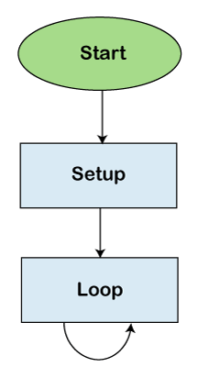
difference between digitalRead () and digitalWrite ():
The digitalRead () function will read the HIGH/LOW value from the digital pin, and the digitalWrite () function is used to set the HIGH/LOW value of the digital pin.
FLOW CHARTS

Slide 12
Serial Communication
Serial.begin()
The serial communication is a simple scheme that uses the UART (Universal Asynchronous Receiver/Transmitter) on the Microcontroller. It uses,
5V for logic 1 (high)
0V for logic 0 (low)
For a 3.3V board, it uses
3V for logic 1 (high)
0V for logic 0 (low)
Every message sent on the UART is in the form of 8 bits or 1 byte, where 1 byte = 8 bits.
The serial.begin( ) sets the baud rate for serial data communication. The baud rate signifies the data rate in bits per second.
The default baud rate in Arduino is 9600 bps (bits per second). We can specify other baud rates as well, such as 4800, 14400, 38400, 28800, etc.
The Serial.begin( ) is declared in two formats, which are shown below:
begin( speed )
begin( speed, config) {config: It sets the stop, parity, and data bits.}

