Slide 1

SENSORS

Slide 2

There are different type of sensors are available to choose from and the characteristics of sensors are used for determining the type of sensor to be used for particular application.

Slide 3

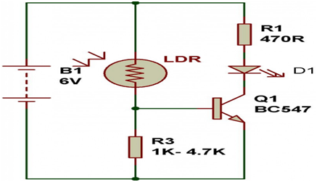
Light Sensors
Light sensor is a transducer used for detecting light and creates a voltage difference equivalent to the light intensity fall on a light sensor.
The two main light sensors used in robots are Photovoltaic cells and Photo resistor. Other kind of light sensors like phototransistors, phototubes are rarely used.
1. Photo resistor - It is a type of resistor used for detecting the light. In
photo resistor resistance varies with change in light intensity. The light falls on photo resistor is inversely proportional to the resistance of the photo resistor. In general photo resistor is also called as Light Dependent Resistor (LDR).

Slide 4
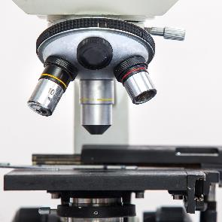

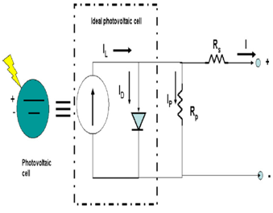
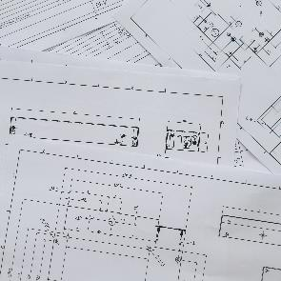



1. Photovoltaic Cells - Photovoltaic cells are energy conversion device used to convert solar radiation into electrical electric energy. It is used if we are planning to build a solar robot. Individually photovoltaic cells are considered as an energy source, an implementation combined with capacitors and transistors can convert this into a sensor.
1
2
3
4
5
6

Slide 5
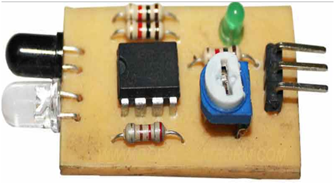
1. Proximity Sensor:
Proximity sensor can detect the presence of nearby object without any physical contact. The working of a proximity sensor is simple. In proximity sensor transmitter transmits an electromagnetic radiation and receiver receives and analyzes the return signal for interruptions. Therefore the amount of light receiver receives by surrounding can be used for detecting the presence of nearby object.
Infrared (IR) Transceivers - In IR sensor LED transmit the beam of IR light and if it find an obstacle then the light is reflected back which is captured by an IR receiver.
1
2
3
4
5
6

Slide 6
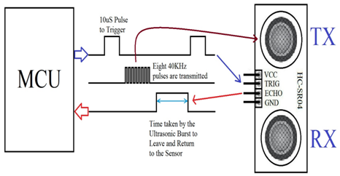
Ultrasonic Sensor
In ultrasonic sensors high frequency sound waves is generated by transmitter, the received echo pulse suggests an object interruption. In general ultrasonic sensors are used for distance measurement in robotic system.

Slide 7
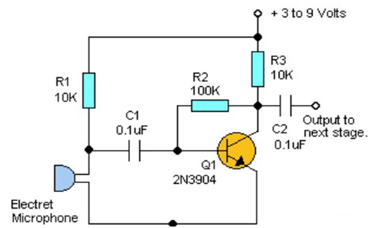
3) Sound Sensor
Sound sensors are generally a microphone used to detect sound and return a voltage equivalent to the sound level. Using sound sensor a simple robot can be designed to navigate based on the sound receives.
Implementation of sound sensors is not easy as light sensors because it generates a very small voltage difference which will be amplified to generate measurable voltage change.

Slide 8
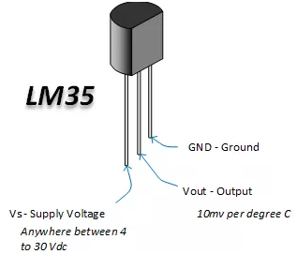
4) Temperature Sensor
Temperature sensors are used for sensing the change in temperature of the surrounding. It is based on the principle of change in voltage difference for a change in temperature this change in voltage will provide the equivalent temperature value of the surrounding.
Few generally used temperature sensors IC?s are TMP35, TMP37, LM34, LM35, etc.

Slide 9
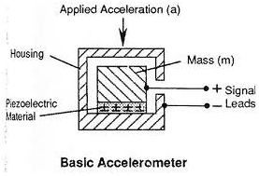
5) Acceleration Sensor
Acceleration sensor is used for measuring acceleration and tilt. An accelerometer is a device used for measuring acceleration.
The two kinds of forces which affect an accelerometer is:-
Static Force - It is the frictional force between any two objects. By measuring this gravitational force we can determine the how much robot is tilting. This measurement is useful in balancing robot, or for determining whether robot is driving on a flat surface or uphill.
Dynamic Force - It is the amount of acceleration required to move an object. Measurement of dynamic force using an accelerometer tells about the velocity/speed at which robot is moving.
Accelerometer is comes in different configuration. Always use the one which is most appropriate for your robot. Some factors need to be considered before selecting accelerometer is:
Sensitivity
Bandwidth
Output type: Analog or Digital
Number of Axis: 1,2 or 3

Slide 10


Thank You
Jens Martensson
jens@bellowscollege.com

