Slide 1

What is a network?

Slide 2

In a Network Data Packets transfer from one point to another point.
Question????
Does different OS understands data packets in different way? If not? Why is it so?

Slide 3
Q. Where does data enters into PC?
Every PC knows the language of Networking(OSI/TCP-IP).
Data Packet Transfer happens through OSI or TCP/IP Protocol; which helps data to encode and decode irrespective of device and its Operating System used.

Slide 4
What is the Purpose of Computer Networking?
Sharing of Resources(Hard disk space, Printer, etc.)
Sharing of Programs/Software Sharing of Files and Folders(Data bases)
Electronic Communication by users
Videoconferencing
Commerce and Banking
Automation of Business Processes
Control of Household Equipments
Entertainment
Electronic News

Slide 5
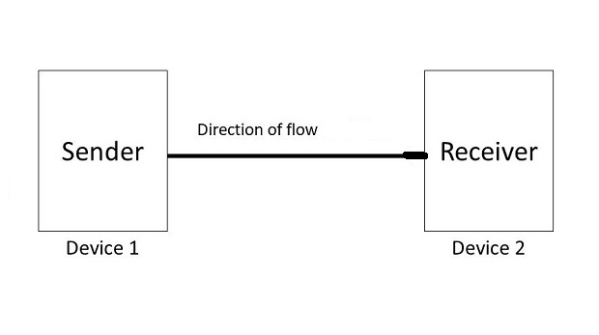
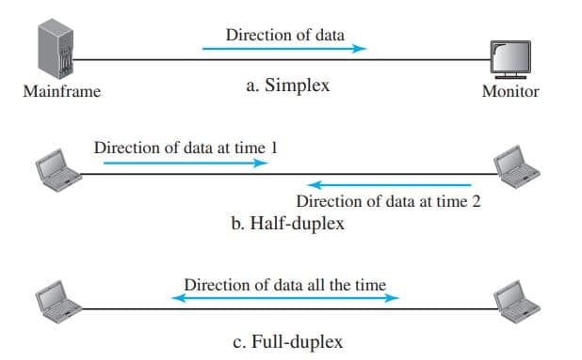
What are the different modes of data transmission?

Slide 6

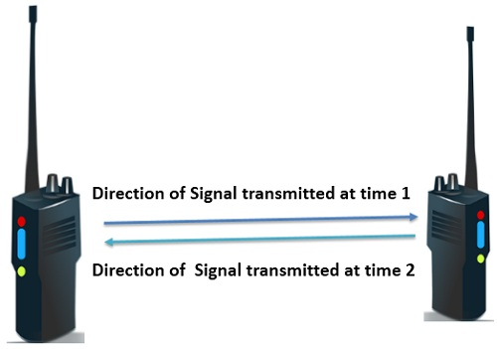

Simplex :
Half-Duplex :
Full-Duplex :

Slide 7
How Does Internet Works? What are the types of Networks available?

Slide 8
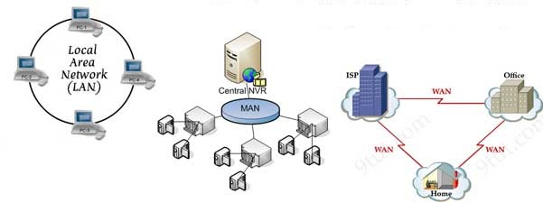
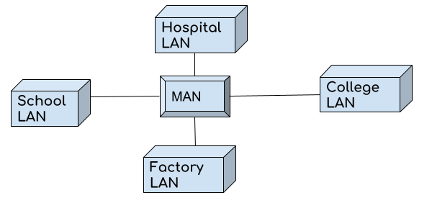

Slide 9
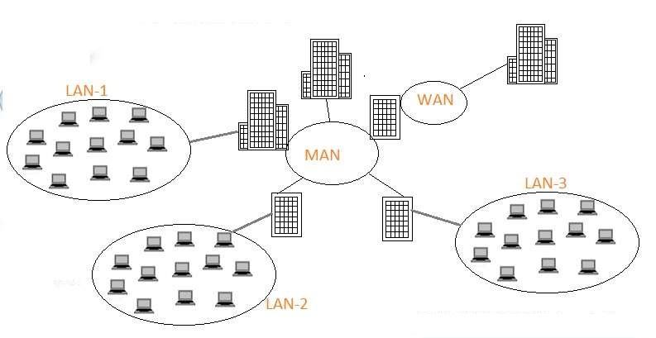

Slide 10
What is Internet/Ethernet?
A Global computer network providing a variety of information and communication facilities, consisting of interconnected networks using standardized communication protocols.

Slide 11
Convert the following nos?
(384) octal = (?) hexadecimal
(1100)binary= (?) decimal
(11011001)binary=(?) decimal
(11011001)binary = (?) hexadecimal
(192)decimal = (?)Hexadecimal
(168)decimal = (?)hexadecimal
(E 5) hexadecimal
=(12) decimal
=(217) decimal
= (D 9) hexadecimal
= divide by 16

Slide 12
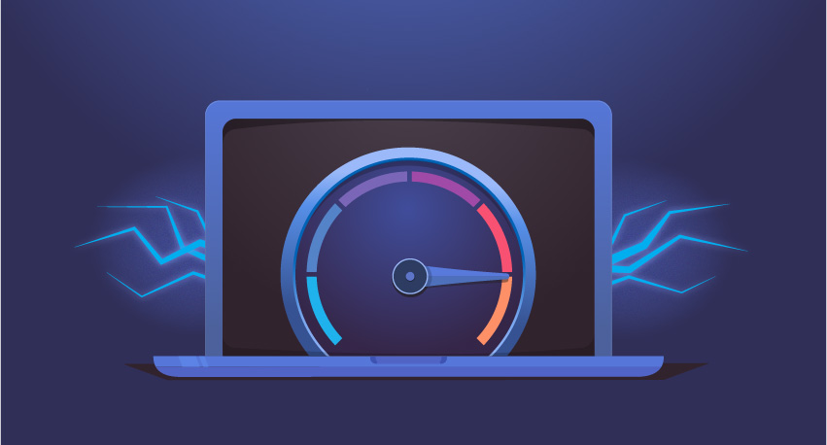
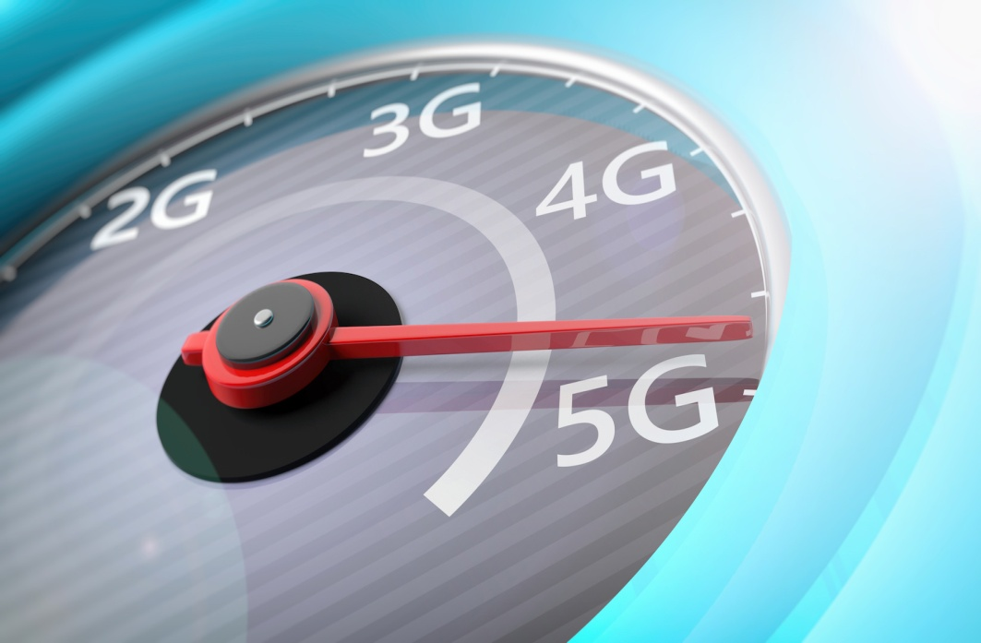
Speed of Internet
bit and byte concept
Difference between bit and Byte

Slide 13
Q. How Long it will take for a 128kb file to go across at 1Mbps ?

