Slide 1

OSI & TCP/IP
What is the need of an
standardize model?

Slide 2
osi
Tcp/ip
Application | Application
Presentation
Session
Transport | Transport
Network | Internet
Data link | Network Interface
Physical
OSI >>> Please Do Not Throw Sausage Pizza Away.

Slide 3
Application layer
Point of contact of all Network aware applications.(Note: Not all application)
Protocols works on this layer are ------>
FTP , TFTP, SNMP, DNS, HTTP etc.

Slide 4
Presentation layer
Presentation layer generify data.
It’s a layer which takes the data coming from the session layer on the way back convert it into a presentable format.
Encryption happens in this layer
Services like TLS, SSS are taken care at this layer.

Slide 5
SESSION LAYER
It creates and maintain session.
When two applications are working simultaneously; it creates two separate session for each of the application and maintains them.
These layers are taken care by the OS.

Slide 6
TRANSPORT LAYER
It is a critical layer for Network Engineer.
Transport Layer breaks data into segments.
It Takes two critical decessions
1. Reliable or Un-reliable (??)
2. Create a port number (??)
Q??? TPC and UDP which is faster and why?

Slide 7
Reliable :
It means; it has to get 100% acknowledgement for every packet it sent.
UN-Reliable:
There is no acknowledgement required for every segment transmitted.
Port Number:
It is a number that is attached with the IP address to identify which application this information is coming from.
IP address + Port number -------→ Socket

Slide 8
NETWORK LAYER
When Network layer gets a Segment from Transport layer; It adds a network Layer Header.
When the Network Layer header is added the information is called a PACKET.
One of the critical functioning of Network layer is IP addressing.
The layer also finds the best path to communicate.

Slide 9
Data-link Layer
It adds a Data unit to the Packet coming from Network layer and this is called a Segment.
It is responsible for MAC addressing.
It also works for Error checking, if there is an error while transmisson.
Error Checking Methods???

Slide 10
Physical Layer
This layer includes Wires, switch , hub, router, cables etc all the physical quantity.
As a Network Engineer, If someone tells you that internet is not working, where do you start first troubleshooting?
It converts data into binary (0 & 1).

Slide 11
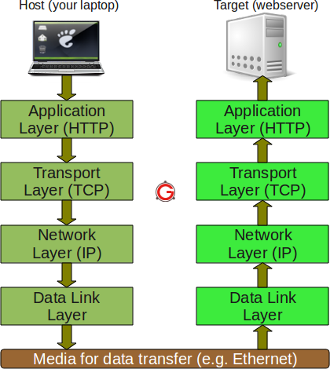
TCP/IP Model

Slide 12
Network Topologies
The physical way in which all the computers in a network are connected
is known as network topology.
Some common network topologies are:
i) Bus
ii) Star
iii) Ring
iv) Mesh

Slide 13
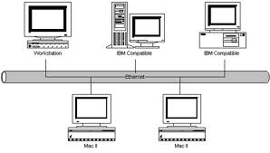
Bus Topology
Bus network use a single cable to connect all devices, attached or tapped into it with
an interface connector. A device wanting to communicate with another device on the
network sends a broadcast message onto the cable that all other devices see, but
only the intended recipient actually
accepts and processes the message.
Advantages:
Easy to connect a computer
or peripheral to a linear bus.
Requires less cable length
than a star topology.
Disadvantages:
Entire network shuts down if there is a break in the main cable.
Terminators are required at both ends of the backbone cable.
Difficult to identify the problem if the entire network shuts down.
Not meant to be used as a stand-alone solution in a large building.

Slide 14
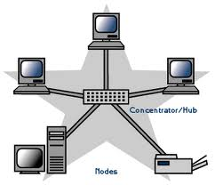
Star Topology
The star topology is the most popularly used topology.
A star network has a central concentrator/hub(switch or router).
Devices typically connect to the hub with Unshielded Twisted Pair (UTP) Ethernet cable.
Compared to the bus topology, a star network generally requires more cable.
The failure in any star network cable will only shut down one computer's network access and not the entire LAN.
If the hub fails, the entire network fails.
Advantages:
Easy to install and wire.
Easy to expand the network.
Failure of one terminal or part of the network
does not affect the function of the network.
No disruptions to the network
when connecting or removing devices.
Easy to detect faults and to remove parts.
Disadvantages:
Requires more cable length than bus topology.
If the hub fails, nodes attached are disabled.
More expensive than bus topology because of the cost of the concentrator/hub(switch or router).

Slide 15
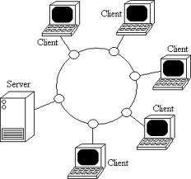
Ring Topology
In a ring network, every
device has exactly two
neighbours for
communication
purposes.
All messages
travel through a ring
in the same direction
(either "clockwise" or "counter clockwise").
A failure in any cable or device breaks the loop and can shut-down the entire network.

Slide 16
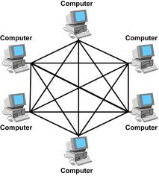
Mesh Topology
In a mesh network, messages sent can take any of several possible paths from source to destination.
Some WANs, most notably
the Internet, employ mesh
routing.
A mesh network in which
every device connects to
every other is called a full
mesh.

Slide 17
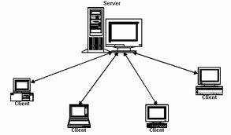
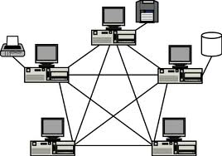
Modes of Configuration
There are two modes of configuration in a Computer Network:
1. Client Server Model 2. Peer-to-Peer Model
Client Server Model:
The Domain Controller(DC) is the Heart of the Client Server Model.
The DC contains the username and password, and authenticates the users.
The Computers or Clients will connect to the DC throw a Switch.
Whenever the DC fails the Additional Domain Controller(ADC) takes over the function.
Disadvantage: The operating system of Client-Server Model is 8 to 10 times costlier
than the operating system of normal Desktop.

Slide 18
Client–Server Computing
The computer that manages network resources is called server
Disk drives (File servers)
Printers (Print servers)
Network traffic (Network servers)
Processes database queries(Database Servers)
Audio/Video programme(Audio/Video Servers)
Process takes place
on the server, and
on the client
Servers
Store and protect data
Process requests from the clients
Clients
Make requests
Format data on the desktop

Slide 19
Client - Server Model
Suited for large networks of more than 10 Computers
The central authentication of user name and password provides better security.
Disk space can be allocated to individual users depending on requirement.
Three level access control with NTFS(New Technology File System) file system like file level, folder level and share level.
Remote Access from outside the city is possible.
Each user can be provided with individual e-mail address.

Slide 20
Peer-to-Peer Model
Suited for small network of 10 computers.
There is no DC and no Central Authentication.
All the systems are given static IP Addresses.
No administrator is involved as computers are operated mostly by individual users.
This system has only one access control i.e. share level access control.
It is very easy to maintain this system as the number of computers are less.
The operating system is cheaper compared to Server operating system.

Slide 21
Network Components(contd.)
Network Medium:
It is the physical medium over which the network traffic is transmitted.
It describes all the cabling and connectors used to connect a network.
The Network Medium can be:
Coaxial cable
Twisted pair cable
Fiber optic cable
Wireless
Coaxial Cables: There are two variants of co-axial cables
The Thick Ethernet or 10Base5 cable(inflexible cable with 0.4 inch dia.)
The Thin Ethernet or 10Base2cable(flexible cable with 0. 2 inch dia.)
These cables support transmission of Baseband data at a maximum
bandwidth of 10Mbps and the maximum cable segment length is 500m for
thick cable and 200m length for thin cables.

Slide 22
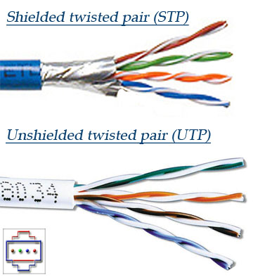
Network Components(contd.)
Twisted pair cable: A twisted pair cable consists of two insulated copper wires of 1mm thick. The wires are twisted about each other to reduce electromagnetic interference called crosstalk. The greater the number of twists the greater is the reduction in crosstalk.
The Ethernet 10BaseT specifications provides for twisted pair cables
(maximum length 100m) which come in two types:

Slide 23
Network Components(contd.)
There are several variants(categories) of twisted pair cables
defined by EIA/TIA:
Category-1(CAT-1): Currently unrecognized by EIA/TIA.
Category-2(CAT-2): Currently unrecognized by EIA/TIA.
Category-3(CAT-3): Support 10 Mbps Ethernet networks.
Category-4(CAT-4): Currently unrecognized by EIA/TIA.
Category-5(CAT-5): Support fast 100 Mbps Ethernet network.
Category-5e(CAT-5e): Support Gigabit(1000 Mbps) Ethernet network.
Category-6(CAT-6): Support Gigabit(1000 Mbps) Ethernet network.
Category-7(CAT-7): Proposed for ultrafast 10 Gbps Ethernet network.
CAT-5 is the most popular of all twisted pair.
Note: Most of the Ethernet twisted pair cables use RJ-45 Connector.

Slide 24
Straight through And crossover Cables
When you connect two devices of different types together, you use a straight through cable.
When you connect two devices of the same type together, you use a crossover cable.

Slide 25
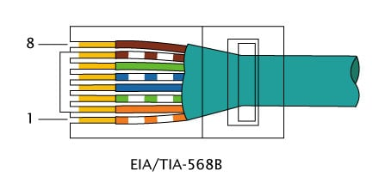
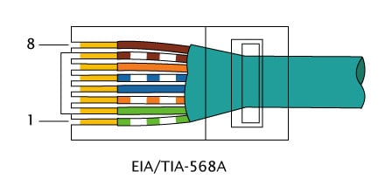
Crossover cable
Straight through cable

Slide 26
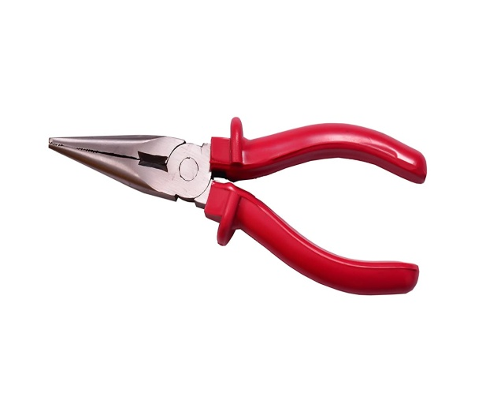
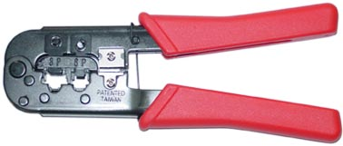
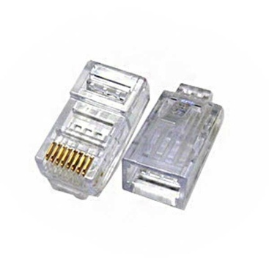
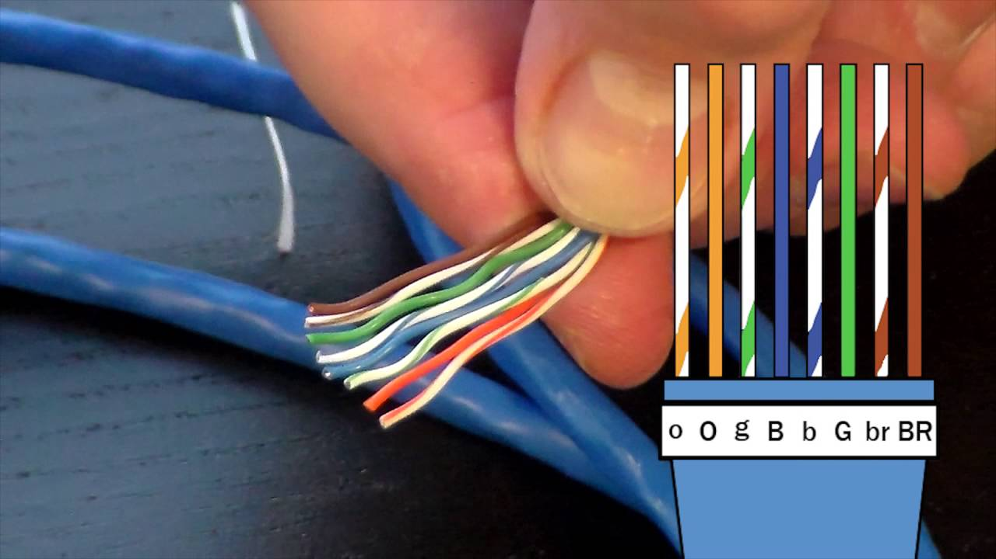
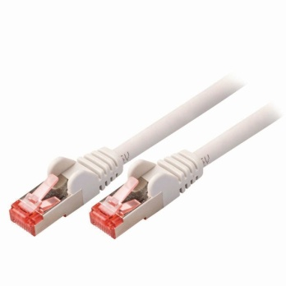
How to make a
LAN / RJ45 Cable?
Crimper Tool
Plier
RJ45 Male
RJ45 Male
RJ45 Cables

