Slide 1
IP ADDRESS
Q. What is IP address? Ipv4 and ipv6??
Q. How to check ip addresses ? What goes hand in hand with ip address?
Q. What is the maximum bit in an octat that can be represent in an ipv4 address?
Q. How to identify the Network ID and the Host id in an IP address?

Slide 2
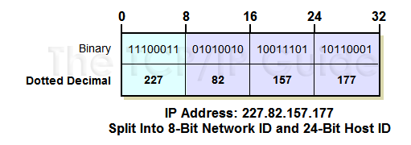
IP Address Size and Notation
IP address is just a 32-bit binary number.
split it into four eight-bit octets and each octet is converted in decimal number.

Slide 3
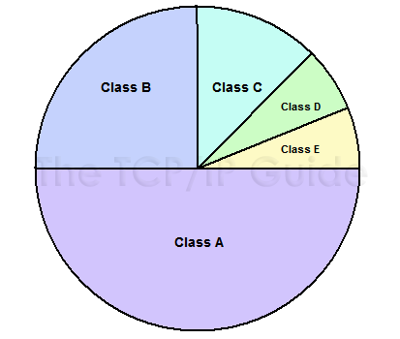
Classful addressing
Fig: Division of IPv4 Address Space Into Classes

Slide 4
Why we need classful addressing?
Why we divide them into class A,B,C etc?
How to Identify which class
the IP address belong?
First octat range | Class Name
1-126 | A
128-191 | B
192-223 | C
224-239 | D
240-255 | E

Slide 5
IP Address Classes and Class Characteristics and Uses
IP Address Class | Number Of Network ID Bits | Number Of Host ID Bits | Intended Use
Class A | 8 | 24 | Unicast addressing for very large organizations with hundreds of thousands or millions of hosts to connect to the Internet.
Class B | 16 | 16 | Unicast addressing for medium-to-large organizations with many hundreds to thousands of hosts to connect to the Internet.
Class C | 24 | 8 | Unicast addressing for smaller organizations with no more than about 250 hosts to connect to the Internet.
Class D | n/a | n/a | IP multicasting.
Class E | n/a | n/a | Reserved for “experimental use”.

Slide 6
Q. How many valid IP address
We can use in class C?
How do you calculate host number?
Q. What is Network ID, Host ID and Broadcast ID?
Q. Calculate no of host , NID & BID for Class A & B?

Slide 7
Facts
According to CISCO, the ideal number of host in a Network should not exceed 500. If it increases more than 500 the traffic will be very huge and network will be inefficient.
What is a Gateway?
What is Private IP ?
What is Public IP ?

Slide 8
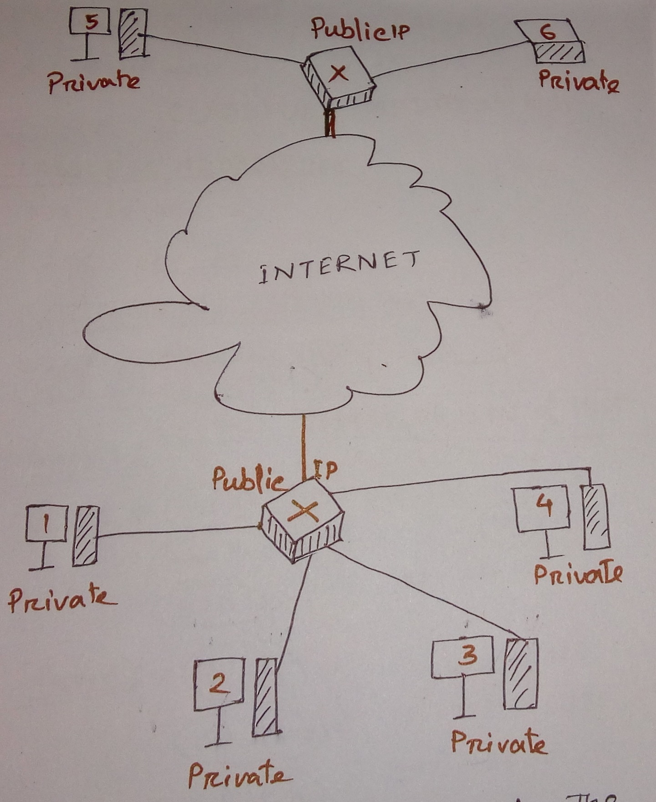

Slide 9
What is a Classless IP Addressing?
What is Subnetting and Supernetting?
No of hosts :
Lets say h= Host bits
and n= Network bits
Then, Total Number of host = (2^h)-2
Total no of subnet :
Total No of Subnet= 2^n, where n is the network bits

Slide 10
Problems
A network of IP address 192.168.25.40 having 30 numbers of hosts. Find out Subnet mask, Total number of subnet, 1st , 2nd , last and IP containing subnet with network ID and Broadcast ID.
A network of IP address 115.56.7.7 having 62 numbers of hosts. Find out Subnet mask, Total number of subnet, 1st , 2nd , last and IP containing subnet with network ID and Broadcast ID.
A network of IP address 175.252.1.6 having 126 numbers of hosts. Find out Subnet mask, Total number of subnet, 1st , 2nd , last and IP containing subnet with network ID and Broadcast ID.

Slide 11
Routing Table for Class C
Value | 128 | 64 | 32 | 16 | 8 | 4 | 2 | 1
Bits | 1 | 1 | 1 | 1 | 1 | 1 | 1 | 1
Borrowed Bits | 1 | 2 | 3 | 4 | 5 | 6
Mask Value/Subnet Mask | 128 | 192 | 224 | 240 | 248 | 252
No of Subnet | 2 | 4 | 8 | 16 | 32 | 64
No of Host | 126 | 62 | 30 | 14 | 6 | 2
CIDR | /25 | /26 | /27 | /28 | /29 | /30
Block Size | 128 | 64 | 32 | 16 | 8 | 4

Slide 12
Requirements :
Create 3 Subnets
Use class C ip address 192.168.1.0
Determine Network id and Host id of all the subnets.
Find Network ID and Host ID for ip address 192.168.225.212 ……. /27.
Requirements :
Design a network with three Networks for Marketing , Sales and Management.
Marketing requires 60 Computer.
Sales requires 100 Computer.
Management requires 35 Computer.
Lets say, Ip address is 192.168.1.1

Slide 13
Routing Table for Class A & Class B
Value | 128 | 64 | 32 | 16 | 8 | 4 | 2 | 1
Bits | 1 | 1 | 1 | 1 | 1 | 1 | 1 | 1
Borrowed Bits | 1 | 2 | 3 | 4 | 5 | 6 | 7 | 8
Mask Value/Subnet Mask | 128 | 192 | 224 | 240 | 248 | 252 | 254 | 255
Place Value/ Block Size | 128 | 64 | 32 | 16 | 8 | 4 | 2 | 1

Slide 14
Question
FIND Network ID and Host ID of the following
20.120.47.225 /13
220.20.17.5 /27
10.10.7.17 /19
192.8.3.2 /18
117.1.4.5 /20

