Slide 1
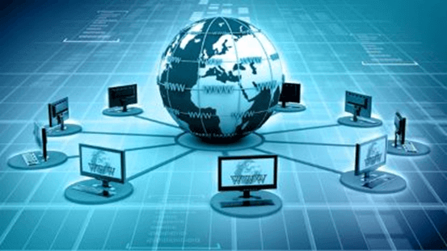
INTERNET
Internet is a global network that connects billions of computers across the world with each other and to the World Wide Web. It uses standard internet protocol suite (TCP/IP) to connect billions of computer users worldwide. It is set up by using cables such as optical fibers and other wireless and networking technologies.
At present, internet is the fastest mean of sending or exchanging information and data between computers across the world.

Slide 2
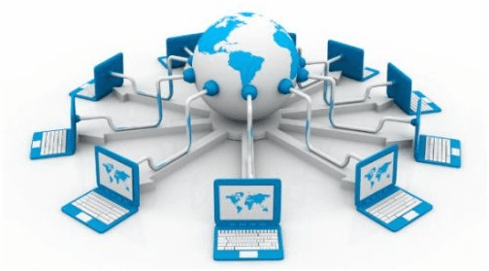
What is World Wide Web?
World Wide Web, which is also known as a Web, is a collection of websites or web pages stored in web servers and connected to local computers through the internet. These websites contain text pages, digital images, audios, videos, etc. Users can access the content of these sites from any part of the world over the internet using their devices such as computers, laptops, cell phones, etc.
The WWW, along with internet, enables the retrieval and display of text and media to your device.

Slide 3
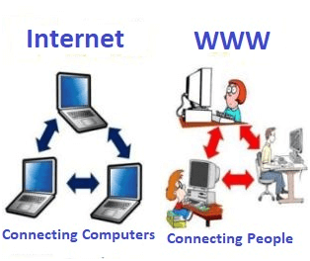
Internet VS World Wide Web
Internet is entirely different from WWW. It is a worldwide network of devices like computers, laptops, tablets, etc. It enables users to send emails to other users and chat with them online. For example, when you send an email or chatting with someone online, you are using the internet.
But, when you have opened a website like google.com for information, you are using the World Wide Web; a network of servers over the internet. You request a webpage from your computer using a browser, and the server renders that page to your browser. Your computer is called a client who runs a program (web browser), and asks the other computer (server) for the information it needs.

