Slide 1
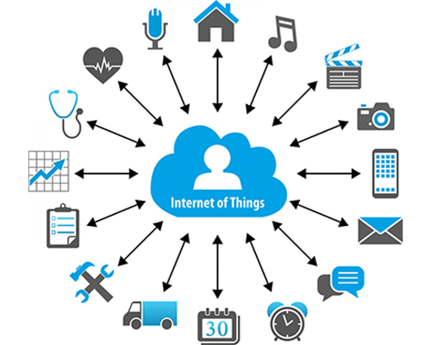
What is IoT?

Slide 2
Connecting everyday things embedded with electronics, software, and sensors to internet enabling to collect and exchange data without human interaction called as the Internet of Things (IoT).
The term "Things" in the Internet of Things refers to anything and everything in day to day life which is accessed or connected through the internet.
Let's us look closely at our mobile device which contains GPS Tracking, Mobile Gyroscope, Adaptive brightness, Voice detection, Face detection etc. These components have their own individual features, but what about if these all communicate with each other to provide a better environment?

Slide 3
Features of IOT
The most important features of IoT on which it works are connectivity, analyzing, integrating, active engagement etc.
Connectivity: Connectivity refers to establish a proper connection between all the things of IoT to IoT platform it may be server or cloud. After connecting the IoT devices, it needs a high speed messaging between the devices and cloud to enable reliable, secure and bi-directional communication.
Analyzing: After connecting all the relevant things, it comes to real-time analyzing the data collected and use them to build effective business intelligence. If we have a good insight into data gathered from all these things, then we call our system has a smart system.
Integrating: IoT integrating the various models to improve the user experience as well.
Artificial Intelligence: IoT makes things smart and enhances life through the use of data. For example, if we have a coffee machine whose beans have going to end, then the coffee machine itself order the coffee beans of your choice from the retailer.
Sensing: The sensor devices used in IoT technologies detect and measure any change in the environment and report on their status. IoT technology brings passive networks to active networks. Without sensors, there could not hold an effective or true IoT environment.
Active Engagement: IoT makes the connected technology, product, or services to active engagement between each other.
Endpoint Management: It is important to be the endpoint management of all the IoT system otherwise, it makes the complete failure of the system. For example, if a coffee machine itself order the coffee beans when it goes to end but what happens when it orders the beans from a retailer and we are not present at home for a few days, it leads to the failure of the IoT system. So, there must be a need for endpoint management.

Slide 4
Advantages of IoT
Efficient resource utilization: If we know the functionality and the way that how each device work we definitely increase the efficient resource utilization as well as monitor natural resources.
Minimize human effort: As the devices of IoT interact and communicate with each other and do lot of task for us, then they minimize the human effort.
Save time: As it reduces the human effort then it definitely saves out time. Time is the primary factor which can save through IoT platform.
Enhance Data Collection:
Improve security: Now, if we have a system that all these things are interconnected then we can make the system more secure and efficient.

Slide 5
Disadvantages of IoT
Security: As the IoT systems are interconnected and communicate over networks. The system offers little control despite any security measures, and it can be lead the various kinds of network attacks.
Privacy: Even without the active participation on the user, the IoT system provides substantial personal data in maximum detail.
Complexity: The designing, developing, and maintaining and enabling the large technology to IoT system is quite complicated.

Slide 6
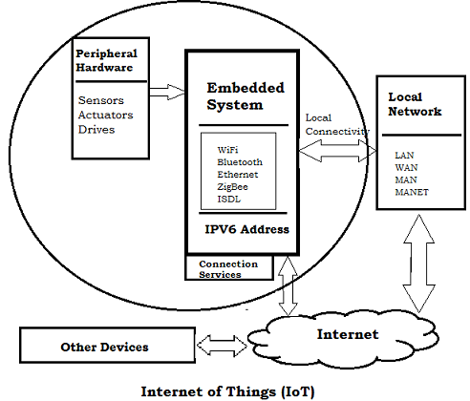
Embedded System in (IoT)
An embedded device system generally runs as a single application. However, these devices can connect through the internet connection, and able communicate through other network devices.

Slide 7
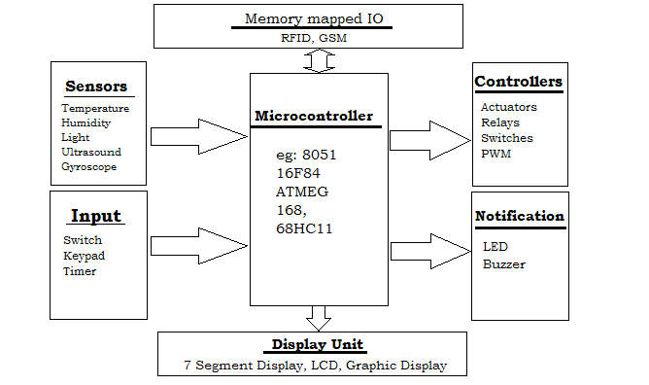
The embedded system can be of type microcontroller or type microprocessor. Both of these types contain an integrated circuit (IC).
The essential component of the embedded system is a RISC family microcontroller like Motorola 68HC11, PIC 16F84, Atmel 8051 and many more. The most important factor that differentiates these microcontrollers with the microprocessor like 8085 is their internal read and writable memory. The essential embedded device components and system architecture are specified below.

Slide 8
IoT Ecosystem
The IoT ecosystem is not easy to define. It is also difficult to capture its proper image due to the vastness and emerging possibility and the rapidity with which it is expanding in the entire sector. However, the IoT ecosystem is a connection of various kind of devices that sense and analyze the data and communicates with each other over the networks.
In the IoT ecosystem, the user uses smart devices such as smartphones, tablet, sensors, etc. to send the command or request to devices for information over the networks. The device response and performs the command to send information back to the user through networks after analyzed.
The typical IoT ecosystem is shown in below image, where the smarter devices send and receive data from the devices themselves in the environment that are integrate over network and Cloud Computing.
The IoT is itself an ecosystem of network devices that transfer the data. It is also well interconnected with Big Data and Cloud Computing.
Sensing, Embedded processing, Connectivity: The IoT ecosystem senses its surrounding like temperature, gyroscope, pressure, etc. and make the embedded processing using devices. These devices are connected through any type of devices such as GPS, WiFi, RFID, etc. over the networks.
Smart devices and environment, Cloud Computing, Big Data: The data transfer or receive through smart devices and environments are communicated through Cloud Computing or others Servers and stored as Big Data.
Technology, Software, Application: The IoT ecosystem uses any of different technologies, software and application to communicate and connect with smart devices and environment.
Users or groups of community: The product or services generated by the IoT ecosystem are consumed by the users or the group of communities to serve the smart life.

Slide 9
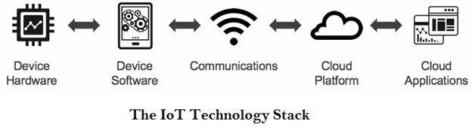
IoT Decision Framework
The IoT decision framework is much more important as the product or services communicates over networks goes through five different layers of complexity of technology.
Device Hardware
Device Software
Communications
Cloud Platform
Cloud Application
The IoT decision framework pays attention to six key decision areas in any IoT product. These decision areas are:
User Experience (UX)
Data
Business
Technology
Security
Standards & Regulations

Slide 10
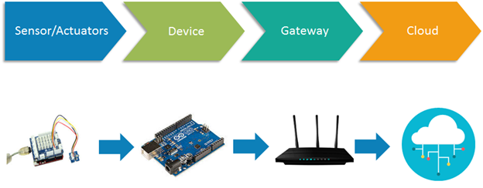
IoT Architecture
The IoT architecture differs from their functional area and their solutions. However, the IoT architecture technology mainly consists of four major components:
Components of IoT Architecture
Sensors/Devices
Gateways and Networks
Cloud/Management Service Layer
Application Layer

Slide 11
IoT Architecture
The IoT architecture is a fundamental way to design the various elements of IoT, so that it can deliver services over the networks and serve the needs for the future.
Following are the primary stages (layers) of IoT that provides the solution for IoT architecture.
Sensors/Actuators: Sensors or Actuators are the devices that are able to emit, accept and process data over the network. These sensors or actuators may be connected either through wired or wireless. This contains GPS, Electrochemical, Gyroscope, RFID, etc. Most of the sensors need connectivity through sensors gateways. The connection of sensors or actuators can be through a Local Area Network (LAN) or Personal Area Network.
Gateways and Data Acquisition: As the large numbers of data are produced by this sensors and actuators need the high-speed Gateways and Networks to transfer the data. This network can be of type Local Area Network (LAN such as WiFi, Ethernet, etc.), Wide Area Network (WAN such as GSM, 5G, etc.).
Edge IT: Edge in the IoT Architecture is the hardware and software gateways that analyze and pre-process the data before transferring it to the cloud. If the data read from the sensors and gateways are not changed from its previous reading value then it does not transfer over the cloud, this saves the data used.
Data center/ Cloud: The Data Center or Cloud comes under the Management Services which process the information through analytics, management of device and security controls. Beside this security controls and device management the cloud transfer the data to the end users application such as Retail, Healthcare, Emergency, Environment, and Energy, etc.

Slide 12
How is IoT transforming businesses?
In the Business Enterprise, IoT not only means to connect the devices to the Internet, however, it is more than that. Now, IoT is transforming the business enterprises by creating the opportunities to get smarter about the product, services, and the customer experience.
There are several ways through IoT is transforming the business. Some of them are mentioned below:
Improving Customer Experience
Greater Efficiency
More Data - More Opportunity
Creating New Business Models
Cost Reduction and Gain Productivity
Asset Tracking and Waste Reduction

Slide 13
IoT Devices
IoT devices are enlarging the internet connectivity beyond standard devices such as smartphones, laptops, tablets, and desktops. Embedding these devices with technology enable us to communicate and interact over the networks and they can be remotely monitored and controlled.
There are large varieties of IoT devices available based on IEEE 802.15.4 standard. These devices range from wireless motes, attachable sensor-boards to interface-board which are useful for researchers and developers.
IoT devices include computer devices, software, wireless sensors, and actuators. These IoT devices are connected over the internet and enabling the data transfer among objects or people automatically without human intervention.

Slide 14
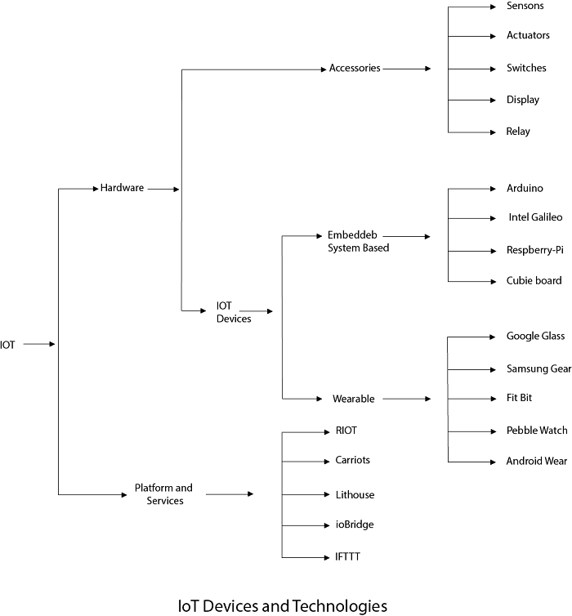

Slide 15
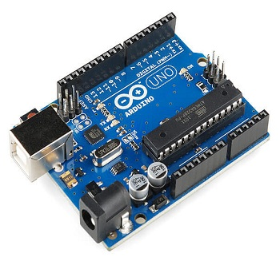
Arduino
Arduino devices are the microcontrollers and microcontroller kit for building digital devices that can be sense and control objects in the physical and digital world. Arduino boards are furnished with a set of digital and analog input/output pins that may be interfaced to various other circuits.

Slide 16
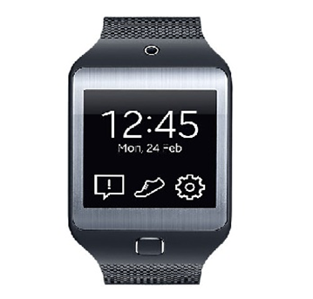
Smart Watch
This device receives alerts about Calls, emails and text messages, and it integrates with Device’s Health app.

Slide 17
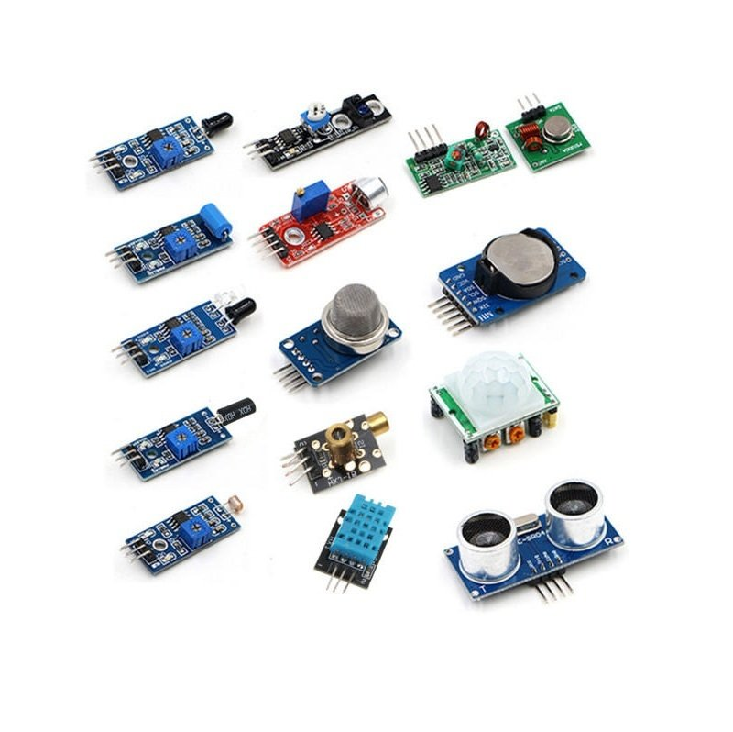
Sensors
A sensor is a device that detects and responds to some type of input from the physical environment. The specific input could be light, heat, motion, moisture, pressure, or any one of a great number of other environmental phenomena. The output is generally a signal that is converted to human-readable display at the sensor location or transmitted electronically over a network for reading or further processing.

Slide 18
Properties of IoT Devices
Some of the essential properties of IoT devices are mention below:
Sense: The devices that sense its surrounding environment in the form of temperature, movement, and appearance of things, etc.
Send and receive data: IoT devices are able to send and receive the data over the network connection.
Analyze: The devices can able to analyze the data that received from the other device over the internet networks.
Controlled: IoT devices may control from some endpoint also. Otherwise, the IoT devices are themselves communicate with each other endlessly leads to the system failure.

Slide 19
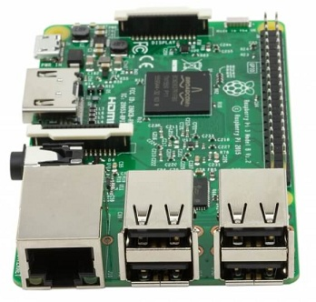
Major IoT Boards in Market
Raspberry Pi
Raspberry Pi is a much popular device used in building IoT project. The recently launched Raspberry Pi includes built-in WiFi and Bluetooth making the most compact and standalone computer. It provides a powerful environment to install a variety of programming packages such as Python, Node.js, LAMP stack, Java and much more. Using 40 GPIO pins, and four USB ports you can connect many peripherals and accessories to the Pi.

Slide 20
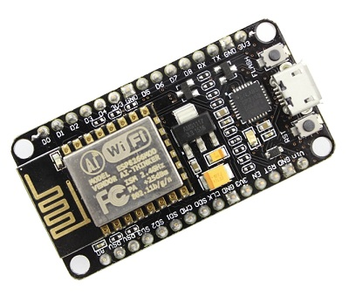
ESP8266
The ESP8266 is a low-cost Wi-Fi microchip with 32-bit microcontroller capability, standard digital peripheral interfaces. There are different types of ESP8266 boards are available for different needs. The primary goal of this board is to deal with the built-in Wifi through AT commands if used as device module, but you can 'program' using Arduino board however it also read and controls input/output, digital and analog.

Slide 21
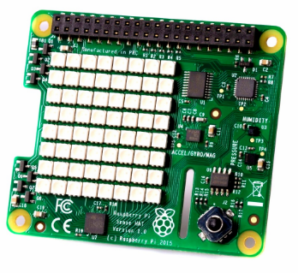
Sense HAT 8x8 RGB LED matrix
Raspberry Pi Sense HAT is an integrated sensor that can measure humidity, temperature, acceleration, and pressure. The 8x8 LED matrix display data read from Raspberry Pi Sense HAT sensors. The Sense HAT has an 8×8 RGB LED matrix includes the following sensors:
Gyroscope
Accelerometer
Magnetometer
Temperature
Barometric pressure
Humidity

Slide 22
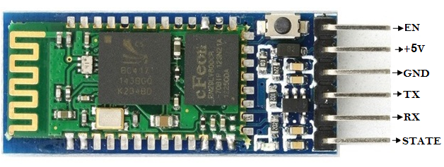
Bluetooth Module HC-05
Bluetooth Module HC-05 device is a 6 pins Bluetooth device that is used for wireless communication. Usually, this device connects small devices like mobile phones, PDAs and TVs using a short-range wireless connection to exchange data. It communicates with the microcontroller using the serial port (USART).
Pin Description
EN: It is the enable pin, when it is connected to 3.3V then model is enabled.
+5V: This is the supply pin for connecting +5V.
GND: It is the ground pin.
TX: It is the transmitter pin of the UART communication.
RX: It is the receiver pin of UART communication.
STATE: It indicates whether the module is connected or not. It acts as a status indicator.

