Slide 1
NPTEL
Video Course on Machine Learning
Professor Carl Gustaf Jansson, KTH
Week 1 Introduction to the
Machine Learning course
Video 1.3 Intelligent Autonomous Systems
and Artificial Intelligence

Slide 2
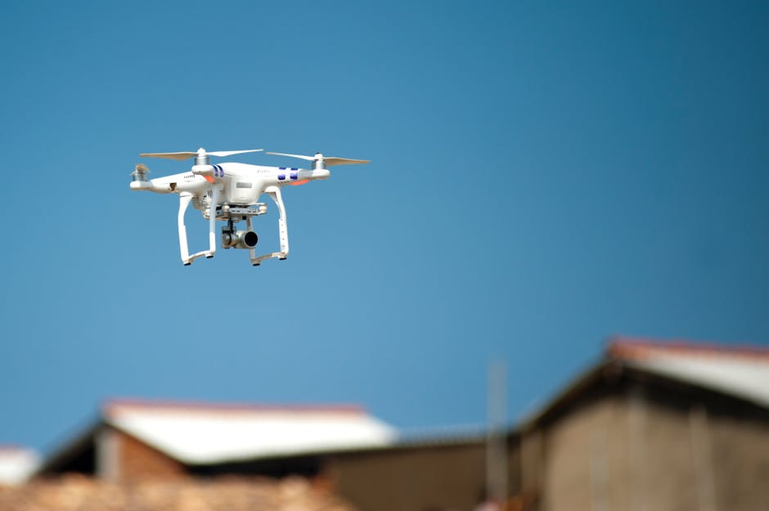
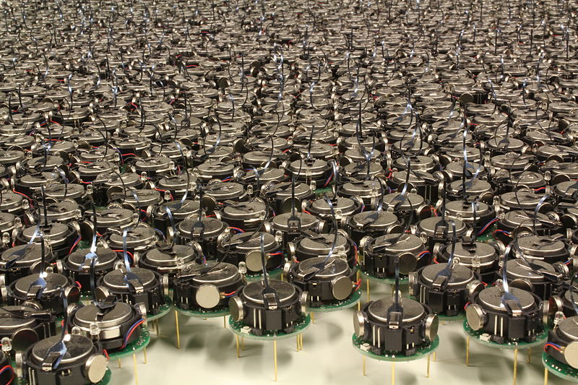
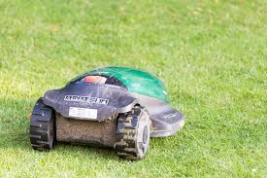
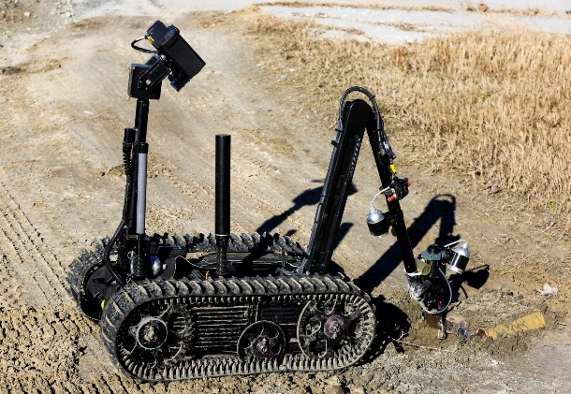

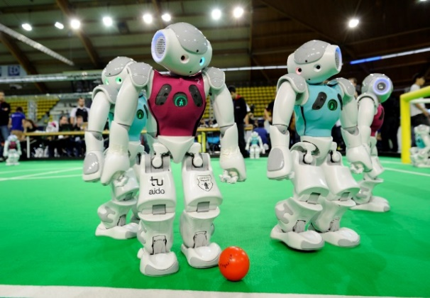
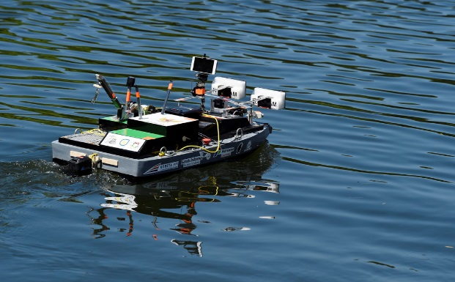
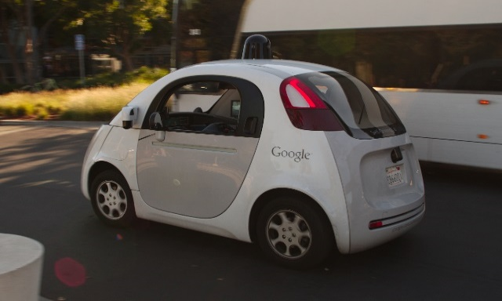
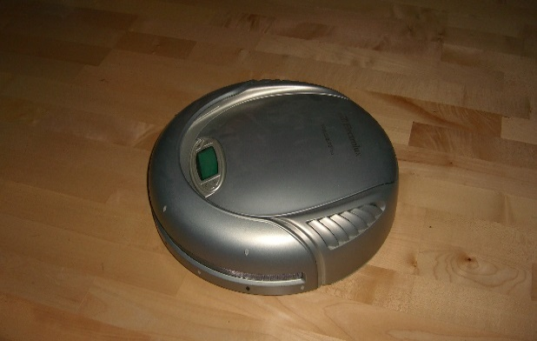
Concrete Examples of Intelligent Autonomous Systems

Slide 3
An Abstract view of an Intelligent Autonomous System
Modelling of the World
Perceiving
Sensing (measurements)
Datacollection
Aggregation and Abstraction
Thinking
Analysis
Reflection
Reasoning
Acting
Planning
Configuration of actions
Performing actions
Learning

Slide 4
Computer Science <-> Artificial Intelligence
Computer Science
Determinism Causality Certainty Completeness Quantitative
Invariance
Artificial Intelligence
Non-Determinism Uncertainty Non-completeness Mixed qualitative and Quantitative
Adaptivity
Mathematics Decisionmaking Theory Cybernetics Psychology Logic
Statistics Operational analysis Information Theory Neuro Science Linguistics
Cognitive Science

Slide 5
Classical sub-areas of Core Artificial Intelligence
Symbolic Sub-symbolic
Knowledge Representation
Predicate logic Neural Networks
Mathematical entities like sets, graphs and functions Genetically inspired strings
Automated Reasoning -> non algorithmic computation, search
Natural Deduction - > Logic Programming Propagation of values in Neural Networks
Production systems Genetic algorithms
Object oriented and functional prog.
Machine Learning
Inductive and abductive learning algorithms Back propagation in Neural networks
Genetic algorithms

Slide 6
The second tier of Artificial Intelligence techniques
Speech
technology
Machine
Perception
Language engineering
Computer Vision
Robotics
Intelligent
Interfaces
Core Artificial Intelligence
Game playing
Softbots
Multi
Agent
Systems
Expert Systems
Dedicated
Datamining
Optimization

Slide 7
Philosophical issues
Are there theoretical limits for the Intelligence of Artificial Systems?
Will Intelligent Artificial Systems dramatically reduce the human workforce?
Are Intelligent Artificial Systems dehumanizing human life?
What does it mean for an Intelligent Artificial Systems to be Benevolent or Malevolent?
Can Intelligent Artificial Systems be given programmed Ethics?
Could concept like intentions, consciousness and mind be meaningfully applied to Intelligent Artificial Systems?
Are Inteligent Artificial Systems an existential threat for the human race (The Singularity)?

Slide 8
NPTEL
Video Course on Machine Learning
Professor Carl Gustaf Jansson, KTH
Thanks for your attention!
The next lecture 1.4 will be on the
topic:
Applications of Machine Learning

