Slide 1
NPTEL
Video Course on Machine Learning
Professor Carl Gustaf Jansson, KTH
Week 2 Characterization of
Learning Problems
Video 2.3 Feature related issues

Slide 2
The Concept Learning task in terms of
Features, Feature vectors and the Object (Feature) Space
The classical way of viewing a scenario for a learning task is to:
Define an appropriate set of Features
View each Data-item as a Feature vector
Consider the Feature (Object) Space spanned by the Features.
Populate the Feature space with the Feature vectors (Data-items)
Find optimal multi-dimensional surfaces (Hyperplanes) in the Object Space that circumscribe the extensions of all concepts involved.
The engineering of Features is crucial for the complexity of the Object Space and as a consequence also crucial for the complexity of the learning problem.

Slide 3
The three basic cases for Feature Engineering
Case1: A reasonably well composed Set of Features is given based on domain theoretic considerations.
Case 2: A huge set of possible features is available that need to be reduced to a manageable size.
Case 3: Data-items are of non digital nature and relevant features need to be extracted from the primary form of the Data-items as a separate process.
We will discuss the first and third case shortly and then focus mostly on the second case.

Slide 4
Case1: A reasonably well composed set of Features is given based on domain theoretic considerations.
The ZOO dataset The features reflected
feature list in the Buffalo example of
conventional taxonomy
hair bilateral symmetry
feathers two body openings
eggs embryonic spinal cord
milk vertebra
airborne jaws
aquatic # of legs
predator mammary glands
toothed fur
backbone neocortex
breathes # of middle ear bones
venomous give birth to live kids
fins lack of epi-pubic bones
legs hoofed
tail middle to large
domestic chewing
catsize cloven or hoofed
The problem in this case is
neither a volume problem due to a large ungraspable set of possible features
nor a representation problem caused by dataitems in non-digital form.
Still a domain-based sanity check is relevant.
Terminological consistency and clear feature
definitions are of key importance.

Slide 5


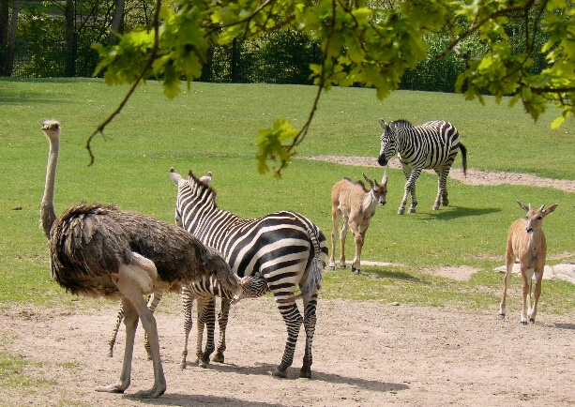

Case 3: Data-items are of a non digital nature and relevant features need to be extracted from the data-items as a separate process.
Features can be derived in a variety of manners ranging from totally manual, via manual/automatic hybrids to totally automated.
Every non-digital form of representation demands it own specialized techniques in the
automated case.
Each image is a Data-item

Slide 6
Case 2: Dimensionality or Feature Reduction
In most realistic cases the amount of possibly available features which can be used to characterize data items is overwhelmingly large. In general we want to reduce the number of considered features.
The ground for removing a specific feature is that it may be either redundant or irrelevant, and therefore can be removed without causing loss of information. The goal is to obtain an adequate set of informative, relevant and non-redundant features still able to describe the available data-set.
The underlying motivations for dimensionality reduction can be elaborated are as follows:
making models easier to interpret by human users.
avoiding the curse of dimensionality
reducing the risk for overfitting.
shortening the computation times for learning processes.

Slide 7
The curse of dimensionality
The curse of dimensionality refers to various phenomena that arise when analyzing and organizing data in high-dimensional spaces (typically with hundreds or thousands of dimensions) that do not occur in low-dimensional settings such as the three-dimensional physical space. The expression was coined by Richard E. Bellman considering problems in Dynamic Optimization.
The common theme of the problematic phenomena is that when the dimensionality increases, the volume of the space increases so fast that the available data become sparse.
This sparsity is problematic for any method that requires statistical significance, as the amount of data needed to support the result often grows exponentially with the dimensionality.
Also, organizing and searching data often relies on detecting areas where objects form groups with similar properties; in high dimensional data, however, all objects appear to be sparse and dissimilar in many ways, which prevents common data organization strategies from being efficient.

Slide 8
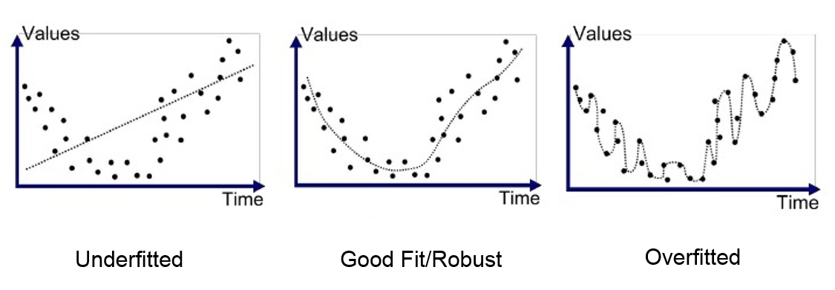
Over-fitting vs Under-fitting
Over-fitting is the production of a model that corresponds too closely or exactly to a particular data-set, and may therefore fail to fit additional data or predict future observations reliably. An over-fitted model is a model that contains more features than can be justified by the data-set.
Under-fitting occurs when a set of features cannot adequately capture the available data-set. An under-fitted model is a model where some features that would appear in a correctly specified model are missing. Such a model will tend to have poor predictive performance.

Slide 9
Feature selection vs Feature extraction
Feature selection is the process of selecting a subset of relevant features from the original set. The three main criteria for selection of a feature are:
informative-ness
relevance and
non-redundancy.
Feature extraction is the process of deriving new features either as simple combinations of original features or as a more complex mapping from the original set to the new set.
In both cases, the learning task is supposed to be more tractable in the resulting feature space than in the original.

Slide 10
NPTEL
Video Course on Machine Learning
Professor Carl Gustaf Jansson, KTH
Thanks for your attention!
The next lecture 2.4 will be on the
topic:
Scenarios for Concept Learning

