Slide 1
NPTEL
Video Course on Machine Learning
Professor Carl Gustaf Jansson, KTH
Week 3 Forms of Representation
Video 3.2 Decision Trees

Slide 2
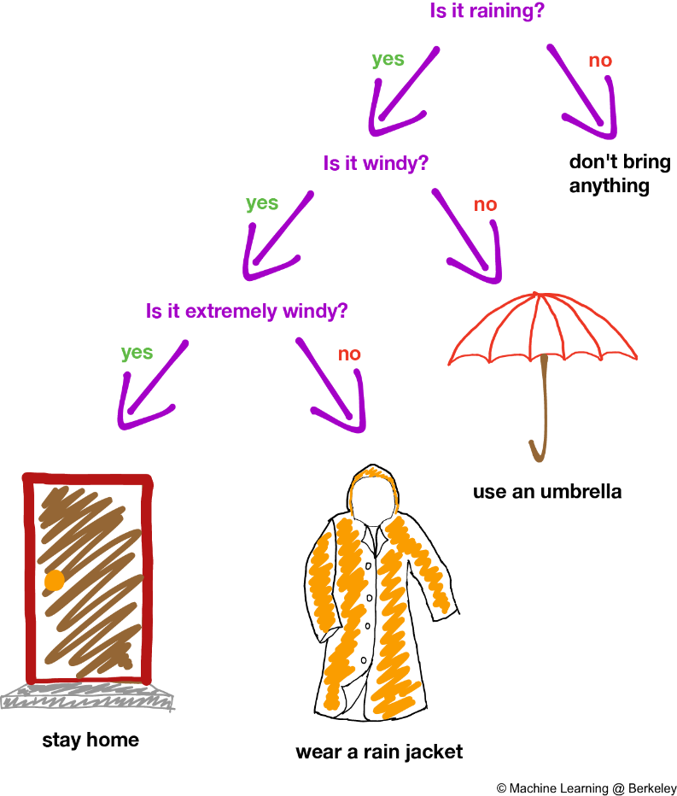
General characteristics
of this Representation
In decision analysis, a decision tree can be used to visually and explicitly represent decision alternatives and decision making options.
A decision tree is drawn upside down with its root at the top. Nodes in the
decision trees represent features, edges represent feature values or feature intervals (decision options) and leaves represent either discrete or continous
outcomes (classification and regression).
In the decisionmaking scenario, decision trees are typically used in a purely normative or prescriptive mode. The structure of the decision tree is then simply stipulated.
In a machine learning setting we want to build up classification or regression decision trees from data-sets collected in some domain. The challenge here is to design an optimal tree design so that the tree optimizes the fit of considered data-items and the predictive performance for still unseen data-items.

Slide 3
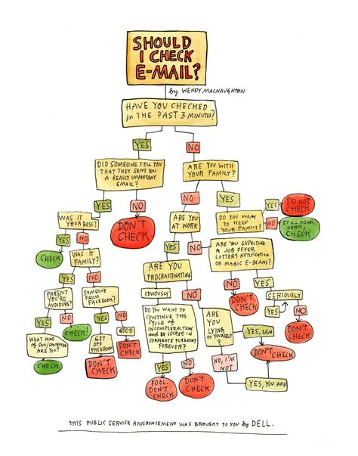
Interdisciplinary sources of inspiration for this Representation
Decision trees are inspired by
simple models for common sense
decision making in Economy
and Business

Slide 4

Core components and Problem solving for this Representation
A decision tree is drawn upside down with its root at the top.
Nodes in the decision trees represent features.
Edges represent feature values or feature intervals.
Leafes represent discrete or continous
Outcomes.
The use of tree is to start from the top and evaluate the values of features in the given order eventually ending up with a unique outcome.

Slide 5
Learning for this Representation
In a machine learning setting we want to build up decision trees for a realistic domain with many features and many data-items. Decision trees analysis are of two main types:
Classification tree analysis when the leaves are the classes
Regression tree analysis when the leaves are real numbers or intervals
The challenge is to design a tree such that this tree optimizes the fit of considered data-items and the predictive performance for still unseen data-items (minimal prediction error).
Building the tree from from the top and downward, the issues is to choose and order features for discrimination in an optimal way.
There are several approaches that can be combined in Decision Tree learning techniques:
use information theoretic measures to guide the selection and order of features (e.g Information gain and Gini impurity)
prune the tree at a later stage
generate several decision trees in parallel (e.g. random forest).
always prefer the simplest of equivalent trees (Occam´s razor).
.

Slide 6
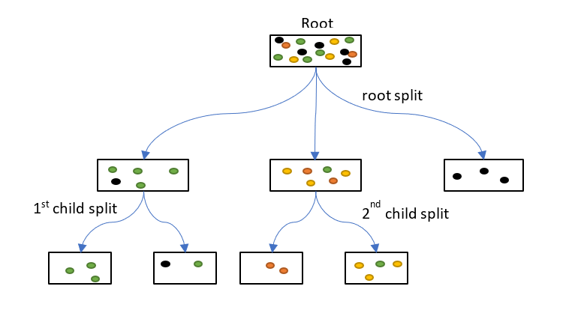
A specific tree design will hierarchically partition
the set of considered data-items

Slide 7
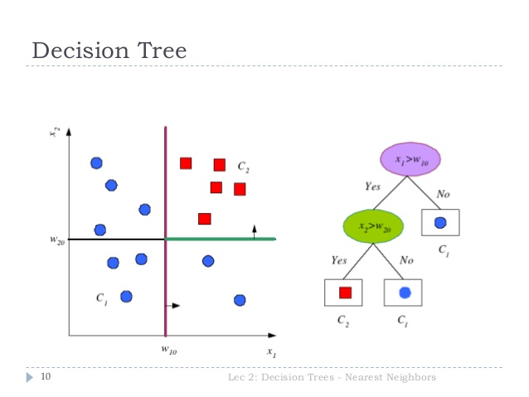
A specific tree design will define sub-regions of the feature space

Slide 8
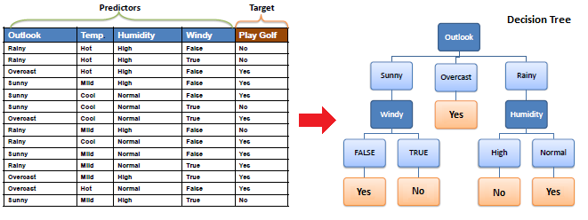
Example 1

Slide 9
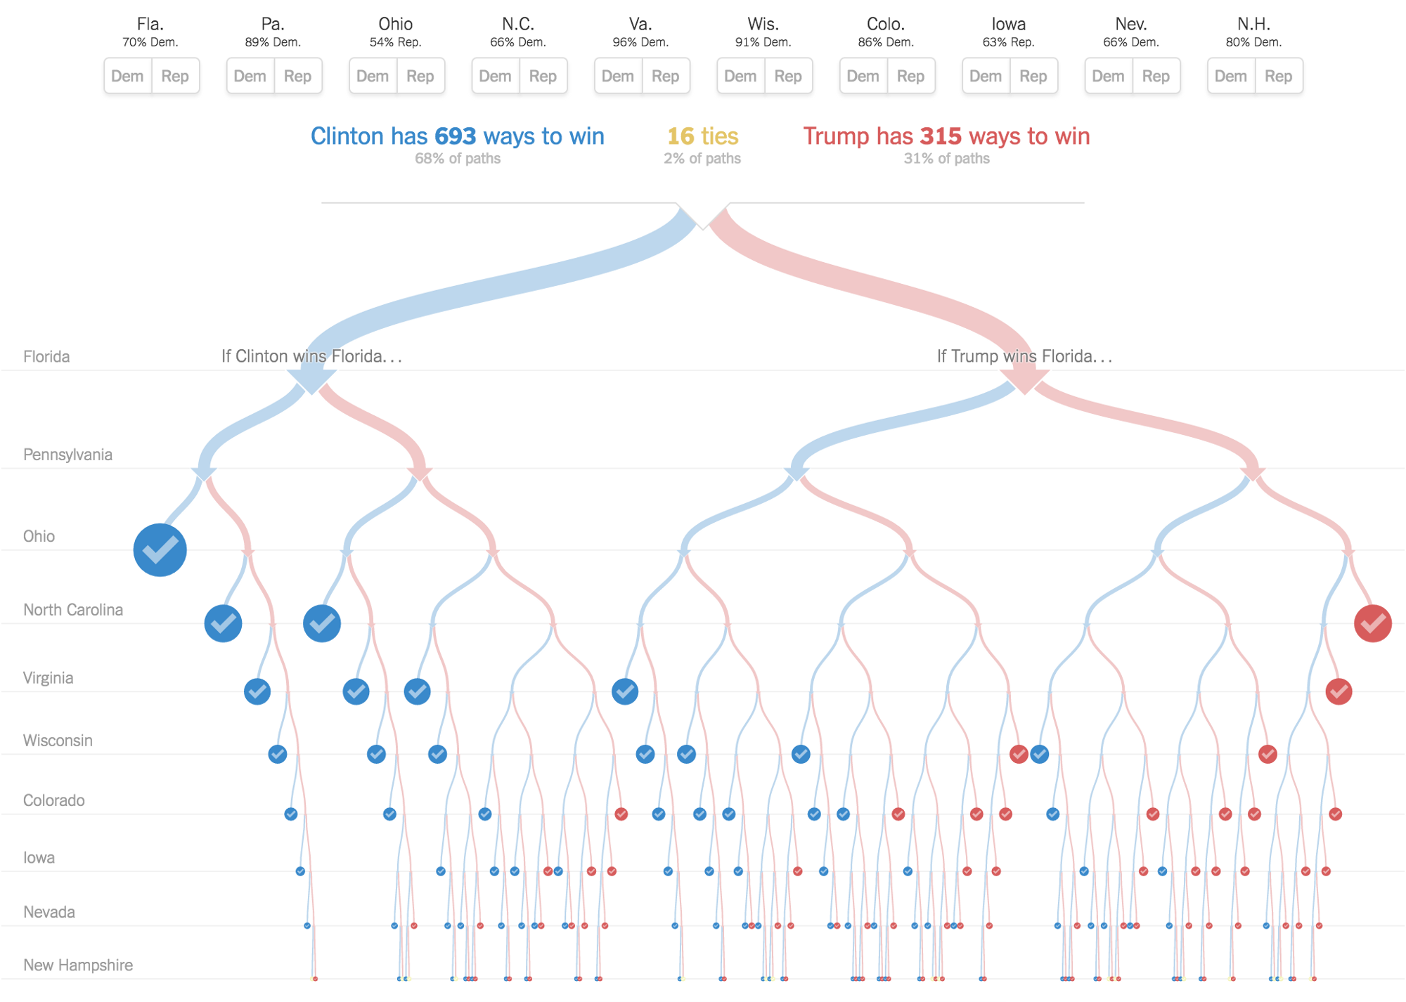
Example 2 - analysis of consequences of election wins in US states

Slide 10
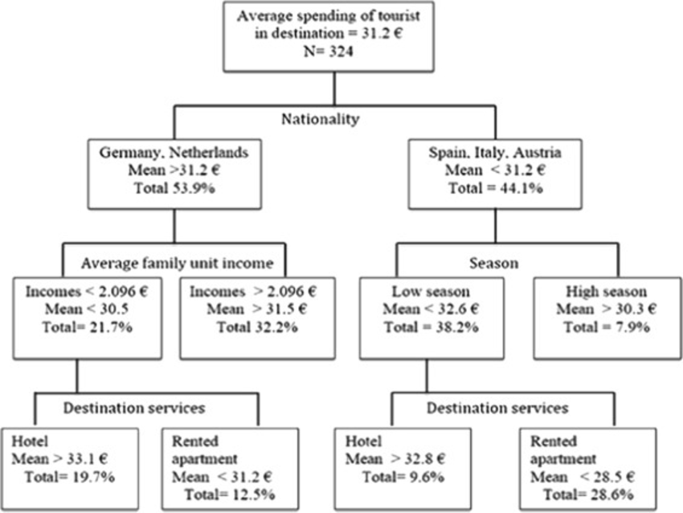
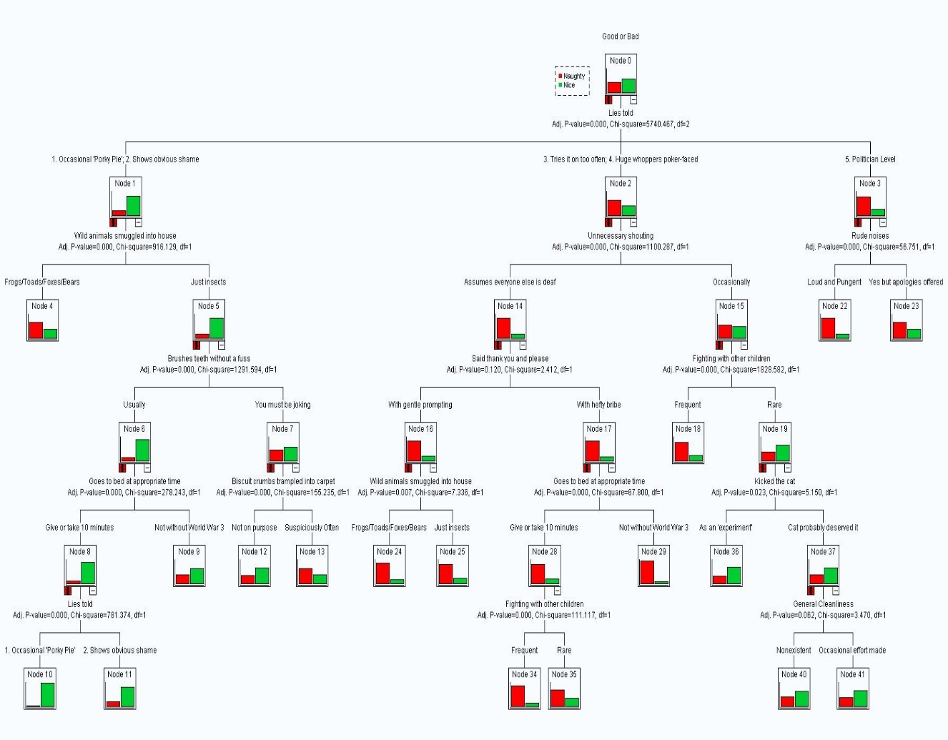
Example 3 and 4

Slide 11
NPTEL
Video Course on Machine Learning
Professor Carl Gustaf Jansson, KTH
Thanks for your attention!
The next lecture 3.3 will be on the topic:
Bayesian Belief Networks

