Slide 1
NPTEL
Video Course on Machine Learning
Professor Carl Gustaf Jansson, KTH
Week 3 Forms of Representation
Video 3.3 Bayes (ian) Belief Networks

Slide 2
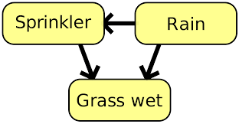
General characteristics
of this Representation
Abbreviation : BBN (Bayesian Belief Network)
Synonyms: Bayes (ian) network, Bayes(ian) model, Belief network, Decision network, or probabilistic directed acyclic graphical model.
A BBN is a probabilistic graphical model that represents a set of variables and their conditional dependencies via a Directed Acyclic Graph (DAG).
BBNs enable us to model and reason about uncertainty. BBNs accommodate both subjective probabilities and probabilities based on objective data.
The most important use of BBNs is in revising probabilities in the light of actual observations of events.

Slide 3
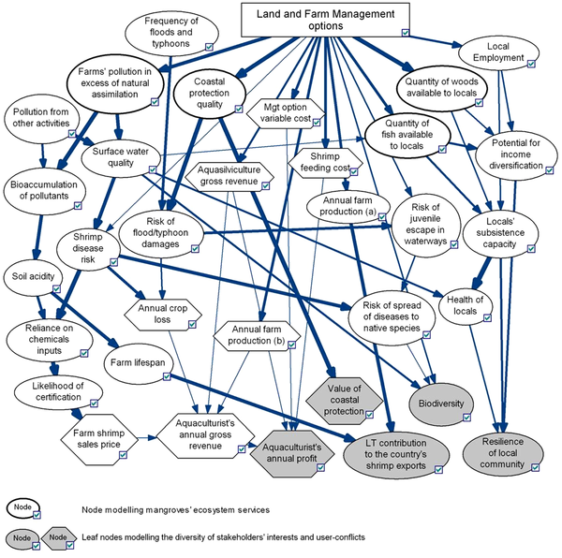
Interdisciplinary inspiration for this Representation
Bayesian probability is an interpretation of the concept of probability, in which, instead of frequency of some phenomenon, probability is interpreted as a reasonable expectation representing
a state of knowledge or
quantification of a personal belief.
In the Bayesian view, a probability is assigned to a hypothesis, in contrast to the frequentist case where a hypothesis is tested without being assigned a probability.
The Bayesian interpretation of probability can be seen as an extension of propositional logic that enables reasoning with hypotheses, i.e., the propositions whose truth or falsity is uncertain.

Slide 4
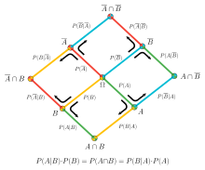
Bayes theorem
P(A) prior probability for A
P(B) prior probability for B
P(B|A) conditional probability for B given A
P(A|B) conditional probability for A given B
P(A, B) joint probability for A and B
P(A,B) = P(B|A) * P(A)
P(A|B) = P (B|A) * P(A) / P(B) Theorem
Intuitive meaning: Infering a conditional probability
for a cause given a symptom.
A
B

Slide 5
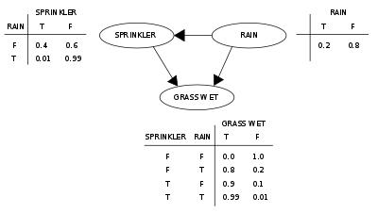
Core components of this Representation
Nodes represent variables in the Bayesian sense: observable quantities, hidden variables or hypotheses. Edges represent conditional dependencies.
Each node is associated with a probability function that takes, as input, a particular set of probabilities for values for the node's parent variables, and outputs the probability of the values of the variable represented by the node.
Prior Probabilities: e.g. P(RAIN)
Conditional Probabilities: e.g. P(SPRINKLER | RAIN)
Joint Probability Function: P(GRASS WET, SPRINKLER, RAIN) =
P(GRASS WET | RAIN, SPRINKLER) * P(SPRINKLER | RAIN) * P ( RAIN)
Typically the probability functions are described in table
form.
P(SPRINKLER | RAIN) P ( RAIN)
P(GRASS WET | RAIN, SPRINKLER)

Slide 6
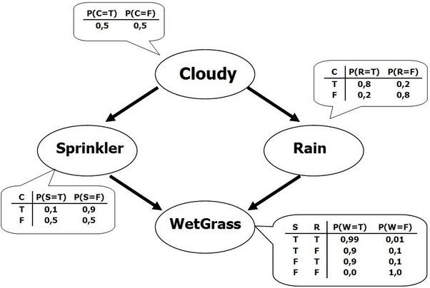
A related example

Slide 7
Conditional Independence
Nodes that are not connected by any path represent variables that are conditionally independent of each other.
e.g. Sprinkler and Rain in the related example are conditionally independent
P(Sprinkler|Cloudy, Rain) = P(Sprinkler|Cloudy)
This joint probabilities for the network can be calculated as.
P(Wetgrass, Sprinkler, Cloudy, Rain)=
P(Wetgrass | Sprinkler, Rain) * P(Sprinkler | Cloudy) * P(Rain | Cloudy) * P (Cloudy)

Slide 8
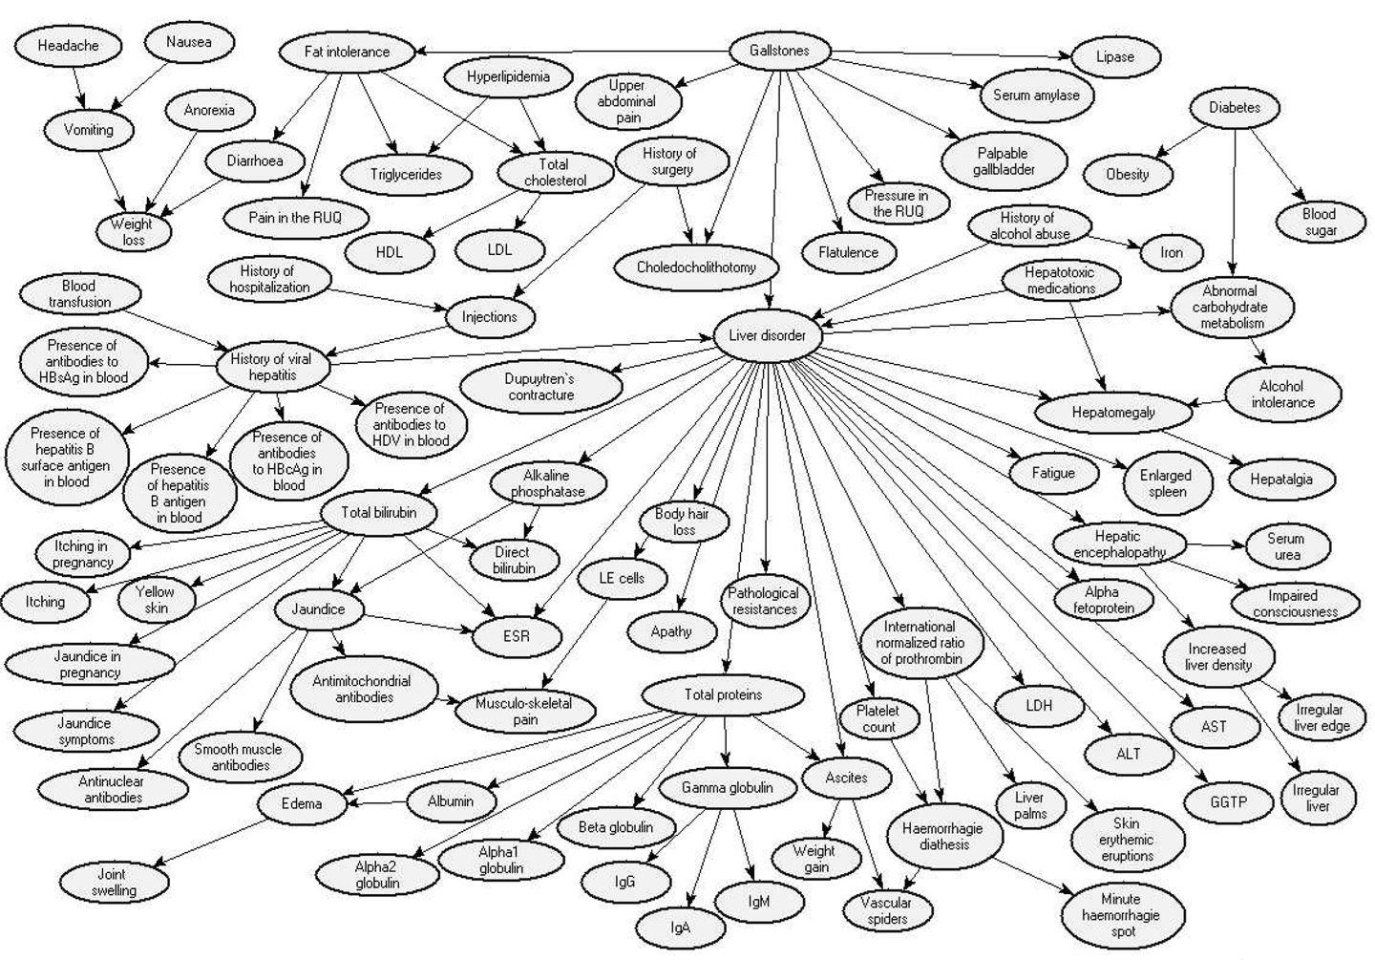
Structural aspects of this Representation
In contrast to toy examples, realistic networks are large

Slide 9
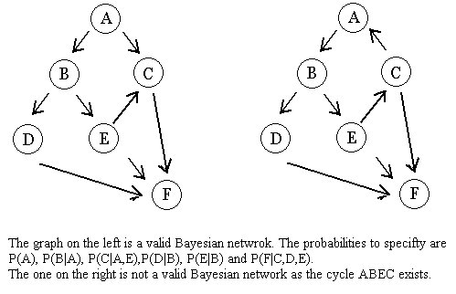
Structural aspects of this Representation
A valid DAG NOT a DAG because of the cycle ABEC

Slide 10
Three kinds of substructures in Bayesian networks
Sequence
Convergence
Divergence
A
B
C
A B
C
A
B C

Slide 11
Problemsolving for this Representation
A Bayesian network is a complete probabilistic model of the variables and their relationships describing effects in terms of causes.
Inferences typically aims to update our beliefs concerning causes in the light of new evidence.
Backward inferences in a Bayesian network can be viewed as the answering of queries about the state of a subset of variables (the hypothesis variables) when other variables (the evidence variables) are observed.
Bayesian inference derives the posterior probability of the subset of hypothesis variables through systematic use of Bayes theorem : P(H|E) = P (E|H) * P(E) / P(H).
Inferences of this kind can be recursively applied throughout the whole structure.
H H
P(E|H) P(H|E)
E E

Slide 12
Learning for this Representation
PARAMETER learning
Learning parameters (conditional probabilities)
given a fixed variable structure
STRUCTURE learning
Learning the variable structure
Learning hidden variables (non observables)

Slide 13
NPTEL
Video Course on Machine Learning
Professor Carl Gustaf Jansson, KTH
Thanks for your attention!
The next lecture 3.4 will be on the topic:
Neural Networks

