Slide 1
NPTEL
Video Course on Machine Learning
Professor Carl Gustaf Jansson, KTH
Week 3 Forms of Representation
Video 3.4 Artificial Neural Networks

Slide 2
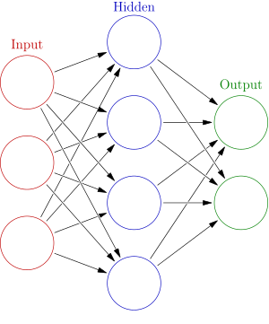
General characteristics of this Representation
Abbreviation: ANN (Artificial Neural Network)
An ANN is a network of nodes (units) called Artificial Neurons connected by 'edges'. The corresponding graph is directed.
Edges typically have a weight that can be adjusted. The weight increases or decreases the strength of the connection.
Artificial Neurons have a threshold such that the signal is only sent if the aggregate signal from all input edges crosses that threshold.
The output of each Artificial Neuron is computed by some non-linear function of the sum of its inputs.
Artificial Neurons are aggregated into layers. Different layers may perform different kinds of transformations on the inputs.
Signals travel from the first layer (the input layer), to the last layer (the output layer), possibly after traversing the layers multiple times. Hidden layers may have loops (Recurrent Neural Networks).

Slide 3
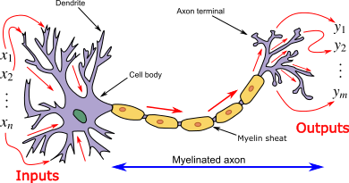
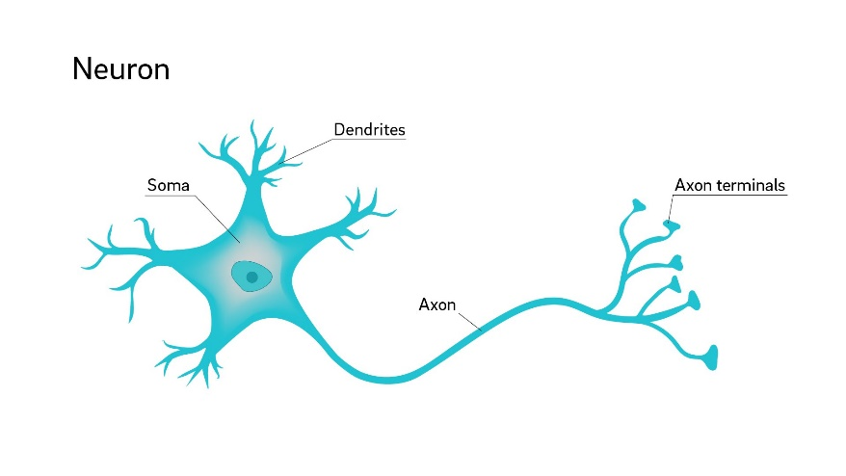
Interdisciplinary sources of inspiration for this representation
ANN are inspired by the way neuron systems work in the human (animal) nervous system as investigated
in Neuro Science.
A Neuron, is an electrically excitable cell that receives, processes, and transmits information
through electrical and chemical signals.
A typical neuron consists of a cell body (soma), dendrites, and an axon. Dendrites are thin structures that arise
from the cell body, often extending for hundreds of micrometers and branching multiple times.
An axon is a special cellular extension that arises from the cell body and travels for a distance,
as far as 1 meter in humans. Neurons receive signals via the dendrites and
send out signals down the axon.

Slide 4
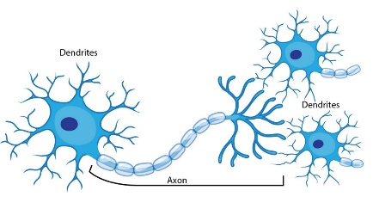
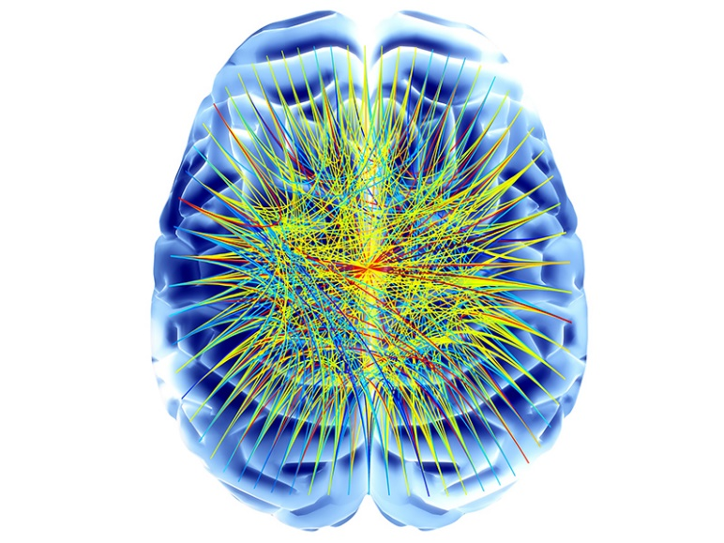
Neurons form huge structures and process in parallell
The human brain is assumed to have in the order of
100 Billion neurons and 10 000 times as many connections
with the potential of large scale parallell activity.

Slide 5
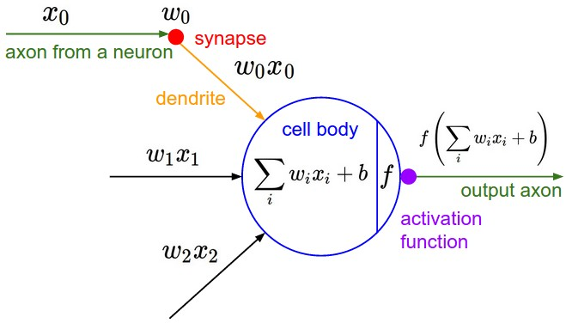
Core Representation and Computation
components of this Representation
Abstract model of an ANN unit : A unit or node of a ANN is engineered with inpiration from the nervous system according to the simple model below:

Slide 6
The core computation of an ANN unit
An ANN network consists of units and connections between units, where the output of unit i = ai is the input to unit j. i is considered the predecessor of j and j the successor of i.
Each connection is assigned a Weight wij.
Each node has an activation treshold. The negation of the threshold is termed Bias (b, for node j =bj)
The weighted inputs are summed together with the bias: = Sum wij * ai + bj
If Sum wij * ai + bj > 0 the output of unit j is calculated as
aj = f ( Sum wij * ai + bj) where f is a so called activation function.

Slide 7
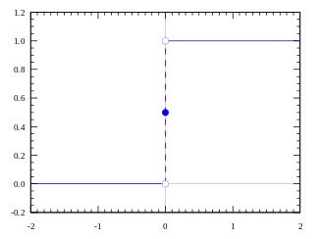
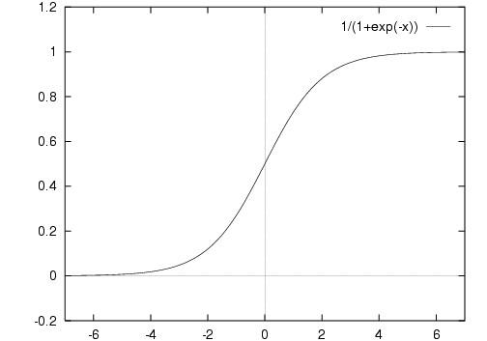
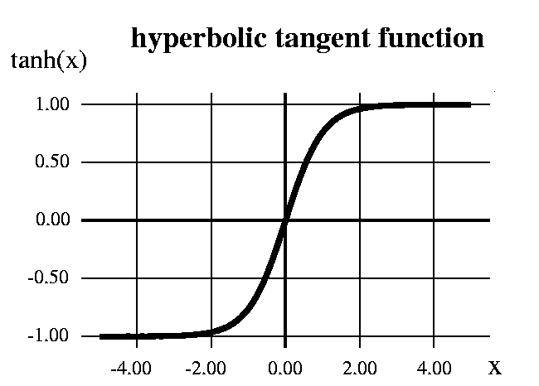
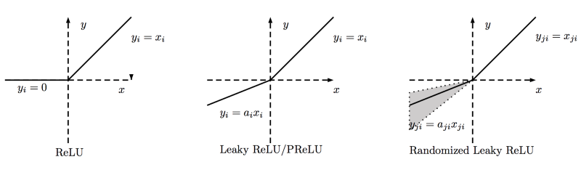
Selection of Activation Functions
Sigmoid
Step function
ReLU = Rectified Linear Unit

Slide 8
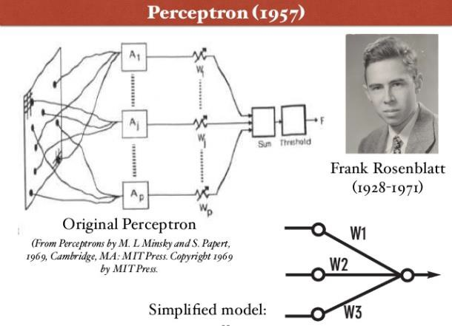
Structural aspects of this Representation

Slide 9
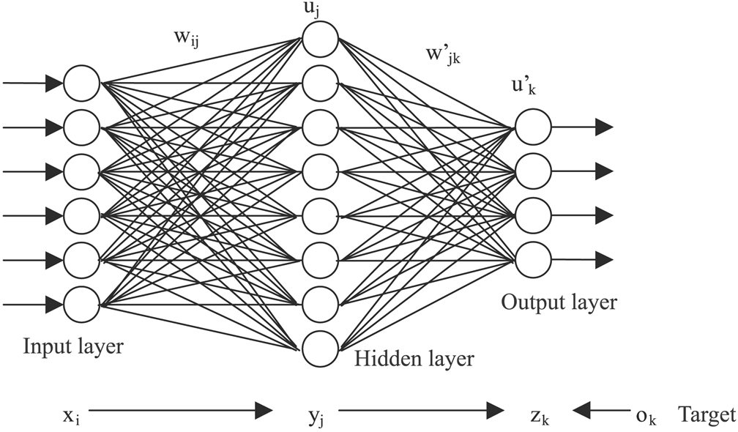

Slide 10
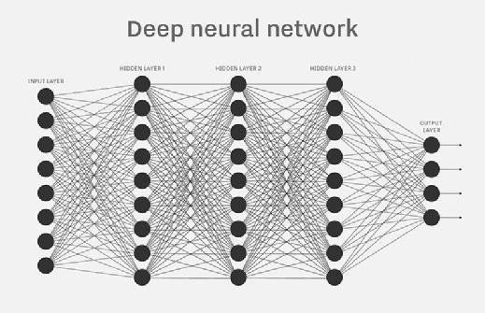

Slide 11
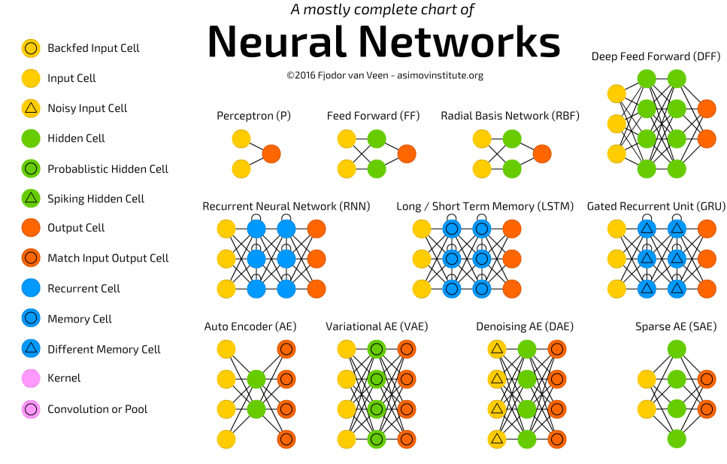
X

Slide 12
Problem solving for this Representation
Problemsolving takes the following form:
A set of features is defined to express the examples
Each example is expressed in this set of features
The featureset is mapped onto the units in the input level. This mapping becomes more or less complex depending on the character of the features. Sequences of input have to be given special consideration.
4. Desired results have to be modelled in terms of the units of the output layer. This
goes for classification,regression as well as for general action problems.
All neural network computation schemes have many so called ´hyperparameters´ that control the detailed behaviour of each scheme. These parameters typically have to be set for each problem solving session.

Slide 13
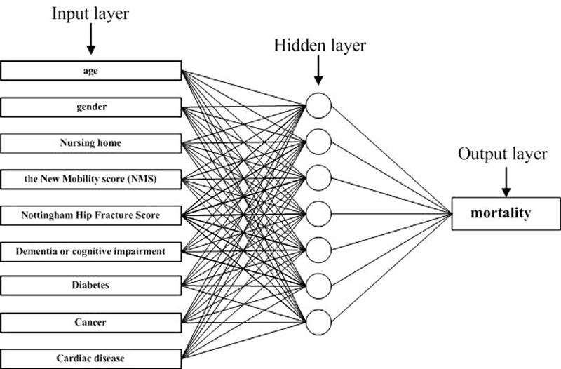
Problem solving for this Representation
Example 1

Slide 14
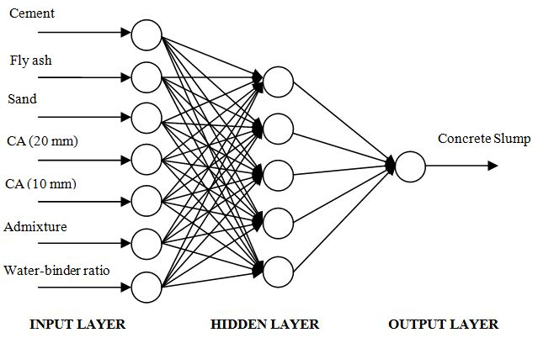
Example 2

Slide 15
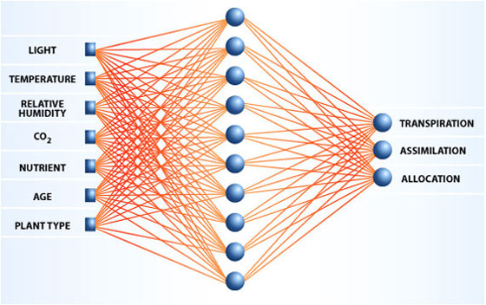
Example 3

Slide 16
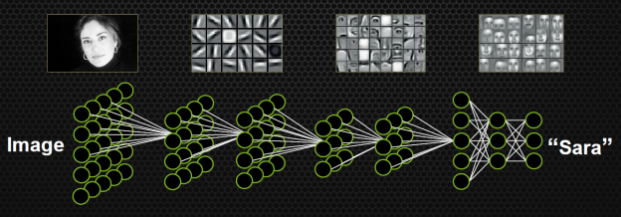
Example 4

Slide 17
Learning for this Representation
1. The basic learning mechanisms in ANN are
mechanisms for updating primarily the weights of edges and the thresholds (biases) of nodes.
2. It is also possible but less common to dynamically modify the structure of the Network, both the structure of connections and the introduction
of new levels.

Slide 18
NPTEL
Video Course on Machine Learning
Professor Carl Gustaf Jansson, KTH
Thanks for your attention!
The next lecture 3.5 will be on the topic:
Genetic Algorithms

