Slide 1
NPTEL
Video Course on Machine Learning
Professor Carl Gustaf Jansson, KTH
Week 5 Machine Learning enabled
by prior Theories
Video 5.2 Explanation Based Learning

Slide 2
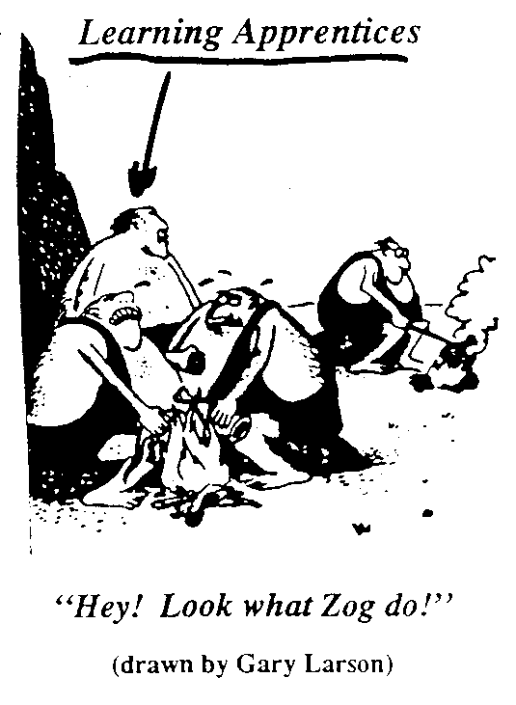
Explanation-Based Learning (EBL)
Learning general problem solving schemata by observing and analyzing solutions to specific problems.

Slide 3
Explanation Based Learning (EBL)
Explanation-based learning (EBL) creates Learning general problem solving schemata by observing and analyzing solutions to specific problems.
EBL spans the spectrum from deduction to abduction:
that uses prior knowledge (domain theory) to ´explain´ why a training example is an instance of a concept
and where the explanations identify what features (predicates) are relevant to the target concept.
Prior knowledge is used to reduce the hypothesis space and focus the learner on hypotheses that are consistent with that knowledge.
Accurate learning is possible even for very few training instances. There is a trade-off between:
the need to collect many examples to be able to induce without prior knowledge and
the ability to explain single examples in the presence of a domain theory.

Slide 4
Explanation Based Learning (EBL)
Given:
A Target concept defined by a predicate statement)
Training examples (some facts expressed by grounded predicates)
A Domain theory (some facts and inference rules that express background knowledge potentially relevant for the target concept)
An Operationality Criteria (which specifies which predicates can occur in the derived concept definition: typically the predicates used to describe the training instance case).
The goal is to find an alternative operational and more efficient definition of the target concept that is consistent with (logically entailed by) both the domain theory and the training examples.
A typical EBL algorithm has the following steps for each example not covered by an already operational
concept definition:
Explain: Use the domain theory to infer an ´explanation´ or ´proof´ (combined application of rules) of why an example is a member of the target concept.
Analyze: Generalize the explanation to determine the most general rule that is still operational.
Add the new rule to the domain theory.

Slide 5
Different Perspectives on EBL
EBL as theory guided generalization of examples:
Explanations are used to distinguish relevant from irrelevant features.
EBL as example guided reformulation of theories:
Examples are used to focus on which reformulations to make in order to produce operational concepts.
EBL as knowledge compilation:
Explanations that are particularly useful for explaining the
training examples are “compiled out” to improve efficiency.

Slide 6
Standard Approach to EBL

Slide 7
Prototypical EBL Architecture

Slide 8
Unification-Based Generalization
An explanation is an inter-connected collection of “pieces” of knowledge (inference rules, rewrite rules, etc.)
These “rules” are connected using unification, as in Logic Programming.
The generalization task is to compute the most general unifier that allows the “knowledge pieces” to be connected together as generally as possible.
Unification-based generalization algorithm
Find the weakest preconditions A for a conclusion C such that A entails C using the given proof.
The general target predicate is regressed through each rule used in the proof and at each step building up a set
of literals P. An element of P we term Q.
To regress a set of literals P through a rule H :- B1,...Bn, (B={B1,...Bn}) using one literal Q being an element of P
Let Ф be the most general unifier of Q and H apply the resulting substitution to all the literals in P and B and
return: P = (PФ - QФ) U BФ
After regressing the general target concept through each rule used in the proof return: C :- P={P1...Pn}.

Slide 9
Example Problem formulation
Domain Theory:
SafeToStack(X,Y) :- not(Fragile(Y)).
SafeToStack(X,Y) :- Lighter(X,Y).
Lighter(X,Y) :- Weight(X,WX), Weight(Y,WY), WX < WY.
Weight(X,W) :- Volume(X,V) Density(D,D), W=V*D.
Weight(X,5) :- Type(X,Endtable).
Fragile(X) :- Material(X,Glass).
Operational predicates:
Type, Color, Volume, Owner, Fragile, Material, Density, On, <, >, =.
Training Example:
SafeToStack (Obj1,Obj2)
On(Obj1,Obj2) Owner(Obj1,Molly)
Type(Obj1,Box) Owner(Obj2, Muffet)
Type(Obj2,Endtable) Fragile(Obj2)
Color(Obj1,Red) Material(Obj1,Cardboard)
Color(Obj2,Blue) Material(Obj2,Wood)
Volume(Obj1, 2) Density(Obj1, 0.3)
Goal concept:
SafeToStack(x,y)

Slide 10
Example Explanation
SafeToStack(Obj1,Obj2)
Lighter(Obj1,Obj2)
Weight(Obj1,0.6)
Weight(Obj2, 5)
0.6<5
Volume(Obj1, 2)
0.6=2*0.3
Type(Obj2, Endtable)
Density(Obj1, 0.3)

Slide 11
Example Generalization , step 1
SafeToStack(Obj1,Obj2)
Lighter(Obj1,Obj2)
P: empty set
Regress {SafeToStack(x,y)} through SafeToStack(x1,y1) :- Lighter(x1,y1).
Unifier: Ф = {x/x1, y/y1} P: {Lighter(x,y)}

Slide 12
Example Generalization , step 2
Lighter(Obj1,Obj2)
Weight(Obj1,0.6)
Weight(Obj2,5)
06.<5
Regress {Lighter(x,y)} through Lighter(x2,y2) :- Weight(x2,wx), Weight(y2,wy), wx2<wy2.
Unifier: Ф = {x/x2, y/y2} P: {Weight(x,wx), Weight(y,wy), wx < wy}

Slide 13
Example Generalization step 3
Weight(Obj1, 0.6)
Volume(Obj1, 2)
0.6=2*0.3
Density(Obj1, 0.3)
Regress {Weight(x,wx), Weight(y,wy), wx < wy} through
Weight(x3,w) :- Volume(x3,v), Density(x3,d), w=v*d.
Unifier: Ф = {x/x3, wx/w} P: {Volume(x,v), Density(x,d), wx=v*d,
Weight(y,wy), wx < wy}

Slide 14
Example Generalization 4
Weight(Obj2, 5)
Type(Obj2, Endtable)
Regress { Volume(x,v), Density(x,d), wx=v*d, Weight(y,wy), wx < wy }
through Weight(x4,5) :- Type(x4,Endtable).
Unifier: Ф = {y/x4, 5/wy}
P: {Volume(x,v), Density(x,d), wx=v*d, Type(y,Endtable), wx < 5}

Slide 15
Example Learned Rule
Goal:-P considering all unifications made.
SafeToStack(x,y) :-
Volume(x,v), Density(x,d), wx=v*d, Type(y, Endtable), wx < 5

Slide 16
EBL and the quality of theories
EBL techniques aims at the improvement of imperfect domain theories.
We can separate four scenarios for imperfect domain theories:
Incomplete Theory Problem
Inconsistent Theory Problem
Incorrect Theory Problem (theory not consistent with the real world domain)
Intractable Theory Problem (computationally complex)
EBL techniques can be useful in these scenarios but can also be disabled by Domain Theory imperfections.
Application of EBL techniques requires a careful analysis of the properties of the available Domain Theories
and realistic strategies for utilizing the most promising opportunities for improvements.

Slide 17
The utility of the created new operational
concept definitions (rules)
EBL in many cases do not create entirely new knowledge but has the goal to improve the domain theory so that problem becomes more efficient. One way of looking at EBL is as Knowledge Compilation.
EBL represents a Dynamic form of knowledge compilation where a system is tuned to incrementally improve efficiency on a particular distribution of problems (training instances).
However after learning many new rules (macro-operators, macro-rules, or search control rules), the time to match and search through this added knowledge may start to outweigh its benefits. This means that the negative overall utility becomes negative resulting in slowdown rather than the intended speedup.
Possible counter measures include:
Selective Acquisition: Only learn rules whose expected benefit outweighs their cost.
Restrict Expressiveness: Prevent learning of rules with combinatorial match costs.
Selective Retention: Dynamically forget expensive rules that are rarely used.
Improve Efficiency of Matching: Preprocess learned rules to improve their match efficiency.
Selective Utilization: Restrict the use of learned rules to avoid undue cost of application.

Slide 18
A sample of EBL systems
STRIPS+MACROPS, Fikes et al, 1972,
´Generalization and memorization of successful plans (Macro operators)´
HACKER, Sussman, 1973,
´Memorization of generalized subroutines and generalized bugs´
SOAR, Rosenbloom, Laird and Newell, 1986,
´Chunking production rules through ´generalization of impasses´.
EBG-Explanation Based Generalization, Mitchell, Keller andKedar-Cabelli, 1986,
´A unified framework for Explanation Based Learning´.
BAGGER : An EBL System that Extends and Generalizes Explanations, Shavlik, 1987,
´focus on minimizing the number of rule applications´
PRODIGY - Learning Control Knowledge, Minton, 1989,
´building up a separate knowledgebase of control rules´.
IOU-Induction over the unexplained, Mooney and Ourston, 1989,
´specialization of overly general theories´.

Slide 19
NPTEL
Video Course on Machine Learning
Professor Carl Gustaf Jansson, KTH
Thanks for your attention!
The next lecture 5.3 will be on the topic:
Inductive Logic Programming

