Slide 1
NPTEL
Video Course on Machine Learning
Professor Carl Gustaf Jansson, KTH
Week 5 Learning based on
Symbolic Representations
with Strong Theories
Video 5.5 Case-based reasoning

Slide 2
Case-Based reasoning (CBR)
Case-Based reasoning (CBR), is the process of solving new problems based on the experiences from solutions of similar past problems. Expressed in an alternative fashion, CBR does solve a new problem by remembering previous similar problems and by reusing knowledge of successful problem solving for those problems.
Case-based reasoning can be motivated by assumptions such as:
Similar problems have similar solutions
Many domains are regular in the sense that successful problem solving schemes are invariant over time.
Case-based reasoning should be contrasted by Rule-based reasoning.
Cases are stored in a case-base or case memory to be retrieved and reused. When a successful solution to the new problem is found, an adapted case can be stored in the case-base to increase its competence, thus implementing a learning behavior.
Technically, case-based reasoning is primarily supported by the techniques described in the previous lecture on Similarity based learning or Memory based learning. Particular examples here are the schemes for distance and similarity measures.

Slide 3
Modelling and Representation
A crucial aspect of a CBR system is how the cases are represented. It is necessary to represent both
the problem and
its solution.
The representations of problems are the basis for case retrievals while the representations of case solutions are the basis for case adaptions.
Different forms of representation are:
Feature-value lists
Graphs
Predicate Logic.
As for all machine learning techniques, feature selection is a crucial sub-process.
The choice of representation is crucial for which kind of similarity-based learning techniques that can be applied.

Slide 4
The four main phases of a CBR system cycle
RETAIN
integrate in
case-base
RETRIEVE
find similar
problems
CBR
REUSE
propose solutions
from retrieved cases
REVISE
adapt and repair
proposed solution

Slide 5
A CBR System Cycle with more details
Problem
New Case
RETRIEVE
Learned
Case
General Knowledge
Retrieved Case
New Case
RETAIN
Previous
Cases
Tested /
Repaired
Case
REUSE
Solved Case
REVISE
Suggested
Solution
Confirmed
Solution

Slide 6
CBR System Cycle Phases: Retrieve
The goal is to find the a small number of cases from the case-base with the highest similarity to the current case.
Retrieval can be based on:
Indexing techniques such as kd-trees, case-retrieval nets, or discrimination networks.
Similarity measures from the area of instance-based learning methods can be employed, most typically the “nearest neighbor” method using a weighted sum of features.
Template retrieval approach: Return all cases that fit certain parameter settings.
One or several cases from the case base are typically selected as output from the retrieval phase.

Slide 7
CBR System Cycle Phases: Reuse
Reusing a retrieved solution can be simple if the stored solution can be used unchanged as the solution for the new problem.
Otherwise Adaptation is required.
The two main techniques for adaptation in CBR are:
Transformational: Modifies the previous solution using domain specific transformation operators.
Derivational: Reuse the algorithms, methods or rules that generated the original solution to produce a new solution to the current problem.

Slide 8
CBR System Cycle Phases: Revise
In this phase, feedback related to the solution constructed so far is obtained from the environment. This feedback can be given in the form of a correctness rating of the result or in the form of a manually corrected revised case.
The retrieved case is adapted to reflect differences between the new case and the retrieved case.
If the solution is unsuccessful the retrieved case can be repaired by using domain-specific knowledge.
After the solution has been successfully adapted to the target problem, the result can be stores as a new case in memory.

Slide 9
CBR System Cycle Phase: Retain
The retain phase is the learning phase of a CBR system where a revised case is added to the case base.
Depending on circumstances a revised case can be retained or forgotten.
The new case is integrated in the memory structure either by indexing or by being positioned in the feature space.
The case base structure may also be consolidated due to the addition of a new case, e.g. by the tuning of the indexing mechanisms or the reconsideration of the importance of features.

Slide 10
CBR compared to other reasoning and learning approaches
One key difference between the implicit generalizations in CBR and the explicit generalizations in main stream inductive machine learning systems is concerned with when the generalizations are made.
Most inductive algorithms make their explicit generalizations from a set of training examples before the presence of any target problem.
We call this: eager generalization.
This is in contrast to CBR, which delays its typically implicit generalizations until testing time.
We call this: lazy generalization.
CBR therefore tends to be a good approach for rich, complex domains in which there are multitude of ways to generalize a case.

Slide 11
Advantages with CBR systems
Cases are sometimes the best way to represent knowledge, especially when the available models or theories are unreliable (weak theory domains).
A good case is often an efficient shortcut in the search for good solutions.
The capability of a CBR is organically increased by the incremental addition of new cases. Intrinsic advantages of an old case can be strengthened by incremental improvements due to the adaptions triggered by new cases.
The processes of storing cases and retrieving cases can be computationally less expensive than alternative learning mechanisms.

Slide 12
Criticism of the CBR
Critics of CBR argue that CBR is an approach that accepts anecdotal evidence as its main operating principle.
Without statistically relevant data for backing up the implicit generalizations, there is no guarantee that the generalizations are correct.
------------------------------------------------------------------------------------------------
As an example of a response, recent research has defined CBR within a statistical framework that formalizes case-based inference as a specific type of probabilistic inference.

Slide 13
CBR applications
Help-desk and customer service systems
Recommender systems
CHEF (1986) – Create Recipes
JULIA (1992) – Meal Planning
Medical applications in particular diagnosis tasks
CASEY (1989) – Heart Failure Diagnosis
Applications in law in particular in Anglo Saxon law systems
JUDGE (1986) - Criminal Sentencing
Technical trouble shooting
CADET (1992) – Mechanical Parts Design
Financial and management decision making

Slide 14
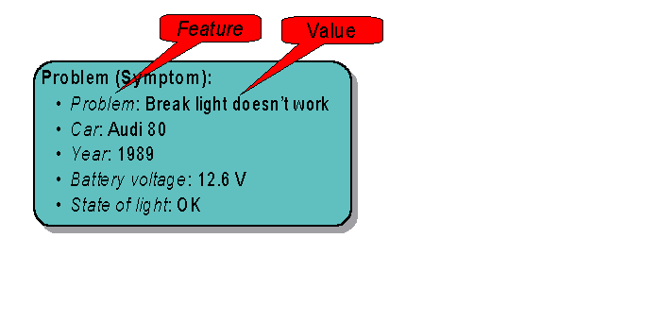
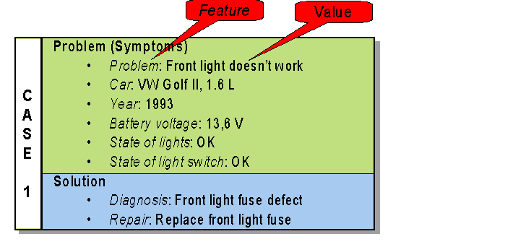
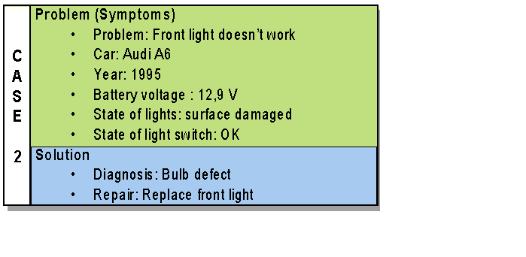
Example : Technical Diagnosis of Car Faults
----------------------------------------------------------

Slide 15
NPTEL
Video Course on Machine Learning
Professor Carl Gustaf Jansson, KTH
Thanks for your attention!
The next lecture 5.6 will be on the topic:
Tutorial for Week 5

