Slide 1
NPTEL
Video Course on Machine Learning
Professor Carl Gustaf Jansson, KTH
Week 6 Machine Learning based
on Artificial Neural Networks
Video 6.2 Perceptrons

Slide 2
Structure of Lectures in week 6
L1 Fundamentals of
We are her now Neural Networks
McCulloch and Pitts
Supervised learning L2 Perceptrons Linear L6 Hebbian Learning and
- classification classification Associative Memory
- regression
L3 och L4 Feed forward multiple layer Reinforcement
networks and Backpropagation learning Unsupervised learning
L5 Recurrent Neural Sequence and L7 Hopfield Networks and
Perception Networks (RNN) temporal data Boltzman Machines
L8 Convolutional Neural
Networks (CNN)
L9 Deep Learning and
recent developments
Development of
the ANN field
L10 Tutorial on assignments

Slide 3
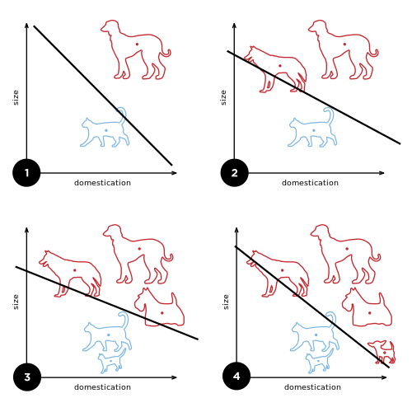
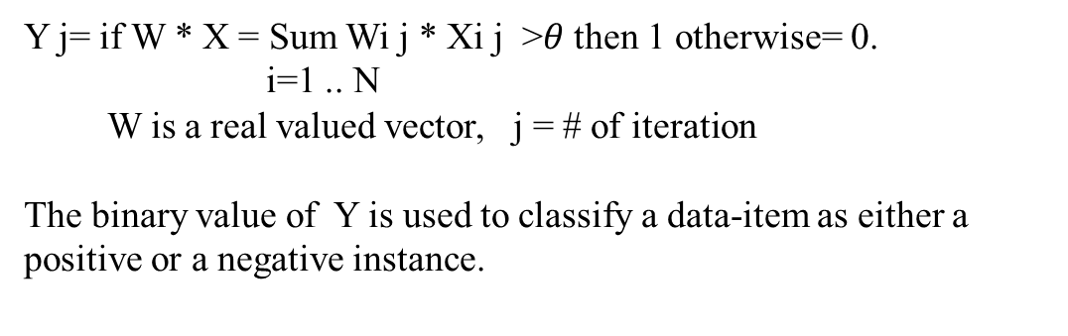
Perceptron
The perceptron is an algorithm for learning a linear binary classifier in the form of a threshold function that maps its input X, a real-valued input vector, to a single output binary value Y.
In the context of neural networks, a perceptron is a single artificial neuron using the Heaviside step function as the activation function.
As a linear classifier, the single-layer perceptron is the simplest feedforward neural network.
Y j= if W * X = Sum Wi j * Xi j >$θ$ then 1 otherwise= 0.
i=1 .. N
W is a real valued vector, j = # of iteration
The binary value of Y is used to classify a data-item as either a
positive or a negative instance.

Slide 4
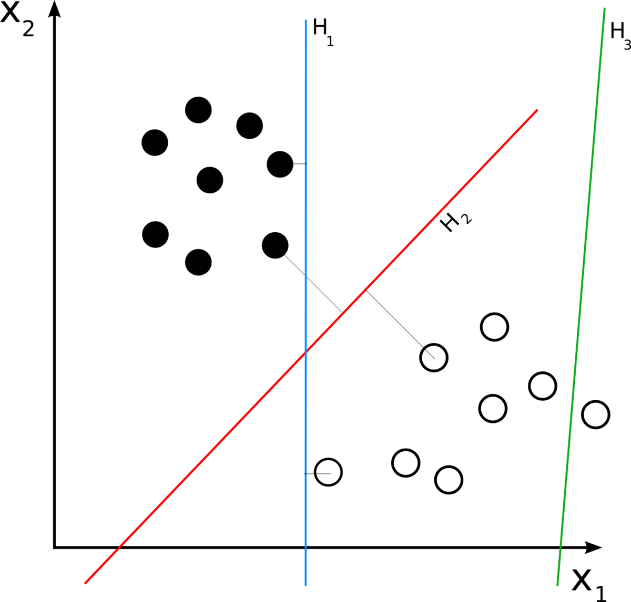
Intuitions for Perceptron Learning
A perceptron is a liner classifier that tries to find a hyperplane in the space spanned by its input.
The adjustments of weights corresponds to changes in orientation of the hyper plane.The adjustments of the bias corresponds to changes in the hyper plan intercepts with
the axes of the space.
For a two dimensional space the perceptron corresponds a line in the plane, the orientation of which is decided by the weights and the intercepts of which are decided by the bias.
An optimal perceptron finds the hyperplane (e.g. line) that
best separates the data-items.

Slide 5
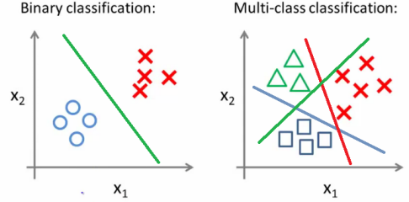
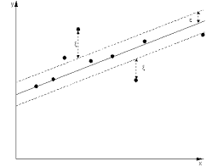
Which problems can a perceptron solve?
= Binary Classification for linearly separable
instance spaces
A multi class classification problem can be reduced to multiple binary classification problems and can therefor indirectly be solved by parallel multiple perceptrons.
As a perceptron only has binary output, regression cannot be performed. A trick can be to discretize the regression problem into number ranges and view it as a multiclass classification problem (see above).

Slide 6
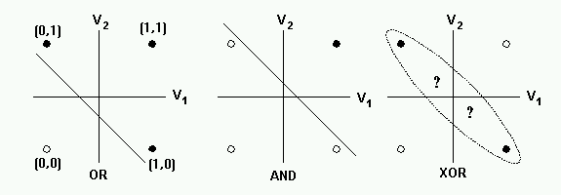
Then non-linear case
The perceptron learning algorithm does not terminate if the learning set is not linearly separable.
The most famous example of the perceptron's inability to solve problems with linearly non-separable vectors is the Boolean XOR problem.

Slide 7
Perceptron Learning Rule
A simpler version of the delta rule for ONE neuron with specific properties.
Wi j+1= Wi j+ a * (Tj-Yj)* Xi j, a = learning rate parameter.
delta weight
T
Yj = Xi j Wi j, i = input, j =iteration, T = target
The treshold can also be learned by transforming it to a bias = - threshold and completing the
dataitems with an extra input x0j=1 and a corresponding weight w0j=bias.
Steps in a Learning Procedure
Initialize the weights and the learning rate.
Weights may be initialized to 0 or to a small random value.
For each example j in the dataset, perform the following steps until total training set error ceases to improve:
calculate the output
calculate the new weights
,

Slide 8

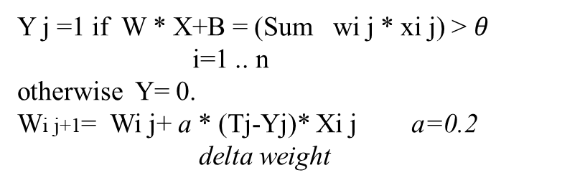
Perceptron
x₁
w₁
Y j =1 if W * X+B = (Sum wi j * xi j) > $θ$
i=1 .. n
otherwise Y= 0.
Wi j+1= Wi j+ a * (Tj-Yj)* Xi j a=0.2
delta weight
x₂
w₂
$$θ$$
Y
x_{n}
w_{n}
X11=0.8 x21=0.3 T1= 0 W11=0.4 W21=-0.2
0.8
0.4
0.1
Y 1 = 1
0.3
-0.2
0.4*0.8 -0.2*0.3 =0 .26 > 0.1 -> Y1 = 1
W12=0.4+0.2*(0-1)*0.8 = 0.24 W22= -0.2 +0.2*(0-1) *0.3=-0.26

Slide 9

Perceptron with threshold handled as a bias that can be learned
x₁
w₁
Y j =1 if W * X+B = (Sum wi j * xi j) > 0
i= .. n
otherwise Y= 0.
Wi j+1= Wi j+ a * (Tj-Yj)* Xi j a=0.2
delta weight
x₂
w₂
Y
x_{n}
w_{n}
X0=1
w0=$−θ$
X11=0.8 x21=0.3 T1= 0 W11=0.4 W21=-0.2 W01=-0.1
0.8
0.4
Y 1 = 1
0.3
-0.2
0.4*0.8 + -0.2*0.3 - 0.1 =0 .16 > 0 -> Y1 = 1
W12=0.4+0.2*(0-1)*0.8 = 0.24 W22= -0.2 +0.2*(0-1) *0.3=-0.26
W02=-0.1 + 0.2*(0-1)*1=-0.3
1
-0.1

Slide 10
Example
Assume a perceptron:
with 3 inputs plus 1 for bias
where net = x0*w0+x1*w1+x2*w2+x3*w3
that outputs 1 if net > 0, else 0
with a learning rate a=1
initial weights all 0
Training set
0 0 1 -> 0
1 1 1 -> 1
1 0 1 -> 1
Y j =1 if W * X = (Sum wi j * xi j) > 0
i= .. n
otherwise Y= 0.
Wi j+1= Wi j+ a * (Tj-Yj)* Xi j
delta weight
Instance Target Weight Vector Net Output Delta Weight
0 0 1 1 0 0 0 0 0 0 0 0 0 0 0
1 1 1 1 1 0 0 0 0 0 0 1 1 1 1
1 0 1 1 1 1 1 1 1 3 1 0 0 0 0

Slide 11
NPTEL
Video Course on Machine Learning
Professor Carl Gustaf Jansson, KTH
Thanks for your attention!
The next lecture 6.3 will be on the topic:
Model of a Neuron in an ANN

