Slide 1


Slide 2
What is Big Data
Collection of large dataset that cannot be processed by using traditional computing technique.
Example:
Black Box Data : It is a component of helicopter, airplanes, and jets, etc.
Social Media Data : Social media such as Facebook and Twitter hold information and the views posted by millions of people across the globe.
Stock Exchange Data : The stock exchange data holds information about the ‘buy’ and ‘sell’ decisions made on a share of different companies made by the customers.
Transport Data : Transport data includes model, capacity, distance and availability of a vehicle.
Search Engine Data : Search engines retrieve lots of data from different databases.

Slide 3
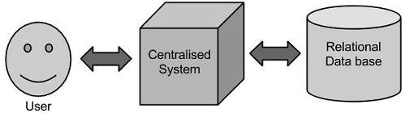
Traditional Approach

Slide 4
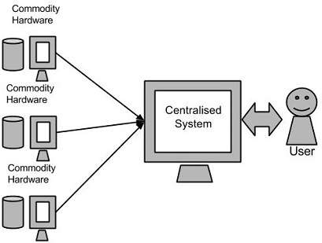
Google’s Solution

Slide 5
Hadoop Background
2002 Google release white papers “Google Distributed File Systems”.
Dug cutting do the implementation with this google white paper in 2003.
Yahoo haired Dug cutting and asked him to implement this white paper.
2005: Doug Cutting and Michael J. Cafarella developed Hadoop to support distribution.
2006: Yahoo gave the project to Apache Software Foundation.
Google released another while paper “Google MapReduce Algorithm”.
Again Dug cutting take this white paper and implemented.
Yahoo gave the project also to Apache Software Foundation.

Slide 6
BIG DATA is about a terabyte or petabyte of file.
Hadoop helps to:
Save the Files → Distributed File System
Do analytics → Google Map Reduce Algorithm

Slide 7
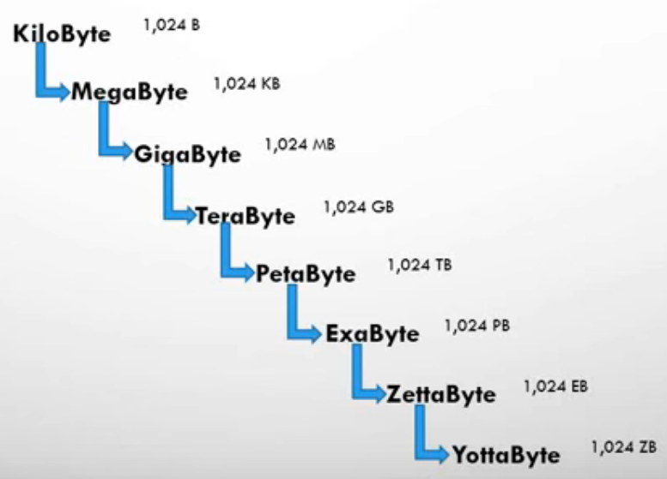
Data Storage

Slide 8
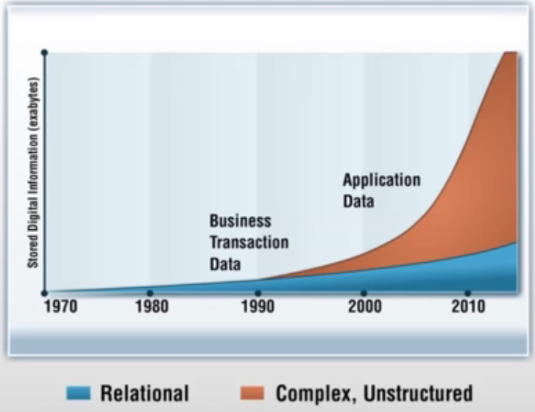
Data Increase Ratio

Slide 9
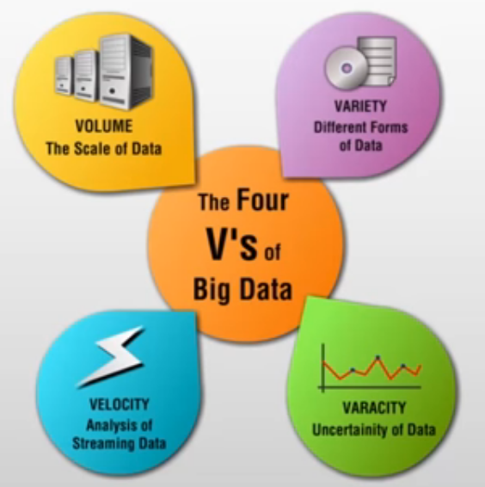
IBMs definition of Big Data

Slide 10
Limitations of Existing Solution
Data Warehousing
Limitations:
Fixed Schema of RDBMS
Cost
Saving hug files and accessing them.
Perform analytics

Slide 11
What is Hadoop
Hadoop is a combination of a Distributed File Systems (DFS) and Analytics Algorithm.
DFS → Saves Big Data Files
Mapreduce Algorithm → Helps to do analytics

Slide 12
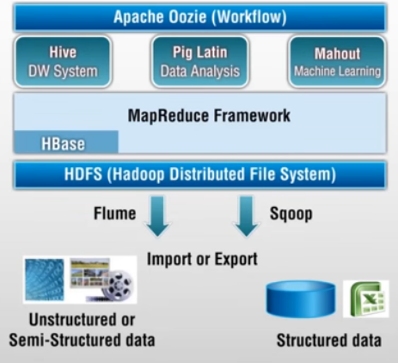
Hadoop 1.x Ecosystem

Slide 13
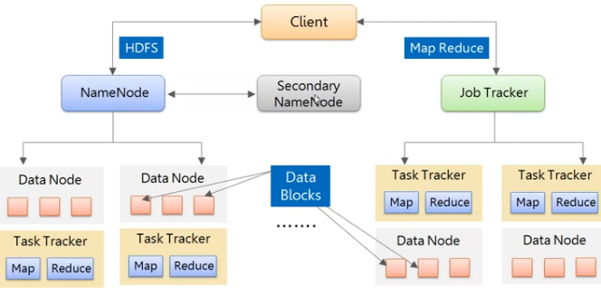
Hadoop 1.x

Slide 14
Limitations of Hadoop 1.x
Problem | Description
NameNode – No horizontal Scalability | Single NameNode Single Namespaces, limited by NameNode RAM.
NameNode - No high Availability (HA) | NameNode is single point of failure, need manual recovery using Secondary NameNode in case of failure
Job Tracker – Overburdended | Spends significant amount of time and effort managing the life cycle of applications.
MRv1 – Only Map and Reduce Tasks | Humongous amount of data stored in HDFS remains unutilized and cannot be used for other workloads such as graph processing ect.

Slide 15
Hadoop 2.x Features
Property | Hadoop 1.x | Hadoop 2.x
Federation | One Namenode and Namespaces | Multiple Namenode and Namespaces
High Availability | Not Present | Highly Available
YARN – Processing control and Multi-tenancy | Job Tracker, Task Tracker | Resource Manager, Node Manager, App Master, Capacity Scheduler

Slide 16
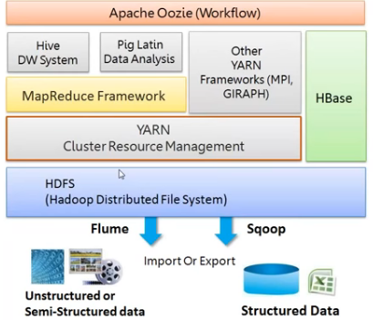
Hadoop 2.x Ecosystem

Slide 17
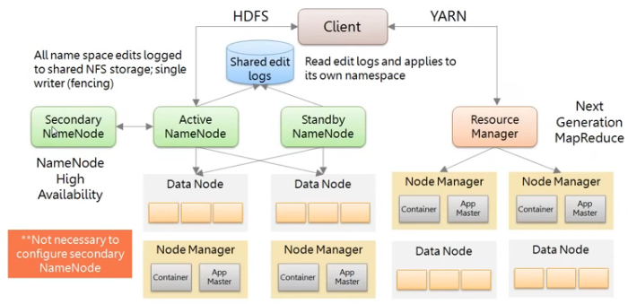
Hadoop 2.x

Slide 18
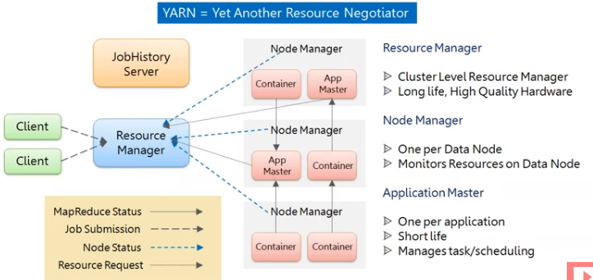
YARN Flow

