Slide 1
Apache Pig

Slide 2
What is Apache Pig?
Using Pig Latin, programmers can perform MapReduce tasks easily without having to type complex codes in Java.
Pig Latin is SQL-like language and it is easy to learn Apache Pig when you are familiar with SQL.

Slide 3
Apache Pig Vs Hive
Apache Pig | Hive
Apache Pig uses a language called Pig Latin. It was originally created at Yahoo. | Hive uses a language called HiveQL. It was originally created at Facebook.
Pig Latin is a data flow language. | HiveQL is a query processing language.
Pig Latin is a procedural language and it fits in pipeline paradigm. | HiveQL is a declarative language.
Apache Pig can handle structured, unstructured, and semi-structured data. | Hive is mostly for structured data.

Slide 4
Apache Pig – History
In 2006, Apache Pig was developed as a research project at Yahoo, especially to create and execute MapReduce jobs on every dataset.
In 2007, Apache Pig was open sourced via Apache incubator. In 2008, the first release of Apache Pig came out. In 2010, Apache Pig graduated as an Apache top-level project.

Slide 5
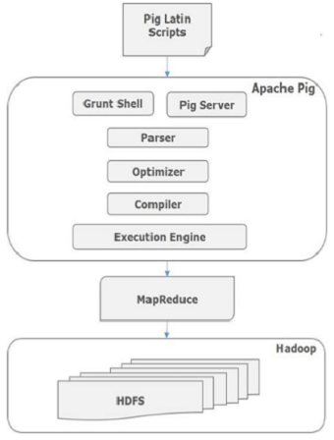
Apache Pig - Architecture

Slide 6
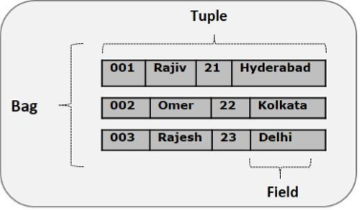
Pig Latin Data Model

Slide 7
Pig Latin – Data Model
As discussed in the previous chapters, the data model of Pig is fully nested. A Relation is the outermost structure of the Pig Latin data model. And it is a bag where −
A bag is a collection of tuples.
A tuple is an ordered set of fields.
A field is a piece of data.

Slide 8
Apache Pig - Installation
Step 1
$ mkdir Pig
Step 2
$ tar zxvf pig-0.15.0-src.tar.gz
$ tar zxvf pig-0.15.0.tar.gz
Configure Apache Pig
export PIG_HOME = /home/Hadoop/Pig
export PATH = $PATH:/home/Hadoop/pig/bin
export PIG_CLASSPATH = $HADOOP_HOME/conf
pig.properties file
pig -h properties
pig –version

Slide 9
Apache Pig Execution Modes
Local Mode:
In this mode, all the files are installed and run from your local host and local file system. There is no need of Hadoop or HDFS. This mode is generally used for testing purpose.
MapReduce Mode:
MapReduce mode is where we load or process the data that exists in the Hadoop File System (HDFS) using Apache Pig. In this mode, whenever we execute the Pig Latin statements to process the data, a MapReduce job is invoked in the back-end to perform a particular operation on the data that exists in the HDFS.

Slide 10
Apache Pig Execution Mechanisms
Interactive Mode (Grunt shell) − You can run Apache Pig in interactive mode using the Grunt shell. In this shell, you can enter the Pig Latin statements and get the output (using Dump operator).
Batch Mode (Script) − You can run Apache Pig in Batch mode by writing the Pig Latin script in a single file with .pig extension.
Embedded Mode (UDF) − Apache Pig provides the provision of defining our own functions (User Defined Functions) in programming languages such as Java, and using them in our script.

Slide 11
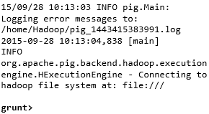
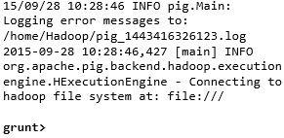
Invoking the Grunt Shell
Local mode | MapReduce mode
Command − $ ./pig –x local | Command − $ ./pig -x mapreduce

Slide 12
Pig Latin – Data types
S.N. | Data Type | Description & Example
1 | int | Represents a signed 32-bit integer. Example : 8
2 | long | Represents a signed 64-bit integer. Example : 5L
3 | float | Represents a signed 32-bit floating point. Example : 5.5F
4 | double | Represents a 64-bit floating point. Example : 10.5
5 | chararray | Represents a character array (string) in Unicode UTF-8 format. Example : ‘tutorials point’

Slide 13
6 | Bytearray | Represents a Byte array (blob).
7 | Boolean | Represents a Boolean value. Example : true/ false.
8 | Datetime | Represents a date-time. Example : 1970-01-01T00:00:00.000+00:00
9 | Biginteger | Represents a Java BigInteger. Example : 60708090709
10 | Bigdecimal | Represents a Java BigDecimal Example : 185.98376256272893883

Slide 14
Complex Types
11 | Tuple | A tuple is an ordered set of fields. Example : (raja, 30)
12 | Bag | A bag is a collection of tuples. Example : {(raju,30),(Mohhammad,45)}
13 | Map | A Map is a set of key-value pairs. Example : [ ‘name’#’Raju’, ‘age’#30]

Slide 15
Pig Latin – Arithmetic Operators
Operator | Description | Example
+ | Addition − Adds values on either side of the operator | a + b will give 30
− | Subtraction − Subtracts right hand operand from left hand operand | a − b will give −10
* | Multiplication − Multiplies values on either side of the operator | a * b will give 200
/ | Division − Divides left hand operand by right hand operand | b / a will give 2

Slide 16
% | Modulus − Divides left hand operand by right hand operand and returns remainder | b % a will give 0
? : | Bincond − Evaluates the Boolean operators. It has three operands as shown below. variable x = (expression) ? value1 if true : value2 if false. | b = (a == 1)? 20: 30; if a=1 the value of b is 20. if a!=1 the value of b is 30.
CASE WHEN THEN ELSE END | Case − The case operator is equivalent to nested bincond operator. | CASE f2 % 2 WHEN 0 THEN 'even' WHEN 1 THEN 'odd' END

Slide 17
Pig Latin – Comparison Operators
Operator | Description | Example
== | Equal − Checks if the values of two operands are equal or not; if yes, then the condition becomes true. | (a = b) is not true
!= | Not Equal − Checks if the values of two operands are equal or not. If the values are not equal, then condition becomes true. | (a != b) is true.
> | Greater than − Checks if the value of the left operand is greater than the value of the right operand. If yes, then the condition becomes true. | (a > b) is not true.

Slide 18
< | Less than − Checks if the value of the left operand is less than the value of the right operand. If yes, then the condition becomes true. | (a < b) is true.
>= | Greater than or equal to − Checks if the value of the left operand is greater than or equal to the value of the right operand. If yes, then the condition becomes true. | (a >= b) is not true.
<= | Less than or equal to − Checks if the value of the left operand is less than or equal to the value of the right operand. If yes, then the condition becomes true. | (a <= b) is true.
matches | Pattern matching − Checks whether the string in the left-hand side matches with the constant in the right-hand side. | f1 matches '.*tutorial.*'

Slide 19
Pig Latin – Type Construction Operators
Operator | Description | Example
() | Tuple constructor operator − This operator is used to construct a tuple. | (Raju, 30)
{} | Bag constructor operator − This operator is used to construct a bag. | {(Raju, 30), (Mohammad, 45)}
[] | Map constructor operator − This operator is used to construct a tuple. | [name#Raja, age#30]

Slide 20
Pig Latin – Relational Operations
Operator | Description
Loading and Storing
LOAD | To Load the data from the file system (local/HDFS) into a relation.
STORE | To save a relation to the file system (local/HDFS).

Slide 21
Filtering
FILTER | To remove unwanted rows from a relation.
DISTINCT | To remove duplicate rows from a relation.
FOREACH, GENERATE | To generate data transformations based on columns of data.
STREAM | To transform a relation using an external program.

Slide 22
Grouping and Joining
JOIN | To join two or more relations.
COGROUP | To group the data in two or more relations.
GROUP | To group the data in a single relation.
CROSS | To create the cross product of two or more relations.

Slide 23
Sorting
ORDER | To arrange a relation in a sorted order based on one or more fields (ascending or descending).
LIMIT | To get a limited number of tuples from a relation.
Combining and Splitting
UNION | To combine two or more relations into a single relation.
SPLIT | To split a single relation into two or more relations.

Slide 24
Diagnostic Operators
DUMP | To print the contents of a relation on the console.
DESCRIBE | To describe the schema of a relation.
EXPLAIN | To view the logical, physical, or MapReduce execution plans to compute a relation.
ILLUSTRATE | To view the step-by-step execution of a series of statements.

