Slide 1
Computer Mini Project Library Management System
By,
Ananda Rao H (14CO103)
Nikhil B M (14EC134)

Slide 2
Abstract-Problem Statement
Library Management System is a library Management Software for Monitoring and controlling the transactions in a Library. The Project is developed in C, which mainly focus on basic Operations in a library like Adding New Member, New Books, and Updating New Information, Searching Books, Members and facility to Borrow and Return Books.

Slide 3
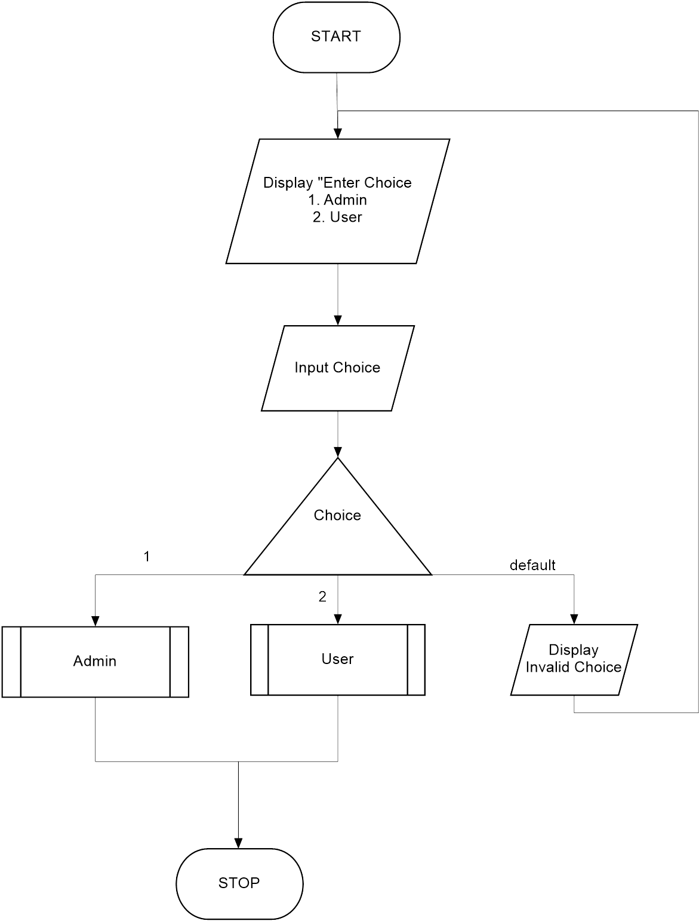
Main Screen

Slide 4
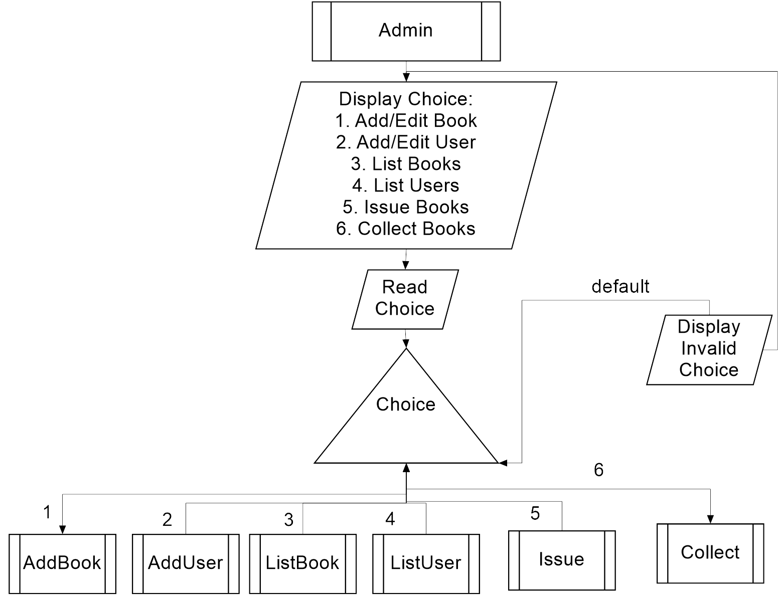
Admin Module

Slide 5
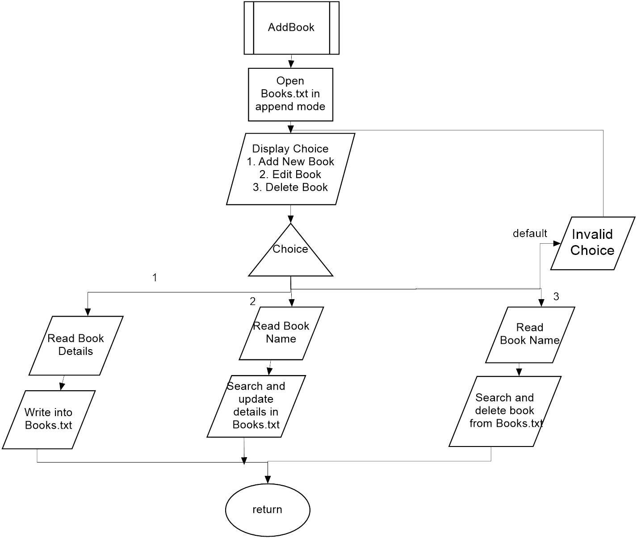
Choice 1-Add Book

Slide 6
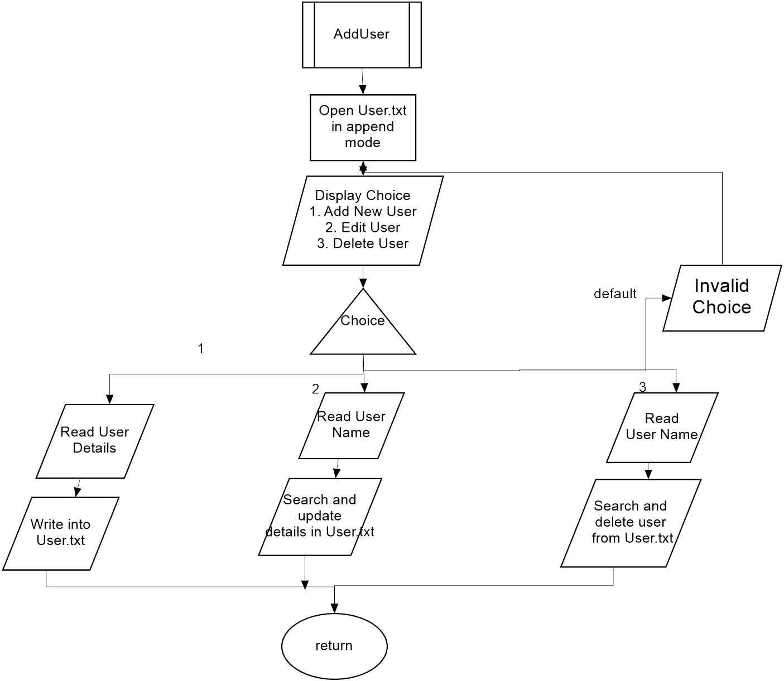
Choice 2-Add User

Slide 7
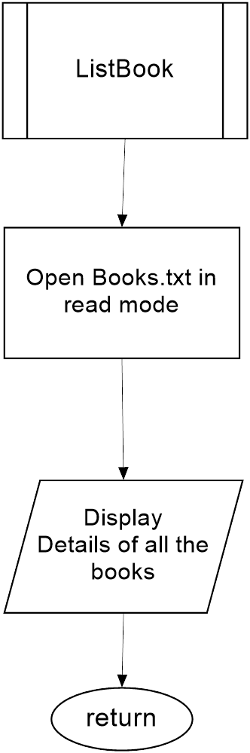
Choice 3-List Book

Slide 8
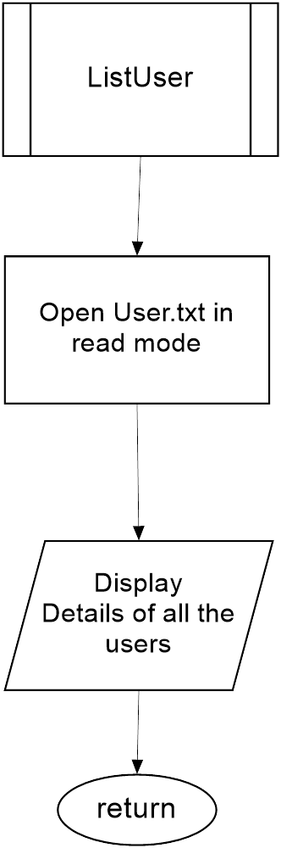
Choice 4-List User

Slide 9
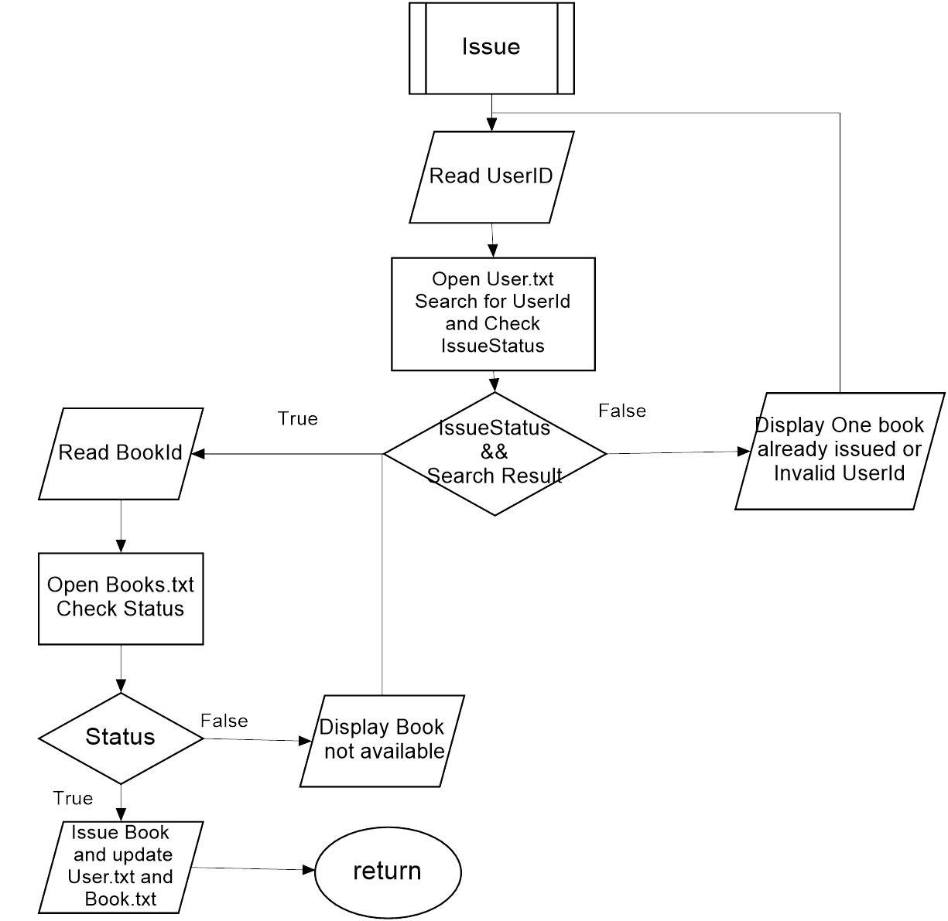
Choice 5-Issue Books

Slide 10
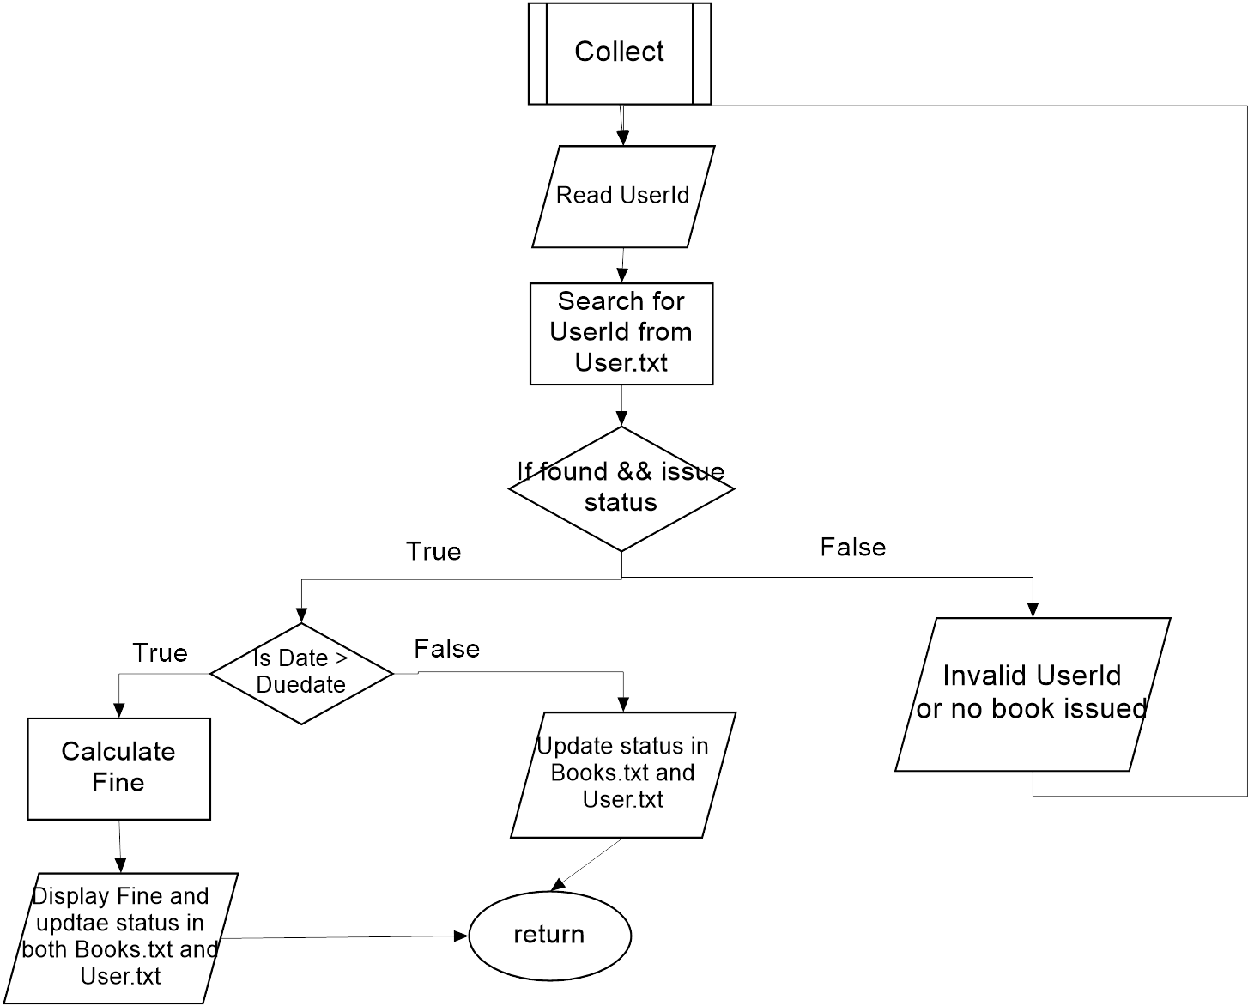
Choice 6-Collect Books

Slide 11
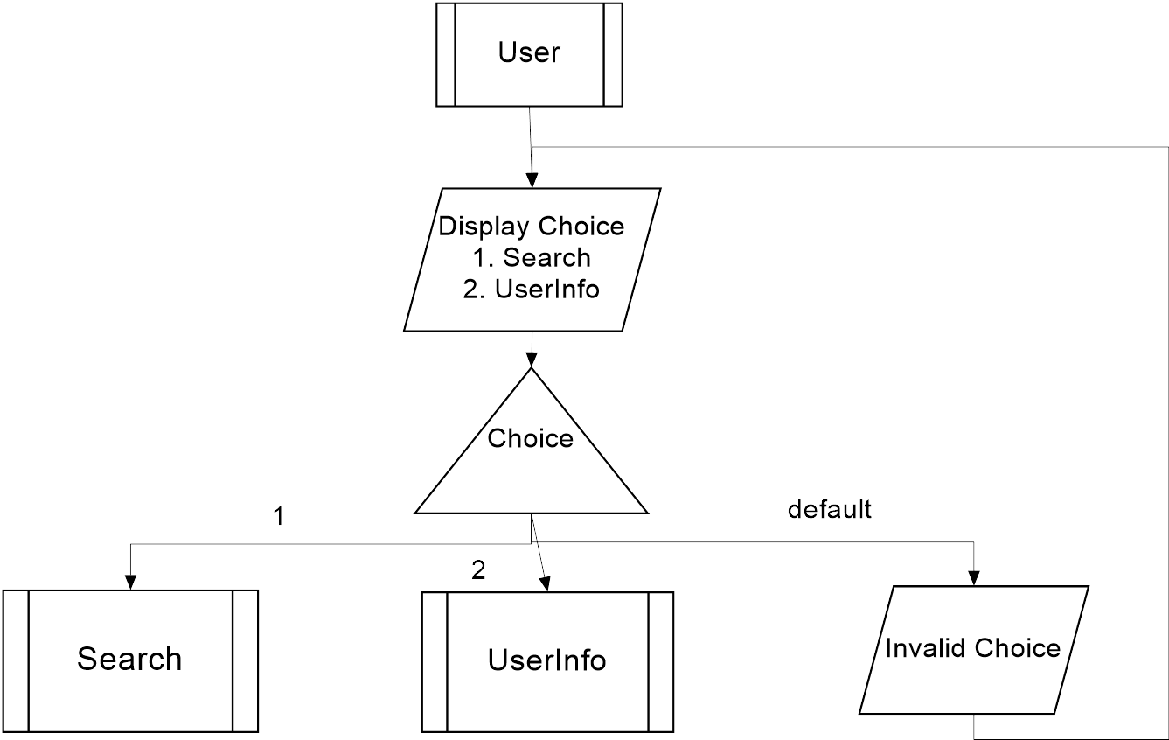
User Module

Slide 12
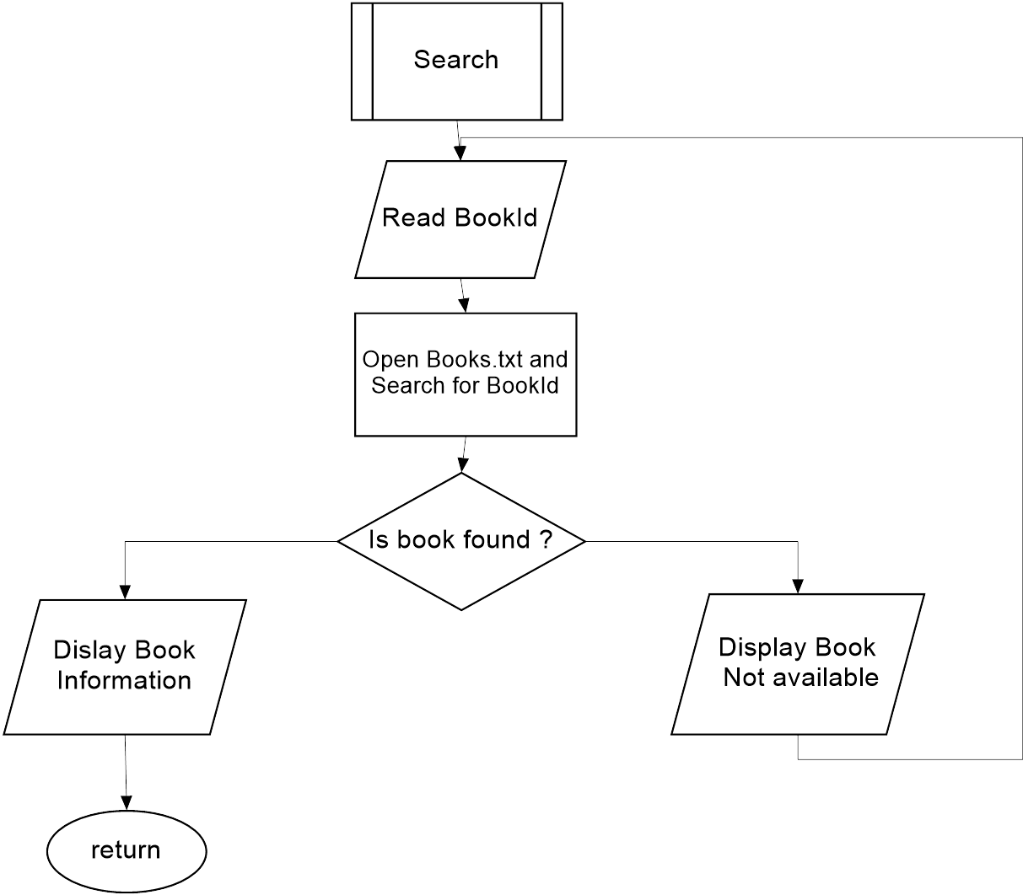
Choice 1-Search for Books

Slide 13
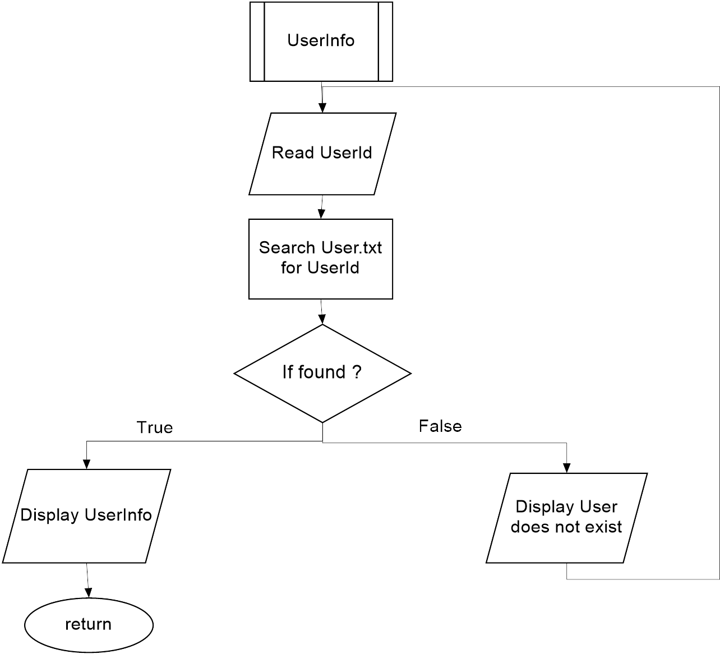
Choice 2-UserInfo

Slide 14
THANK YOU

