Slide 1
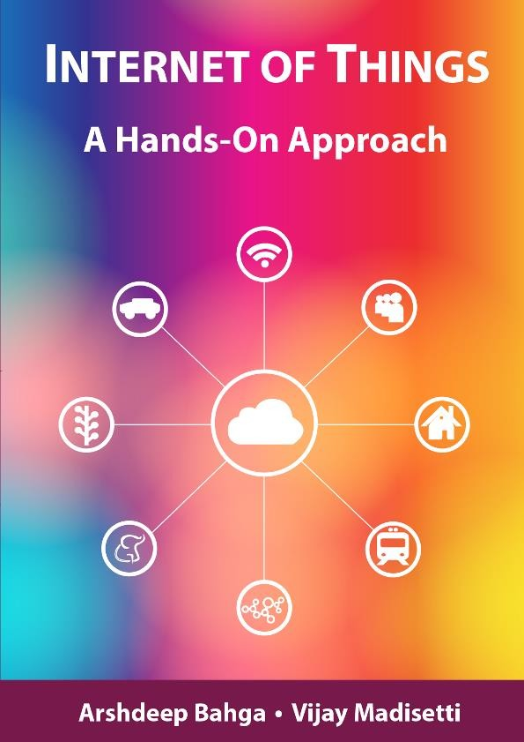
Introduction to IoT

Slide 2
Outline
Definition of IoT
Characteristics of IoT
Physical design of IoT
Logical design of IoT
IoT protocols
IoT levels and deployment templates

Slide 3
Definition
Internet of Things(IoT) is a network of physical objects or people called "things" that are embedded with software, electronics, network, and sensors that allows these objects to collect and exchange data.
The goal of IoT is to extend to internet connectivity from standard devices like computer, mobile, tablet to relatively dumb devices like a toaster.
IoT makes virtually everything "smart," by improving aspects of our life with the power of data collection, AI algorithm, and networks.
The thing in IoT can also be a person with a diabetes monitor implant, an animal with tracking devices, etc.

Slide 4

Formal Definition of IoT
A dynamic global network infrastructure with self- configuring capabilities
based on standard and interoperable communication protocols, where physical and virtual “things” have identities, physical attributes, and use intelligent interfaces, and are seamlessly integrated into information network that communicate data with users and environments.

Slide 5
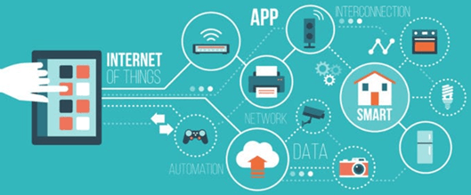
What is IoT?

Slide 6
History of IOT
1970- The actual idea of connected devices was proposed
1990- John Romkey created a toaster which could be turned on/off over the Internet
1995- Siemens introduced the first cellular module built for M2M
1999- The term "Internet of Things" was used by Kevin Ashton during his work at P&G which became widely accepted
2004 - The term was mentioned in famous publications like the Guardian, Boston Globe, and Scientific American
2005-UN's International Telecommunications Union (ITU) published its first report on this topic.
2008- The Internet of Things was born
2011- Gartner, the market research company, include "The Internet of Things" technology in their research

Slide 7
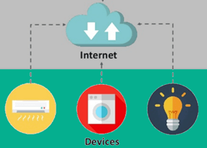
How IOT works?
The entire IOT process starts with the devices themselves like smartphones, smartwatches, electronic appliances like TV, Washing Machine which helps you to communicate with the IOT platform.

Slide 8
Fundamental components of an IoT system:
Sensors/Devices
Connectivity
Data Processing
User Interface

Slide 9
Sensors/Devices:
Sensors or devices are a key component that helps you to collect live data from the surrounding environment.
All this data may have various levels of complexities.
It could be a simple temperature monitoring sensor, or it may be in the form of the video feed.
A device may have various types of sensors which performs multiple tasks apart from sensing.
Example, A mobile phone is a device which has multiple sensors like GPS, camera but your smartphone is not able to sense these things.

Slide 10
Connectivity:
All the collected data is sent to a cloud infrastructure.
The sensors should be connected to the cloud using various mediums of communications.
These communication mediums include mobile or satellite networks, Bluetooth, WI-FI, WAN, etc.

Slide 11
Data Processing:
Once that data is collected, and it gets to the cloud, the software performs processing on the gathered data.
This process can be just checking the temperature, reading on devices like AC or heaters.
However, it can sometimes also be very complex like identifying objects, using computer vision on video.

Slide 12
User Interface:
The information needs to be available to the end-user in some way which can be achieved by triggering alarms on their phones or sending them notification through email or text message.
The user sometimes might need an interface which actively checks their IOT system.
For example, the user has a camera installed in his home. He wants to access video recording and all the feeds with the help of a web server.
However, it's not always one-way communication. Depending on the IoT application and complexity of the system, the user may also be able to perform an action which may create cascading effects.
For example, if a user detects any changes in the temperature of the refrigerator, with the help of IOT technology the user should able to adjust the temperature with the help of their mobile phone.

Slide 13
Challenges of IoT
At present IoT is faced with many challenges, such as:
Insufficient testing and updating
Concern regarding data security and privacy
Software complexity
Data volumes and interpretation
Integration with AI and automation
Devices require a constant power supply which is difficult
Interaction and short-range communication

Slide 14
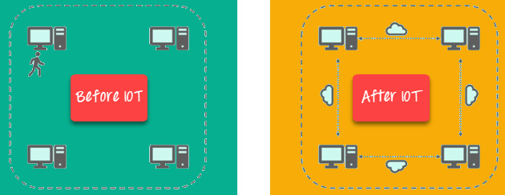
Advantages of IoT

Slide 15
Key benefits of IoT technology are as follows:
Technical Optimization: IoT technology helps a lot in improving technologies and making them better. Example, with IoT, a manufacturer is able to collect data from various car sensors. The manufacturer analyzes them to improve its design and make them more efficient.
Improved Data Collection: Traditional data collection has its limitations and its design for passive use. IoT facilitates immediate action on data.
Reduced Waste: IoT offers real-time information leading to effective decision making & management of resources. For example, if a manufacturer finds an issue in multiple car engines, he can track the manufacturing plan of those engines and solves this issue with the manufacturing belt.
Improved Customer Engagement: IoT allows you to improve customer experience by detecting problems and improving the process.

Slide 16
Disadvantages IOT
Security: IoT technology creates an ecosystem of connected devices. However, during this process, the system may offer little authentication control despite sufficient security measures.
Privacy: The use of IOT, exposes a substantial amount of personal data, in extreme detail, without the user's active participation. This creates lots of privacy issues.
Flexibility: There is a huge concern regarding the flexibility of an IoT system. It is mainly regarding integrating with another system as there are many diverse systems involved in the process.
Complexity: The design of the IOT system is also quite complicated. Moreover, it's deployment and maintenance also not very easy.
Compliance: IOT has its own set of rules and regulations. However, because of its complexity, the task of compliance is quite challenging.

Slide 17
IOT Best Practices
Design products for reliability and security
Use strong authentication and security protocols
Disable non-essential services
Ensure Internet-managed, and IoT management hubs & services are secured
Energy efficient algorithms should be designed for the system to be active longer.

Slide 18
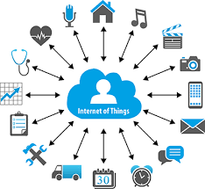
IoT

Slide 19
IoT
Internet Of Things is Fully Networked and Connected Devices sending analytics data back to cloud or data center.
The definition of Internet of things is that it is the network in which every object or thing is provided unique identifier and data is transferred through a network without any verbal communication.
Scope of IoT is not just limited to just connecting things to the internet, but it allows these things to communicate and exchange data, process them as well as control them while executing applications.

Slide 20
Characteristics of IoT
Dynamic Global network & Self-Adapting : Adapt the changes w.r.t changing contexts
Self Configuring : Eg. Fetching latest s/w updates without manual intervention.
Interoperable Communication Protocols : Communicate through various protocols
Unique Identity : Such as Unique IP Address or a URI
Integrated into Information Network : This allows to communicate and exchange data with other devices to perform certain analysis.

Slide 21
Physical Design of IoT
Things in IoT
IoT Protocols

Slide 22
Things in IoT
Refers to IoT devices which have unique identities that can perform sensing, actuating and monitoring capabilities.
IoT devices can exchange data with other connected devices or collect data from other devices and process the data either locally or send the data to centralized servers or cloud – based application back-ends for processing the data.

Slide 23
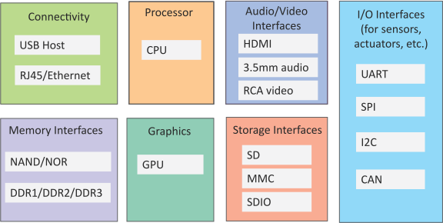
Generic Block Diagram of an IoT Device
An IoT device may consist of several interfaces for connections to other devices, both wired and wireless.
I/O interfaces for sensors
Interfaces for internet connectivity
Memory and storage interfaces
Audio/video interfaces
Book website: http://www.internet-of-things-book.com
Bahga & Madisetti, © 2015

Slide 24
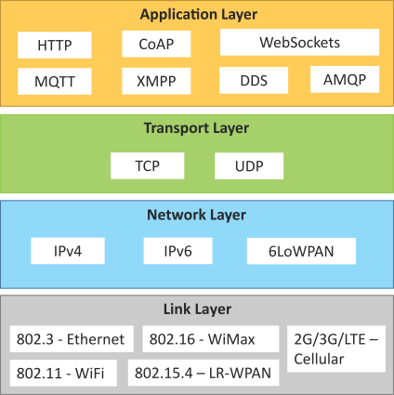
IoT Protocols
Link Layer
802.3 – Ethernet
802.11 – WiFi
802.16 – WiMax
802.15.4 – LR-WPAN
2G/3G/4G
Network/Internet Layer
IPv4
IPv6
6LoWPAN
Transport Layer
TCP
UDP
Application Layer
HTTP
CoAP
WebSocket
MQTT
XMPP
DDS
AMQP
Book website: http://www.internet-of-things-book.com
Bahga & Madisetti, © 2015

Slide 25
IoT Protocols…Link Layer…Ethernet
Sr.No | Standard | Shared medium
1 | 802.3 | Coaxial Cable…10BASE5
2 | 802.3.i | Copper Twisted pair …..10BASE-T
3 | 802.3.j | Fiber Optic……10BASE-F
4 | 802.3.ae | Fiber…..10Gbits/s
Data Rates are provided from 10Gbit/s to 40Gb/s and higher

Slide 26
IoT Protocols…Link Layer…WiFi
Sr.No | Standard | Operates in
1 | 802.11a | 5 GHz band
2 | 802.11b and 802.11g | 2.4GHz band
3 | 802.11.n | 2.4/5 GHz bands
4 | 802.11.ac | 5GHz band
5 | 802.11.ad | 60Hz band
Collection of Wireless LAN
Data Rates from 1Mb/s to 6.75 Gb/s

Slide 27
IoT Protocols…Link Layer…WiMax
Sr.No | Standard | Data Rate
1 | 802.16m | 100Mb/s for mobile stations 1Gb/s for fixed stations
Collection of Wireless Broadband standards
Data Rates from 1.5Mb/s to 1 Gb/s

Slide 28
IoT Protocols…Link Layer…LR-WPAN
Collection of standards for low-rate wireless personal area networks
Basis for high level communication protocols such as Zigbee
Data Rates from 40Kb/s to 250Kb/s
Provide low-cost and low-speed communication for power constrained devices

Slide 29
IoT Protocols…Link Layer…2G/3G/4G –Mobile Communication
Sr.No | Standard | Operates in
1 | 2G | GSM-CDMA
2 | 3G | UMTS and CDMA 2000
3 | 4G | LTE
Data Rates from 9.6Kb/s (for 2G) to up to 100Mb/s (for 4G)

Slide 30
IoT Protocols…Network/Internet Layer
Responsible for sending of IP datagrams from source to destination network
Performs the host addressing and packet routing
Host identification is done using hierarchical IP addressing schemes such as IPV4 or IPV6

Slide 31
IoT Protocols…Network Layer
IPV4
Used to identify the devices on a network using hierarchical addressing scheme
Uses 32-bit address scheme
IPV6
Uses 128-bit address scheme
6LoWPAN (IPV6 over Low power Wireless Personal Area Network)
Used for devices with limited processing capacity
Operates in 2.4 Ghz
Data Rates of 250Kb/s

Slide 32
IoT Protocols…Transport Layer
Provide end-to-end message transfer capability independent of the underlying network
It provides functions such as error control, segmentation, flow- control and congestion control

Slide 33
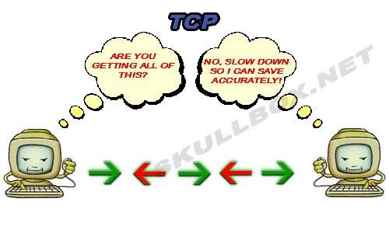
IoT Protocols…TCP
Transmission Control Protocol
Connection Oriented
Ensures Reliable transmission
Provides Error Detection Capability to ensure no duplicacy of packets and retransmit lost packets
Flow Control capability to ensure the sending data rate is not too high for the receiver process
Congestion control capability helps in avoiding congestion which leads to degradation
of n/w performance

Slide 34
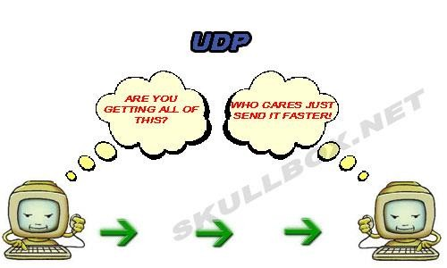
IoT Protocols…UDP
User Datagram Protocol
Connectionless
Does not ensures Reliable transmission
Does not do connection before transmitting
Does not provide proper ordering of messages
Transaction oriented and stateless

Slide 35

IoT Protocols…Application Layer…Hyper Transfer Protocol
Forms foundation of World Wide Web(WWW)
Includes commands such as GET,PUT, POST, HEAD, OPTIONS, TRACE..etc
Follows a request-response model
Uses Universal Resource Identifiers(URIs) to identify HTTP resources

Slide 36
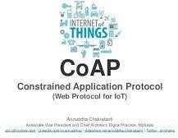
IoT Protocols…Application Layer…CoAP
Constrained Application Protocol
Used for Machine to machine (M2M) applications meant for constrained devices and n/w’s
Web transfer protocol for IoT and uses request-response model
Uses client –server architecture
Supports methods such as GET,POST, PUT and DELETE

Slide 37
IoT Protocols…Application Layer…WebSocket
Allows full-duplex communication over single socket
Based on TCP
Client can be a browser, IoT device or mobile application
IoT Protocols…Application Layer…MQTT
Message Queue Telemetry Transport , light-weight messaging protocol
Based on publish-subscribe model
Well suited for constrained environments where devices have limited processing, low
memory and n/w bandwith requirement

Slide 38
IoT Protocols…Application Layer…XMPP
Extensible messaging and presence protocol
For Real time communication and streaming XML data between n/w entities
Used for Applications such as Multi-party chat and voice/video calls.
Decentralized protocol and uses client server architecture.

Slide 39
IoT Protocols…Application Layer…DDS
Data Distribution service is a data-centric middleware standard for device-to-device or machine-to-machine communication.
Publish subscribe model where publishers create topics to which subscribers can use.
Provides Quality-of-service control and configurable reliability.

Slide 40
IoT Protocols…Application Layer…AMQP
Advanced Messaging Queuing Protocol used for business messaging.
Supports both point-to-point and publisher/subscriber models, routing and queuing
Broker here receives messages from publishers and route them over connections to consumers through messaging queues.

Slide 41
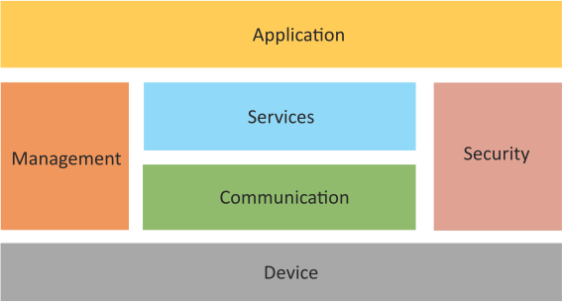
Logical Design of IoT
Logical design of an IoT system refers to an abstract representation of the entities and processes without going into the low-level specifics of the implementation.
An IoT system comprises a number of functional blocks that
provide capabilities sensing,
the system the
for
identification, actuation,
communication and management.
Book website: http://www.internet-of-things-book.com
Bahga & Madisetti, © 2015

Slide 42
Logical Design of IoT
Device : Devices such as sensing, actuation, monitoring and control functions.
Communication : IoT Protocols
Services like device monitoring, device control services, data publishing services and device discovery
Management : Functions to govern the system
Security : Functions as authentication, authorization, message and content integrity, and data security
Applications

Slide 43
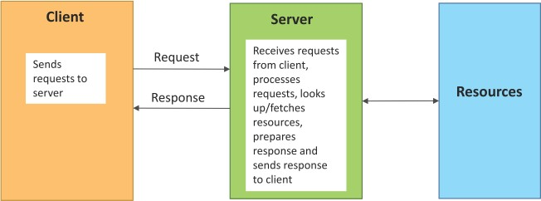
Request–Response Communication Model
Request–Response is a communication model in which the client sends requests to the server and the server responds to the requests.
When the server receives a request, it decides how to respond, fetches the data, retrieves resource representations, prepares the response and then sends the response to the client.
Stateless communication model

Slide 44
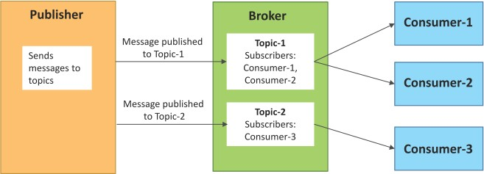
Publish–Subscribe Communication Model
Publish–Subscribe is a communication model that involves publishers, brokers and consumers.
Publishers are the source of data. Publishers send the data to the topics which are managed by the broker.
Publishers are not aware of the consumers.
Consumers subscribe to the topics which are managed by the broker.
When the broker receives data for a topic from the publisher, it sends the data to all the subscribed consumers.

Slide 45
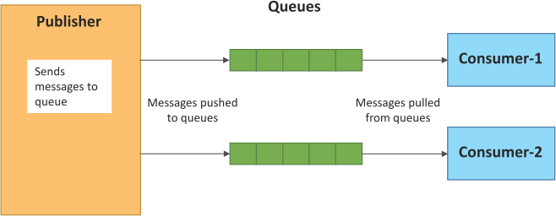
Push–Pull Communication Model
Push–Pull is a communication model in which the data producers push the data to queues and the consumers pull the data from the queues. Producers do not need to be aware of the consumers.
Queues help in decoupling the messaging between the producers and consumers.
Queues also act as a buffer which helps in situations when there is a mismatch between the rate at which the producers push data and the rate at which the consumers pull data.

Slide 46
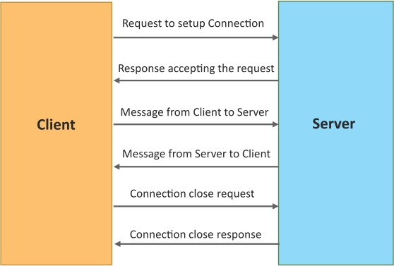
Exclusive Pair Communication Model
• Exclusive Pair is a bidirectional, fully duplex communication model that uses a persistent connection between the client and the server.
• Once the connection is set up it, remains open until the client sends a request to close the connection.
• Client and server can send messages to each other after connection setup.

Slide 47
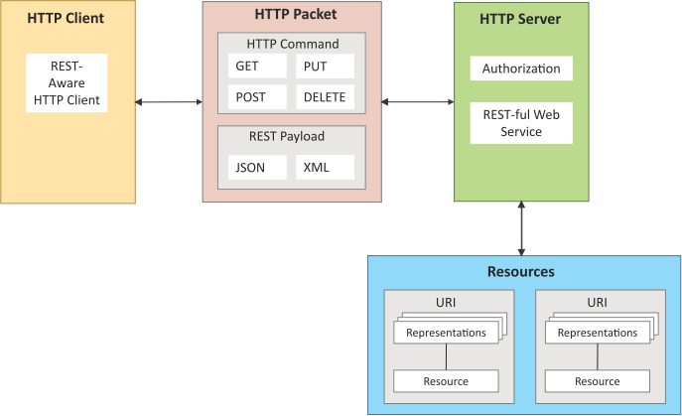
REST-based Communication APIs
• Representational State Transfer (REST) is a set of architectural principles by which you can design web services and web APIs that focus on a system’s resources and how resource states are addressed and transferred.
• REST APIs follow the request– response communication model.
• REST architectural constraints apply to the components, connectors and data elements within a distributed hypermedia system.

Slide 48
REST-based Communication APIs Constraints
Client – Server
Stateless
Cacheable
Layered System
Uniform Interface
Code on demand
Client
Server
Request
Response
Request
Response

Slide 49
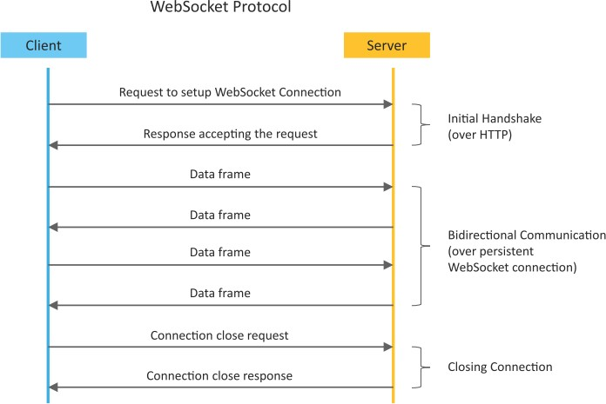
WebSocket-based Communication APIs
WebSocket APIs allow bi- directional, full duplex communication between clients and servers.
WebSocket APIs follow the exclusive pair communication model.

Slide 50
Difference between REST and WebSocket-based Communication APIs
Comparison Based on | REST | Websocket
State | Stateless | Stateful
Directional | Unidirectional | Bidirectional
Req-Res/Full Duplex | Follow Request Response Model | Exclusive Pair Model
TCP Connections | Each HTTP request involves setting up a new TCP Connection | Involves a single TCP Connection for all requests
Header Overhead | Each request carries HTTP Headers, hence not suitable for real-time | Does not involve overhead of headers.
Scalability | Both horizontal and vertical are easier | Only Vertical is easier

Slide 51
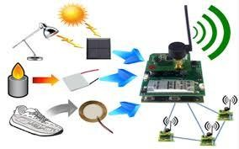

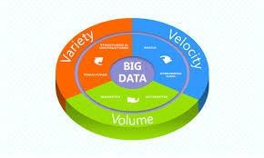
IoT Enabling Technologies
Wireless Sensor Network
Cloud Computing
Big Data Analytics
Embedded Systems

Slide 52
WSN
Distributed Devices with sensors used to monitor the environmental and physical conditions
Consists of several end-nodes acting as routers or coordinators too
Coordinators collects data from all nodes / acts as gateway that connects WSN to internet
Routers route the data packets from end nodes to coordinators.

Slide 53
Example of WSNs in IoT & Protocols used
Example
Weather monitoring system
Indoor Air quality monitoring system
Soil moisture monitoring system
Survelliance systems
Health monitoring systems
Protocols
Zigbee

Slide 54
Cloud Computing
Deliver applications and services over internet
Provides computing, networking and storage resources on demand
Cloud computing performs services such as Iaas, Paas and Saas
Iaas : Rent Infrastructure
Paas : supply an on-demand environment for developing, testing, delivering and managing software applications.
Saas : method for delivering software applications over the Internet, on demand and typically on a subscription basis.

Slide 55

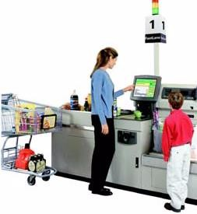
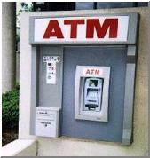
Big Data Analytics
Collection of data whose volume, velocity or variety is too large and difficult to store, manage, process and analyze the data using traditional databases.
It involves data cleansing, processing and visualization
Lots of data is being collected and warehoused
Web data, e-commerce
purchases at department/ grocery stores
Bank/Credit Card transactions
Social Network

Slide 56
Big Data Analytics
Variety Includes different types of data
Structured
Unstructured
SemiStructured
All of above

Slide 57
Big Data Analytics
Velocity Refers to speed at which data is processed
Batch
Real-time
STreams

Slide 58
Big Data Analytics
Volume refers to the amount of data
Terabyte
Records
Transactions
Files
Tables

Slide 59
IoT Levels and Deployment Templates
An IoT system comprises the following components:
Device: An IoT device allows identiﬁcation, remote sensing, actuating and remote monitoring capabilities.
Resource: Resources are software components on the IoT device for accessing, processing and storing sensor information, or for controlling actuators connected to the device. Resources also include the software components that enable network access for the device.
Controller Service: Controller service is a native service that runs on the device and interacts with the web services. Controller service sends data from the device to the web service and receives commands from the application (via web services) for controlling the device.
Bahga & Madisetti, © 2015

Slide 60
IoT Levels and Deployment Templates
Database: Database can be either local or in the cloud and stores the data generated by the IoT device.
Web Service: Web services serve as a link between the IoT device, application, database and analysis components.Web service can be implemented using HTTP and REST principles (REST service) or using the WebSocket protocol (WebSocket service).
Analysis Component: This is responsible for analyzing the IoT data and generating results in a form that is easy for the user to understand.
Application: IoT applications provide an interface that the users can use to control and monitor various aspects of the IoT system. Applications also allow users to view the system status and the processed data.

Slide 61
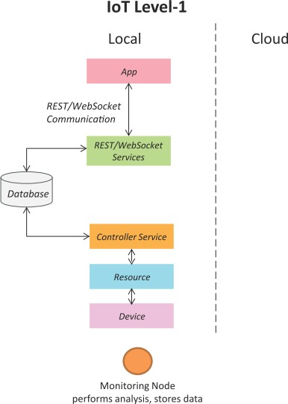
IoT Level-1
A level - 1 IoT system has a single node/device that performs sensing and/or actuation, stores data, performs analysis and hosts the application .
Level - 1 IoT systems are suitable for modeling low - cost and low -complexity solutions where the data involved is not big and the analysis requirements are not computationally intensive .

Slide 62
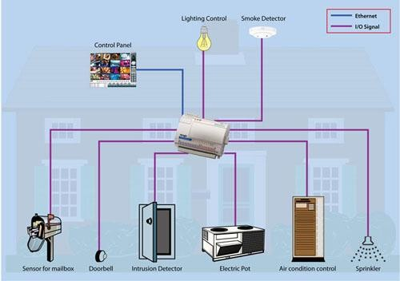
IoT – Level 1 Example …Home Automation System

Slide 63
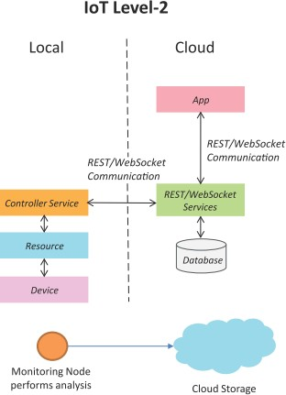
IoT Level-2
A level-2 IoT system has a single node that performs sensing and/or actuation and local analysis.
Data is stored in the cloud and the application is usually cloud-based.
Level-2 IoT systems are suitable for solutions where the data involved is big; however, the primary analysis requirement is not computationally intensive and can be done locally.

Slide 64
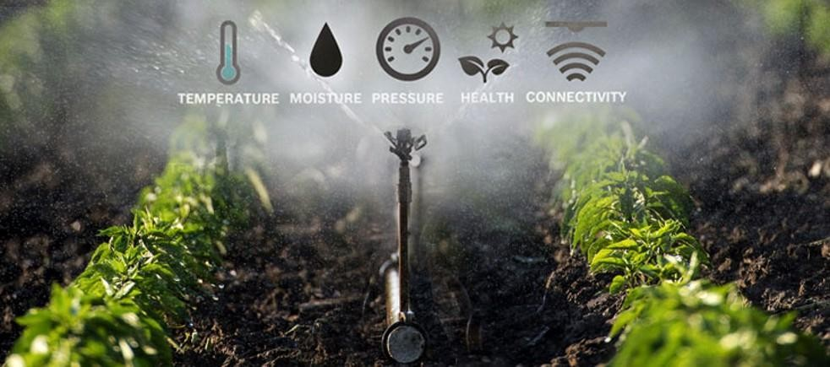
IoT – Level 2 Example …Smart Irrigation

Slide 65
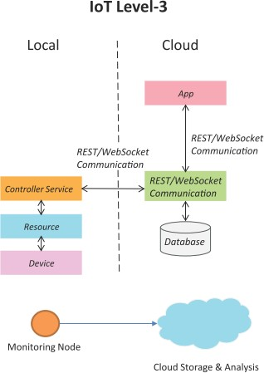
IoT Level-3
A level-3 IoT system has a single node. Data is stored and analyzed in the cloud and the application is cloud-based.
Level-3 IoT systems are suitable for solutions where the data involved is
computationally intensive.

Slide 66
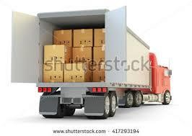
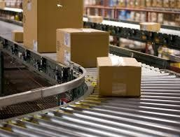
IoT – Level 3 Example …Tracking Package Handling
Sensors used accelrometer and gyroscope

Slide 67
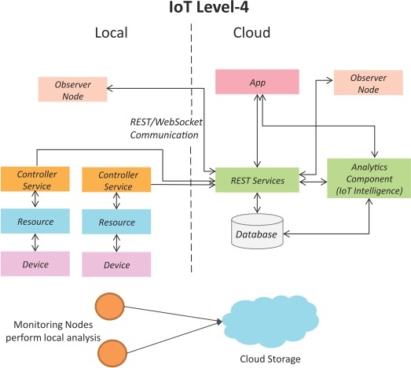
IoT Level-4
A level-4 IoT system has multiple nodes that perform local analysis. Data is stored in the cloud and the application is cloud-based.
Level-4 contains local and cloud- based observer nodes which can subscribe to and receive information collected in the cloud from IoT devices.
Level-4 IoT systems are suitable for solutions where multiple nodes are required, the data involved is big and the analysis requirements are computationally intensive.

Slide 68
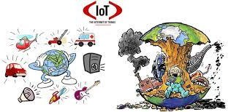
IoT – Level 3 Example …Noise Monitoring
Sound Sensors are used

Slide 69
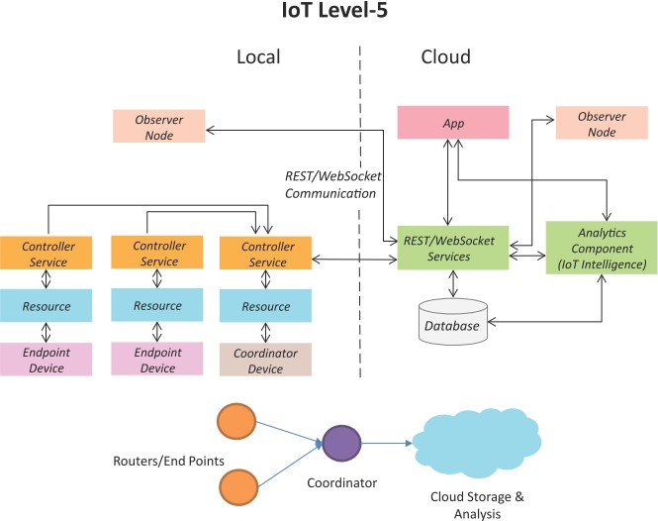
IoT Level-5
A level-5 IoT system has multiple end nodes and one coordinator node.
The end nodes perform sensing
and/or actuation.
The coordinator node collects data from the end nodes and sends it to the cloud.
Data is stored and analyzed in the cloud and the application is cloud- based.
Level-5 IoT systems are suitable for solutions based on wireless sensor networks, in which the data involved is big and the analysis requirements are computationally intensive.

Slide 70
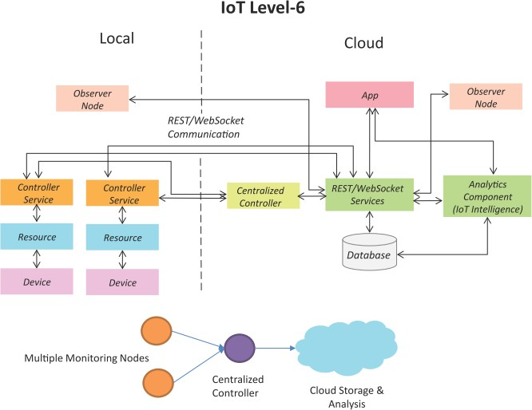
IoT Level-6
A level-6 IoT system has multiple independent end nodes that perform sensing and/or actuation and send data to the cloud.
Data is stored in the cloud and the application is cloud-based.
The analytics component analyzes the data and stores the results in the cloud database.
The results are visualized with the cloud-based application.
The centralized controller is aware of the status of all the end nodes and sends control commands to the nodes.

