Slide 1
IoT & M2M

Slide 2
Outline
M2M
Differences and Similarities between M2M and IoT
SDN and NFV for IoT

Slide 3
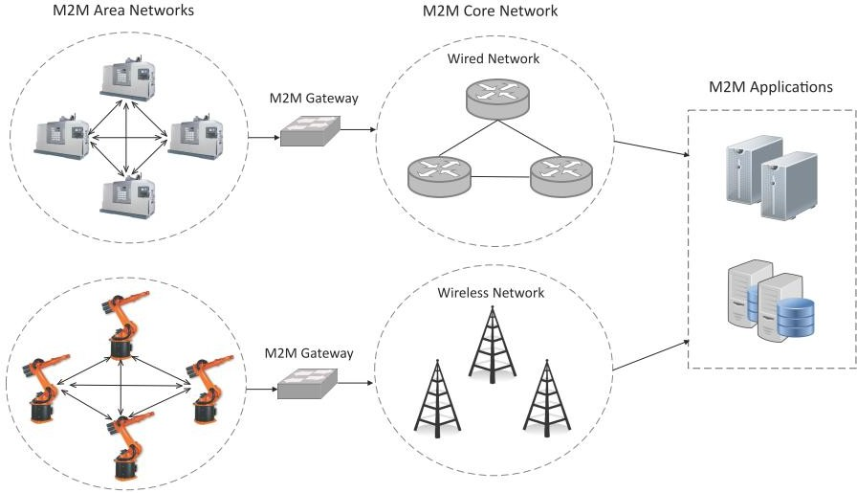
Machine-to-Machine (M2M)
Machine-to-Machine (M2M) refers to networking of machines (or devices) for the purpose of remote monitoring and control and data exchange.

Slide 4
Machine-to-Machine (M2M)
An M2M area network comprises of machines (or M2M nodes) which have embedded hardware modules for sensing, actuation and communication.
Various communication protocols can be used for M2M local area networks such as ZigBee, Bluetooh, ModBus, M-Bus, Wirless M-Bus, Power Line Communication (PLC), 6LoWPAN, IEEE 802.15.4, etc.
The communication network provides connectivity to remote M2M area networks.
The communication network can use either wired or wireless networks (IP- based).
While the M2M area networks use either proprietary or non-IP based communication protocols, the communication network uses IP-based networks.

Slide 5
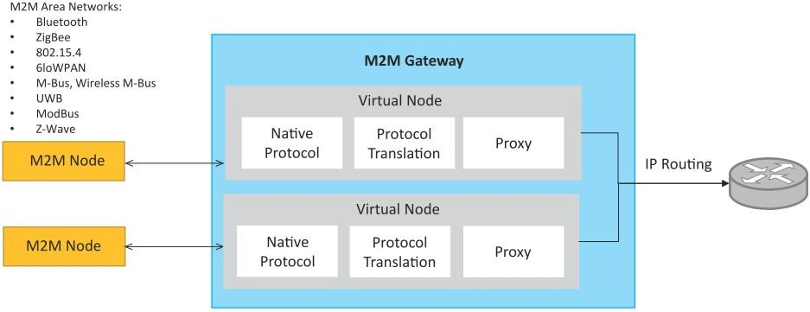
M2M gateway
Since non-IP based protocols are used within M2M area networks, the M2M nodes within one network cannot communicate with nodes in an external network.
To enable the communication between remote M2M area networks, M2M gateways are used.

Slide 6
Difference between IoT and M2M
Communication Protocols
M2M and IoT can differ in how the communication between the machines or devices happens.
M2M uses either proprietary or non-IP based communication protocols for communication within the M2M area networks.
Machines in M2M vs Things in IoT
The "Things" in IoT refers to physical objects that have unique identiﬁers and can sense and communicate with their external environment (and user applications) or their internal physical states.
M2M systems, in contrast to IoT, typically have homogeneous machine types within an M2M area network.

Slide 7
Difference between IoT and M2M
Hardware vs Software Emphasis
While the emphasis of M2M is more on hardware with embedded modules, the emphasis of IoT is more on software.
Data Collection & Analysis
M2M data is collected in point solutions and often in on-premises storage infrastructure.
In contrast to M2M, the data in IoT is collected in the cloud (can be public, private or hybrid cloud).
Applications
M2M data is collected in point solutions and can be accessed by on-premises applications such as diagnosis applications, service management applications, and on- premisis enterprise applications.
IoT data is collected in the cloud and can be accessed by cloud applications such as analytics applications, enterprise applications, remote diagnosis and management applications, etc.

Slide 8
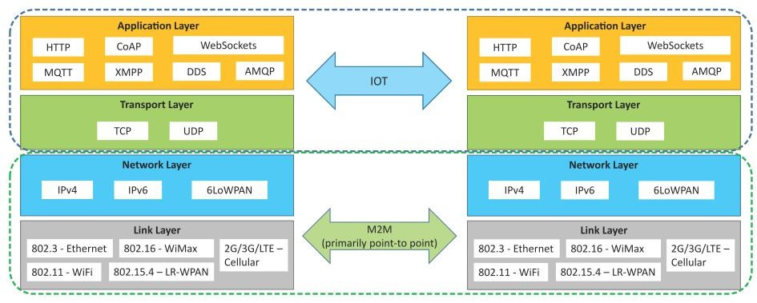
Communication in IoT vs M2M

Slide 9
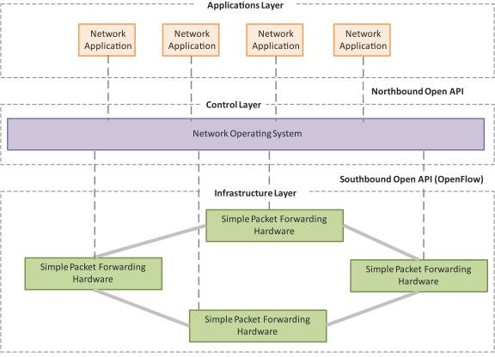
SDN
Software-Deﬁned Networking (SDN) is a networking architecture that separates the control plane from the data plane and centralizes the network controller.
Software-based SDN controllers maintain a uniﬁed view of the network and make conﬁ guration, management and provisioning simpler.
The underlying infrastructure in SDN uses simple packet forwarding hardware as opposed to specialized hardware in conventional networks.

Slide 10
Key elements of SDN
Centralized Network Controller
With decoupled control and data planes and centralized network controller, the network administrators can rapidly configure the network.
Programmable Open APIs
SDN architecture supports programmable open APIs for interface between the SDN application and control layers (Northbound interface).
Standard Communication Interface (OpenFlow)
SDN architecture uses a standard communication interface between the control and infrastructure layers (Southbound interface).
OpenFlow, which is deﬁned by the Open Networking Foundation (ONF) is the broadly accepted SDN protocol for the Southbound interface.

Slide 11
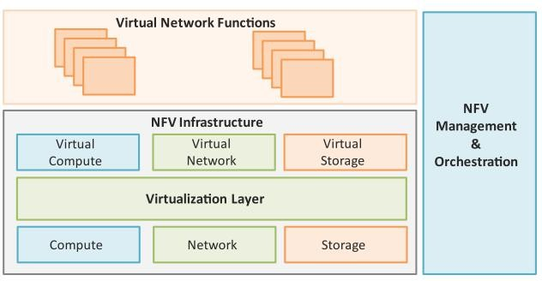
NFV
Network Function Virtualization (NFV) is a technology that leverages virtualization to consolidate the heterogeneous network devices onto industry standard high volume servers, switches and storage.
NFV is complementary to SDN as NFV can provide the infrastructure on which SDN can run.

Slide 12
Key elements of NFV
Virtualized Network Function (VNF):
VNF is a software implementation of a network function which is capable of running over the NFV Infrastructure (NFVI).
NFV Infrastructure (NFVI):
NFVI includes compute, network and storage resources that are virtualized.
NFV Management and Orchestration:
NFV Management and Orchestration focuses on all virtualization-specific management tasks and covers the orchestration and life-cycle management of physical and/or software resources that support the infrastructure virtualization, and the life-cycle management of VNFs.

Slide 13
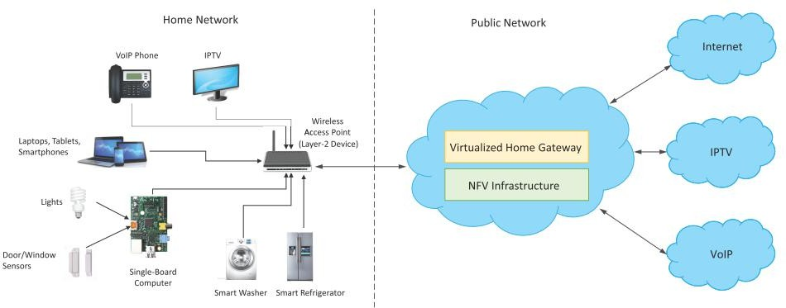
NFV Use Case
NFV can be used to virtualize the Home Gateway. The NFV infrastructure in the cloud hosts a virtualized Home Gateway. The virtualized gateway provides private IP addresses to the devices in the home. The virtualized gateway also connects to network services such as VoIP and IPTV.

Slide 14
IoT System Management with NETCONF-YANG
Book website: http://www.internet-of-things-book.com
Bahga & Madisetti, © 2015

Slide 15
Outline
Need for IoT Systems Management
SNMP
Network Operator Requirements
NETCONF
YANG
IoT Systems Management with NETCONF-YANG
Book website: http://www.internet-of-things-book.com

Slide 16
Need for IoT Systems Management
Automating Configuration
Monitoring Operational & Statistical Data
Improved Reliability
System Wide Configurations
Multiple System Configurations
Retrieving & Reusing Configurations
Book website: http://www.internet-of-things-book.com

Slide 17
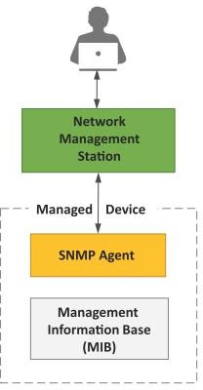
Simple Network Management Protocol (SNMP)
SNMP is a well-known and widely used network management protocol that allows monitoring and conﬁguring network devices such as routers, switches, servers, printers, etc.
SNMP component include
Network Management Station (NMS)
Managed Device
Management Information Base (MIB)
SNMP Agent that runs on the device
Book website: http://www.internet-of-things-book.com

Slide 18
Limitations of SNMP
SNMP is stateless in nature and each SNMP request contains all the information to process the request. The application needs to be intelligent to manage the device.
SNMP is a connectionless protocol which uses UDP as the transport protocol, making it unreliable as there was no support for acknowledgement of requests.
MIBs often lack writable objects without which device configuration is not possible using SNMP.
It is difficult to differentiate between configuration and state data in MIBs.
Retrieving the current configuration from a device can be difficult with SNMP.
Earlier versions of SNMP did not have strong security features.
Book website: http://www.internet-of-things-book.com

Slide 19
Network Operator Requirements
Ease of use
Distinction between configuration and state data
Fetch configuration and state data separately
Configuration of the network as a whole
Configuration transactions across devices
Configuration deltas
Dump and restore configurations
Configuration validation
Configuration database schemas
Comparing configurations
Role-based access control
Consistency of access control lists:
Multiple configuration sets
Support for both data-oriented and task- oriented access control
Book website: http://www.internet-of-things-book.com

Slide 20
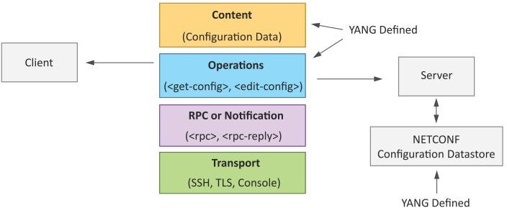
NETCONF
Network Configuration Protocol (NETCONF) is a session-based network management protocol. NETCONF allows retrieving state or configuration data and manipulating configuration data on network devices
Book website: http://www.internet-of-things-book.com

Slide 21
NETCONF
NETCONF works on SSH transport protocol.
Transport layer provides end-to-end connectivity and ensure reliable delivery of messages.
NETCONF uses XML-encoded Remote Procedure Calls (RPCs) for framing request and response messages.
The RPC layer provides mechanism for encoding of RPC calls and notifications.
NETCONF provides various operations to retrieve and edit configuration data from network devices.
The Content Layer consists of configuration and state data which is XML-encoded.
The schema of the configuration and state data is defined in a data modeling language called YANG.
NETCONF provides a clear separation of the configuration and state data.
The configuration data resides within a NETCONF configuration datastore on the server.
Book website: http://www.internet-of-things-book.com

Slide 22
YANG
YANG is a data modeling language used to model configuration and state data manipulated by the NETCONF protocol
YANG modules contain the definitions of the configuration data, state data, RPC calls that can be issued and the format of the notifications.
YANG modules defines the data exchanged between the NETCONF client and server.
A module comprises of a number of 'leaf' nodes which are organized into a hierarchical tree structure.
The 'leaf' nodes are specified using the 'leaf' or 'leaf-list' constructs.
Leaf nodes are organized using 'container' or 'list' constructs.
A YANG module can import definitions from other modules.
Constraints can be defined on the data nodes, e.g. allowed values.
YANG can model both configuration data and state data using the 'config' statement.
Book website: http://www.internet-of-things-book.com

Slide 23
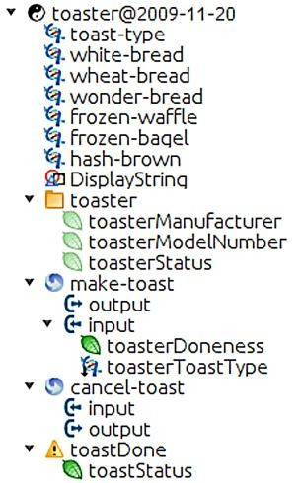
YANG Module Example
This YANG module is a YANG version of the toaster MIB
The toaster YANG module begins with the header information followed by identity declarations which define various bread types.
The leaf nodes (‘toasterManufacturer’, ‘toasterModelNumber’ and oasterStatus’) are defined in the ‘toaster’ container.
Each leaf node definition has a type and optionally a description and default value.
The module has two RPC definitions (‘make-toast’ and ‘cancel-toast’).
Book website: http://www.internet-of-things-book.com

Slide 24
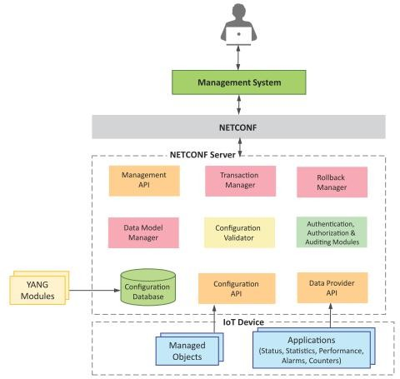
IoT Systems Management with NETCONF-YANG
Management System
Management API
Transaction Manager
Rollback Manager
Data Model Manager
Configuration Validator
Configuration Database
Configuration API
Data Provider API
Book website: http://www.internet-of-things-book.com

