Slide 1
IoT Physical Devices & Endpoints
IoT Physical Devices and Endpoints:
Introduction to Raspberry PI-Interfaces (serial, SPI, I2C) Programming Python program with Raspberry PI with focus of interfacing external gadgets, controlling output, reading input from pin.

Slide 2

What is an IoT Device
A "Thing" in Internet of Things (IoT) can be any object that has a unique identiﬁer and which can send/receive data (including user data) over a network (e.g., smart phone, smart TV, computer, refrigerator, car, etc. ).
IoT devices are connected to the Internet and send information about themselves or about their surroundings (e.g. information sensed by the connected sensors) over a network (to other devices or servers/storage) or allow actuation upon the physical entities/environment around them remotely.
Book website: http://www.internet-of-things-book.com

Slide 3
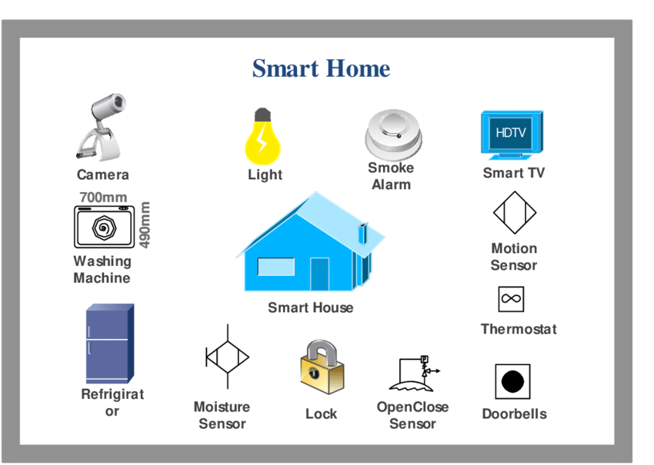
IoT Device Examples

Slide 4
A home automation device that allows remotely monitoring the status of appliances and controlling the appliances.
An industrial machine which sends information abouts its operation and health monitoring data to a server.
A car which sends information about its location to a cloud-based service.
A wireless-enabled wearable device that measures data about a person such as the number of steps walked and sends the data to a cloud-based service.

Slide 5
Basic building blocks of an IoT Device
An IoT device consists of number of modules based on functional attributes such as..
Sensing
Sensors can be either on-board the IoT device or attached to the device.
Ex temperature, humidity, light intensity.
Actuation
IoT devices can have various types of actuators attached that allow taking actions upon the physical entities in the vicinity of the device. Ex. On/off based on the commands send to the device

Slide 6
Communication
Communication modules are responsible for sending collected data to other devices or cloud-based servers/storage and receiving data from other devices and commands from remote applications.
Analysis & Processing
Analysis and processing modules are responsible for making sense of the collected data.

Slide 7
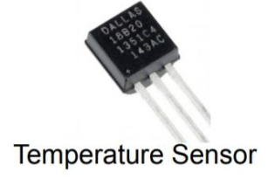
Different types of sensors
1.) A temperature sensor is a device used to measure temperature. This can be air temperature, liquid temperature or the temperature of solid matter. There are different types of temperature sensors available and they each use different technologies and principles to take the temperature measurement.

Slide 8
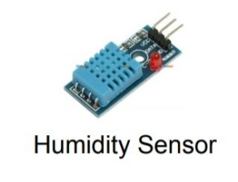
2) A humidity sensor is an electronic device that measures the humidity in its environment and converts its findings into a corresponding electrical signal.

Slide 9

3) A proximity sensor is a sensor able to detect the presence of nearby objects without any physical contact

Slide 10
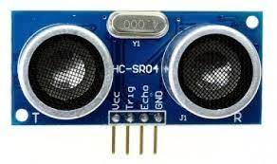
Different types of sensors
3) An ultrasonic sensor is an instrument that measures the distance to an object using ultrasonic sound waves. An ultrasonic sensor uses a transducer to send and receive ultrasonic pulses that relay back information about an object's proximity.

Slide 11
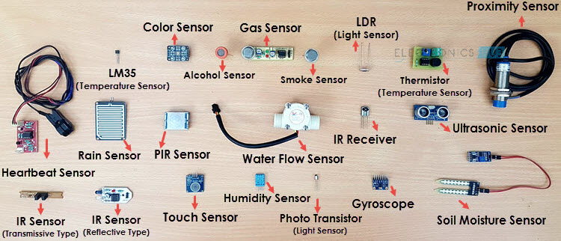
Different types of sensors

Slide 12
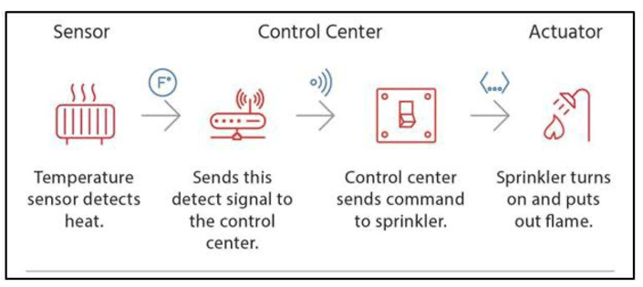
Actuators
An actuator is a device that produces a motion by converting energy and signals going into the system. The motion it produces can be either rotary or linear.
An actuator is a device that produces a motion by converting energy and signals going into the system. ... The actuator could be electrical, pneumatic or hydraulic.
Sensor to actuator flow

Slide 13
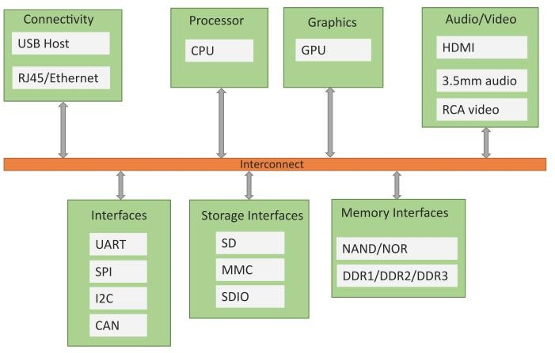
Block diagram of an IoT Device
Single Board Computer(SBC) based on IoT device
Controller Area Network (CAN bus)
I2c:Inter-Integrated Circuit
Spi:serial Peripheral Interface
UART:universal asynchronous receiver-transmitter

Slide 14
Exemplary Device: Raspberry Pi
Raspberry Pi is a low-cost mini-computer with the physical size of a credit card.
Raspberry Pi runs various ﬂavors of Linux and can perform almost all tasks that a normal desktop computer can do.
Raspberry Pi also allows interfacing sensors and actuators through the general purpose I/O pins.
Since Raspberry Pi runs Linux operating system, it supports Python "out of the box".
Book website: http://www.internet-of-things-book.com

Slide 15
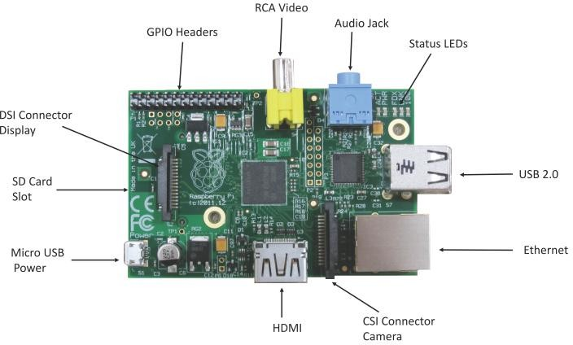
Raspberry Pi
Book website: http://www.internet-of-things-book.com

Slide 16
Raspberry Pi
1. Micro-USB Power Supply:
A 5V micro USB typically powers the Raspberry Pi. But how much current (in milliamps or amps) the Pi
requires to function depends on your usage.The Raspberry Pi boards typically draw much lower amounts, between
200 and 500mA
2. SD Card Slot:
Secure Digital Card slot (SD Card) slot is a solid-state removable storage device which is required to run operating
systems on Raspberry Pi as Raspberry Pi doesn’t have any onboard memory and data storage functionality.
3. USB Ports & Ethernet Port:
USB Port: The number and type of USB ports on Raspberry Pi depends on the model.
The Pi 4 has two USB 2.0 ports and two USB 3.0 ports.
Ethernet Port: In order to enable Internet connection online and to update the software’s or to install latest packages
from online repositories, Raspberry Pi supports Ethernet Connection. Raspberry Pi (Every Model)
comprise of RJ45 Ethernet Jack which supports CAT5/6 cable
Book website: http://www.internet-of-things-book.com

Slide 17
Raspberry Pi
4.HDMI (High Definition Multimedia Interface):
HDMI Port enables Raspberry Pi to be connected to HDTV via HDMI cable.
5.Video Out (RCA Cable):
In addition to HDMI Connectivity which facilitates HD connection, Raspberry Pi also has provision to be connected to standard monitor or TV using RCA video cable. RCA cable is less expensive as compared to HDMI
.

Slide 18
Raspberry Pi
6. Status Led’s:
Raspberry Pi comprise of 5 main LED’s performing the following functions:
ACT: (Color-Green): The main function of ACT LED is to show card status. Normally flashing during any SD Card activity performed by end user.
PWR: (Color-Red): The main function of PWR led is power. This led is continuously ON when raspberry Pi is switched on and keep on till switched off.
FDX: (Color-Orange): The main function of FDX led is full duplex. This Led is powered on when Ethernet connection is of Full Duplex type.
LNK: (Color- Orange): The function performed by LNK led is Link. This LED is powered on when Ethernet connection is established and packet transfer starts taking place.
100: (Color-Orange): The 100 Led objective is to show 100 Mbps connection. When any connection is established at Ethernet port, this LED only gets on when connection is of 100 Mbps speed and gets powered off when connection is at 10 Mbps

Slide 19
Raspberry Pi
.
7. GPIO (General Purpose Input Output):
GPIO facilitates connecting all sorts of peripheral devices to Raspberry Pi. Raspberry Pi has onboard GPIO with 40 pins, 26 of which are used as digital inputs or outputs
8. CSI Camera Connector:
Raspberry Pi has a Mobile Industry Processor Interface (MIPI) Camera Serial Interface Type 2 (CSI-2). CSI-2 facilitates connection of small camera to Broadcom BCM 2835 processor. The function of this interface is to standardize the attachment of camera modules to the processors for the mobile phone industry.

Slide 20
Raspberry Pi
Both Arduino and Raspberry Pi are good teaching tools for students, beginners and hobbyists. Let us see some of the differences between Raspberry Pi and Arduino.
The main difference between them is: Arduino is microcontroller board,
while Raspberry Pi is a microprocessor based mini computer (SBC).
The Microcontroller on the Arduino board contains the CPU, RAM and ROM. All the additional hardware on
Arduino Board is for power supply, programming and IO Connectivity.
Raspberry Pi SBC has all features of a computer with a processor, memory, storage, graphics driver,
connectors on the board.
Differences between Raspberry Pi and Arduino

Slide 21
Raspberry Pi
Raspberry Pi needs an Operating System to run.
Arduino doesn’t need any operating system. All you need is a binary of the compiled source code.
Raspberry Pi comes with a fully functional operating system called Raspberry Pi OS (previously known as Raspbian OS). Although Pi can use different operating systems, Linux is preferred by Raspberry Pi Foundation. You can install Android, if you want.
Arduino does not have any operating system. You just need a firmware instructing the Microcontroller what task to do.
The clock speed of Arduino is 16 MHz while the clock speed of Raspberry Pi is around 1.2 GHz.
Raspberry Pi is good for developing software applications using Python,
while Arduino is good for interfacing Sensors and controlling LEDs and Motors.

Slide 22
Linux on Raspberry Pi Rasberry Pi supports various flavors on Linux including
Raspbian
Raspbian Linux is a Debian Wheezy port optimized for Raspberry Pi.
Arch
Arch is an Arch Linux port for AMD devices.
Pidora
Pidora Linux is a Fedora Linux optimized for Raspberry Pi.
RaspBMC
RaspBMC is an XBMC media-center distribution for Raspberry Pi.
OpenELEC
OpenELEC is a fast and user-friendly XBMC media-center distribution.
RISC OS
RISC OS is a very fast and compact operating system.

Slide 23
Raspberry Pi GPIO
One powerful feature of the Raspberry Pi is the row of GPIO pins along the top edge of the board.
GPIO= General-Purpose Input/Output
The GPIO pins allow the Raspberry Pi to control and monitor the outside world by being connected to electronic circuits

Slide 24
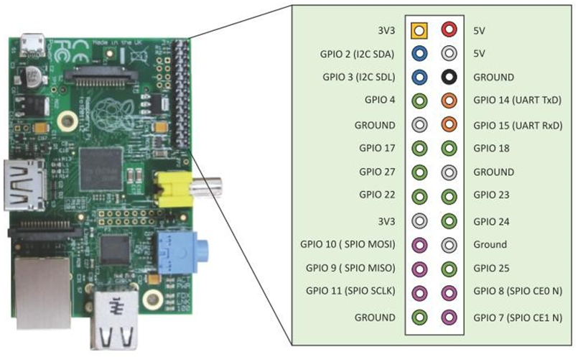

Slide 25
3V3 | 3.3 volts | Anything connected to these pins will always get 3.3V of power
5V | 5 volts | Anything connected to these pins will always get 5V of power
GND | ground | Zero volts, used to complete a circuit
GP2 | GPIO pin 2 | These pins are for general-purpose use and can be configured as input or output pins

Slide 26
Raspberry Pi Interfaces
Serial
The serial interface on Raspberry Pi has receive (Rx) and transmit (Tx) pins for communication with serial peripherals.
SPI
Serial Peripheral Interface (SPI) is a synchronous serial data protocol used for communicating with one or more peripheral devices.
I2C
The I2C interface pins on Raspberry Pi allow you to connect hardware modules. I2C interface allows synchronous data transfer with just two pins - SDA (data line) and SCL (clock line).
Book website: http://www.internet-of-things-book.com

Slide 27
Raspberry Pi OS
Raspberry Pi needs an OS to work. Raspberry Pi OS previously called Raspbian is the official supported operating system.
Step 1: Download the Required Software and Files
Raspbian OS( Rasberry Pi OS): This is the Main operating system of the Pi.
https://www.raspberrypi.org/downloads/raspbian/
or https://www.raspberrypi.com/software/
The imager tool is available on Windows, macOS, and Ubuntu. Images shown will be from a Mac, but the tool will work the same across the supported platforms.

Slide 28
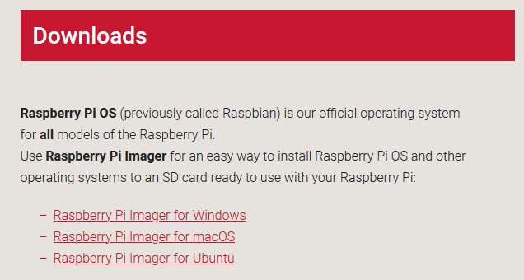

Slide 29
Raspberry Pi OS
Raspberry Pi needs an OS to work. Raspberry Pi OS previously called Raspbian is the official supported operating system.
Step 2: Download the Raspberry Pi Imager for your operating system and follow the installation instructions.
Launch Raspberry Pi Imager

Slide 30
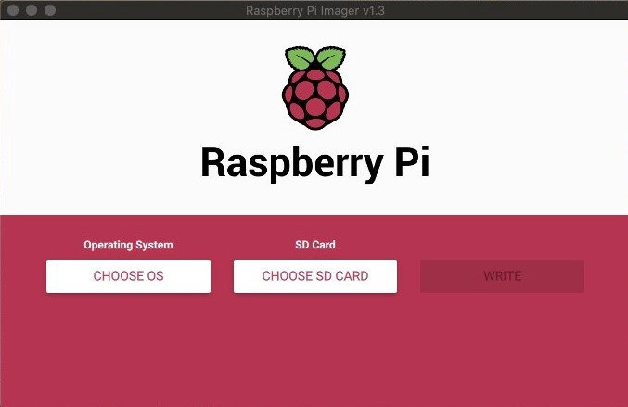

Slide 31
Raspberry Pi OS
Raspberry Pi needs an OS to work. Raspberry Pi OS previously called Raspbian is the official supported operating system.
Step 3: Choose SD Card
You’ll now need your SD card connected to your computer to copy over the OS you chose
Select CHOOSE SD CARD and select the SD card you have connected to your computer.
You’re now ready to begin writing the OS to your SD card

Slide 32
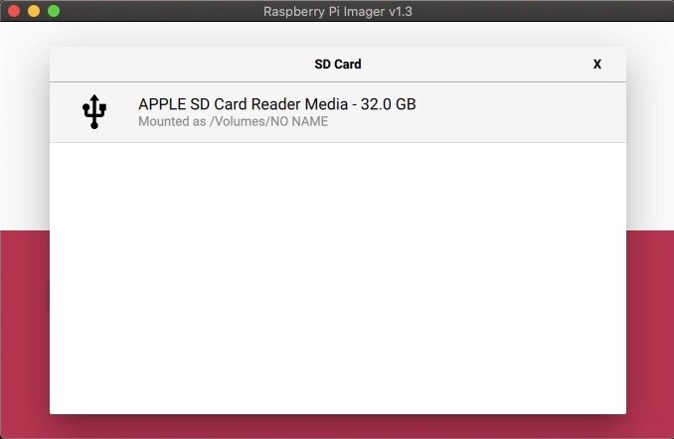

Slide 33
Raspberry Pi OS
Raspberry Pi needs an OS to work. Raspberry Pi OS previously called Raspbian is the official supported operating system.
Step 3: Write to SD Card
This step will write the selected OS to the SD card and run a verification that the copy was successful
Select WRITE
The OS has now been copied to your SD card. You are now ready to move on to booting your Raspberry Pi.

Slide 34
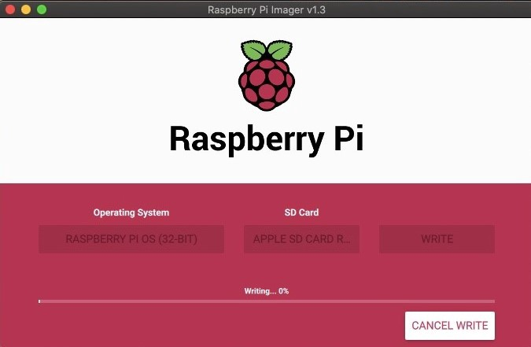

Slide 35
Raspberry Pi OS
Step 5:
Booting Your Raspberry Pi Insert your microSDHC card into your Raspberry Pi. Then, hook up your Raspberry Pi to power, keyboard, mouse, and monitor.
You should be brought directly into the Raspberry Pi OS with a Welcome to Raspberry Pi dialog on the display.

Slide 36
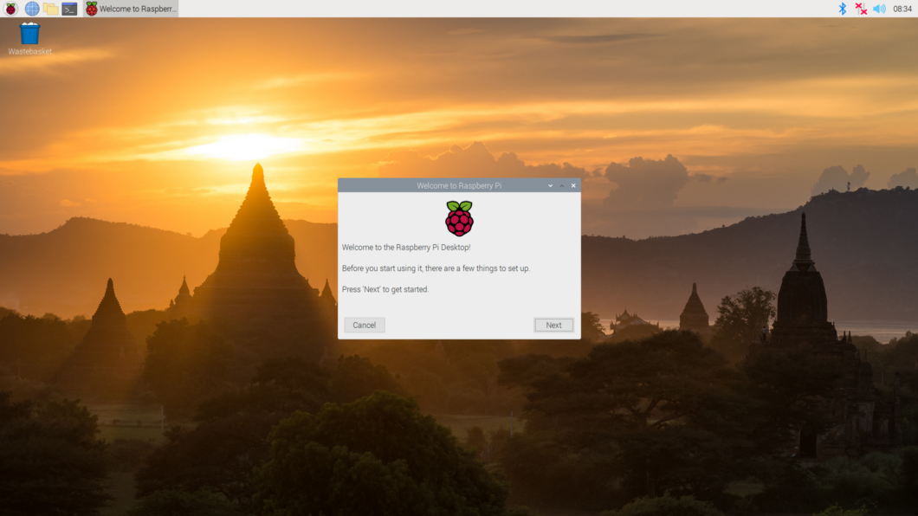

Slide 37
Programming Raspberry Pi with Python
Controlling LED with Rasberry Pi
Step 1:
Hardware setup – Make a circuit with your Raspberry Pi and the LED
First of all, make sure your Raspberry Pi is powered off. This is very important. Never plug/unplug any hardware component while your Pi is powered on.
To build this circuit you will need:
A breadboard
A Raspberry Pi with GPIO header
1 LED – the color doesn’t matter
1 resistor
A set of male to female wires.

Slide 38
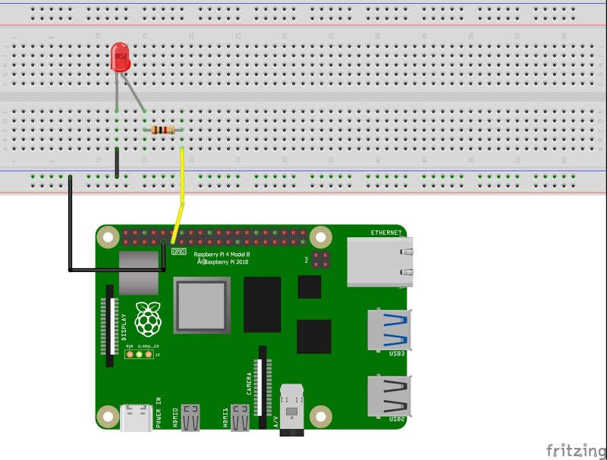

Slide 39
Programming Raspberry Pi with Python
Controlling LED with Raspberry Pi
Step 2: Make a circuit with your Raspberry Pi and the LED
Connect one wire between one GND (ground) pin of the Raspberry Pi and the blue line of the breadboard.
Take the LED and check the 2 legs. You will see that one is shorter than the other. Plug the shorter leg to the blue line (now connected to GND), and the longer to any other connector. You can either directly connect the shorter leg to the blue line, or add an additional short male-to-male connector (like in the picture), the result is the same.
Plug one leg of the resistor to the same line as the longer leg of the LED, and the other leg of the resistor to a different line.
Finally, to close the circuit plug one wire between the same line as the other leg of the resistor, and the GPIO number 17 This is the 6th pin on the GPIO header, starting from the left, on the inside side.

Slide 41
Programming Raspberry Pi with Python
Controlling LED with Rasberry Pi
Step 3:
Control the LED with Python 3 on Raspberry Pi OS
Open Thonny IDE on Raspberry Pi OS (Menu > Programming > Thonny Python IDE) or any other
IDE/text editor you like.
PYTHON Code Simple control of the LED

Slide 42
import RPi.GPIO as GPIO
import time
LED_PIN = 17
GPIO.setmode(GPIO.BCM)
GPIO.setup(LED_PIN, GPIO.OUT)
GPIO.output(LED_PIN, GPIO.HIGH)
time.sleep(1)
GPIO.output(LED_PIN, GPIO.LOW)
GPIO.cleanup()
This program will power on the LED for one second, and then power it off.

Slide 44



Programming Raspberry Pi with Python
Controlling LED with Rasberry Pi
Step 3: Control the LED with Python 3 on Raspberry Pi OS
Open Thonny IDE on Raspberry Pi OS (Menu > Programming > Thonny Python IDE) or any other IDE/text editor you like.
PYTHON Code Simple control of the LED
import the RPi.GPIO Python module which will allow us to control all GPIOs from the Raspberry Pi’s GPIO header
import RPi.GPIO as GPIO
import time
LED_PIN = 17
GPIO.setmode(GPIO.BCM)
GPIO.setup(LED_PIN, GPIO.OUT)
GPIO.output(LED_PIN, GPIO.HIGH)
time.sleep(1)
GPIO.output(LED_PIN, GPIO.LOW)
GPIO.cleanup()
create a “constant” global variable containing the GPIO number for the LED
All the setup is finished, we can power on/off the LED. To do that you just have to use one simple command: GPIO.output(), with either GPIO.HIGH to power on the LED, or GPIO.LOW to power off the LED.
This program will power on the LED for one second, and then power it off.

Slide 45
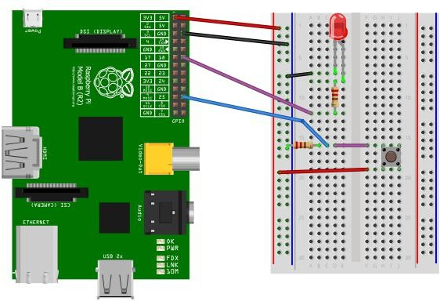
Raspberry Pi Example:
Interfacing LED and switch with Raspberry Pi

