Slide 1
Unit 5
IoT Physical Servers, Cloud Offerings & IoT Case Studies

Slide 2
Content
Introduction to Cloud Storage Models
Communication API
WAMP: AutoBahn for IoT
Xively Cloud for IoT
Python Web Application Framework: Djanjo
Amazon Web Services for IoT
SkyNet IoT Messaging Platform.
Case Studies:
Home Intrusion Detection,
Weather Monitoring System,
Air Pollution Monitoring,
Smart Irrigation.

Slide 3
Introduction to Cloud Storage Models
Cloud computing:
The Internet of Things (IoT) involves the internet-connected devices we use to perform the processes and services that support our way of life. Another component set to help IoT succeed is cloud computing, which acts as a sort of front end.
Cloud computing is the delivery of different services through the Internet. These resources include tools and applications like data storage, servers, databases, networking, and software.
ex. Google photos- You can use Google Photos to upload your photos to internet-based storage.
In truth, cloud computing and IoT are tightly coupled. The growth of IoT and the rapid development of associated technologies create a widespread connection of ―things. This has lead to the production of large amounts of data, which needs to be stored, processed and accessed.

Slide 4
Introduction to Cloud Storage Models
Cloud computing as a paradigm for big data storage and analytics. While IoT is exciting on its own, the real innovation will come from combining it with cloud computing
For example, sensory data can be uploaded and stored with cloud computing, later to be used intelligently for smart monitoring and actuation with other smart devices.
Popular Models are
Amazon Web Service (AWS)
Xively Cloud (PAAS)

Slide 5
Communication API
Cloud Models are relied on Communication API
Communication API facilitate data transfer, control information transfer from application to cloud, one service to another.
It also exist in the form of Communication Protocols
It supports RPC, PUBSUB and WAMP
RPC- RPC is a request–response protocol. An RPC is initiated by the client, which sends a request message to a known remote server to execute a specified procedure
Pub/Sub enables you to create systems of event producers and consumers, called publishers and subscribers.
WAMP: Web Application Messaging Protocol (WAMP) was developed as a solution to the problem of integrating PubSub and RPC

Slide 6
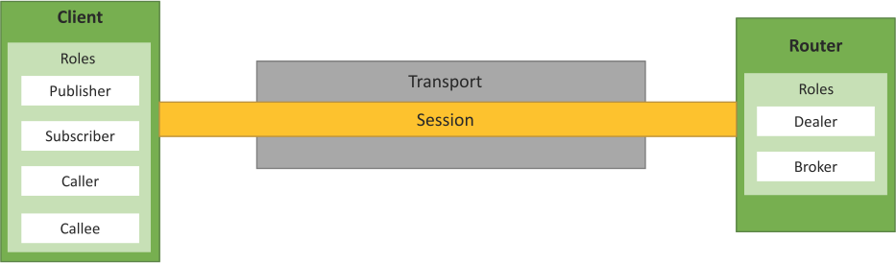
WAMP:
WAMP : Web Application Messaging Protocol
Mainly used in cloud storage model for IoT & other messaging services.
WAMP is a routed protocol, with all components connecting to a WAMP Router,
where the WAMP Router performs message routing between the component
It is protocol for Web Socket (PUBSUB based protocol) : uses RPC Messaging Pattern
WAMP enables distributed application architectures where the application components are distributed on multiple nodes and communicate with messaging patterns provided by WAMP.
Fig.WAMP session between Client and router

Slide 7
WAMP – Concepts
Transport: Transport is a channel that connects two peers.
Session: Session is a conversation between two peers that runs over a transport.
Client: Clients are peers that can have one or more roles.
In the publish–subscribe model, the Client can have the following roles:
Publisher: Publisher publishes events (including payload) to the topic maintained by the Broker.
Subscriber: Subscriber subscribes to the topics and receives the events including the payload.
In the RPC model, the Client can have the following roles:
Caller: Caller issues calls to the remote procedures along with call arguments.
Callee: Callee executes the procedures to which the calls are issued by the Caller and returns the results to the Caller.

Slide 8
Router: Routers are peers that perform generic call and event routing.
In the publish–subscribe model, the Router has the role of a Broker.
Broker: Broker acts as a Router and routes messages published to a topic to all the subscribers subscribed to the topic.
In the RPC model, the Router has the role of a Dealer.
Dealer: Dealer acts a router and routes RPC calls from the Caller to the Callee and routes results from the Callee to the Caller.
Application code: Application code runs on the Clients (Publisher, Subscriber, Callee or Caller).

Slide 9
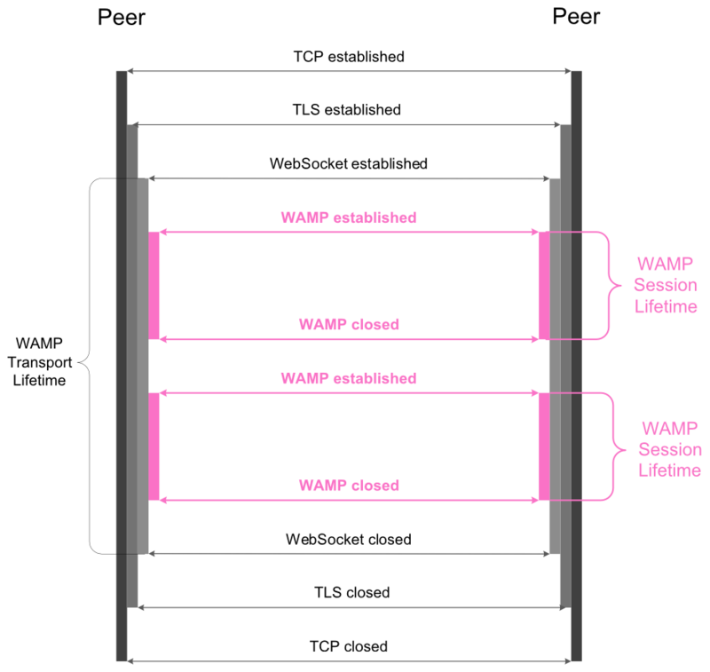
WAMP – Concepts

Slide 10
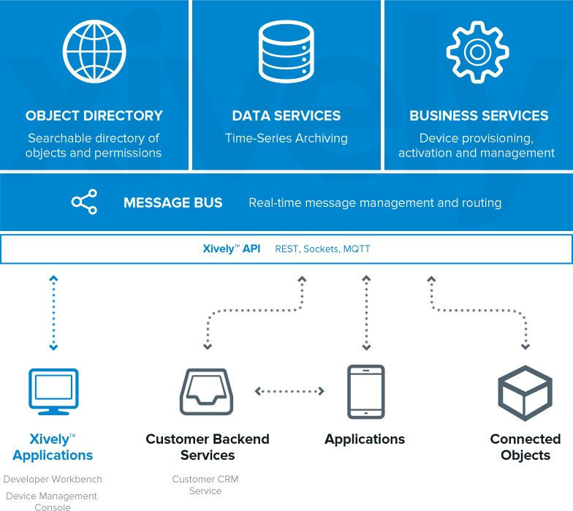
Xively Cloud Services
Commercial Platform as a Service for the Internet of Things
Supports hundreds of platforms, millions of gateways and billions of smart devices
Comprehensive and secure infrastructure
services
Online development tools and dev center
Best of breed approach
Built on LogMeIn’s Gravity platform connecting 255+ m devices for 55+ m users

Slide 11
Xively …Contd…
Xively is an IoT Cloud Platform
It is an enterprise platform for building, managing, and deriving business value from connected products.
It also provides the cloud base API with an SDK
It supports platforms and technologies like Android, Arduino, C etc.
Xively is a PaaS (Platform as a Service) which exposes its service via RESTful API
It supports messaging service based on MQTT- MQ Telemetry Transport

Slide 12
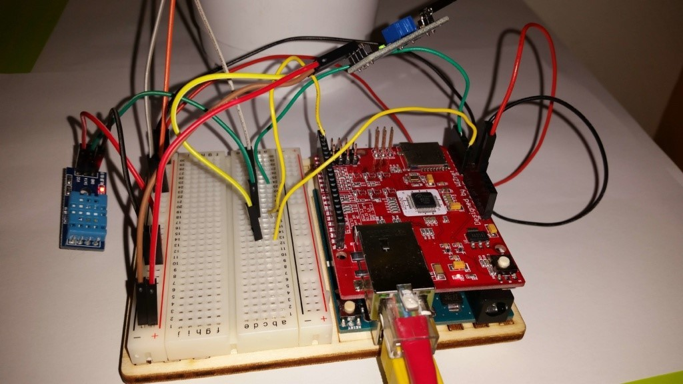
Case Study: “Smart Plant System“ [3]

Slide 13
Details
This IoT project uses Arduino Uno and a set of sensors:
DHT11: Temperature and humidity sensor
TEMT6000: Light intensity sensor
YL-38 + YL-69: Soil moisture sensor
We want to send all values read from these sensors to Xively and create a dashboard so we can monitor these parameters.
Code : Download

Slide 14
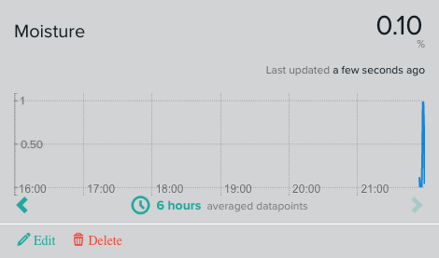
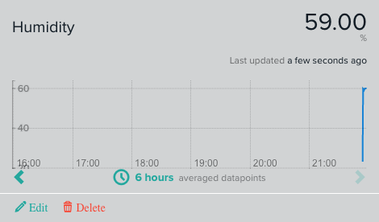
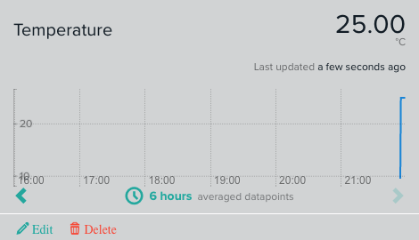
Results by Xively

Slide 15
Amazon EC2 (Elastic Compute Cloud) Python Example
Boto is a Python package that provides interfaces to Amazon Web Services (AWS)
In this example, a connection to EC2 service is ﬁrst established by calling the boto.ec2.connect_to_region function.
#Python program for launching an EC2 instance
import boto.ec2
from time import sleep ACCESS_KEY="<enter access key>" SECRET_KEY="<enter secret key>"
REGION="us-east-1" AMI_ID = "ami-d0f89fb9"
EC2_KEY_HANDLE = "<enter key handle>" INSTANCE_TYPE="t1.micro"
SECGROUP_HANDLE="default"
conn = boto.ec2.connect_to_region(REGION, aws_access_key_id=ACCESS_KEY,
aws_secret_access_key=SECRET_KEY)
reservation = conn.run_instances(image_id=AMI_ID, key_name=EC2_KEY_HANDLE,
instance_type=INSTANCE_TYPE, security_groups = [ SECGROUP_HANDLE, ] )
The EC2 region, AWS access key and AWS secret key are passed to this function. After connecting to EC2 , a new instance is launched using the conn.run_instances function.
The AMI-ID, instance type, EC2 key handle and security group are passed to this function.

Slide 16
Amazon AutoScaling – Python Example
#Python program for creating an AutoScaling group (code excerpt)
import boto.ec2.autoscale
:
print "Connecting to Autoscaling Service"
conn = boto.ec2.autoscale.connect_to_region(REGION, aws_access_key_id=ACCESS_KEY, aws_secret_access_key=SECRET_KEY)
print "Creating launch configuration"
lc = LaunchConfiguration(name='My-Launch-Config-2',
image_id=AMI_ID,
key_name=EC2_KEY_HANDLE, instance_type=INSTANCE_TYPE,
security_groups = [
SECGROUP_HANDLE, ])
conn.create_launch_configuration(lc)
print "Creating auto-scaling group"
ag = AutoScalingGroup(group_name='My-Group', availability_zones=['us-east-1b'],
AutoScaling Service
A connection to the AutoScaling service is first established by calling the boto.ec2.autoscale.connect_to_region function.
Launch Configuration
After connecting to the AutoScaling service, a new launch configuration is created by calling conn.create_launch_con f iguration. Launch configuration contains instructions on how to launch new instances including the AMI-ID, instance type, security groups, etc.
AutoScaling Group
After creating a launch configuration, it is then associated with a new AutoScaling group. The AutoScaling group is created by calling conn.create_auto_scaling_group. There are settings for the AutoScaling group such as the maximum and minimum number of instances in the group, the launch configuration, availability zones, optional load balancer to use with the group, etc.
launch_config=lc, min_size=1, max_size=2,
connection=conn) conn.create_auto_scaling_group(ag)

Slide 17
Amazon AutoScaling – Python Example
AutoScaling Policies
#Creating AutoScaling policies
scale_up_policy = ScalingPolicy(name='scale_up',
adjustment_type='ChangeInCapacity', as_name='My-Group', scaling_adjustment=1, cooldown=180)
scale_down_policy = ScalingPolicy(name='scale_down', adjustment_type='ChangeInCapacity',
as_name='My-Group',
After creating an AutoScaling group, the policies for
scaling up and scaling down are defined.
In this example, a scale up policy with adjustment type ChangeInCapacity and scaling_ad justment = 1 is defined.
Similarly, a scale down policy with adjustment type ChangeInCapacity and scaling_ad justment = −1 is defined.
scaling_adjustment=-1,
cooldown=180)
conn.create_scaling_policy(scale_up_policy) conn.create_scaling_policy(scale_down_policy)

Slide 18
Amazon AutoScaling – Python Example
#Connecting to CloudWatch
cloudwatch = boto.ec2.cloudwatch.connect_to_region(REGION,
aws_access_key_id=ACCESS_KEY, aws_secret_access_key=SECRET_KEY)
alarm_dimensions = {"AutoScalingGroupName": 'My-Group'}
#Creating scale-up alarm
scale_up_alarm = MetricAlarm( name='scale_up_on_cpu', namespace='AWS/EC2', metric='CPUUtilization', statistic='Average', comparison='>', threshold='70',
period='60', evaluation_periods=2, alarm_actions=[scale_up_policy.policy_arn], dimensions=alarm_dimensions)
cloudwatch.create_alarm(scale_up_alarm)
#Creating scale-down alarm
scale_down_alarm = MetricAlarm( name='scale_down_on_cpu', namespace='AWS/EC2', metric='CPUUtilization', statistic='Average', comparison='<', threshold='40',
period='60', evaluation_periods=2, alarm_actions=[scale_down_policy.policy_arn], dimensions=alarm_dimensions)
cloudwatch.create_alarm(scale_down_alarm)
CloudWatch Alarms
With the scaling policies defined, the next step is to create Amazon CloudWatch alarms that trigger these policies.
The scale up alarm is defined using the CPUUtilization metric with the Average statistic and threshold greater 70% for a period of 60 sec. The scale up policy created previously is associated with this alarm. This alarm is triggered when the average CPU utilization of the instances in the group becomes greater than 70% for more than 60 seconds.
The scale down alarm is defined in a similar manner with a threshold less than 50%.

Slide 19
Amazon S3 (Simple Storage Service) Python Example
In this example, a connection to the S3 service is first established by calling the boto.connect_s3
function.
The upload_to_s3_bucket_path function uploads the file to the S3 bucket specified at the specified
path.
# Python program for uploading a ﬁle to an S3 bucket
import boto.s3
conn = boto.connect_s3(aws_access_key_id='<enter>', aws_secret_access_key='<enter>')
def percent_cb(complete, total): print ('.')
def upload_to_s3_bucket_path(bucketname, path, filename): mybucket = conn.get_bucket(bucketname) fullkeyname=os.path.join(path,filename)
key = mybucket.new_key(fullkeyname) key.set_contents_from_filename(filename, cb=percent_cb,
num_cb=10)

Slide 20
Amazon RDS (Relational Database Service) Python Example
#Python program for launching an RDS instance (excerpt)
import boto.rds
ACCESS_KEY="<enter>" SECRET_KEY="<enter>" REGION="us-east-1" INSTANCE_TYPE="db.t1.micro" ID = "MySQL-db-instance-3" USERNAME = 'root'
PASSWORD = 'password' DB_PORT = 3306
DB_SIZE = 5
DB_ENGINE = 'MySQL5.1'
DB_NAME = 'mytestdb' SECGROUP_HANDLE="default"
#Connecting to RDS
conn = boto.rds.connect_to_region(REGION, aws_access_key_id=ACCESS_KEY, aws_secret_access_key=SECRET_KEY)
#Creating an RDS instance
db = conn.create_dbinstance(ID, DB_SIZE, INSTANCE_TYPE, USERNAME, PASSWORD, port=DB_PORT, engine=DB_ENGINE,
db_name=DB_NAME, security_groups = [ SECGROUP_HANDLE, ] )
In this example, a connection to the RDS service is ﬁrst established by calling the boto.rds.connect_to_region function.
The RDS region, AWS access key and AWS secret key are passed to this function.
After connecting to the RDS service, the conn.create_dbinstance function is called to launch a new RDS instance.
The input parameters to this function include the instance ID, database size, instance type, database username, database password, database port, database engine (e.g., MySQL5.1), database name, security groups, etc.

Slide 21
Amazon DynamoDB –Non Relational Databases Python Example
# Python program for creating a DynamoDB table (excerpt)
import boto.dynamodb
ACCESS_KEY="<enter>" SECRET_KEY="<enter>" REGION="us-east-1"
#Connecting to DynamoDB
conn = boto.dynamodb.connect_to_region(REGION, aws_access_key_id=ACCESS_KEY, aws_secret_access_key=SECRET_KEY)
table_schema = conn.create_schema( hash_key_name='msgid', hash_key_proto_value=str, range_key_name='date', range_key_proto_value=str
)
#Creating table with schema
table = conn.create_table( name='my-test-table', schema=table_schema, read_units=1, write_units=1
)
In this example, a connection to the DynamoDB service is ﬁrst established by calling boto.dynamodb.connect_to_region.
After connecting to the DynamoDB service, a schema for the new table is created by calling conn.create_schema.
The schema includes the hash key and range key
names and types.
A DynamoDB table is then created by calling the conn.create_table function with the table schema, read units and write units as input parameters.

Slide 22
Python Packages of Interest
JSON
JavaScript Object Notation (JSON) is an easy to read and write data-interchange format. JSON is used as an alternative to XML and is easy for machines to parse and generate. JSON is built on two structures: a collection of name–value pairs (e.g., a Python dictionary) and ordered lists of values (e.g., a Python list).
XML
XML (Extensible Markup Language) is a data format for structured document interchange. The Python minidom library provides a minimal implementation of the Document Object Model interface and has an API similar to that in other languages.
HTTPLib & URLLib
HTTPLib2 and URLLib2 are Python libraries used in network/internet programming.
SMTPLib
Simple Mail Transfer Protocol (SMTP) is a protocol which handles sending email and routing email between mail servers. The Python SMTPLib module provides an SMTP client session object that can be used to send email.
NumPy
NumPy is a package for scientific computing in Python. NumPy provides support for large multi-dimensional arrays and matrices.
Scikit-learn
Scikit-learn is an open source machine learning library for Python that provides implementations of various machine learning algorithms for classification, clustering, regression and dimension reduction problems.

Slide 23
Python Web Application Framework – Django
Django is an open source web application framework for developing web applications in Python.
A web application framework in general is a collection of solutions, packages and best practices
that allows development of web applications and dynamic websites.
Django is based on the Model–Template–View architecture and provides separation of the data model from the business rules and the user interface.
Django provides a unified API to a database backend.
Thus, web applications built with Django can work with different databases without requiring any
code changes.
With this flexibility in web application design combined with the powerful capabilities of the Python language and the Python ecosystem, Django is best suited for cloud applications.
Django consists of an object-relational mapper, a web templating system and a regular-expression- based URL dispatcher.

Slide 24
Django Architecture
Django uses a Model–Template–View (MTV) framework.
Model
The model acts as a definition of some stored data and handles the interactions with the database. In a web application, the data can be stored in a relational database, non-relational database, an XML file, etc. A Django model is a Python class that outlines the variables and methods for a particular type of data.
Template
In a typical Django web application, the template is simply an HTML page with a few extra placeholders. Django’s template language can be used to create various forms of text files (XML, email, CSS, Javascript, CSV, etc.).
View
The view ties the model to the template. The view is where you write the code that actually generates the web pages. View determines what data is to be displayed, retrieves the data from the database and passes the data to the template.

Slide 25
Django Project Layout
django-admin.py startproject
<PROJECT_ROOT>
manage.py
<PROJECT_DIR>
init .py settings.py urls.py wsgi.py

Slide 26
settings.py
Defines settings used by a Django application
Referenced by wsgi.py to bootstrap the project loading
Techniques for managing dev vs prod settings:
Create settings-dev.py and settings-prod.py and use symlink to link settings.py to the correct settings
Factor out common settings into base-settings.py and import. Use conditionals to load correct settings based on DEBUG or other setting

Slide 27
Sample Settings…
DEBUG = True TEMPLATE_DEBUG = True ALLOWED_HOSTS = []
# Application definition INSTALLED_APPS = (
'django.contrib.admin',
'django.contrib.auth', 'django.contrib.contenttypes', 'django.contrib.sessions', 'django.contrib.messages', 'django.contrib.staticfiles',
)

Slide 28
Django Apps
Reusable modules
django-admin.py startapp <app_name>
Creates stub layout:
<APP_ROOT>
admin.py models.py
templates (directory)
tests.py views.py urls.py

Slide 29
Django Models
Defined in models.py
Typically inherit from django.db.models.Model Example Model:
from django.db import models class TestModel(models.Model):
name = models.CharField(max_length = 20) age = models.IntegerField()

Slide 30
Models (cont’d)
Default is to set NOT NULL on all fields. Override by adding null = True to field definition:
name = models.CharField(max_length=20, null = True)
Relationships defined through special field types: models.OneToOneField(model)
models.ForeignKey(model) models.ManyToManyField(model)

Slide 31
Models (cont’)
Need Nulls in a Boolean Field? Use models.NullBooleanField()
Set Default value with “default”:
count = models.IntegerField(default = 0)
Use a inner Meta class to define additional options, especially useful for abstract classes:
class TestModel(models.Model): class Meta:
abstract = True

Slide 32
Model Methods
model.save(self, *args, **kwargs)
model.delete(self, *args, **kwargs)
model.get_absolute_url(self)
model. str (self) [Python 3] model. unicode (self) [Python 2]
Override with super(MODEL, self).save(*args, **kwargs)

Slide 33
Activating a Model
Add the app to INSTALLED_APPS in settings.py
Run manage.py validate
Run manage.py syncdb
Migrations
Write custom script or manually handle migrations
Use South

Slide 34
Selecting Objects
Models include a default manager called objects
Manager methods allow selecting all or some instances Question.objects.all()
Question.objects.get(pk = 1)
Use try block, throws DoesNotExist exception if no match Question.objects.filter(created_date lt = ‘2014-01-01’)
Returns QuerySet

Slide 35
Introspecting Legacy Models
manage.py inspectdb
Cut and paste generated code into models.py – Easy!!

Slide 36
Full Sample
from django.db import models from datetime import datetime
class TimestampedModel(models.Model): created_datetime = models.DateTimeField() updated_datetime = models.DateTimeField()
def save(self, *args, **kwargs): if self.id is None:
self.created_datetime = datetime.now() updated_datetime = datetime.now() super(TimestampedModel,self).save(*args, **kwargs)
class Meta: abstract = True

Slide 37
Full Sample (cont’d)
class Question(TimestampedModel):
question_text = models.CharField(max_length = 200)
def str (self):
return self.question_text

Slide 38
Function vs. Class Views
Django allows two styles of views – functions or class based views
Functions – take a request object as the first parameter and must return a response object
Class based views – allow CRUD operations with minimal code. Can inherit from multiple generic view classes (i.e. Mixins)

Slide 39
Sample – Viewing a List of Questions
Function based:
from .models import Question
from django.shortcuts import render_to_response
def question_list(request): questions = Question.objects.all()
return render_to_response(‘question_list.html’, {
‘questions’:questions})

Slide 40
Quick CRUD Operations with Generic Views
ListView
UpdateView
CreateView
If Model is specified, automagically creates a matching ModelForm
Form will save the Model if data passes validation
Override form_valid() method to provide custom logic (i.e sending email or setting additional fields)

Slide 41
Sample – As Class Based View
from .models import Question
from django.views.generic import ListView
class QuestionList(ListView): model = Question
context_object_name = ‘questions’

Slide 42
Django Templates
Very simple syntax:
variables = {{variable_name}} template tags = {%tag%}
Flexible – can be used to render html, text, csv, email, you name it!
Dot notation – template engine attempts to resolve by looking for matching attributes, hashes and methods

Slide 43
Question List Template
<!doctype html>
<html lang=en>
<head>
<meta charset=utf-8>
<title>List of Questions</title>
</head>
<body>
{%if questions%}
<ul>
{%for q in questions%}
<li>{{q.question_text}}</li>
{%endfor%}
</ul>
{%else%}
<p>No questions have been defined</p>
{%endif%}
</body>
</html>

Slide 44
urls.py
Defines routes to send urls to various views
Can use regular expressions
Extract parameters from a url and pass to the view as a named parameter:
r(‘^question/(?P<question_id>\d+)/$’,’views.question_detail’)
Extensible – urls.py can include additional url files from apps: r(‘^question/’,include(question.urls))

Slide 45
Hooking up the Question List
from django.conf.urls import patterns, url, include urlpatterns = patterns(‘’,
(r’^questions/$’,’views.QuestionList’)
)
OR:
from django.conf.urls import patterns from views import QuestionListView
urlpatterns = patterns(‘’,
(r’^questions/$’,’views.QuestionList.as_view())
)

Slide 46
Forms in Django
django.forms provides a class to build HTML forms and validation. Example:
from django import forms
class EditQuestionForm(forms.Form):
question_text = forms.CharField(max_length = 200)
Often redundant when creating forms that work on a single model

Slide 47
ModelForms
Automatically generate a form from a model.
Handles saving a bound model
Can specify fields to be included or excluded in the form
Sample:
from django.forms import ModelForm from .models import Question
class QuestionForm(ModelForm): class Meta:
model = Question
fields = [‘question_text’]

Slide 48
Using a ModelForm
Create an instance of an empty form: form = QuestionForm()
Create a form to update an existing instance of a model: question = Question.objects.get(pk = 1)
form = QuestionForm(instance = question)
Pass the form into the template and use the form methods to render the form:
form.as_p form.as_ul form.<field_name>
form.<field_name>.errors

Slide 49
Request & Response
Request object encapsulate the request and provide access to a number of attributes and methods for accessing cookies, sessions, the logged in user object, meta data (i.e environment variables),
Response objects are returned to the browser. Can set content type, content length, response does not have to return HTML or a rendered template
Special response types allow for common functionality: HttpResponeRedirect
Http404 HttpStreamingResponse

Slide 50
Django Extras
CRSF Middleware – enabled by default. Include template tag in all forms:
{%csrf_token%}
Authentication
Caching
Sessions
Messages
Email
Logging

Slide 51
Authentication
Django’s out of the box Auth system uses database authentication.
Changed extensively in Django 1.6 to allow custom User objects.
AUTHENTICATION_BACKENDS setting in settings.py allows overriding how User objects are authenticated
If using the Authentication middleware and context_processors the current user is available to code as request.user and {{user}} is defined in all templates

Slide 52
Auth Decorators
Live in django.contrib.auth.decorators
login_required
@login_required
def function_view(request):
….
user_passes_test (can be used with lambda functions for real power)
–
@user_passes_test(lambda u: u.is_staff) def function_view(request):
…
has_perms – test for user permissions

Slide 53
Decorating CBVs
Decorator is applied to the dispatch method
Must be converted to a method_decorator – use django.utils.decorators.method_decorator function:
class MyView(ListView):
@method_decorator(login_required) def dispatch(self, *args, **kwargs):
super(MyView,self).dispatch(*args, **kwargs)

Slide 54
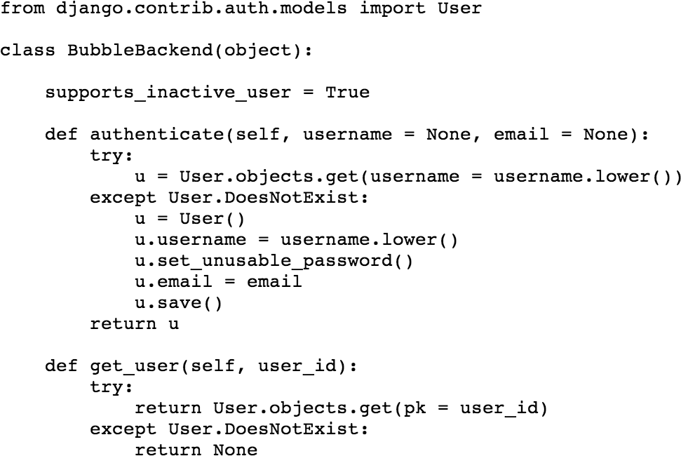
Custom Auth Backend for the Bubble

Slide 55
Sending Email
django.core.mail includes functions and classes for handling email
Set EMAIL_HOST in settings.py to outgoing mailserver
Import send_mail for simple mail: send_mail(subject, message, from, to_emails)
Use django.template.render_to_string to format a message using a template
Use EmailMultiAlternatives to create a text message and attach a html version as well.

