Slide 1
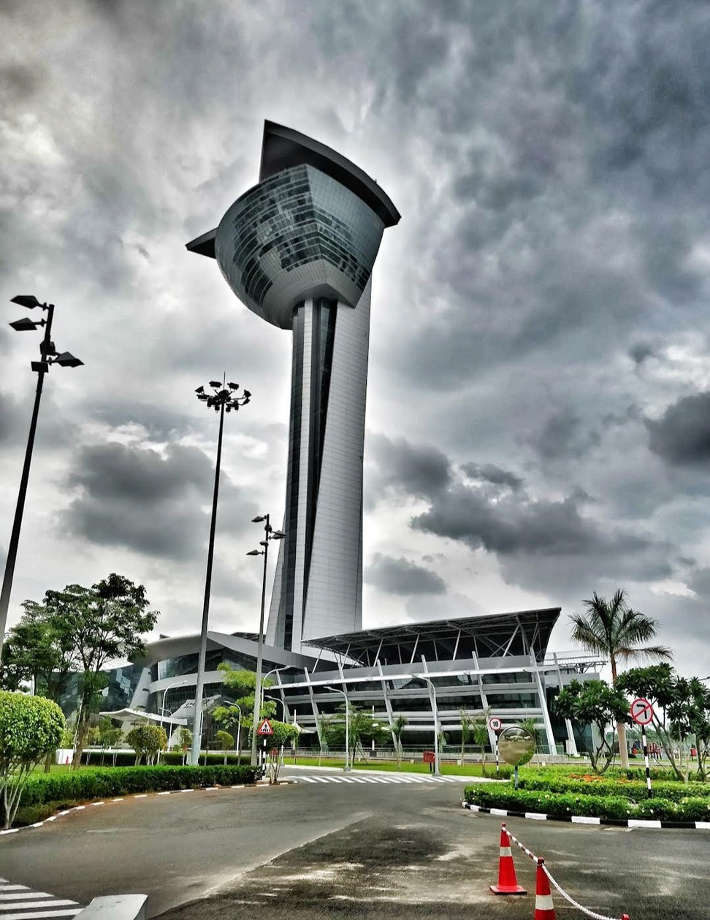

Tata Consultancy Services
Welcomes
American Express Executives
It is our pleasure to welcome you to TCS. We look
forward to making your experience a memorable one.
November 2025

Slide 2
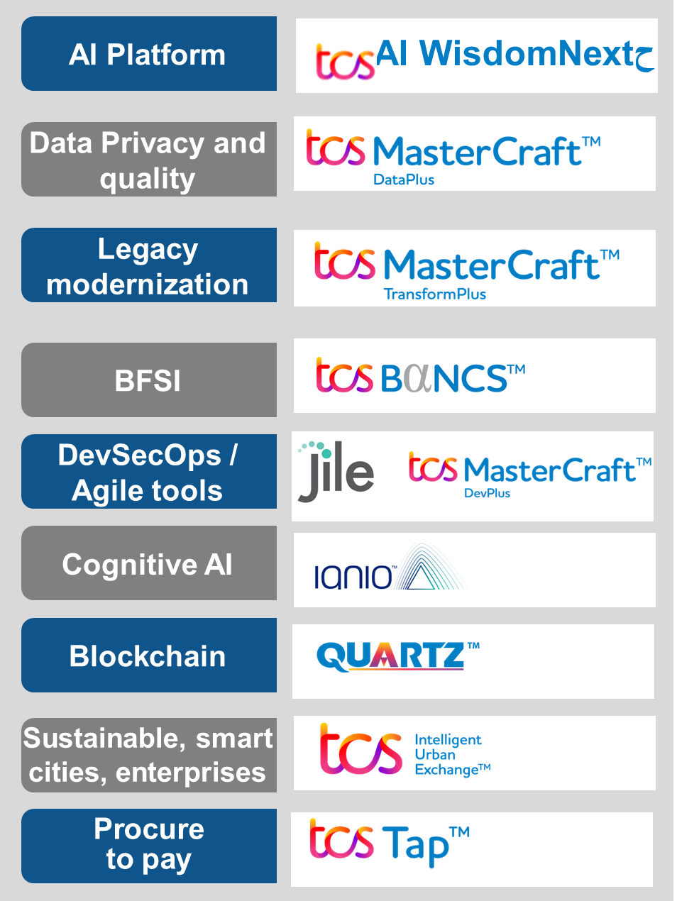
















Portfolio of services and Offerings
TCS Offers a portfolio of cutting-edge solutions and offerings to power up our Customer’s business needs, the suite of services will help transform Businesses with advanced state of art Solutions and Technologies
Cybersecurity
Network solutions and services
Data and
analytics
IoT and digital engineering
TCS Interactive
Enterprise
solutions
Consulting
Enterprise cognitive business operations
  TCS and AWS Cloud
  TCS and Google Cloud
  TCS and Microsoft Cloud
  TCS Enterprise Cloud
Cloud
Sustainability
services
Frameworks:

Slide 3






















Customer-centricity – TCS Chennai
Chennai being the largest Delivery Centre for TCS, advocates the Ethos of Tata
Group with core focus on Customer Centricity and Next Gen Technology Solutions
Artificial
intelligence
Google Garage
1
Data
Labs, Experience Centers and Design Studios in Chennai
IBM RedHat GenAI Experience Center
2
Cybersecurity threat
Management Center
3
Cloud
Accountability
Partnership ecosystems
Agile
Research and innovation
4
TCS Interactive Studio
BFSI
Relationship focus
Cognitive Business Ops Global Labs
5
Talent development
Customer at the center of our
investments
RPA
Contextual knowledge
Full stakeholder coverage
MFDM
BFSI Innovation Space
6
IoT Lab
7
IP development
Blockchain
Time to market
Design Space
8
IoT
Insurance and Healthcare Innovation space
9
Research and innovation
TCS has a strong partnership with IIT Madras for Research, Innovation and to curate State of Art Technology Solutions
Others
Travel and Hospitality Lab 10

Slide 4





Google Garage : TCS Cloud Lab, Culture of Innovation
@TCS Chennai
Google Cloud Lab in Chennai
TCS GCP Sandbox
150+ active projects on Google Sandbox | GCP Cloud Management |
Access Management | Budget Mgmt. | Security & Compliance
1
2
3
4
5
Google Tested Tester Partner
Accelerated experimentation with POCs/POTs
Identify use cases and build business case
Architecture finalization
Foundation build, achieve business goals
TCS POV
Pioneering & testing new functionalities of GCP Gen AI offerings.
Continual Improvement with iterative testing under Trusted Tester Program.
Ideation
Value chain approach to identify and prioritize ideas.
In collaboration with ISU/customers identify the business use cases.
Solutioning & Demo’s
Showcasing the potential of lab accelerators.
Tailoring demos to address business specific challenges
Generative AI – Path to Production
Setup Cloud Lab for customers to accelerate Business Transformation
Rapidly test feasibility of ideas before embarking on full fledged implementation.
8-10 weeks of Rapid MVP development in Cloud Lab sandbox environment.
Cross Domain and Contextual Knowledge
Uncovering relevant use cases | Anchoring ideation and experimentation in reality
TCS is #1 GSI in Specialization, Launch Partner for Google Cloud Generative AI

Slide 5
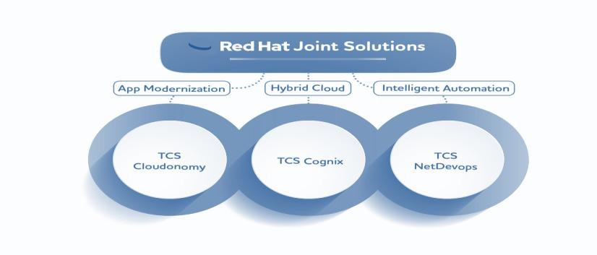
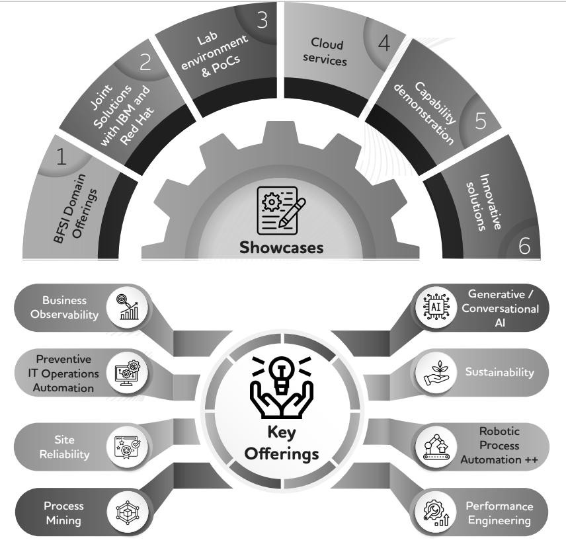


BFSI Intelligent Xperience - IBM RedHat GenAI Experience Center
@TCS Chennai
Designed with a goal of creating a personalized experience by demonstrating cutting – edge solutions, the IBM Redhat GenAI Experience Center is an exclusive space to encourage open conversations resulting in improved customer satisfaction.
Key Themes
Intelligent Automation to optimize hybrid Cloud
Financial Operations Optimization
GenAI solutions via Watsonx
Mainframe modernization
Watsonx GenAI Solutions
IBM Cloud – AS400 / AIX on Cloud, VMWare on Cloud
RedHat, Ansible and OpenShift related Entities

Slide 6
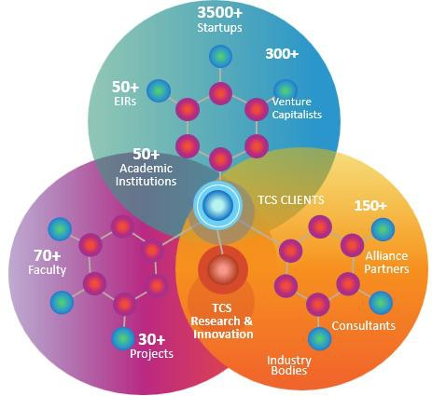

BFSI Innovation Space
@TCS Chennai
To harnesses the culture of innovation, TCS Chennai provides an exclusive innovation Space to enable a strong foundational research supported by extended
ecosystem
TCS Innovation Partners - Summon the best of the start-up ecosystem
Academic Research Labs - Engage with the Best of Academia through
Rapid Labs - Watch your Ideas come alive
Innovation Showcases - Explore digital drivers for growth and transformation
Digital Libraries - Consume the best of TCS’ Thought Leadership
Agile Workspaces - Develop nimble business model to embrace breakthrough technologies
Alliance Partners
5,500 researchers, inventors, and innovators^ | 3,153/7,665 patents granted/filed (cumulative)* | 275/360 patents granted/filed in Q1 and Q2FY24* | 159 publications in Q1 and Q2FY24* | 40 Research and Innovation centers^ | 74 academic partners* | 2,800 start-up partners*
Across TCS

Slide 7

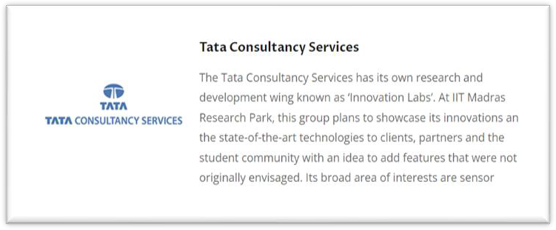
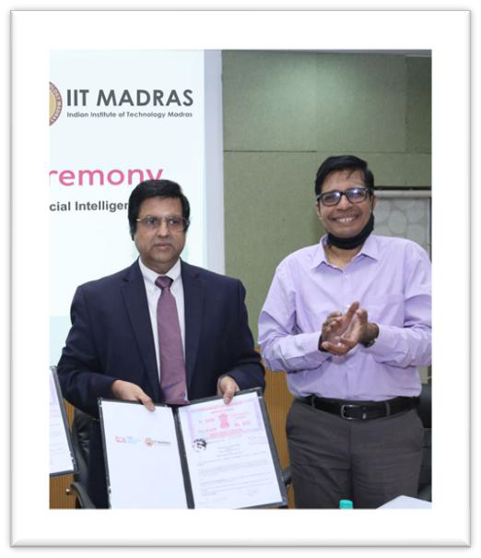
Research and Innovation : TCS and IIT Madras Partnership
TCS has a R&D Wing “Innovation Labs” that collaborates with IIT Madras for full pledged Research and Innovation
TCS Research Areas with IITM
Data Centre Power Reduction
Smart Water Network
Energy Consumption in High Rise Building
Drug Design
Consumer business price dynamics
TCS and IIT Madras Partner to Launch
M Tech Program in Industrial AI
TCS operations at IIT Madras Research Park are certified by Indian Government Ministry of Science and Technology scheme under Department of Scientific and Industrial Research (DSIR)
DSIR certified research Centers are engaged in innovative research & development activities including new technologies, design & engineering, process /product /design improvements
Research for increased efficiency of resources, such as, capital equipment, materials & energy; pollution control, effluent treatment & recycling of waste products/other areas of research.
TCS has master Collaboration Agreement with IITM for Research projects, Faculty engagements as Research Advisor to TCS Research projects, Student engagement internships, engagement with startups in IITM Research
TCS Innovation Lab at IITM Research Park facilitates easy engagement with Faculty and Students
TCS has signed MOUs / COIN partnerships in various niche areas
7 Public

Slide 8


Collaborative R&I : TCS-IIT Madras

