Slide 1
Peer-to-Peer
Content Delivery Network
Seminar by:
Anand Babu
int82657@stud.uni-stuttgart.de
Institute for Parallel and Distributed Systems (IPVS)
University of Stuttgart
Peer to Peer Content Delivery Networks

Slide 2
Outline
Motivation
Traditional Approaches
P2P Architecture
Types of P2P
  Centralized
  Decentralized
    Unstructured
    Structured
Summary
References
Peer to Peer Content Delivery Networks

Slide 3
Motivation
Millions of users want to download the same popular huge files (for free)
E.g:
  Film, Video and music
  Media content from Broadcasters
  Personal Content
  Software
  Institutions
Peer to Peer Content Delivery Networks

Slide 4
Client-Server
Source
Router
“Interested”
End-host
Peer to Peer Content Delivery Networks

Slide 5
Client-Server
Overloaded!
Source
Router
“Interested”
End-host
Peer to Peer Content Delivery Networks

Slide 6
IP multicast
Source
Router
“Interested”
End-host
Peer to Peer Content Delivery Networks

Slide 7
End-host based multicast
Source
Router
“Interested”
End-host
Peer to Peer Content Delivery Networks

Slide 8
End-host based multicast
“Single-uploader” ➔ “Multiple-uploaders”
  Node that has downloaded file will then upload it to other nodes.
  Uploading costs amortized across all nodes
Also called “Application-level Multicast”
Many protocols proposed early this decade
  Yoid (2000), Narada (2000), Overcast (2000), ALMI (2001)
    All use single trees
    Problem with single trees?
Peer to Peer Content Delivery Networks

Slide 9
End-host multicast using single tree
Source
Peer to Peer Content Delivery Networks

Slide 10
End-host multicast using single tree
Source
Peer to Peer Content Delivery Networks

Slide 11
End-host multicast using single tree
Source
Slow data transfer
Peer to Peer Content Delivery Networks

Slide 12






Why is P2P CDN important?
P2P consumes significant amount of internet traffic today
  In 2004, Total P2P traffic was 60% (Source: Cachelogic)
  Slightly lower share in 2005 (possibly because of legal action), but still significant
  BT is the most popular P2P Protocol(30% in 2004)
  Well-Known BT users:
Peer to Peer Content Delivery Networks

Slide 13
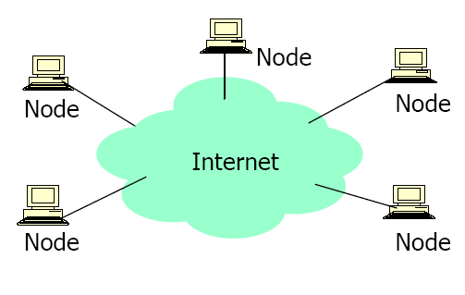
Peer-to-Peer System
All nodes are both clients and servers
No centralized data source
Scalable
Resistant to Flash crowds
Cost Effective
Peer to Peer Content Delivery Networks

Slide 14
Types of Peer-to-Peer Systems
Centralized
  Napster
Decentralized
    Gnutella
    Fast-track
  Structured
    Freenet
    Chord
    Pastry
Peer to Peer Content Delivery Networks
Notes:
P2P systems are classified under two major categories centralized and decentralized. Example of centralized is Napster in which one server keeps the information of of all the other peers and decentralized is further divided into structured and unstructured. These are categorized under unstructured as they do not follow any structured way for file placement and do not optimize the search algorithm. Due to their unstructured way, they flood the queries in network and increase the network congestion…..whereas in structured they follow particular algorithms to search a file in the network.

Slide 15
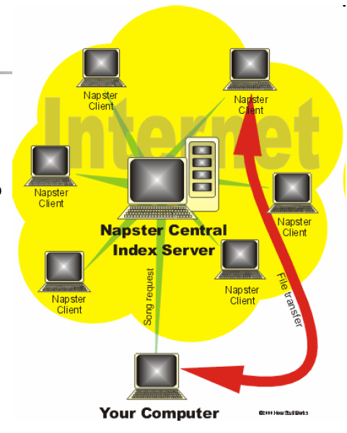
Napster
Only mp3
Peer updates file list and the Napster database is updated periodically.
User sends search request to the server
Server replies with the information of nodes containing the file
User connects directly to remote peer and start download
Peer to Peer Content Delivery Networks
Notes:
Napster was the start of P2P and it could share only music files with peers.
Every node uploads the list of shared files onto the server and whenever any peer search for a file, the server replies back with the list of nodes containing the file. User connect directly to remote peer and start download. However if the remote peer is behind a firewall, the peer send this information to the server and server forwards this request to the remote peer and then our node waits for the remote peer to connect in order to download the file.

Slide 16
Napster -- continued
Search is centralized and dynamic.
File transfer is direct (Peer to Peer)
Pros and Cons:
  Fast and Efficient and up-to-date(no stale links)
  Single point of failure
Peer to Peer Content Delivery Networks
Notes:
Issues with Napster…Since it has a single server maintaining the list, the server is the single point of failure….Hence it is prone to denial of service…………However it ensures correct results till the time server is working properly…..as the list is uploaded directly to the server…..
Search is centralized but the file transfer is peer to peer….

Slide 17
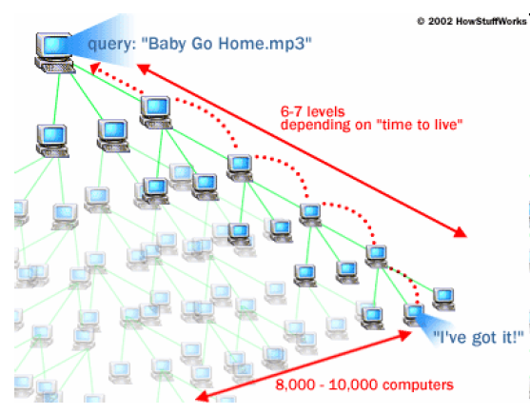
Gnutella
Share any type of files
Decentralized search
Request send to neighbors(Flooding)
Neighbor forwards it to its neighbors.
  If TTL is over request is finished.
Users with matching file replies
Peer to Peer Content Delivery Networks
Notes:
Gnutella could share any type of files, in opposition to Napster…..The search is decentralized….

Slide 18
Gnutella -- continued
Decentralized system
  No Single point of failure
  Less Prone to denial of service
Flooding queries
  Increase network congestion
  Search only reaches to a subset of peers due to TTL.
  Compromise in Privacy as peers are able to see search queries.
Peer to Peer Content Delivery Networks
Notes:
Since the system is completely decentralized there is no single point of failure…………and this is less prone to denial of service…..
However it cannot ensure correct results as one node may have the requested file but before the request reaches this node TTL is over and peer is refused about the file…….
It increases network congestion as each time the query is broadcasted to all the neighbors…..

Slide 19
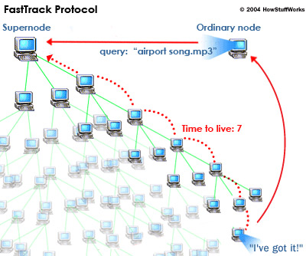
Fast-track
Hybrid of centralized Napsters and decentralized Gnutella.
Super Nodes acts as local search server
  Each super node act as a Napster server for a small network
  Super nodes are chosen according to their capacity and availability
User upload the list of shared files to a super-peer
Super nodes exchange the list periodically
Peer send the query to super node
Peer to Peer Content Delivery Networks
Notes:
It connect different networks together…..each network has a super node that keeps the information of all the shared file by the nodes in that network…….

Slide 20
BitTorrent
“Pull-based”
Each file split into smaller pieces
  Nodes pull desired pieces
  Pieces not downloaded in sequential order
  Previous multicast schemes aimed to support “streaming”; Bit Torrent does not
“swarming” approach
  Encourages contribution by all nodes
Peer to Peer Content Delivery Networks

Slide 21
Basic Components
Seed
  Peer that has the entire file
Leacher
  Peer that has an incomplete copy of the file
A Torrent file
  Passive component
  Contains meta-data about the file to be downloaded and the peers
  Typically hosted on a web server
A Tracker
  Central component
  Returns a random list of peers with state information(Completed or Downloading)
Peer to Peer Content Delivery Networks

Slide 22
Data types
All the data used in Bit-torrent communication is Bencoded.
Integer: 2011 → Bencoded: i2011e
String: “Something” →Bencoded: 9: Something
List: List[0]=1337 List[1]=“DEF” List[2]=“CON” Bencoded: li1337e:3DEF:3CONe
Dictionary:Dictionary[“uname”]=“hpcbabu” Dictionary[“password”]=“default” Benocded form d5:uname7:hpcbabu8:password7:defaulte
Peer to Peer Content Delivery Networks

Slide 23
Contents of .torrent file
Piece length – Usually 256 KB
Pieces: SHA-1 hashes of all pieces
SHA-1 hashes of each piece in file
  For reliability
Announce Lists: List of all URL of trackers
The piece length and pieces information are fixed while announce lists are dynamic.
Peer to Peer Content Delivery Networks

Slide 24





The big picture
Harry Potter.torrent
Bob
Web Server
Tracker
Downloader:
A
Seeder:
B
Downloader:
C
Peer to Peer Content Delivery Networks

Slide 25
Request and Response
Scrape Request
e.g: http://example.com/scrape.php?info_hash=aaaaaaaaaaaaaaaaaaaa&info_hash=bbbbbbbbbbbbbbbbbbbb&info_hash=cccccccccccccccccccc
Scrape Response
e.g: d5:filesd20:....................d8:completei5e10:downloadedi50e10:incompletei10eeee
5 seeders, 10 leechers, and 50 complete downloads
Peer to Peer Content Delivery Networks

Slide 26
Request and Response
Announce Request:
e.g: http://some.tracker.com:999/announce ?info_hash=12345678901234567890 &peer_id=ABCDEFGHIJKLMNOPQRST &ip=255.255.255.255&port=6881 &downloaded=0&uploaded=0 &left=98765 &event=started
Announce Response:
The tracker response is a BEncoded dictionary that has two keys: interval and peers.
Peer to Peer Content Delivery Networks

Slide 27
Peer wire Protocol(TCP)
exchange of pieces
The file into several pieces and sub-pieces and are downloaded from different peers.
Each client will need to maintain the state information for each peers. This list looks like
    am_choking: this client is choking the peer
    am_interested: this client is interested in the peer
    peer_choking: peer is choking this client
    peer_interested: peer is interested in this client
Peer to Peer Content Delivery Networks

Slide 28
Steps in PWP:
Handshaking
Message Communication
    Pipelining
    Piece selection strategy
Peer selection strategy
  Choking and optimistic unchoking
  Anti-snubbing
  Upload-Only Mode
End Game Mode
Peer to Peer Content Delivery Networks

Slide 29
Messaging
Initial handshake message: <pstrlen><pstr><reserved><info_hash><peer_id>
An UDP ping request/response.
All other messages are sent over TCP and are of the form:
<length prefix><message ID><payload>
  Request: <len=013><id=6><index><begin><length>
  e.g.: have: <len=0005><id=4><piece index>
  choke: <len=0001><id=0>
  bitfield: <len=0001+X><id=5><bitfield>
Peer to Peer Content Delivery Networks

Slide 30
Pipelining
Keep unfulfilled requests on each connection
To cut down the round-trip
This scheme has been found to saturate most connections in practice
Extremely efficient over slow lines.
Default - 5
Peer to Peer Content Delivery Networks

Slide 31
Piece Selection
critical for performance
If a bad algorithm is used → all the effort would go waste.
Until a piece is assembled, only download sub-pieces for that piece
This policy lets complete pieces assemble quickly
Peer to Peer Content Delivery Networks

Slide 32
Rarest Piece First
Policy: Determine the pieces that are most rare among your peers and download those first
This ensures that the most common pieces are left till the end to download
Rarest first also ensures that a large variety of pieces are downloaded from the seed
Peer to Peer Content Delivery Networks

Slide 33
Random First Piece
Initially, a peer has nothing to trade
Important to get a complete piece ASAP
Rare pieces are typically available at fewer peers, so downloading a rare piece initially is not a good idea
Policy: Select a random piece of the file and download it
Peer to Peer Content Delivery Networks

Slide 34
Endgame Mode
Policy: Last blocks trickle slowly in general. To speed this up , send a request for all the missing blocks to every peer.
Send a cancel message to all peers whenever a block arrives.
This ensures that a download doesn’t get prevented from completion due to a single peer with a slow transfer rate
Some bandwidth is wasted, but in practice, this is not too much.
Peer to Peer Content Delivery Networks

Slide 35
Choking
Choking is a temporary refusal to upload; downloading is normal
Tit-for-tat strategy
Peer A said to choke peer B if it (A) decides not to upload to B
Each peer (say A) unchokes a certain number peers at any time(default – 4)
  The three with the largest upload rates to A
    Where the tit-for-tat comes in
  Another randomly chosen (Optimistic Unchoke)
    To periodically look for better choices
Peer to Peer Content Delivery Networks

Slide 36
Anti-snubbing
A peer is said to be snubbed if each of its peers chokes it
Poor download rates until the optimistic unchoke finds better peers.
If No data download for over a minute, assume its snubbed. Don’t upload to that peer unless as an optimistic unchoke.
More than one concurrent optimistic unchoke – fast recovery.
Peer to Peer Content Delivery Networks

Slide 37
Upload-Only mode
Once download is complete, a peer has no download rates to use for comparison nor has any need to use them
The question is, which nodes to upload to?
Policy: Upload to those with the best upload rate.
This ensures that pieces get replicated faster
Peer to Peer Content Delivery Networks

Slide 38
Pros and cons of BitTorrent
Pros
  Proficient in utilizing partially downloaded files
  Discourages “freeloading”
    By rewarding fastest uploaders
  No infrastructure costs
  Better resource utilization
Works well for “hot content”
Peer to Peer Content Delivery Networks

Slide 39
Pros and cons of BitTorrent
Cons
  Long tail doesn’t work
  Even worse: no trackers for obscure content
  Single point of failure: New nodes can’t enter swarm if tracker goes down
  Lack of a search feature
    ☹ Users need to resort to out-of-band search: well known torrent-hosting sites / plain old web-search
Peer to Peer Content Delivery Networks

Slide 40
Analysis
Random neighbor selection → high cross-traffic
ISP Perspective: Different links have different costs
P2P Applications Perspective: No knowledge of underlying ISP topology
No longer optimal if nodes should connect only to same ISP nodes.
End result: Throttling
Peer to Peer Content Delivery Networks

Slide 41
Challenges/Open questions
Network-Friendly Bit torrent: ISPs informs Bit-torrent of its link preferences.
Biased Neighbor selection
Rarest Piece First suffers
Move from TCP-UDP: take control of the internet ?
Legal Complexity
Peer to Peer Content Delivery Networks

Slide 42
Summary
P2P CDNs can be
cost-effective
Provide better resource utilization
Challenges:
Network Congestion
Network cost–Friendly Protocols
Handling copyright issues
Peer to Peer Content Delivery Networks

Slide 43
  Thank You
Peer to Peer Content Delivery Networks

