Slide 1

GLOBAL ELECTRIC VEHCILES SALES ANALYSIS
Innomatics Research Labs – Dilsukhnagar
Batch No : 403
Meduri V S Anand Bharadwaj
Melluri Vamshi Krishna Sharma

Slide 2
Contents:
Problem Statement
Summary of the Data
Data Visualizations.
Conclusion

Slide 3
Problem Statement:
EV adoption is growing worldwide, but not at the same speed everywhere. Our goal was to understand who is leading, which EV types are popular, and how EV usage has changed.
This Power BI project visualizes global EV data to find top-performing regions, fast-growing technologies, and overall market trends.

Slide 4
Summary of the Data:
Column Name Description
● Region – The geographic region or country where the EV data is reported.
● Category – The type of vehicle (e.g., cars, buses, 2-wheelers, trucks).
● Parameter – The measured metric (e.g., stock, sales, energy use).
● Mode – The transport mode (e.g., road, rail, etc.).
● Powertrain – The type of EV drivetrain (e.g., BEV, PHEV, FCEV).
● Year – The calendar year for which the data is recorded.
● Unit – The unit of measurement (e.g., number of vehicles, TWh).
● Value – The numeric value of the recorded parameter.

Slide 5
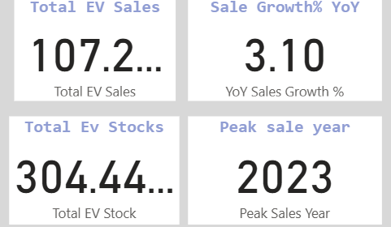
Insights :
Key Performance Indicators KPI’S:
Total EV Sales: The current recorded total EV sales are 107.2 millions.
YoY Sales Growth %: The Year-over-Year (YoY) sales growth percentage 3.1%. This indicates a moderate rate of sales growth compared to the previous year.
Total EV Stocks: The total EV stock (inventory or existing vehicles) is 304.44 millions.
Peak Sales Year: The year with the highest recorded sales was 2023.

Slide 6
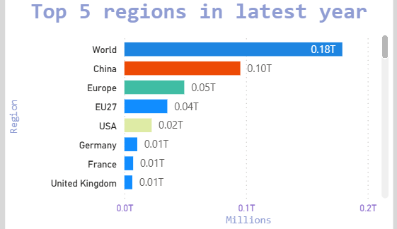
Insights And Recommendations:
What are the top 5 regions contributing most to EV adoption in the latest year?
Insights:
China leads with 0.10bn 100,000 million , showing dominant individual performance.
Europe union together contribute 0.09bn 90,000 million, indicating strong regional presence.
USA trails with 0.02bn 20,000 million, suggesting lower impact in this metric.
Other countries like Germany, France, UK, and Japan each contribute ≤0.01bn, highlighting a steep drop-off beyond the top few .

Slide 7
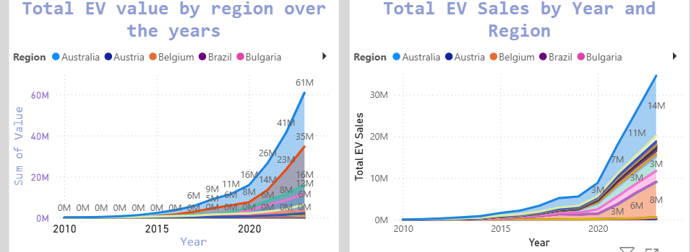
Insights And Recommendations:
What is the total EV value by region over the years, Which region has shown the highest EV growth over time?
Insights:
Australia shows both high investment and high adoption, making it a standout EV market.
Belgium and Austria are fast followers, while Brazil and Bulgaria are developing markets with potential.

Slide 8
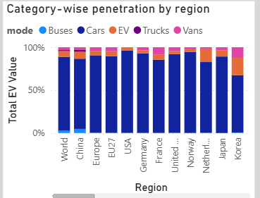
Insights And Recommendations:
How does EV penetration differ between categories (e.g., car, bus, truck) by region?
Insights :
Cars are the leading category across nearly all regions, especially in China, Europe, EU27, USA, and Germany indicating strong consumer EV adoption.
Korea stands out with a more balanced mix, including a significant share of Vans and Buses suggesting broader fleet electrification

Slide 9
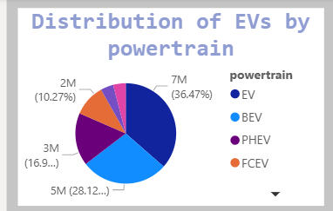
Insights And Recommendations:
What is the distribution of EVs by powertrain (BEV, PHEV, FCEV, etc.)?
BEVs dominate the market, making to 28% of total powertrains.
PHEVs hold a moderate share 17%, while FCEVs remain niche at 10%, reflecting limited adoption

Slide 10
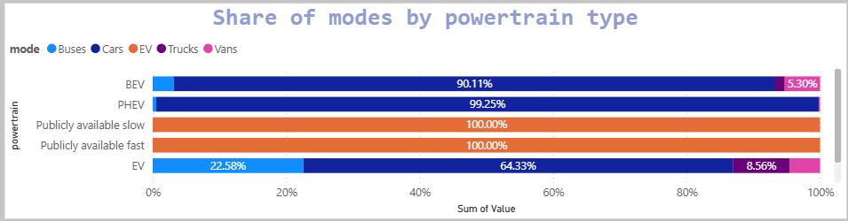
Insights And Recommendations:
What is the share of different modes (road, rail, etc.) by powertrain type?
Insight:
BEV & PHEV are dominated by Cars (90–99% share).
Public charging types (slow & fast) are entirely classified under EV.
General EV category shows a mix: Cars (64%), Buses (23%), and Vans (9%), indicating broader fleet diversity.

Slide 11
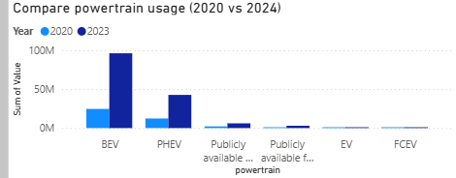
Insights And Recommendations:
Compare powertrain usage in 2020 vs. 2024 – what changed?
Insight:
Battery Electric Vehicles (BEVs) grew the most—highest usage in 2023.
Plug-in Hybrids (PHEVs) also increased, but less than BEVs.
Other types like Fuel Cell EVs and public charging categories stayed low—little growth.

Slide 12
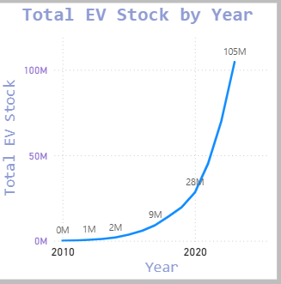
Insights And Recommendations:
Electric vehicles Growth
Insight:
EV stock grew exponentially from 0M in 2010 to 105M in 2022.
This reflects a global shift toward electrification, driven by policy, tech advances, and consumer adoption.

Slide 13
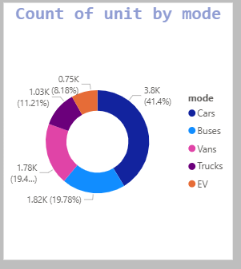
Insights And Recommendations:
Mode Distribution
Insight:
Cars dominate with 41.4% of total units 3.8K, showing the highest adoption.
Buses and Vans are nearly equal 20% each, indicating balanced fleet use.
Trucks account for 11.2%, while EV (general category) is the smallest at 8.2%, suggesting limited classification or mixed usage.

Slide 14
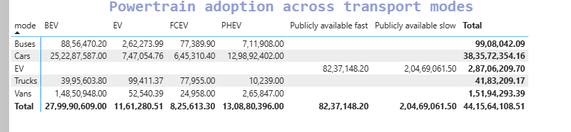
Insights And Recommendations:
How does powertrain adoption differ across transport modes (passenger, freight)?
Insight:
Cars are driving the EV revolution—they make up the majority of electric vehicles on the road.
Buses are going electric fast, especially with full battery systems (BEVs), likely due to public transport electrification.
Trucks and vans are slower to adopt, showing room for growth.
Fuel Cell EVs (FCEVs) are rare, likely due to limited hydrogen infrastructure.
In short: EV adoption is led by cars and buses, but infrastructure and commercial vehicle electrification still need to catch up.

Slide 15
Conclusion:
This Power BI dashboard provides a comprehensive view of global Ev market
EV growth is accelerating fast, especially in China, Europe, and the USA.
Battery Electric Vehicles (BEVs) are the most popular type worldwide.
Charging stations are increasing, making EVs easier to use.
Government policies are helping boost EV adoption.
EV adoption varies by vehicle type and region—some areas are ahead, others are catching up.
Overall trend shows rapid electrification, with more EVs replacing fuel-based vehicles.
Energy demand is rising, as more EVs hit the roads.
The market is maturing, with better technology, infrastructure, and consumer awareness.
These insights help decision-makers plan production, build charging networks, and invest in future mobility.

Slide 16
THANK YOU

