Slide 1

LOGISTICS AND INVENTORY MANAGEMENT ANALYSIS
Innomatics Research Labs – Dilsukhnagar
Batch No : 403
Meduri V S Anand Bharadwaj

Slide 2
Contents:
Problem Statement
Summary of the Data
Data Visualizations.
Conclusion

Slide 3
Problem Statement:
Retail Businesses struggle to balance inventory, manage warehouse capacity, and handle supplier delays resulting in higher costs and backorders.
This dashboard analyzes key metrics across inventory, sales, and logistics to uncover inefficiencies and enhance overall supply chain performance and decision-making.

Slide 4
Summary of the Data:
Column Name Description
Date - The date when stock is sold
Region - The specific region
Category - The specific items in warehouse
Supplier - supply different items.
Order Status - The status of the order placed.
Units Sold - Number of items sold.
Inventory Level - Availability of the stock in the warehouse.
Lead Time - The Time taken for a product to get manufactured and to reach the
Customer.
Backorder - customer order the product but it is out of stock.
Warehouse Capacity – The number of product that we can store in warehouse

Slide 5
What is Inventory and Logistics:
Inventory:
Inventory refers to the stock of goods a business holds for sale or use in production. It includes raw materials, work-in-progress items, and finished products. Proper inventory management ensures that companies meet customer demand without overstocking or running out of essential items.
Logistics:
Supply chain management is the coordination of all steps from raw materials to product delivery.
Effective SCM reduces costs, improves efficiency, and enhances customer satisfaction.

Slide 6
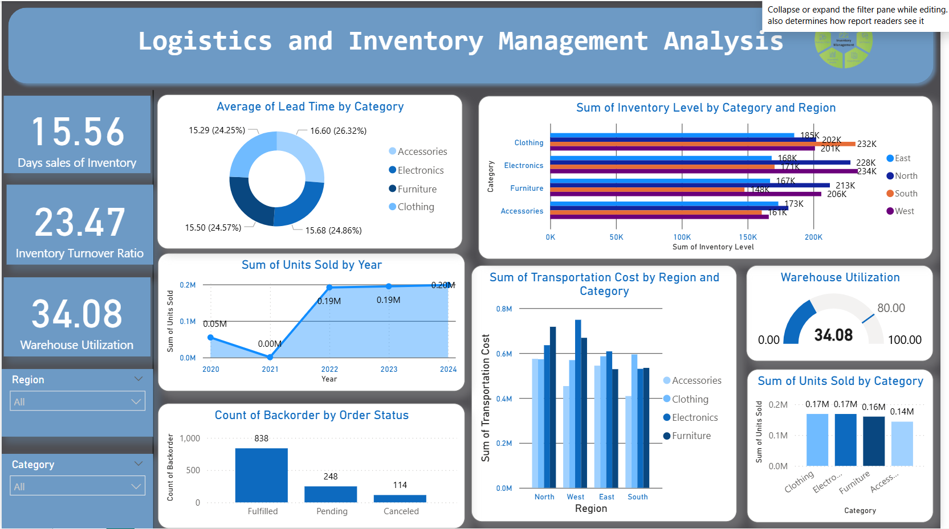
Dashboard Overview:

Slide 7
Your dashboard — “Logistics and Inventory Management Analysis” — provides a comprehensive view of supply chain and warehouse performance.
It covers five core areas of logistics:
Inventory efficiency (Days Sales of Inventory, Inventory Turnover Ratio)
Warehouse utilization
Supplier performance (Lead Time)
Sales trend (Units Sold)
Operational Performance (Transportation & Backorders)

Slide 8
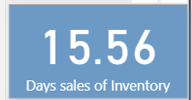
Insights And Recommendations:
Key Performance Indicators KPI’S:
Day Sales of Inventory:
Measure how long a product was there in the warehouse before sold.
Days Sales of Inventory (15.56 days) – products stay about 16 days in a year in the warehouse before being sold, which is Very Good because of less holding cost of inventory.
Recommendations:
Optimize reorder points, remove slow-moving items.

Slide 9
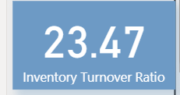
Key Performance Indicators KPI’S:
Inventory Turnover Ratio:
Measures how many times a company sells and replaces its inventory over a specific period (usually a year)
Inventory Turnover Ratio (23.47) → stock is sold and restocked 23 times a year ,which is very high and typically indicates:
Strong sales performance.
Efficient inventory management.
Low holding costs and minimal overstock.
Recommendations:
A turnover ratio of 23.47 is excellent—your inventory is moving fast.
Just ensure:
Stock levels don’t run too low.

Slide 10
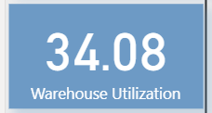
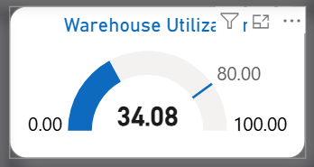
Key Performance Indicators KPI’S:
Warehouse Utilization:
Measures Percent of space used in the warehouse.
34.08% utilization means only about one-third of your warehouse space is occupied. This could suggest: Underutilization: You may be paying for unused space.
Recommendations:
Use idle space : Fill underutilized areas with high-demand or seasonal products.
Scale operations: Consider increasing inventory intake if demand supports it like Clothing and electronics.
Evaluate cost efficiency: If space is consistently underused, explore downsizing or subleasing options.
A utilization target of 80–85% is generally considered optimal for balancing space and flexibility.

Slide 11
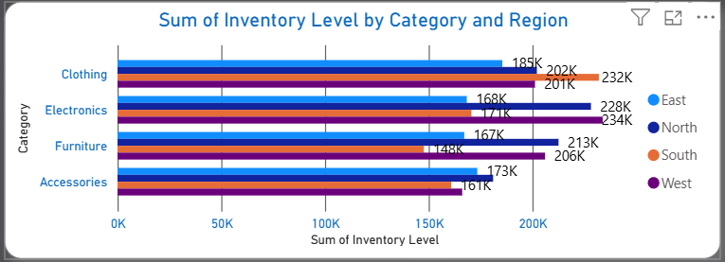
Insights And Recommendations:
Sum of Inventory Level By Category and Region:
Insights:
West region holds the highest inventory across all categories.
Clothing and Electronics have the largest inventory volumes overall.
Furniture shows strong presence in South and West.
Accessories have uniform inventory across all regions (173K), suggesting balanced distribution.

Slide 12
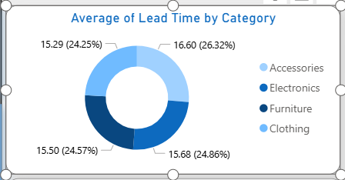
Insights And Recommendations:
Average of lead time by category: (Donut Chart)
Lead time can refer to the total time from when a product is manufactured to when it’s delivered to the customer. This includes: Production time: Time to make the product ,Packaging and handling Shipping and delivery time
Insights:
Clothing has the highest lead time (16.6 days), indicating slower supplier response.
Accessories have the shortest lead time (15.3 days), showing efficient procurement.
Lead times vary only slightly (~1.3 days), reflecting a stable supply chain.
Optimizing clothing lead times would deliver the most significant improvement.

Slide 13
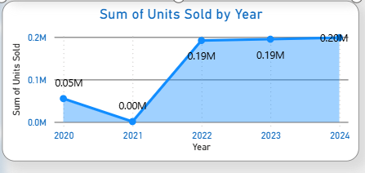
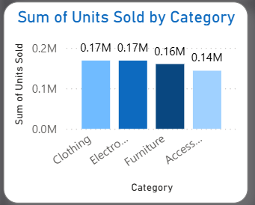
Insights And Recommendations:
Sum of units sold in a year and category wise: (Line Chart)
Insights :
Units sold surged post-2021, peaking at 0.20M in 2024.
Sales stabilized from 2022 to 2024.
Clothing and Electronics lead (0.17M); Accessories lag (0.14M).
2021 dip hints at supply chain or market issues.

Slide 14
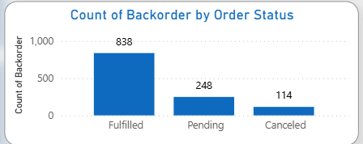
Insights And Recommendations:
Count of backorders by status: (Bar Chart)
Backorders are orders that couldn’t be fulfilled on time due to stockouts or delays
Fulfilled: 838 — most backorders are successfully completed
Pending: 248 — needs attention to avoid delays
Canceled: 114 — review reasons to reduce future cancellations

Slide 15
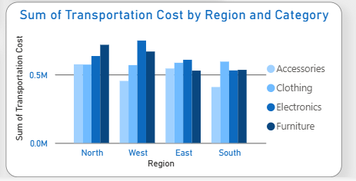
Insights And Recommendations:
Sum of transportation by region and category:(Bar Chart)
Insight:
North and West regions have higher transport costs, especially for Electronics and Furniture.
Transport routes, distance, or vendor inefficiencies are impacting cost.
Recommendation: Use route optimization or third-party logistics for cost efficiency.

Slide 16
Conclusion:
This Power BI dashboard provides a comprehensive view of inventory and supply chain performance.
Inventory turnover is strong, indicating effective stock management.
Warehouse utilization is moderate, suggesting potential space optimization.
Lead times are consistent across categories, though clothing can be improved.
Sales show steady growth after 2021, reflecting business recovery.
Regional analysis highlights transportation cost variations needing attention
These insights support smarter procurement, streamlined logistics, and better planning driving efficiency and improving customer satisfaction.

Slide 17
THANK YOU

