Slide 1

OYO HOTELS Analysis Using Web Scraping And Performed EDA
Innomatics Research Labs – Dilsukhnagar
Batch No : 403
Team:
Meduri V S Anand Bharadwaj
Melluri Vamshi Krishna Sharma

Slide 2
Problem Statement:
OYO offers staycations across India with varying prices, ratings, and facilities. To support trip planning, market analysis, and investment decisions.
This project collects and analyses OYO hotel data from multiple Indian cities to:
Compare hotel prices, ratings, and amenities
Identify top-rated and budget-friendly options
Understand trends in hospitality services

Slide 3
Contents:
Web Scraping –Details
Summary of the Data
Exploratory Data Analysis
Univariate Analysis
Bivariate Analysis
Multivariate Analysis
Conclusion
Experience and Challenges

Slide 4
Web Scraping –Tools & Process
Website: https://www.oyorooms.com
Web Scraping: Web Scraping means Automatically collecting the information from the websites using code instead of copying it manually.
Processor Followed:
1.Imported libraries:
requests for HTTP requests
BeautifulSoup for HTML parsing
re for text pattern matching
2.Number of Pages: Around 90 Pages.
3.HTTP GET requests sent with headers to avoid blocks.
4.Parsed HTML with BeautifulSoup.
5.Stored data in lists, later combined into a pandas DataFrame.

Slide 5
Summary of the Data:
Column Name Description
City - The major metropolitan area or city where the hotel is located
Hotel Name - The specific name of the OYO hotel property
Location - The area or neighborhood within the city where the hotel is situated.
Price - The price to book a room for one night
Ratings - The average customer satisfaction rating for the hotel.
Amenities - A list of the services and facilities offered by the hotel
Area - Nearby locations to Hotel
Price Category - The range of the hotel i.e Budget, Mid-range , Premium

Slide 6
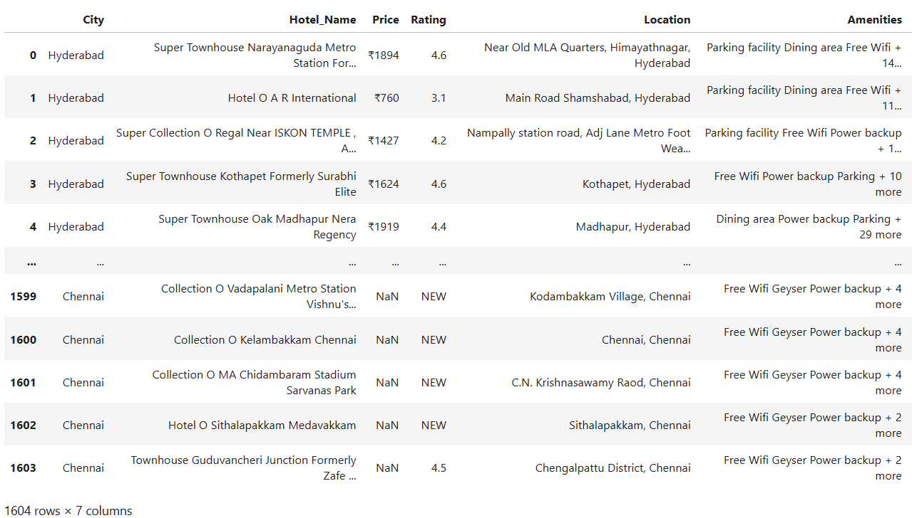
Raw Data:

Slide 7
Exploratory Data Analysis(EDA):
Data Cleaning and Data Manipulation:
Converted Columns into Proper Data Types
1.Price – Object to Integer
2.Rating - Object to Integer
Cleaning Steps:
1. Extract numeric price values
2. Extract numeric rating values
3. Extract primary area from location
4. Create binary indicators for amenities (AC, WiFi, TV)
5. Categorize prices into Budget/Mid-range/Premium
Handled Missing Values in important columns by filling them:
Price and Rating→ missing values are filled with median and mean, since they are key for analysis.

Slide 8
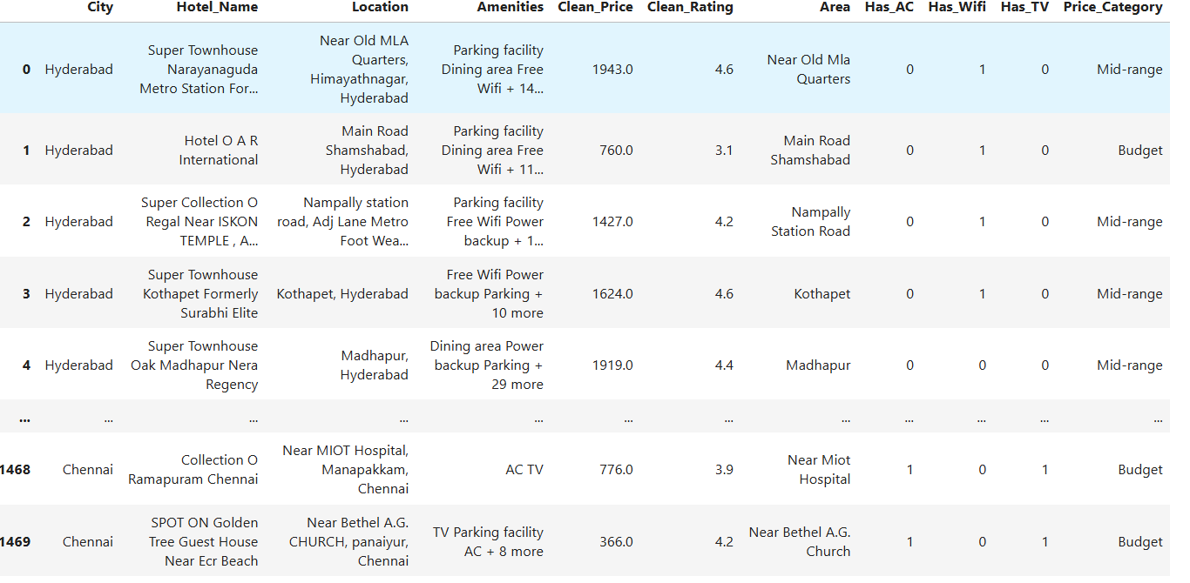
Cleaned Data:

Slide 9
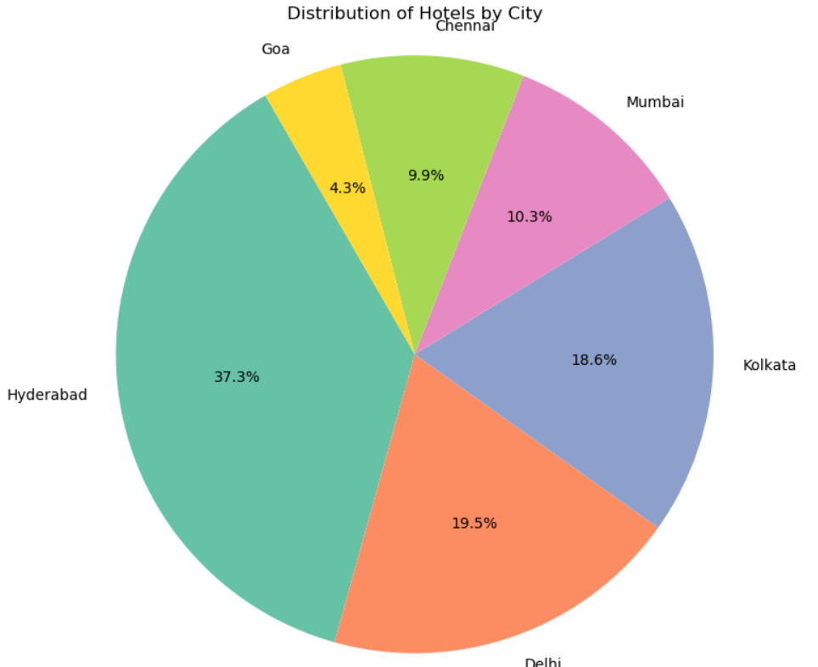
Univariate Analysis – Number of Hotels in Each City
Objective:
To see how many Hotels are there in each city
Listed In Oyo Platform.
Insights:
More number of Hotels in Hyderabad which is around
37% hotels across these 6 cities.
Less number of Hotels in Goa which is around 4.3%
hotels across these 6 cities..
Delhi and Kolkata has equal number of hotels which is
around 19%.
Conclusion:
Based on this analysis, Hyderabad dominates the OYO
platform with the highest number of hotel listings.
Delhi and Kolkata reflect both cities showing steady
and balanced growth in OYO's network.

Slide 10
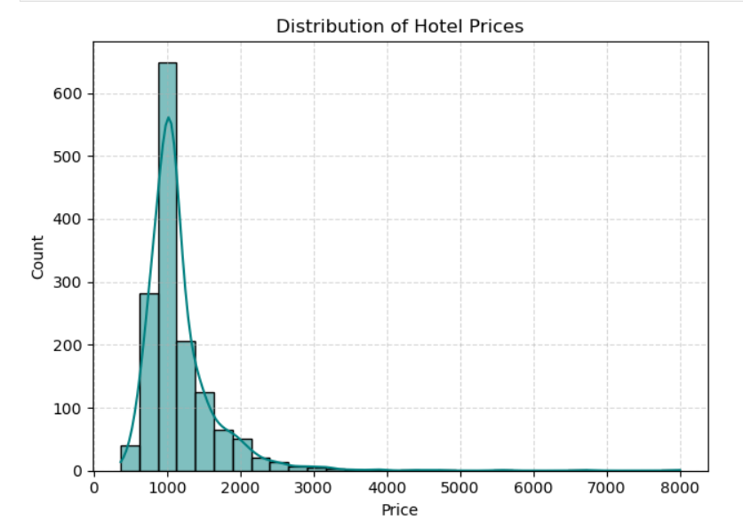
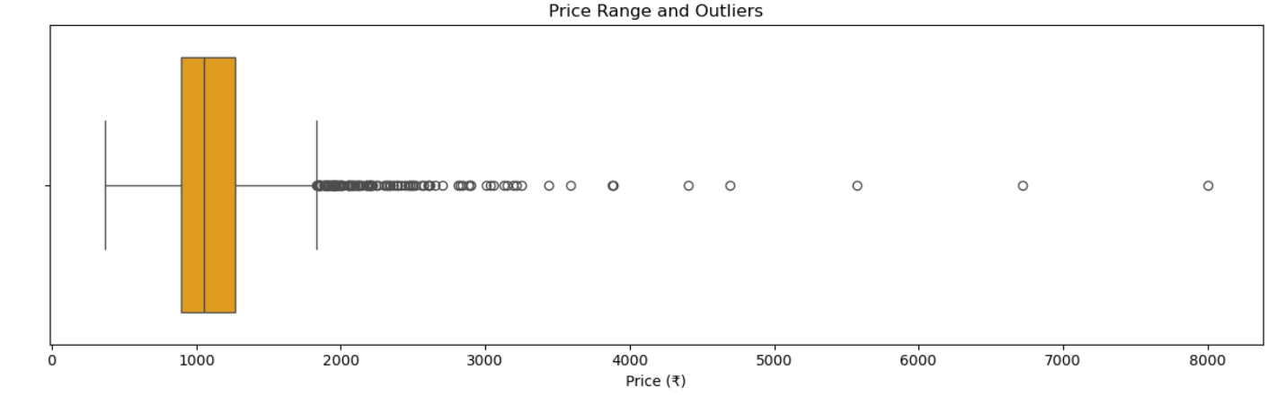
Univariate Analysis – Distribution of Hotel Price
Objective:
To know the price distribution of each Hotels
Listed In Oyo Platform.
Insights:
The price distribution is right-skewed (positively skewed).
This means the majority of OYO hotels are concentrated at
the left side of the price scale, primarily between
₹500 and ₹2000.
The long tail extending to the right shows a few premium
hotels that are significantly more expensive than the rest of
the properties.
In outliers the prices are distributed more between 2000-3500
Conclusion:
The price distribution for OYO hotels with the majority of properties
concentrated in the budget and lower-mid-range segment

Slide 11
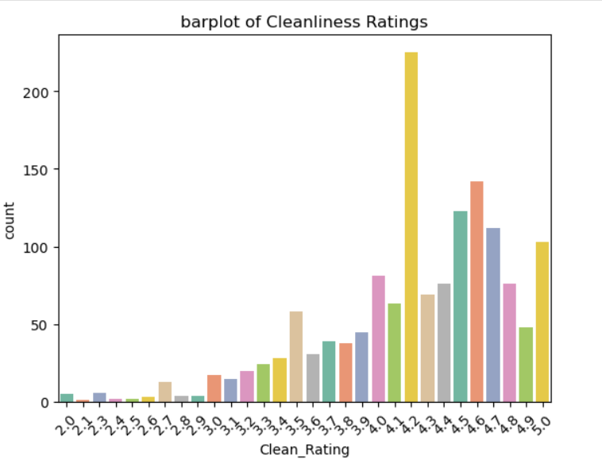
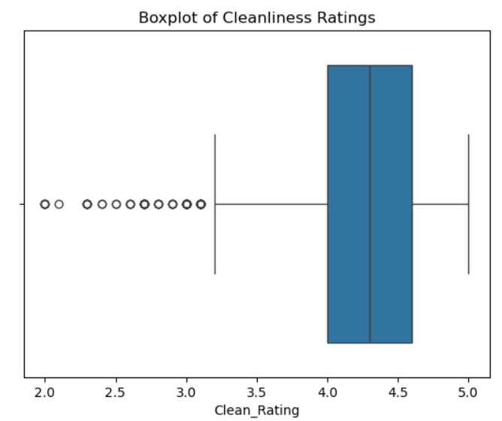
Univariate Analysis – Ratings
Objective:
To know the Cleanliness Ratings of each Hotels
Listed In Oyo Platform.
Insights:
The Majority ratings ranges from 4.0 to 4.5
There are several outliers ratings below 3.5
Conclusion:
The ratings distribution for OYO hotels with the majority
of properties concentrated between 4.0 to 4.5

Slide 12
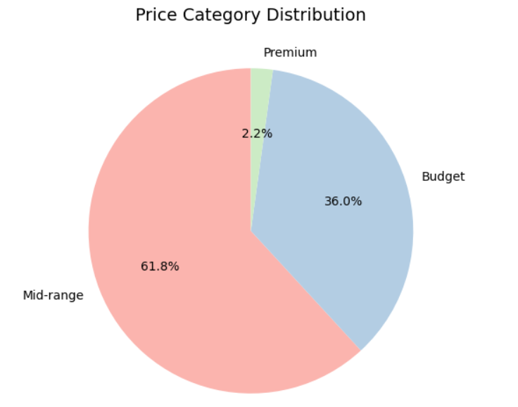
Univariate Analysis – Price Category Distribution
Objective:
To know the Price Category Distribution
each Hotels Listed In Oyo Platform.
Insights:
The mid-range category clearly dominates the market.
Fewer hotels are classified as premium
Conclusion:
The Price Category Distribution for OYO hotels
with the majority of properties concentrated in Mid-range
hotels

Slide 13
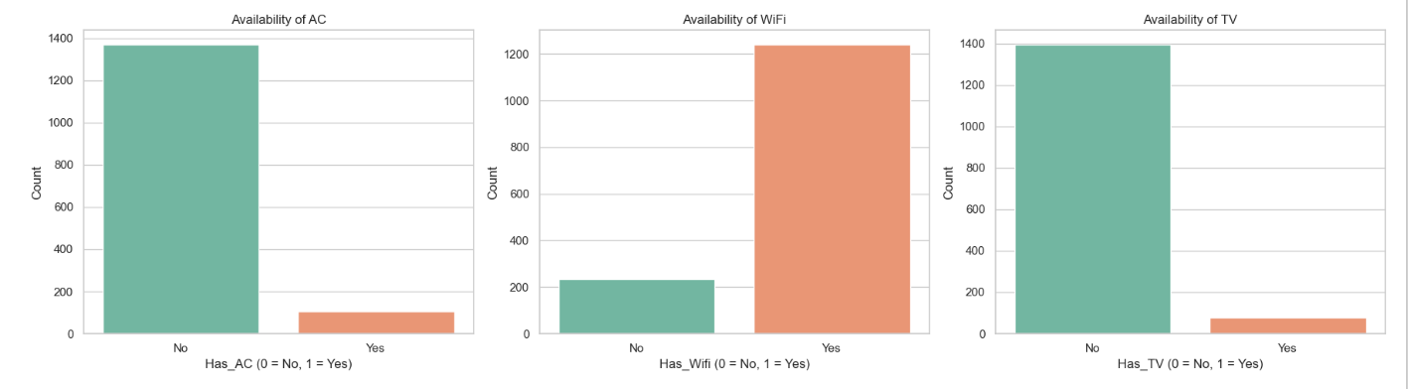
Univariate Analysis - Amenities -Availability of Ac-Wi-fi-Tv
Objective:
To know the Amenities -Availability of Ac-Wi-fi-Tv each Hotels Listed In Oyo Platform.
Insights:
Hotels are with more number of non Ac rooms and less Ac rooms.
Hotels have more availability of wifi.
Hotels have less availability of Tv
Conclusion:
The hotels with more availability of wifi and less availability of Ac rooms and Tv.

Slide 14
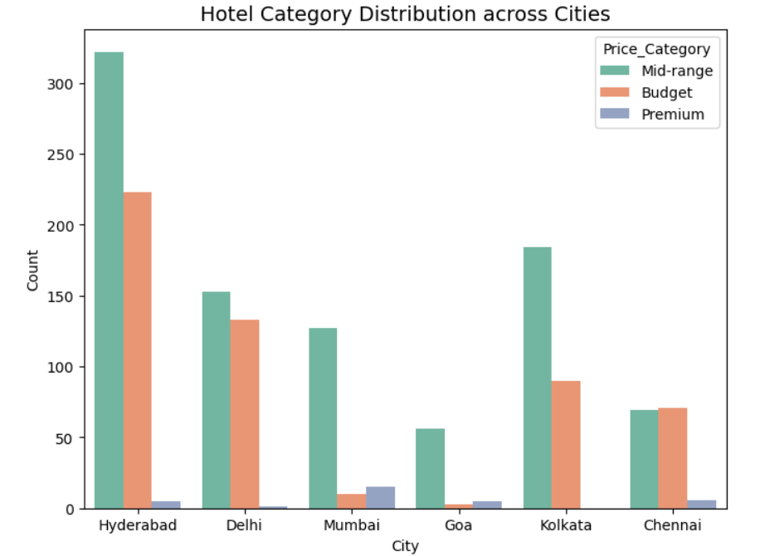
Bivariate Analysis - Hotel Category Distribution across Cities
Objective:
To know the Hotel Price Category Distribution
by City.
Insights:
Hyderabad leads in Mid-range hotels, suggesting it’s a hotspot
for value-conscious travelers who still expect decent amenities
Mumbai stands out in the Premium category.
Conclusion:
Mid-range hotels are abundant across most cities
especially Hyderabad, Delhi, and Mumbai

Slide 15
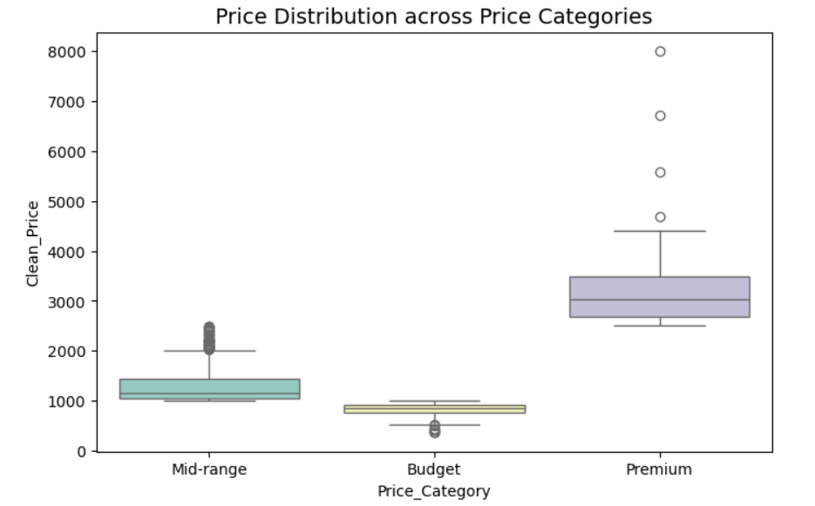
Bivariate Analysis - Price Distribution across Price Categories
Objective:
To know the Price Distribution across Price
Categories.
Insights:
Premium category has multiple outliers above ₹4500.
Mid Range has multiple outliers above 2000.
Conclusion:
Most of the Hotel prices are ranges from
1000 to 2000.

Slide 16
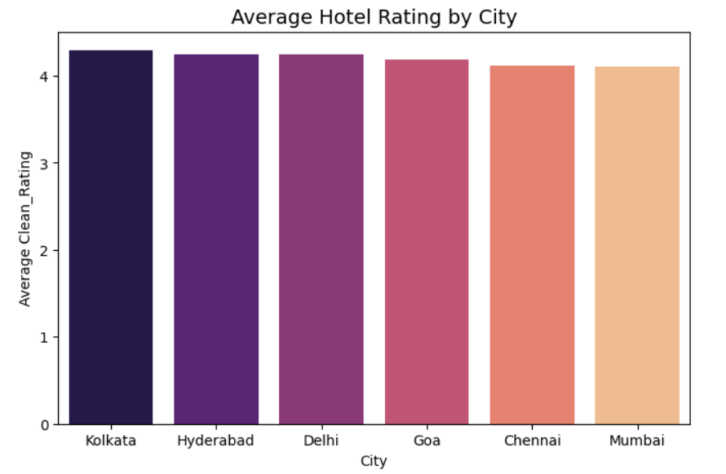
Bivariate Analysis - Average Hotel Rating by City
Objective:
To know Average Hotel Rating by City.
Insights:
All cities maintain high cleanliness standards,
with average ratings above 4.
Conclusion:
Consistently high cleanliness ratings across all
cities reflect a strong baseline of hygiene standards.

Slide 17
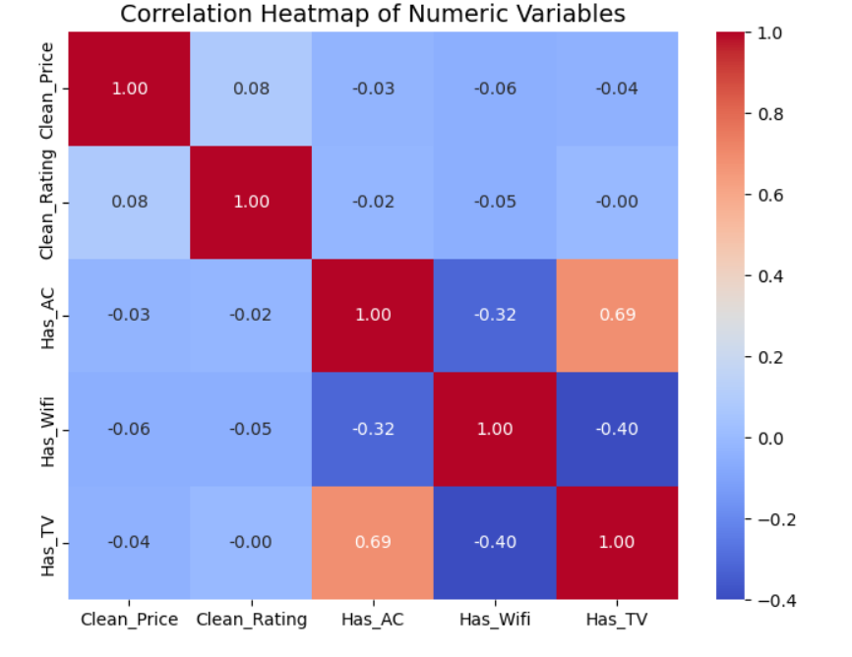
Multivariate Analysis – Price , Rating , Amenities
Objective:
To know the relation between Price , Rating , Amenities.
Insights:
Price vs Rating → 0.08 Very weak positive correlation Suggests that higher prices don’t necessarily guarantee better cleanliness ratings. Guests may not perceive value purely through price Mumbai stands out in the Premium category,
Conclusion:
Has AC vs Has TV → 0.6 Strong positive correlation Indicates that AC and TV often co-occur, likely bundled in mid-range or premium listings. Could be used as a proxy for comfort tier

Slide 18
Experience & Challenges:
Experience:
Learned how to scrape real-time data from Websites.
Gained hands-on practice in Univariate, Bivariate, and Multivariate Analysis.
Improved skills in Python, Pandas, Matplotlib/Seaborn, and Data Cleaning.
Challenges
Faced issues with missing, inconsistent, and noisy data.
Data cleaning & preprocessing required more effort than coding.
Handling dynamic website structure and anti-scraping measures

Slide 19
Conclusion:
City Distribution shows a balanced representation, enabling fair regional comparisons.
City vs Rating highlights that cleanliness standards vary across cities and price categories—some budget hotels outperform mid-range ones in other regions
Cleanliness Ratings cluster around mid-to-high values, suggesting generally acceptable standards

Slide 20
THANK YOU

