Slide 1

What do Generative Image
Models Know?
Anand Bhattad
Research Assistant Professor
Toyota Technological Institute at Chicago

Slide 2



StyLitGAN: Image-based Relighting via Latent Control
CVPR 2024
Anand Bhattad
James Soole
David Forsyth
https://anandbhattad.github.io/stylitgan/

Slide 3
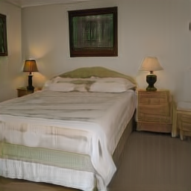

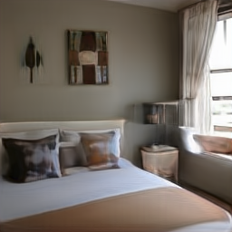
StyLitGAN: Single Image Diverse Relighting
Videos show scene geometry and albedo doesn’t change. Only thing that changes is lighting.
Notes:
StyLitGAN that can generate diverse and different variants of the same scene with extreme illumination changes that are difficult to find in training images and which a StyleGAN cannot produce otherwise.
Notice large illumination changes without change in geometry of the scene or the albedo.

Slide 4
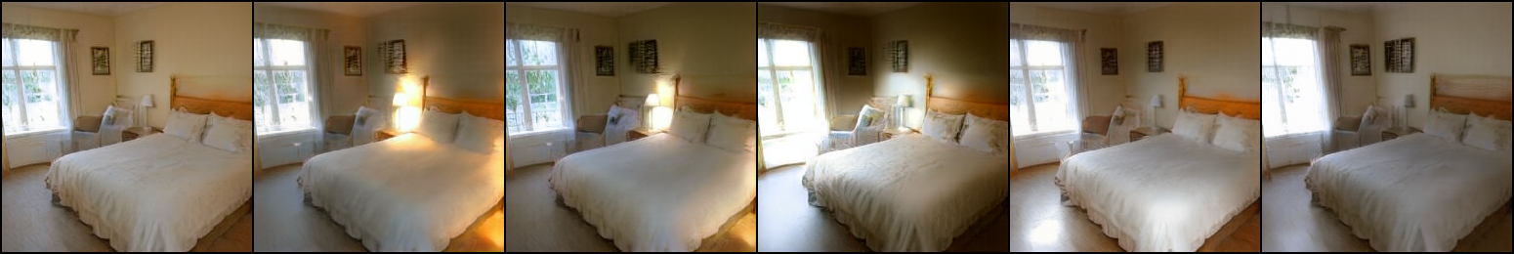
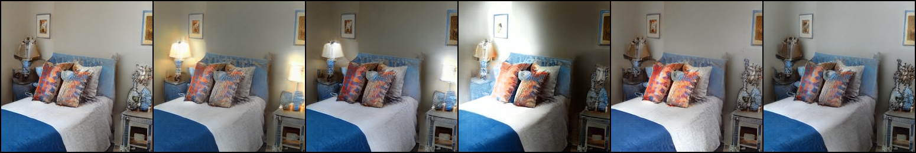
StyLitGAN: Relighting via Latent Control
direction-1
direction-2
direction-3
direction-4
direction-5
Same direction means similar lighting for all scenes
https://anandbhattad.github.io/stylitgan/
Notes:
Lets look at some results and analyze them frame by frame

Slide 5
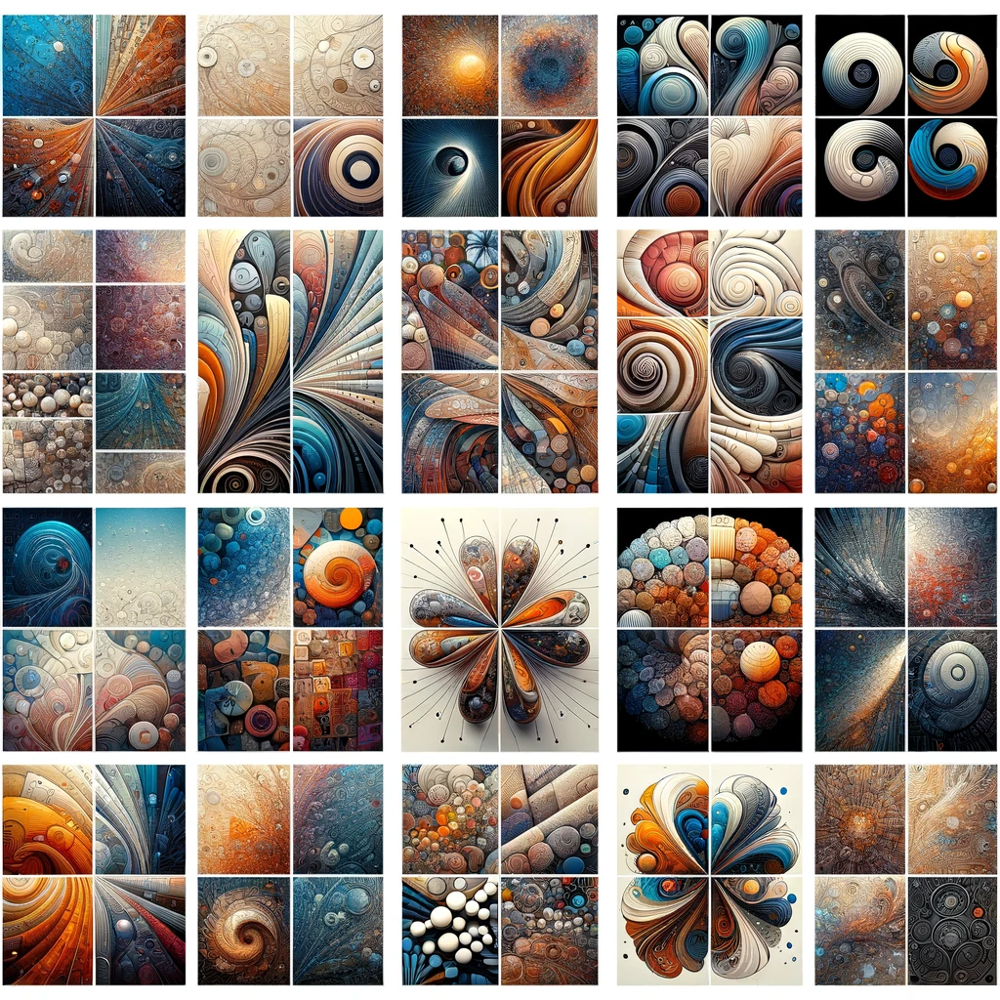
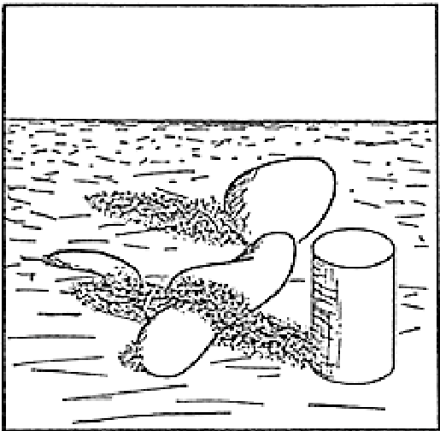
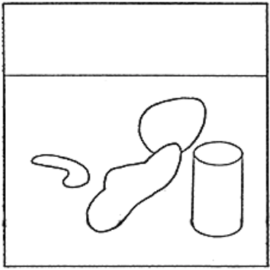
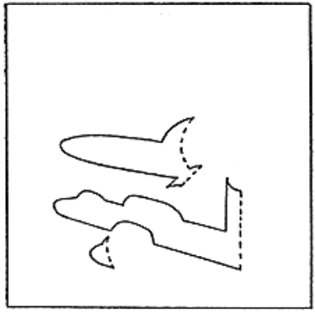
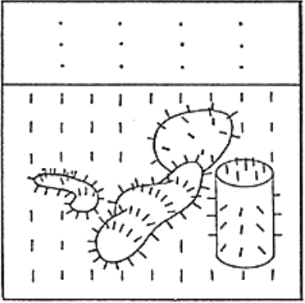
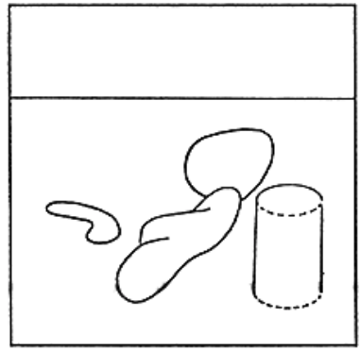
How Generative Models are doing this?
Abstract Representations
“Intrinsic Images”
Barrow and Tenenbaum 1978
Original Scene
Reflectance/Albedo
Illumination
Orientation
Distance
Notes:
Fundamental Scene Representations

Slide 6
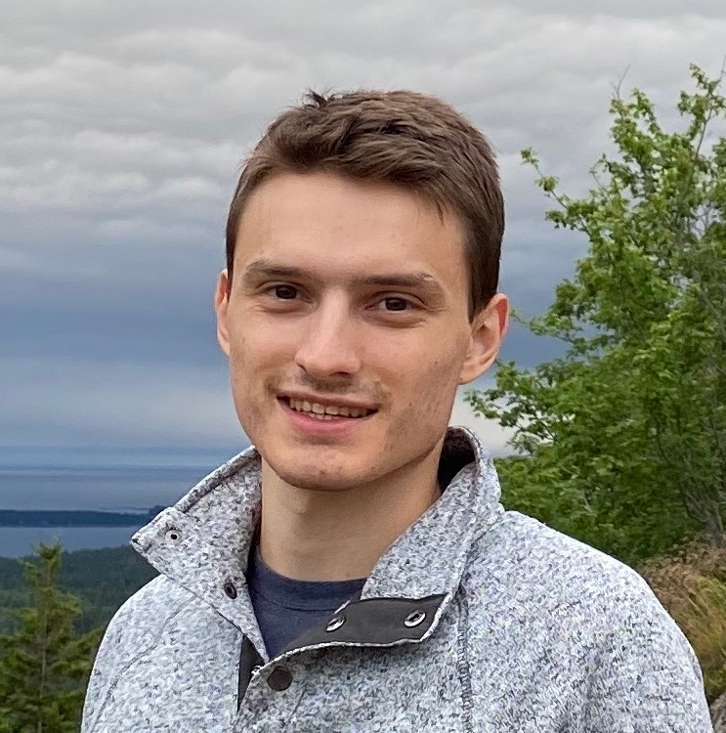
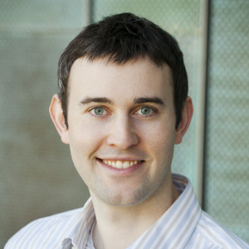
StyleGAN knows Normal, Depth, Albedo, and More
NeurIPS 2023
Anand Bhattad
Daniel McKee
Derek Hoiem
David Forsyth

Slide 7
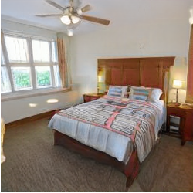
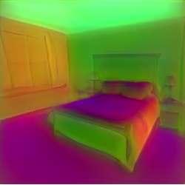
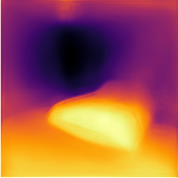
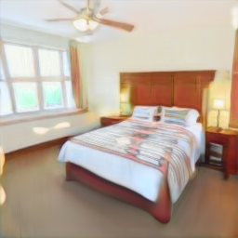
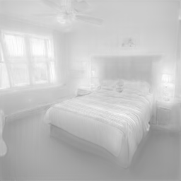
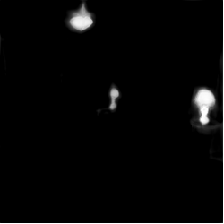
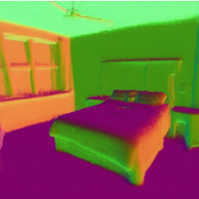
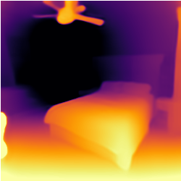
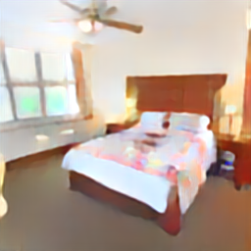
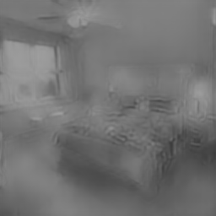

StyleGAN knows “Intrinsic Images”
StyleGAN Image
StyleGAN Normals
StyleGAN Depth
StyleGAN Albedo
StyleGAN Shading
StyleGAN Segment
Normals
[Kar et al. ’22]
Depth
[Bhat et al. ’23]
Albedo
[Forsyth and Rock ’22]
Shading
[Forsyth and Rock ’22]
Segment
[Fang et al. ’23]

Slide 8
Is it only StyleGAN that knows Intrinsic Images?
Nope! All Generative Models seem to know about Intrinsic Images

Slide 9

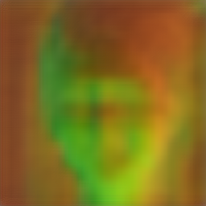
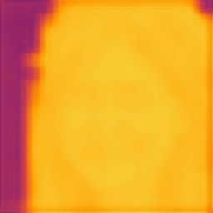
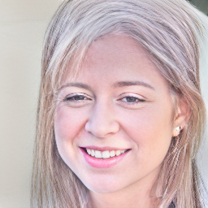
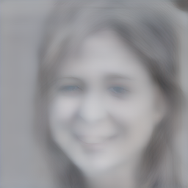
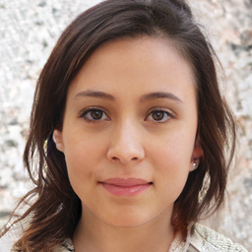
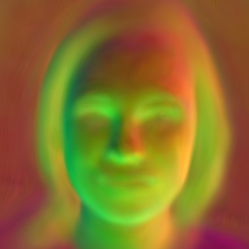
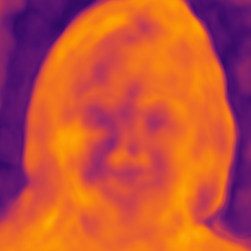
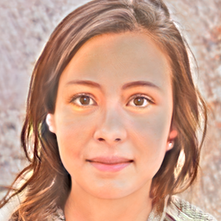
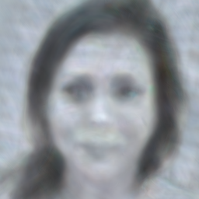
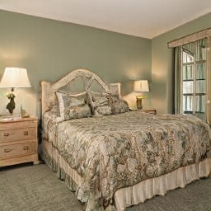
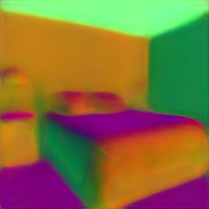
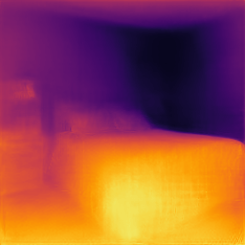
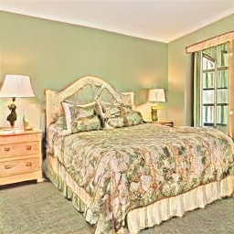
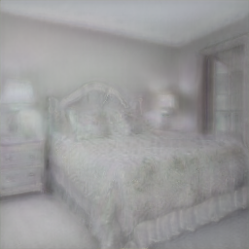
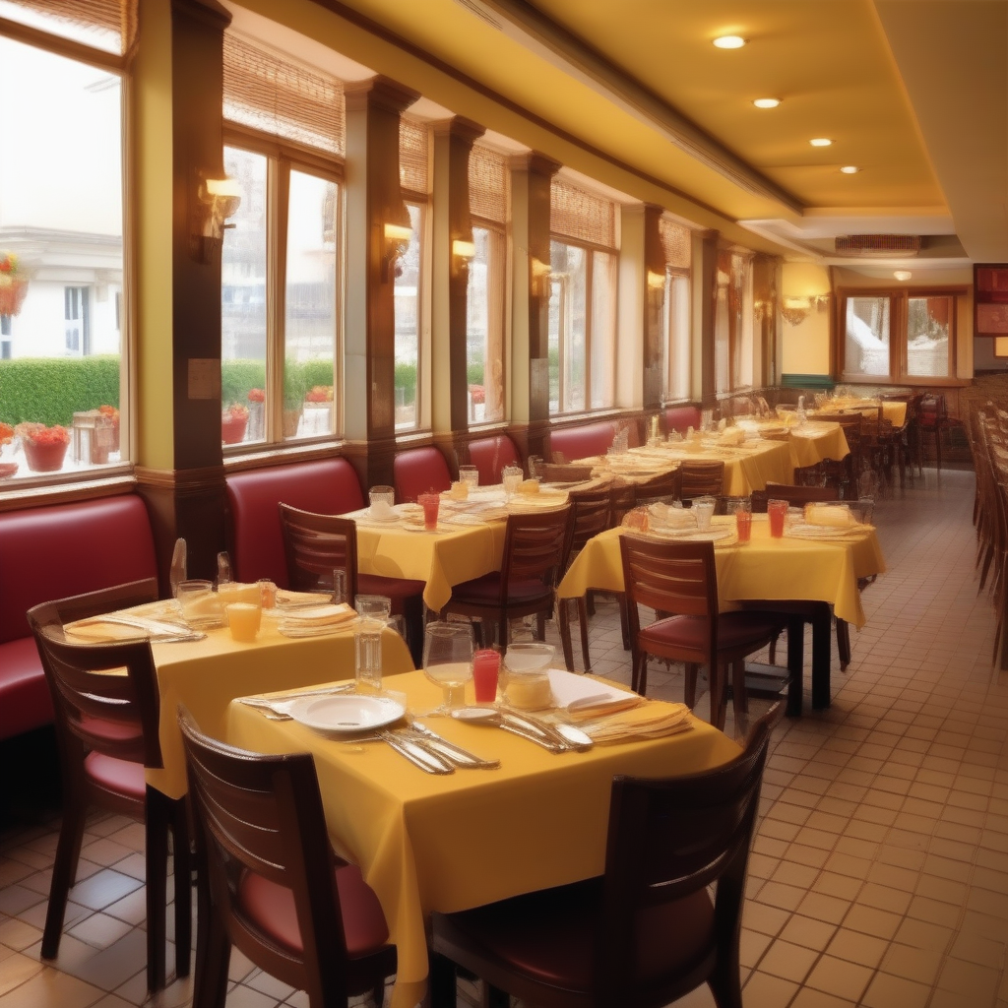
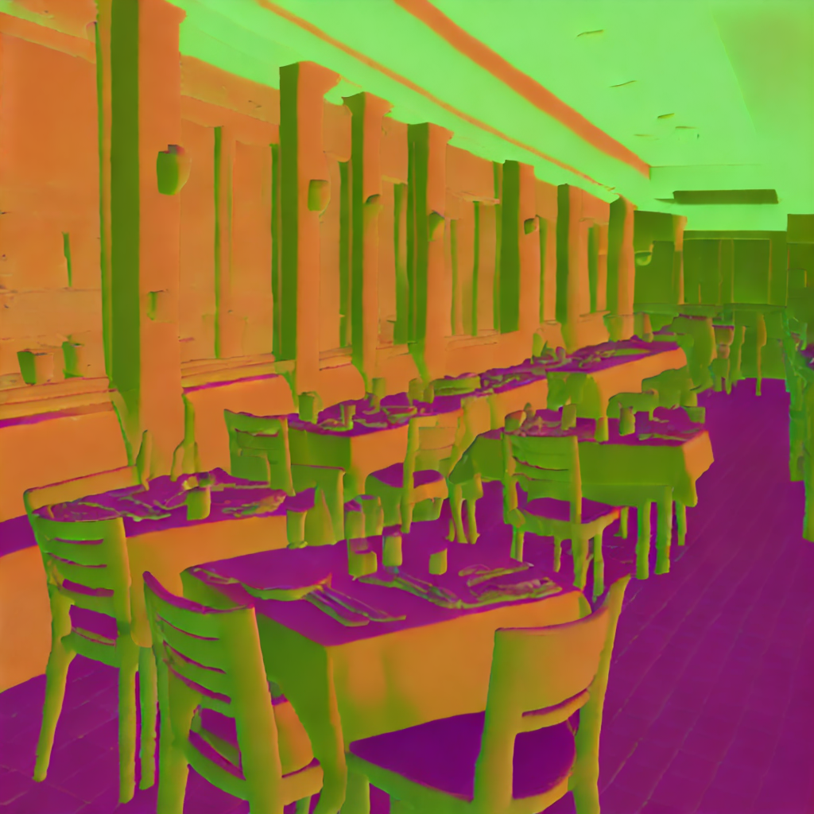
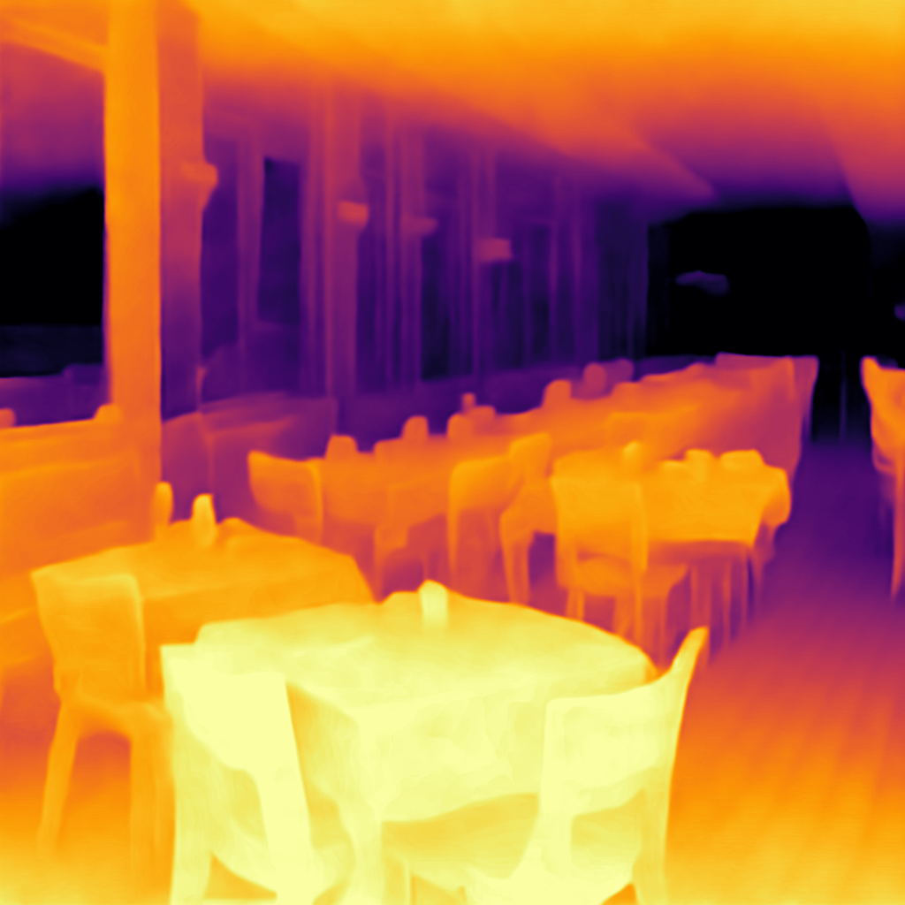
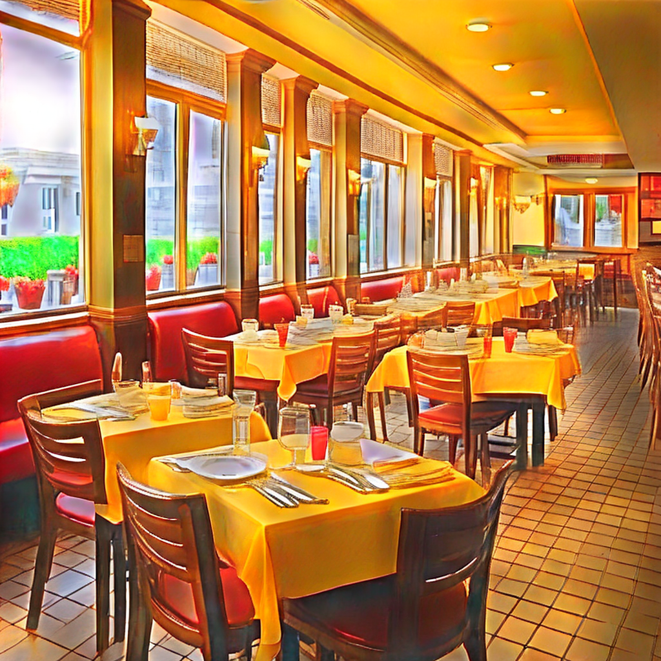

Image
Normals
Depth
Albedo
Shading
Image
Normals
Depth
Albedo
Shading
(a) VQGAN FFHQ (Autoregressive)
(b) StyleGAN-XL FFHQ (GAN)
Image
Normals
Depth
Albedo
Shading
(c) StyleGAN-v2 LSUN Bedroom (GAN)
Image
Normals
Depth
Albedo
Shading
Intrinsic LoRA: Xiaodan Du et al. 2024 (TTIC)
(d) Stable Diffusion 2.1 (Diffusion)
9

Slide 10
Generative Models seems to “understand” 3D world
Is there anything that they get it wrong?

Slide 11

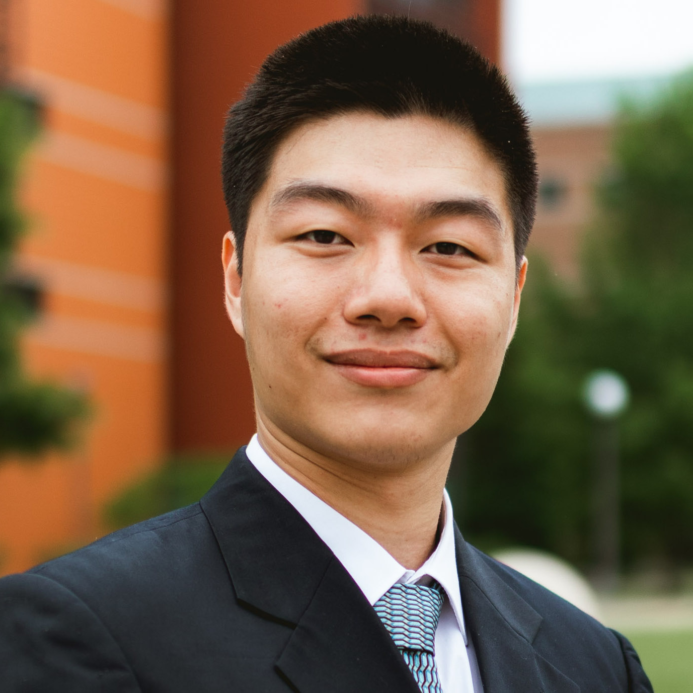

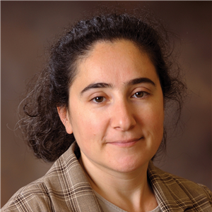
Shadows Don’t Lie and Lines Can’t Bend!
Generative Models Don’t Know
Projective Geometry…for now
CVPR 2024
Ayush Sarkar*
Hanlin Mai*
Amitabh Mahapatra*
Lana Lazebnik
David Forsyth
Anand Bhattad

Slide 12
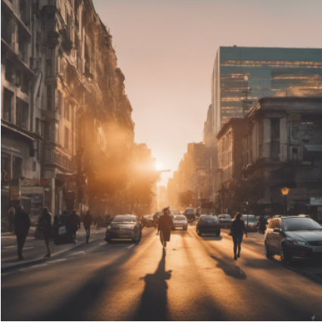
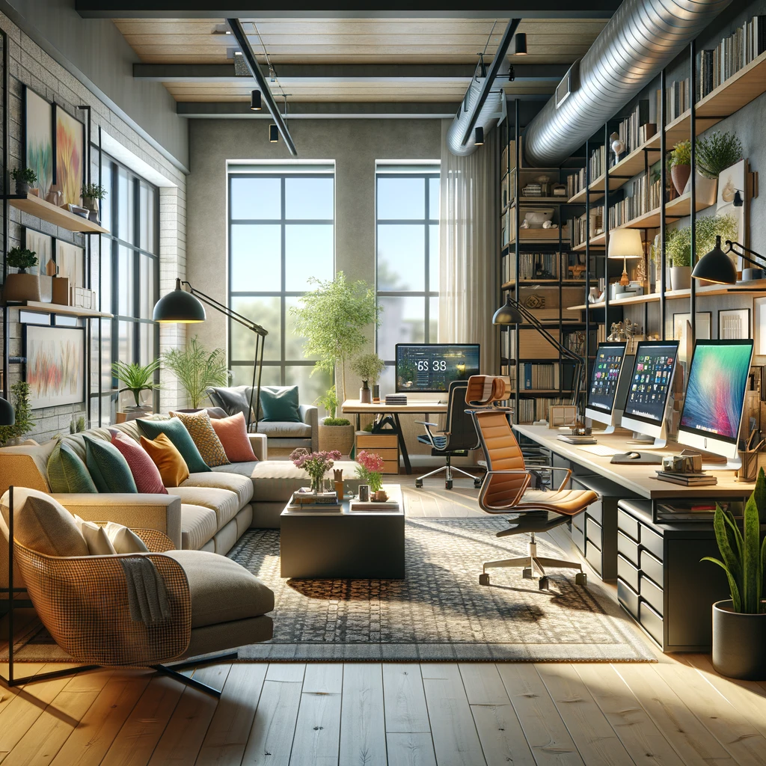
Realistic Generated Images …

Slide 13
… but there are Shadow Errors

Slide 14
… but there are Perspective Errors

Slide 15
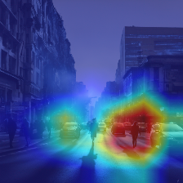
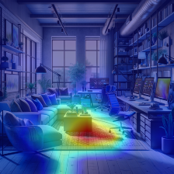
Detected Shadow Errors

Slide 16
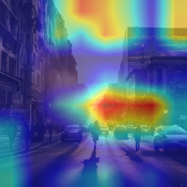
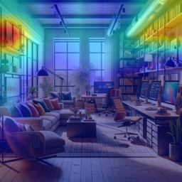
Detected Perspective Errors

Slide 17
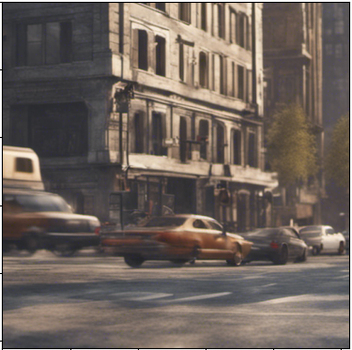
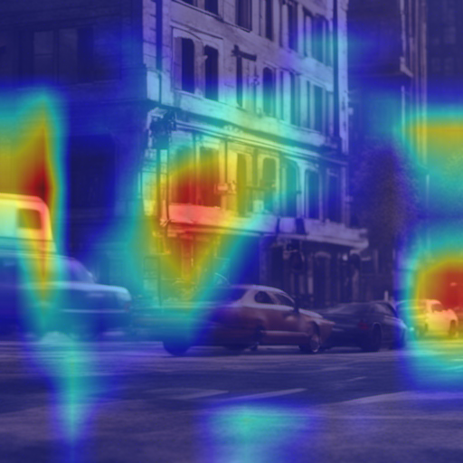

What do Generative Image Models know?
  a great deal of unexplored knowledge about scenes
  seem to ‘‘understand” 3D Scene
  but only to a point and makes interesting mistakes

Slide 18


Latent Intrinsics Emerge from Training to Relight
Ongoing work!
Model never seen albedo like images; Extracted from Latents

