Slide 1

Past Meets Present:
A Tale of Two Visions
TTIC 41000
Instructor: Anand Bhattad
Lecture 1: Introduction

Slide 2
Introduction: Anand
I am a Research Assistant Professor at TTIC since Sept 2023
Before that, a PhD student at UIUC with David A. Forsyth
Research Interest: Computer Vision, Computer Graphics and Computational Photography
Current Research Focus
  Generative Models
    Exploring Knowledge, Image Editing
  Image-based Rendering
    Object Compositing, Image-based Relighting
  Neural Radiance Fields
    Interpretable and Controllable Fields, Understanding building blocks of NeRF

Slide 3
Today’s Agenda
Why this class?
Requirements and logistics
How is the class going to be?
Marr’s Vision

Slide 4
Today’s Agenda
Why this class?
Requirements and logistics
How is the class going to be?
Marr’s Vision

Slide 5
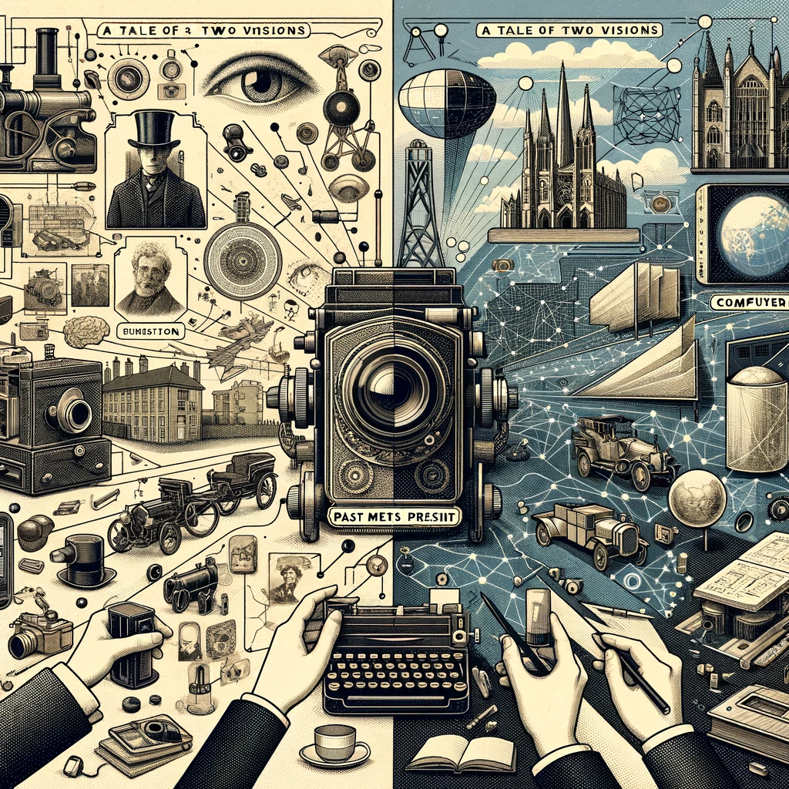
It was the best of times,
it was the worst of times,
it was the age of wisdom,
it was the age of foolishness,
it was the epoch of belief,
it was the epoch of incredulity,
it was the season of light,
it was the season of darkness,
it was the spring of hope,
it was the winter of despair.
- Charles Dickens,
A Tale of Two Cities

Slide 6
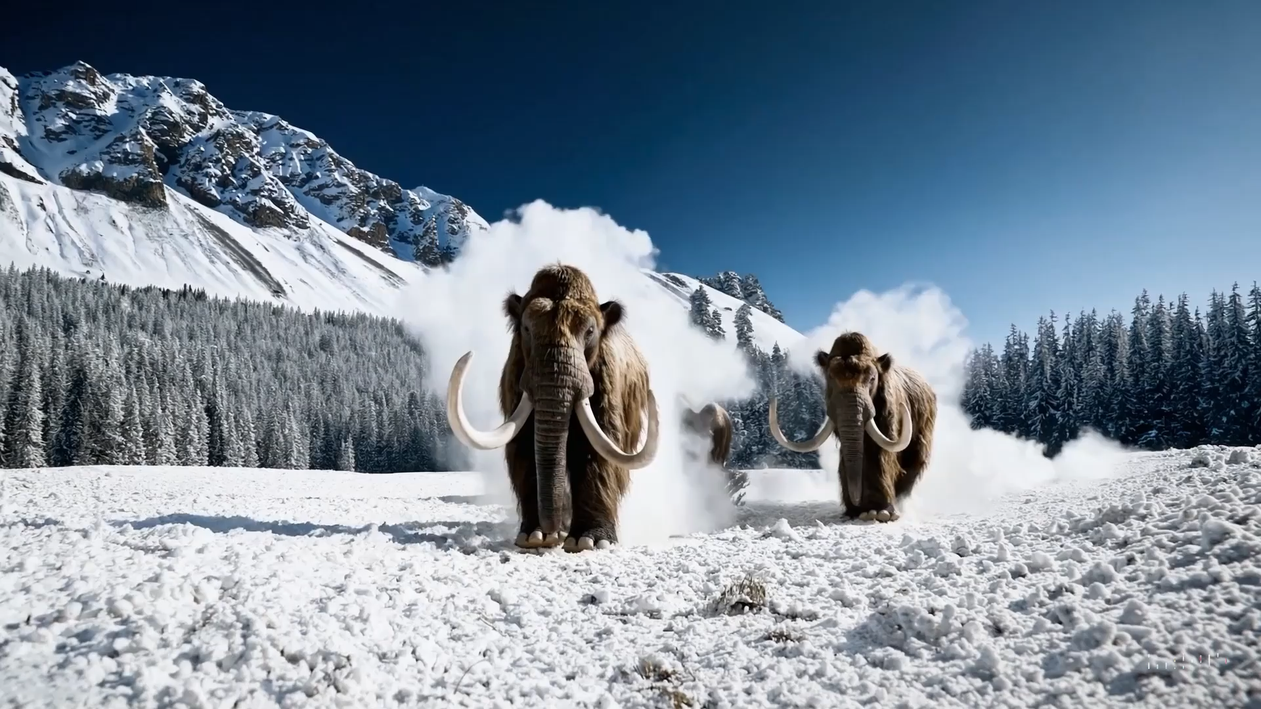
“It was the best of times…”
Source: Sora (Open AI)

Slide 7
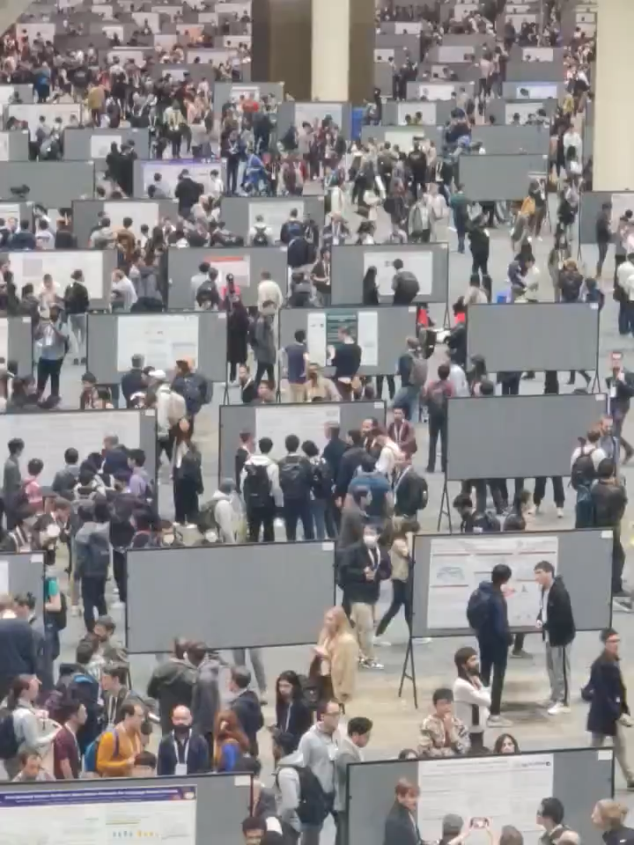
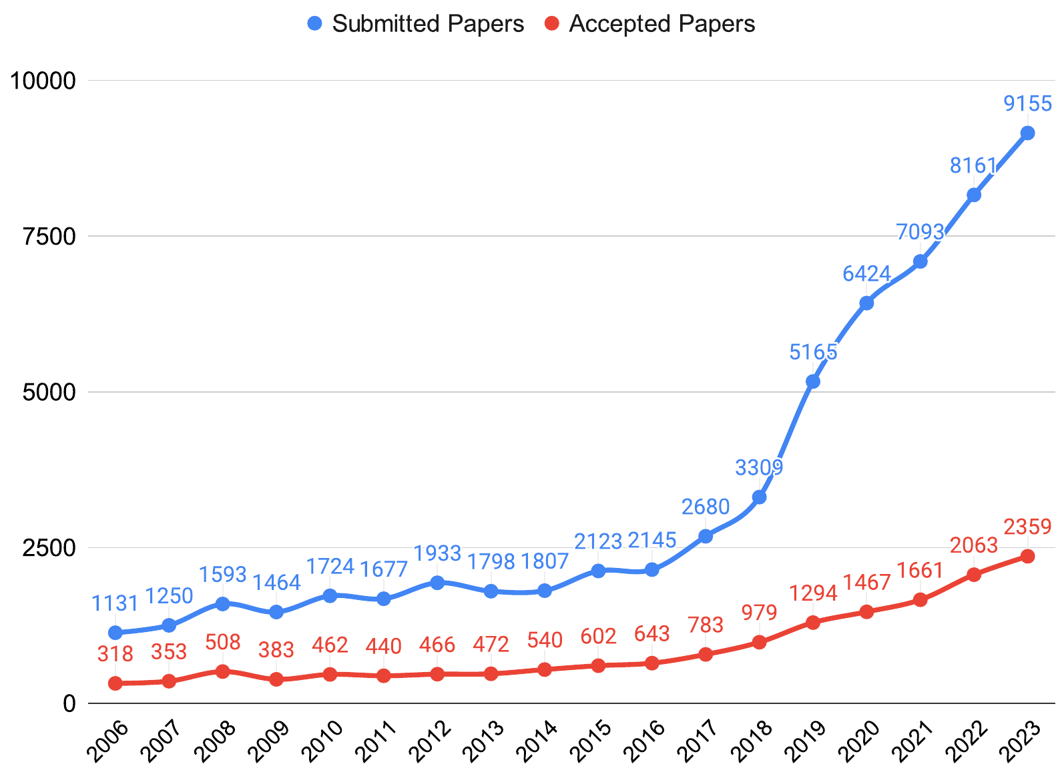
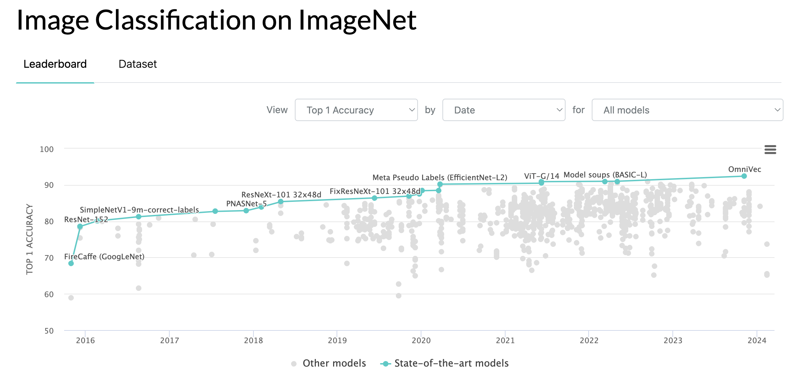
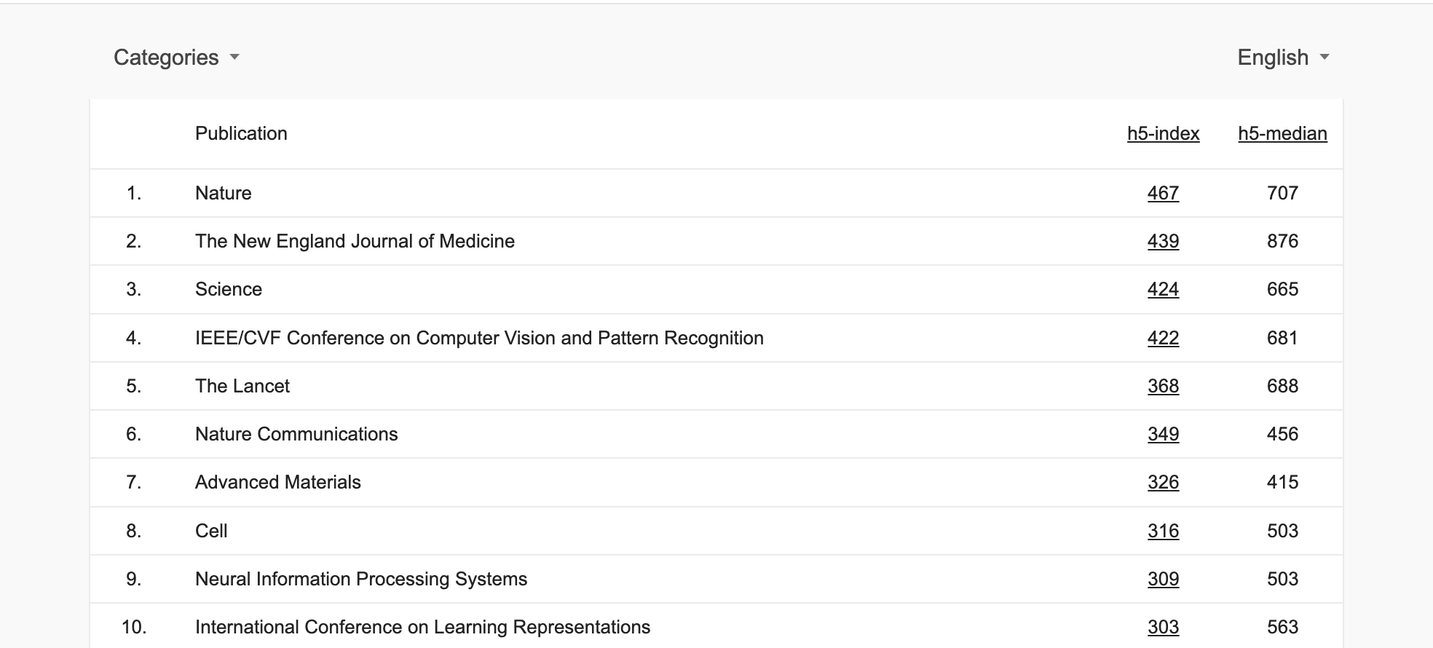
“It was the best of times…”
Source:: CVPR 2023 opening slides
Source: Bram Grooten on Twitter(X) from NeurIPS 2023
Source: Google Scholar
Source: https://paperswithcode.com/sota/image-classification-on-imagenet

Slide 8

“It was the worst of times…”
“I have no compute”
“No one cares about my small model”
“My research is no longer relevant. For real.”
“I can’t access big models!”
“What did OpenAI train DALL-E on?”
“Is it ok to use this data?”
“Will I have no job?”
“SORA”
Source: Scholars & Big Models Opening slides
(from a survey before the workshop):

Slide 9

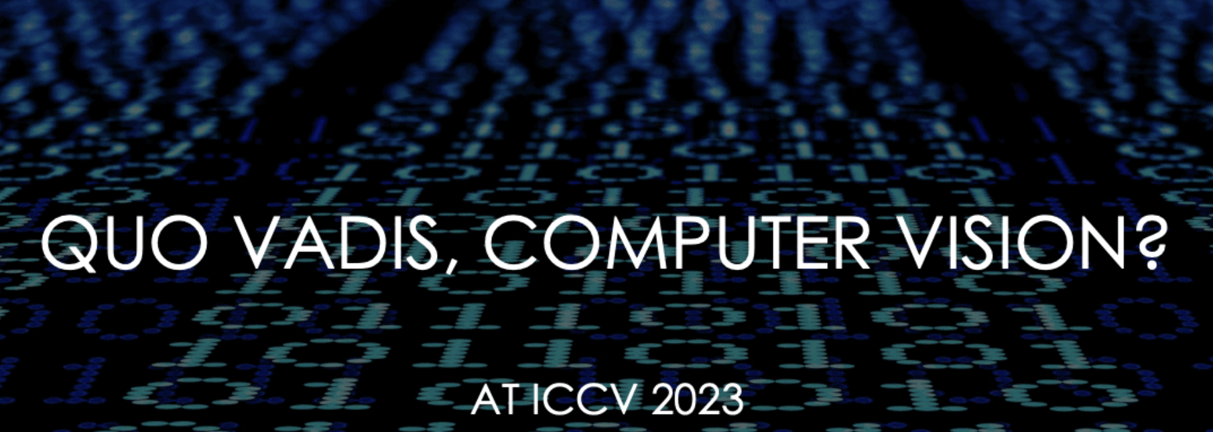
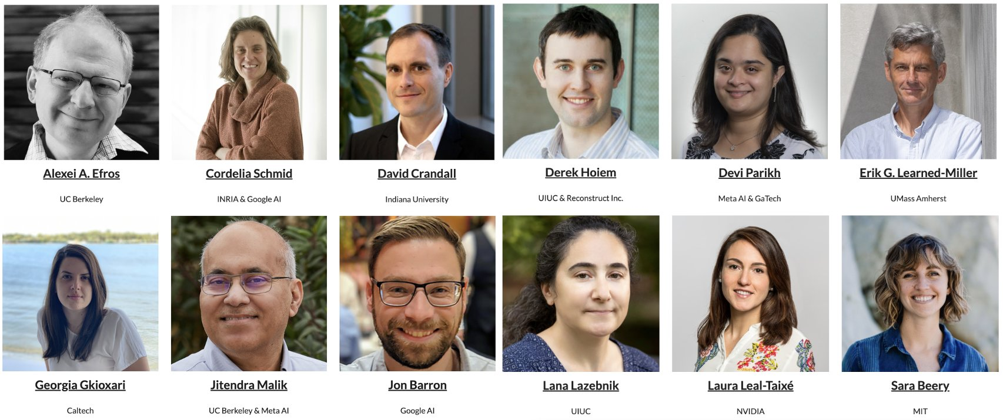
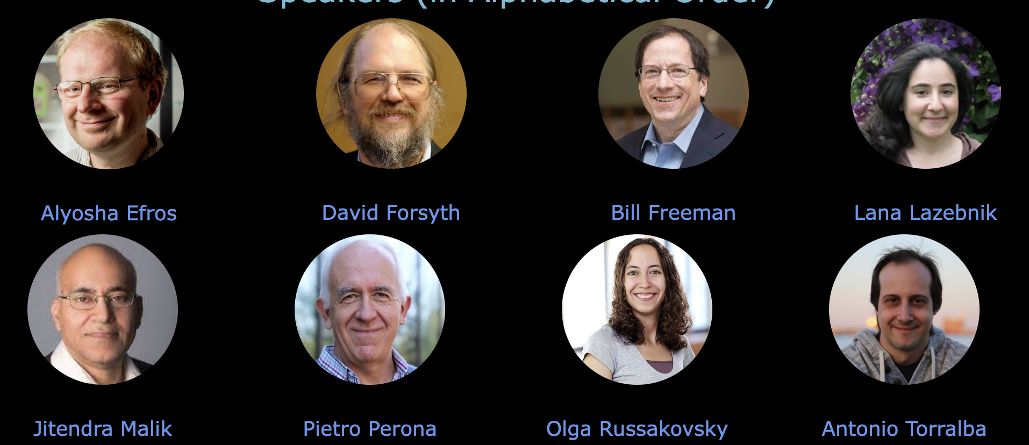
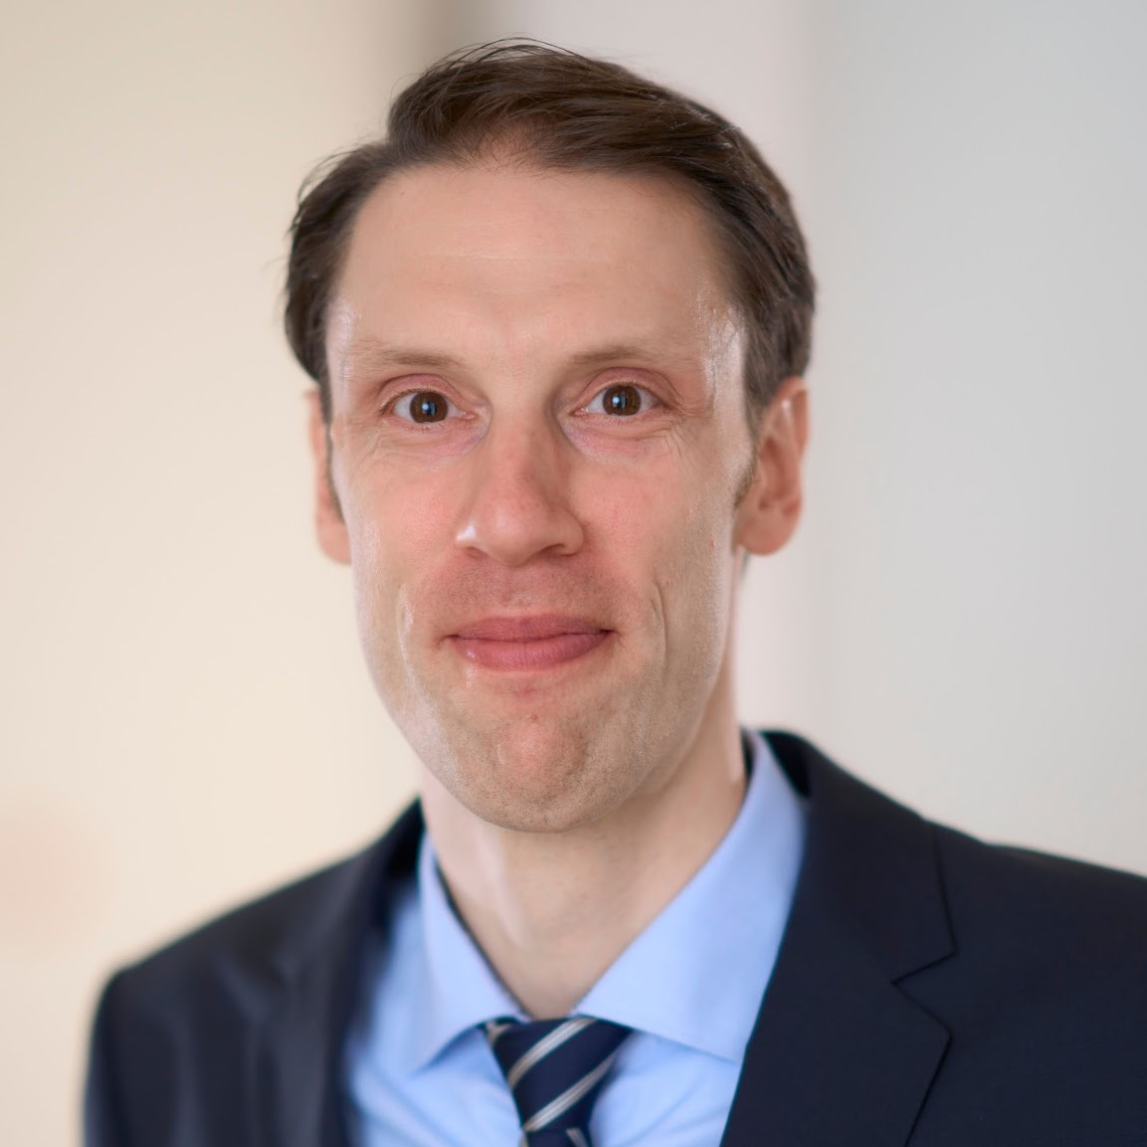
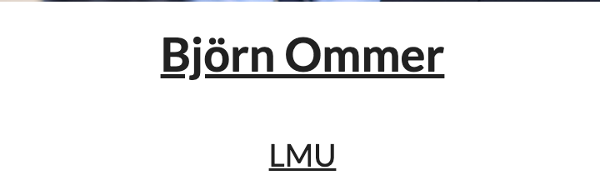
“We have everything before us, we have nothing before us...”
At CVPR 2023
https://sites.google.com/view/academic-cv/
https://gkioxari.github.io/Tutorials/iccv2023/

Slide 10

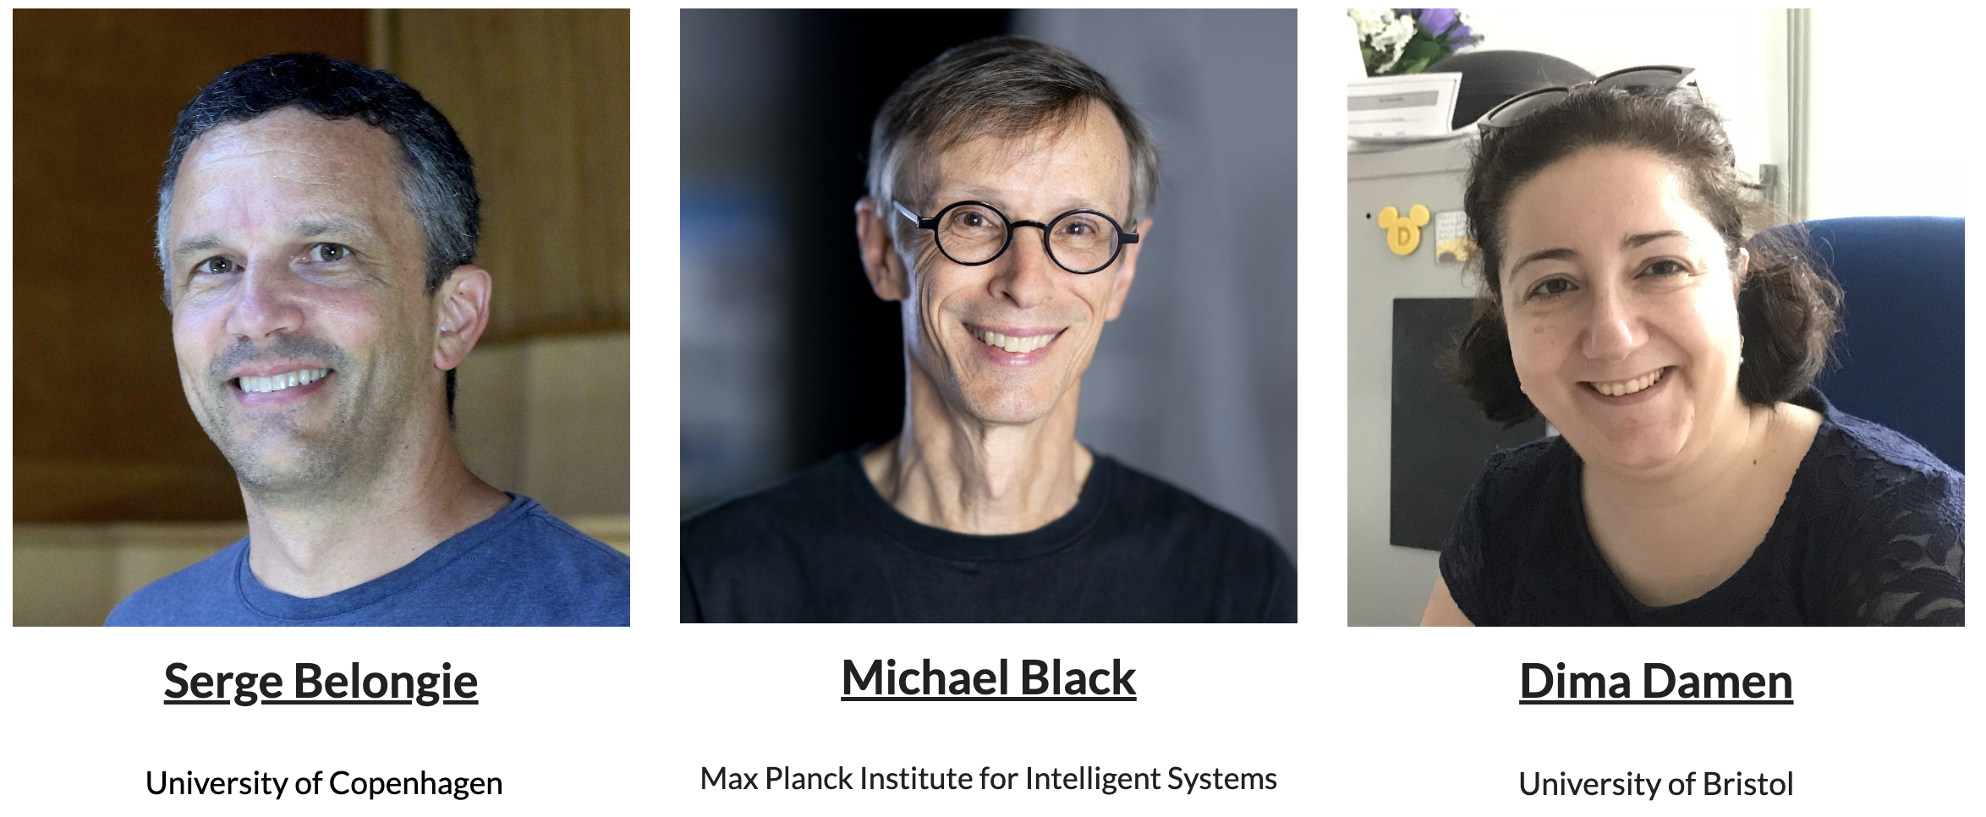
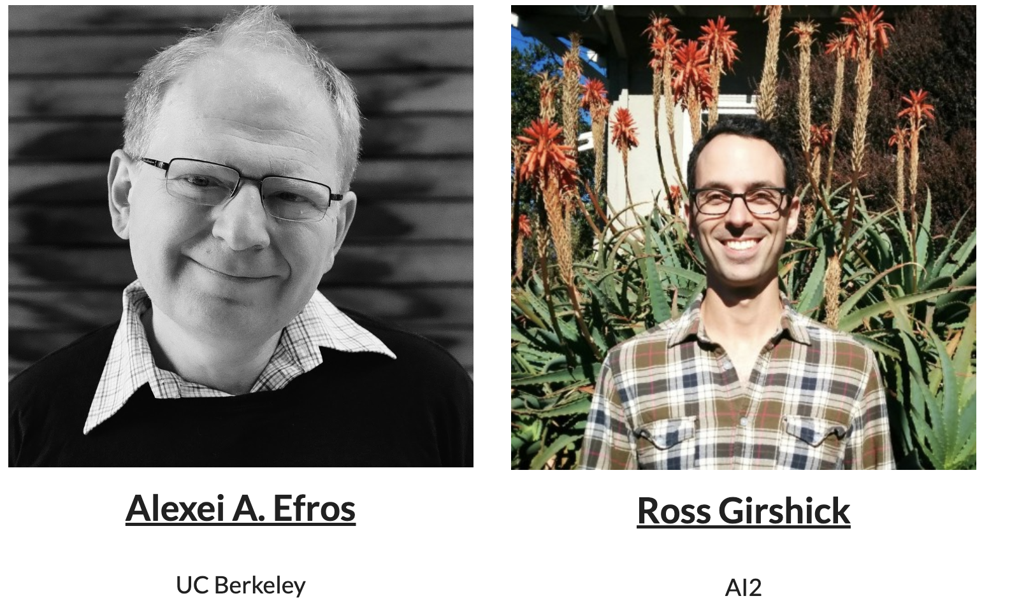
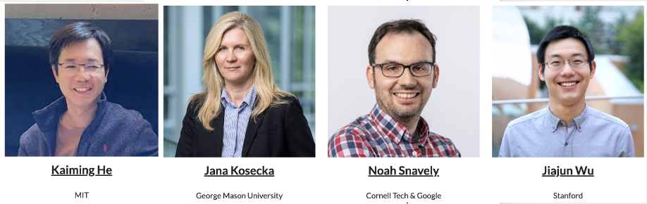
“Change begets change. Nothing propagates so rapidly”
At CVPR 2024
Source::https://sites.google.com/view/retrocv

Slide 11
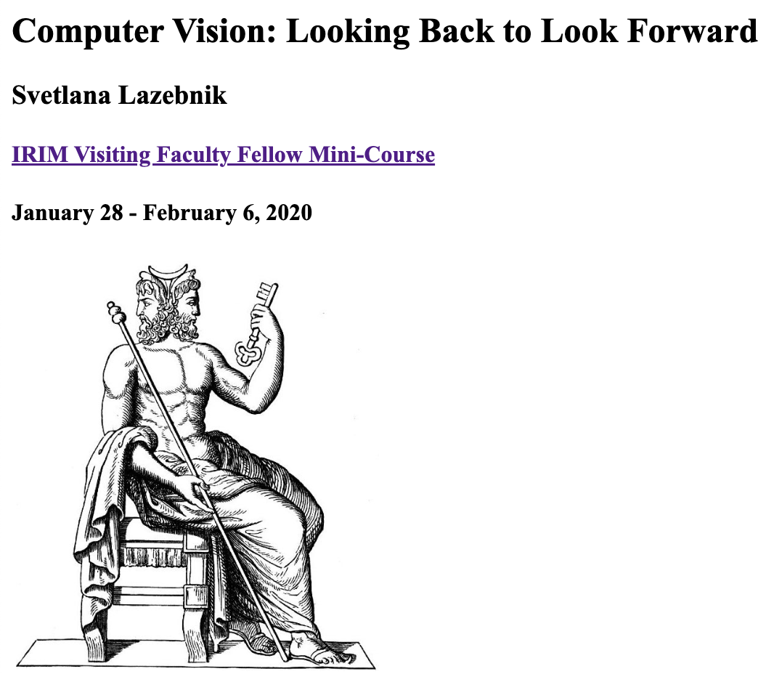
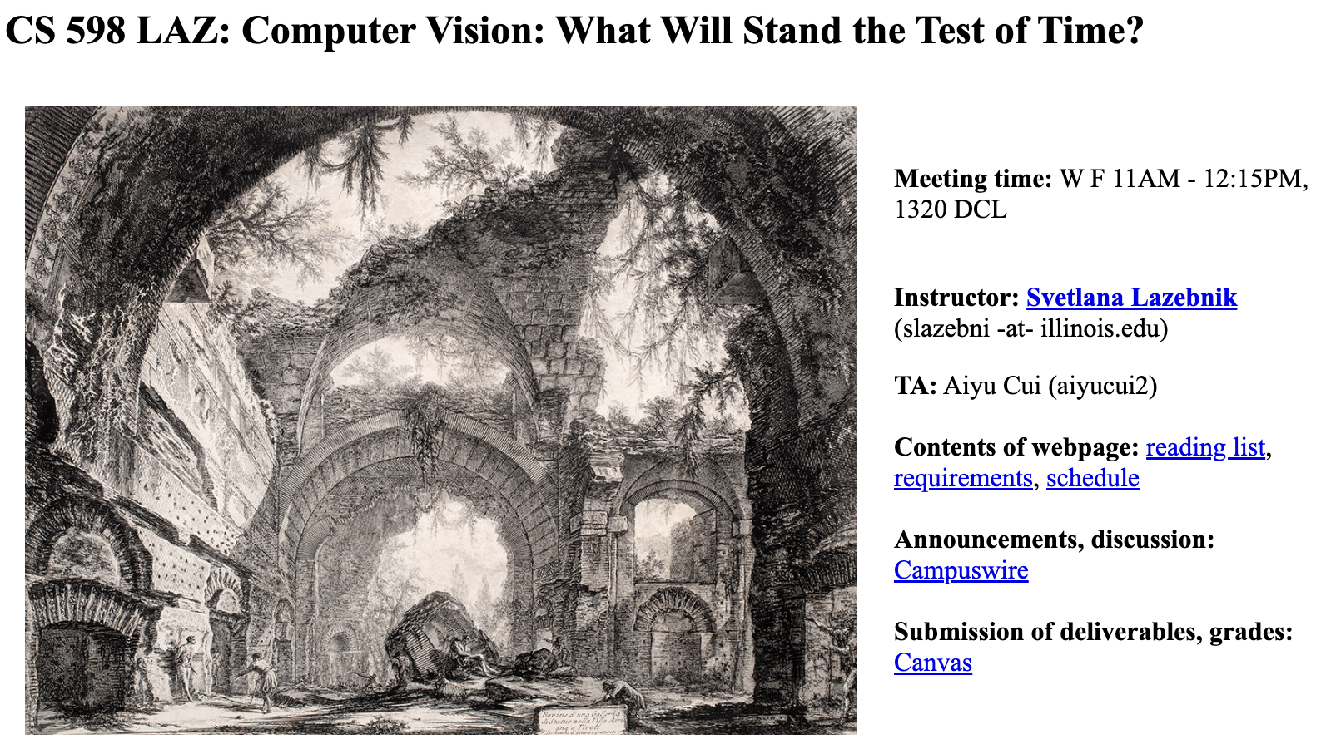
“Change begets change. Nothing propagates so rapidly”
https://slazebni.cs.illinois.edu/spring20/
https://slazebni.cs.illinois.edu/fall23/

Slide 12
“It was the age of wisdom, it was the age of foolishness”
Past Meets Present: A Tale of Two Vision
Engage with the foundational concepts and seminal works that have shaped computer vision
Explore recent advancements and SOTA approaches in computer vision, appreciating the progress made possible by building upon the solid foundations.
Bridge the gap between historical wisdom and modern approach, identifying dots that connect the past and present, for a better future

Slide 13
Today’s Agenda
Why this class?
Requirements and logistics
How is the class going to be?
Marr’s Vision

Slide 14
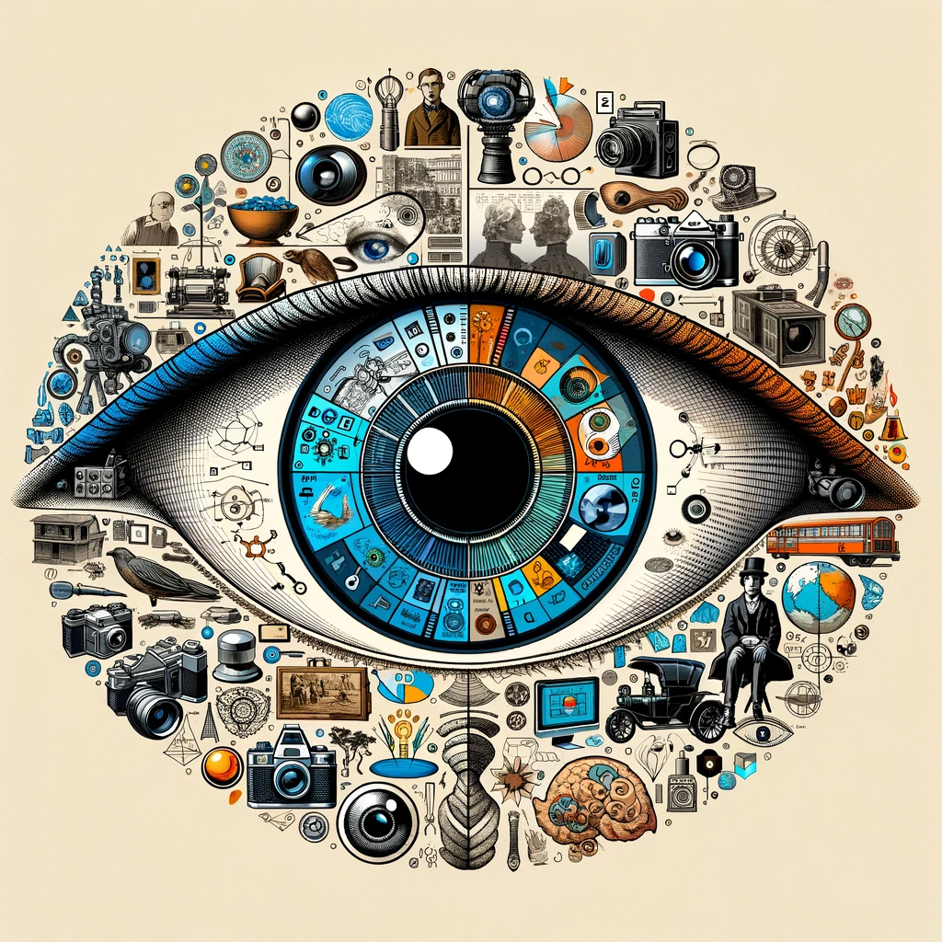
This Class: Past Meets Present
https://anandbhattad.github.io/teaching/past_meets_present/
Topics: https://docs.google.com/spreadsheets/d/11NWzULs6WsValL0t_qH4AN_47bIF1x0rE3c3zglrfSk
Slack: https://join.slack.com/t/slack-yji5371/shared_invite/zt-2evvhpolh-gQUQYPyWQ0Kbj6ypDgysTQ

Slide 15
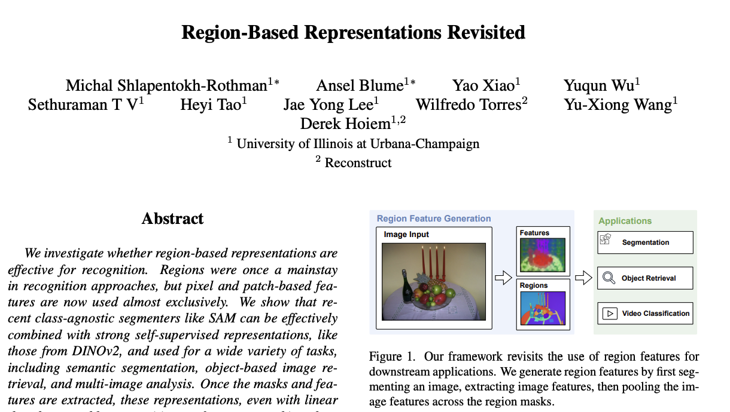
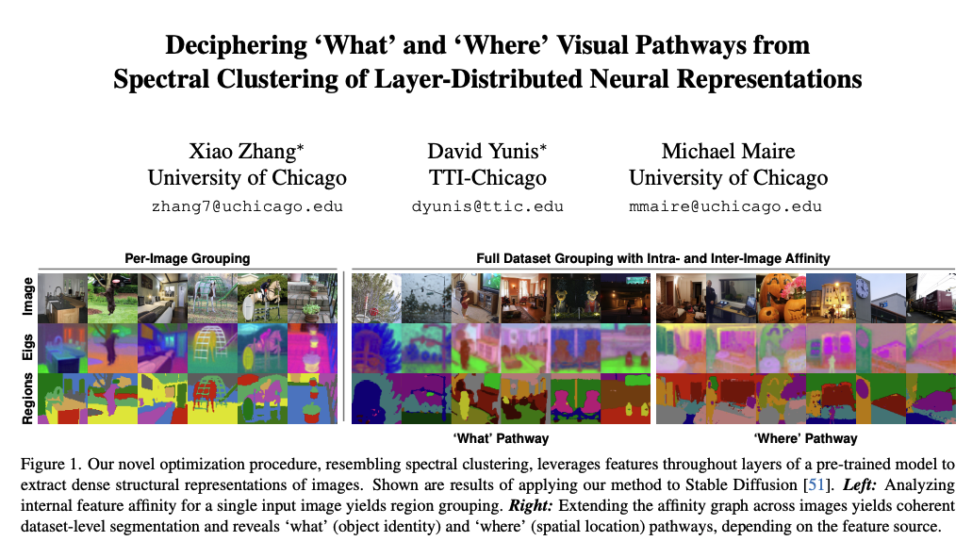
Requirements
Presentations (2x): 60%
  An historical foundation paper and a modern approach paper
Participation: 20%
Project: 20%
  Use Old Ideas with Modern Tools
Zhang*, Yunis*, Maire. CVPR 2024
Shlapentokh-Rothman*, Blume* et al. CVPR 2024

Slide 16
Class Format: Two papers per class
Historical Foundational Paper (25 mins + 5 mins for questions)
  Introduce topic or problem statement with precise formal definition
  Discuss specifics of the paper
  Bonus: one or two slides summarize key developments till modern approach
Modern Approach paper (25 mins + 5 mins for questions)
  Discuss specifics of the paper
  Make an effort to connect modern approach with foundational paper
  Bonus: Future direction combining old ideas with modern approach
Discussion led by me (15 mins)
  Questions collected via survey before every class
  Open audience questions

Slide 17
Presentation Requirements
Signup – by the start of next class, Mar 21st!
Practice presentation (30% of grade)
Slides (30% of grade)
In-class presentation (30% of grade)
Peer grading (10% of grade)

Slide 18
Project Requirements
Proposal (10% of project grade) – due on April 8th
Progress report or first draft (10% of grade) – due on April 29th
Project Presentation (30% of grade) – on May 16th (last day of class)
Final report (50% of grade) – May 16th, end of the day

Slide 19
Who Should Attend This Class?
Expect a small/close setting with engaging discussions
Introductory Computer Vision Knowledge is recommended
  For newcomers, recommend watching Greg’s videos here.
Enrollment is must for those who wish to take the class for credit
Auditing is possible with permission
  active participation is still expected
You can also register for pass/fail or equivalent
  Then no need to do course project (but I would highly recommend it!)
  must present papers and contribute to discussions

Slide 20
Today’s Agenda
Why this class?
Requirements and logistics
How is the class going to be?
Marr’s Vision

Slide 21
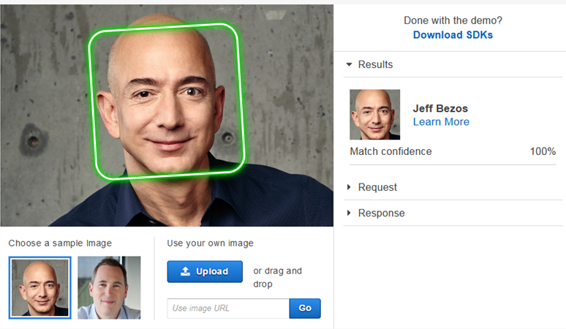
Example: Face Recognition
Identify or verifies a person's identity using their facial features
Decades of research and used to be a huge part of computer vision
Applications: security systems, surveillance, and personal device authentication
Image Source

Slide 22
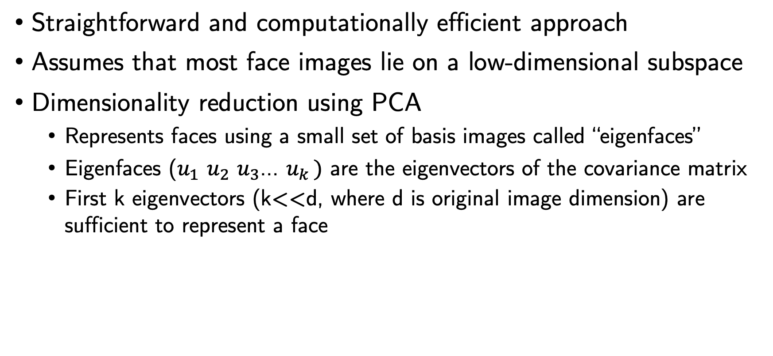
Eigenfaces
Straightforward and computationally efficient approach
Assumes that most face images lie on a low-dimensional subspace
Dimensionality reduction using PCA
  Represents faces using a small set of basis images called “eigenfaces”
  Eigenfaces ($u_{1}$ $u_{2}$ $u_{3}$… $u_{k })$ are the eigenvectors of the covariance matrix
  First k eigenvectors (k<<d, where d is original image dimension) are sufficient to represent a face
Turk & Pentland (1991)

Slide 23
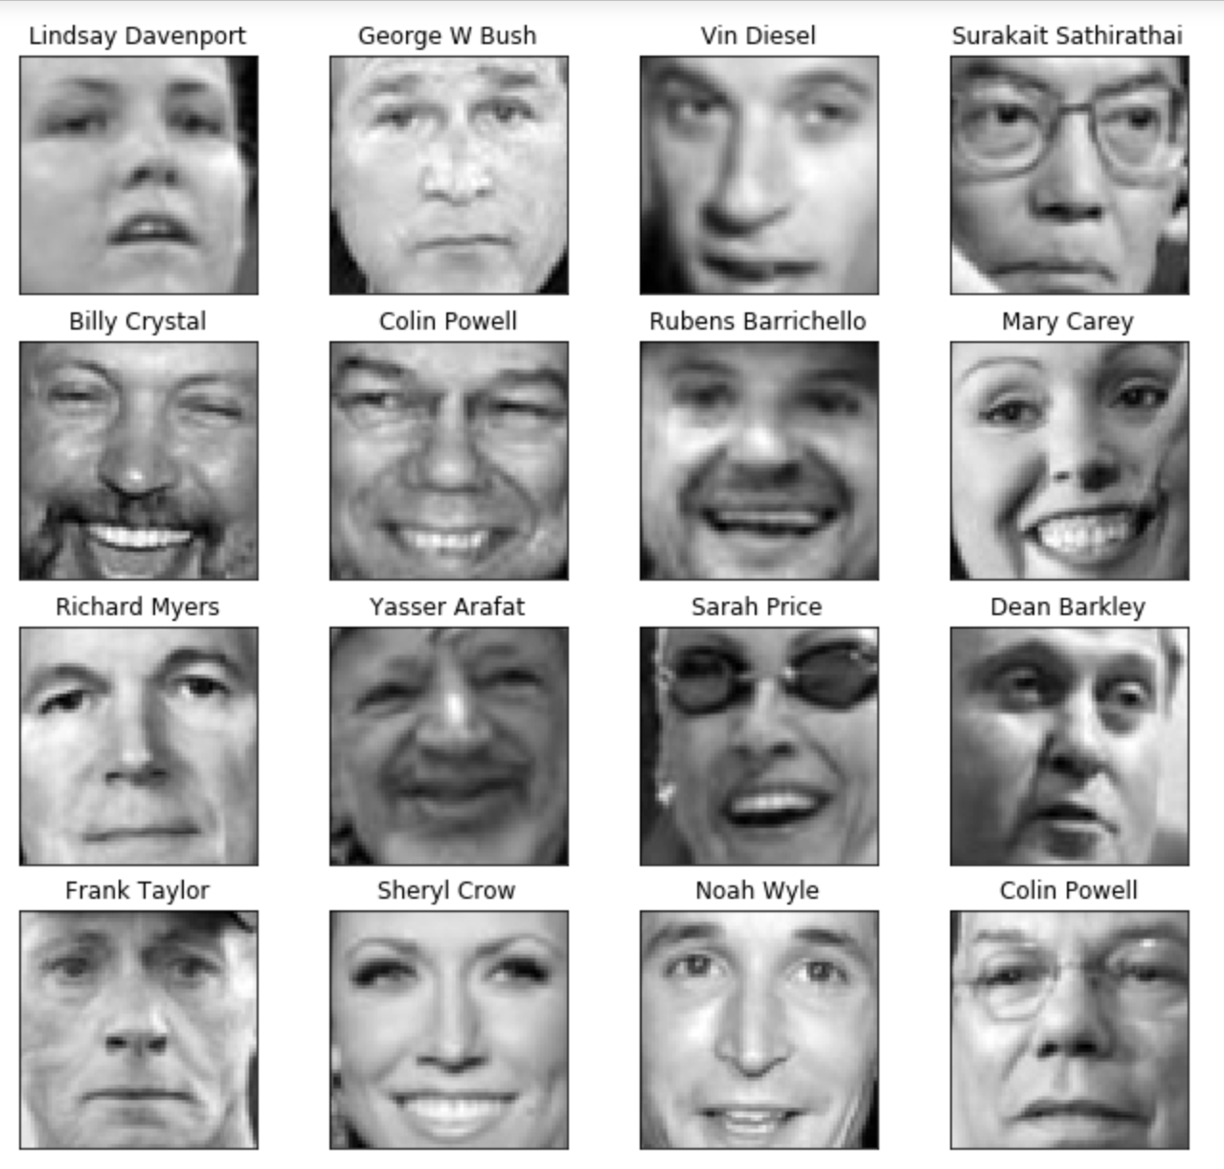
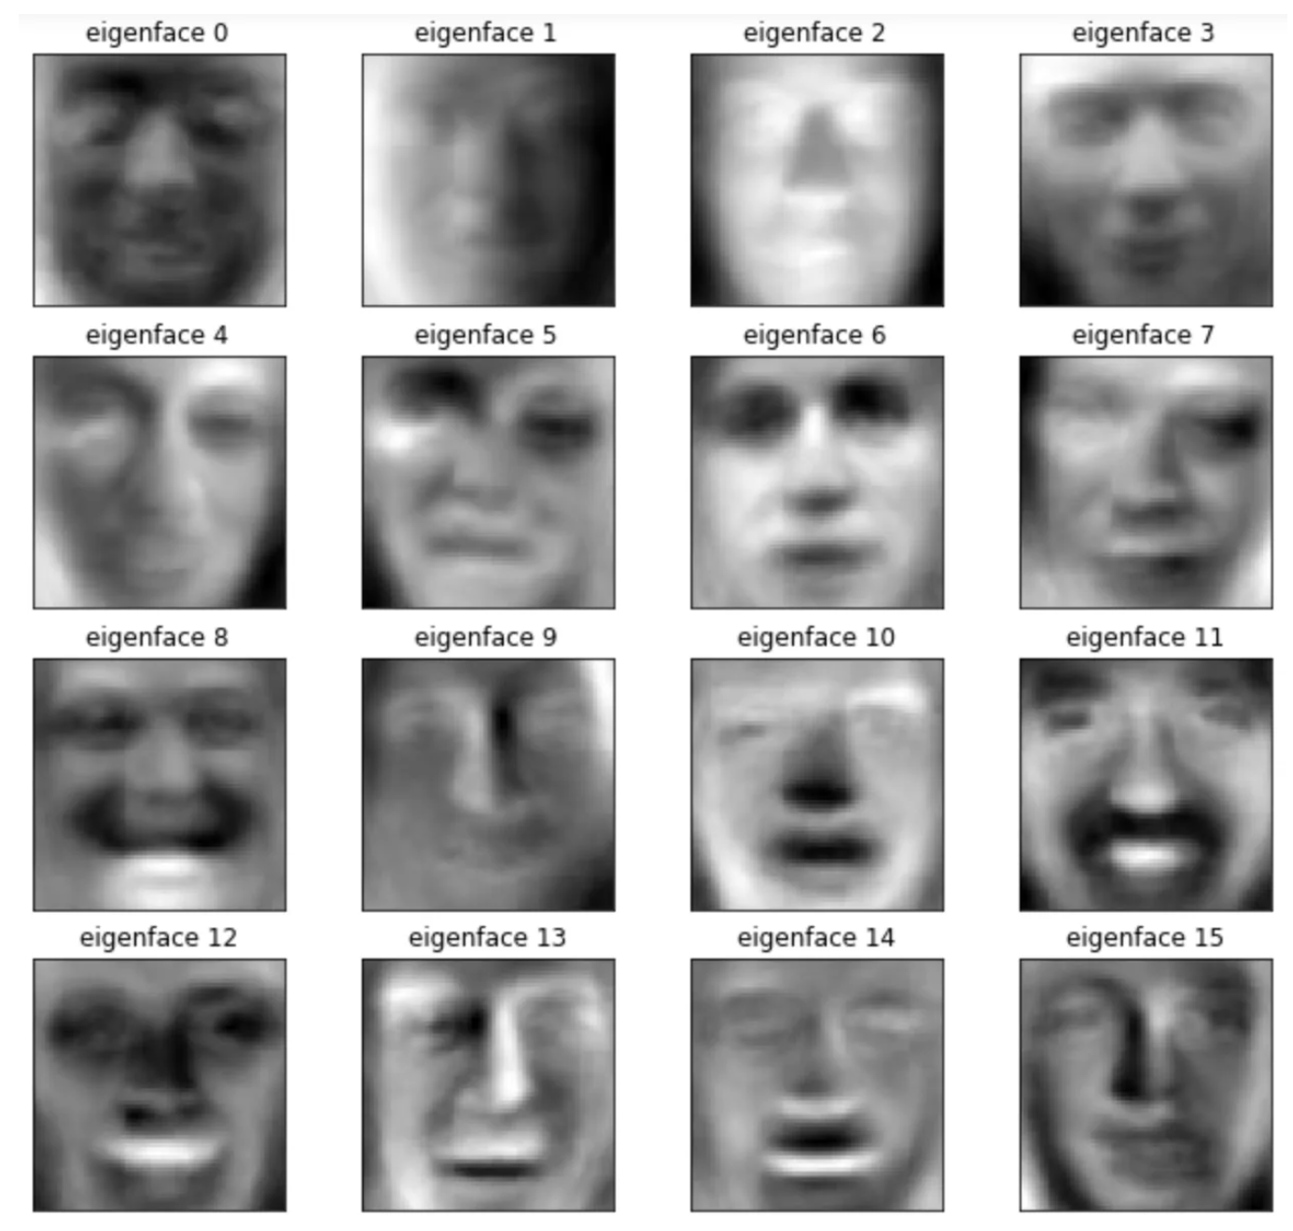
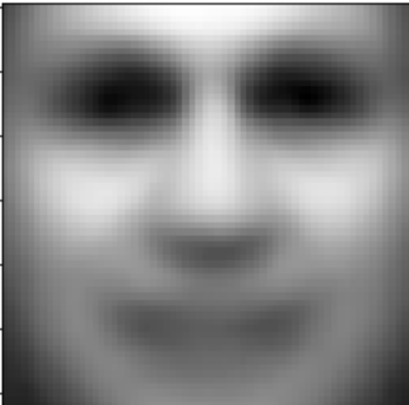
Eigenfaces
Eigenfaces capture the most significant variations among the face images in the dataset
Each eigenface represents a different facial feature or characteristics
Mean Face
Training Dataset
Eigenfaces
Turk & Pentland (1991)
Images from here

Slide 24
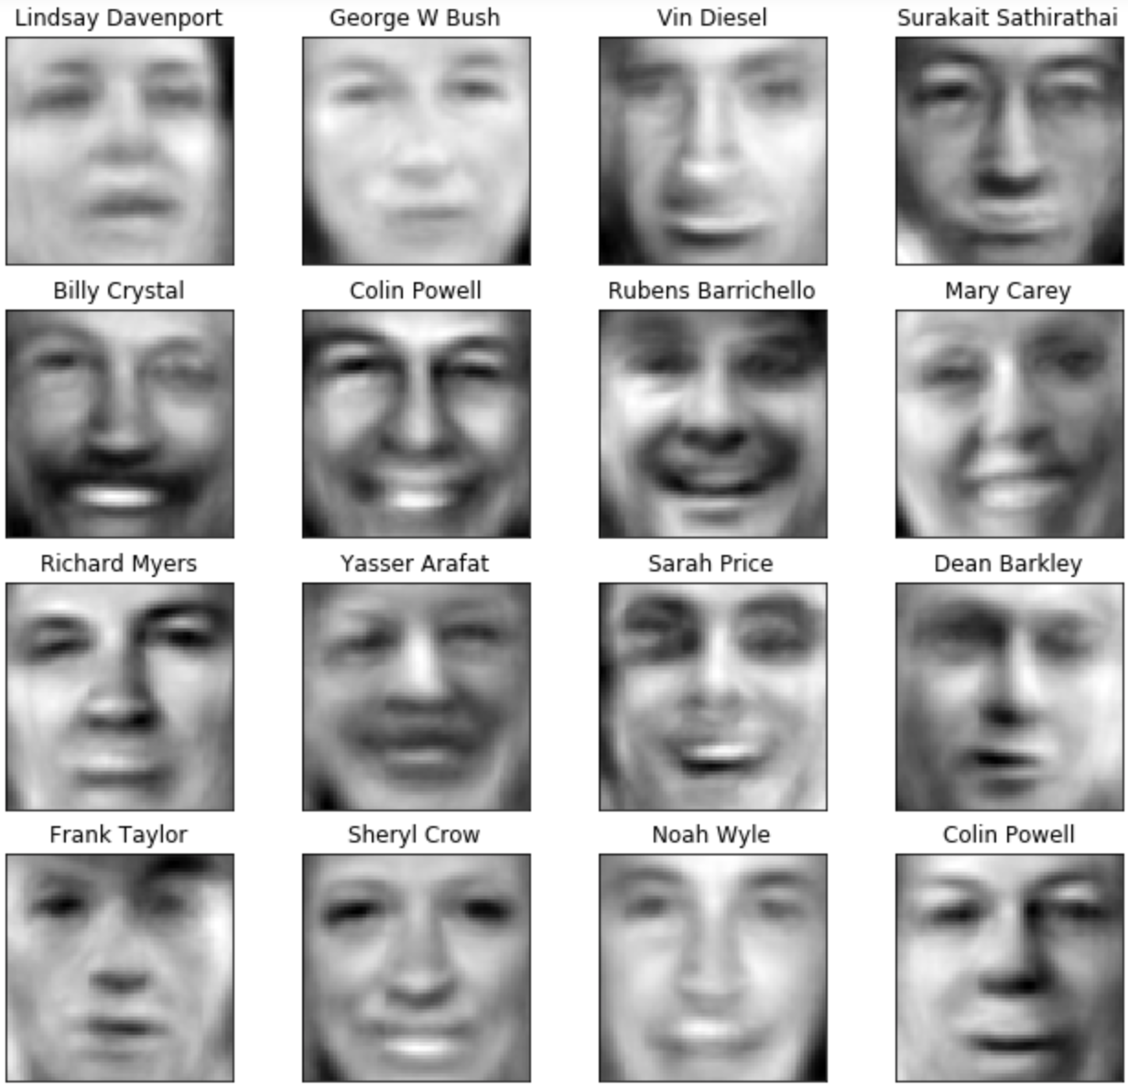
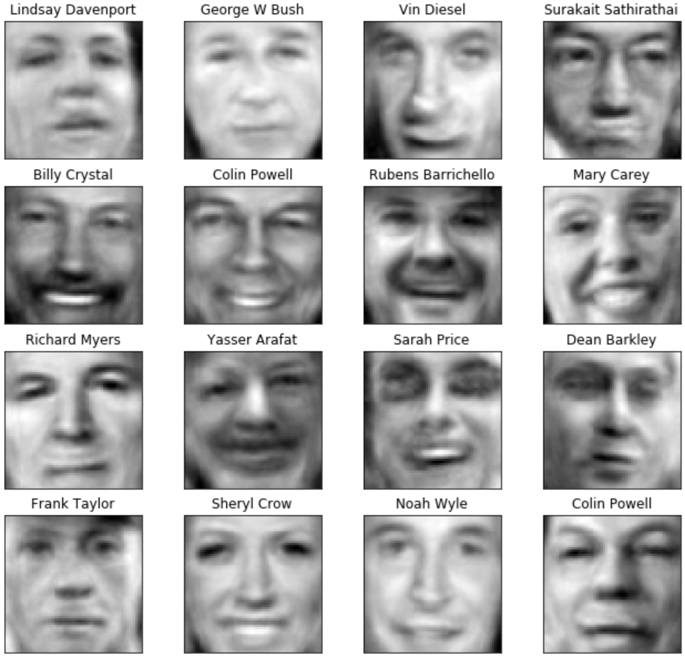
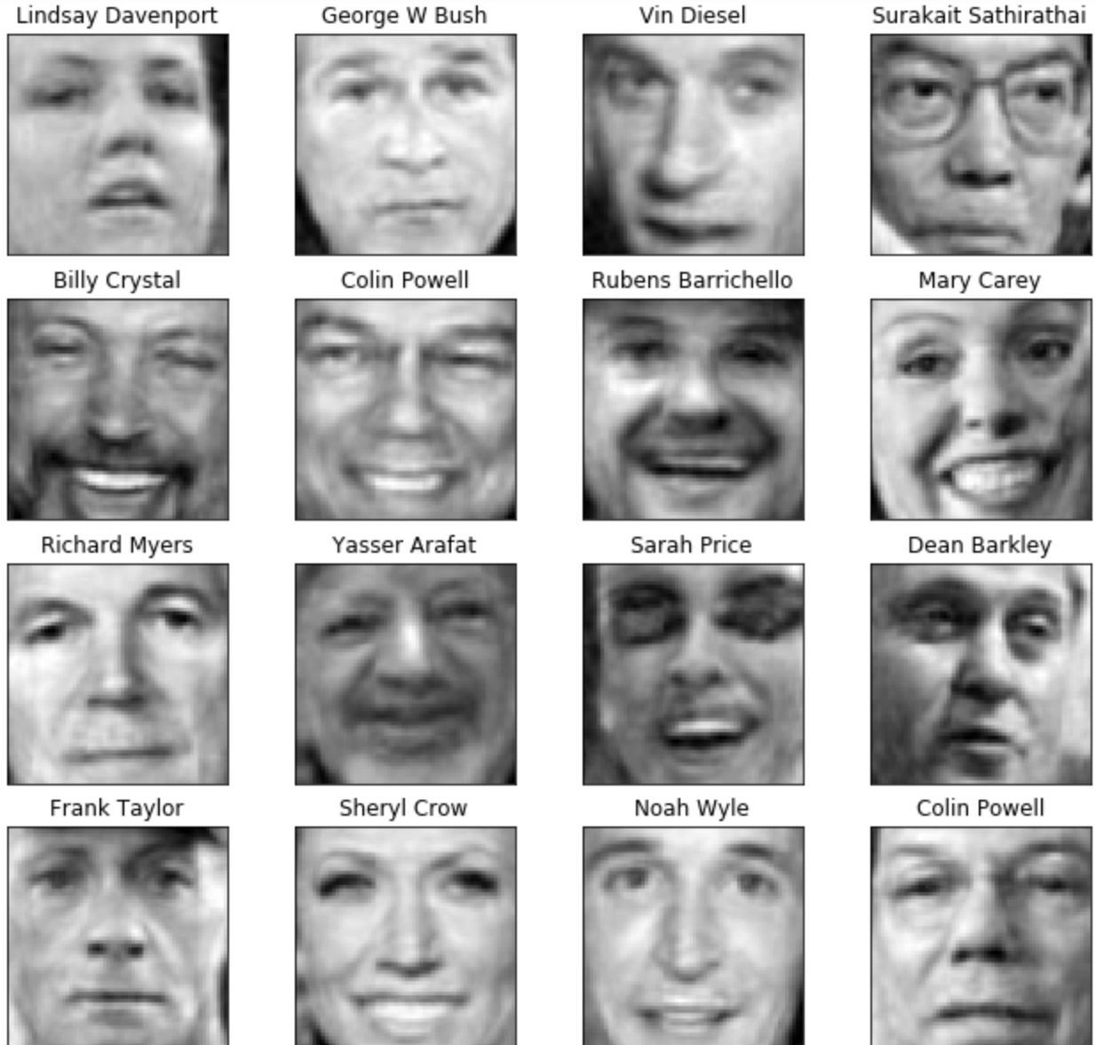
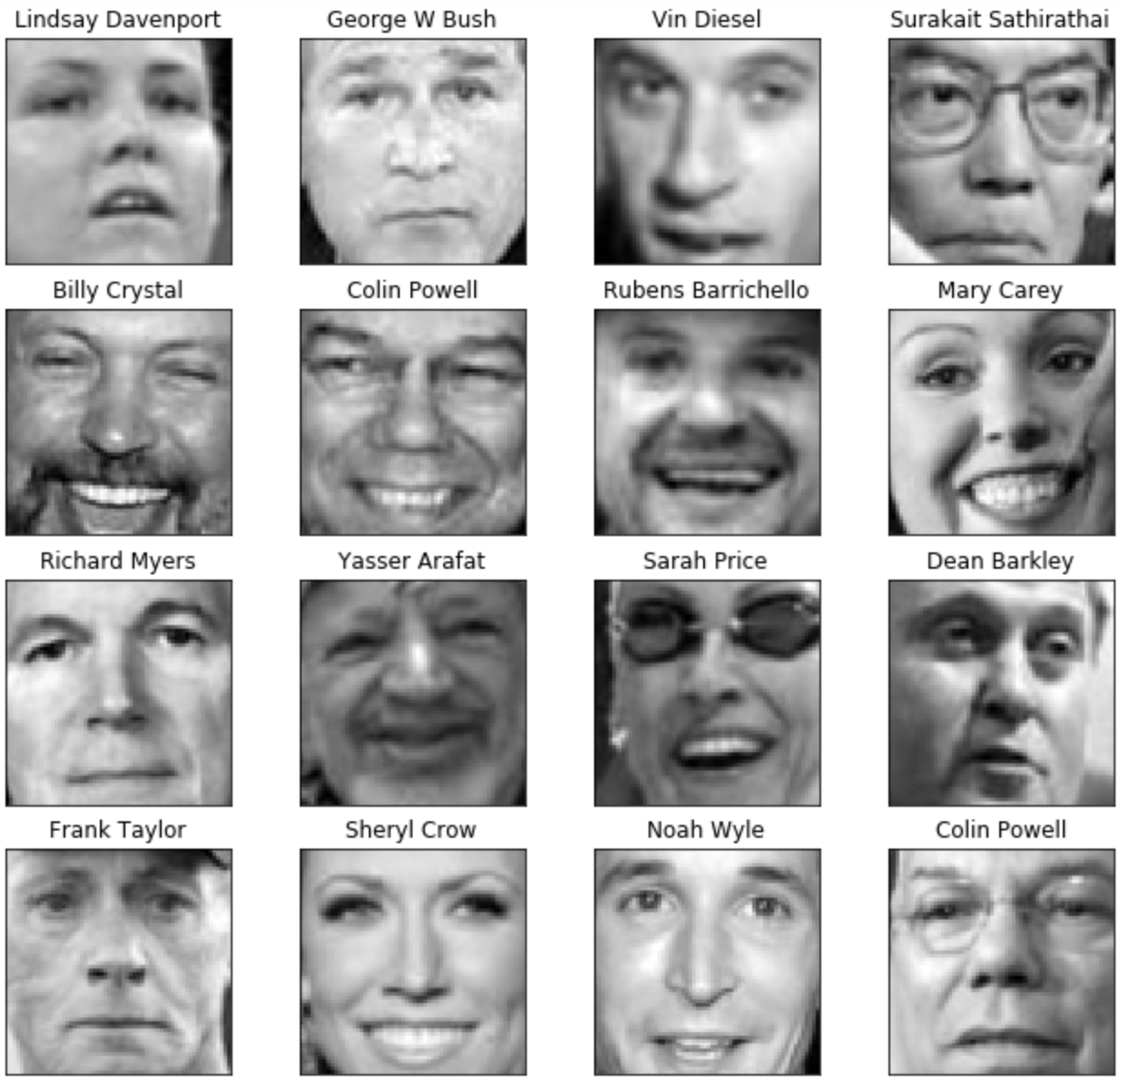
Eigenface as Representation
Each face image in the dataset is represented as a linear combinations of eigenfaces
Coefficients are computed using the dot product between the face image and each eigenface
50 Eigenfaces
100 Eigenfaces
250 Eigenfaces
1000 Eigenfaces
Turk & Pentland (1991)
Images from here

Slide 25
Recognition and Matching
A query face image is projected onto the eigenface subspace to obtain its coefficients
The coefficients are compared with those of the faces in the database using a similarity metric (e.g., Euclidean distance)
The face in the database with the closest match (minimum distance) is considered the recognized individual
Turk & Pentland (1991)

Slide 26
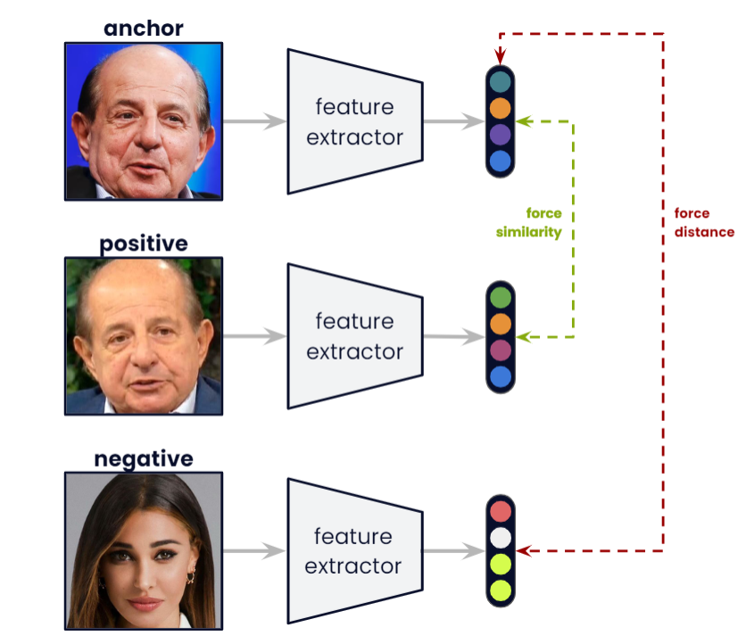
FaceNet
Florian Schroff, Dmitry Kalenichenko and James Philbina (2015)
Image from here

Slide 27
FaceNet
Florian Schroff, Dmitry Kalenichenko and James Philbina (2015)
Image from here

Slide 28
FaceNet
Triplet Loss
Florian Schroff, Dmitry Kalenichenko and James Philbina (2015)
Image from here

Slide 29
Comparing Eigenfaces and FaceNet
Similarities
Compact Representation
Differences
Eigenfaces is a self-supervised and FaceNet is supervised
Eigenfaces is generative model and FaceNet is discriminative model
Eigenfaces is based on global structure and FaceNet learns hierarchical features from low-level to high-level representations

Slide 30
Today’s Agenda
Why this class?
Requirements and logistics
How is the class going to be?
Marr’s Vision
  Koenderink

Slide 31
Slides from Lana Lazebnik

Slide 32
Computer Vision: A Modern Approach

Slide 33
Computer Vision: A Modern Approach
Source: paintings of Lascaux, made some 17000 years ago.

Slide 34
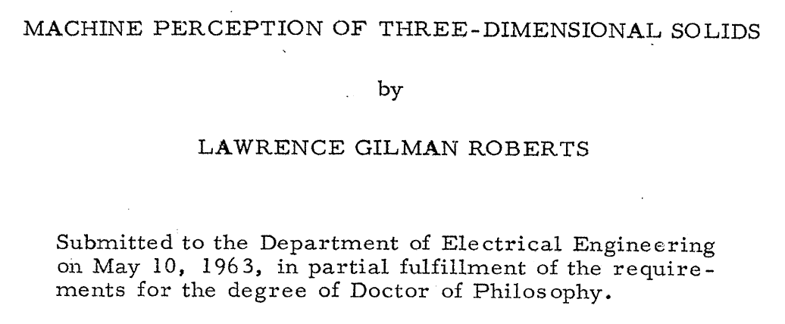
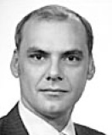
Machine Perception of 3Dimensional Solids
1963: Roberts Ph.D. thesis at MIT
1937– 2018
Wikipedia bio
Slide from Lana Lazebnik

Slide 35
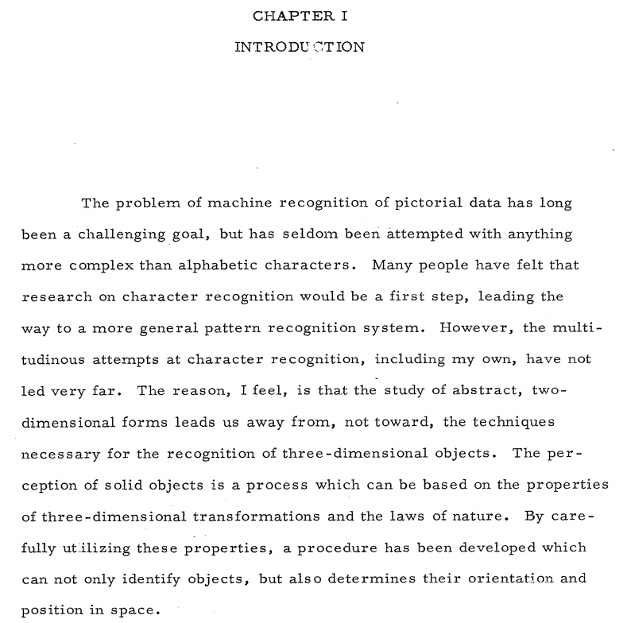
Slide from Lana Lazebnik

Slide 36
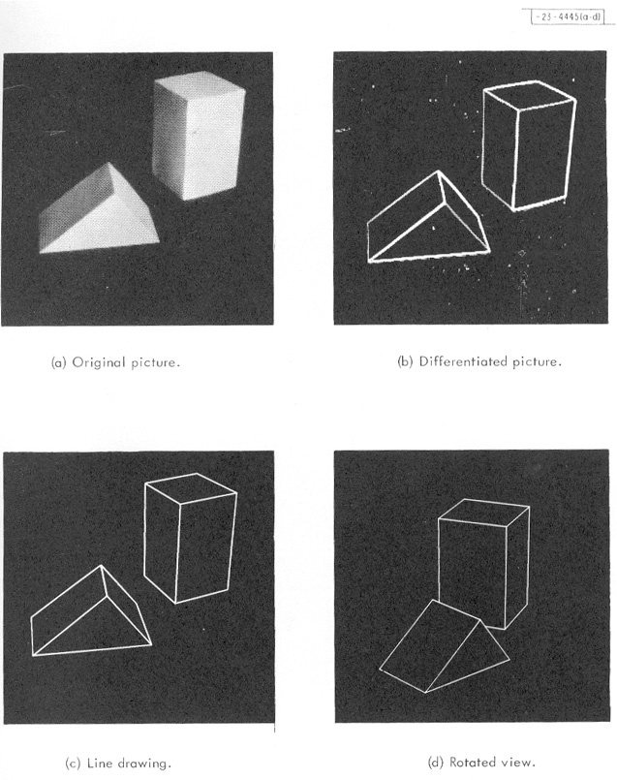
From the abstract:
“It is assumed that a photograph is a projection of… known three-dimensional models… These assumptions enable a computer to obtain a reasonable, three-dimensional description from the edge information in a photograph by means of a topological, mathematical process.”
Slide from Lana Lazebnik

Slide 37
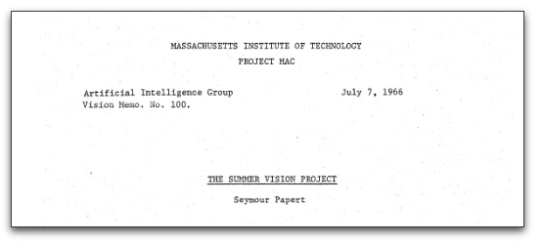
MIT Summer Vision Project

Slide 38
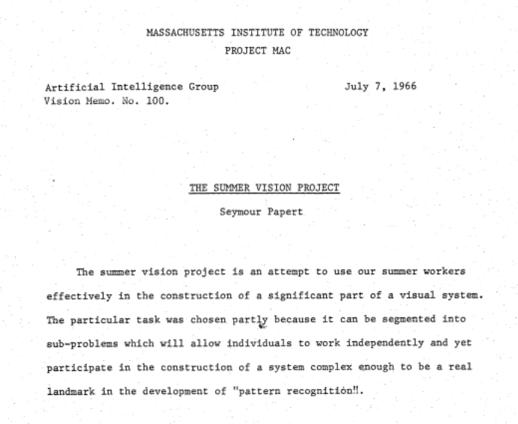
Slide from Lana Lazebnik

Slide 39
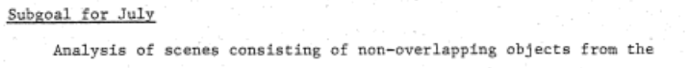
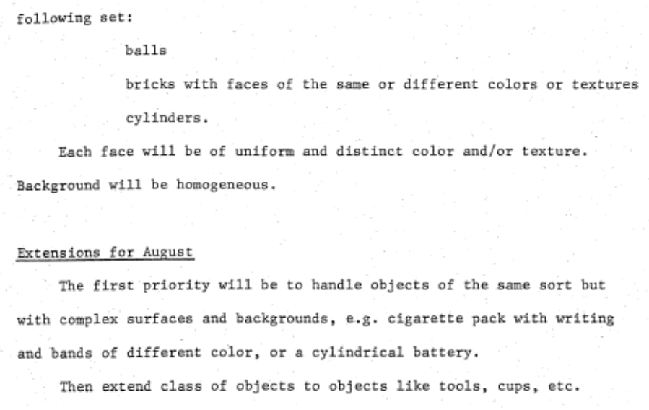
See Lana Lazebnik’s Computer Vision: What will stand test of time? Lecture 2 for History
Slide from Lana Lazebnik

Slide 40
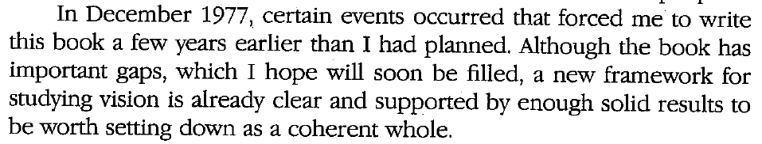
David Marr (1945-1980)
Ph.D. in theoretical neuroscience, Cambridge, 1969
  Models of the cerebellum (1969), neocortex (1970), hippocampus (1971)
Joined MIT AI Lab in 1973, became professor of psychology in 1977
  Stereo algorithms (with Tommaso Poggio), 1976-79
  3D object representation (with Keith Nishihara), 1978
  Edge detection (with Ellen Hildreth), 1980
Posthumous book: Vision (1982)
Bio
Full text
Slide from Lana Lazebnik

Slide 41
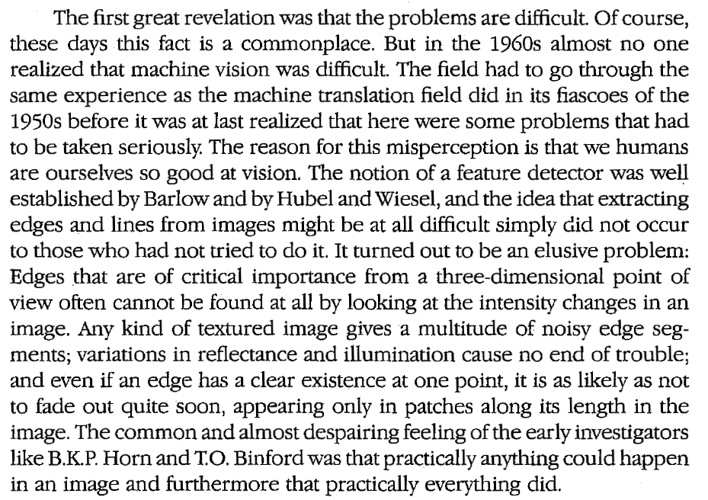
Marr’s motivation (ch. 1)
Vision is hard
Slide from Lana Lazebnik

Slide 42
Marr’s motivation (ch. 1)
Vision is hard
We may not be able to figure out the right solution right away, but at least we should start by establishing a sound methodology
  Marr explicitly considered and rejected low-level neurophysiology, empirical “hacking”, and blocks world simplification
Hubel & Wiesel (1959)
Roberts (1963)
(source)
Slide from Lana Lazebnik
Yakimovsky & Feldman (1973)

Slide 43
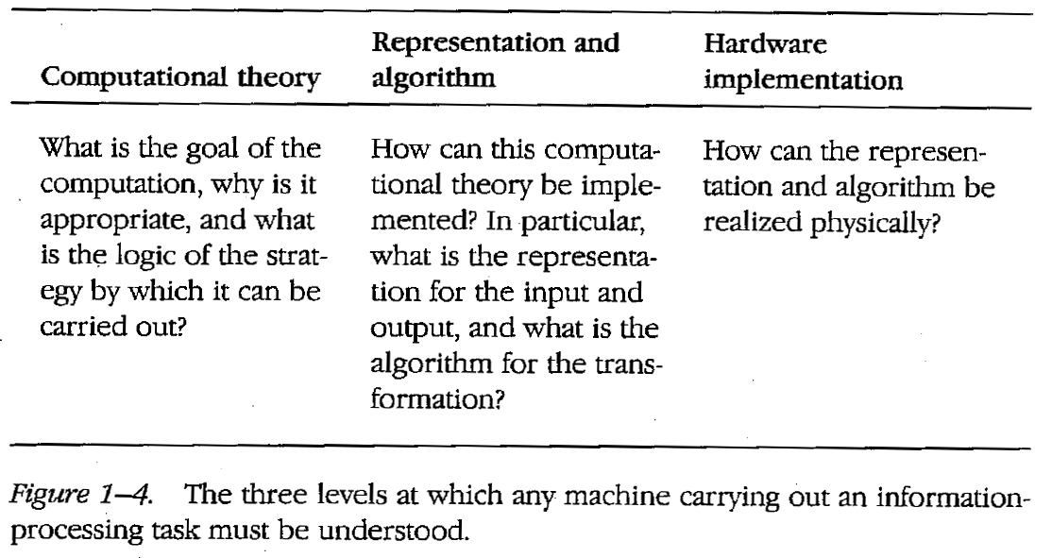
Towards an information processing theory of vision
Slide from Lana Lazebnik

Slide 44
Towards an information processing theory of vision
Slide from Lana Lazebnik

Slide 45
Towards an information processing theory of vision
Slide from Lana Lazebnik

Slide 46
Computational theory description of vision
What should be the goal of vision?
  “Vision is a process that produces from images of the external world a description that is useful to the viewer and not cluttered with irrelevant information.”
What should be the input?
  “In the case of human vision, the initial representation is in no doubt – it consists of arrays of image intensity values as detected by the photoreceptors in the retina.”
What should be the output?
  ”[The purpose of vision is] building a description of the shapes and positions of things from images… It also tells about the illumination and about the reflectances of the surfaces that make the shapes – their brightnesses and colors and visual textures – and about their motion. But these things seemed secondary; they could be hung off a theory in which the main job of vision was to derive a representation of shape.”
Slide from Lana Lazebnik

Slide 47
Proposed algorithmic pipeline
Image source
Slide from Lana Lazebnik
Notes:
Bottom-up, feedforward, modular

Slide 48
Proposed algorithmic pipeline
Image source
Slide from Lana Lazebnik
Notes:
Bottom-up, feedforward, modular

Slide 49
Proposed algorithmic pipeline
Image source
Slide from Lana Lazebnik
Notes:
Bottom-up, feedforward, modular

Slide 50
Proposed algorithmic pipeline
Image source
Slide from Lana Lazebnik
Notes:
Bottom-up, feedforward, modular

Slide 51
So, what’s the big deal?
Marr’s book was a major milestone
  Critical summary of key developments in study of human and computer vision to date
  Unprecedented attempt at a unified account of the entire visual system
Computational framework was very appealing to computer vision researchers from a “software engineering” perspective
  Abstraction, modularity, feedforward pipeline
Theories meshed well with the dominant computer vision paradigms
  Vision as “inverse graphics” or “inverse optics”
  Emphasis on recovery of general-purpose 3D representations composed of simple geometric primitives
  Convenient division of vision problems into “low-level”, “mid-level”, and “high-level”
Special issue dedicated to Marr: Perception 41(9), 2012
Slide from Lana Lazebnik

Slide 52
What about the bad stuff?
Marr’s approach have not panned out either on the human or the computer vision side (did not consider feedback)
Principles of modularity and feedforward processing don’t hold for human vision
  P. Churchland, V.S. Ramachandran, and T. Sejnowski, A critique of pure vision, 1994
Humans do not recover veridical, task-independent 3D representations
  W. Warren, Does This Computational Theory Solve the Right Problem? Marr, Gibson, and the Goal of Vision, Perception 41(9), 2012
Marr dismissed statistical approaches, did not even consider learning
Even the goals, inputs, and outputs of a vision system are very much open to question (see embodied agent literature)
Slide from Lana Lazebnik

Slide 53
Was it only Marr who came up with “Theory of Perception”?

Slide 54
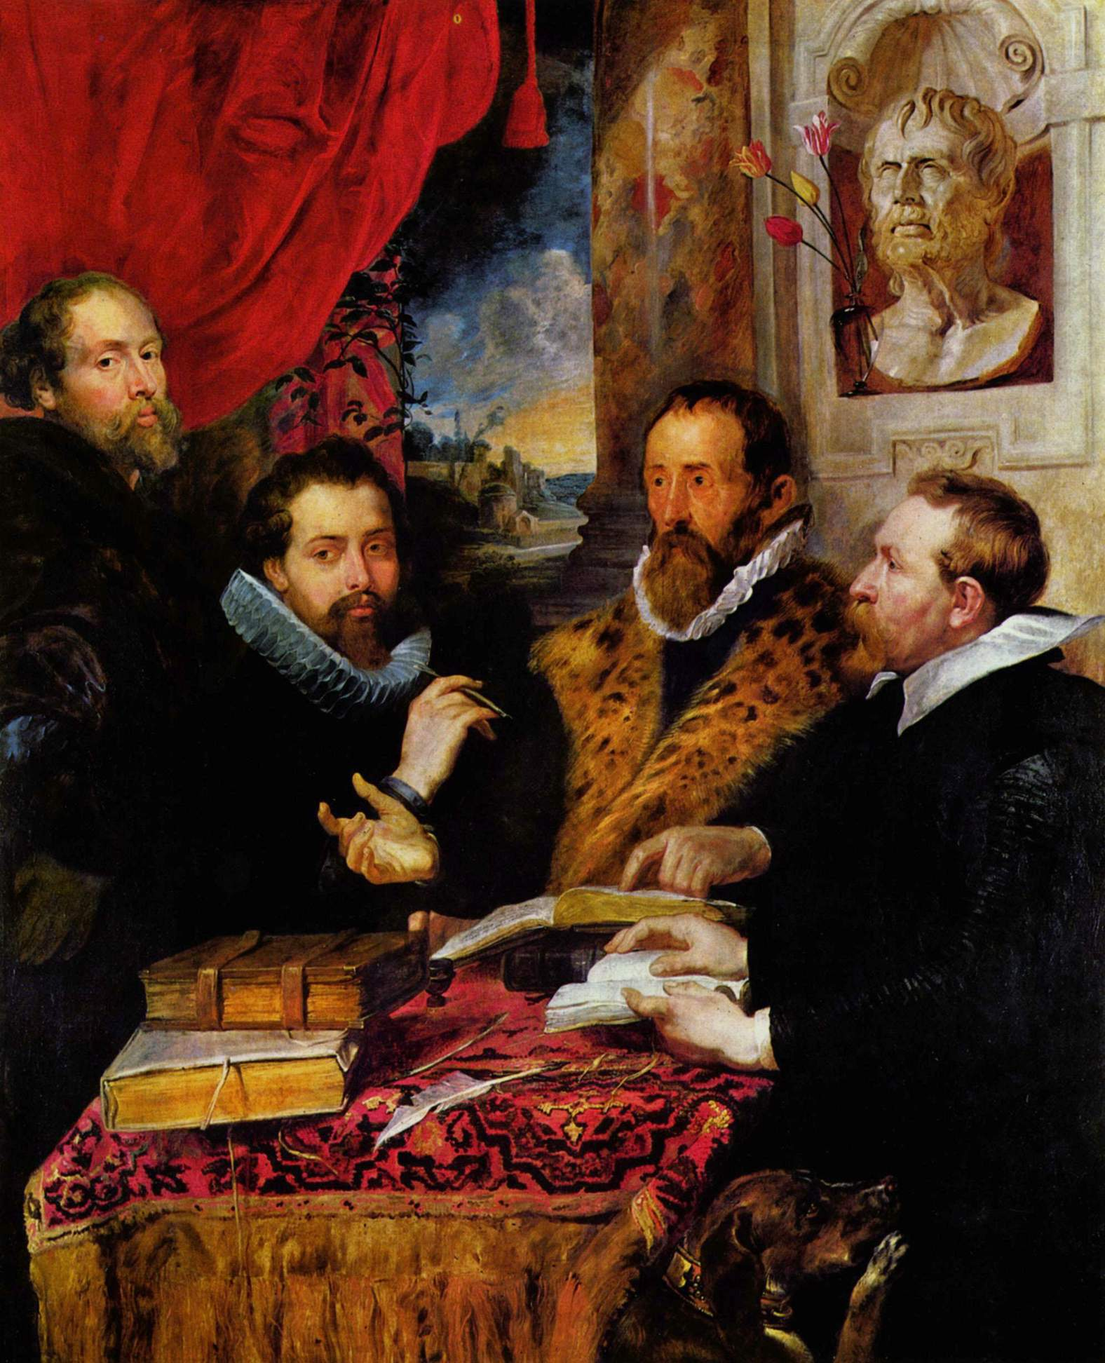
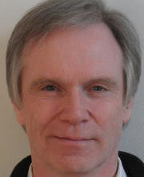
Marr, Gibson, Cavanagh, Koenderink of Many
David Marr (1945-1980)
James Jerome Gibson (1904-1979)
Patrick Cavanagh (b. 1947)
Jan Johan Koenderink (b. 1943)
Giorgione, The Four Philosophers
Slide adapted from Lana Lazebnik

Slide 55
Summary of 4 Views on Perception
Marr, Gibson, Cavanagh and Koenderink all asked about the nature of vision and came up with different answers
“Vision is a computational process that transforms the retinal image into an objective representation of 3D shape. Vision is inverse optics.”
“There is no computation. There is no retinal image. There are no representations. There is no 3D shape. There is only direct pickup of ecologically relevant variants and invariants. Vision is in the world, not the observer.”
“Perception is not a passive process of recording the world but an active process of constructing representations of the world that are shaped by our knowledge, expectations, and goals.”
“There is no objective world, only the observer’s umwelt (surrounding world). Thus, vision cannot be in the world but is a creative act of the observer.”
Slide adapted from Lana Lazebnik
Notes:
Cavanagh argues that perception is an active process involving the interpretation and understanding of sensory information. The brain constructs what we perceive, influenced by our prior knowledge, expectations, and the objectives we have at any given moment. This view moves away from the idea that perception is merely about passively receiving images or information from the environment; rather, it's a dynamic, interpretative process that's integral to the way we engage with the world

Slide 56
Inspirational quote
“The past is never dead. It's not even past.”
– William Faulkner
Slide from Lana Lazebnik

