Slide 1

INTRODUCTION
India is a country highly dependent on agriculture and the availability of water.
Rainfall plays a crucial role in the overall economic growth of the country.

Slide 2

BENEFITS OF RAINFALL
Agricultural Planning
Water Resource Management
Flood and Drought Mitigation
Disaster Preparedness
Economic Planning

Slide 3
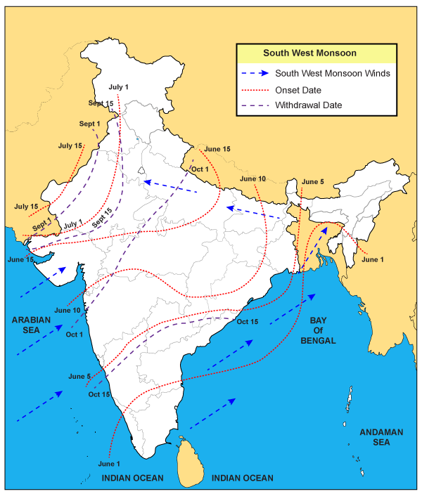
WEATHER DIRECTION IN DETAIL
I
India's weather is influenced by a variety of factors such as geography, topography, ocean currents, and atmospheric circulation patterns. Generally, India experiences three main seasons: summer, monsoon, and winter.
During the summer season (March to May), the weather is hot and dry in most parts of the country, with temperatures ranging from 30 to 45 degrees Celsius. The southern and coastal regions of India, however, experience a relatively moderate climate during this time.
The monsoon season (June to September) brings most of India's annual rainfall, with the southwest monsoon winds bringing moisture from the Arabian Sea and Bay of Bengal. The monsoon season is characterized by heavy rainfall, thunderstorms, and occasional flooding, especially in low-lying areas.
The winter season (December to February) is generally mild and dry, with temperatures ranging from 10 to 25 degrees Celsius. The northern parts of India, however, experience cold temperatures and occasional snowfall during this time.
Overall, India's weather is diverse and varies from region to region. It is important to note that extreme weather events such as cyclones, droughts, and heatwaves can occur in different parts of the country at any time of the year.

Slide 4
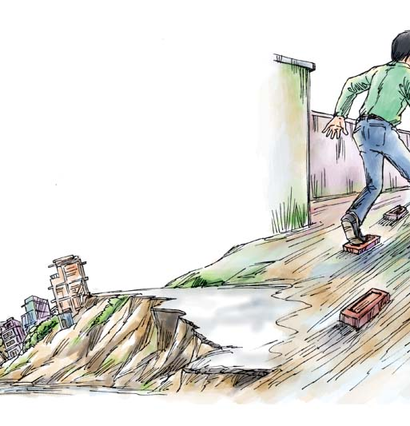
PROBLEM STATMENT
The problem at hand is to analyze the patterns and trends of rainfall in India and identify
the factors that influence it. Specifically,
we want to understand the spatial and temporal variability of rainfall across different regions in India
and assess the impact of climate change on rainfall patterns. Additionally,
we aim to identify the socioeconomic and environmental consequences of changes in rainfall patterns
and explore potential solutions to mitigate the negative effects. Ultimately,
the goal is to inform policymakers and stakeholders on how to manage
and adapt to the changing rainfall patterns in India

