Slide 1

UX/UI Design
My users are the reason I'm making this product.

Slide 2
UX ≠ UI
User Interface = The stuff where interaction between human and website occur. Text, images, buttons. Allows user to operate the site.
User experience = All aspects of the user's dealings with the services, products, and company associated with the website.
UX encompasses UI.

Slide 3
UI Principles
What does it look like?
Does it look professional/reputable?
Colors, fonts, imagery, space.

Slide 4
UX Principles
Does it meet their needs?
Easy/intuitive/simple to use?
Enjoyable to use?
A website can have beautiful UI, but if a user just wants info like the hours of operation for a business and they can't find it, that's a terrible UX.

Slide 5
Reduce “Cognitive Load” with these
Alignment
Proximity
Contrast
Color
Typography
Visibility
Simplicity
Usability
Consistency
Keeping users informed

Slide 6
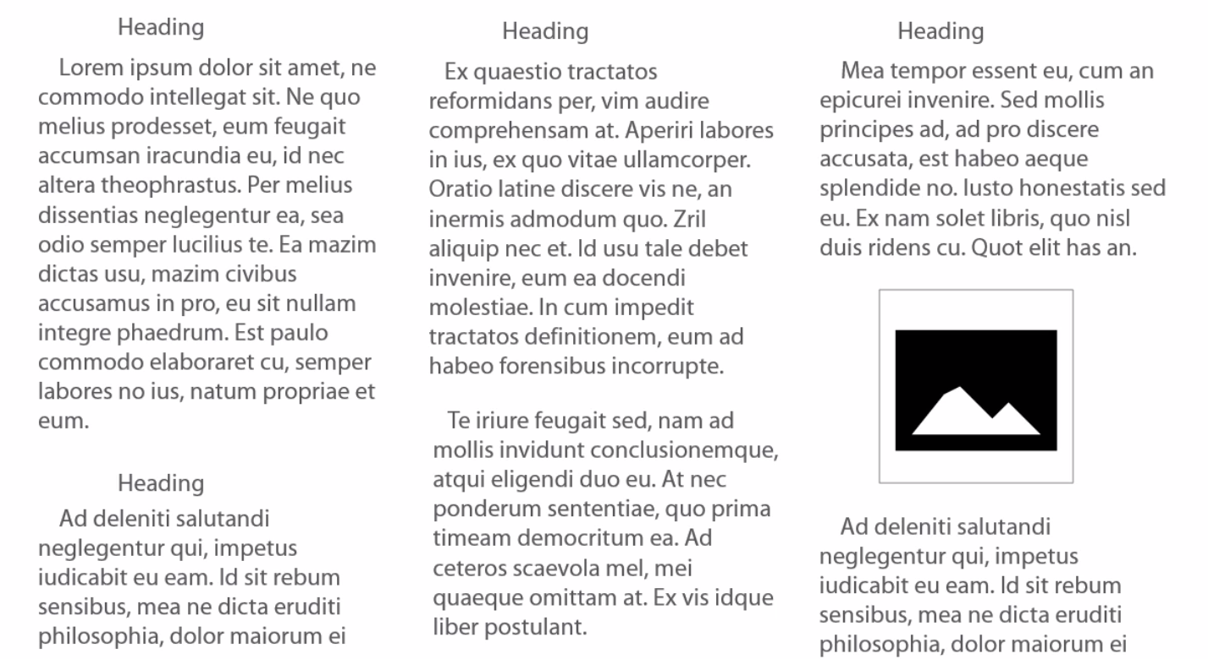
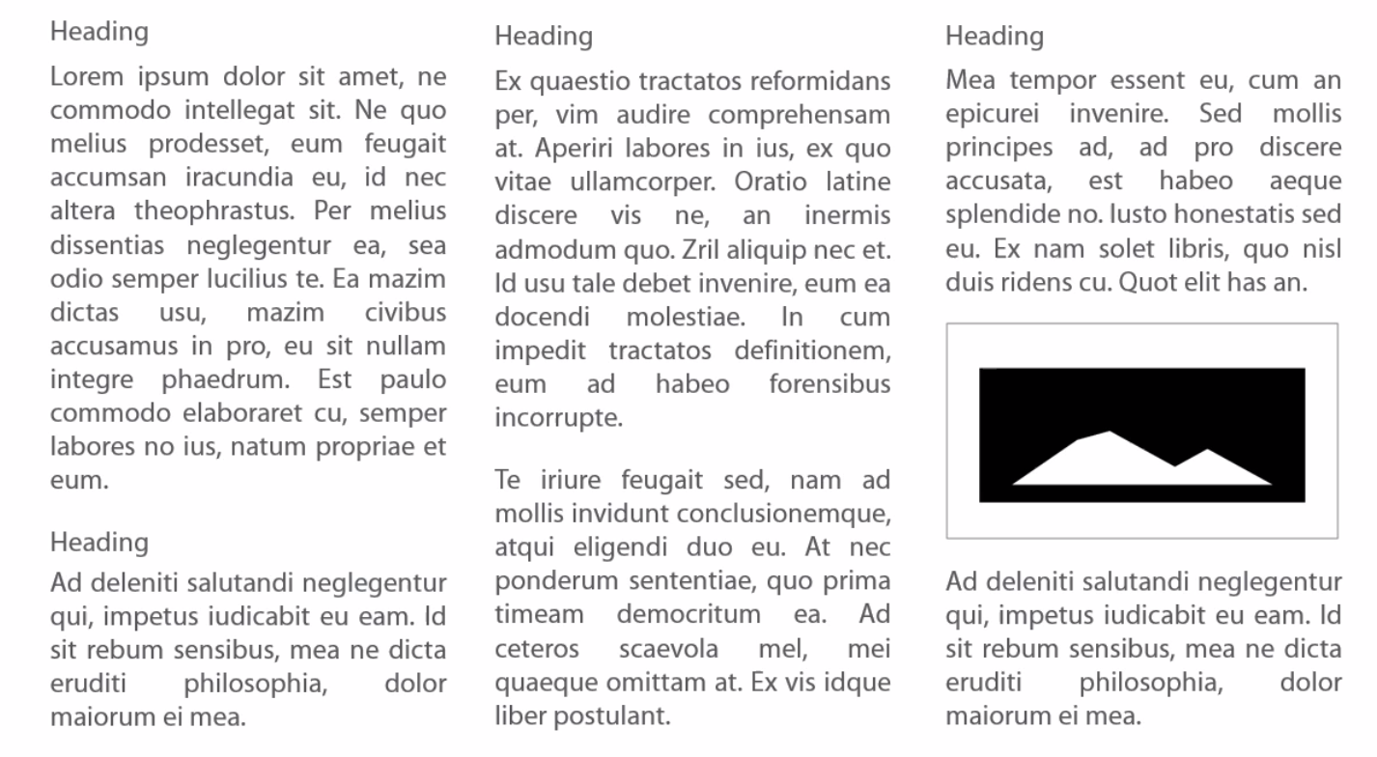
Alignment

Slide 7
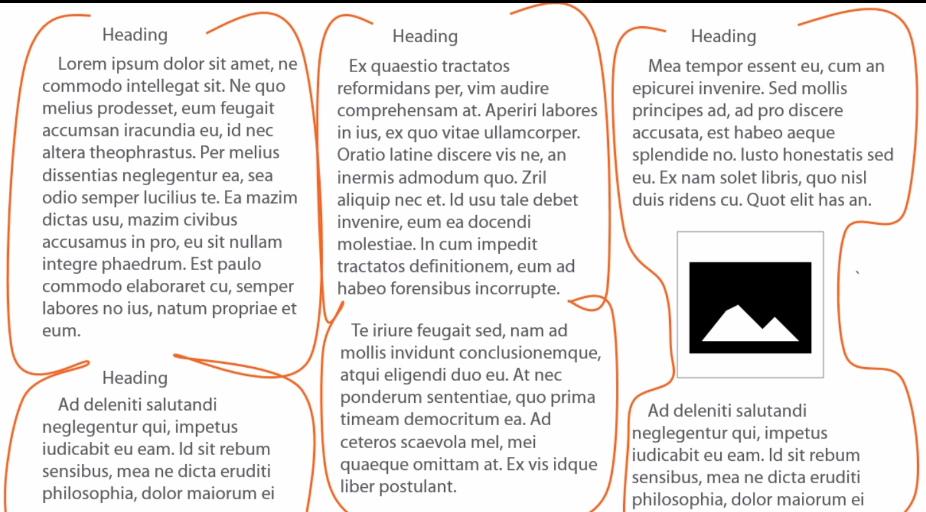
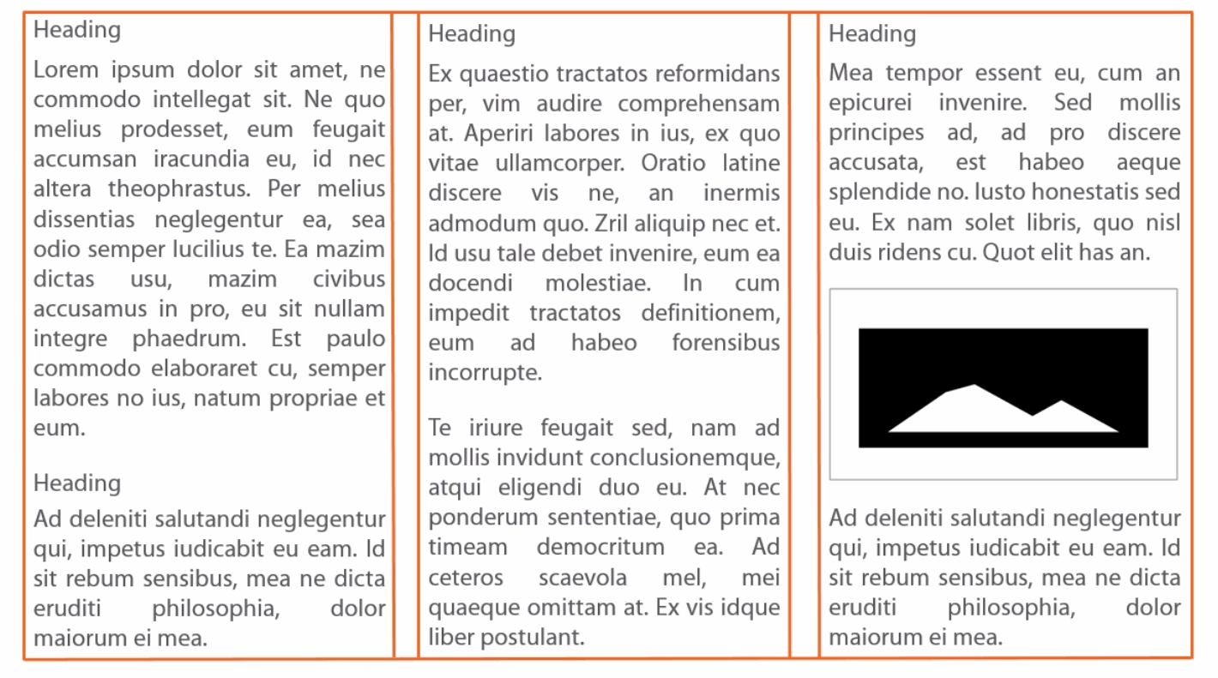
Alignment

Slide 8
Alignment
Create “strong” straight lines using left or right alignment.
Andrew Carlson
Codesmith
5300 Beethoven Street
Marina del Rey
555-555-5555
Andrew Carlson
Codesmith
5300 Beethoven Street
Marina del Rey
555-555-5555
Andrew Carlson
Codesmith
5300 Beethoven Street
Marina del Rey
555-555-5555

Slide 9
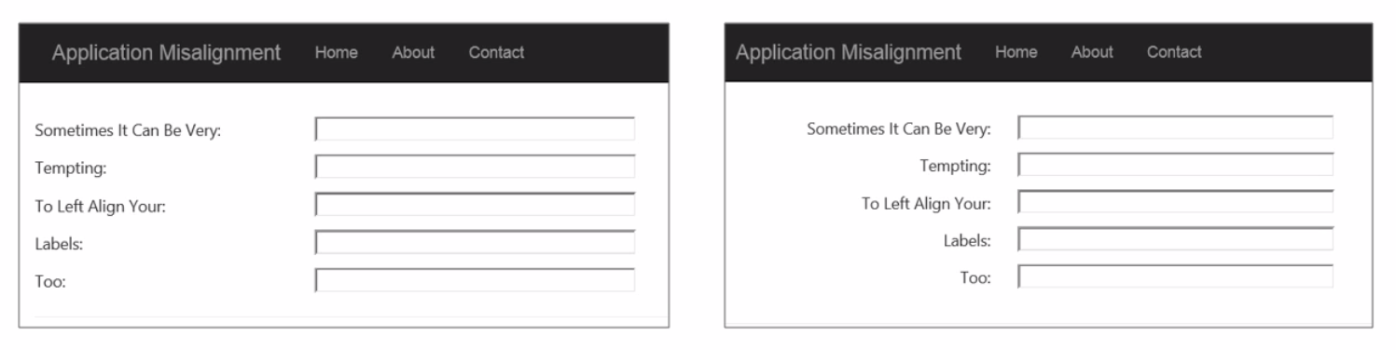
Alignment

Slide 10

Proximity

Slide 11
Proximity
How many dots?
How many groups?
How do they relate?

Slide 12

Proximity

Slide 13
Proximity
How many dots?
How many groups?
How do they relate?

Slide 14
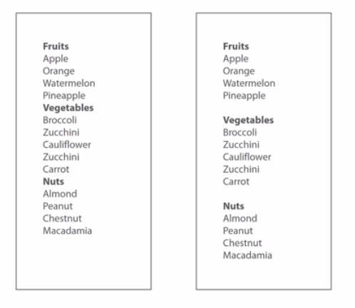
Proximity

Slide 15

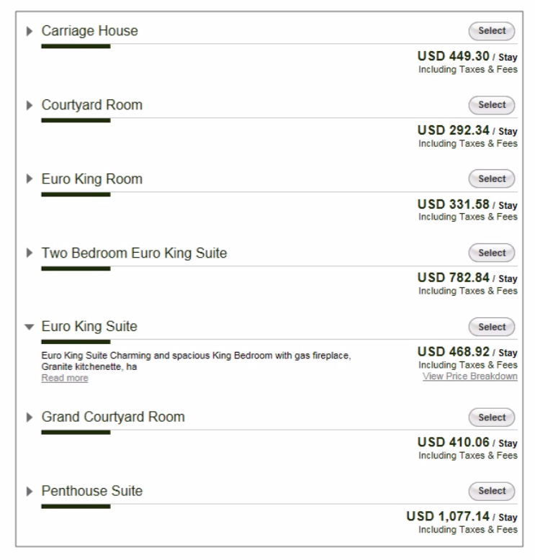
Proximity

Slide 16
Alignment and Proximity Example
https://www.youtube.com/watch?v=9bZkp7q19f0

Slide 17
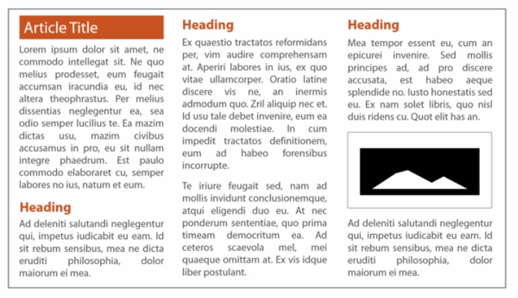
Contrast

Slide 18
Contrast Example
http://www.amazon.com/

Slide 19
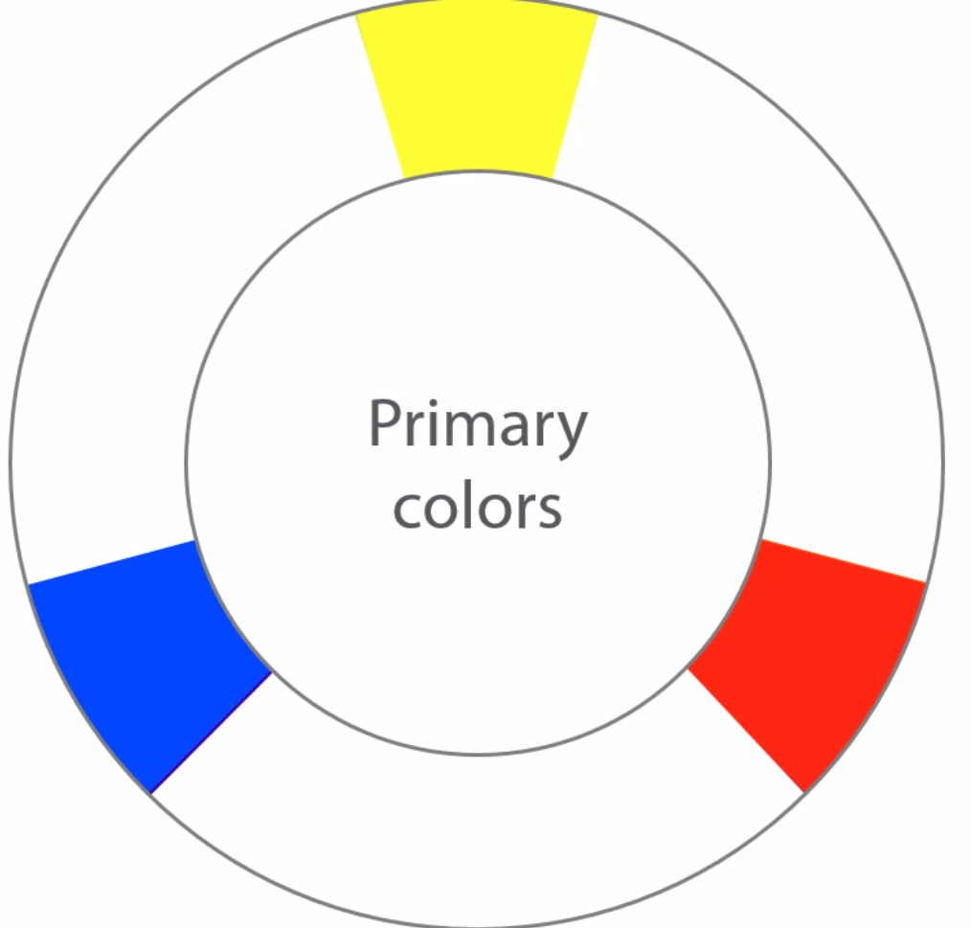
Color wheel

Slide 20
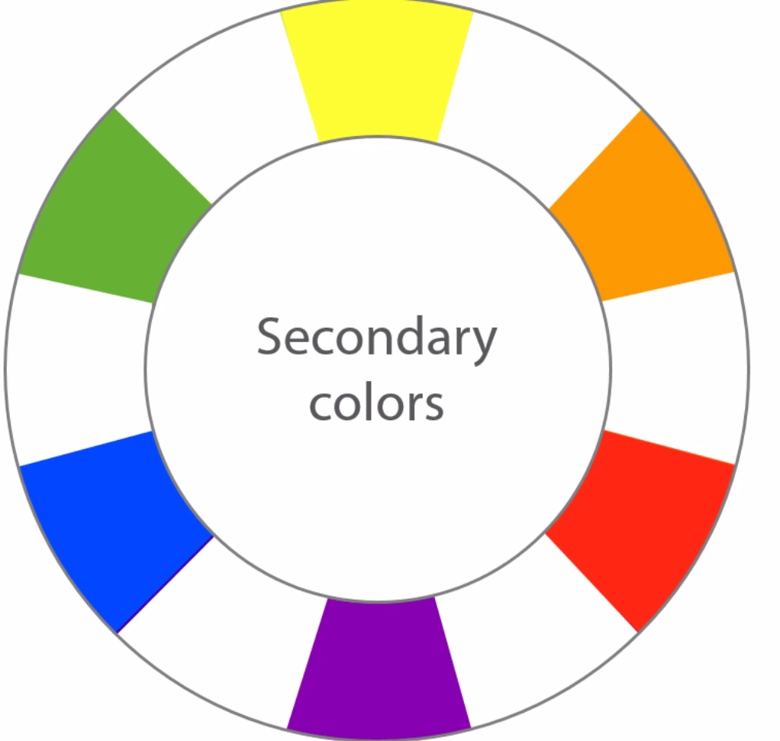
Color wheel

Slide 21
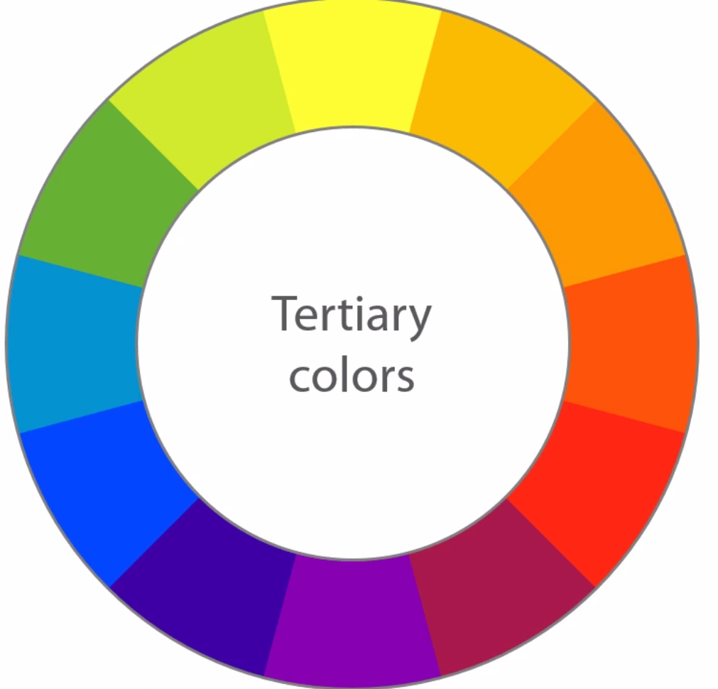
Color wheel

Slide 22

What looks good:
Analogous colors: they look similar and naturally match together
Complementary colors: opposing colors can provide attractive contrast.

Slide 23
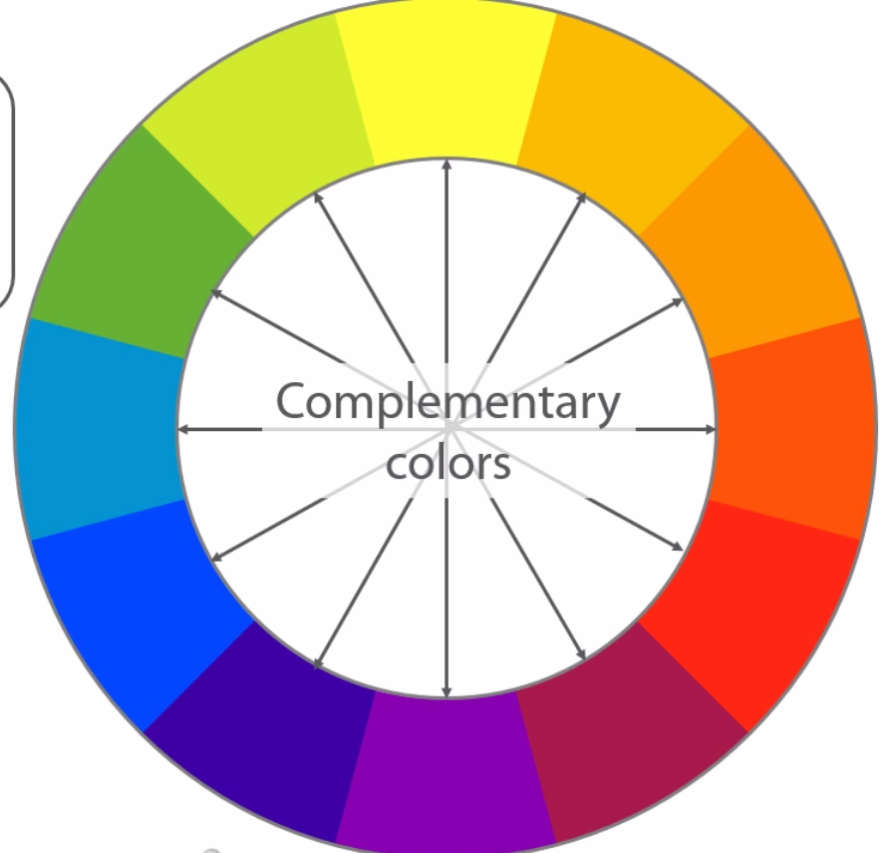
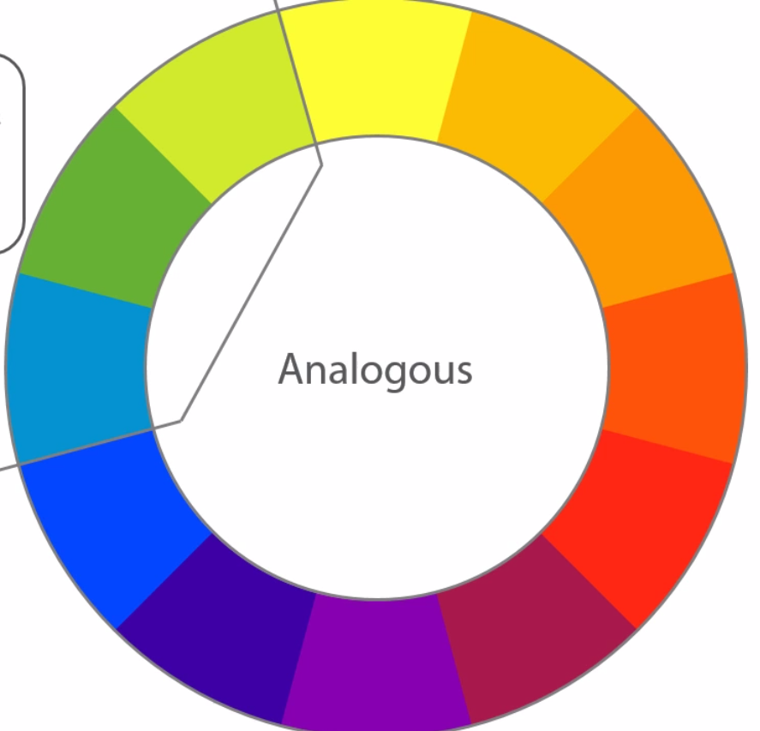
What looks good:

Slide 24
Pick Color Schemes
https://color.adobe.com/create/color-wheel/
Use colors sparingly. No more than 5 should be necessary.

Slide 25
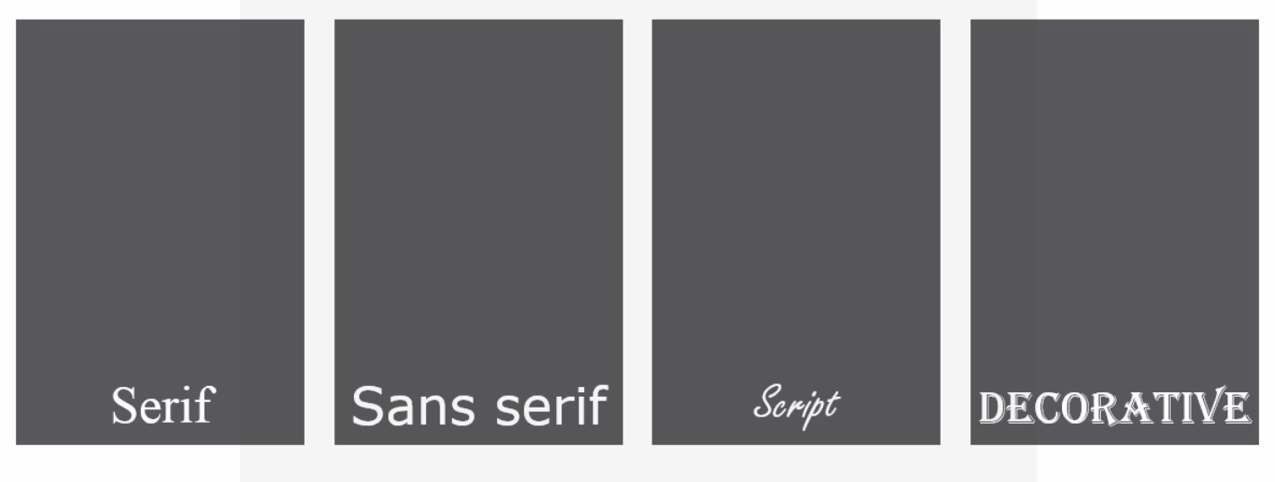
Typography

Slide 26

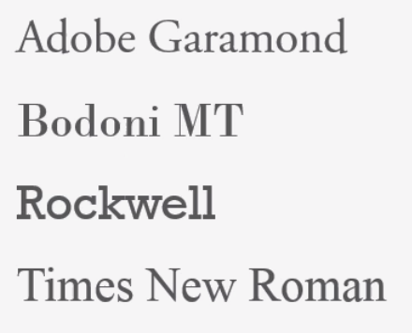
Serif Fonts
Classic feel, authoritative, scholarly.
Good for large fonts, but harder to read in paragraphs.
Generally better for print than the web.
Can be seen as amatuerish since Times New Roman is the default.

Slide 27

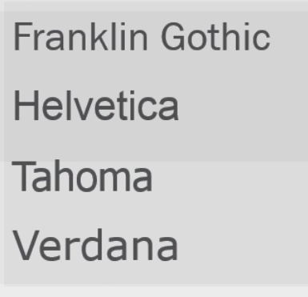
Sans Serif Fonts
Modern, cleaner, minimalistic
Looks good for all font sizes.
Less emphatic

Slide 28

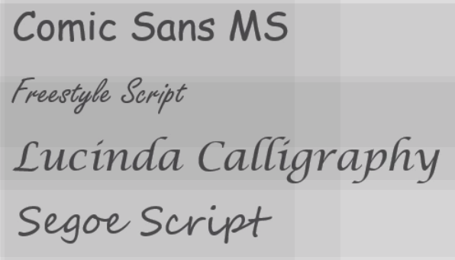
Script Fonts
Fancy, artistic, hand-written appeal.
Can be hard to read.
Should be used sparingly on the web.

Slide 29

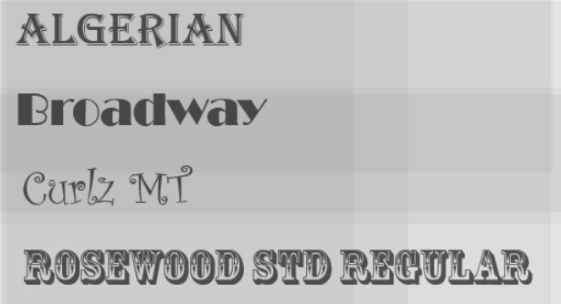
Decorative Fonts
very “decorative”
high emphasis
Can appear gaudy or hard to read.
Should also be used sparingly.

Slide 30
Typography
Sans serif fonts are by far the most popular
Keep most font sizes above 12px
Avoid all-caps
Rules for consistency and contrast apply
Like with colors, fonts can be combined well, but don't get carried away!

Slide 31
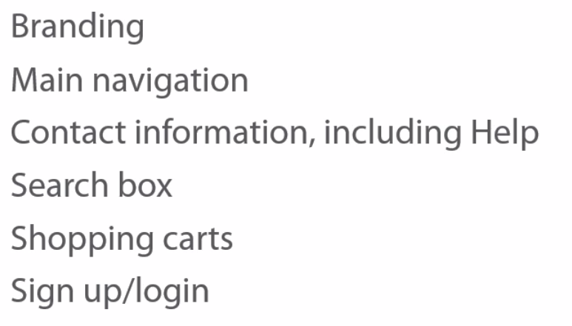
Visibility
Not everyone who lands on your site is going to scroll the page. Keep these things at the top of the page:

Slide 32
Simplicity: Whitespace is GOOD
https://www.google.com/
https://www.dropbox.com/
http://www.tiffany.com/jewelry/rings/return-to-tiffany-round-tag-ring-GRP08664

Slide 33
Keep users informed
Show logged in/out status
Provide progress bars and steps

Slide 34
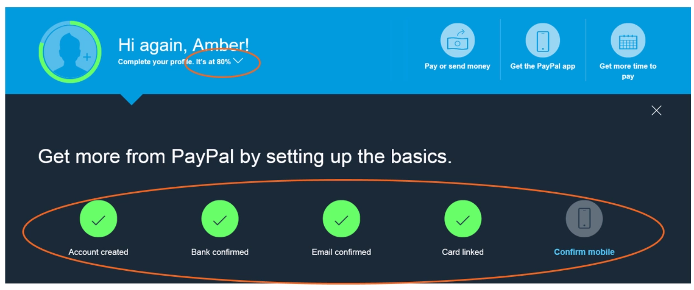
Example from paypal

Slide 35
Keep users informed
Provide clear navigation. If the navigation is complex, provide “breadcrumbs”.
Give feedback that their requests are successful.

Slide 36
Example
https://www.codesmith.io/apply

Slide 37
How do I improve my UX
Keep these criteria in mind. Do not annoy your users by recklessly ignoring UX principles.
Watch other people use your site without you coaching them through it.
“Scenarios” - breif stories of typical users visiting the site. What is their path through it? How can they find what they are looking for?

