Slide 1

Hacking

Slide 2
Untrusted Data
Request body
Request headers
Query string
Route
HTTP verb
API responses (external services)

Slide 3
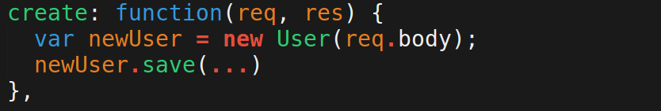
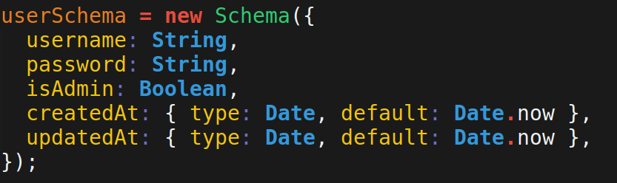
Mass Assignment

Slide 4
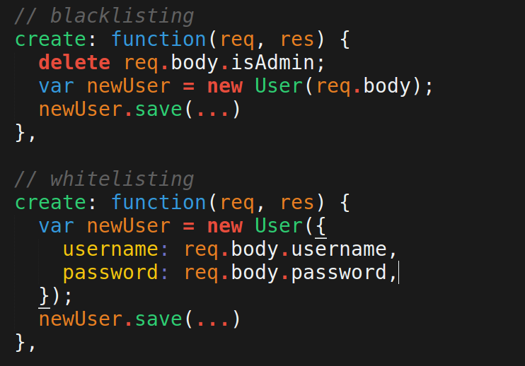
Be explicit instead...

Slide 5
Direct Object Reference
GET api.com/messages/13
DELETE api.com/messages/13
DELETE api.com/messages/9001

Slide 6
Cookie Poisoning
Manually changing the cookie

Slide 7
Giving the user too much info
If you expose error logs or give too detailed messages to the user, you can expose security holes
Risks involve user enumeration, and banner getting.

Slide 8
User Enumeration
Revealing who owns an account. Usually happens when users try to sign up with duplicate emails or recover passwords.
http://wordasaurus.herokuapp.com/#/
vs…
https://secure2.entropay.com/processes/upchangelostpassword/unprot/up_changelostpassword_page1.do

Slide 9
Attack on Ashley Madison
Login attempts where made with a bunch of emails and intentionally wrong passwords.
Ashley Madison did not tell users if the email didn't exist. but…
The HASH algorithm on the password was only attempted if the the email was registered.
Hackers cound determine who was registered by TIMING how fast the response came! Because the response was FASTER when the email wasn't registered.

Slide 10
The Most common types of attacks
XSS (Cross-site scripting)
SQL injection
CSRF (CORS)
DoS

Slide 11
Cross site scripting (XSS)
Embedding malicious code to a website that steals info.
Reflected XSS
Persisted XSS

Slide 12
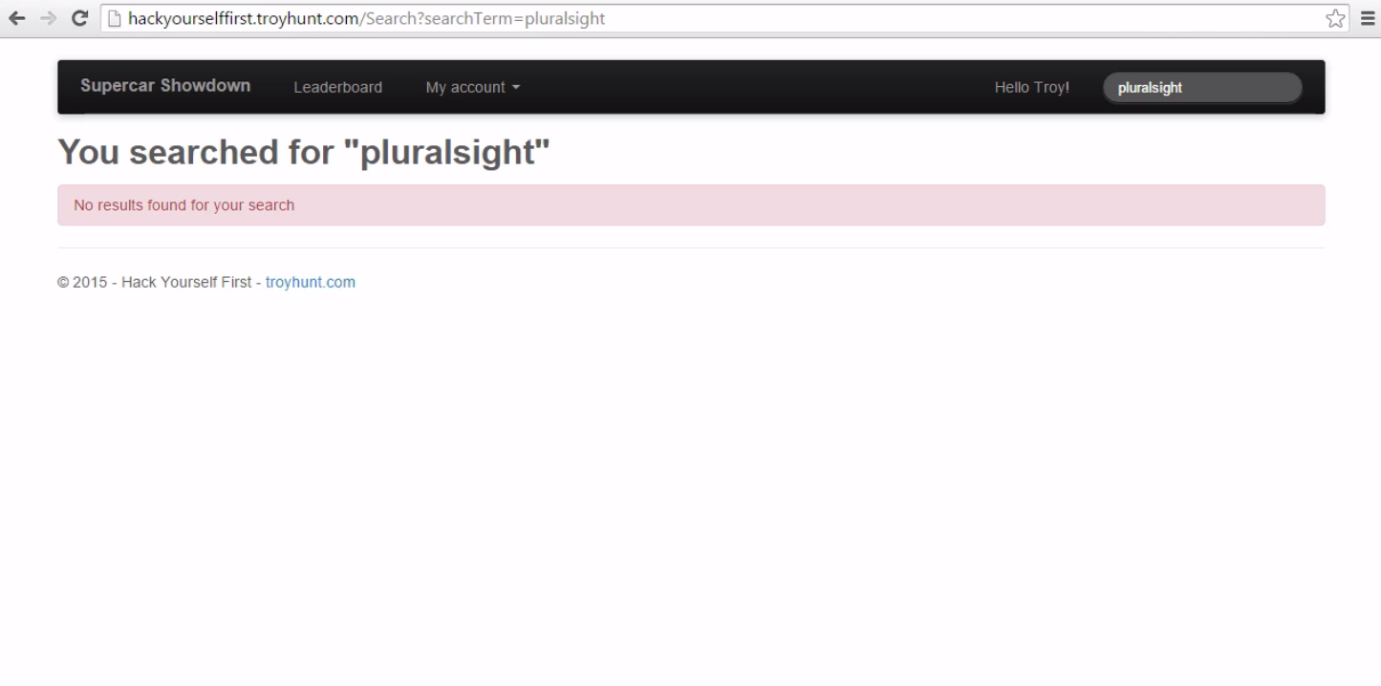
Reflected XSS

Slide 13
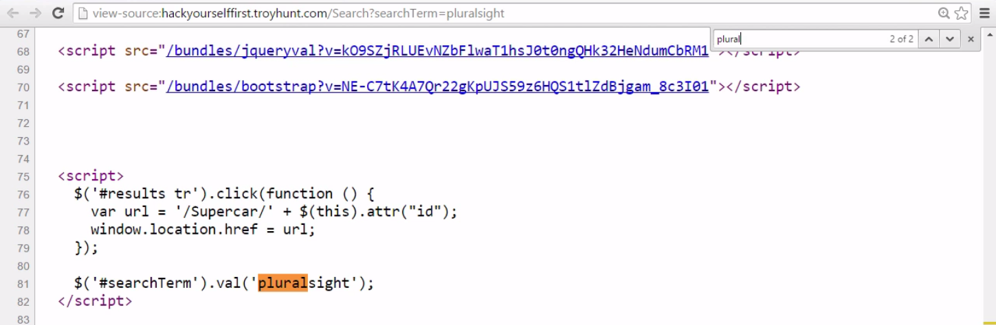
The query ends up in the DOM
Some evil dude sent me this link with an evil query… I click it and...

Slide 14
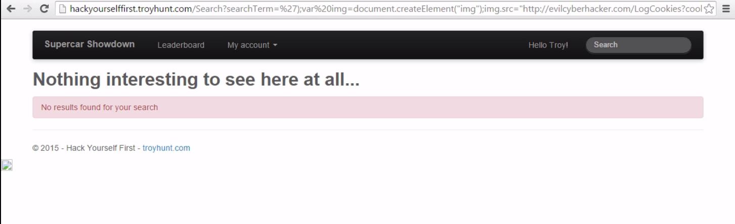
Some evil dude sent me this link with an evil query… I click it and...

Slide 15
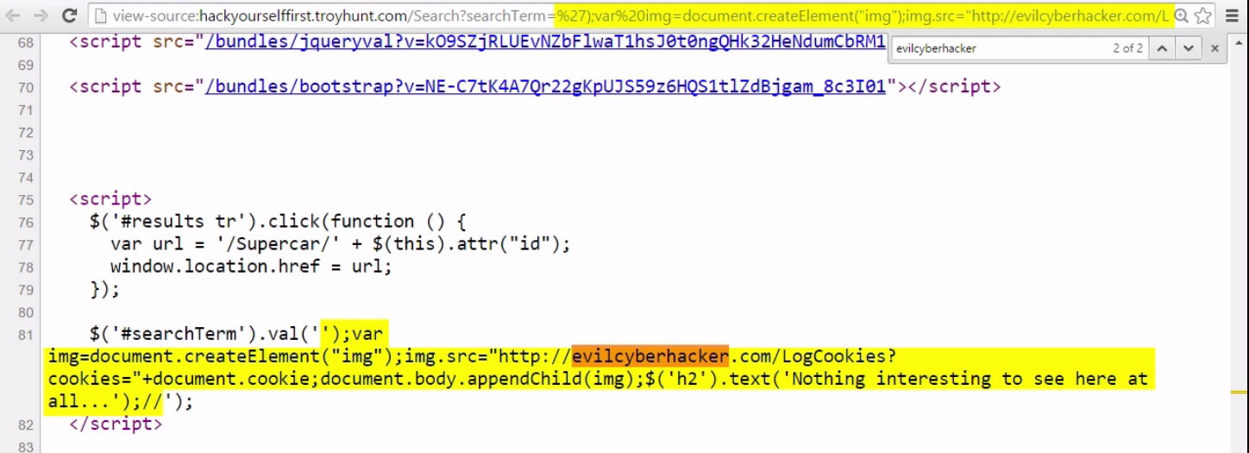
It's in the DOM

Slide 16
It creates an <img />...

Slide 17
which has a suspicious src...

Slide 18
that contains my cookie...

Slide 19
and inserts to the DOM

Slide 20
And gives me a message like nothing is wrong

Slide 21
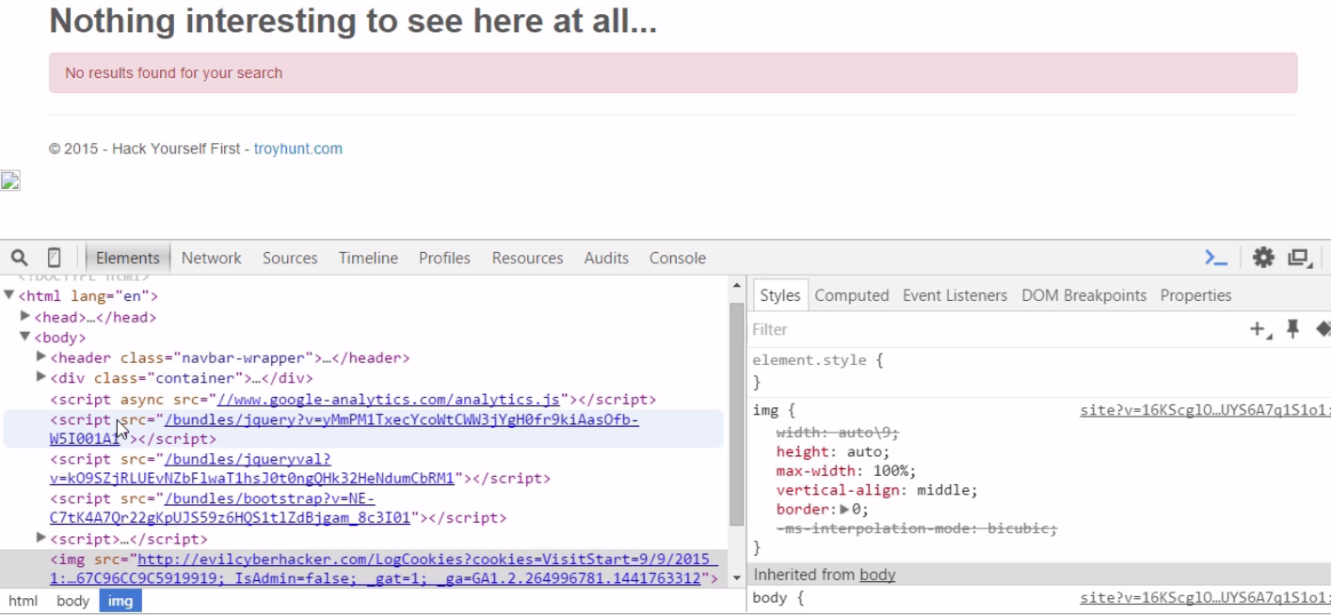
There's the new <img />

Slide 22
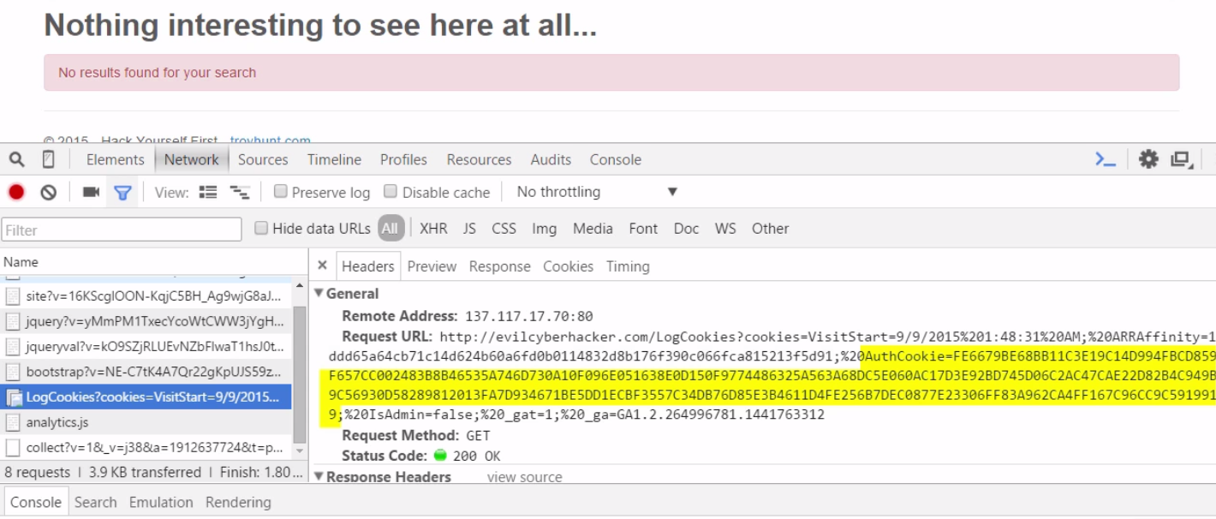
And it made a request, revealing my cookie. game over.

Slide 23
Persistent XSS
Not sent via a link, but instead comes from the actual database.
Affects any user who visits the infected page(s)
https://www.owasp.org/index.php/XSS_Filter_Evasion_Cheat_Sheet#IMG_onerror_and_javascript_alert_encode

Slide 24
how to prevent
If user input ends up in the DOM, SCRUB IT
convert the < to &lt and > to &gt

Slide 25
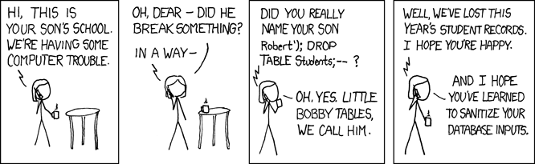
SQL Injection
Passing string to the server that end up in a SQL statement that is desctructive/penetrative.

Slide 26

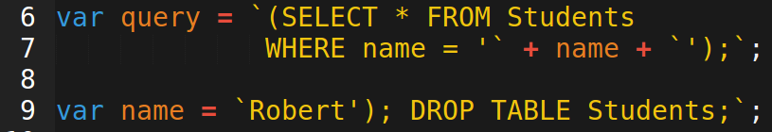
How it works

Slide 27
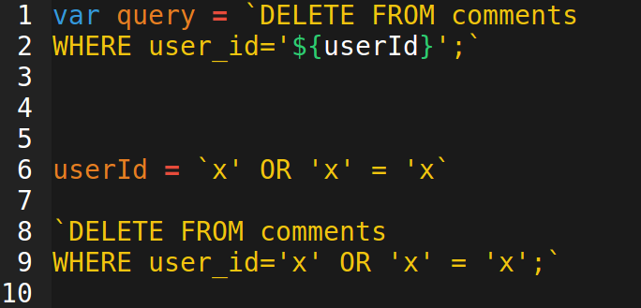
Another way

Slide 28
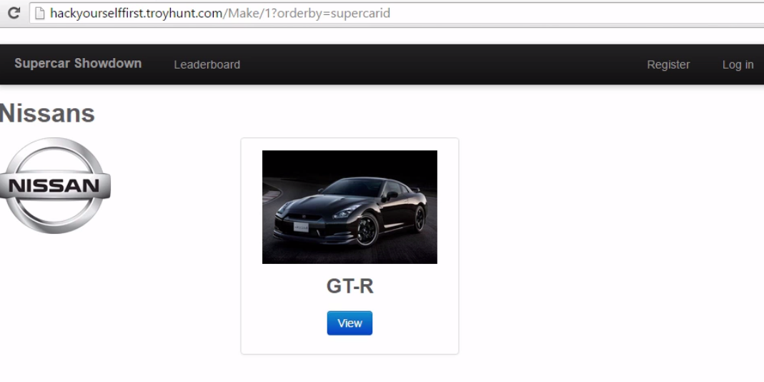
SQL Injection

Slide 29
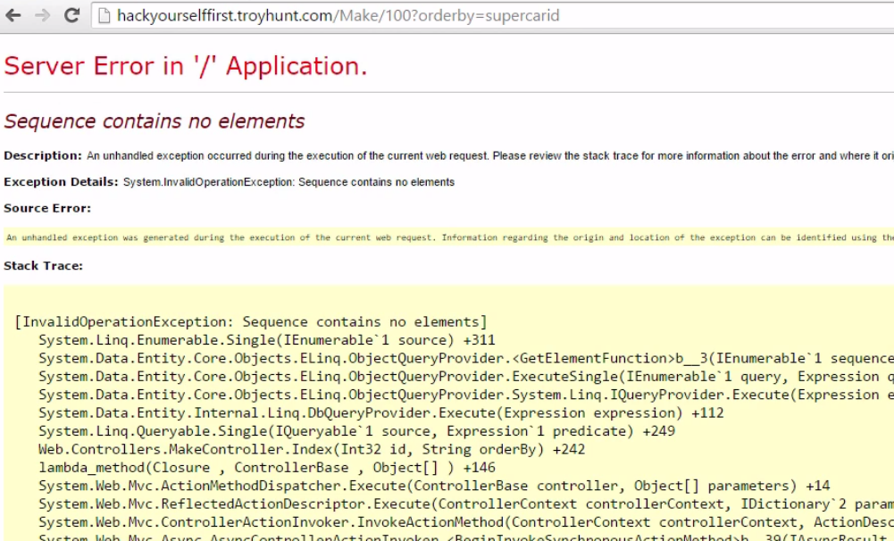
Url ends up in a SQL query

Slide 30
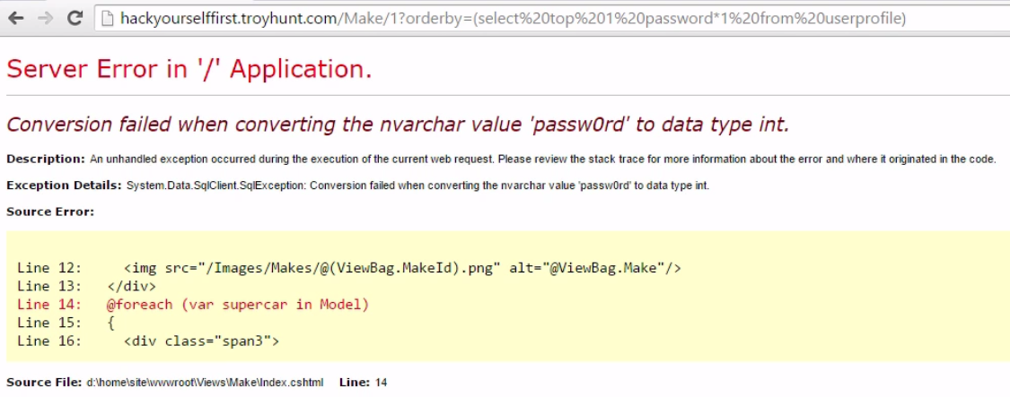
SQL Injection

Slide 31
Prevent this
Scrub the inputs!
Use an ORM, which scrubs it for you

Slide 32
Cross-site request forgery, a.k.a. Cross-origin request script (CORS)
Making request to a site/API from an evil site that looks the same as a legitimate request from the website itself.

Slide 33
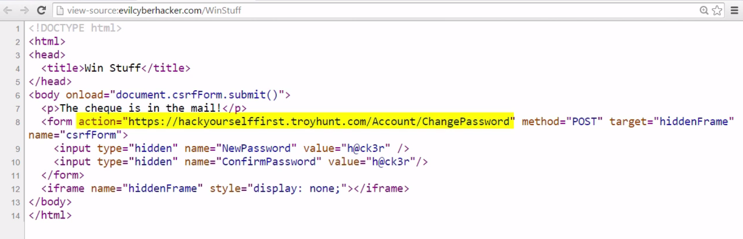
An evil person sets up this site...

Slide 34
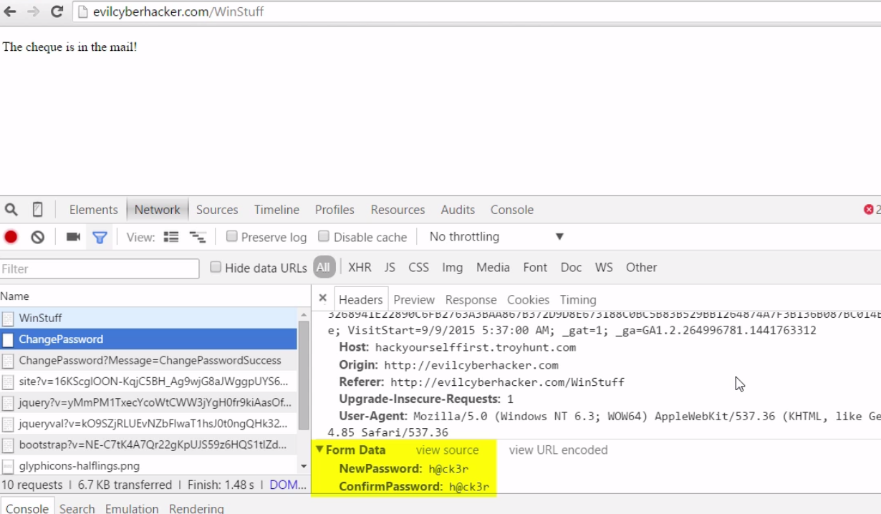
Andy this is what happens

Slide 35
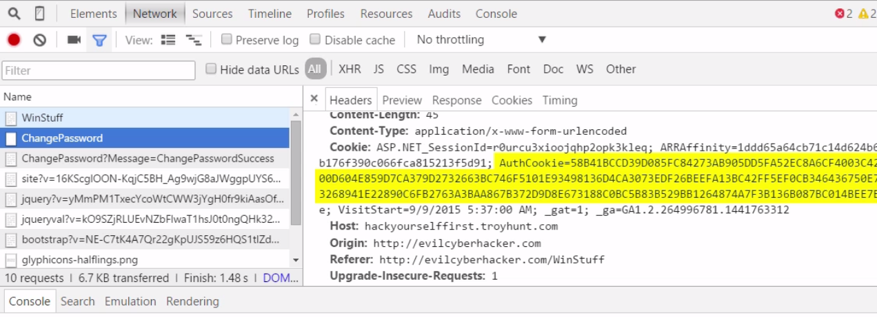
Andy this is what happens

Slide 36
How to prevent this?
ExpressJS and other popular frameworks disallow CORS by default. Requests from other domains are rejected.
Send a CSRF Token. Randomly generated token inserted into DOM that is validated on the server.
Lets check the <head> tag here https://teamdarity.herokuapp.com/

Slide 37
DoS attacks
Denial of service
Can be against an individual
Can take down an entire website

Slide 38
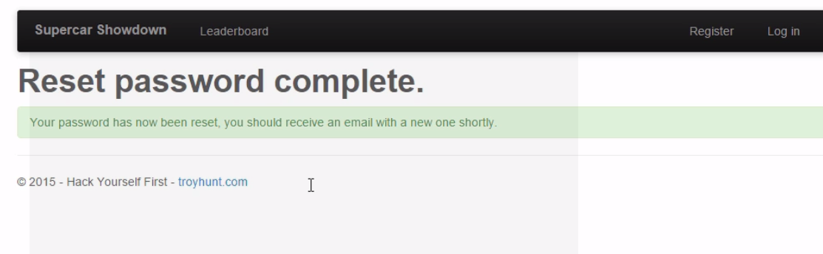
Repeated password reset

Slide 39
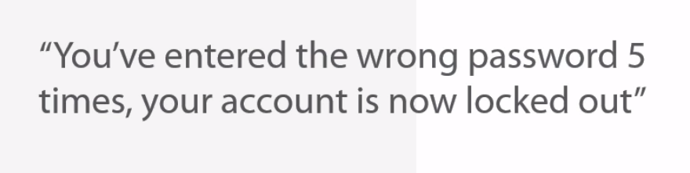
Exploiting account logout

Slide 40
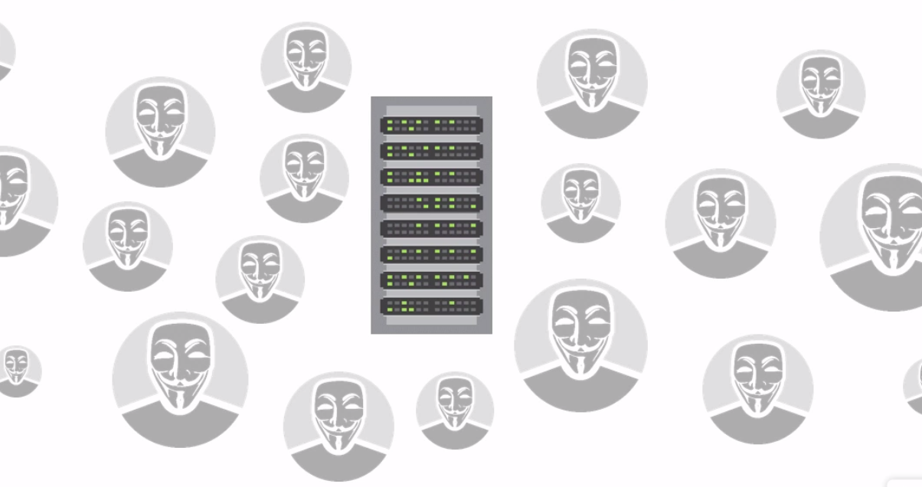
Distributed DoS attacks
a LOT of requests. Too much to handle. Server falls over.

Slide 41
Visualize this here
See actuall DdoS attacks in progress http://map.norsecorp.com/
How to bootstrap a DdoS attack using LOIChttps://www.youtube.com/watch?v=sQRu-J3f_Kw

Slide 42
Services involving DDoS
you can BUY a DdoS attack here:http://networkstresser.com/login.php
you can pay CloudFlare to defend against DDoS here: https://www.cloudflare.com/overview/

