Slide 1
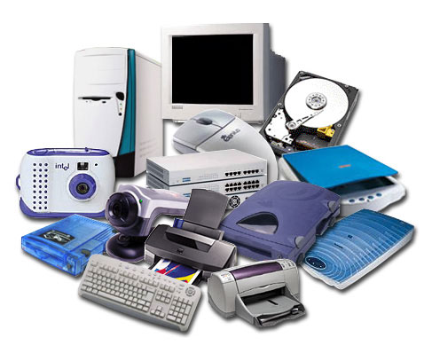
Hardware

Slide 2
Why learn hardware?
https://www.youtube.com/watch?v=ojnDWxf5DvU

Slide 3
Why learn hardware?
https://www.youtube.com/watch?v=ojnDWxf5DvU
No matter how awesome, or stupid, or evil your idea is, you can make devices that interact with the real world.

Slide 4
What is it?
The physical elements that comprise an electronic system.
For a computer: monitor, mouse, keyboard, hard drive, graphic cards, sound cards, memory (RAM), motherboard, etc.

Slide 5
Scope of what we'll learn
As a software developer, you'll never to to build hardware from scratch.
You'll be making existing hardware talk to one another.
We'll get an overview of how to make pieces of hardware interact.

Slide 6

User
Network
Microsoft Office, Chrome, Sublime Text, etc...
Applications
Operating System
Windows,
OSX, Linux
Drivers
Kernel
Hardware
CPU
RAM
Mouse
Keyboard
Speakers
Other

Slide 7
other devices
User
Network
Microsoft Office, Chrome, Sublime Text, etc...
Applications
Operating System
Windows,
OSX, Linux
Drivers
Kernel
Hardware
CPU
RAM
Mouse
Keyboard
Speakers
Other
devices

Slide 8


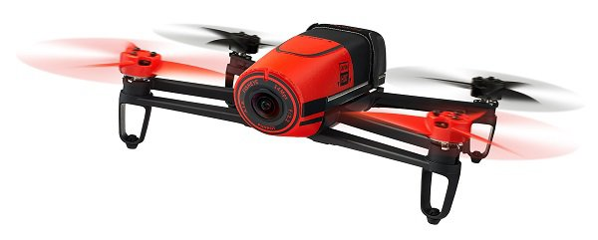
Over the network
Need a server and a client
UDP
server

Slide 9
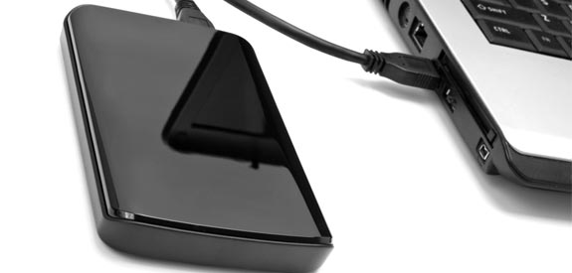
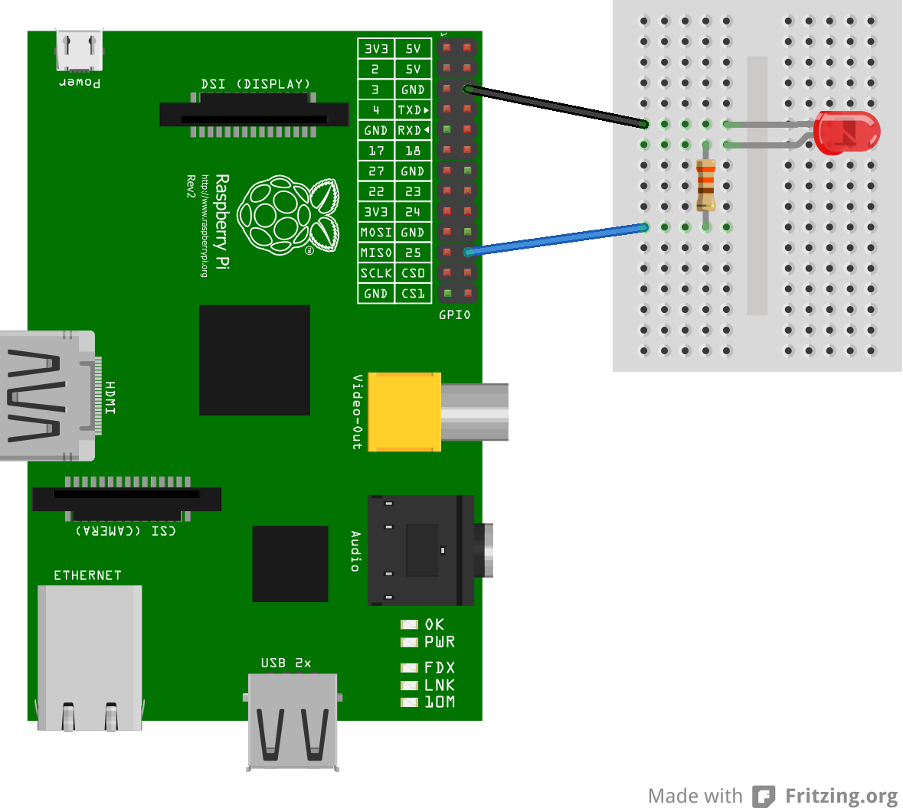
Physical connection
USB
electrical pins

Slide 10
Combine them
light up
HTTP
server

Slide 11
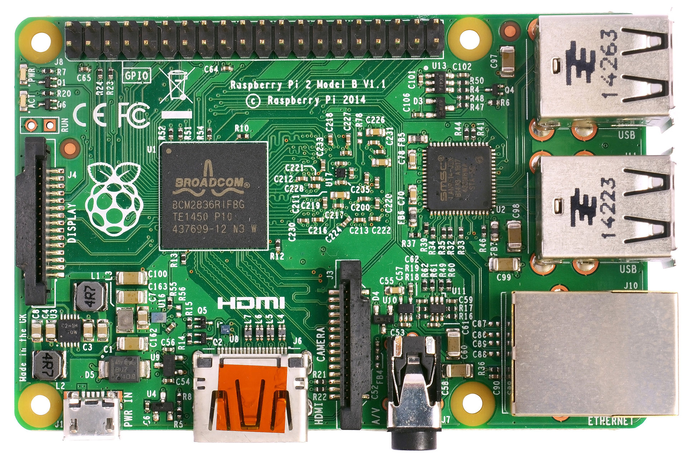
Raspberry Pi
Basically miniature computers
RAM, CPU, Ethernet, USB, SD card, HDMI, etc.
Typically run some distribution of Linux
Pins for general purpose input/output (GPIO)
You can run scripts (e.g.
Node, Python) to send
electricity through the pins,
to interact with hardware.

Slide 12
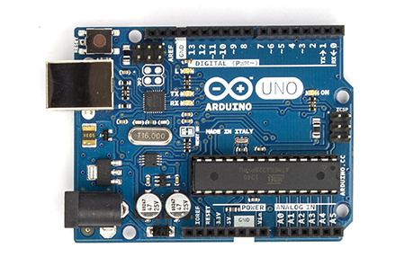
Arduino Board
Not a computer, but a programmable microcontroller with some pins.
Basically a CPU with the RAM and I/) peripherals built into one circuit.
It's like a cheap, lower power computer.
Upload a program to the
microcontroller which just
runs on loop. It controls the
pins.

Slide 13
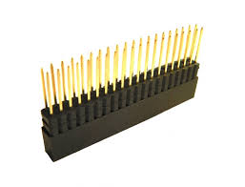
Pins
device
device
output
electricity
input
electricity
the voltage can vary
(represent as an 8-bit
integer 0-255)
output
input (0 - 255)
Your compiled program
(some logic)

