Slide 1
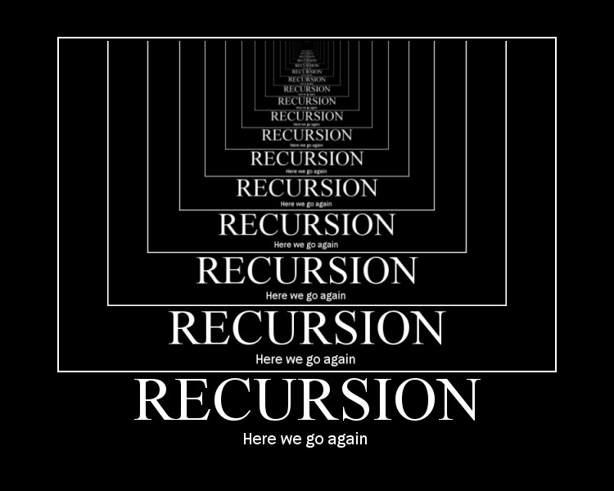

Slide 2
What is Recursion?
A strategy wherein solving a problem progresses via increasingly smaller (less complex) instances of the same problem.

Slide 3

Why Recursion?
People will think you are smart.
Practicality.
Beauty.

Slide 4
What is Recursion?
Repitition
Iteration
Depends on a mutable state (value of a counter variable)
for loops, while loops, etc.
Recursion
Reduction of complexity on each repetition
Requires a base case
Functions calling themselves

Slide 5
Stopping Recursion: Base Case
BASE
CASE

Slide 6
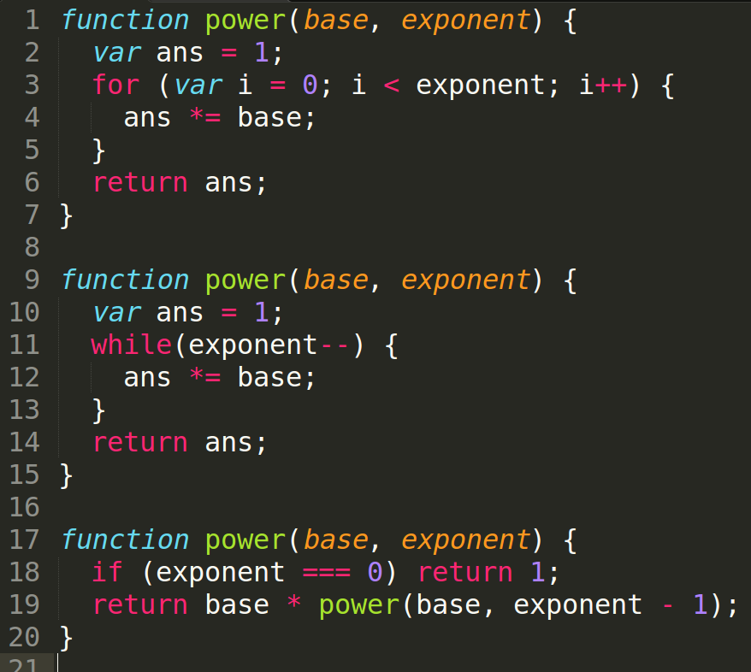
Use Case: Exponents

Slide 7
Single Recursion
Method
Method Call
return
value
if base case

Slide 8
How should I solve a problem by recursion?
Identify base case
  exponents: n⁰ = 1
  factorial: 1! = 1
Devise algorithm to whittle down higher complexity instances into the base case.
(Pseudo)code it

Slide 9
Types of Recursion
single recursion
mutual recursion
multiple recursion
…
…
base case

Slide 10
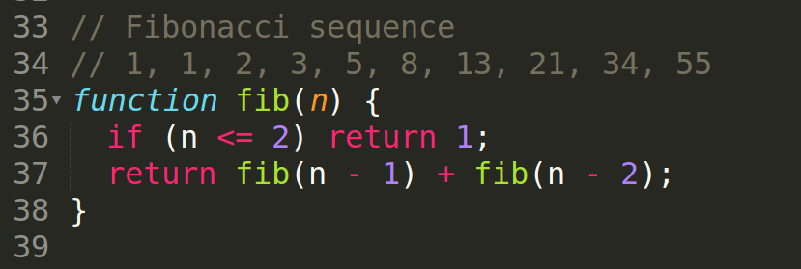
Fibonacci Numbers

Slide 11
Fibonacci Numbers
1, 1,

Slide 12
Fibonacci Numbers
1, 1, 2,

Slide 13
Fibonacci Numbers
1, 1, 2, 3,

Slide 14
Fibonacci Numbers
1, 1, 2, 3, 5, 8, 13, 21, 34, 55

Slide 15
Fibonacci Numbers
1, 1, 2, 3, 5, 8, 13, 21, 34, 55
fib(6)
fib(4)
+
fib(5)
fib(2)
+
fib(3)
fib(3)
+
fib(4)
fib(1)
+
fib(2)
fib(1)
+
fib(2)
fib(2)
+
fib(3)
fib(1) + fib(2)

Slide 16
Fibonacci Numbers

Slide 17
Consider this Puzzle
Find a sequence of operations, either *3 or +5, that transforms a starting number to a destination number.
For example, 1 to 13:
13 = 1 * 3 + 5 + 5
But for 1 to 15:
15 is impossible!
from Eloquent JS chapter 3

Slide 18
The Recursive Approach
1
* 3
+ 5
3
6
9
8
18
11
27
14
24
13
NIL
33
16
THE
ANSWER!
NIL
NIL
NIL
NIL
NIL

Slide 19
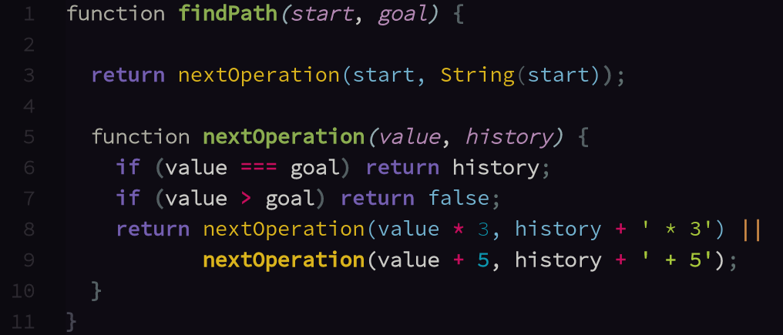
The Code
1
findPath

Slide 20
The Code
3
findPath

Slide 21
The Code
9
findPath

Slide 22
The Code
27
findPath

Slide 23
The Code
14
findPath

Slide 24
The Code
8
findPath

Slide 25
The Code
24
findPath

Slide 26
The Code
13
findPath

Slide 27
Why Recursion?
It's the best for cases using multiple recursion.
“The reason we think about recursion isn't so much that it's fast, it's because it's expressive... Some algorithms are easy to describe recursively.”
-Prof. Dennis Freeman, MIT

