Slide 1
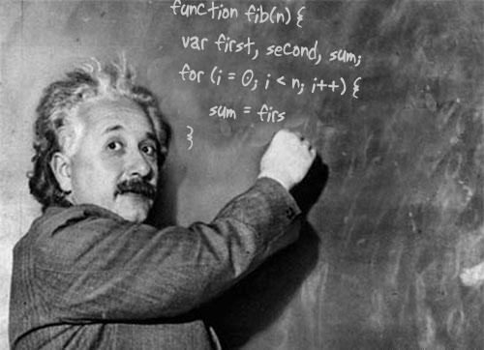
Whiteboarding

Slide 2
The Goal
Show your critical thinking skills
Its not about finding 'the right answer'!
Talk through your thinking process.

Slide 3
The Problem
Write a function that checks for balanced parentheses.
balancedParens('hello world'); → true
balancedParens('[x](y){z}'), → true
balancedParens('[({yay})]'), → true
balancedParens('[(nope]{wrong)}') → false

Slide 4
Probe. Listen.
What will the input be? Contents? Size?
Do I have to worry about curly braces? Angle brackets?
( [ { <

Slide 5
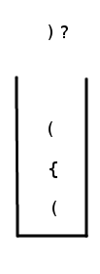
Pictures
DO NOT CODE RIGHT AWAY
Draw pictures to illustrate your approach
“( { ( corn ) } )”

Slide 6
Space
Begin writing at top-left-most part of board
Leave blank line between

Slide 7
Pseudo-code
function balancedParens(str) {
var bracs = filter non-bracs from str
var stack = [ ]
for (brac in bracs) {
If (brac is opening)
Put brac in stack
Else
Check the stack
}
return stack.empty?
}

Slide 8
Goldilocks Variable Names
Too short: var n;
Too long: var indexForWeekToBeRendered;
Accaptableeee:
var weekIndex;

Slide 9
Helper Methods
function balancedParens(str) {
var bracs = getBracs(str); //returns array of bracs
var stack = [ ];
for (var i in bracs) {
var brac = bracs[i];
if (brac.match(/ ( [ { /) {
stack.push(brac);
} else {
if (!stack.length) return false;
if (!bracMatch(stack.pop(), brac)) return false;
}
}
return !stack.length;
}
function bracMatch(open, close) {
return Math.abs( close.charCodeAt(0) -
open.charCodeAt(0) ) <= 2;
}

Slide 10
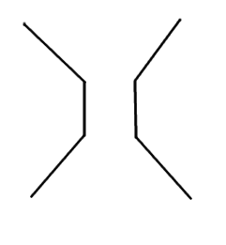
Double Funnel Model
Start broad, get detailed when you start writing
After you have first answer, get broad again
time

Slide 11
Optimize later
Focus on getting an initial solution
Evaluate it, suggest optimizations
Analyze space/time complexity
Linear O(n)?

Slide 12
Optimize
function balancedParens(str) {
var bracs = getBracs(str); //returns array of bracs
var stack = [ ];
for (var i in bracs) {
var brac = bracs[i];
if (brac.match(/ ( [ { /) {
stack.push(brac);
} else {
if (!stack.length) return false;
if (!bracMatch(stack.pop(), brac)) return false;
}
}
return !stack.length;
}

Slide 13
Misc. Tips
Don't freak out if you don't know. Just break down the problem into small steps, draw pics, pseudo-code, and think through it.
Always take interviewer's suggestions.
Verbalize clearly. State intentions before coding!
Should be language agnostic. You hsould be able to communicate your ideas to a C++ developer.

